Slide 1
Speech Recognition
Vector Quantization and Clustering

Slide 2
Vector Quantization and Clustering
Introduction
K-means clustering
Clustering issues
Hierarchical clustering
  Divisive (top-down) clustering
  Agglomerative (bottom-up) clustering
Applications to speech recognition

Slide 3
Acoustic Modeling
Signal Representation
Vector Quantization
Waveform
Feature Vectors
Symbols
Signal representation produces feature vector sequence
Multi-dimensional sequence can be processed by:
  Methods that directly model continuous space
  Quantizing and modeling of discrete symbols
Main advantages and disadvantages of quantization:
  Reduced storage and computation costs
  Potential loss of information due to quantization

Slide 4
Vector Quantization (VQ)
Used in signal compression, speech and image coding
More efficient information transmission than scalar quantization (can achieve less that 1 bit/parameter)
Used for discrete acoustic modeling since early 1980s
Based on standard clustering algorithms:
  Individual cluster centroids are called codewords
  Set of cluster centroids is called a codebook
  Basic VQ is K-means clustering
  Binary VQ is a form of top-down clustering (used for efficient quantization)

Slide 5
VQ & Clustering
Clustering is an example of unsupervised learning
  Number and form of classes {C_{i}} unknown
  Available data samples {x_{i}} are unlabeled
  Useful for discovery of data structure before classification or tuning or adaptation of classifiers
Results strongly depend on the clustering algorithm

Slide 6
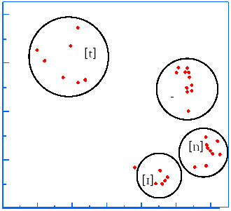
Acoustic Modeling Example

Slide 7
Clustering Issues
What defines a cluster?
  Is there a prototype representing each cluster?
What defines membership in a cluster?
  What is the distance metric, d(x; y)?
How many clusters are there?
  Is the number of clusters picked before clustering?
How well do the clusters represent unseen data?
  How is a new data point assigned to a cluster?

Slide 8
K-Means Clustering
Used to group data into K clusters, {C₁,… ,C_{K}}
Each cluster is represented by mean of assigned data
Iterative algorithm converges to a local optimum:
  Select K initial cluster means, {µ₁,… ,µ_{K}}
  Iterate until stopping criterion is satisfied:
    Assign each data sample to the closest cluster
      X∈C_{i}; d(x;µ_{i})≤d(x;µ_{j}), ∀i≠j
    Update K means from assigned samples
      µ_{i} = E(x), X∈C_{i}; 1 ≤ i ≤ K
Nearest neighbor quantizer used for unseen data

Slide 9
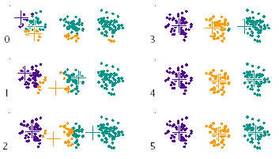
K-Means Example: K = 3
Random selection of 3 data samples for initial means
Euclidean distance metric between means and samples

Slide 10

K-Means Properties
Usually used with a Euclidean distance metric
The total distortion, D, is the sum of squared error
D decreases between nth and n + 1st iteration
Also known as Isodata, or generalized Lloyd algorithm
Similarities with Expectation-Maximization (EM) algorithm for learning parameters from unlabeled data

Slide 11

K-Means Clustering: Initialization
K-means converges to a local optimum
  Global optimum is not guaranteed
  Initial choices can influence final result
Initial K-means can be chosen randomly
  Clustering can be repeated multiple times
Hierarchical strategies often used to seed clusters
  Top-down (divisive) (e.g., binary VQ)
  Bottom-up (agglomerative)

Slide 12

K-Means Clustering: Stopping Criterion
Many criterion can be used to terminate K-means :
No changes in sample assignments
Maximum number of iterations exceeded
Change in total distortion, D, falls below a threshold

Slide 13
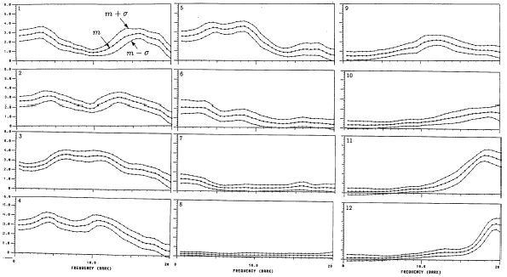
Acoustic Clustering Example
12 clusters, seeded with agglomerative clustering
Spectral representation based on auditory-model

Slide 14
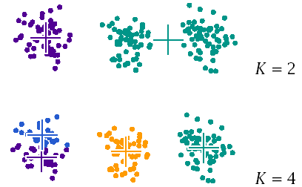
Clustering Issues: Number of Clusters
In general, the number of clusters is unknown
Dependent on clustering criterion, space, computation or
distortion requirements, or on recognition metric

Slide 15
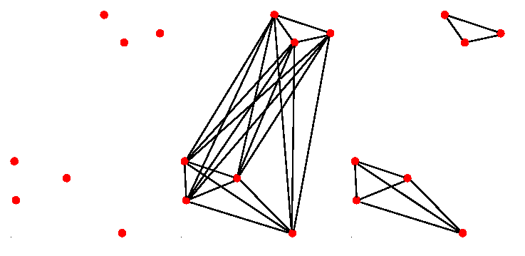
Clustering Issues: Clustering Criterion
The criterion used to partition data into clusters plays a strong role in determining the final results

Slide 16
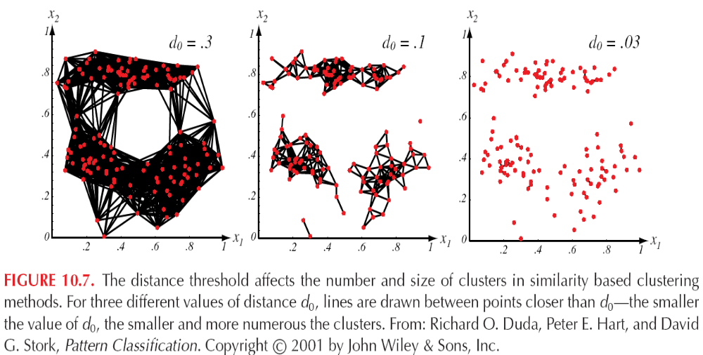
Distance Threshold

Slide 17
Clustering Issues: Distance Metrics
A distance metric usually has the properties:
  0 ≤ d(x;y) ≤ 1
  d(x;y) = 0 iff x = y
  d(x;y) = d(y;x)
  d(x;y) ≤ d(x;z) + d(y;z)
  d(x+z;y+z) = d(x;y) (invariant)
In practice, distance metrics may not obey some of these properties but are a measure of dissimilarity

Slide 18
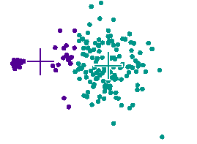
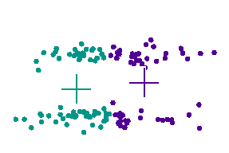
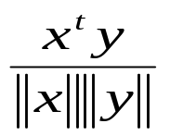

Clustering Issues: Distance Metrics
Distance metrics strongly influence cluster shapes:
Normalized dot-product:
Euclidean:
Weighted Euclidean:
Minimum distance (chain): min d(x; xi); x_{i}∈C_{i}
Representation specific

Slide 19
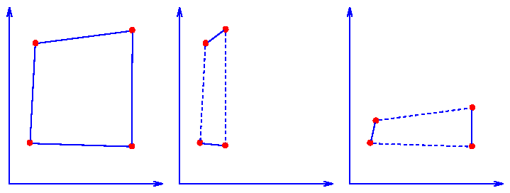
Clustering Issues: Impact of Scaling
Scaling feature vector dimensions can significantly impact clustering results
Scaling can be used to normalize dimensions so a simple distance metric is a reasonable criterion for similarity

Slide 20

Clustering Issues: Training and Test Data
Training data performance can be arbitrarily good e.g.,
Independent test data needed to measure performance
  Performance can be measured by distortion, D, or some more relevant speech recognition metric
  Robust training will degrade minimally during testing
  Good training data closely matches test conditions
Development data are often used for refinements, since through iterative testing they can implicitly become a form of training data

Slide 21
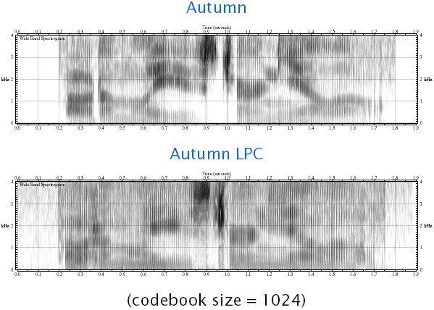
Alternative Evaluation Criterion: LPC VQ Example

Slide 22
Hierarchical Clustering
Clusters data into a hierarchical class structure
Top-down (divisive) or bottom-up (agglomerative)
Often based on stepwise-optimal, or greedy, formulation
Hierarchical structure useful for hypothesizing classes
Used to seed clustering algorithms such as K-means

Slide 23
Divisive Clustering
Creates hierarchy by successively splitting clusters into smaller groups
On each iteration, one or more of the existing clusters are split apart to form new clusters
The process repeats until a stopping criterion is met
Divisive techniques can incorporate pruning and merging heuristics which can improve the final result

Slide 24
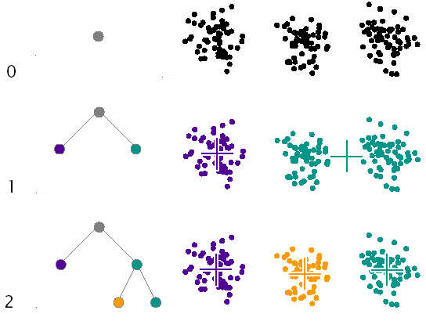
Example of Non-Uniform Divisive Clustering

Slide 25
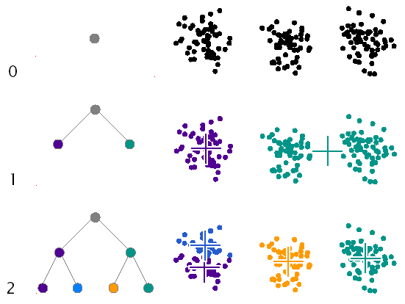
Example of Uniform Divisive Clustering

Slide 26
Divisive Clustering Issues
Initialization of new clusters
  Random selection from cluster samples
  Selection of member samples far from center
  Perturb dimension of maximum variance
  Perturb all dimensions slightly
Uniform or non-uniform tree structures
Cluster pruning (due to poor expansion)
Cluster assignment (distance metric)
Stopping criterion
  Rate of distortion decrease
  Cannot increase cluster size

Slide 27
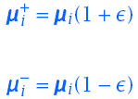
Divisive Clustering Example: Binary VQ
Often used to create M = 2^{B} size codebook (B bit codebook, codebook size M)
Uniform binary divisive clustering used
On each iteration each cluster is divided in two
K-means used to determine cluster centroids
Also known as LBG (Linde, Buzo, Gray) algorithm
A more efficient version does K-means only within each binary split, and retains tree for efficient lookup

Slide 28
Agglomerative Clustering
Structures N samples or seed clusters into a hierarchy
On each iteration, the two most similar clusters are merged together to form a new cluster
After N - 1 iterations, the hierarchy is completen
The dendogram is at level k when C = N-k+1
  N – total number of samples
  C – Number of clusters
Structure displayed in the form of a dendrogram
By keeping track of the similarity score when new clusters are created, the dendrogram can often yield insights into the natural grouping of the data

Slide 29
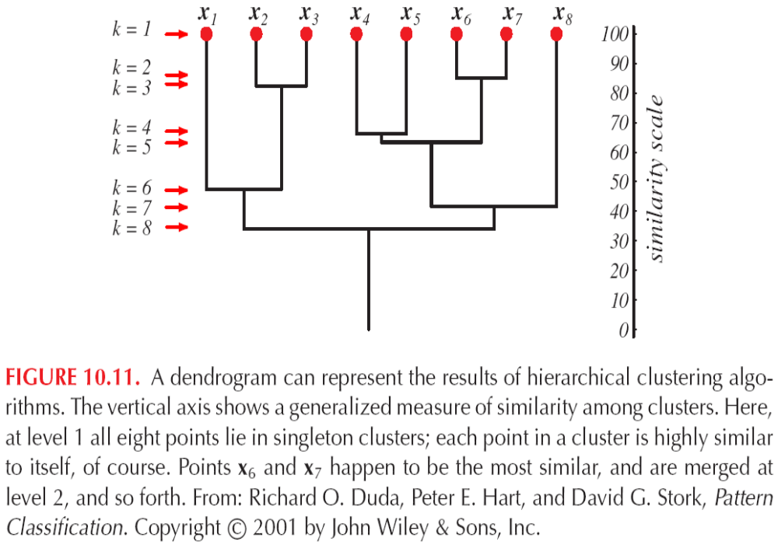
Hierachical Clustering

Slide 30
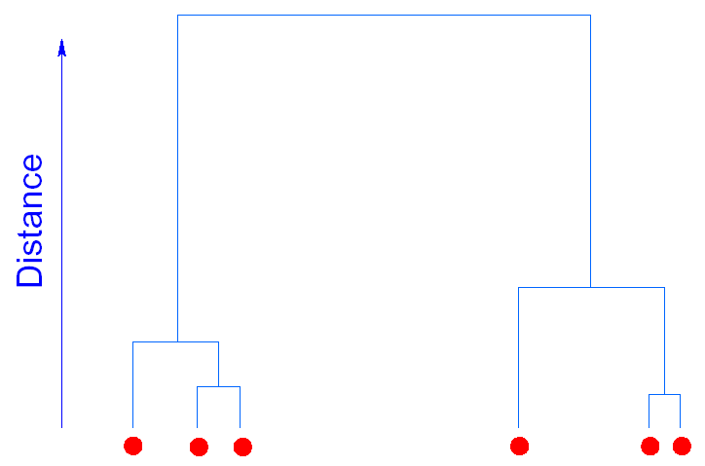
Dendrogram Example (One Dimension)

Slide 31
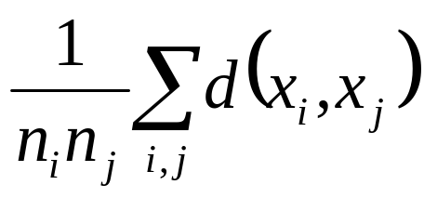
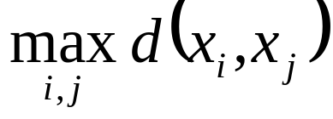

Agglomerative Clustering Issues
Measuring distances between clusters C_{i} and C_{j} with respective number of tokens n_{i} and n_{j}
  Average distance:
  Maximum distance (compact):
  Minimum distance (chain):
  Distance between two representative vectors of each cluster such as their means: d(µ_{i};µ_{j})

Slide 32
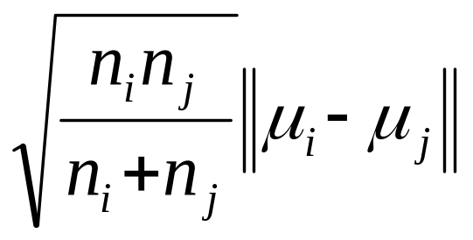
Stepwise-Optimal Clustering
Common to minimize increase in total distortion on each merging iteration: stepwise-optimal or greedy
On each iteration, merge the two clusters which produce the smallest increase in distortion
Distance metric for minimizing distortion, D, is:
Tends to combine small clusters with large clusters before merging clusters of similar sizes

Slide 33
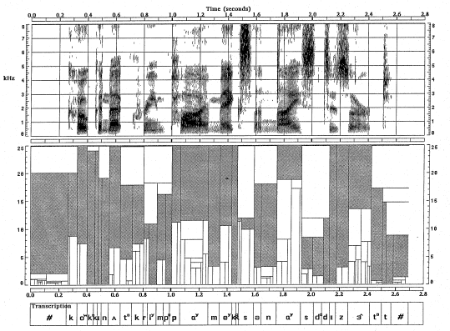
Clustering for Segmentation

Slide 34
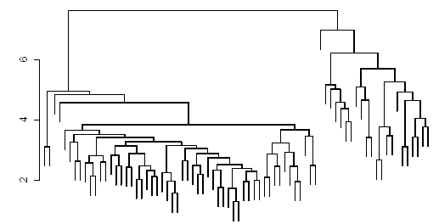
Speaker Clustering
23 female and 53 male speakers from TIMIT corpus
Vector based on F1 and F2 averages for 9 vowels
Distance d(C_{i},C_{j}) is average of distances between members

Slide 35
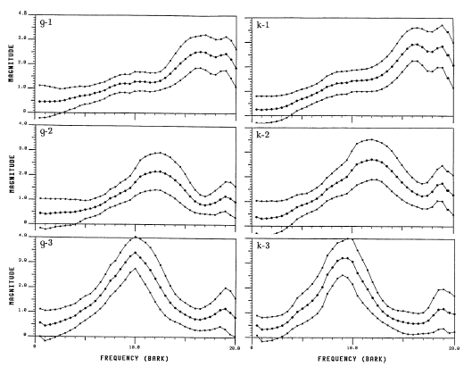
Velar Stop Allophones

Slide 36
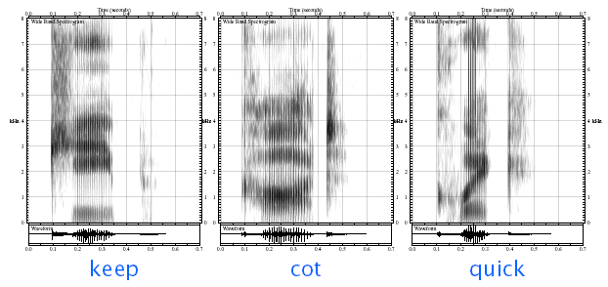
Velar Stop Allophones (con’t)

Slide 37
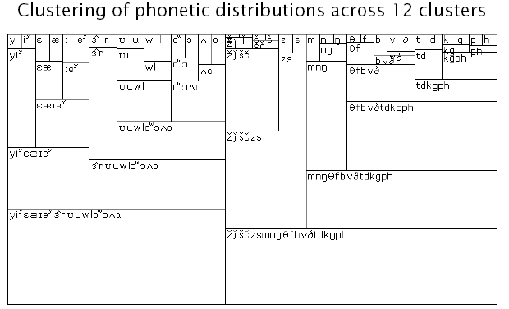
Acoustic-Phonetic Hierarchy

Slide 38
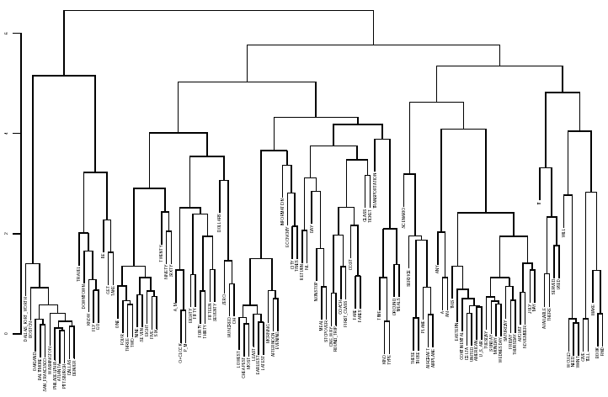
Word Clustering

Slide 39
VQ Applications
Usually used to reduce computation
Can be used alone for classification
Used in dynamic time warping (DTW) and discrete hidden Markov models (HMMs)
Multiple codebooks are used when spaces are statistically independent (product codebooks)
Matrix codebooks are sometimes used to capture correlation between successive frames
Used for semi-parametric density estimation (e.g., semi-continuous mixtures)

Slide 40
References
Huang, Acero, and Hon, Spoken Language Processing, Prentice-Hall, 2001.
Duda, Hart and Stork, Pattern Classification, John Wiley & Sons, 2001.
A. Gersho and R. Gray, Vector Quantization and Signal Compression, Kluwer Academic Press, 1992.
R. Gray, Vector Quantization, IEEE ASSP Magazine, 1(2), 1984.
B. Juang, D. Wang, A. Gray, Distortion Performance of Vector Quantization for LPC Voice Coding, IEEE Trans ASSP, 30(2), 1982.
J. Makhoul, S. Roucos, H. Gish, Vector Quantization in Speech Coding, Proc. IEEE, 73(11), 1985.
L. Rabiner and B. Juang, Fundamentals of Speech Recognition, Prentice-Hall, 1993.

