Slide 1
Speech Recognition
Hidden Markov Models

Slide 2
Outline
Introduction
Problem formulation
Forward-Backward algorithm
Viterbi search
Baum-Welch parameter estimation
Other considerations
  Multiple observation sequences
  Phone-based models for continuous speech recognition
  Continuous density HMMs
  Implementation issues

Slide 3
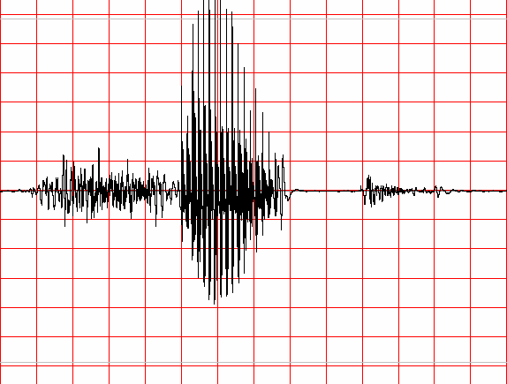
Information Theoretic Approach to ASR
Speaker's
Mind
Speech
Producer
Acoustic
Processor
Linguistic
Decoder
W
Speech
A
Ŵ
Speaker
Acoustic Channel
Speech Recognizer
Statistical Formulation of Speech Recognition
A – denotes the acoustic evidence (collection of feature vectors, or data in general) based on which recognizer will make its decision about which words were spoken.
W – denotes a string of words each belonging to a fixed and known vocabulary.

Slide 4
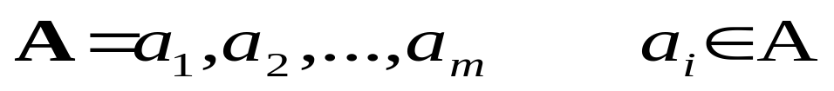
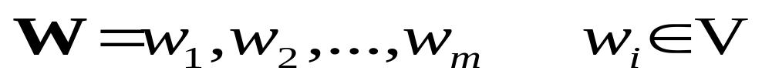
Information Theoretic Approach to ASR
  Assume that A is a sequence of symbols taken from some alphabet A.
  W – denotes a string of n words each belonging to a fixed and known vocabulary V.

Slide 5
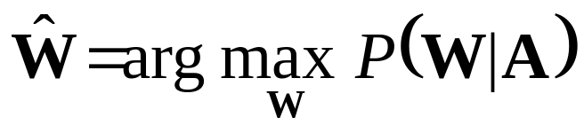
Information Theoretic Approach to ASR
  If P(W|A) denotes the probability that the words W were spoken, given that the evidence A was observed, then the recognizer should decide in favor of a word string Ŵ satisfying:
  The recognizer will pick the most likely word string given the observed acoustic evidence.

Slide 6
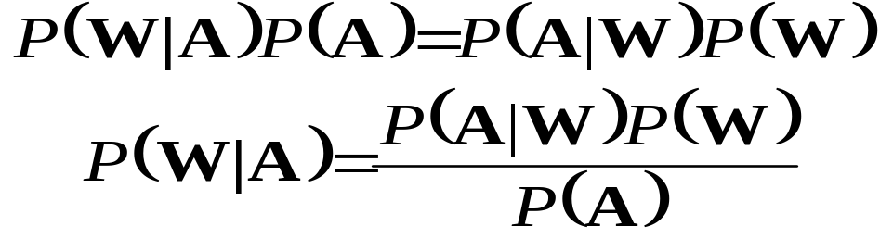
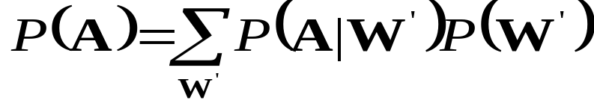
Information Theoretic Approach to ASR
From the well known Bayes’ rule of probability theory:
P(W) – Probability that the word string W will be uttered
P(A|W) – Probability that when W was uttered the acoustic evidence A will be observed
P(A) – is the average probability that A will be observed:

Slide 7
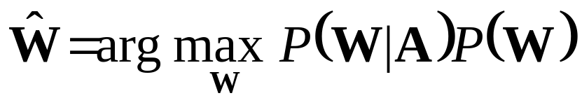
Information Theoretic Approach to ASR
Since Maximization in:
Is carried out with the variable A fixed (e.g., there is not other acoustic data save the one we are give), it follows from Baye’s rule that the recognizer’s aim is to find the word string Ŵ that maximizes the product P(A|W)P(W), that is

Slide 8
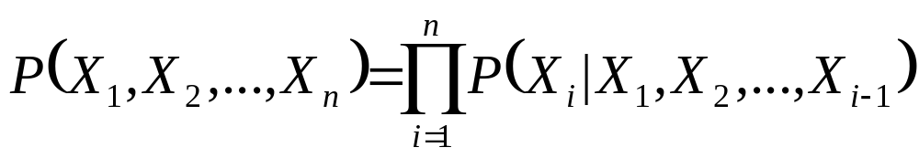

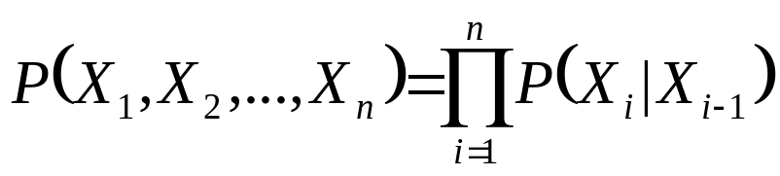
Hidden Markov Models
About Markov Chains:
  Let X₁, X₂, …, X_{n}, … be a sequence of random variables taking their values in the same finite alphabet χ = {1,2,3,…,c}. If nothing more is said then Bayes’ formula applies:
  The random variables are said to form a Markov chain, however, if
  Thus for Markov chains the following holds:

Slide 9

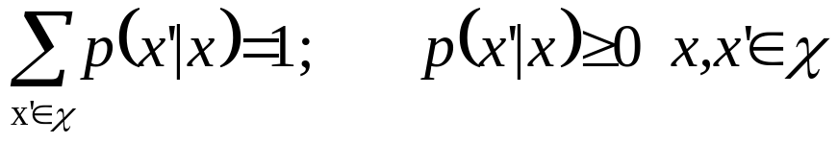
Markov Chains
The Markov chain is time invariant or homogeneous if regardless of the value of the time index i,
p(x’|x) – referred to as transition function and can be represented as a c x c matrix and it satisfies the usual conditions:
One can think of the values of X_{i} as sates and thus of the Markov chain as a finite state process with transitions between states specified by the function p(x’|x).

Slide 10
Markov Chains
If the alphabet χ is not too large then the chain can be completely specified by an intuitively appealing diagram presented below:
Arrows with attached transition probability values mark the transitions between states
Missing transitions imply zero transition probability: p(1|2)=p(2|2)=p(3|3)=0.
p(1|3)
1
p(3|1)
3
p(3|2)
p(1|1)
p(2|1)
2
p(2|3)

Slide 11
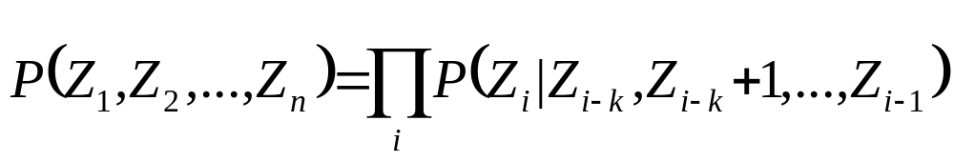

Markov Chains
Markov chains are capable of modeling processes of arbitrary complexity even though they are restricted to one-step memory:
  Consider a process Z₁, Z₂, …, Z_{n},… of memory length k:
  If we define new random variables:
  Then Z sequence specifies X-sequence (and vice versa), and
  X process is a Markov chain as defined earlier.

Slide 12
Hidden Markov Model Concept
Hidden Markov Models allow more freedom to the random process while avoiding a substantial complications to the basic structure of Markov chains.
This freedom can be gained by letting the states of the chain generate observable data while hiding the sate sequence itself from the observer.

Slide 13
Hidden Markov Model Concept
Focus on three fundamental problems of HMM design:
  The evaluation of the probability (likelihood) of a sequence of observations given a specific HMM;
  The determination of a best sequence of model states;
  The adjustment of model parameters so as to best account for the observed signal.

Slide 14
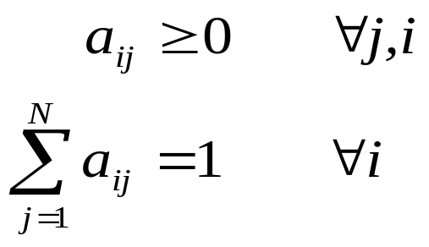
Discrete-Time Markov Processes Examples
Define:
  A system with N distinct states S = {1,2,…,N}
  Time instances associated with state changes as t=1,2,…
  Actual state at time t as s_{t}
  State-transition probabilities as:
a_{ij} = p(s_{t}=j|s_{t-i}=i), 1≤i,j≤N
  State-transition probability properties
a_{ij}
j
i

Slide 15
Discrete-Time Markov Processes Examples
Consider a simple three-state Markov Model of the weather as shown:
State 1: Precipitation (rain or snow)
State 2: Cloudy
State 3: Sunny
0.4
0.3
0.6
1
2
0.2
0.1
0.1
0.3
0.2
3
0.8

Slide 16
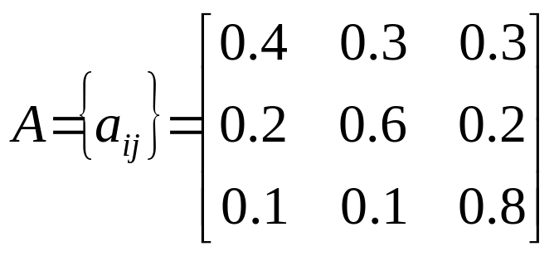
Discrete-Time Markov Processes Examples
Matrix of state transition probabilities:
Given the model in the previous slide we can now ask (and answer) several interesting questions about weather patterns over time.

Slide 17
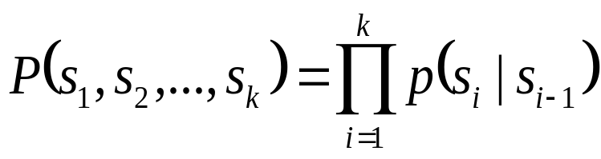
Discrete-Time Markov Processes Examples
Problem 1:
  What is the probability (according to the model) that the weather for eight consecutive days is “sun-sun-sun-rain-sun-cloudy-sun”?
Solution:
  Define the observation sequence, O, as:
  Day 1 2 3 4 5 6 7 8
    O = ( sunny, sunny, sunny, rain, rain, sunny, cloudy, sunny )
    O = ( 3, 3, 3, 1, 1, 3, 2, 3 )
  Want to calculate P(O|Model), the probability of observation sequence O, given the model of previous slide. Given that:

Slide 18
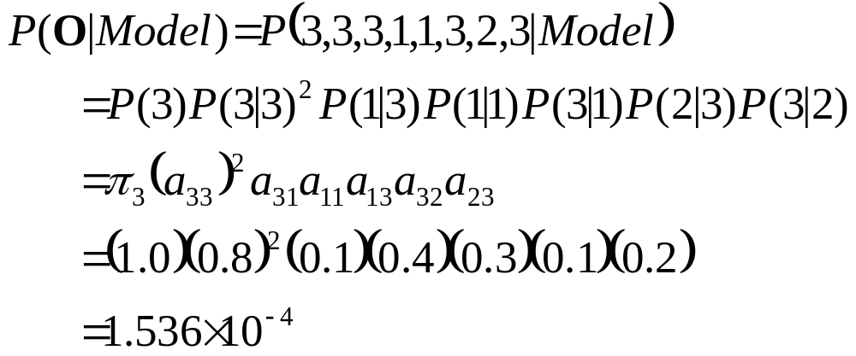
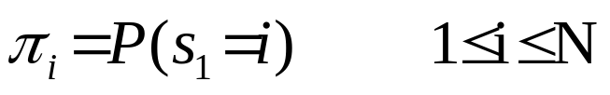
Discrete-Time Markov Processes Examples
Above the following notation was used

Slide 19
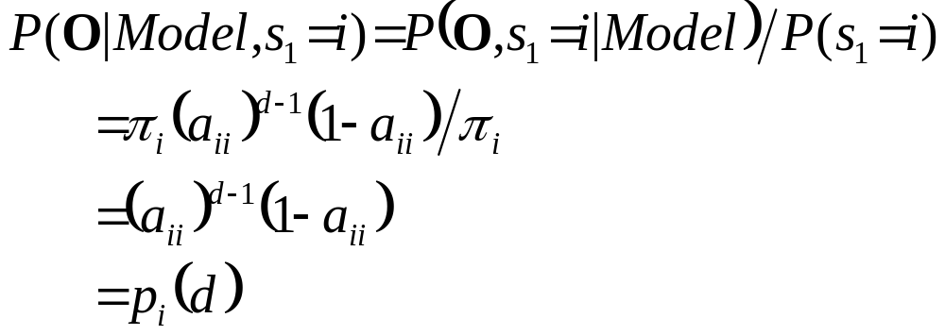
Discrete-Time Markov Processes Examples
Problem 2:
  Given that the system is in a known state, what is the probability (according to the model) that it stays in that state for d consecutive days?
Solution
  Day 1 2 3 d d+1
    O = ( i, i, i, …, i, j≠i )
The quantity p_{i}(d) is the probability
distribution function of duration d in
state i. This exponential distribution is
characteristic of the sate duration in
Markov Chains.

Slide 20
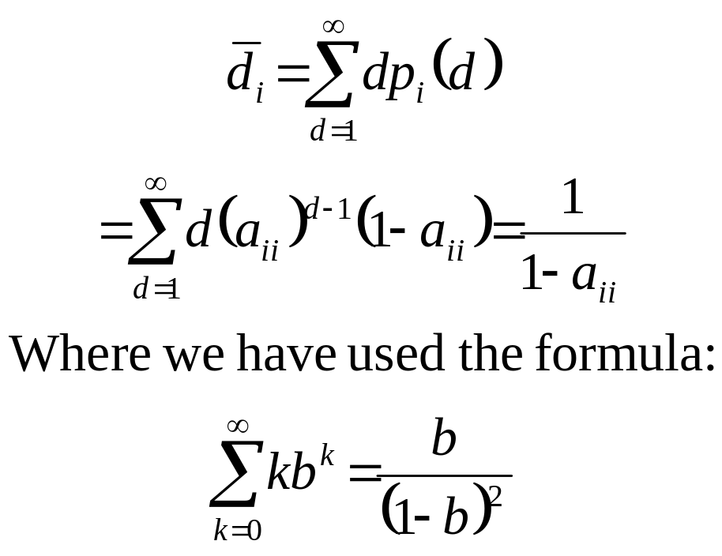
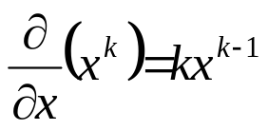
Discrete-Time Markov Processes Examples
  Expected number of observations (duration) in a state conditioned on starting in that state can be computed as ⇨
  Thus, according to the model, the expected number of consecutive days of
    Sunny weather: 1/0.2=5
    Cloudy weather: 2.5
    Rainy weather: 1.67
Exercise Problem: Derive the above formula or directly mean of p_{i}(d)
Hint:

Slide 21
Extensions to Hidden Markov Model
In the examples considered only Markov models in which each state corresponded to a deterministically observable event.
This model is too restrictive to be applicable to many problems of interest.
Obvious extension is to have observation probabilities to be a function of the state, that is, the resulting model is doubly embedded stochastic process with an underlying stochastic process that is not directly observable (it is hidden) but can be observed only through another set of stochastic processes that produce the sequence of observations.

Slide 22
Illustration of Basic Concept of HMM.
Exercise 1.
  Given a single fair coin, i.e., P(Heads)=P(Tails)=0.5. which you toss once and observe Tails.
  What is the probability that the next 10 tosses will provide the sequence (HHTHTTHTTH)?
  What is the probability that the next 10 tosses will produce the sequence (HHHHHHHHHH)?
  What is the probability that 5 out of the next 10 tosses will be tails? What is the expected number of tails overt he next 10 tosses?

Slide 23
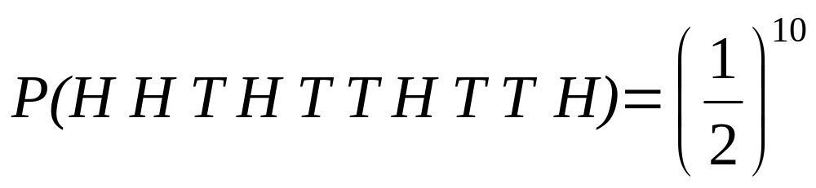
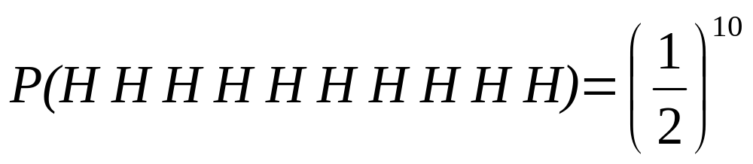
Illustration of Basic Concept of HMM.
Solution 1.
  For a fair coin, with independent coin tosses, the probability of any specific observation sequence of length 10 (10 tosses) is (1/2)¹⁰ since there are 2¹⁰ such sequences and all are equally probable. Thus:
  Using the same argument:

Slide 24
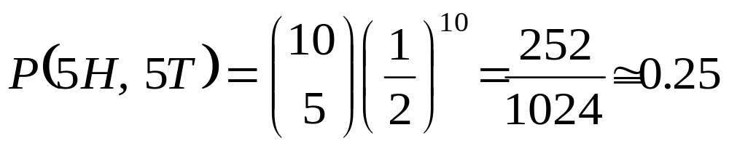
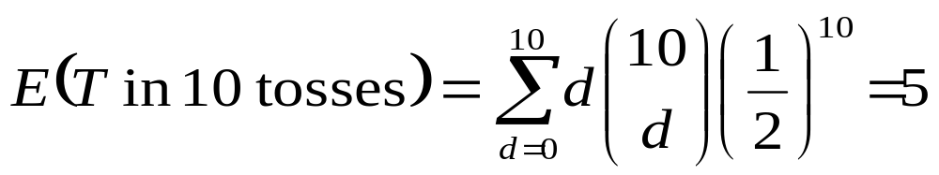
Illustration of Basic Concept of HMM.
Solution 1. (Continued)
  Probability of 5 tails in the next 10 tosses is just the number of observation sequences with 5 tails and 5 heads (in any order) and this is:
    Expected Number of tails in 10 tosses is:
  Thus, on average, there will be 5H and 5T in 10 tosses, but the probability of exactly 5H and 5T is only 0.25.

Slide 25
Illustration of Basic Concept of HMM.
Coin-Toss Models
  Assume the following scenario: You are in a room with a barrier (e.g., a curtain) through which you cannot see what is happening.
  On the other side of the barrier is another person who is performing a coin-tossing experiment (using one or more coins).
  The person (behind the curtain) will not tell you which coin he selects at any time; he will only tell you the result of each coin flip.
  Thus a sequence of hidden coin-tossing experiments is performed, with the observation sequence consisting of a series of heads and tails.

Slide 26
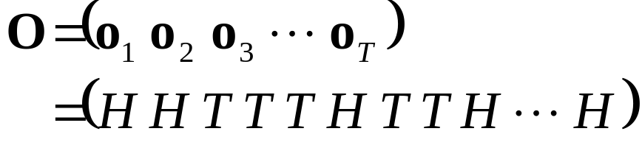
Coin-Toss Models
A typical observation sequence would be:
Given the above scenario, the question is:
  How do we build an HMM to explain (model) the observation sequence of heads and tails?
  First problem we face is deciding what the states in the model correspond to.
  Second, how many states should be in the model.

Slide 27
Coin-Toss Models
One possible choice would be to assume that only a single biased coin was being tossed.
In this case, we could model the situation with a two-state model in which each state corresponds to the outcome of the previous toss (i.e., heads or tails).
1-P(H)
1-P(H)
1- Coin Model
(Observable Markov Model)
O = H H T T H T H H T T H …
S = 1 1 2 2 1 2 1 1 2 2 1 …
P(H)
1
2
P(H)
HEADS
TAILS

Slide 28
Coin-Toss Models
Second HMM for explaining the observed sequence of con toss outcomes is given in the next slide.
In this case:
  There are two states in the model, and
  Each state corresponds to a different, biased coin being tossed. Each state is characterized by a probability distribution of heads and tails, and
  Transitions between state are characterized by a state-transition matrix.
  The physical mechanism that accounts for how state transitions are selected could be itself be a set of independent coin tosses or some other probabilistic event.

Slide 29
Coin-Toss Models
1-a₁₁
a₂₂
2- Coins Model
(Hidden Markov Model)
O = H H T T H T H H T T H …
S = 2 1 1 2 2 2 1 2 2 1 2 …
a₁₁
1
2
1-a₂₂
P(H) = P₁
P(T) = 1-P₁
P(H) = P₂
P(T) = 1-P₂

Slide 30
Coin-Toss Models
A third form of HMM for explaining the observed sequence of coin toss outcomes is given in the next slide.
In this case:
  There are tree states in the model.
  Each state corresponds to using one of the three biased coins, and
  Selection is based on some probabilistic event.

Slide 31
Coin-Toss Models
3- Coins Model
(Hidden Markov Model)
O = H H T T H T H H T T H …
S = 3 1 2 3 3 1 1 2 3 1 3 …
a₁₁
a₁₂
a₂₂
1
2
a₂₁
a₃₁
a₃₂
a₁₃
a₂₃
3
a₃₃
 | State
Probability | 1 | 2 | 3
P(H) | P₁ | P₂ | P₃
P(T) | 1-P₁ | 1-P₂ | 1-P₃

Slide 32
Coin-Toss Models
Given the choice among the three models shown for explaining the observed sequence of heads and tails, a natural question would be which model best matches the actual observations.
  It should be clear that the simple one-coin model has only one unknown parameter,
  The two-coin model has four unknown parameters, and
  The three-coin model has nine unknown parameters.
HMM with larger number of parameters inherently has greater number of degrees of freedom and thus potentially more capable of modeling a series of coin-tossing experiments than HMM’s with smaller number of parameters.
Although this is theoretically true, practical considerations impose some strong limitations on the size of models that we can consider.

Slide 33
Coin-Toss Models
Another fundamental question here is whether the observed head-tail sequence is long and rich enough to be able to specify a complex model.
Also, it might just be the case that only a single coin is being tossed. In such a case it would be inappropriate to use three-coin model because it would be using an underspecified system.

Slide 34
The Urn-and-Ball Model
To extend the ideas of the HMM to a somewhat more complicated situation, consider the urn-and-ball system depicted in the figure.
Assume that there are N (large) glass urns in a room.
Assume that there are M distinct colors.
Within each urn there is a large quantity of colored marbles.
A physical process for obtaining observations is as follows:
  A genie is in the room, and according to some random procedure, it chooses an initial urn.
  From this urn, a ball is chosen at random, and its color is recorded as the observation.
  The ball is then replaced in the urn form which it was selected.
  A new urn is then selected according to the random selection procedure associated with the current urn.
  Ball selection process is repeated.
This entire process generates a finite observation sequence of colors, which we would like to model as the observable output of an HMM.

Slide 35
The Urn-and-Ball Model
Simples HMM model that corresponds to the urn-and-ball process is one in which:
  Each state corresponds to a specific urn, and
  For which a (marble) color probability is defined for each state.
  The choice of state is dictated by the state-transition matrix of the HMM.
It should be noted that the color of the marble in each urn may be the same, and the distinction among various urns is in the way the collection of colored marbles is composed.
Therefore, an isolated observation of a particular color ball does not immediately tell which urn it is drawn from.

Slide 36

The Urn-and-Ball Model
…
An N-State urn-and-ball model illustrating the general case of a discrete symbol HMM
O = {GREEN, GREEN, BLUE, RED, YELLOW, …, BLUE}
URN 1 | URN 2 | URN N
P(RED)=b₁(1) | P(RED)=b₂(1) | P(RED)=b_{N}(1)
P(BLUE)=b₁(2) | P(BLUE)=b₂(2) | P(BLUE)=b_{N}(2)
P(GREEN)=b₁(3) | P(GREEN)=b₂(3) | P(GREEN)=b_{N}(3)
P(YELLOW)=b₁(4) | P(YELLOW)=b₂(4) | P(YELLOW)=b_{N}(4)
… | … | …
P(ORANGE)=b₁(M) | P(ORANGE)=b₂(M) | P(ORANGE)=b_{N}(M)

Slide 37
Elements of a Discrete
HMM
N : number of states in the model
  states s = {s₁,s₂,...,s_{N}}
  state at time t, q_{t} ∈ s
M: number of (distinct) observation symbols (i.e., discrete observations) per state
  observation symbols, v = {v₁,v₂,...,v_{M} }
  observation at time t, o_{t} ∈ v
A = {a_{ij}} : state transition probability distribution
  a_{ij} = P(q_{t+1}=s_{j}|q_{t}=s_{i}), 1 ≤ i,j ≤ N
B = {bj} : observation symbol probability distribution in state j
  b_{j}(k) = P(v_{k} at t|q_{t}=sj ), 1 ≤ j ≤ N, 1 ≤ k ≤ M
π = {π_{i}}: initial state distribution
  π_{i} = P(q₁=s_{i} )1 ≤ i ≤ N
HMM is typically written as: λ = {A, B, π}
  This notation also defines/includes the probability measure for O, i.e., P(O|λ)

Slide 38
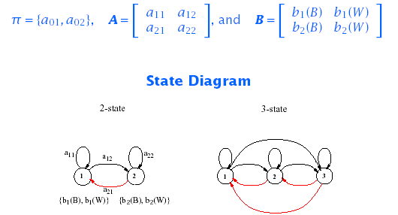
HMM: An Example
For our simple example:

Slide 39
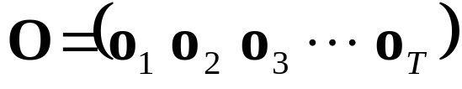
HMM Generator of Observations
Given appropriate values of N, M, A, B, and π, the HMM can be used as a generator to give an observation sequence:
Each observation o_{t} is one of the symbols from V, and T is the number of observation in the sequence.

Slide 40
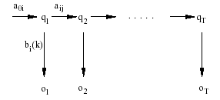
HMM Generator of Observations
The algorithm:
  Choose an initial state q₁=s_{i} according to the initial state distribution π.
  For t=1 to T:
    Choose o_{t}=v_{k} according to the symbol probability distribution in state s_{i}, i.e., b_{i}(k).
    Transit to a new state q_{t+1} = s_{j} according the state-transition probability distribution for state s_{i}, i.e., a_{ij}.
  Increment t, t=t+1; return to step 2 if t<T; otherwise, terminate the procedure.

Slide 41
Three Basic HMM Problems
Scoring: Given an observation sequence O={o₁,o₂,...,o_{T}} and a model λ = {A, B,π}, how do we compute P(O| λ), the probability of the observation sequence?
    ⇒ The Probability Evaluation (Forward & Backward Procedure)
Matching: Given an observation sequence O={o₁,o₂,...,o_{T}} how do we choose a state sequence Q={q₁,q₂,...,q_{T}} which is optimum in some sense?
    ⇒ The Viterbi Algorithm
Training: How do we adjust the model parameters λ = {A,B, π} to maximize P(O| λ)?
    ⇒ The Baum-Welch Re-estimation

Slide 42
Three Basic HMM Problems
Problem 1 - Scoring:
  Is the evaluation problem; namely, given a model and a sequence of observations, how do we compute the probability that the observed sequence was produced by the model?
  It can also be views as the problem of scoring how well a given model matches a given observation sequence.
  The later viewpoint is extremely useful in cases in which we are trying to choose among several competing models. The solution to Problem 1 allows us to choose the model that best matches the observations.

Slide 43
Three Basic HMM Problems
Problem 2- Matching:
  Is the one in which we attempt to uncover the hidden part of the model – that is to find the “correct” state sequence.
  It must be noted that for all but the case of degenerate models, there is no “correct” state sequence to be found. Hence, in practice one can only find an optimal state sequence based on chosen optimality criterion.
    Several reasonable optimality criteria can be imposed and thus the choice of criterion is a strong function of the intended use.
    Typical uses are:
      Learn about the structure of the model
      Find optimal state sequences for continues speech recognition.
      Get average statistics of individual states, etc.

Slide 44
Three Basic HMM Problems
Problem 3 – Training:
  Attempts to optimize the model parameters to best describe how a given observation sequence comes about.
  The observation sequence used to adjust the model parameters is called a training sequence because it is used to “train” the HMM.
  Training algorithm is the crucial one since it allows to optimally adapt model parameters to observed training data to create best HMM models for real phenomena.

Slide 45
Simple Isolated-Word Speech Recognition
For each word of a W word vocabulary design separate N-state HMM.
Speech signal of a given word is represented as a time sequence of coded spectral vectors (How?).
There are M unique spectral vectors; hence each observation is the index of the spectral vector closest (in some spectral distortion sense) to the original speech signal.
For each vocabulary word, we have a training sequence consisting of a number of repetitions of sequences of codebook indices of the word (by one ore more speakers).

Slide 46
Simple Isolated-Word Speech Recognition
First task is to build individual word models.
  Use solution to Problem 3 to optimally estimate model parameters for each word model.
  To develop an understanding of the physical meaning of the model states:
    Use the solution to Problem 2 to segment each word training sequences into states
    Study the properties of the spectral vectors that led to the observations occurring in each state.
    Goal is to make refinements of the model:
      More states,
      Different Codebook size, etc.
    Improve and optimize the model
Once the set of W HMM’s has been designed and optimized, recognition of an unknown word is performed using the solution to Problem 1 to score each word model based upon the given test observation sequence, and select the word whose model score is highest (i.e., the highest likelihood).

Slide 47
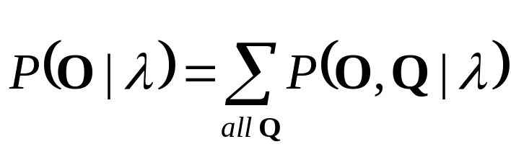
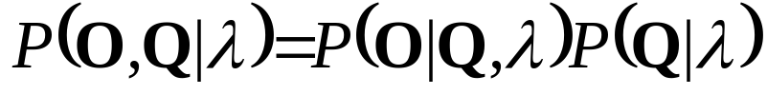
Computation of P(O|λ)
Solution to Problem 1:
  Wish to calculate the probability of the observation sequence, O={o₁,o₂,...,o_{T}} given the model λ.
  The most straight forward way is through enumeration of every possible state sequence of length T (the number of observations). Thus there are N^{T} such state sequences:
  Where:

Slide 48
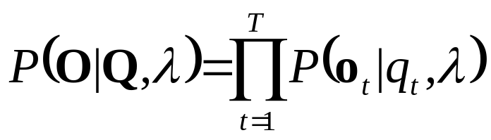
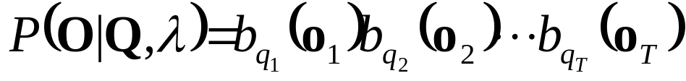
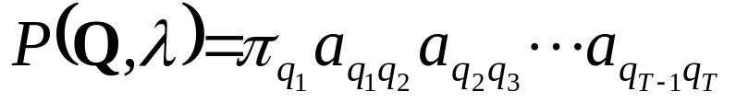
Computation of P(O|λ)
Consider the fixed state sequence: Q= q₁q₂ ...q_{T}
The probability of the observation sequence O given the state sequence, assuming statistical independence of observations, is:
Thus:
The probability of such a state sequence q can be written as:

Slide 49
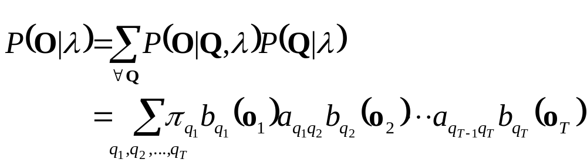
Computation of P(O|λ)
The joint probability of O and Q, i.e., the probability that O and Q occur simultaneously, is simply the product of the previous terms:
The probability of O given the model λ is obtained by summing this joint probability over all possible state sequences Q:

Slide 50
Computation of P(O|λ)
Interpretation of the previous expression:
  Initially at time t=1 we are in state q₁ with probability π_{q1}, and generate the symbol o₁ (in this state) with probability b_{q1}(o₁).
  In the next time instance t=t+1 (t=2) transition is made to state q₂ from state q₁ with probability a_{q1q2} and generate the symbol o₂ with probability b_{q2}(o₂).
  Process is repeated until the last transition is made at time T from state q_{T} from state q_{T-1} with probability a_{qT-1qT} and generate the symbol o_{T} with probability b_{qT}(o_{T}).
Practical Problem:
  Calculation required ≈ 2T · N^{T} (there are N^{T} such sequences)
  For example: N =5 (states),T = 100 (observations) ⇒ 2 · 100 · 5¹⁰⁰ . 10⁷² computations!
  More efficient procedure is required ⇒ Forward Algorithm

Slide 51
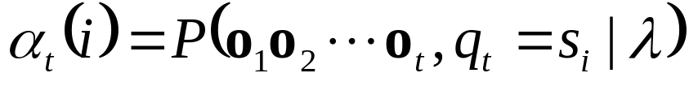
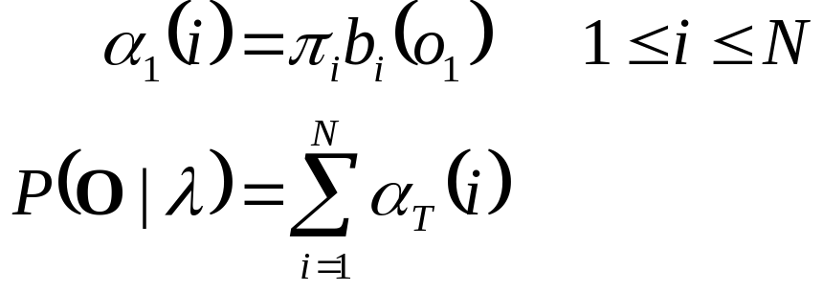
The Forward Algorithm
Let us define the forward variable, α_{t}(i), as the probability of the partial observation sequence up to time t and state s_{i} at time t, given the model, i.e.
It can easily be shown that:
Thus the algorithm:

Slide 52
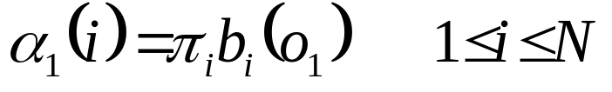
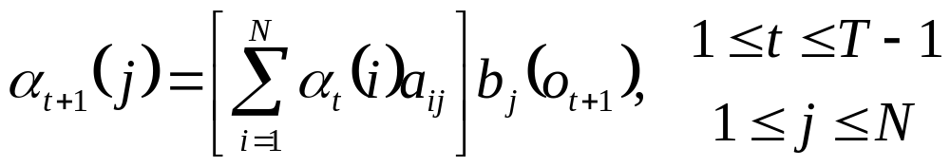
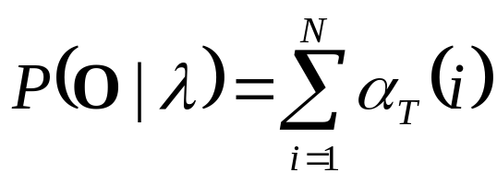
The Forward Algorithm
Initialization
Induction
Termination
t
t+1
s₁
s₂
a_{1j}
a_{2j}
s₃
a_{3j}
s_{j}
a_{Nj}
s_{N}
α_{t}(i)
α_{t+1}(j)

Slide 53
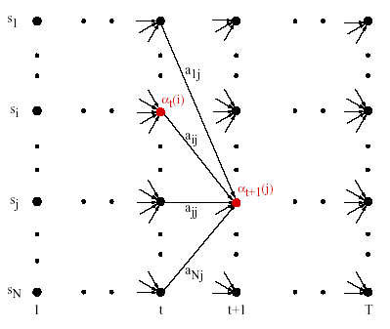
The Forward Algorithm

Slide 54
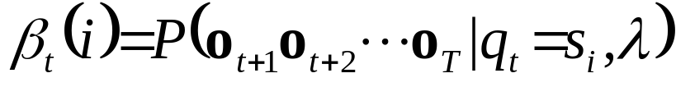
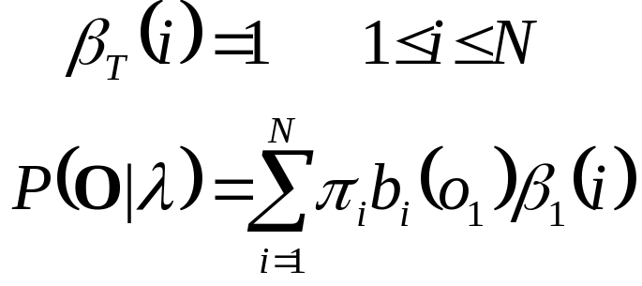
The Backward Algorithm
Similarly, let us define the backward variable, β_{t}(i), as the probability of the partial observation sequence from time t+1 to the end, given state s_{i} at time t and the model, i.e.
It can easily be shown that:
By induction the following algorithm is obtained:

Slide 55
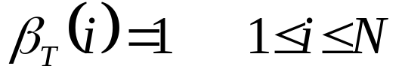
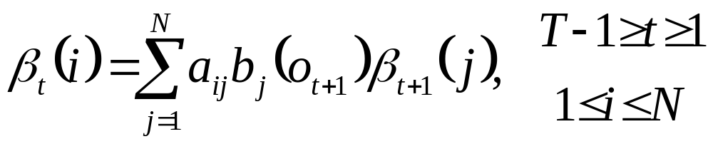
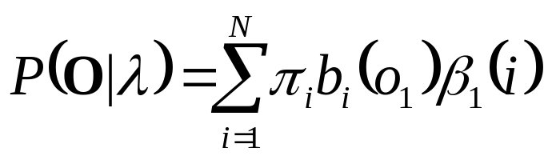
The Backward Algorithm
Initialization
Induction
Termination
t
t+1
s₁
a_{i1}
a_{i2}
s₂
s_{i}
a_{i3}
s₃
a_{iN}
s_{N}
β_{t}(i)
β_{t+1}(j)

Slide 56
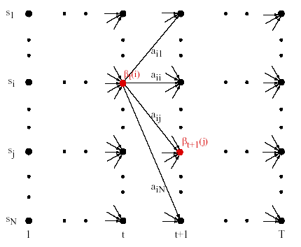
The Backward Algorithm

Slide 57
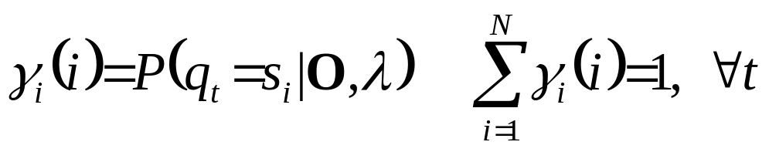
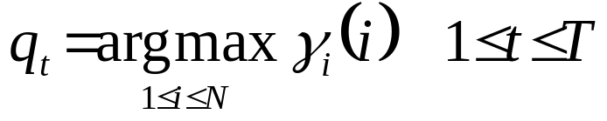
Finding Optimal State Sequences
One criterion chooses states, q_{t}, which are individually most likely
  This maximizes the expected number of correct states
Let us define γ_{t}(i) as the probability of being in state s_{i} at time t, given the observation sequence and the model, i.e.
Then the individually most likely state, q_{t}, at time t is:

Slide 58
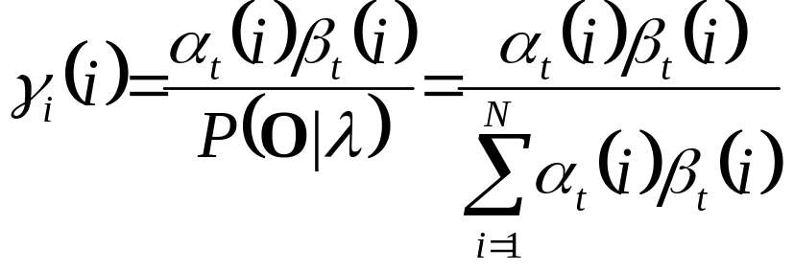
Finding Optimal State Sequences
Note that it can be shown that:
The individual optimality criterion has the problem that the optimum state sequence may not obey state transition constraints
Another optimality criterion is to choose the state sequence which maximizes P(Q ,O|λ);
  This can be found by the Viterbi algorithm

Slide 59
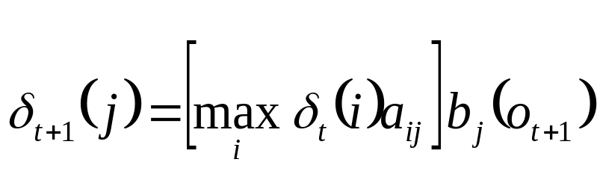
The Viterbi Algorithm
Let us define δ_{t}(i) as the highest probability along a single path, at time t, which accounts for the first t observations, i.e.
By induction:
To retrieve the state sequence, we must keep track of the state sequence which gave the best path, at time t, to state s_{i}
  We do this in a separate array ψ_{t}(i).

Slide 60
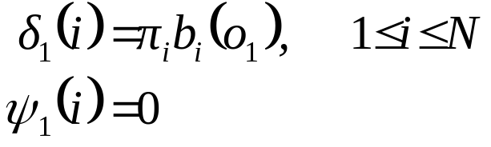


The Viterbi Algorithm
Initialization:
Recursion
Termination

Slide 61

The Viterbi Algorithm
Path (state-sequence) backtracking:
Computation Order: ≈N²T

Slide 62

The Viterbi Algorithm Example
0.5*0.8
0.3*0.7
0.2*1
0.4*0.5

Slide 63

The Viterbi Algorithm: An Example (cont’d)

Slide 64

Matching Using Forward-Backward Algorithm

Slide 65


Solution to Problem 3:
Baum-Welch Re-estimation
Baum-Welch re-estimation uses EM to determine ML parameters
Define ξ_{t}(i,j) as the probability of being in state s_{i} at time t and state s_{j} at time t+1, given the model and observation sequence
Then, from the definitions of the forward and backward variables, can write ξ_{t}(i,j) in the form:

Slide 66


Solution to Problem 3:
Baum-Welch Re-estimation
Hence considering that we have defined γ_{t}(i) as the probability of being in state s_{i} at time t, we can relate γ_{t}(i) to ξ_{t}(i,j) by summing over j:

Slide 67

Solution to Problem 3:
Baum-Welch Re-estimation
Summing over γ_{t}(i) and ξ_{t}(i,j), we get

Slide 68

Baum-Welch Re-estimation Procedures

Slide 69

Baum-Welch Re-estimation Formulas

Slide 70

Baum-Welch Re-estimation Formulas
If λ =(A , B, π).is the initial model, and re-estimated model. Then it can be proved that either:
  The initial model, λ, defines a critical point of the likelihood function, in which case λ=λ, or
  Model λ is more likely than λ in the sense that P(O|λ)>P(O|λ), i.e., we have found a new model λ from which the observation sequence is more likely to have been produced.
Thus we can improve the probability of O being observed from the model if we iteratively use λ in place of λ and repeat the re-estimation until some limiting point is reached. The resulting model is called the maximum likelihood HMM.
-
-
-
-
-

Slide 71
Multiple Observation Sequences
Speech recognition typically uses left-to-right HMMs. These HMMs can not be trained using a single observation sequence, because only a small number of observations are available to train each state. To obtain reliable estimates of model parameters, one must use multiple observation sequences. In this case, the re-estimation procedure needs to be modified.
Let us denote the set of K observation sequences as
O = {O⁽¹⁾, O⁽²⁾, …, O^{(K)}}
Where O^{(k)} = {O₁^{(k)}, O₂^{(k)}, …, O_{Tk}^{(k)}} is the k-th observation sequence.

Slide 72

Multiple Observation Sequences
Assume that the observations sequences are mutually independent, we want to estimate the parameters so as to maximize
Since the re-estimation formulas are based on frequency of occurrence of various events, we can modify them by adding up the individual frequencies of occurrence for each sequence. The modified re-estimation formulas for ā_{ij} and b_{j}(l) are:
_

Slide 73

Multiple Observation Sequences

Slide 74
Multiple Observation Sequences
Note: π_{i} is not re-estimated since:
  π₁ = 1 and
  π_{i} = 0, i≠1.

Slide 75

Phone-based HMMs
Word-based HMMs are appropriate for small vocabulary speech recognition. For large vocabulary ASR, sub-word-based (e.g., phone-based) models are more appropriate.

Slide 76

Phone-based HMMs (cont’d)
The phone models can have many states, and words are made up from a concatenation of phone models.

Slide 77


Continuous Density Hidden Markov Models
A continuous density HMM replaces the discrete observation probabilities, b_{j}(k), by a continuous PDF b_{j}(x)
A common practice is to represent b_{j}(x) as a mixture of Gaussians:
Where:

Slide 78
Acoustic Modeling Variations
Semi-continuous HMMs first compute a VQ codebook of size M
  The VQ codebook is then modeled as a family of Gaussian PDFs
Each codeword is represented by a Gaussian PDF, and may be used together with others to model the acoustic vectors
  From the CD-HMM viewpoint, this is equivalent to using the same set of M mixtures to model all the states
  It is therefore often referred to as a Tied Mixture HMM
All three methods have been used in many speech recognition tasks, with varying outcomes
For large-vocabulary, continuous speech recognition with sufficient amount (i.e., tens of hours) of training data, CD-HMM systems currently yield the best performance, but with considerable increase in computation

Slide 79
Implementation Issues
Scaling:
  To prevent underflow
Segmental K-means Training:
  To train observation probabilities by first performing Viterbi alignment
Initial estimates of λ:
  To provide robust models
Pruning:
  To reduce search computation

Slide 80
References
X. Huang, A. Acero, and H. Hon, Spoken Language Processing, Prentice-Hall, 2001.
F. Jelinek, Statistical Methods for Speech Recognition. MIT Press, 1997.
L. Rabiner and B. Juang, Fundamentals of Speech Recognition, Prentice-Hall, 1993.

Slide 81
Hidden Markov Model Concept
Definitions:
  An output alphabet Y={0,1,…,b-1}
  A state space S={1,2,…,c} with a unique starting state s₀.
  A probability distribution of transitions between states p(s’|s), and
  An output probability distribution q(y|s,s’) associated with transitions from state s to state s’.

Slide 82

Hidden Markov Model Concept
The probability of observing an HMM output string y₁, y₂, …,y_{k} is given by:
Next Figure is an example of an HMM with b=2 and c=3.
q(y|3,1)
1
q(y|1,3)
3
q(y|1,1)
q(y|2,3)
q(y|1,2)
2
q(y|3,2)
Three State Hidden Markov Model with outputs y ∈ {0,1}

Slide 83
Hidden Markov Model Concept
The underlying state process still has only one-step memory:
However, the memory of observables is unlimited (except in degenerate cases.
That is is, in general for all k≥2

Slide 84
Hidden Markov Model Concept
It will frequently be convenient to regard the HMM as having multiple transitions between pairs of states, each associated with a different output symbol generated, with probability of 1, when transition is taken. The HMM example given below can generate the same random sequence as the pervious example assuming that q(1|1,1)=q(1|1,3)=q(0|3,1)=q(0|3,2) = 0
1
1
0
3
0
0
1
1
0
2
1
Hidden Markov Model representation attaching outputs to transitions

Slide 85


Hidden Markov Model Concept
This view has the advantage of allowing us to provide each transition of the entire HMM with a different identifier t and to define an output function Y(t) that assigns to t a unique output symbol taken from the alphabet Y.
We then denote by L(t) and R(t) the source and target states of the transition t, respectively. We let p(t) denote the probability that the state L(t) is exited via the transition t, so that for all s ∈S
The correspondence between the two ways of viewing an HMM is given by the relationship

Slide 86


Hidden Markov Model Concept
When transitions determine outputs, the probability P(y₁,y₂,…, y_{k}) becomes equal to the sum of the products:
over all transition sequences t₁,…,t_{k} such that
L(t₁)=s₀, Y(t_{i})=y_{i,} and R(t_{i})=L(t_{i+1}) for i=1,…,k or formally:
Where
S (y₁,y₂,…, y_{k}) = {t₁,t₂,…, t_{k}: L(t₁)=s₀,Y(t_{i})=y_{i}, R(t_{i})=L(t_{i+1}) for i=1,…,k}
In the following sections we will take whichever point of view:
  Multiple transitions between states s and s’, or
  Multiple possible outputs generated by the single transition s→s’
  Will be more convenient for the problem at hand.

Slide 87
The evaluation of the probability: The Trellis
There is an easy way to calculate the probability P(y₁,y₂,…, y_{k}) with the help of trellis. Trellis:
  Consists of the concatenation of elementary stages determined by the particular outputs y_{i}.
  The number of elementary states is equal to the number of different output symbols.
1
1
1
1
2
2
2
2
3
3
3
3
y=0
y=1
Two different trellis stages corresponding to the binary HMM presented in the slide 16.

Slide 88
The Trellis
Trellis corresponding to the output sequence 0110.
The required probability P(0110) is equal to the sum of the probabilities of all complete paths through the trellis (those ending in the last column) that start in the obligatory starting state.
1
1
1
1
1
2
2
2
2
2
3
3
3
3
3
y=0
y=1
y=1
y=0
Trellis for output sequence 0110 generated by the binary HMM presented in the slide 16.

Slide 89
The Trellis
Example of paths for s₀=1 that could generate 0110 sequence.
s₀
1
1
1
1
1
2
2
2
2
2
3
3
3
3
3
y=0
y=1
y=1
y=0
Trellis of previous slide purged of all paths that could not have generated the output sequence 0110.

Slide 90



The Trellis
The probability P(y₁,y₂,…, y_{n}) can be obtained recursively:
  Define the probabilities:
  Using boundary conditions:
  And applying the simplified notation:

Slide 91


The Trellis
We get the recursion expression:
From the definition of α_{i}(s) the desired probability is then:

Slide 92






The Trellis
Unit probability assigned to starting state s₀=1, i.e., α₀(s₀)=1.
Computing the flows p(0,s|1)α₀(1) for s∈{1,2,3}
s₀
1
1
1
1
1
2
2
2
2
2
3
3
3
3
3
y=0
y=1
y=1
y=0
Trellis of previous slide purged of all paths that could not have generated the output sequence 0110.

