Slide 1
Speech Recognition
Dynamic Time Warping & Search

Slide 2
Dynamic Time Warping & Search
Dynamic time warping
Search
  Graph search algorithms
  Dynamic programming algorithms

Slide 3
Word-Based Template Matching
Feature
Measurement
Pattern
Similarity
Decision
Rule
Spoken
Word
OutputWord
Word
Reference
Templates
Whole word representation:
  No explicit concept of sub-word units (e.g., phones)
  No across-word sharing
Used for both isolated-and connected-word recognition
Popular in late 1970s to mid 1980s

Slide 4
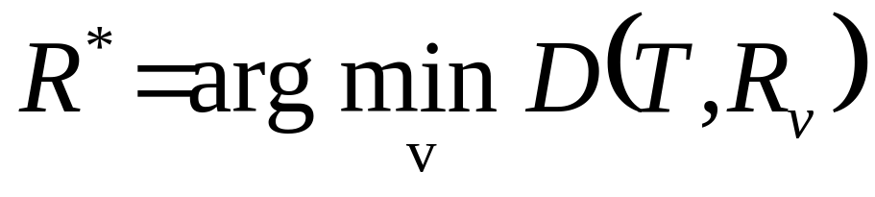
Template Matching Mechanism
Test pattern, T , and reference patterns, {R₁,..., R_{V} },are represented by sequences of feature measurements
Pattern similarity is determined by aligning test pattern, T ,with reference pattern, R_{v} , with distortion D(T,R_{v})
Decision rule chooses reference pattern, R* , with smallest alignment distortion D(T,R*)
Dynamic time warping (DTW) is used to compute the best possible alignment warp, φ_{v}, between T and R_{v}, and associated distortion D(T,R_{v})

Slide 5
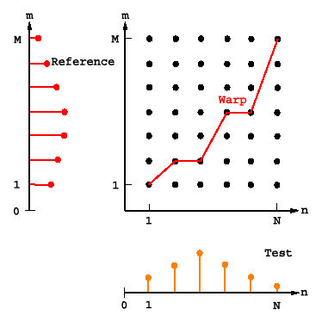
Alignment Example

Slide 6
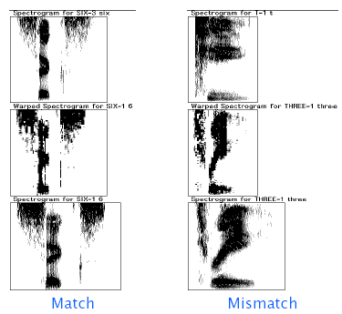
Digit Alignment Examples

Slide 7
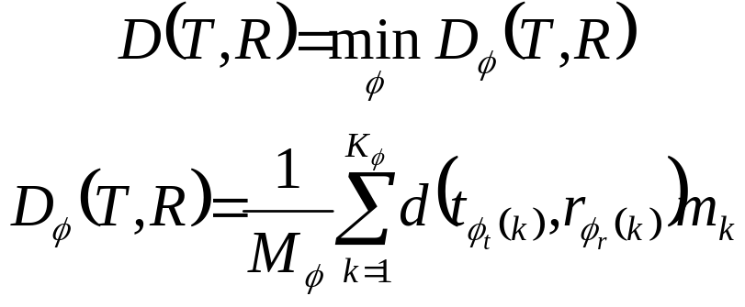
Dynamic Time Warping (DTW)
Objective: an optimal alignment between variable length sequences T = {t₁,..., t_{N}} and R = {r₁,..., r_{M}}
The overall distortion D(T,R) is based on a sum of local distances between elements d(t_{i}, r_{j})
A particular alignment warp, φ, aligns T and R via a point-to-point mapping, φ =(φ_{t}, φ_{r}), of length Kφ
t_{φt(k)} ⬄ r_{φr(k)} 1≤k≤K_{φ}
The optimal alignment minimizes overall distortion:

Slide 8
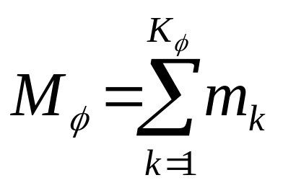
DTW Issues
Endpoint constraints:
φ_{t}(1)=φ_{r}(1)=1 φ_{t}(K)=N φ_{r}(K)=M
Monotonicity:
φ_{t}(k+1)≥φ_{t}(k) φ_{r}(k+1)≥φ_{r}(k)
Path weights, m_{k}, can influence shape of optimal path
Path normalization factor, M_{φ}, allows comparison between different warps (e.g., with different lengths).

Slide 9
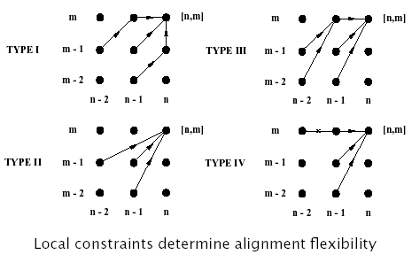
DTW Issues: Local Continuity

Slide 10
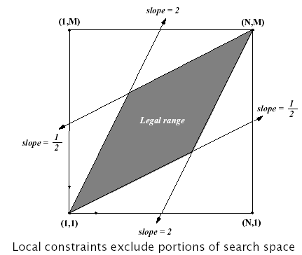
DTW Issues: Global Constraints

Slide 11
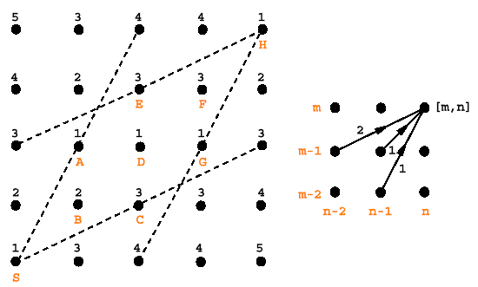
Computing DTW Alignment

Slide 12
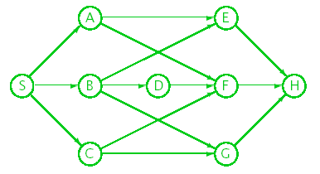
Graph Representations of Search Space
Search spaces can be represented as directed graphs
Paths through a graph can be represented with a tree

Slide 13
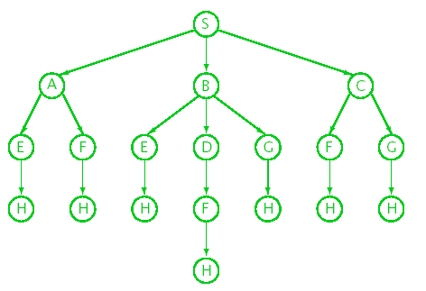
Search Space Tree

Slide 14
Graph Search Algorithms
Iterative methods using a queue to store partial paths
  On each iteration the top partial path is removed from the queue and is extended one level
  New extensions are put back into the queue
  Search is complete when goal is reached
Depth of queue is potentially unbounded
Weighted graphs can be searched to find the best path
Admissible algorithms guarantee finding the best path
Many speech-based search problems can be configured to proceed time-synchronously

Slide 15
Depth First Search
Searches space by pursuing one path at a time
Path extensions are put on top of queue
Queue is not reordered or pruned
Not well suited for spaces with long dead-end paths
Not generally used to find the best path

Slide 16
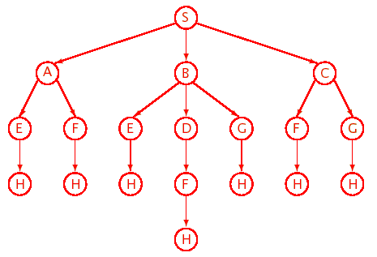
Depth First Search Example

Slide 17
Breadth First Search
Searches space by pursuing all paths in parallel
Path extensions are put on bottom of queue
Queue is not reordered or pruned
Queue can grow rapidly in spaces with many paths
Not generally used to find the best path
Can be made much more effective with pruning

Slide 18
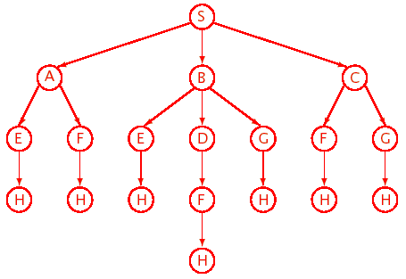
Breadth First Search Example

Slide 19
Best First Search
Used to search a weighted graph
Uses greedy or step-wise optimal criterion, whereby each iteration expands the current best path
On each iteration, the queue is resorted according to the cumulative score of each partial path
If path scores exhibit monotonic behavior, (e.g., d(t_{i}, r_{j} ) ≥ 0), search can terminate when a complete path has a better score than all active partial paths

Slide 20
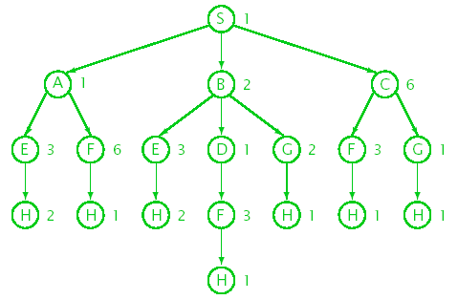
Tree Representation (with node scores)

Slide 21
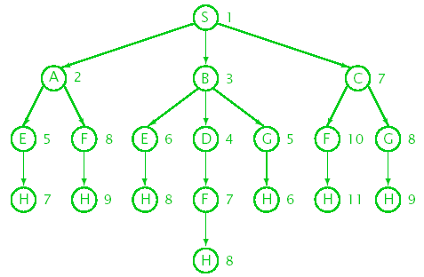
Tree Representation (with cumulative scores)

Slide 22
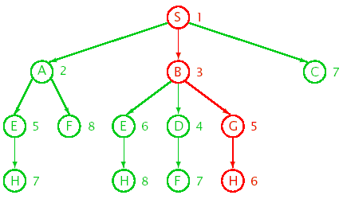
Best First Search Example

Slide 23
Pruning Partial Paths
Both greedy and dynamic programming algorithms can take advantage of optimal substructure:
  Let φ(i,j) be the best path between nodes i and j
  If k is a node in φ(i,j):
  φ(i,j)= {φ(i,k), φ(k,j)}
  Let φ(i,j) be the cost of φ(i,j):
  φ(i,j) = min(φ(i,k)+ φ(k,j))
Solutions to subproblems need only be computed once
Sub-optimal partial paths can be discarded while maintaining admissibility of search
k

Slide 24
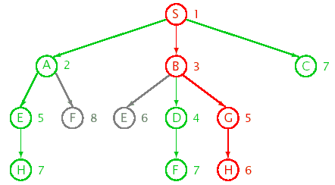
Best First Search with Pruning

Slide 25
Estimating Future Scores
Partial path scores, ϕ(l,i), can be augmented with future estimates ϕ(i), of the remaining cost:
ϕ_{φ}=ϕ(l,i)+ϕ(i)
If ϕ(i) is underestimate of the remaining cost, additional paths can be pruned while maintaining admissibility of search.
A* search uses:
  Best-first search strategy
  Pruning
  Future estimates
^
^
^

Slide 26
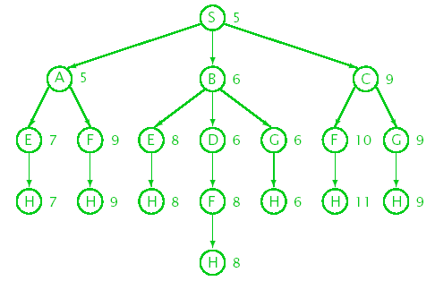
Tree Representation (with future estimates)
Original Distance Scores
1+4
4=(2+3+7)/3
???

Slide 27
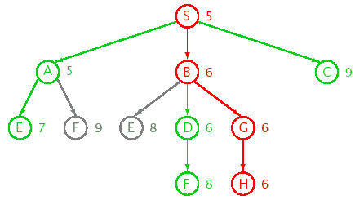
A* Search Example

Slide 28
N -Best Search
Used to compute top N paths
  Can be re-scored by more sophisticated techniques
  Typically used at the sentence level
Can use modified A* search to rank paths
  No pruning of partial paths
  Completed paths are removed from queue
  Can use a threshold to prune paths, and still identify admissibility violations
  Can also be used to produce a graph
Alternative methods can be used to compute N -best outputs (e.g., asynchronous DP)

Slide 29
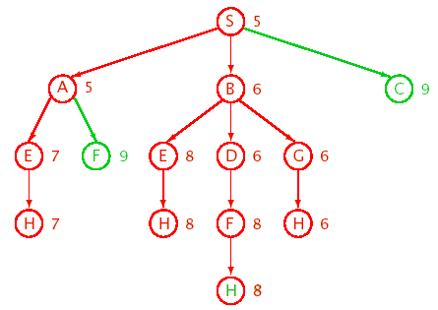
N -Best Search Example

Slide 30
Dynamic Programming (DP)
DP algorithms do not employ a greedy strategy
DP algorithms typically take advantage of optimal substructure and overlapping subproblems by arranging search to solve each subproblem only once
Can be implemented efficiently:
  Node j retains only best path cost of all ϕ(i,j)
  Previous best node id needed to recover best path
Can be time-synchronous or asynchronous
DTW and Viterbi are time-synchronous searches and look like breadth-first with pruning

Slide 31
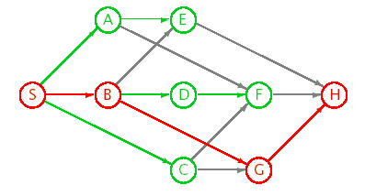
Time-Synchronous DP Example

Slide 32
Inadmissible Search Variations
Can use a beam width to prune current hypotheses
  Beam width can be static or dynamic based on relative score
Can use an approximation to a lower bound on A* lookahead for N -best computation
Search is inadmissible, but may be useful in practice

Slide 33
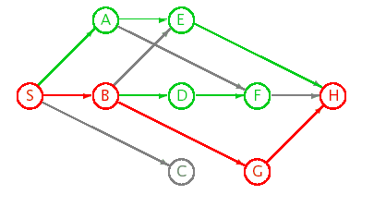
Beam Search Example

Slide 34
DTW - DP Algorithm Details
The result of applying DTW is a measure of similarity of a test pattern (for example, an uttered word) and a reference pattern (e.g., a template or model of a word).
Each test pattern and each reference pattern may be represented as a sequence of vectors.
The two speech patterns are aligned in time and DTW measures a global distance between the two sequences of vectors.

Slide 35
DTW - DP Algorithm Details
The uttered word is represented by a sequence of feature vectors (also called frames) arrayed along the horizontal axis.
The template or model of the word is represented by a sequence of feature vectors (also called frames) arrayed along the vertical axis.
The feature vectors are generated at intervals of, for example, 0.01 sec (e.g., 100 feature vectors per second).
Each feature vector captures properties of speech typically centered within 20-30 msec.
Properties of the speech signal generally do not change significantly within a time duration of the analysis window (i.e., 20-30 msec).
The analysis window is shifted by 0.01 sec to capture the properties of the speech signal in each successive time instance.
Details of how a raw signal may be represented as a set of features are provided in:
  L.R. Rabiner and R.W. Schafer, “Digital Processing of Speech Signals”, Prentice-Hall, 1978, Chapter 4: Time-Domain Methods for Speech Processing, pp117-171, and
  “Fundamentals of Speech Recognition” Lawrence Rabiner, and Biing-Hwang Juang, Prentice Hall, 1993, Chapter 3., Signal Processing and Analysis Methods for Speech Recognition, pp. 69-139.

Slide 36
DTW - DP Algorithm Details
A time-time matrix illustrates the alignment process
H
C
E
E
i-1, j
P
i-1
j-1
i, j-1
S
S
s
P
E
E
h
H

Slide 37
DTW - DP Algorithm Details
In the example depicted in previous slide, the utterance is SsPEEhH, a noisy version of the template SPEECH.
The utterance SsPEEhH will typically be compared to all other templates (i.e., reference patterns or models that correspond to other words) in a repository to find the template that is the best match.
The best matching template is deemed to be the one that has the lowest global distance from the utterance, computed along a path that best aligns the utterance with a given template, i.e., produces the lowest global distance of any alignment path between the utterance and the given template.
By a path, we mean a series of associations between frames of the utterance and corresponding frames of the template. The complete universe of possible paths includes every possible set of associations between the frames.
A global distance of a path is the sum of local distances for each of the associations of the path.

Slide 38
DTW - DP Algorithm Details
One way to find the path that yields the best match (i.e., lowest global distance) between the utterance and a given template is by evaluating all possible paths in the universe.
That approach is time consuming because the number of possible paths is exponential with the length of the utterance.
The matching process can be shortened by requiring that
  A path cannot go backwards in time; (i.e., to the left or down in the Figure)
  A path must include an association for every frame in the utterance, and
  Local distance scores are combined by adding to give a global distance.

Slide 39
DTW - DP Algorithm Details
For the moment, assume that a path must include an association for every frame in the template and every frame in the utterance.
Then, for a point (i, j) in the time-time matrix (where i indexes the utterance frame, j the template frame), the previous point must have been (i-1, j-1), (i-1, j) or (i, j-1) (because of the prohibition of going backward in time).
(i-1,j)
(i,j)
j
(i,j-1)
(i-1,j-1)
i

Slide 40
DTW - DP Algorithm Details
The principle of dynamic programming (DP) is that a point (i, j), the next selected point on the path, comes from one among (i-1, j-1), (i-1, j) or (i, j-1) that has the lowest distance.
DP finds the lowest distance path through the matrix, while minimizing the amount of computation.
The DP algorithm operates in a time-synchronous manner by considering each column of the time-time matrix in succession (which is equivalent to processing the utterance frame-by-frame).
For a template of length N (corresponding to an N-row matrix), the maximum number of paths being considered at any time is N.
A test utterance feature vector j is compared to all reference template features, 1…N, thus generating a vector of corresponding local distances d(1, j), d(2, j), … d(N, j).

Slide 41
DTW - DP Algorithm Details
If D(i, j) is the global distance up to, but not including point (i, j) and the local distance of (i, j) is given by d(i, j), then
  D(i, j) = min [D(i-1, j-1), D(i-1, j), D(i, j-1)] + d(i, j)
Given that D(1, 1) = d(1, 1) (this is the initial condition), we have the basis for an efficient recursive algorithm for computing D(i, j).
The final global distance D(M, N) at the end of the path gives the overall lowest matching score of the template with the utterance, where M is the number of vectors of the utterance.
The utterance is then recognized as the word corresponding to the template with the lowest matching score. (Note that N may be different for different templates.)

Slide 42
DTW - DP Algorithm Details
Equation presented in the previous slide enforces the rule that the only directions in which a path can move when at (i, j) in the time-time matrix is:
  up,
  right, or
  diagonally up and right.
Computationally, equation 1 is in a form that could be recursively programmed. However, unless the language is optimized for recursion, this method can be slow even for relatively small pattern sizes.
Another method that is both quicker and requires less memory storage uses two nested "for" loops. This method only needs two arrays that hold adjacent columns of the time-time matrix.

Slide 43
Referring to next Figure, the algorithm to find the least global distance path is as follows (Note that from the Figure, which shows a representative set of rows and columns, the cells at (i, j) and (i, 0) have different possible originator cells. The path to (i, 0) can originate only from (i-1, 0).
But the path to any other (i, j) can originate from the three standard locations):
i-1, j
i, j
i-1
j-1
i, j-1
Prev. Col.: i-1
Cur. Column: i

Slide 44
DTW - DP Algorithm Details
Calculate the global distance for the bottom most cell of the left-most column, column 0.
  The global distance up to this cell is just its local distance.
  The calculation then proceeds upward in column 0.
  The global distance at each successive cell is the local distance for that cell plus the global distance to the cell below it.
  Column 0 is then designated the predCol (predecessor column).
Calculate the global distance to the bottom most cell of the next column, column 1 (which is designated the curCol, for current column).
  The global distance to that bottom most cell is the local distance for that cell plus the global distance to the bottom most cell of the predecessor column.
Calculate the global distance of the rest of the cells of curCol.
  For example, at cell (i, j) this is the local distance at (i, j) plus the minimum global distance at either (i-1, j), (i-1, j-1) or (i, j-1).
curCol becomes predCol and step 2 is repeated until all columns have been calculated.
Minimum global distance is the value stored in the top most cell of the last column.

Slide 45
DTW - DP Algorithm Details
The pseudocode for this process is:
  Calculate First Column Distances (Prev. Column)
  for i=1 to Number of Input Feature Vectors
  CurCol[0] = local distance at (i,0)
  + global cost at (i-1,0)
  for j=1 to Number of Template Feature Vectors
  CurCol[j] = local distance at (i,j)
  + minimal global cost at (i-1,j), (i-1,j-1), (i,j-1)
  end
  end

Slide 46
DTW - DP Algorithm Details
To perform recognition on an utterance, the algorithm is repeated for each template.
The template file that gives the lowest global matching score is picked as the most likely word.

Slide 47
DTW - DP Algorithm Details
Note that the minimum global matching score for a template need be compared only with a relatively limited number of alternative score values representing other minimum global matching scores (that is, even though there may be 1000 templates, many templates will share the same value for minimum global score).
All that is needed for a correct recognition is the best matching score to be produced by a corresponding template (In certain application that Out-of-vocabulary Words (OOV’s) are not an issue).
The best matching score is simply the one that is relatively the lowest compared to other scores. Thus, we may call this a "relative scoring" approach to word matching.
The situation in which two matches share a common score can be resolved in various ways, for example, by a tie breaking rule, by asking the user to confirm, or by picking the one that has lowest maximal local distance.

Slide 48
DTW - DP Algorithm Details
This algorithm works well for tasks having a relatively small number of possible choices, for example, recognizing one word from among 10-100 possible ones. The average number of alternatives for a given recognition cycle of an utterance is called the perplexity of the recognition.
However, the algorithm is not practical for real-time tasks that have nearly infinite perplexity, for example, correctly detecting and recognizing a specific word/command phrase (for example, a so-called wake-up word, hot-word or OnWord) from all other possible words/phrases/sounds.
  It is impractical to have a corresponding model for every possible word/phrase/sound that is not the word to be recognized.
  And absolute values of matching scores are not suited to select correct word recognition because of wide variability in the scores.

Slide 49
DTW - DP Algorithm Details
More generally, templates against which an utterance are to be matched may be divided between those that are within a vocabulary of interest (called in-vocabulary or INV) and those that are outside a vocabulary of interest (called out-of-vocabulary or OOV).
Then a threshold can be set so that an utterance that yields a test score below the threshold is deemed to be INV, and an utterance that has a score greater than the threshold is considered not to be a correct word (OOV).
Typically, this approach can correctly recognize less than 50% of INV words (correct acceptance) and treats 50% of uttered words as OOV (false rejection).
On the other hand, using the same threshold, about 5% - 10% of utterances of OOV words would be recognized as INV (false acceptance).
Basic DTW insufficient.

Slide 50
References
Cormen, Leiserson, Rivest, Introduction to Algorithms, 2nd Edition, MIT Press, 2001.
Huang, Acero, and Hon, Spoken Language Processing, Prentice-Hall, 2001.
Jelinek, Statistical Methods for Speech Recognition. MIT Press, 1997.
Winston, Artificial Intelligence, 3rd Edition, Addison-Wesley, 1993.

