Slide 1
Speech Recognition
A Practical Introduction to Graphical Models and their use in ASR

Slide 2
Graphical models for ASR
HMMs (and most other common ASR models) have some drawbacks
  Strong independence assumptions
  Single state variable per time frame
May want to model more complex structure
  Multiple processes (audio + video, speech + noise, multiple streams of acoustic features, articulatory features)
  Dependencies between these processes or between acoustic observations
Graphical models provide:
  General algorithms for large class of models
    No need to write new code for each new model
  A “language” with which to talk about statistical models

Slide 3
Outline
First half –intro to GMs
  Independence & conditional independence
  Bayesian networks (BNs)
    Definition
    Main problems
  Graphical models in general
Second half –dynamic Bayesian networks (DBNs) for speech recognition
  Dynamic Bayesian networks --HMMs and beyond
  Implementation of ASR decoding/training using DBNs
  More complex DBNs for recognition
  GMTK

Slide 4
(Statistical) independence
Definition: Given the random variables X and Y,
X⊥Y
p(x|y)=p(x)
p(x,y)=p(x) p(y)
p(y|x)=p(y)

Slide 5
(Statistical) conditional independence
Definition: Given the random variables X, Y, and Z,
X⊥Y|Z
p(x|y,z)=p(x|z)
p(x,y,z)=p(x|z)p(y|z)
p(y|x,z)=p(y|z)

Slide 6
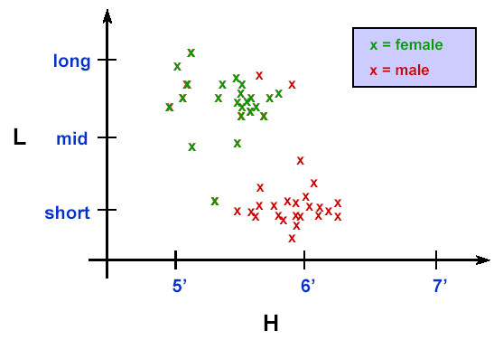
Is height independent of hair length?

Slide 7
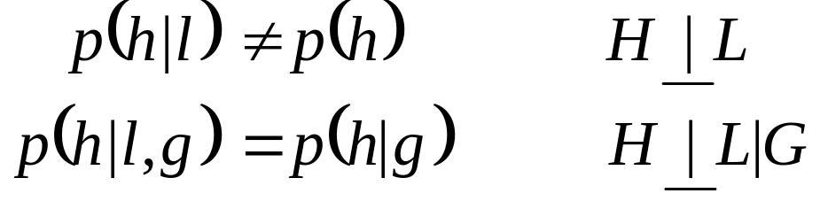
Graphical models for ASR76.345 Automatic Speech Recognition
Is height independent of hair length?
Generally, no
If gender known, yes
This is the “common cause” scenario
G
gender
heir
length
L
H
height

Slide 8
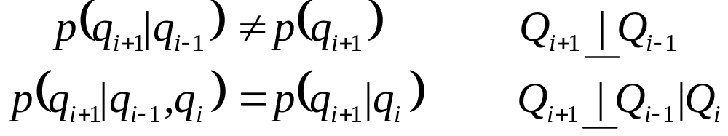
Is the future independent of the past (in a Markov process)?
Generally, no
If present state is known, then yes
Q_{i-1}
Q_{i}
Q_{i+1}

Slide 9
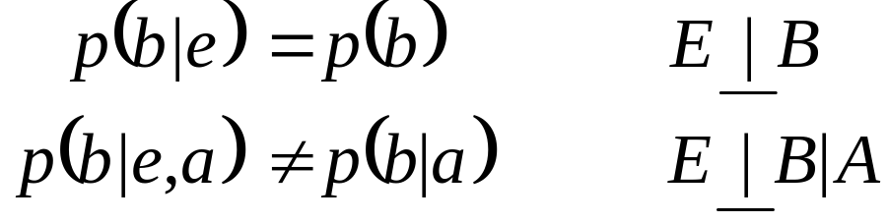
Are burglaries independent of earthquakes?
Generally, yes
If alarm state known, no
Explaining-away effect: the earthquake “explains away” the burglary
earth-
quake
E
B
burglary
A
alarm

Slide 10
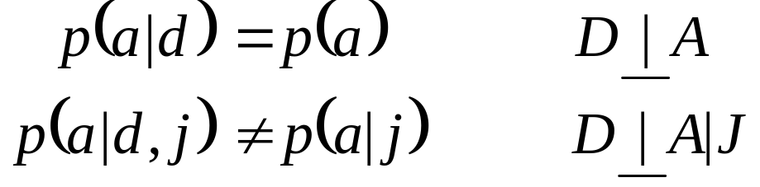
Are alien abductions independent of daylight savings time?
Generally, yes
If Jim doesn’t show up for lecture, no
Again, explaining-away effect
D
A
alien
abduction
DST
J
Jim
absent

Slide 11
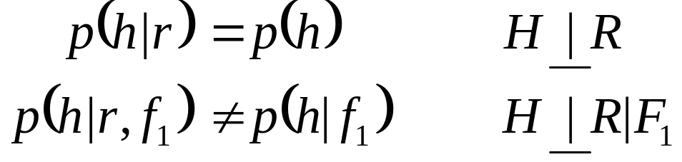
Is tongue height independent of lip rounding?
Generally, yes
If F1 is known, no
Yet again, explaining-away effect …
tongue
height
H
R
lip
rounding
F₁

Slide 12
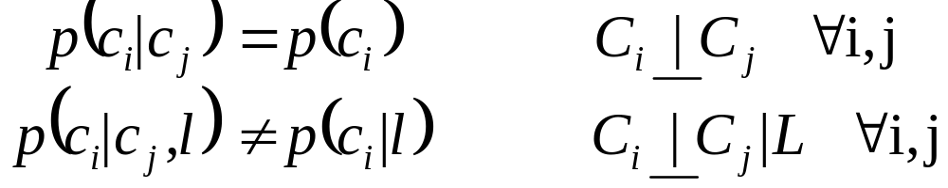
More explaining away...
pipes
faucet
caulking
drain
upstairs
c₁
c₂
c₃
c₄
c₅
L
leak

Slide 13
Bayesian networks
The preceding slides are examples of simple Bayesian networks
Definition:
  Directed acyclic graph (DAG) with a one-to-one correspondence between nodes (vertices) and variables X₁, X₂, ... , X_{N}
  Each node X_{i} with parents pa(X_{i}) is associated with the “local” probability function p_{Xi|pa(Xi)}
  The joint probability of all of the variables is given by the product of the local probabilities, i.e. p(x_{i},...,x_{N})=∏p(x_{i}|pa(x_{i}))
  A given BN represents a family of probability distributions
A
B
p(b|a)
p(a)
C
p(a,b,c,d)=
p(a) p(b|a) p(c|b) p(d|b,c)
p(c|b)
D
p(d|c)

Slide 14
Bayesian networks, cont’d
Missing edges in the graph correspond to independence assumptions
Joint probability can always be factored according to the chain rule:
  p(a,b,c,d) = p(a) p(b|a) p(c|a,b) p(d|a,b,c)
But by making some independence assumptions, we get a sparse factorization, i.e. one with fewer parameters
    p(a,b,c,d) = p(a) p(b|a) p(c|b) p(d|b,c)

Slide 15
Medical example
profession
parent
smoker
smoker
genes
Things we may want to know:
  What independence assumptions does this model encode?
  What is
  p(lung cancer| profession) ? p(smoker| parent smoker, genes) ?
  Given some of the variables, what are the most likely values of others?
  How do we estimate the local probabilities from
lung
cancer

Slide 16
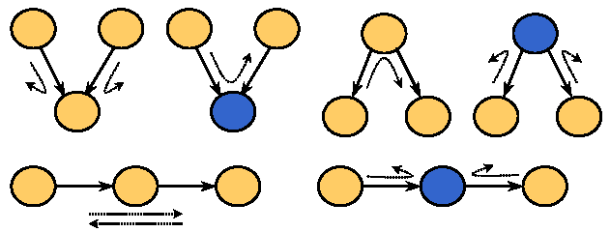
Determining independencies from a graph
There are several ways...
Bayes-ball algorithm (“Bayes-Ball: The Rational Pastime”, Schachter 1998)
  Ball bouncing around graph according to a set of rules
  Two nodes are independent given a set of observed nodes if a ball can’t get from one to the

Slide 17
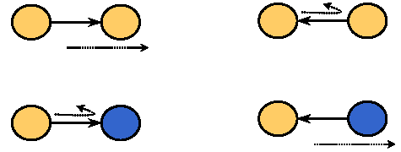
Bayes-ball, cont’d
Boundary conditions:

Slide 18
Bayes-ball in medical example
profession
parent
smoker
genes
smoker
lung
cancer
According to this model:
  Are a person’s genes independent of whether they have a parent who smokes? What about if we know the person has lung cancer?
  Is lung cancer independent of profession given that the person is a smoker?
  (Do the answers make sense?)

Slide 19
Inference
Definition:
  Computation of the probability of one subset of the variables given another subset
Inference is a subroutine of:
  Viterbi decoding
q* = argmax_{q}p(q|obs)
  Maximum-likelihood estimation of the parameters of the local probabilities
  λ* = argmax _{λ} p(obs|λ)

Slide 20
Graphical models (GMs)
In general, GMs represent families of probability distributions via graphs
  directed, e.g. Bayesian networks
  undirected, e.g. Markov random fields
  combination, e.g. chain graphs
To describe a particular distribution with a GM, we need to specify:
  Semantics: Bayesian network, Markov random field, ...
  Structure: the graph itself
  Implementation: the form of the local functions (Gaussian, table, ...)
  Parameters of local functions (means, covariances, table entries...)
Not all types of GMs can represent all sets of independence properties!

Slide 21
Example of undirected graphical models: Markov random fields
Definition:
  Undirected graph
  Local function (“potential”) defined on each maximal clique
  Joint probability given by normalized product of potentials
Independence properties can be deduced via simple graph separation
A
B
C
p(a,b,c,d)∝ψ_{A,B}(a,b) ψ_{B,C,D}(b,c,d)
D

Slide 22
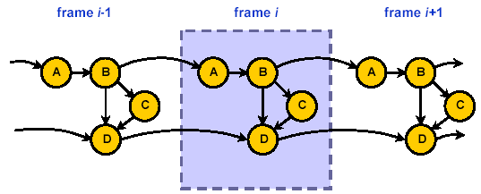
Dynamic Bayesian networks (DBNs)
BNs consisting of a structure that repeats an indefinite (or dynamic) number of times
  Useful for modeling time series (e.g. speech)

Slide 23


DBN representation of n-gram language models
Bigram:
Trigram:

Slide 24
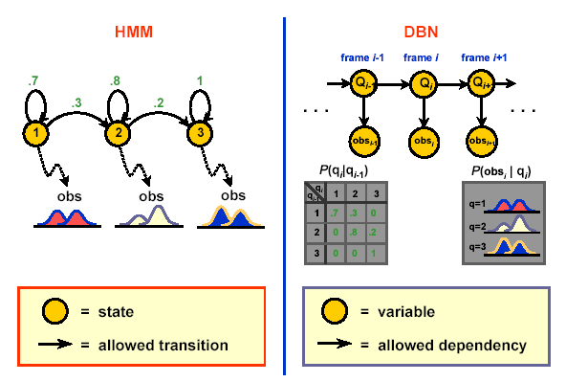
Representing an HMM as a DBN

Slide 25
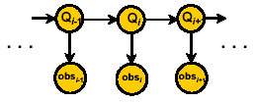
Casting HMM-based ASR as a GM problem
Viterbi decoding ⇨ finding the most probable settings for all q_{i} given the acoustic observations {obs_{i}}
Baum-Welch training ⇨ finding the most likely settings for the parameters of P(q_{i}|q_{i-1})and P(obs_{i}| q_{i})
Both are special cases of the standard GM algorithms for Viterbi and EM training

Slide 26
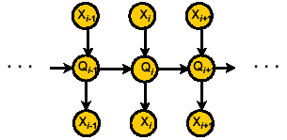
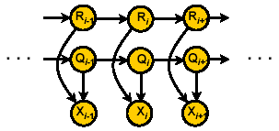
Variations
Input-output HMMs
Factorial HMMs

Slide 27
Switching parents
Definition:
  A variable X is a switching parent of variable Y if the value of X determines the parents and/or implementation of Y
Example:
A
B
C
D
A=0 ⇒ D has parent B with Gaussian distribution
A=1 ⇒ D has parent C with Gaussian distribution
A=2 ⇒ D has parent C with mixture Gaussian distribution

Slide 28
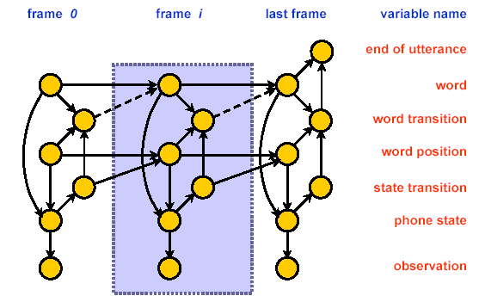
HMM-based recognition with a DBN
What language model does this GM implement?

Slide 29
Training and testing DBNs
Why do we need different structures for training testing? Isn’t training just the same as testing but with more of the variables observed?
Not always!
  Often, during training we have only partial information about some of the variables, e.g. the word sequence but not which frame goes with which word.

Slide 30
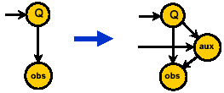
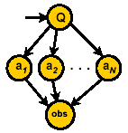
More complex GM models for recognition
HMM + auxiliary variables (Zweig 1998, Stephenson 2001)
  Noise clustering
  Speaker clustering
  Dependence on pitch, speaking rate, etc.
  Articulatory/feature-based modeling
Multi-rate modeling, audio-visual speech recognition (Nefian et al. 2002)

Slide 31
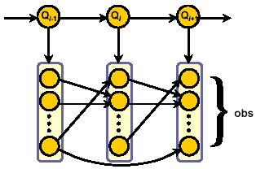
Modeling inter-observation dependencies: Buried Markov models (Bilmes 1999)
First note that observation variable is actually a vector of acoustic observations (e.g. MFCCs)
Consider adding dependencies between observations
Add only those that are discriminative with respect to classifying the current state/phone/word

Slide 32
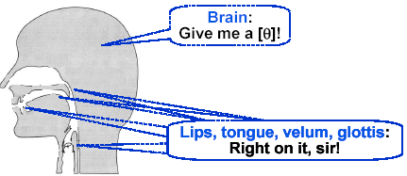
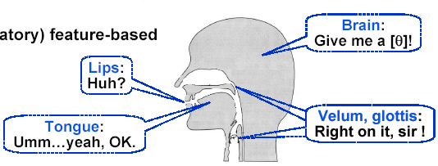
Feature-based modeling
Phone-based view:
(Articulatory) feature-based view:

Slide 33
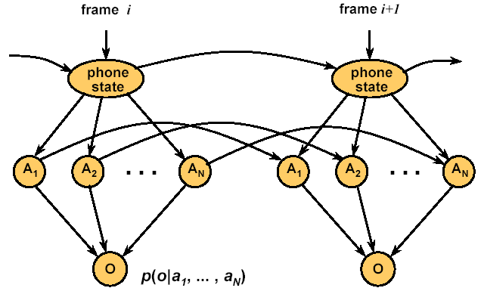
A feature-based DBN for ASR

Slide 34
GMTK: Graphical Modeling Toolkit
(J. Bilmes and G. Zweig, ICASSP 2002)
Toolkit for specifying and computing with dynamic Bayesian networks
Models are specified via:
  Structure file: defines variables, dependencies, and form of associated conditional distributions
  Parameter files: specify parameters for each distribution in structure file
Variable distributions can be
  Mixture Gaussians + variants
  Multidimensional probability tables
  Sparse probability tables
  Deterministic (decision trees)
Provides programs for EM training, Viterbi decoding, and various utilities.

Slide 35
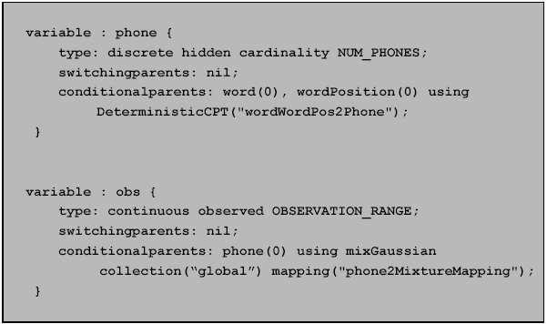
Example portion of structure file

Slide 36
Some issues...
For some structures, exact inference may be computationally infeasible ⇒
approximate inference algorithms
Structure is not always known ⇒
structure learning

Slide 37
References
J. Bilmes, “Graphical Models and Automatic Speech Recognition”, in Mathematical Foundations of Speech and Language Processing, Institute of Mathematical Analysis Volumes in Mathematics Series, Springer-Verlag, 2003.
G. Zweig, Speech Recognition with Dynamic Bayesian Networks, Ph.D. dissertation, UC Berkeley, 1998.
J. Bilmes, “What HMMs Can Do”, UWEETR-2002-0003, Feb. 2002

