Slide 1
Speech Recognition
Language Modeling for Speech Recognition

Slide 2
Language Modeling for Speech Recognition
Introduction
n-gram language models
Probability estimation
Evaluation
Beyond n-grams

Slide 3
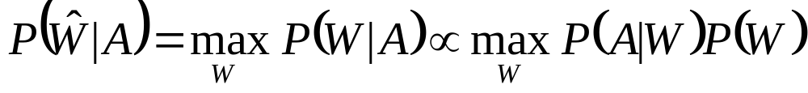
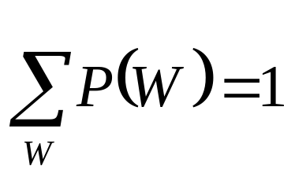
Language Modeling for Speech Recognition
Speech recognizers seek the word sequence Ŵ which is most likely to be produced from acoustic evidence A.
Speech recognition involves acoustic processing, acoustic modeling, language modeling, and search
Language models (LMs) assign a probability estimate P(W ) to word sequences W = {w₁,...,w_{n}} subject to

Slide 4
Language Modeling for Speech Recognition
Language models help guide and constrain the search among alternative word hypotheses during recognition

Slide 5
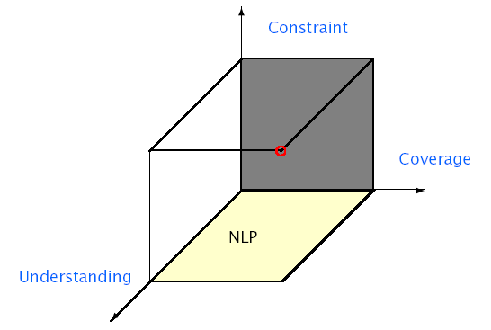
Language Model Requirements

Slide 6
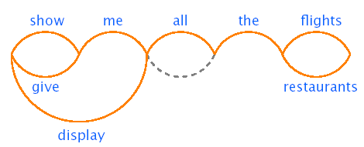
Finite-State Networks (FSN)
Language space defined by a word network or graph.
Describable by a regular phrase structure grammar.
A ⇒ aB | a
Finite coverage can preset difficulties for ASR.
Graph arcs or rules can be augmented with probabilities.

Slide 7
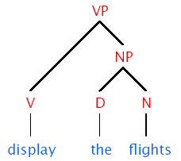
Context-Free Grammars (CFGs)
Language space defined by context-free rewrite rules, e.g.,
A ⇒ BC | a
More powerful representation than FSNs
Stochastic CFG rules have associated probabilities which can be learned automatically from corpus.
Finite coverage can present difficulties for ASR.

Slide 8

Word-Pair Grammars & Bigrams
Language space defined by lists of legal word-pairs
Can be implemented efficiently within Viterbi search
Finite coverage can present difficulties for ASR
Bigrams define probabilities for all word-pairs and can produce a nonzero P(W) for all possible sentences

Slide 9

Example of LM Impact (Lee, 1988)
Resource Management domain
Speaker-independent, continuous speech corpus
Sentences generated form a finite state network
997 word vocabulary
Word-pair perplexity ~60. Bigram ~20
Error includes substitutions, deletions, and insertions

Slide 10
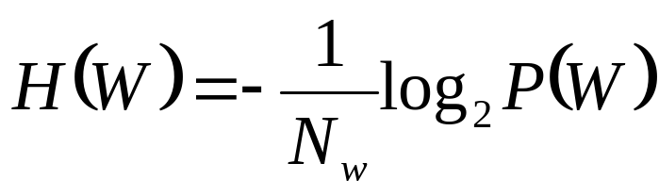
Note on Perplexity
Language can be thought of as an information source whose outputs are words w_{i} belonging to the vocabulary of the language.
Probability of a language model assigning to test word stings is known as perplexity.
P(W) – probability (that a language model assignees) to a word sequence.
Cross-entropy H(W) of a model P(w_{i}|w_{i-n+1},…,w_{i-1}) on data W can be approximated as:
N_{w} is the length of the text W measured in number of words.

Slide 11
Note on Perplexity
The perplexity PP(W) of a language model P(W) is defined as the reciprocal of the (geometric) average probability assigned by the model to each word in the test set W. This is a measure, related to cross-entropy, known as test-set perplexity:
PP(W)=2^{H(W)}
The perplexity can be roughly interpreted as the geometric mean of the branching factor of the text when presented to the language model.

Slide 12
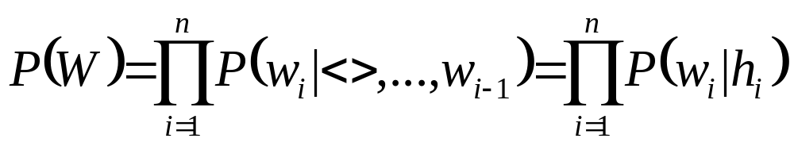
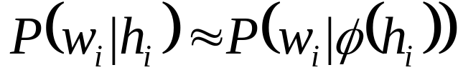
LM Formulation for ASR
Language model probabilities P(W) are usually incorporated into the ASR search as early as possible
Since most searches are performed unidirectionally, P(W) is usually formulated as a chain rule
Where h_{i} = {<>,…,w_{i-1}} is the word history for w_{i}.
h_{i} is often reduced to equivalence class φ(h_{i}):

Slide 13
LM Formulation for ASR
Good equivalence classes maximize the information about the next word w_{i} given its history φ(hi).
Language models which require the full word sequence W are usually used as post-processing filters

Slide 14
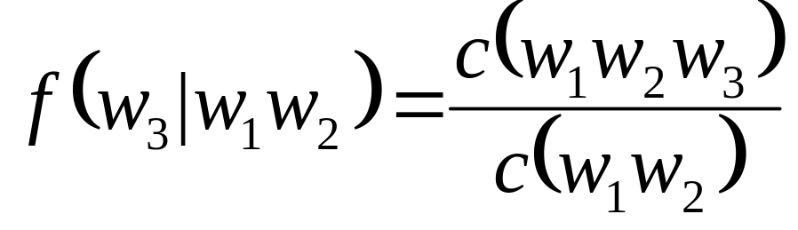
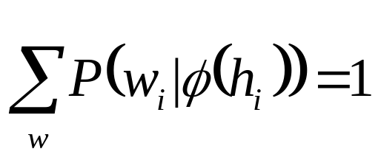
n-gram Language Models
n-gram models use the previous n - 1 words to represent the history φ(h_{i})= {w_{i-1} ,...,w_{i-(n-1)}}
Probabilities are based on frequencies and counts:
Due to sparse data problems, n-grams are typically smoothed with lower order frequencies subject to:

Slide 15
n-gram Language Models
Bigrams are easily incorporated in Viterbi search
Trigrams used for large vocabulary recognition in mid-1970’s and remain the dominant language model

Slide 16
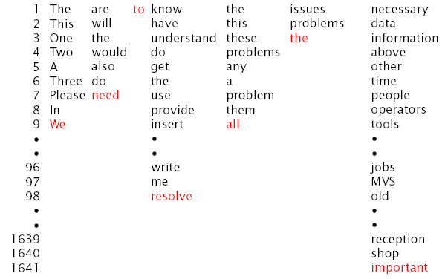
IBM Trigram Example (Jelinek, 1997)

Slide 17
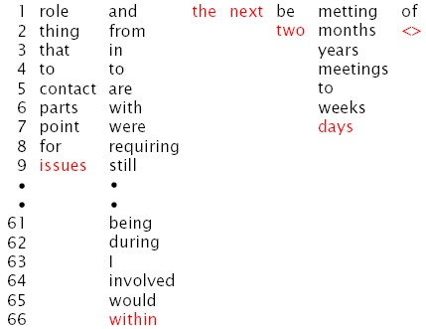
IBM Trigram Example (cont.)

Slide 18
n-gram Issues: Sparse Data (Jelinek, 1985)
Text corpus of IBM patent descriptions
1.5 million words for training
300,000 words used to test models
Vocabulary restricted to 1,000 most frequent words
23% of trigrams occurring in test corpus were absent from training corpus!
In general, a vocabulary of size V will have V^{n} n-grams (e.g., 20,000 words will have 400 million bigrams, and 8 trillion trigrams!)

Slide 19
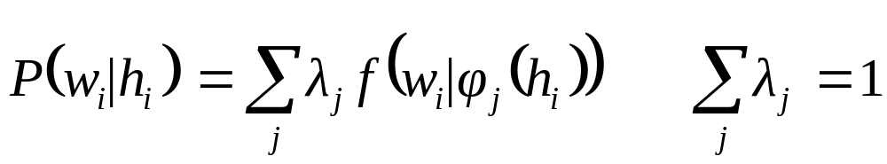
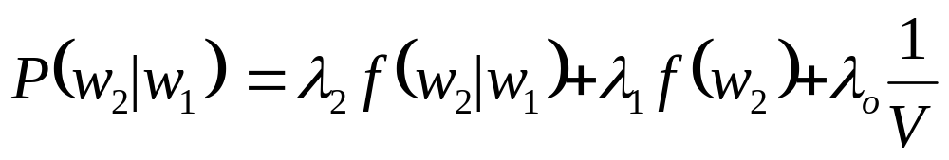
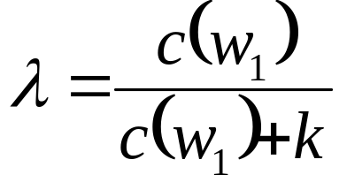
n-gram Interpolation
Probabilities are a linear combination of frequencies
For example:
λ’s are computed with EM algorithm on held-out data
Different λ’s can be used for different histories hi
Simplistic formulation of λ’s can be used:

Slide 20
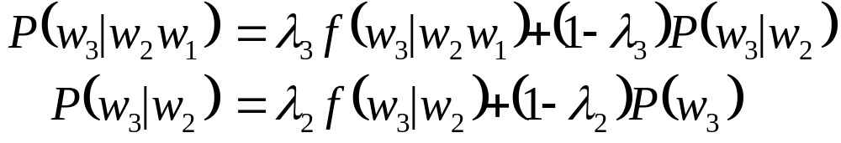
n-gram Interpolation
Estimates can be solved recursively:

Slide 21
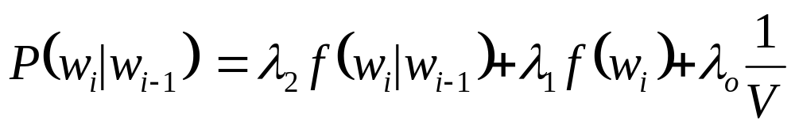
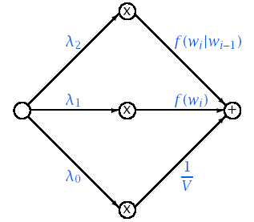
Interpolation Example

Slide 22
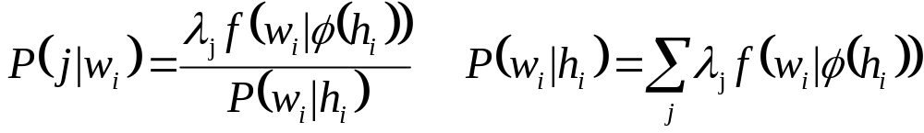
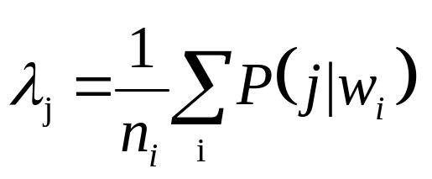
Deleted Interpolation
Initialize λ’s (e.g., uniform distribution)
Compute probability P(j|w_{i}) that the j^{th} frequency estimate was used when word w_{i} was generated
Recompute λ’s for n_{i} words in held-out data:
Iterate until convergence

Slide 23
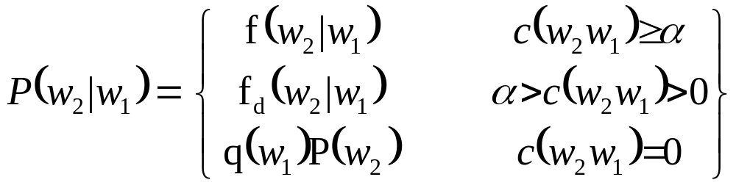
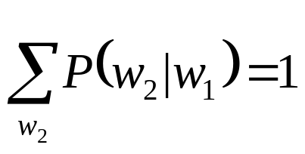
Back-Off n-grams (Katz, 1987)
ML estimates are used when counts are large
Low count estimates are reduced (discounted) to provide probability mass for unseen sequences
Zero count estimates based on weighted (n-1)-gram
Discounting typically based on Good-Turing estimate
Factor q(w₁) chosen so that
High order n-grams computed recursively

Slide 24
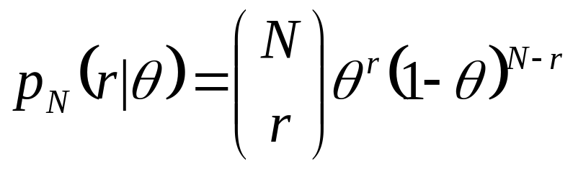
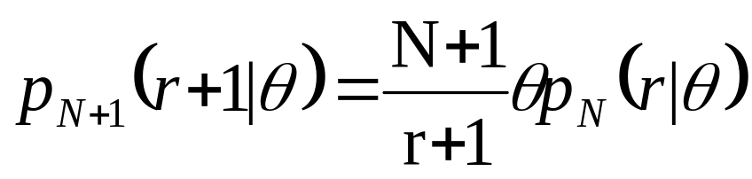
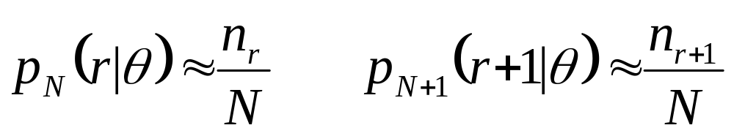
Good-Turing Estimate
Probability a word will occur r times out of N ,given θ
Probability a word will occur r+1 times out of N+1
Assume n_{r} words occurring r times have same value of θ

Slide 25
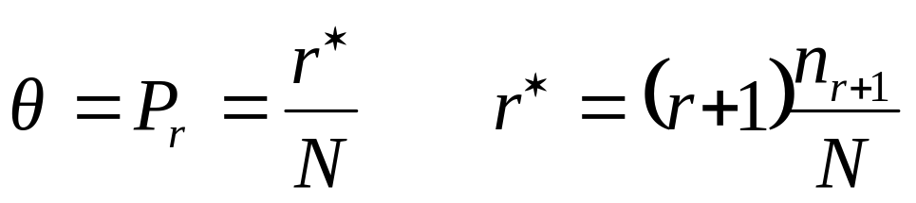
Good-Turing Estimate
Assuming large N, we can solve for θ or discounted r*

Slide 26
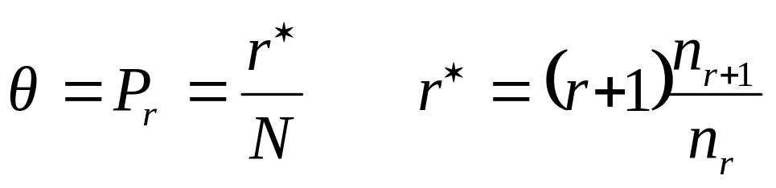
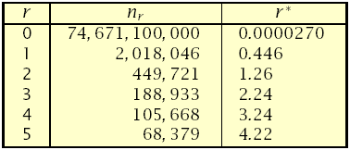
Good-Turing Example (Church and Gale, 1991)
GT estimate for an item occurring r times out of N is:
where nr is number of items (e.g., n-grams) occurring r-times.
Consider bigram counts from a 22 million word corpus of AP news articles (273,000 word vocabulary):

Slide 27
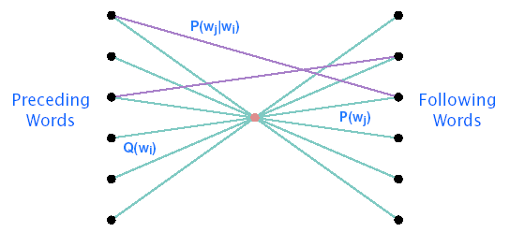
Integration into Viterbi Search
Bigrams can be efficiently incorporated into Viterbi search using an intermediate node between words
Interpolated: Q(w_{i}) = (1 - λ_{i})
Back-off: Q(w_{i})= q(w_{i})

Slide 28
Evaluating Language Models
Recognition accuracy
Qualitative assessment
  Random sentence generation
  Sentence reordering
Information-theoretic measures

Slide 29
Random Sentence Generation: Air Travel Domain Bigram
Show me the flight earliest flight from Denver
How many flights that flight leaves around is the Eastern Denver
I want a first class
Show me a reservation the last flight from Baltimore for the first
I would like to fly from Dallas
I get from Pittsburgh
Which just small
In Denver on October
I would like to San Francisco
Is flight flying
What flights from Boston to San Francisco
How long can you book a hundred dollars
I would like to Denver to Boston and Boston
Make ground transportation is the cheapest
Are the next week on AA eleven ten
First class
How many airlines from Boston on May thirtieth
What is the city of three PM
What about twelve and Baltimore

Slide 30
Random Sentence Generation: Air Travel Domain Trigram
What type of aircraft
What is the fare on flight two seventy two
Show me the flights I’ve Boston to San Francisco on Monday
What is the cheapest one way
Okay on flight number seven thirty six
What airline leaves earliest
Which airlines from Philadelphia to Dallas
I’d like to leave at nine eight
What airline
How much does it cost
How many stops does Delta flight five eleven o’clock PM that go from
What AM
Is Eastern from Denver before noon
Earliest flight from Dallas
I need to Philadelphia
Describe to Baltimore on Wednesday from Boston
I’d like to depart before five o’clock PM
Which flights do these flights leave after four PM and lunch and <unknown>

Slide 31
Sentence Reordering (Jelinek, 1991)
Scramble words of a sentence
Find most probable order with language model
Results with trigram LM
  Short sentences from spontaneous dictation
  63% of reordered sentences identical
  86% have same meaning

Slide 32
IBM Sentence Reordering
would I report directly to you
I would report directly to you
now let me mention some of the disadvantages
let me mention some of the disadvantages now
he did this several hours later
this he did several hours later
this is of course of interest to IBM
of course this is of interest to IBM
approximately seven years I have known John
I have known John approximately seven years
these people have a fairly large rate of turnover
of these people have a fairly large turnover rate
in our organization research has two missions
in our missions research organization has two
exactly how this might be done is not clear
clear is not exactly how this might be done

Slide 33
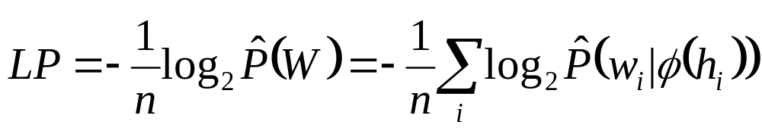
Quantifying LM Complexity
One LM is better than another if it can predict an n word test corpus W with a higher probability P(W)
For LMs representable by the chain rule, comparisons are usually based on the average per word logprob, LP
A more intuitive representation of LP is the perplexity:
PP = 2^{LP}
  (a uniform LM will have PP equal to vocabulary size)
PP is often interpreted as an average branching factor.
^

Slide 34
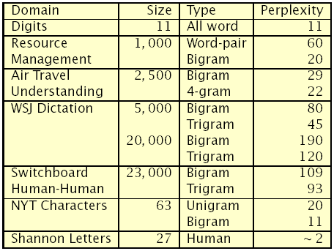
Perplexity Examples

Slide 35
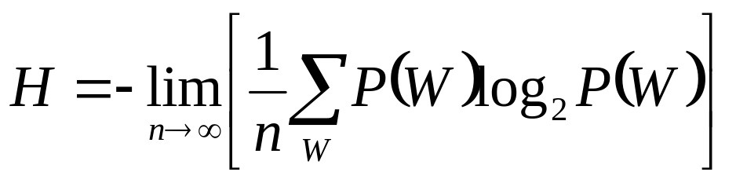
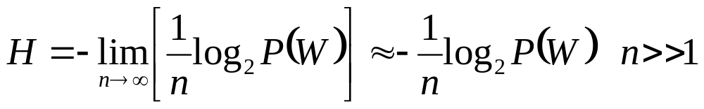
Language Entropy
The average logprob LP is related to the overall uncertainty of the language, quantified by its entropy
If W is obtained from a well-behaved source (ergodic), P(W ) will converge to the expected value and H is

Slide 36
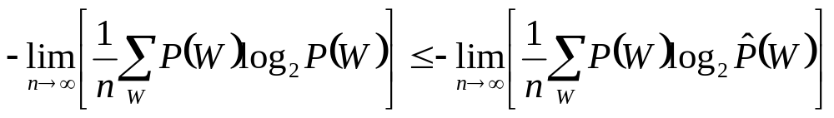
Language Entropy
The entropy H is a theoretical lower bound on LP

Slide 37

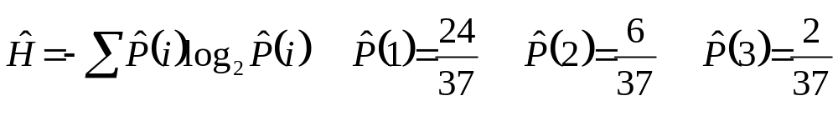
Human Language Entropy (Shannon, 1951)
An attempt to estimate language entropy of humans
Involved guessing next words in order to measure subjects probability distribution
Letters were used to simplify experiments
Shannon estimated Ĥ≈1 bit/letter

Slide 38
Why do n-grams work so well?
Probabilities are based on data (the more the better)
Parameters determined automatically from corpora
Incorporate local syntax, semantics, and pragmatics
Many languages have a strong tendency toward standard word order and are thus substantially local
Relatively easy to integrate into forward search methods such as Viterbi (bigram) or A*

Slide 39
Problems with n-grams
Unable to incorporate long-distance constraints
Not well suited for flexible word order languages
Cannot easily accommodate
  New vocabulary items
  Alternative domains
  Dynamic changes (e.g., discourse)
Not as good as humans at tasks of
  Identifying and correcting recognizer errors
  Predicting following words (or letters)
Do not capture meaning for speech understanding

Slide 40
Clustering words
Many words have similar statistical behavior
  e.g., days of the week, months, cities, etc.
n-gram performance can be improved by clustering words
  Hard clustering puts a word into a single cluster
  Soft clustering allows a word to belong to multiple clusters
Clusters can be created manually, or automatically
  Manually created clusters have worked well for small domains
  Automatic clusters have been created bottom-up or top-down

Slide 41
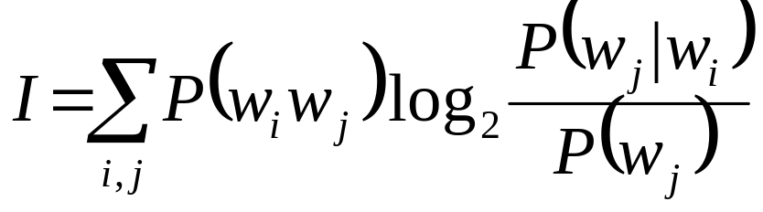
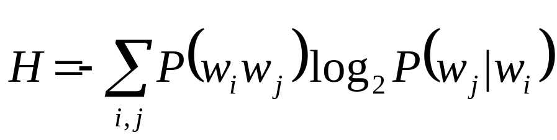
Bottom-Up Word Clustering (Brown et al., 1992)
Word clusters can be created automatically by forming clusters in a stepwise-optimal or greedy fashion
Bottom-up clusters created by considering impact on metric of merging words w_{a} and w_{b} to form new cluster w_{ab}
Example metrics for a bigram language model:
  Minimum decrease in average mutual information
  Minimum increase in training set conditional entropy

Slide 42
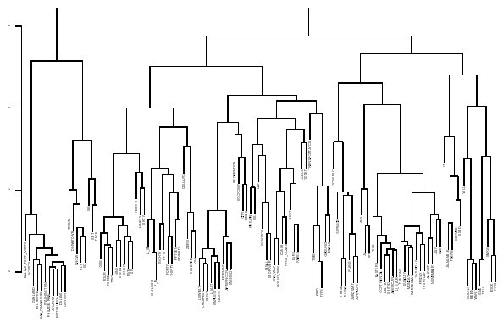
Example of Word Clustering

Slide 43
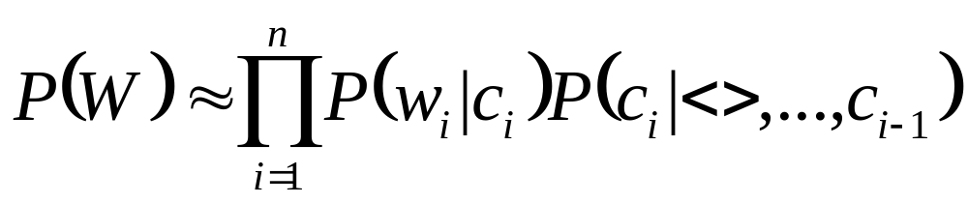
Word Class n-gram models
Word class n-grams cluster words into equivalence classes
W = {w₁,…,w_{n}} → {c₁,…,c_{n}}
If clusters are non-overlapping, P(W) is approximated by:
Fewer parameters than word n-grams
Relatively easy to add new words to existing clusters
Can be linearly combined with word n-grams if desired

Slide 44
Predictive Clustering (Goodman, 2000)
For word class n-grams :
P(w_{i}|h_{i}) ≈ P(w_{i}|c_{i})P(c_{i}|c_{i-1} ...)
Predictive clustering is exact:
P(w_{i}|h_{i}) = P(w_{i}|h_{i}c_{i})P(c_{i}|h_{i})
History, h_{i}, can be clustered differently for the two terms
This model can be larger than the n-gram, but has been shown to produce good results when combined with pruning

Slide 45
Phrase Class n-grams (PCNG) (McCandless, 1994)
Probabilistic context-free rules parse phrases
W = {w₁,…,w_{n}} → {u₁,…,u_{m}}
n-gram produces probability of resulting units
P(W) is product of parsing and n-gram probabilities
P(W) = P_{r}(W) P_{n}(U)
Intermediate representation between word-based n-grams and stochastic context-free grammars
Context-free rules can be learned automatically

Slide 46
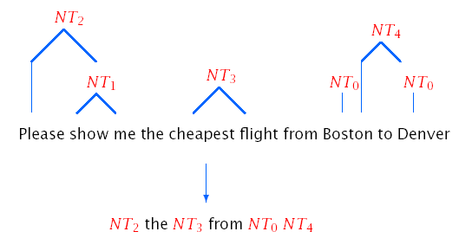
PCNG Example

Slide 47
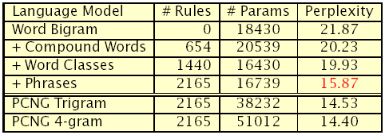
PCNG Experiments
Air-Travel Information Service (ATIS) domain
Spontaneous, spoken language understanding
21,000 train, 2,500 development, 2,500 test sentences
1,956 word vocabulary

Slide 48
Decision Tree Language Models (Bahl et al., 1989)
Equivalence classes represented in a decision tree
  Branch nodes contain questions for history h_{i}
  Leaf nodes contain equivalence classes
Word n-gram formulation fits decision tree model
Minimum entropy criterion used for construction
Significant computation required to produce trees

Slide 49
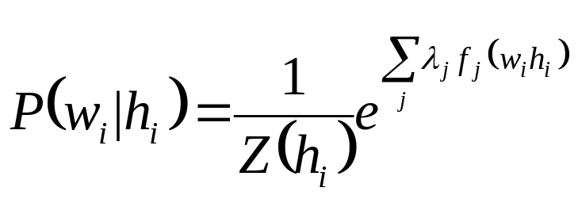
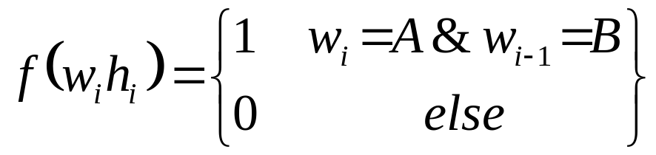
Exponential Language Models
P(w_{i}|h_{i}) modeled as product of weighted features f_{j}(w_{i}h_{i})
where λ’s are parameters, and Z(h_{i}) is a normalization factor
Binary-valued features can express arbitrary relationships, e.g.,
When E(f(wh)) corresponds to empirical expected value, ML estimates for λ’s correspond to maximum entropy distribution
ML solutions are iterative, and can be extremely slow
Demonstrated perplexity and WER gains on large vocabulary tasks

Slide 50
Adaptive Language Models
Cache-based language models incorporate statistics of recently used words with a static language model
  P(w_{i}|h_{i})= λP_{c}(w_{i}|h_{i})+ (1-λ)P_{s}(w_{i}|h_{i} )
Trigger-based language models increase word probabilities when key words observed in history h_{i}
  Self triggers provide significant information
  Information metrics used to find triggers
  Incorporated into maximum entropy formulation

Slide 51
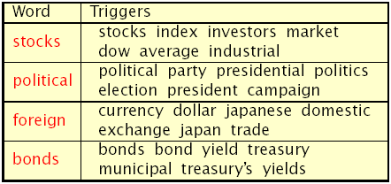
Trigger Examples (Lau, 1994)
Triggers determined automatically from WSJ corpus (37 million words) using average mutual information
Top seven triggers per word used in language model

Slide 52
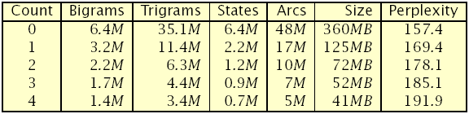
Language Model Pruning
n-gram language models can get very large (e.g., 6B/n-gram )
Simple techniques can reduce parameter size
  Prune n-grams with too few occurrences
  Prune n-grams that have small impact on model entropy
Trigram count-based pruning example:
  Broadcast news transcription (e.g., TV, radio broadcasts)
  25K vocabulary; 166M training words (∼ 1GB), 25K test words

Slide 53
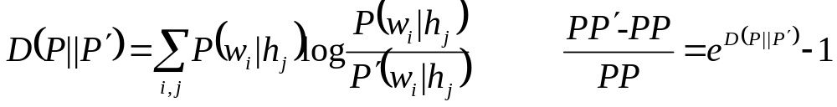
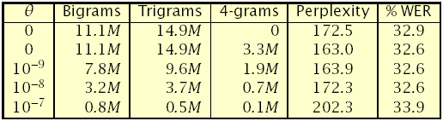
Entropy-based Pruning (Stolcke, 1998)
Uses KL distance to prune n-grams with low impact on entropy
Select pruning threshold θ
Compute perplexity increase from pruning each n-gram
Remove n-grams below θ, and recompute backoff weights
Example: resorting Broadcast News N -best lists with 4-grams

Slide 54
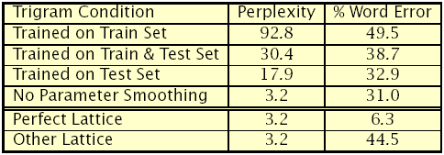
Perplexity vs. Error Rate (Rosenfeld et al., 1995)
Switchboard human-human telephone conversations
2.1 million words for training, 10,000 words for testing
23,000 word vocabulary, bigram perplexity of 109
Bigram-generated word-lattice search (10% word error)

Slide 55
References
X. Huang, A. Acero, and H. -W. Hon, Spoken Language Processing, Prentice-Hall, 2001.
K. Church & W. Gale, A Comparison of the Enhanced Good-Turing and Deleted Estimation Methods for Estimating Probabilities of English Bigrams, Computer Speech & Language, 1991.
F. Jelinek, Statistical Methods for Speech Recognition, MIT Press, 1997.
S. Katz, Estimation of Probabilities from Sparse Data for the Language Model Component of a Speech Recognizer. IEEE Trans. ASSP-35, 1987.
K. F. Lee, The CMU SPHINX System, Ph.D. Thesis, CMU, 1988.
R. Rosenfeld, Two Decades of Statistical Language Modeling: Where Do We Go from Here?, IEEE Proceedings, 88(8), 2000.
C. Shannon, Prediction and Entropy of Printed English, BSTJ, 1951.

