Slide 1
Review
Probability & Random Variables
Objective
To provide background material in support of topics in Digital Image Processing that are based on probability and random variables.

Slide 2
Review: Probability and Random Variables
Sets and Set Operations
Probability events are modeled as sets, so it is customary to begin a study of probability by defining sets and some simple operations among sets.
A set is a collection of objects, with each object in a set often referred to as an element or member of the set. Familiar examples include the set of all image processing books in the world, the set of prime numbers, and the set of planets circling the sun. Typically, sets are represented by uppercase letters, such as A, B, and C, and members of sets by lowercase letters, such as a, b, and c.

Slide 3

Review: Probability and Random Variables
Sets and Set Operations (Con’t)
We denote the fact that an element a belongs to set A by
If a is not an element of A, then we write
A set can be specified by listing all of its elements, or by listing properties common to all elements. For example, suppose that I is the set of all integers. A set B consisting the first five nonzero integers is specified using the notation

Slide 4

Review: Probability and Random Variables
Sets and Set Operations (Con’t)
The set of all integers less than 10 is specified using the notation
which we read as "C is the set of integers such that each members of the set is less than 10." The "such that" condition is denoted by the symbol “ | “ . As shown in the previous two equations, the elements of the set are enclosed by curly brackets.
The set with no elements is called the empty or null set, denoted in this review by the symbol Ø.

Slide 5



Review: Probability and Random Variables
Sets and Set Operations (Con’t)
Two sets A and B are said to be equal if and only if they contain the same elements. Set equality is denoted by
If the elements of two sets are not the same, we say that the sets are not equal, and denote this by
If every element of B is also an element of A, we say that B is a subset of A:

Slide 6
Review: Probability and Random Variables
Sets and Set Operations (Con’t)
Finally, we consider the concept of a universal set, which we denote by U and define to be the set containing all elements of interest in a given situation. For example, in an experiment of tossing a coin, there are two possible (realistic) outcomes: heads or tails. If we denote heads by H and tails by T, the universal set in this case is {H,T}. Similarly, the universal set for the experiment of throwing a single die has six possible outcomes, which normally are denoted by the face value of the die, so in this case U = {1,2,3,4,5,6}. For obvious reasons, the universal set is frequently called the sample space, which we denote by S. It then follows that, for any set A, we assume that Ø ⊆ A ⊆ S, and for any element a, a ∈ S and a ∉ Ø.

Slide 7



Review: Probability and Random Variables
Some Basic Set Operations
The operations on sets associated with basic probability theory are straightforward. The union of two sets A and B, denoted by
is the set of elements that are either in A or in B, or in both. In other words,
Similarly, the intersection of sets A and B, denoted by
is the set of elements common to both A and B; that is,

Slide 8




Review: Probability and Random Variables
Set Operations (Con’t)
Two sets having no elements in common are said to be disjoint or mutually exclusive, in which case
The complement of set A is defined as
Clearly, (A^{c})^{c}=A. Sometimes the complement of A is denoted as .
The difference of two sets A and B, denoted A − B, is the set of elements that belong to A, but not to B. In other words,

Slide 9

Review: Probability and Random Variables
Set Operations (Con’t)
It is easily verified that
The union operation is applicable to multiple sets. For example the union of sets A₁,A₂,…,A_{n} is the set of points that belong to at least one of these sets. Similar comments apply to the intersection of multiple sets.
The following table summarizes several important relationships between sets. Proofs for these relationships are found in most books dealing with elementary set theory.

Slide 10
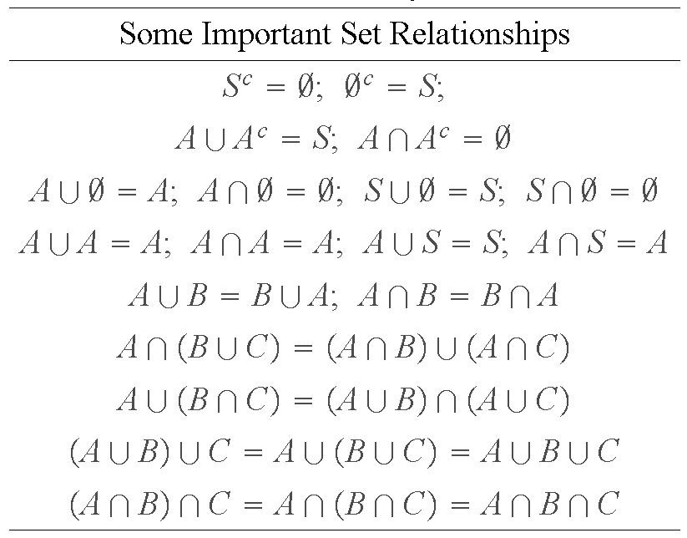
Review: Probability and Random Variables
Set Operations (Con’t)

Slide 11
Review: Probability and Random Variables
Set Operations (Con’t)
It often is quite useful to represent sets and sets operations in a so-called Venn diagram, in which S is represented as a rectangle, sets are represented as areas (typically circles), and points are associated with elements. The following example shows various uses of Venn diagrams.
Example: The following figure shows various examples of Venn diagrams. The shaded areas are the result (sets of points) of the operations indicated in the figure. The diagrams in the top row are self explanatory. The diagrams in the bottom row are used to prove the validity of the expression
which is used in the proof of some probability relationships.

Slide 12
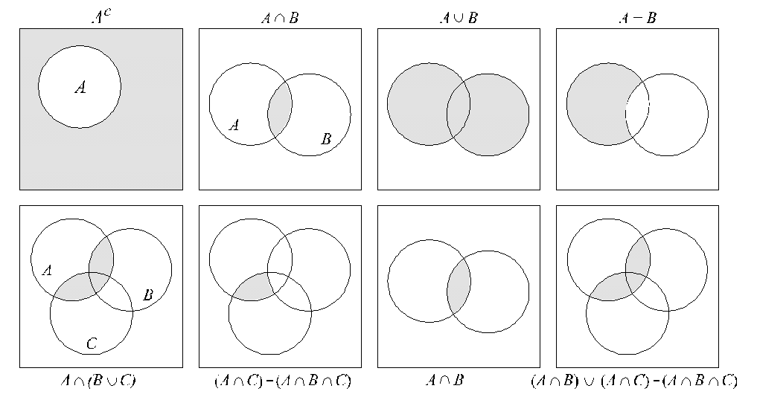
Review: Probability and Random Variables
Set Operations (Con’t)

Slide 13

Review: Probability and Random Variables
Relative Frequency & Probability
A random experiment is an experiment in which it is not possible to predict the outcome. Perhaps the best known random experiment is the tossing of a coin. Assuming that the coin is not biased, we are used to the concept that, on average, half the tosses will produce heads (H) and the others will produce tails (T). This is intuitive and we do not question it. In fact, few of us have taken the time to verify that this is true. If we did, we would make use of the concept of relative frequency. Let n denote the total number of tosses, n_{H} the number of heads that turn up, and n_{T} the number of tails. Clearly,

Slide 14

Review: Probability and Random Variables
Relative Frequency & Prob. (Con’t)
Dividing both sides by n gives
The term n_{H}/n is called the relative frequency of the event we have denoted by H, and similarly for n_{T}/n. If we performed the tossing experiment a large number of times, we would find that each of these relative frequencies tends toward a stable, limiting value. We call this value the probability of the event, and denoted it by P(event).

Slide 15


Review: Probability and Random Variables
Relative Frequency & Prob. (Con’t)
In the current discussion the probabilities of interest are P(H) and P(T). We know in this case that P(H) = P(T) = 1/2. Note that the event of an experiment need not signify a single outcome. For example, in the tossing experiment we could let D denote the event "heads or tails," (note that the event is now a set) and the event E, "neither heads nor tails." Then, P(D) = 1 and P(E) = 0.
The first important property of P is that, for an event A,
That is, the probability of an event is a positive number bounded by 0 and 1. For the certain event, S,

Slide 16

Review: Probability and Random Variables
Relative Frequency & Prob. (Con’t)
Here the certain event means that the outcome is from the universal or sample set, S. Similarly, we have that for the impossible event, S^{c}
This is the probability of an event being outside the sample set. In the example given at the end of the previous paragraph, S = D and S^{c} = E.

Slide 17
Review: Probability and Random Variables
Relative Frequency & Prob. (Con’t)
The event that either events A or B or both have occurred is simply the union of A and B (recall that events can be sets). Earlier, we denoted the union of two sets by A ∪ B. One often finds the equivalent notation A+B used interchangeably in discussions on probability. Similarly, the event that both A and B occurred is given by the intersection of A and B, which we denoted earlier by A ∩ B. The equivalent notation AB is used much more frequently to denote the occurrence of both events in an experiment.

Slide 18
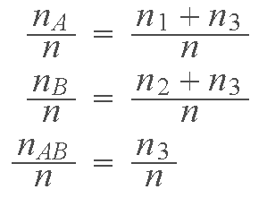
Review: Probability and Random Variables
Relative Frequency & Prob. (Con’t)
Suppose that we conduct our experiment n times. Let n₁ be the number of times that only event A occurs; n₂ the number of times that B occurs; n₃ the number of times that AB occurs; and n₄ the number of times that neither A nor B occur. Clearly, n₁+n₂+n₃+n₄=n. Using these numbers we obtain the following relative frequencies:

Slide 19
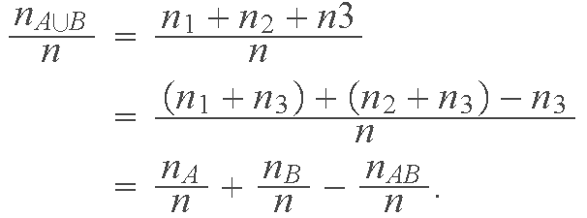
Review: Probability and Random Variables
Relative Frequency & Prob. (Con’t)
and
Using the previous definition of probability based on relative frequencies we have the important result
If A and B are mutually exclusive it follows that the set AB is empty and, consequently, P(AB) = 0.

Slide 20
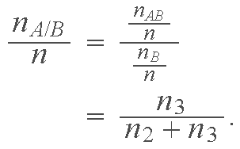
Review: Probability and Random Variables
Relative Frequency & Prob. (Con’t)
The relative frequency of event A occurring, given that event B has occurred, is given by
This conditional probability is denoted by P(A/B), where we note the use of the symbol “ / ” to denote conditional occurrence. It is common terminology to refer to P(A/B) as the probability of A given B.

Slide 21
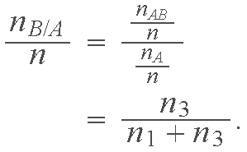
Review: Probability and Random Variables
Relative Frequency & Prob. (Con’t)
Similarly, the relative frequency of B occurring, given that A has occurred is
We call this relative frequency the probability of B given A, and denote it by P(B/A).

Slide 22
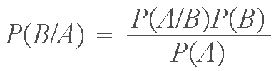
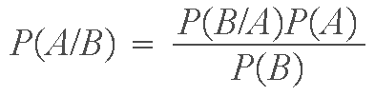
Review: Probability and Random Variables
Relative Frequency & Prob. (Con’t)
A little manipulation of the preceding results yields the following important relationships
and
The second expression may be written as
which is known as Bayes' theorem, so named after the 18th century mathematician Thomas Bayes.

Slide 23

Review: Probability and Random Variables
Relative Frequency & Prob. (Con’t)
Example: Suppose that we want to extend the expression
to three variables, A, B, and C. Recalling that AB is the same as A ∩ B, we replace B by B ∪ C in the preceding equation to obtain
The second term in the right can be written as
From the Table discussed earlier, we know that

Slide 24
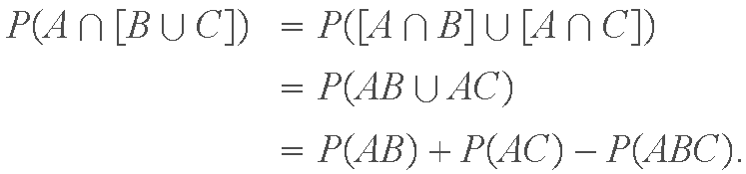
Review: Probability and Random Variables
Relative Frequency & Prob. (Con’t)
so,
Collecting terms gives us the final result
Proceeding in a similar fashion gives
The preceding approach can be used to generalize these expressions to N events.

Slide 25


Review: Probability and Random Variables
Relative Frequency & Prob. (Con’t)
If A and B are statistically independent, then P(B/A) = P(B) and it follows that
and
It was stated earlier that if sets (events) A and B are mutually exclusive, then A ∩ B = Ø from which it follows that P(AB) = P(A ∩ B) = 0. As was just shown, the two sets are statistically independent if P(AB)=P(A)P(B), which we assume to be nonzero in general. Thus, we conclude that for two events to be statistically independent, they cannot be mutually exclusive.

Slide 26

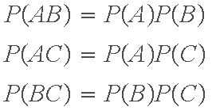
Review: Probability and Random Variables
Relative Frequency & Prob. (Con’t)
For three events A, B, and C to be independent, it must be true that
and

Slide 27
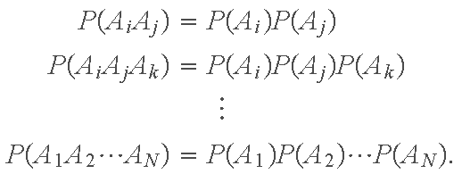
Review: Probability and Random Variables
Relative Frequency & Prob. (Con’t)
In general, for N events to be statistically independent, it must be true that, for all combinations 1 ≤ i ≤ j ≤ k ≤ . . . ≤ N

Slide 28

Review: Probability and Random Variables
Relative Frequency & Prob. (Con’t)
Example: (a) An experiment consists of throwing a single die twice. The probability of any of the six faces, 1 through 6, coming up in either experiment is 1/6. Suppose that we want to find the probability that a 2 comes up, followed by a 4. These two events are statistically independent (the second event does not depend on the outcome of the first). Thus, letting A represent a 2 and B a 4,
We would have arrived at the same result by defining "2 followed by 4" to be a single event, say C. The sample set of all possible outcomes of two throws of a die is 36. Then, P(C)=1/36.

Slide 29

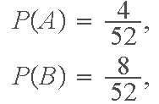
Review: Probability and Random Variables
Relative Frequency & Prob. (Con’t)
Example (Con’t): (b) Consider now an experiment in which we draw one card from a standard card deck of 52 cards. Let A denote the event that a king is drawn, B denote the event that a queen or jack is drawn, and C the event that a diamond-face card is drawn. A brief review of the previous discussion on relative frequencies would show that
and

Slide 30


Review: Probability and Random Variables
Relative Frequency & Prob. (Con’t)
Example (Con’t): Furthermore,
and
Events A and B are mutually exclusive (we are drawing only one card, so it would be impossible to draw a king and a queen or jack simultaneously). Thus, it follows from the preceding discussion that P(AB) = P(A ∩ B) = 0 [and also that P(AB) ≠ P(A)P(B)].

Slide 31
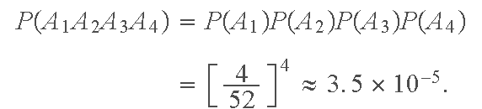
Review: Probability and Random Variables
Relative Frequency & Prob. (Con’t)
Example (Con’t): (c) As a final experiment, consider the deck of 52 cards again, and let A₁, A₂, A₃, and A₄ represent the events of drawing an ace in each of four successive draws. If we replace the card drawn before drawing the next card, then the events are statistically independent and it follows that

Slide 32
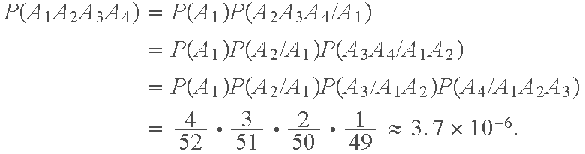
Review: Probability and Random Variables
Relative Frequency & Prob. (Con’t)
Example (Con’t): Suppose now that we do not replace the cards that are drawn. The events then are no longer statistically independent. With reference to the results in the previous example, we write
Thus we see that not replacing the drawn card reduced our chances of drawing fours successive aces by a factor of close to 10. This significant difference is perhaps larger than might be expected from intuition.

Slide 33
Review: Probability and Random Variables
Random Variables
Random variables often are a source of confusion when first encountered. This need not be so, as the concept of a random variable is in principle quite simple. A random variable, x, is a real-valued function defined on the events of the sample space, S. In words, for each event in S, there is a real number that is the corresponding value of the random variable. Viewed yet another way, a random variable maps each event in S onto the real line. That is it. A simple, straightforward definition.

Slide 34
Review: Probability and Random Variables
Random Variables (Con’t)
Part of the confusion often found in connection with random variables is the fact that they are functions. The notation also is partly responsible for the problem. In other words, although typically the notation used to denote a random variable is as we have shown it here, x, or some other appropriate variable, to be strictly formal, a random variable should be written as a function x(·) where the argument is a specific event being considered. However, this is seldom done, and, in our experience, trying to be formal by using function notation complicates the issue more than the clarity it introduces. Thus, we will opt for the less formal notation, with the warning that it must be keep clearly in mind that random variables are functions.

Slide 35
Review: Probability and Random Variables
Random Variables (Con’t)
Example: Consider again the experiment of drawing a single card from a standard deck of 52 cards. Suppose that we define the following events. A: a heart; B: a spade; C: a club; and D: a diamond, so that S = {A, B, C, D}. A random variable is easily defined by letting x = 1 represent event A, x = 2 represent event B, and so on.
As a second illustration, consider the experiment of throwing a single die and observing the value of the up-face. We can define a random variable as the numerical outcome of the experiment (i.e., 1 through 6), but there are many other possibilities. For example, a binary random variable could be defined simply by letting x = 0 represent the event that the outcome of throw is an even number and x = 1 otherwise.

Slide 36
Review: Probability and Random Variables
Random Variables (Con’t)
Note the important fact in the examples just given that the probability of the events have not changed; all a random variable does is map events onto the real line.

Slide 37
Review: Probability and Random Variables
Random Variables (Con’t)
Thus far we have been concerned with random variables whose values are discrete. To handle continuous random variables we need some additional tools. In the discrete case, the probabilities of events are numbers between 0 and 1. When dealing with continuous quantities (which are not denumerable) we can no longer talk about the "probability of an event" because that probability is zero. This is not as unfamiliar as it may seem. For example, given a continuous function we know that the area of the function between two limits a and b is the integral from a to b of the function. However, the area at a point is zero because the integral from,say, a to a is zero. We are dealing with the same concept in the case of continuous random variables.

Slide 38

Review: Probability and Random Variables
Random Variables (Con’t)
Thus, instead of talking about the probability of a specific value, we talk about the probability that the value of the random variable lies in a specified range. In particular, we are interested in the probability that the random variable is less than or equal to (or, similarly, greater than or equal to) a specified constant a. We write this as
If this function is given for all values of a (i.e., − ∞ < a < ∞), then the values of random variable x have been defined. Function F is called the cumulative probability distribution function or simply the cumulative distribution function (cdf). The shortened term distribution function also is used.

Slide 39

Review: Probability and Random Variables
Random Variables (Con’t)
Observe that the notation we have used makes no distinction between a random variable and the values it assumes. If confusion is likely to arise, we can use more formal notation in which we let capital letters denote the random variable and lowercase letters denote its values. For example, the cdf using this notation is written as
When confusion is not likely, the cdf often is written simply as F(x). This notation will be used in the following discussion when speaking generally about the cdf of a random variable.

Slide 40
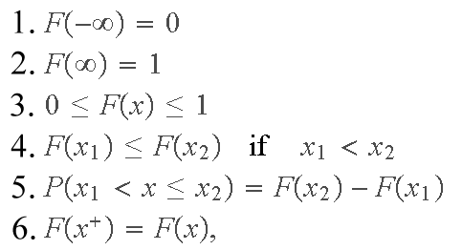
Review: Probability and Random Variables
Random Variables (Con’t)
Due to the fact that it is a probability, the cdf has the following properties:
where x⁺ = x + ε, with ε being a positive, infinitesimally small number.

Slide 41
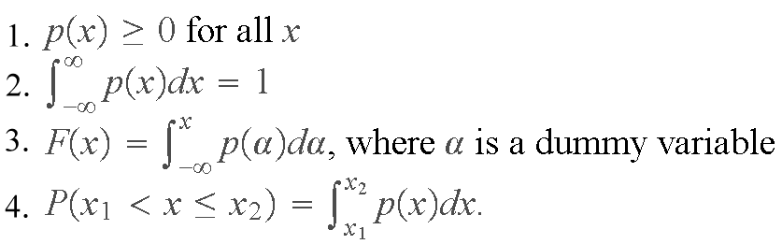

Review: Probability and Random Variables
Random Variables (Con’t)
The probability density function (pdf) of random variable x is defined as the derivative of the cdf:
The term density function is commonly used also. The pdf satisfies the following properties:

Slide 42
Review: Probability and Random Variables
Random Variables (Con’t)
The preceding concepts are applicable to discrete random variables. In this case, there is a finite no. of events and we talk about probabilities, rather than probability density functions. Integrals are replaced by summations and, sometimes, the random variables are subscripted. For example, in the case of a discrete variable with N possible values we would denote the probabilities by P(x_{i}), i=1, 2,…, N.

Slide 43
Review: Probability and Random Variables
Random Variables (Con’t)
In Sec. 3.3 of the book we used the notation p(r_{k}), k = 0,1,…, L - 1, to denote the histogram of an image with L possible gray levels, r_{k}, k = 0,1,…, L - 1, where p(r_{k}) is the probability of the kth gray level (random event) occurring. The discrete random variables in this case are gray levels. It generally is clear from the context whether one is working with continuous or discrete random variables, and whether the use of subscripting is necessary for clarity. Also, uppercase letters (e.g., P) are frequently used to distinguish between probabilities and probability density functions (e.g., p) when they are used together in the same discussion.

Slide 44

Review: Probability and Random Variables
Random Variables (Con’t)
If a random variable x is transformed by a monotonic transformation function T(x) to produce a new random variable y, the probability density function of y can be obtained from knowledge of T(x) and the probability density function of x, as follows:
where the subscripts on the p's are used to denote the fact that they are different functions, and the vertical bars signify the absolute value. A function T(x) is monotonically increasing if T(x₁) < T(x₂) for x₁ < x₂, and monotonically decreasing if T(x₁) > T(x₂) for x₁ < x₂. The preceding equation is valid if T(x) is an increasing or decreasing monotonic function.

Slide 45
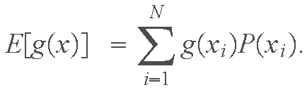

Review: Probability and Random Variables
Expected Value and Moments
The expected value of a function g(x) of a continuos random variable is defined as
If the random variable is discrete the definition becomes

Slide 46
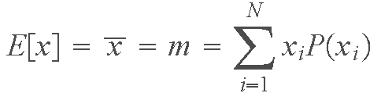

Review: Probability and Random Variables
Expected Value & Moments (Con’t)
The expected value is one of the operations used most frequently when working with random variables. For example, the expected value of random variable x is obtained by letting g(x) = x:
when x is continuos and
when x is discrete. The expected value of x is equal to its average (or mean) value, hence the use of the equivalent notation and m.

Slide 47
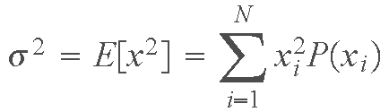

Review: Probability and Random Variables
Expected Value & Moments (Con’t)
The variance of a random variable, denoted by σ², is obtained by letting g(x) = x² which gives
for continuous random variables and
for discrete variables.

Slide 48
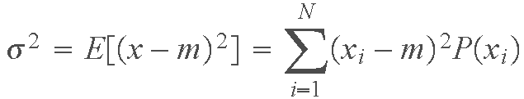

Review: Probability and Random Variables
Expected Value & Moments (Con’t)
Of particular importance is the variance of random variables that have been normalized by subtracting their mean. In this case, the variance is
and
for continuous and discrete random variables, respectively. The square root of the variance is called the standard deviation, and is denoted by σ.

Slide 49
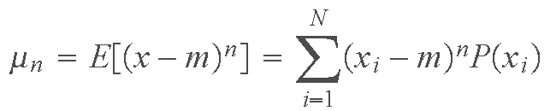


Review: Probability and Random Variables
Expected Value & Moments (Con’t)
We can continue along this line of thought and define the nth central moment of a continuous random variable by letting
and
for discrete variables, where we assume that n ≥ 0. Clearly, µ₀=1, µ₁=0, and µ₂=σ². The term central when referring to moments indicates that the mean of the random variables has been subtracted out. The moments defined above in which the mean is not subtracted out sometimes are called moments about the origin.

Slide 50
Review: Probability and Random Variables
Expected Value & Moments (Con’t)
In image processing, moments are used for a variety of purposes, including histogram processing, segmentation, and description. In general, moments are used to characterize the probability density function of a random variable. For example, the second, third, and fourth central moments are intimately related to the shape of the probability density function of a random variable. The second central moment (the centralized variance) is a measure of spread of values of a random variable about its mean value, the third central moment is a measure of skewness (bias to the left or right) of the values of x about the mean value, and the fourth moment is a relative measure of flatness. In general, knowing all the moments of a density specifies that density.

Slide 51
Review: Probability and Random Variables
Expected Value & Moments (Con’t)
Example: Consider an experiment consisting of repeatedly firing a rifle at a target, and suppose that we wish to characterize the behavior of bullet impacts on the target in terms of whether we are shooting high or low.. We divide the target into an upper and lower region by passing a horizontal line through the bull's-eye. The events of interest are the vertical distances from the center of an impact hole to the horizontal line just described. Distances above the line are considered positive and distances below the line are considered negative. The distance is zero when a bullet hits the line.

Slide 52
Review: Probability and Random Variables
Expected Value & Moments (Con’t)
In this case, we define a random variable directly as the value of the distances in our sample set. Computing the mean of the random variable indicates whether, on average, we are shooting high or low. If the mean is zero, we know that the average of our shots are on the line. However, the mean does not tell us how far our shots deviated from the horizontal. The variance (or standard deviation) will give us an idea of the spread of the shots. A small variance indicates a tight grouping (with respect to the mean, and in the vertical position); a large variance indicates the opposite. Finally, a third moment of zero would tell us that the spread of the shots is symmetric about the mean value, a positive third moment would indicate a high bias, and a negative third moment would tell us that we are shooting low more than we are shooting high with respect to the mean location.

Slide 53

Review: Probability and Random Variables
The Gaussian Probability Density Function
Because of its importance, we will focus in this tutorial on the Gaussian probability density function to illustrate many of the preceding concepts, and also as the basis for generalization to more than one random variable. The reader is referred to Section 5.2.2 of the book for examples of other density functions.
A random variable is called Gaussian if it has a probability density of the form
where m and σ are as defined in the previous section. The term normal also is used to refer to the Gaussian density. A plot and properties of this density function are given in Section 5.2.2 of the book.

Slide 54
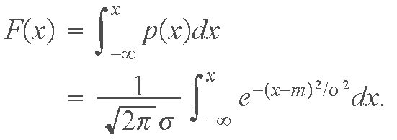
Review: Probability and Random Variables
The Gaussian PDF (Con’t)
The cumulative distribution function corresponding to the Gaussian density is
which, as before, we interpret as the probability that the random variable lies between minus infinite and an arbitrary value x. This integral has no known closed-form solution, and it must be solved by numerical or other approximation methods. Extensive tables exist for the Gaussian cdf.

Slide 55
Review: Probability and Random Variables
Several Random Variables
In the previous example, we used a single random variable to describe the behavior of rifle shots with respect to a horizontal line passing through the bull's-eye in the target. Although this is useful information, it certainly leaves a lot to be desired in terms of telling us how well we are shooting with respect to the center of the target. In order to do this we need two random variables that will map our events onto the xy-plane. It is not difficult to see how if we wanted to describe events in 3-D space we would need three random variables. In general, we consider in this section the case of n random variables, which we denote by x₁, x₂,…, x_{n} (the use of n here is not related to our use of the same symbol to denote the nth moment of a random variable).

Slide 56
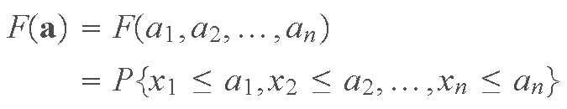
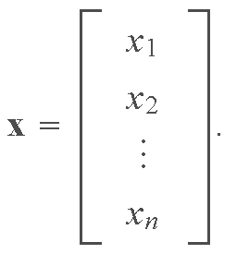
Review: Probability and Random Variables
Several Random Variables (Con’t)
It is convenient to use vector notation when dealing with several random variables. Thus, we represent a vector random variable x as
Then, for example, the cumulative distribution function introduced earlier becomes

Slide 57
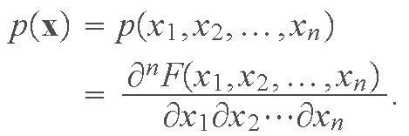
Review: Probability and Random Variables
Several Random Variables (Con’t)
when using vectors. As before, when confusion is not likely, the cdf of a random variable vector often is written simply as F(x). This notation will be used in the following discussion when speaking generally about the cdf of a random variable vector.
As in the single variable case, the probability density function of a random variable vector is defined in terms of derivatives of the cdf; that is,

Slide 58
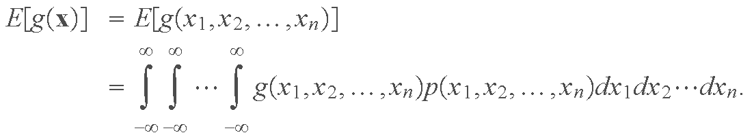
Review: Probability and Random Variables
Several Random Variables (Con’t)
The expected value of a function of x is defined basically as before:

Slide 59
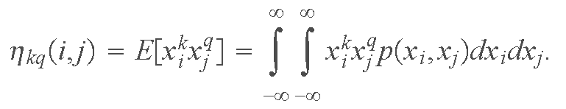
Review: Probability and Random Variables
Several Random Variables (Con’t)
Cases dealing with expectation operations involving pairs of elements of x are particularly important. For example, the joint moment (about the origin) of order kq between variables x_{i} and x_{j}

Slide 60
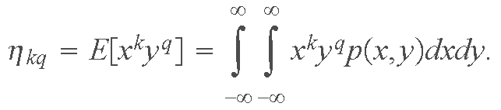
Review: Probability and Random Variables
Several Random Variables (Con’t)
When working with any two random variables (any two elements of x) it is common practice to simplify the notation by using x and y to denote the random variables. In this case the joint moment just defined becomes
It is easy to see that η_{k0} is the kth moment of x and η_{0q} is the qth moment of y, as defined earlier.

Slide 61
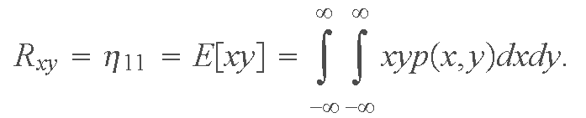
Review: Probability and Random Variables
Several Random Variables (Con’t)
The moment η₁₁ = E[xy] is called the correlation of x and y. As discussed in Chapters 4 and 12 of the book, correlation is an important concept in image processing. In fact, it is important in most areas of signal processing, where typically it is given a special symbol, such as R_{xy}:

Slide 62
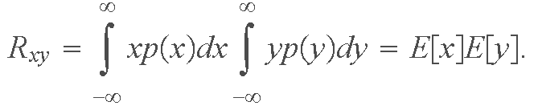

Review: Probability and Random Variables
Several Random Variables (Con’t)
If the condition
holds, then the two random variables are said to be uncorrelated. From our earlier discussion, we know that if x and y are statistically independent, then p(x, y) = p(x)p(y), in which case we write
Thus, we see that if two random variables are statistically independent then they are also uncorrelated. The converse of this statement is not true in general.

Slide 63


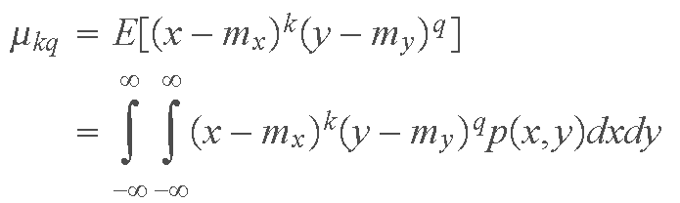
Review: Probability and Random Variables
Several Random Variables (Con’t)
The joint central moment of order kq involving random variables x and y is defined as
where m_{x} = E[x] and m_{y} = E[y] are the means of x and y, as defined earlier. We note that
and
are the variances of x and y, respectively.

Slide 64
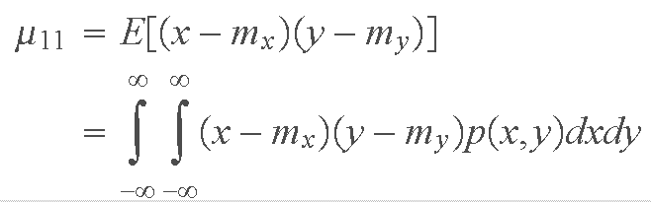
Review: Probability and Random Variables
Several Random Variables (Con’t)
The moment µ₁₁
is called the covariance of x and y. As in the case of correlation, the covariance is an important concept, usually given a special symbol such as C_{xy}.

Slide 65
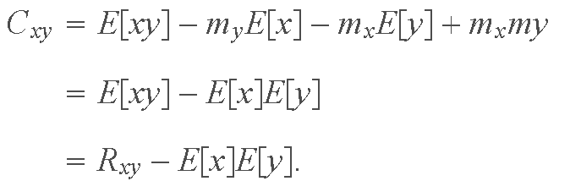
Review: Probability and Random Variables
Several Random Variables (Con’t)
By direct expansion of the terms inside the expected value brackets, and recalling the m_{x} = E[x] and m_{y} = E[y], it is straightforward to show that
From our discussion on correlation, we see that the covariance is zero if the random variables are either uncorrelated or statistically independent. This is an important result worth remembering.

Slide 66
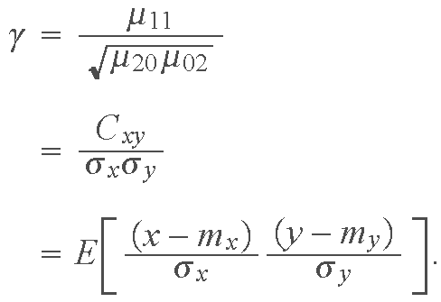
Review: Probability and Random Variables
Several Random Variables (Con’t)
If we divide the covariance by the square root of the product of the variances we obtain
The quantity γ is called the correlation coefficient of random variables x and y. It can be shown that γ is in the range −1 ≤ γ ≤ 1 (see Problem 12.5). As discussed in Section 12.2.1, the correlation coefficient is used in image processing for matching.

Slide 67

Review: Probability and Random Variables
The Multivariate Gaussian Density
As an illustration of a probability density function of more than one random variable, we consider the multivariate Gaussian probability density function, defined as
where n is the dimensionality (number of components) of the random vector x, C is the covariance matrix (to be defined below), |C| is the determinant of matrix C, m is the mean vector (also to be defined below) and T indicates transposition (see the review of matrices and vectors).

Slide 68

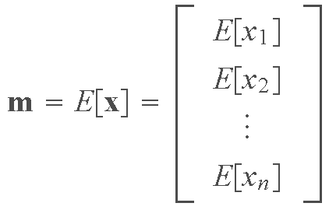
Review: Probability and Random Variables
The Multivariate Gaussian Density (Con’t)
The mean vector is defined as
and the covariance matrix is defined as

Slide 69

Review: Probability and Random Variables
The Multivariate Gaussian Density (Con’t)
The element of C are the covariances of the elements of x, such that
where, for example, x_{i} is the ith component of x and m_{i} is the ith component of m.

Slide 70
Review: Probability and Random Variables
The Multivariate Gaussian Density (Con’t)
Covariance matrices are real and symmetric (see the review of matrices and vectors). The elements along the main diagonal of C are the variances of the elements x, such that c_{ii}= σ_{xi}². When all the elements of x are uncorrelated or statistically independent, c_{ij} = 0, and the covariance matrix becomes a diagonal matrix. If all the variances are equal, then the covariance matrix becomes proportional to the identity matrix, with the constant of proportionality being the variance of the elements of x.

Slide 71
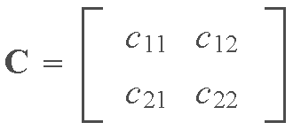
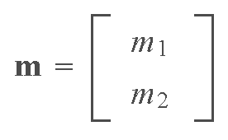
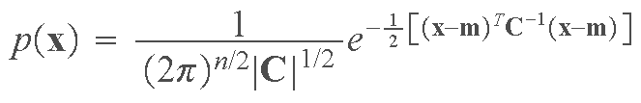
Review: Probability and Random Variables
The Multivariate Gaussian Density (Con’t)
Example: Consider the following bivariate (n = 2) Gaussian probability density function
with
and

Slide 72
Review: Probability and Random Variables
The Multivariate Gaussian Density (Con’t)
where, because C is known to be symmetric, c₁₂ = c₂₁. A schematic diagram of this density is shown in Part (a) of the following figure. Part (b) is a horizontal slice of Part (a). From the review of vectors and matrices, we know that the main directions of data spread are in the directions of the eigenvectors of C. Furthermore, if the variables are uncorrelated or statistically independent, the covariance matrix will be diagonal and the eigenvectors will be in the same direction as the coordinate axes x₁ and x₂ (and the ellipse shown would be oriented along the x₁ - and x₂-axis). If, the variances along the main diagonal are equal, the density would be symmetrical in all directions (in the form of a bell) and Part (b) would be a circle. Note in Parts (a) and (b) that the density is centered at the mean values (m₁,m₂).

Slide 73
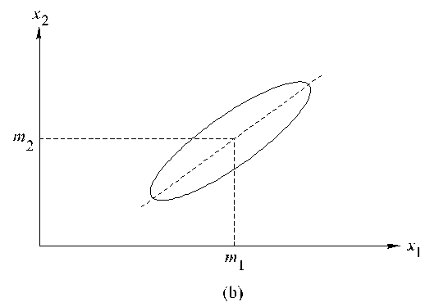
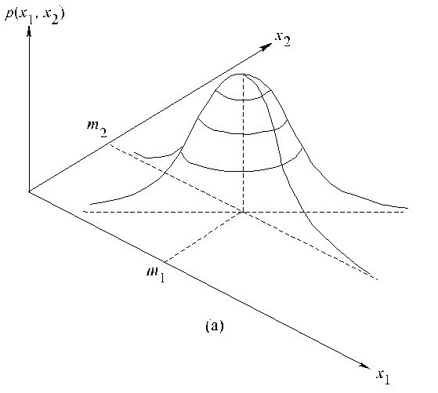
Review: Probability and Random Variables
The Multivariate Gaussian Density (Con’t)

Slide 74
Review: Probability and Random Variables
Linear Transformations of Random Variables
As discussed in the Review of Matrices and Vectors, a linear transformation of a vector x to produce a vector y is of the form y = Ax. Of particular importance in our work is the case when the rows of A are the eigenvectors of the covariance matrix. Because C is real and symmetric, we know from the discussion in the Review of Matrices and Vectors that it is always possible to find n orthonormal eigenvectors from which to form A. The implications of this are discussed in considerable detail at the end of the Review of Matrices and Vectors, which we recommend should be read again as a conclusion to the present discussion.

