Slide 1
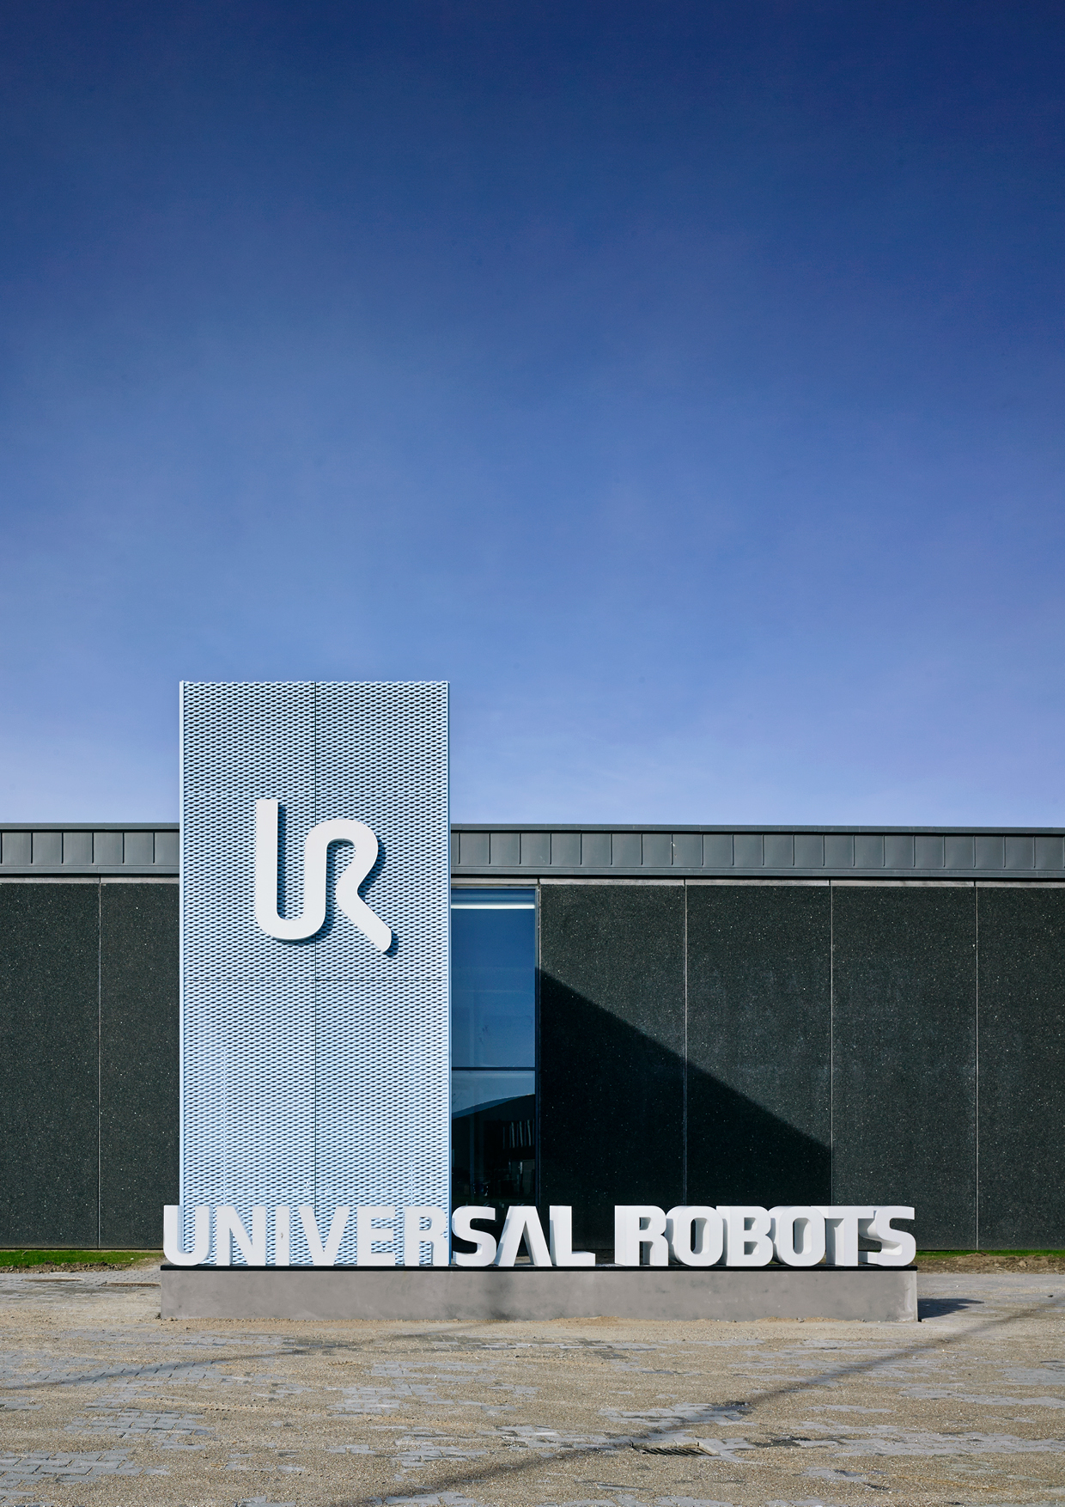
CERTIFICATE
This certificate has been assigned to
刘常明
Liu Changming
This is to certify that participant successfully has completed
Universal Robots Advanced Training
Date: 2018-3-22~3-23
Certificate No. 20180037
Period of Validity: for one year
This certificate has been issued by
________________________________________________________
Technical Training Manager
Ivy Chen
Universal Robots (Shanghai) Co.,Ltd | 2008 Room | No.688 West Nanjing Road| Shanghai|China | T: +86 21 61326299 | support.china@universal-robots.com

