Slide 1
HTK使用方法介绍

Slide 2
主要内容
HTK下载与安装
HTKDemo演示
孤立字识别的过程和数据流图
孤立字识别实验演示

Slide 3
HTK介绍
The Hidden Markov Model Toolkit (HTK) is a portable toolkit for building and manipulating hidden Markov models. HTK is primarily used for speech recognition research
HTK was originally developed at the Machine Intelligence Laboratory (formerly known as the Speech Vision and Robotics Group) of the Cambridge University Engineering Department (CUED) where it has been used to build CUED's large vocabulary speech recognition systems (see CUED HTK LVR). In 1993 Entropic Research Laboratory Inc. acquired the rights to sell HTK and the development of HTK was fully transferred to Entropic in 1995 when the Entropic Cambridge Research Laboratory Ltd was established. HTK was sold by Entropic until 1999 when Microsoft bought Entropic. Microsoft has now licensed HTK back to CUED and is providing support so that CUED can redistribute HTK and provide development support via the HTK3 web site
in C source form

Slide 4
HTK下载
http://htk.eng.cam.ac.uk下载得到，需要先注册。最新版本htk3.4。

Slide 5
HTK安装
安装
  linux 下安装：
    cd ./htk
    ./configure
    ./make all
    ./make install
    完成
  Windows XP下安装（直接按照read有错误）
    http://www.co.it.pt/~aveiga/htk/
    上下载mytool，解压后HMMIRest.c和HTK34Compile.bat放到htk目录下；
    下载HDecode，将解压后的HTKLVRec文件夹覆盖待安装HTK的HTKLVRec文件夹；
    执行HTK34Compile.bat，等待compile结束；
    完成

Slide 6
主要内容
HTK下载与安装
HTKDemo演示
孤立字识别的过程和数据流图
孤立字识别实验演示

Slide 7
HTKDemo演示
演示前准备
    下载HTKsamples并解压
    在HTKDemo文件夹下建
    HTKDemo/hmms/
    HTKDemo/test/
    HTKDemo/proto/
    在文件夹HTKDemo/hmms/ 下建 HTKDemo/hmms/hmm.0/
    HTKDemo/hmms/hmm.1/
    HTKDemo/hmms/hmm.2/

Slide 8
HTKDemo演示
运行HTKDemo
  Windows
    cd HTKDemo
    runDemo.pl configs/monPlainM1S3.dcf
  linux
    cd HTKDemo
    ./runDemo configs/monPlainM1S3.dcf

Slide 9
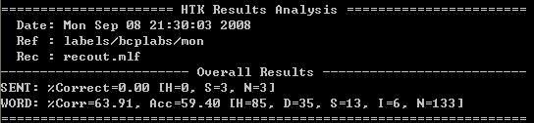
HTKDemo演示
Demo结果

Slide 10
主要内容
HTK下载与安装
HTKDemo演示
孤立字识别的过程和数据流图
孤立字识别实验演示

Slide 11
.sig/.wav
Train.list
Test.list
HCopy
Train.mfcc
Test.mfcc
字典
HMM原型
HInit
hmm.init
HRest
HMM
HVite
Result
词网络
HCompV
Vfloor
HParse
HMM模型列表
语法规则

Slide 12
主要内容
HTK下载与安装
HTKDemo演示
孤立字识别的过程和数据流图
孤立字识别实验演示

Slide 13
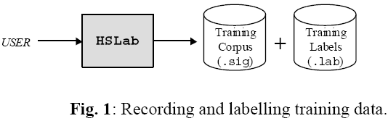
数据准备
录取语音数据（Record the Signal）
    每个sig文件中包含一个关键字发音
    每个字发音至少10次
    例：HSLab yes0.sig
    存放在data目录下（包括训练的和测试的语音）
Back

Slide 14
数据准备
语音标注（Label the Signal）
    例：HSLab yes0.sig
      0 14375625 sil
    14565625 21919375 yes
    26568750 32405000 sil
    其中单位是100ns （100ns (10 million per second)）
    存储格式为lab文件，存放在lab目录下
Back

Slide 15
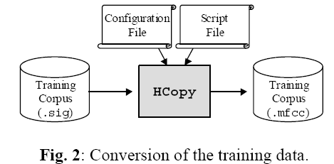
声学特征分析
HCopy -A -D -C analysis.conf -S targetlist.txt

Slide 16

声学特征分析
语音特征：mfcc，plp，lpc
配置文件参数设置（Configuration Parameters）
    #
    # Example of an acoustical analysis configuration file
    #
    SOURCEFORMAT = HTK # Gives the format of the speech files
    TARGETKIND = MFCC_0_D_A # Identifier of the coefficients to use
    # Unit = 0.1 micro-second :
    WINDOWSIZE = 250000.0 # = 25 ms = length of a time frame
    TARGETRATE = 100000.0 # = 10 ms = frame periodicity
    NUMCEPS = 12 # Number of MFCC coeffs (here from c1 to c12)
    USEHAMMING = T # Use of Hamming function for windowing frames
    PREEMCOEF = 0.97 # Pre-emphasis coefficient
    NUMCHANS = 26 # Number of filterbank channels
    CEPLIFTER = 22 # Length of cepstral liftering（LPC没影响）
    # The End

Slide 17
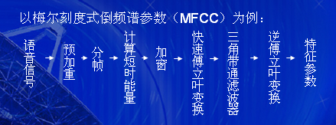
声学特征分析
这里得到的是mfcc（mel倒频谱系数）
每一个为39维的向量：（12个Mel系数＋1个能量参数）×3
MFCC的求解过程：
其中三角滤波的过程就是模仿人耳的听觉特性，通过二十多组（个数不固定）三角滤波器对FFT所得频谱进行滤波，得到mel尺度下的频谱。
Back

Slide 18
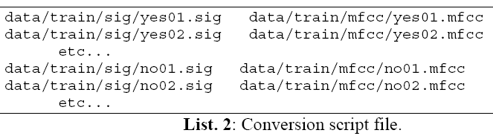
声学特征分析
源文件和目标文件（Source / Target Specification）

Slide 19
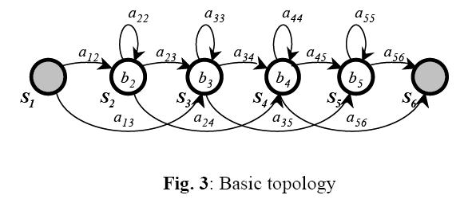
HMM 定义
HMM结构

Slide 20
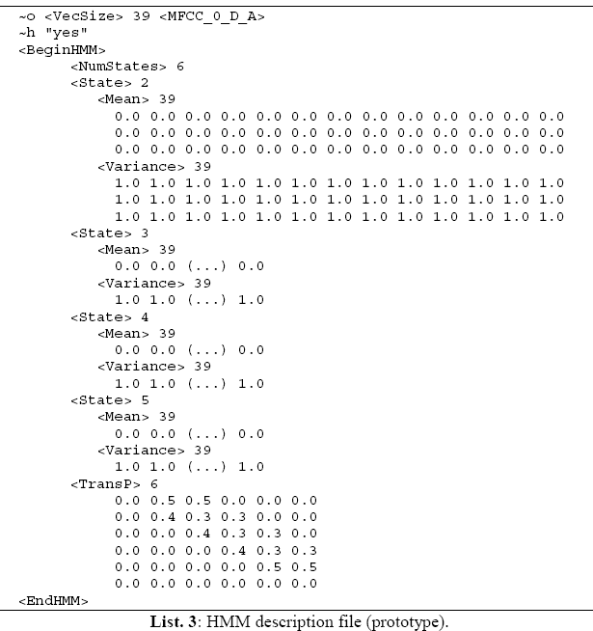
HMM 定义

Slide 21
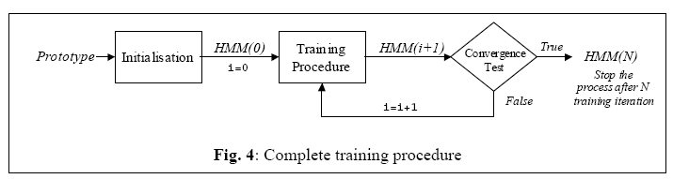
HMM 训练

Slide 22
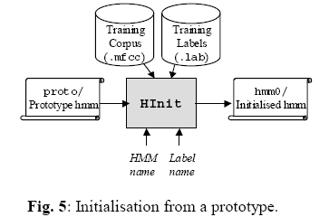
HMM 训练
Initialisation

Slide 23
HMM 训练
初始化（Initialisation）
    HInit
    The following command line initialises the HMM by time-alignment of the training data with a Viterbi algorithm:
    HInit -A -D –T 1 -S trainlist.txt -M model/hmm0 \
    -H model/proto/hmmfile -l label -L label_dir nameofhmm
    nameofhmm is the name of the HMM to initialise (here: yes, no, or sil).
    hmmfile is a description file containing the prototype of the HMM called nameofhmm (here:
    proto/hmm_yes, proto/hmm_no, or proto/hmm_sil).
    trainlist.txt gives the complete list of the .mfcc files forming the training corpus
    (stored in directory data/train/mfcc/).
    label_dir is the directory where the label files (.lab) corresponding to the training corpus
    (here: data/train/lab/).
    label indicates which labelled segment must be used within the training corpus (here: yes,
    no, or sil because have used the same names for the labels and the HMMs, but this is not
    mandatory…)
    model/hmm0 is the name of the directory (must be created before) where the resulting
    initialised HMM description will be output.
    This procedure has to be repeated for each model (hmm_yes, hmm_no, hmm_sil).
    Remark:
    The HMM file output by HInit has the same name as the input prototype.

Slide 24

HMM 训练
初始化（Initialisation）
    HCompv
    The HCompv tool performs a “flat” initialisation of a model. Every state of the HMM is
    given the same mean and variance vectors: these are computed globally on the whole training corpus. The initialisation command line is in this case:
    HCompv -A -D –T 1 -S trainlist.txt -M model/hmm0flat \
    -H model/proto/hmmfile -f 0.01 nameofhmm
    nameofhmm , hmmfile , trainlist.txt : see HInit.
    model/hmm0flat : the output directory must be different from the one used with HInit (to avoid overwrite).
    这里的重要作用是产生一个宏，当训练过程中某一个hmm的方差小于某一个值的时候
    就用varFloor1中的方差去替换。

Slide 25
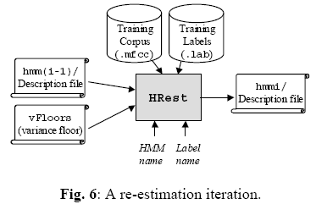
HMM 训练
Training

Slide 26
HMM 训练
Training
    HRest -A -D -T 1 -S trainlist.txt -M model/hmmi -H vFloors -H model/hmmi-1/hmmfile -l label -L label_dir nameofhmm
    nameofhmm is the name of the HMM to train (here: yes, no, or sil).
    hmmfile is the description file of the HMM called nameofhmm. It is stored in a directory
    whose name indicates the index of the last iteration (here model/hmmi-1/ for example).
    vFloors is the file containing the variance floor macro obtained with HCompv.
    trainlist.txt gives the complete list of the .mfcc files forming the training corpus(stored in directory data/train/mfcc/).
    label_dir is the directory where the label files (.lab) corresponding to the training corpus(here: data/train/lab/).
    label indicates the label to use within the training data (yes, no, or sil)
    model/hmmi , the output directory, indicates the index of the current iteration i.

Slide 27
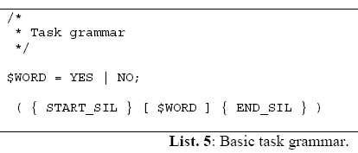
任务定义
语法和字典（Grammar and Dictionary）

Slide 28
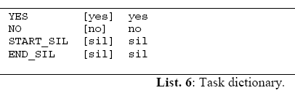
Task Definition
语法和字典（Grammar and Dictionary）

Slide 29
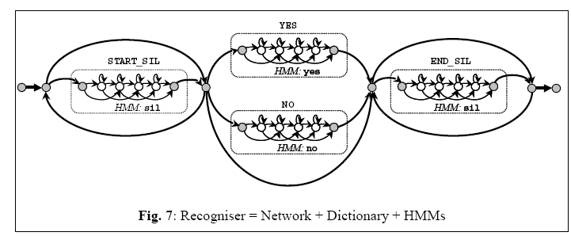
Task Definition
网络（Network）
    HParse -A -D -T 1 gram.txt net.slf
    To be sure that no mistakes were made when writing the grammar, the tool HSGen can be used to test it:
        HSGen -A -D -n 10 -s net.slf dict.txt

Slide 30
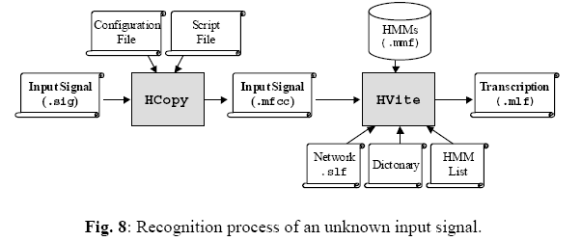
Recognition

Slide 31
Recognition
HVite -A -D -T 1 -H hmmsdef.mmf -i reco.mlf -w net.slf dict.txt hmmlist.txt input.mfcc
input.mfcc is the input data to be recognised.
hmmlist.txt lists the names of the models to use (yes, no, and sil). Each element is separated by a new line character. Don’t forget to insert a new line after the last element.
dict.txt is the task dictionary.
net.slf is the task network.
reco.mlf is the output recognition transcription file.
hmmsdef.mmf contains the definition of the HMMs. It is possible to repeat the -H option and list our different HMM definition files, in our case:
-H model/hmm3/hmm_yes -H model/hmm3/hmm_no -H model/hmm3/hmm_sil
but it is more convenient (especially when there are more than 3 models) to gather every definitions in a single file (called a Master Macro File, with extension .mmf). Such a file is simply obtained by copying each definition after the other in a single file, without repeating the header information (see List.7).

Slide 32
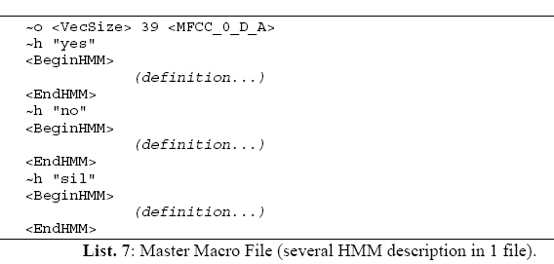
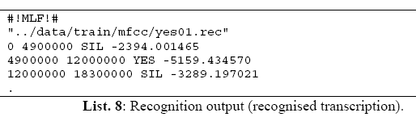
Recognition
    reco.mlf (output)

Slide 33
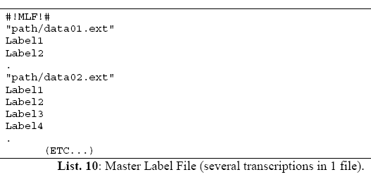
测试结果
Master Label Files
    HVite -A -D -T 1 -S testlist.txt -H hmmsdef.mmf -i rec.mlf -w net.slf dict.txt hmmlist.txt
    hmmlist.txt, dict.txt, net.slf, hmmsdef.mmf: the same as previously.
    rec.mlf is the output recognition transcription file.
    testlist.txt lists the names of the test files (data/test/*.mfcc).

Slide 34
测试结果
Error Rates
    HResults -A -D -T 1 -e ??? sil -I ref.mlf labellist.txt rec.mlf > results.txt
    results.txt contains the output performance statistics (example: List.11).
    rec.mlf contains the transcriptions of the test data, as output by the recogniser.
    labellist.txt lists the labels appearing in the transcription files (here: yes, no, and sil).
    ref.mlf contains the reference transcriptions of the test data (obtained by hand-labelling).
    -e ??? sil option indicates that the sil labels will be ignored when computing the performance statistics (since we are interested in the recognition rate of words “Yes” and “No” only).

Slide 35
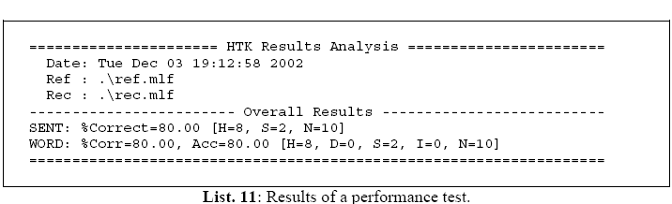
测试结果
Error Rates

Slide 36
Thank you

