Slide 1
Bias-variance trade-off
We can call it the bias-generality tradeoff
Terence Parr
MSDS program University of San Francisco

Slide 2
Many poor descriptions of this concept on web (and with high variance of definitions 🤪)
For example, Wikipedia starts a paragraph with “Models with high bias are usually more complex” and finishes that same paragraph with “…models with higher bias tend to be relatively simple…” (the latter bit is correct)
This blog is pretty good: https://elitedatascience.com/bias-variance-tradeoff
When you hear “bias-variance,” think “bias-generality”
It’s a trade-off because increasing accuracy (reducing bias) usually means reducing generality (and sometimes vice versa)
https://en.wikipedia.org/wiki/Bias%E2%80%93variance_tradeoff

Slide 3
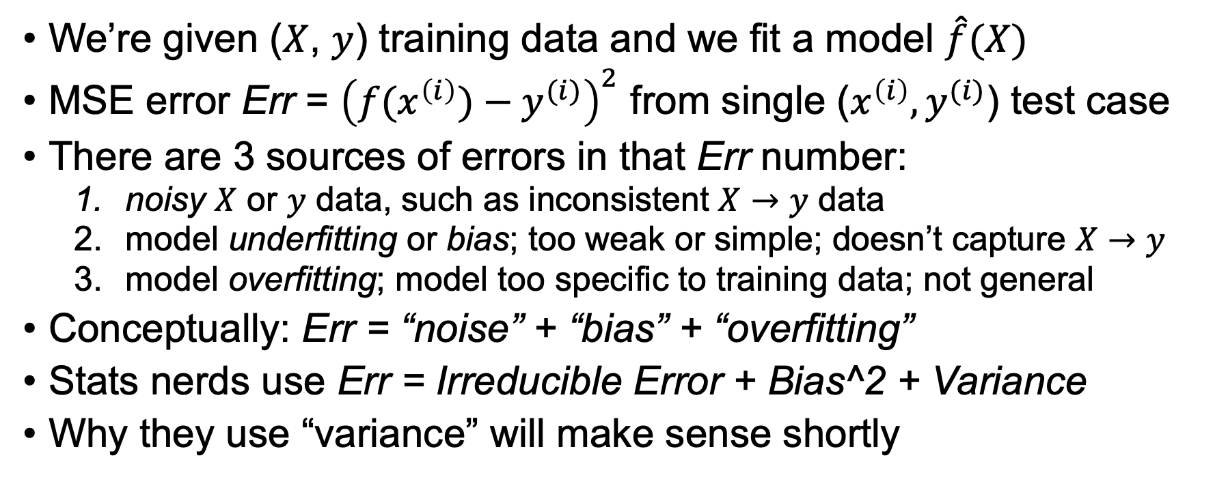
Sources of prediction error
We’re given ($X$, $y$) training data and we fit a model $\hat{f}(X)$
MSE error Err = ${\left(f(x^{\left(i\right)})−y^{(i)}\right)}^{2}$ from single ($x^{\left(i\right)},y^{(i)}$) test case
There are 3 sources of errors in that Err number:
noisy $X$ or $y$ data, such as inconsistent $X→y$ data
model underfitting or bias; too weak or simple; doesn’t capture $X→y$
model overfitting; model too specific to training data; not general
Conceptually: Err = “noise” + “bias” + “overfitting”
Stats nerds use Err = Irreducible Error + Bias^2 + Variance
Why they use “variance” will make sense shortly

Slide 4
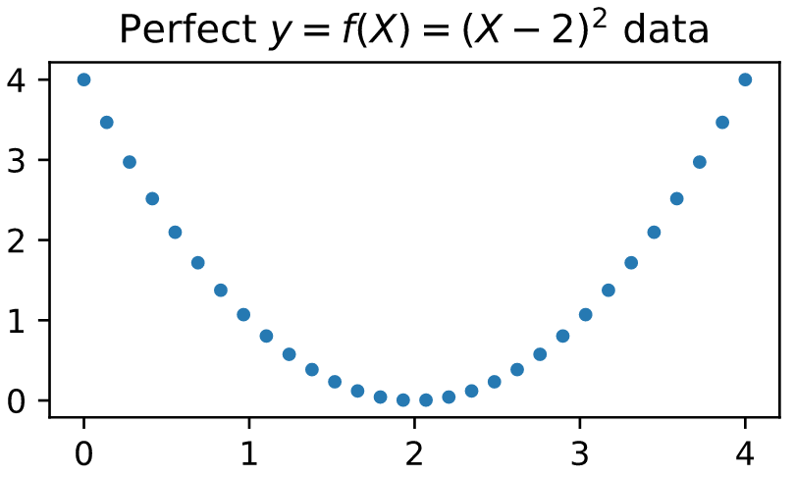
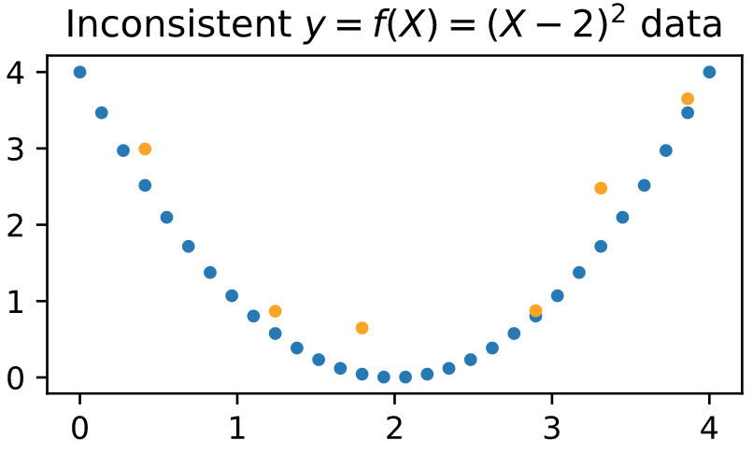
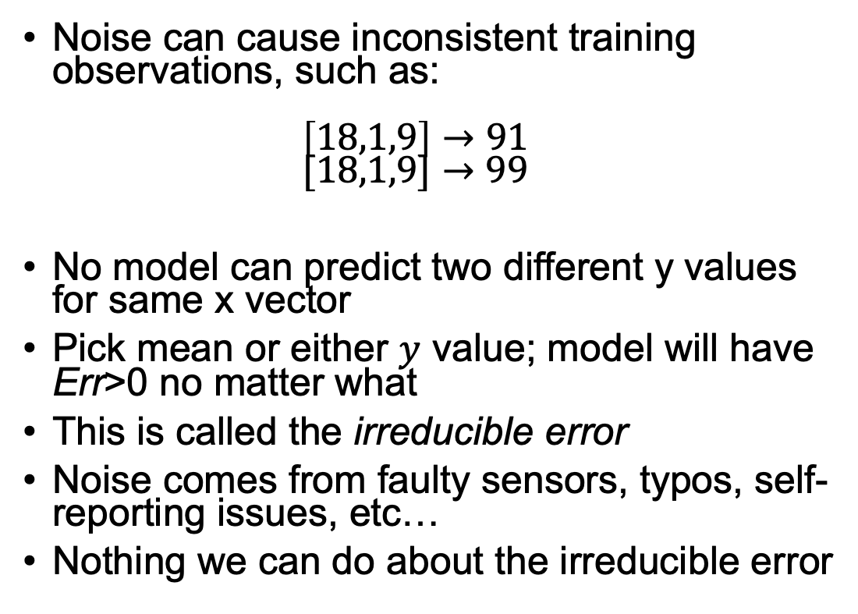
1. Noise can lead to inconsistent data
Noise can cause inconsistent training observations, such as: $\left[18,1,9\right]→91$ $[18,1,9]→99$
No model can predict two different y values for same x vector
Pick mean or either $y$ value; model will have Err>0 no matter what
This is called the irreducible error
Noise comes from faulty sensors, typos, self-reporting issues, etc…
Nothing we can do about the irreducible error

Slide 5
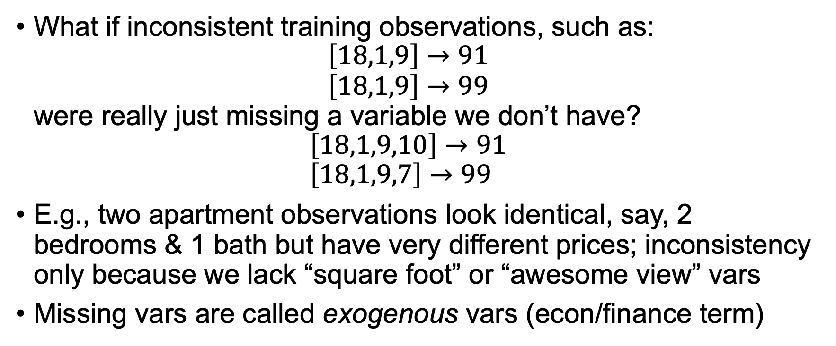
Missing variables looks like noise
What if inconsistent training observations, such as: $\left[18,1,9\right]→91$ $\left[18,1,9\right]→99$ were really just missing a variable we don’t have? $\left[18,1,9,10\right]→91$ $\left[18,1,9,7\right]→99$
E.g., two apartment observations look identical, say, 2 bedrooms & 1 bath but have very different prices; inconsistency only because we lack “square foot” or “awesome view” vars
Missing vars are called exogenous vars (econ/finance term)

Slide 6
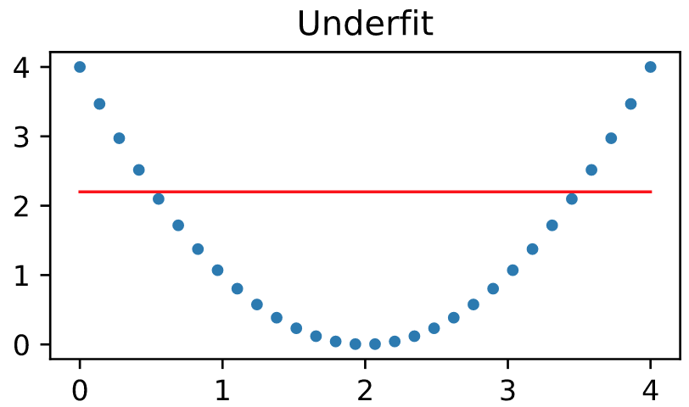
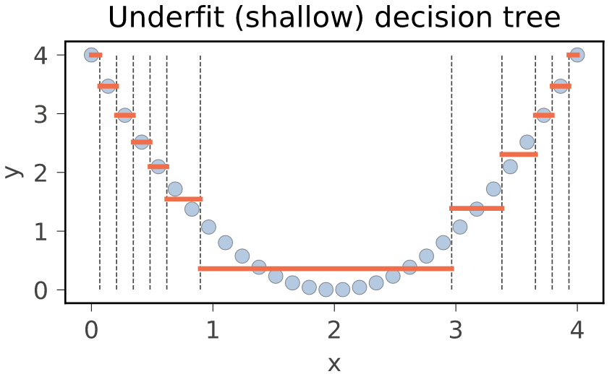
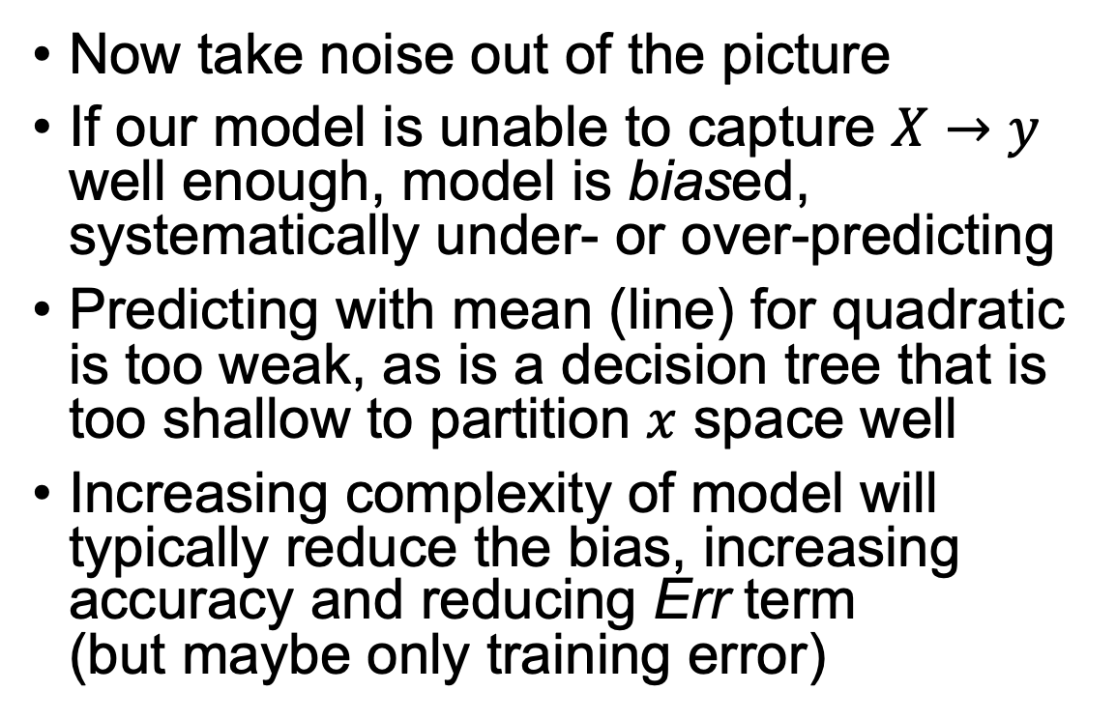
2. Overly simple leads to biased models
Now take noise out of the picture
If our model is unable to capture $X→y$ well enough, model is biased, systematically under- or over-predicting
Predicting with mean (line) for quadratic is too weak, as is a decision tree that is too shallow to partition $x$ space well
Increasing complexity of model will typically reduce the bias, increasing accuracy and reducing Err term (but maybe only training error)

Slide 7
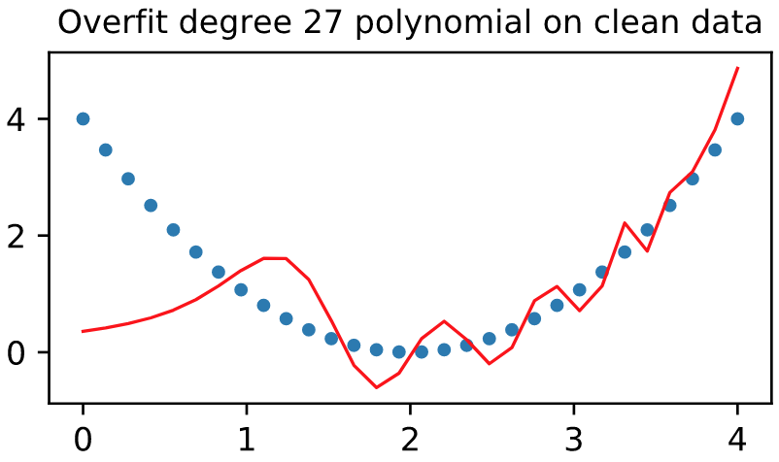
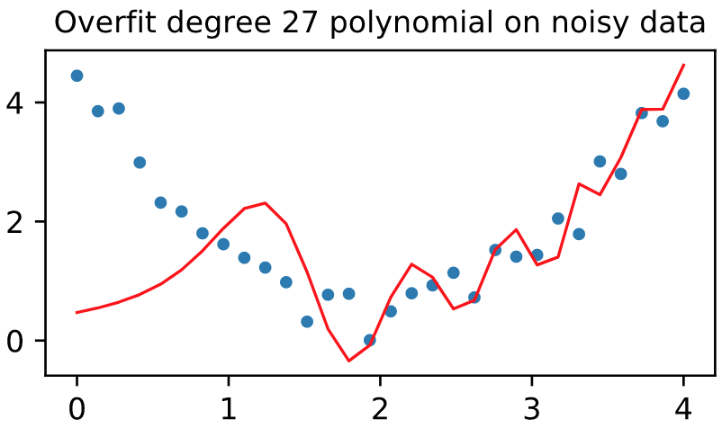
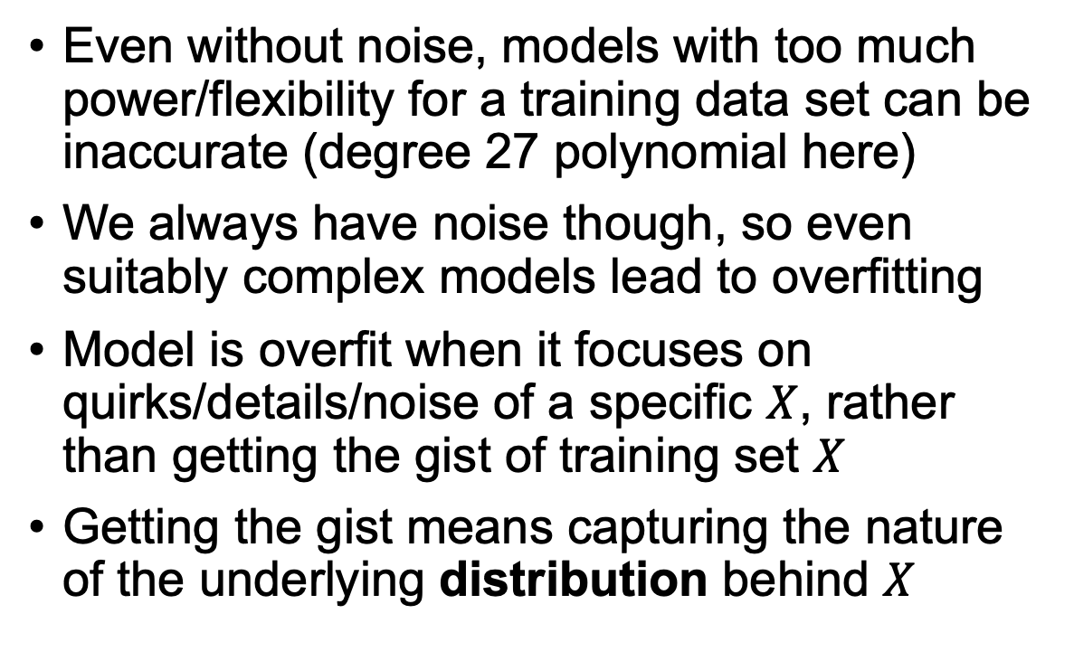
3. Overly-complex models can overfit
Even without noise, models with too much power/flexibility for a training data set can be inaccurate (degree 27 polynomial here)
We always have noise though, so even suitably complex models lead to overfitting
Model is overfit when it focuses on quirks/details/noise of a specific $X$, rather than getting the gist of training set $X$
Getting the gist means capturing the nature of the underlying distribution behind $X$
See https://github.com/parrt/msds621/blob/master/notebooks/assessment/bias-variance.ipynb

Slide 8
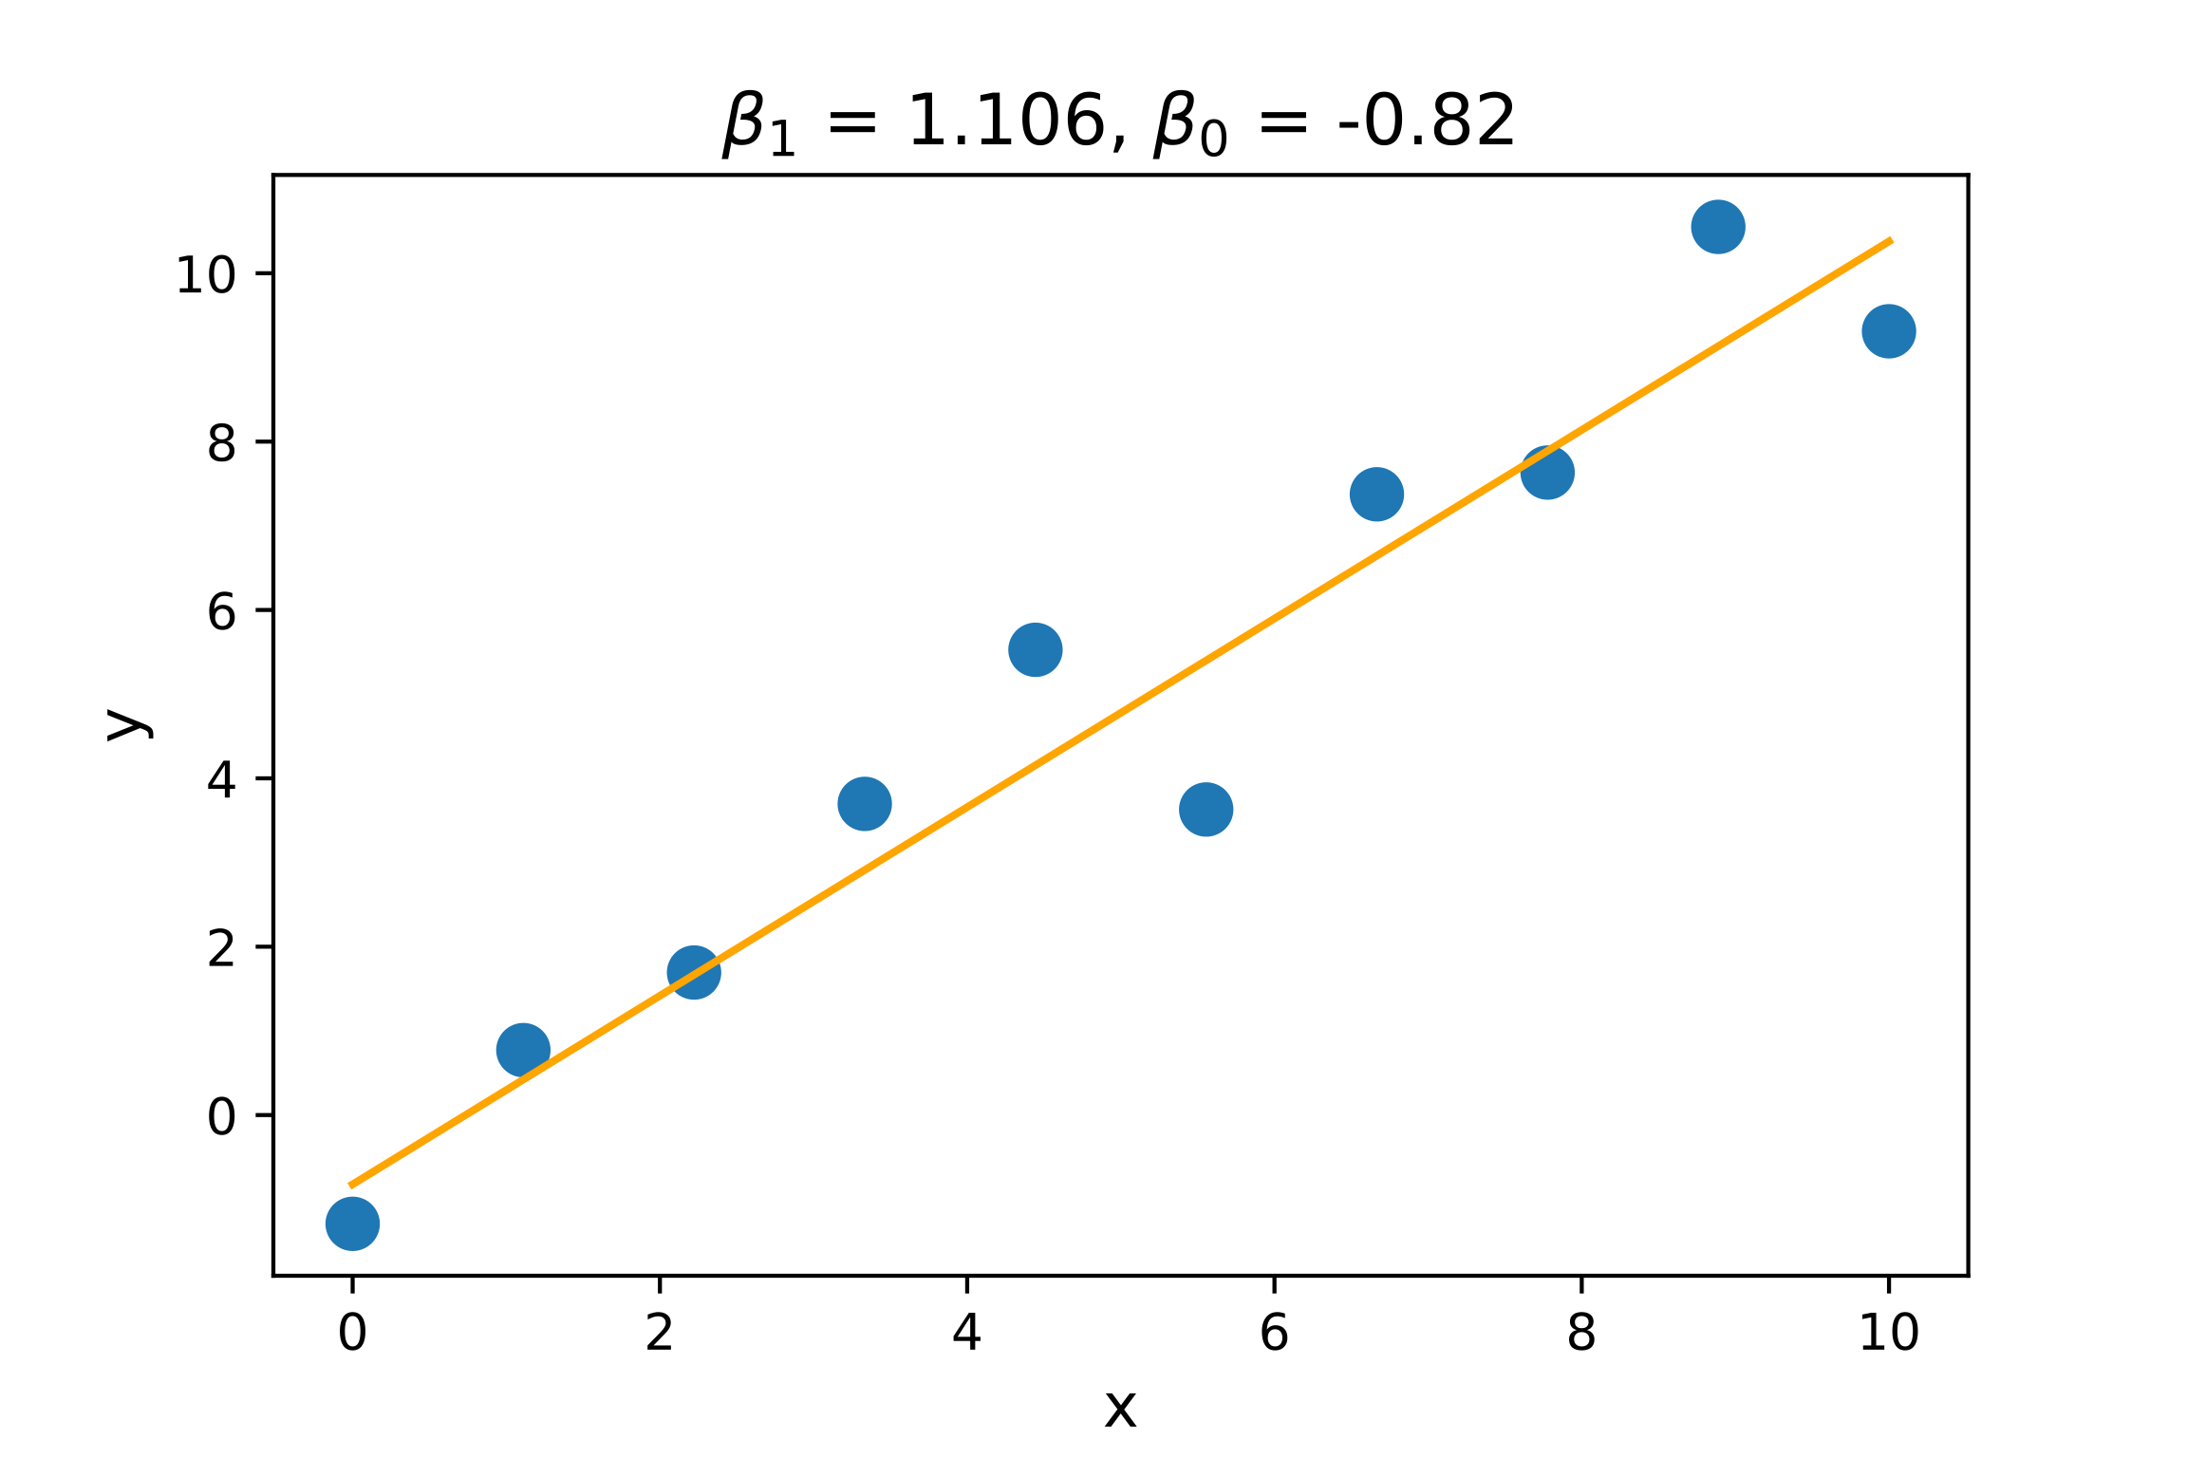
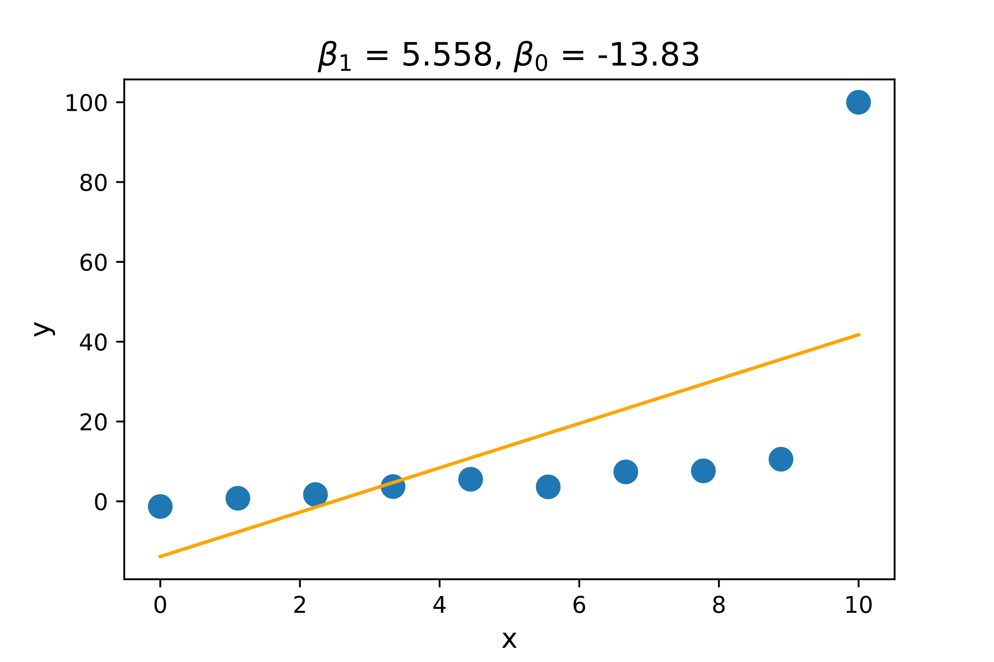
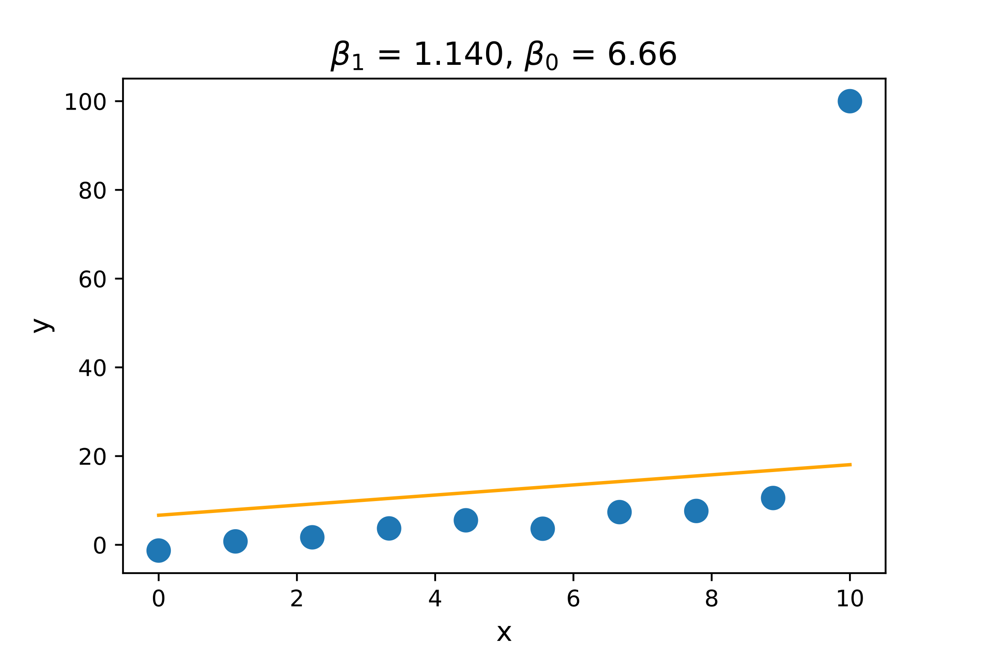

Recall: even simple models can overfit
Regularization trades a bit of bias for increased generality
Below, we see two training sets; center panel has quirk (outlier) that causes OLS to get different model parameters; not general
Small change to data set causes dramatic change in $β$'s
Outlier
Ordinary least squares
OLS with outlier
L1 regularization with outlier

Slide 9
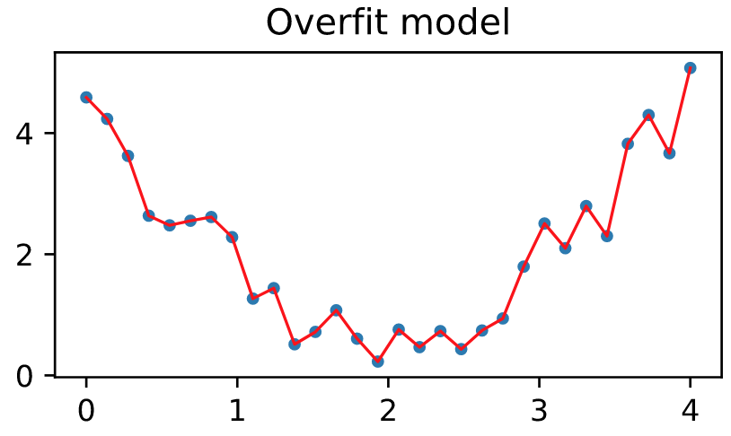
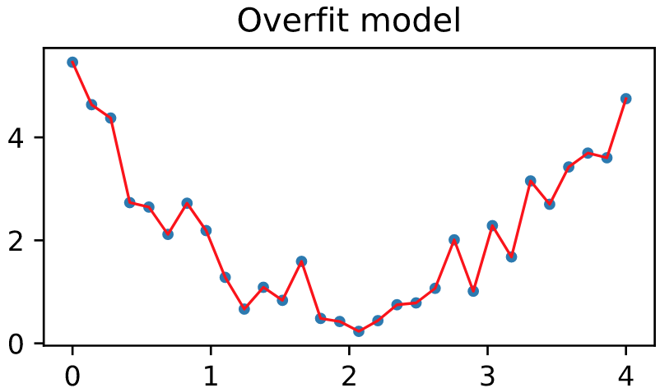
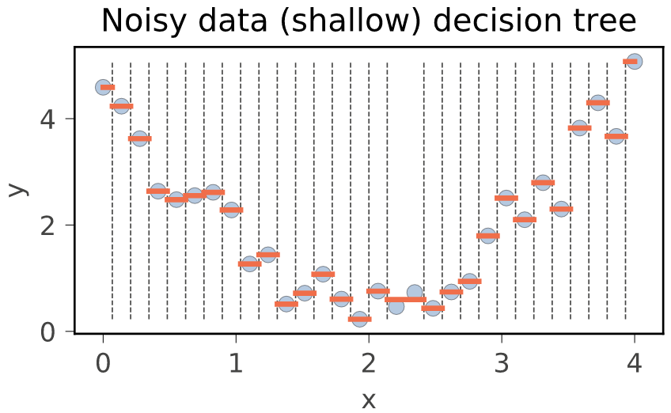
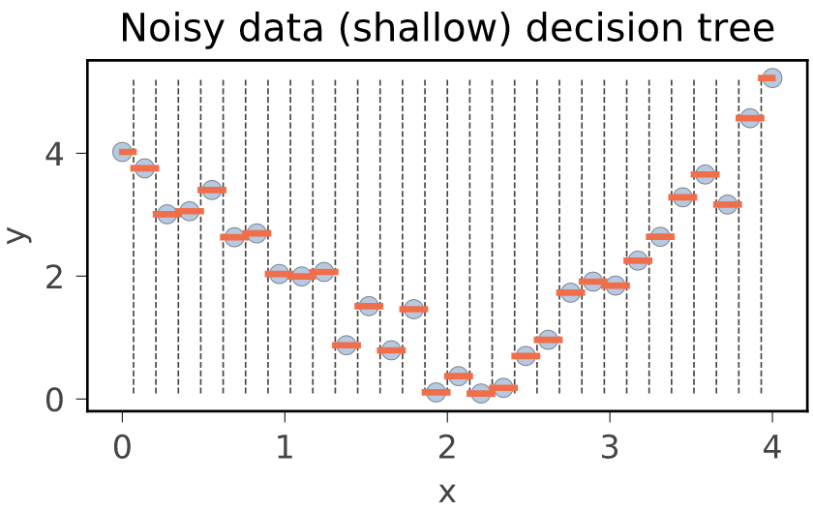
Stats view of overfitting: variance
Small changes in training data lead to very different models
Here are 2 training sets drawn (cols) from same distribution
Same fitting strategy leads to different models (for interpolation & decision trees)
Variance refers to model parameters not predictions, though they are related
See https://github.com/parrt/msds621/blob/master/notebooks/assessment/bias-variance.ipynb

Slide 10
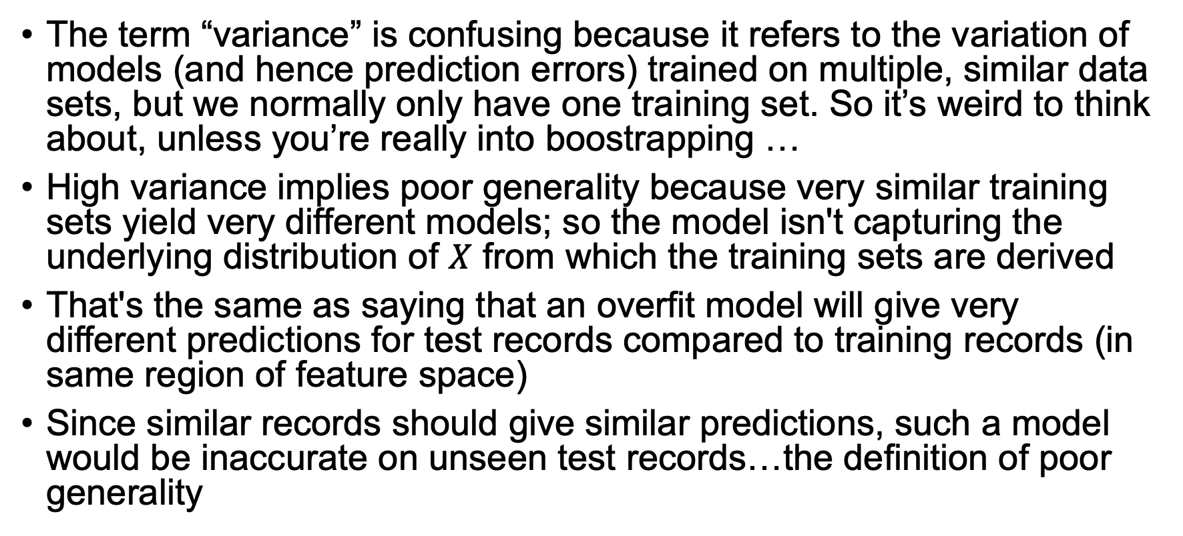
High model variance = overfitting
The term “variance” is confusing because it refers to the variation of models (and hence prediction errors) trained on multiple, similar data sets, but we normally only have one training set. So it’s weird to think about, unless you’re really into boostrapping …
High variance implies poor generality because very similar training sets yield very different models; so the model isn't capturing the underlying distribution of $X$ from which the training sets are derived
That's the same as saying that an overfit model will give very different predictions for test records compared to training records (in same region of feature space)
Since similar records should give similar predictions, such a model would be inaccurate on unseen test records…the definition of poor generality

Slide 11
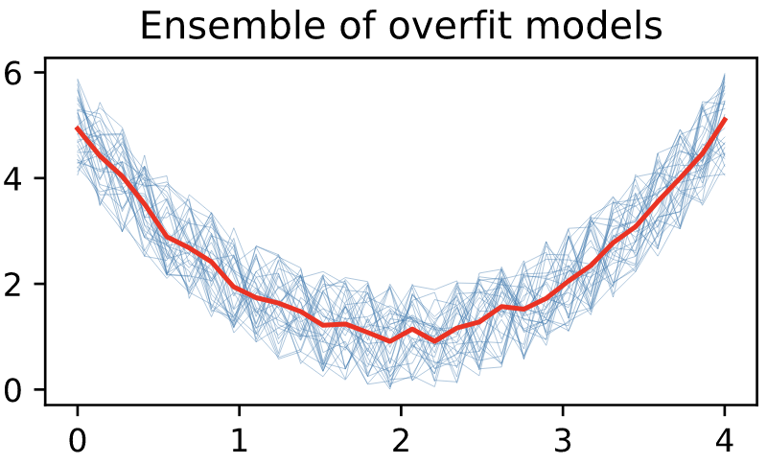
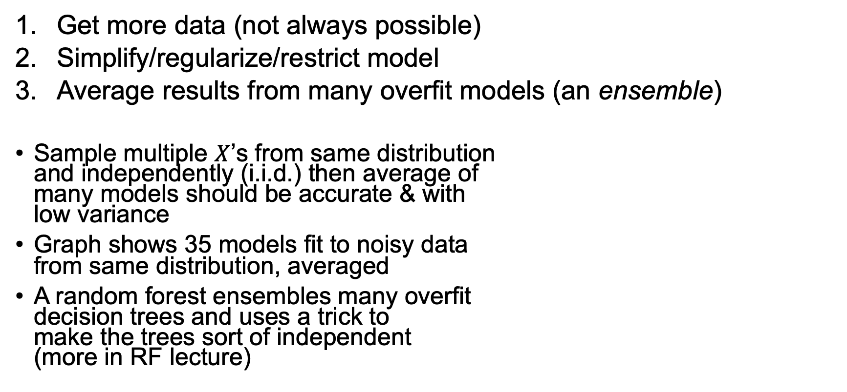
What to do about high variance (overfitting)?
Get more data (not always possible)
Simplify/regularize/restrict model
Average results from many overfit models (an ensemble)
Sample multiple $X$’s from same distribution and independently (i.i.d.) then average of many models should be accurate & with low variance
Graph shows 35 models fit to noisy data from same distribution, averaged
A random forest ensembles many overfit decision trees and uses a trick to make the trees sort of independent (more in RF lecture)

Slide 12
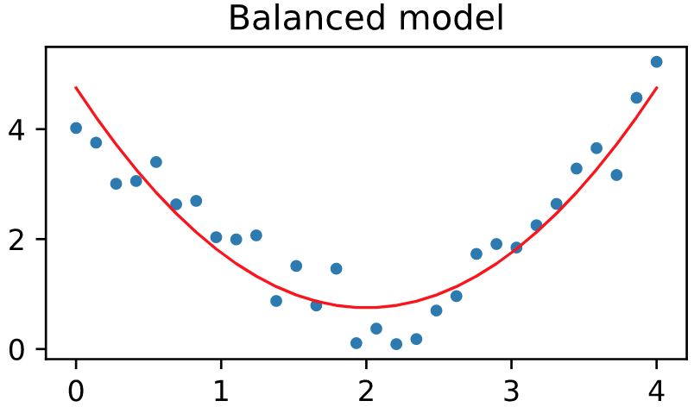
The trade-off
Must increase the complexity of the model to get more accuracy
But, increased complexity means more ability to chase quirks of data, making the model overly-specific to the training set
E.g., decision trees are sensitive to small data changes; change in root split node propagates to all splits below root
Let the validation error be your guide to appropriate complexity!

Slide 13
Detecting bias and variance
In the end, practitioners talk about underfitting and overfitting not bias and variance (colloquially biased just means less accurate)
How do we know that the simple mean model to the right is underfit?
How do we know that the other model is overfit?
We need to measure how accurately our model fits the data but which data? Training and non-training data
Models inaccurate on training data are biased
Models inaccurate on non-training data lack generality
We'll do a lecture on properly assessing models, followed by a lecture on how to quantify (later)

