Slide 1
A crash course in binary trees
We’ll revisit in MSDS689 but we need binary trees for projects now
Terence Parr
MSDS program University of San Francisco

Slide 2
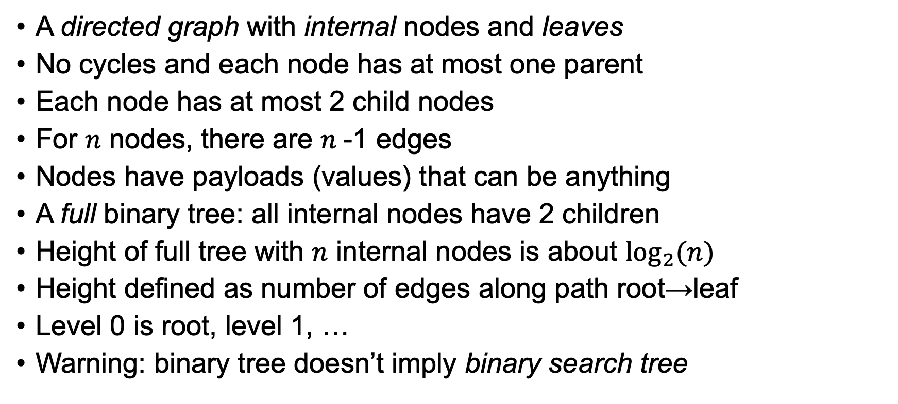
Binary tree abstract data structure
A directed graph with internal nodes and leaves
No cycles and each node has at most one parent
Each node has at most 2 child nodes
For $n$ nodes, there are $n$-1 edges
Nodes have payloads (values) that can be anything
A full binary tree: all internal nodes have 2 children
Height of full tree with $n$ internal nodes is about $\log_{2}(n)$
Height defined as number of edges along path root→leaf
Level 0 is root, level 1, …
Warning: binary tree doesn’t imply binary search tree

Slide 3
Concrete binary tree using pointers
class TreeNode:
def __init__(self, value,
left=None, right=None):
self.value = value
self.left = left
self.right = right
For our purposes here, you can think of a class definition as defining a dictionary that maps fields/members to values. Objects are instances of a class and can act like dictionary objects. Compare:
o = dict()
O['value'] = 3
o = TreeNode()
o.value = 3
Drawn with https://github.com/parrt/lolviz

Slide 4
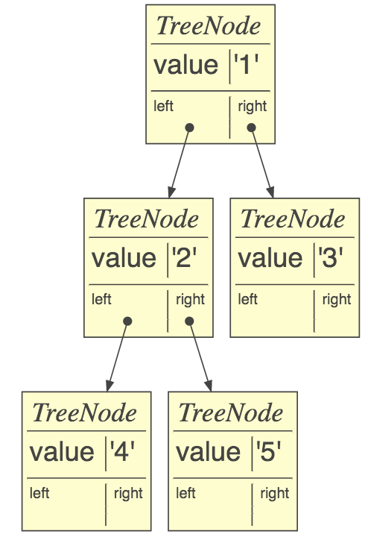
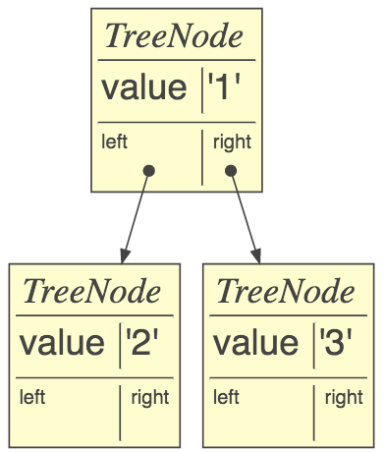
Building binary trees
class TreeNode:
def __init__(self, value,
left=None, right=None):
self.value = value
self.left = left
self.right = right
Manual construction is a simple matter of creating nodes and setting left/right child pointers or passing kids to init method
root = TreeNode(1)
root.left = TreeNode(2)
root.right = TreeNode(3)
root.left.left = TreeNode(4)
root.left.right = TreeNode(5)
or
root = TreeNode(1, TreeNode(2), TreeNode(3))
https://github.com/parrt/msds621/blob/master/notebooks/trees/basics.ipynb

Slide 5
Recursion detour

Slide 6
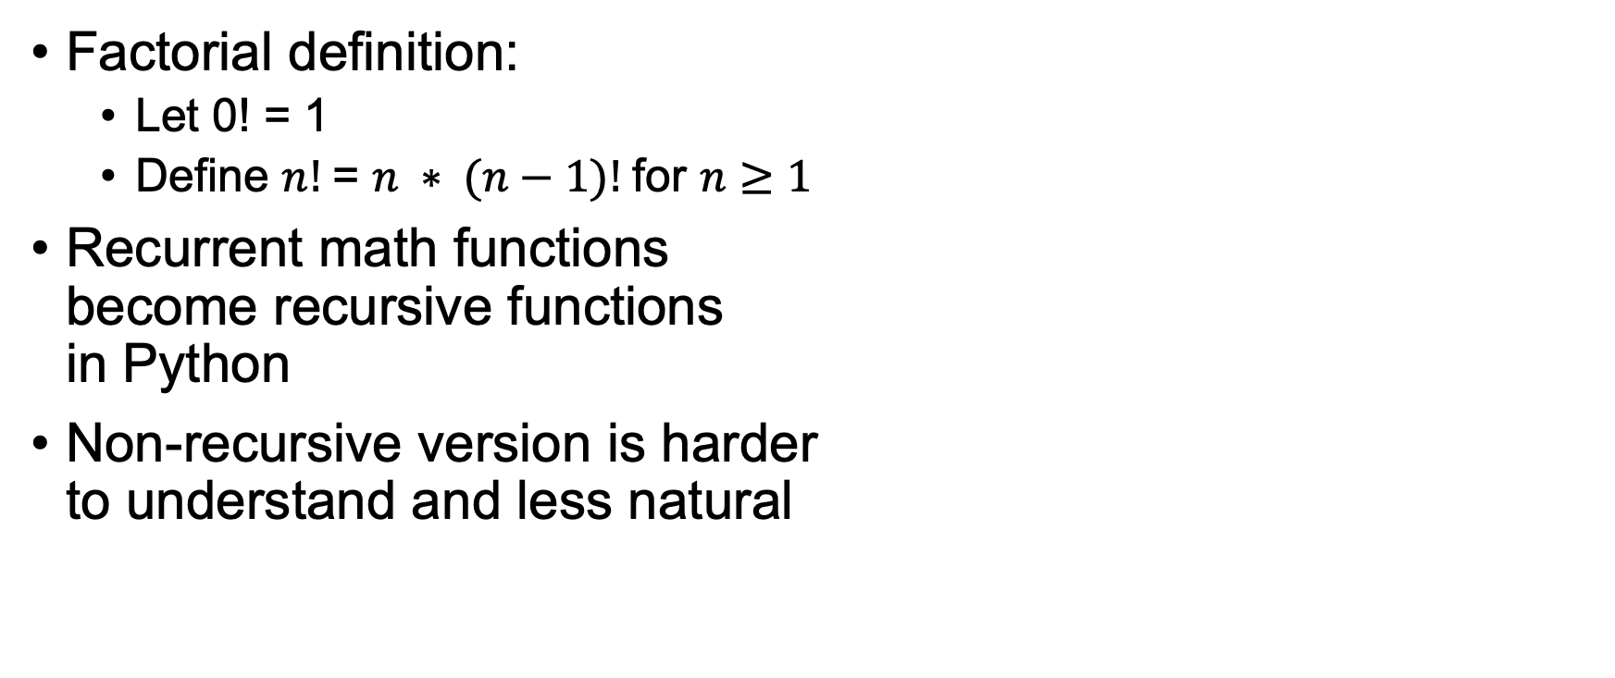

Math recurrence relations $⇒$ recursion
Factorial definition:
Let 0! = 1
Define $n!$= $n ∗ (n−1)!$for $n≥1$
Recurrent math functions become recursive functions in Python
Non-recursive version is harder to understand and less natural
def fact(n):
if n==0: return 1
return n * fact(n-1)
def factloop(n):
r = 1
for i in range(1,n+1):
r *= i
return r

Slide 7
Recursion traces out a call graph
Think of each call to the function as node in chain or graph of calls
Result of each function call is a piece of the result and each call combines subresult(s) to create more complete answer and pass it back
def fact(n):
if n==0: return 1
return n * fact(n-1)

Slide 8
Formula for writing recursive functions
def f(input):
1. check termination condition
2. process the active input region / current node, etc…
3. invoke f on subregion(s)
4. combine and return results
Steps 2 and 4 are optional
def fact(n):
if n==0: return 1
return n * fact(n-1)
Terminology: currently-active region or element is what f is currently trying to process.
Here, that is argument n (the “region” is the numbers 0..n)

Slide 9
Don't let the recursion scare you
Just pretend that you are calling a different function
Or, as you write the function, pretend that you are calling the same function except that it is already complete
We call this the recursive leap of faith
Follow the “Formula for recursive functions” and all will be well!

Slide 10
Recursive tree procedures

Slide 11


An analogy for recursive tree walking
Imagine searching for an item in a maze of rooms connected by doors (no cycles)
Each room has at most 2 doors, some have none
Search procedure that works in ANY room:
This approach is called backtracking
def visit(room):
if item in room: print(“rejoice!”)
if room.left exists: visit(room.left)
if room.right exists: visit(room.right)

Slide 12
Recursive tree walk is natural
def f(input):
1. check termination condition
2. process the current node
3. invoke f on subregion(s)
4. combine and return results
Depth-first search is how we walk (visit) through nodes
Pre-order traversal: executing an action at discovery time, before visiting kids
Follows formula for recursive functions
def walk(p:TreeNode):
if p is None: return
print(p.value) # preorder
walk(p.left)
walk(p.right)
Think of launching a minion to walk the left subtree and then another to walk the right
Indicates action execution
https://github.com/parrt/msds621/blob/master/notebooks/trees/basics.ipynb

Slide 13
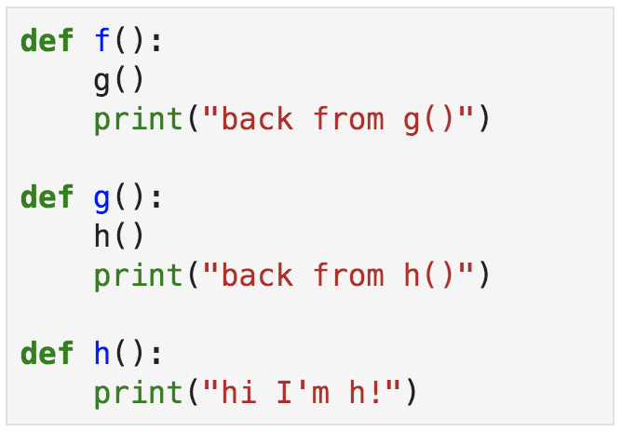
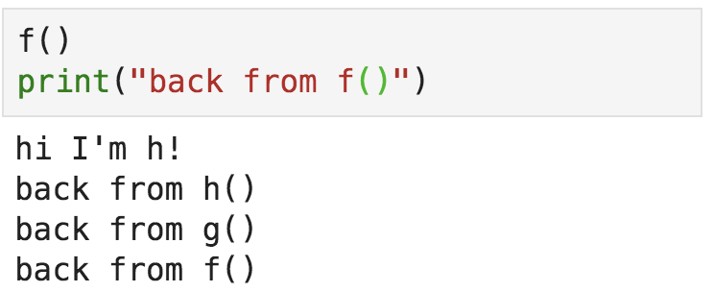
How can walk() remember where it has visited?
“Where to return” is tracked per function call not per function definition
Function f calls g calls h and Python remembers where each was called from
Each function call saves its place like keeping a finger on the call statement; return statement uses that as location to resume after invoked function returns
Just imagine that f, g, and h are the same function and you'll see that recursive calls also remember where they came from

Slide 14
Recursion call tree vs tree
def walk(p:TreeNode):
if p is None: return
walk(p.left)
walk(p.right)
Exhaustive search of all nodes

Slide 15
Searching in binary tree
Let’s modify the tree walker to search for an element and compare to unrestricted depth-first tree walk
def walk(p:TreeNode):
if p is None: return
print(p.value)
walk(p.left)
walk(p.right)
def search(p:TreeNode, x:object):
if p is None: return None
if x==p.value: return p
q = search(p.left, x)
if q is not None: return q
q = search(p.right, x)
return q

Slide 16
Decision tree stumps

Slide 17
Stumps
A stump is a 2-level tree w/decision node root & 2 predictor leaves
Used by gradient boosting machines as the “weak learners”
If node has field split, it’s a decision node else it’s a leaf
# Define a single-node class for simplicity
class TreeNode:
def __init__(self, split=None, prediction=None,
left=None, right=None):
self.split = split
self.prediction = prediction
self.left = left
self.right = right

Slide 18
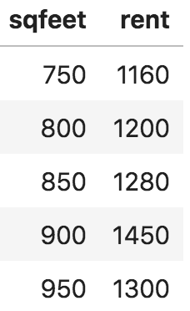
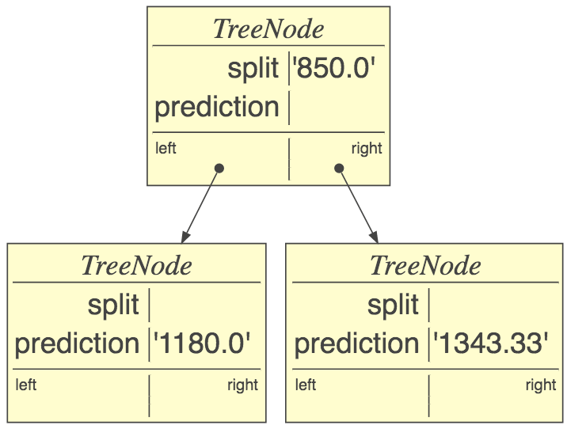


Sample stump that picks midpoint as split
Split sqfeet feature space at 850
$$<$$
$$≥$$
Average in right region

Slide 19

Creating decision tree stumps
For demonstration purposes only, let’s split $x$ always at midpoint between min/max:
def stumpfit(x, y):
if len(x)==1 or len(np.unique(x))==1:
# if just one or unique x value, create & return a leaf
return TreeNode(prediction=y[0])
split = (min(x) + max(x)) / 2 # split at x midpoint
t = TreeNode(split)
t.left = TreeNode(prediction=np.mean(y[x<split]))
t.right = TreeNode(prediction=np.mean(y[x>=split]))
return t

Slide 20
In practice, better to use two classes
See notebook for 1D decision tree implementation https://github.com/parrt/msds621/blob/master/notebooks/trees/decision-trees.ipynb
class DecisionNode:
def __init__(self, split, left=None, right=None):
self.split = split # split point chosen from x
self.left = left
self.right = right
class LeafNode:
def __init__(self,y):
self.y = y

Slide 21
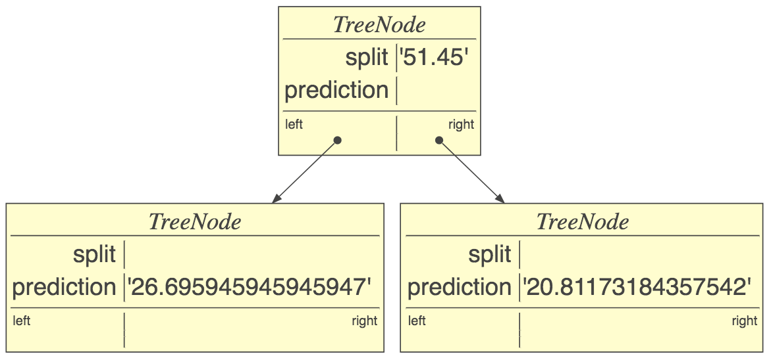
The magic of recursion
(midpoint split)
Demo converting stumpfit() to treefit()
See “Regression tree midpoint split for Boston dataset” in notebook
In treefit(x,y), simply convert
t.left = TreeNode(prediction=np.mean(y[x<split]))
Create node
to
t.left = treefit(x[x<split], y[x<split])
Create subtree
Notebook: https://github.com/parrt/msds621/blob/master/notebooks/trees/decision-trees.ipynb

Slide 22
Key takeaways
Binary tree: acyclic tree structure with at most two children, constructed by hooking nodes together (e.g., root.left = TreeNode(2))
Self-similar data structures built and walked with recursion
Each recursive call does a piece of the work and returns its piece combined with results obtained from recursive calls
Recursion traces out a call tree that's like a tree data structure
Recursive call in treefit() returns newly-constructed subtree
Remember the recursive function template!
Depth-first-search visits each node through backtracking
Study these recursive tree functions!

