Slide 1
Preparing data for modeling
Terence Parr
MSDS program University of San Francisco

Slide 2
Data prep overview
Data sets must follow two fundamental rules before use in models:
all data must be numeric
there can't be any missing values
Must delete or derive numeric features from nonnumeric features, such as strings, dates, and categorical variables
Even with purely numeric data, there is potential cleanup work, such as deleting or replacing erroneous/missing entries or even deleting entire records that are outside our business rules

Slide 3
Data cleaning

Slide 4
Decide what you care about
View all data cleaning operations through the lens of what exactly we want the model to do, as dictated by business or application
For apartment data set, we want to predict apartment prices but
just for New York City
just for the reasonably-priced apartments
E.g., $1k < rent < $10k and GPS inside NYC
Don’t make decisions about “reasonable values” after looking at the data because we risk losing generality; inappropriate data peeking is a form of overfitting
See https://mlbook.explained.ai/prep.html and https://mlbook.explained.ai/bulldozer-intro.html

Slide 5
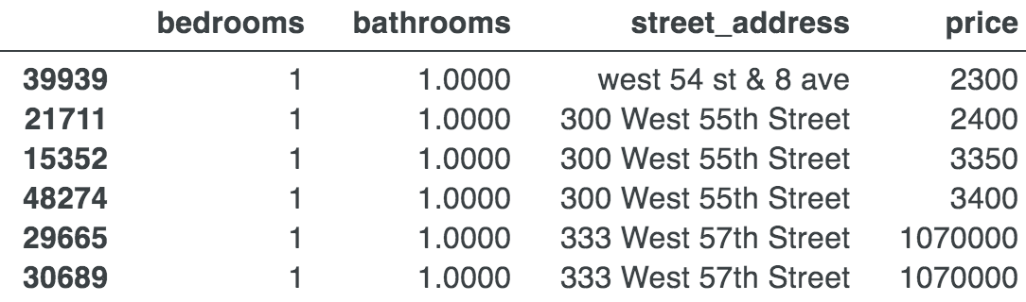
Why we care about noise, outliers
Noise and outliers can lead to inconsistencies
Zooming in on a small region of New York City there are two apartments with similar features but that are much more expensive:
Could be missing a key feature (view or parking?); sale not rent price?
Could be errors or simply outliers but such inconsistent data leads to inaccurate predictions
RFs predict the average price for all apartments in same feature space so predictions for these will be way off
??

Slide 6
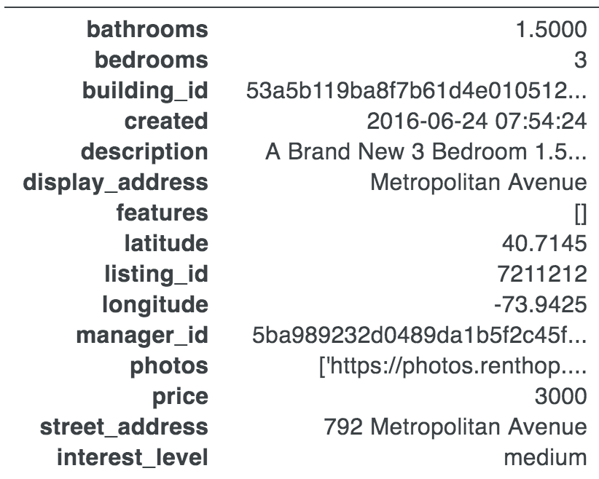
To begin: take a quick sniff of the data
Identify:
column names
their datatypes
whether target column has numeric values or categories
Look inside the values of string columns as we might want to break them into multiple columns

Slide 7
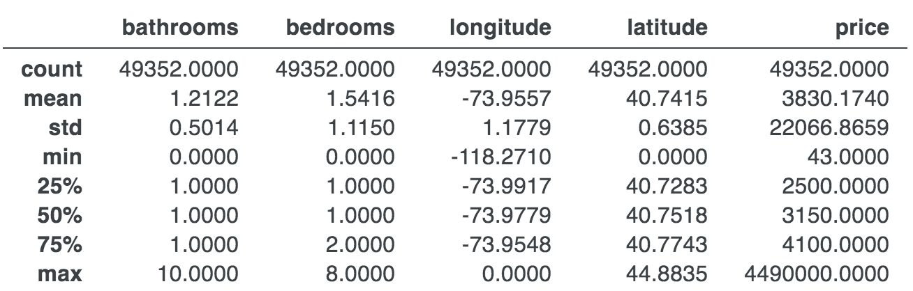
Look at data ranges with describe()
10 bathrooms? 0 bedrooms? Wow.
Longitude and latitude of 0?
Apts that are $43 and $4,490,000 / month? Wow

Slide 8
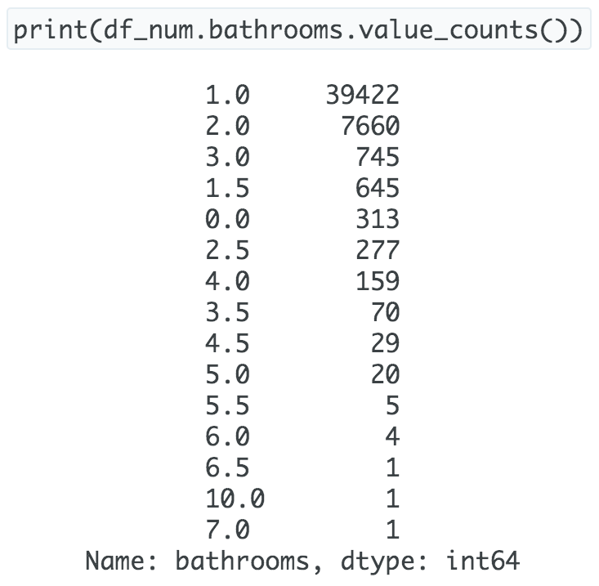
Check distributions
Only a few outlier apartments with > 6 bedrooms/bathrooms
Not many outliers:
len(df[df.price>10_000]) = 878

Slide 9
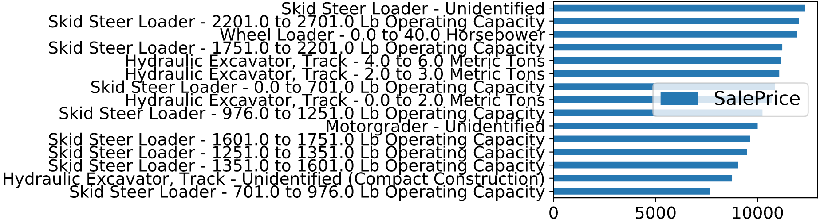
Check variable-target relationships too
Sometimes checking the relationship between each variable and the target can be illuminating; e.g., here is a categorical variable versus bulldozer sale price:
We should try extracting useful info from feature as it is predictive

Slide 10
Let’s clean up
Filter data per business goals
In NY only:
Reasonable prices:
If column known to be corrupted or useless, can just delete it; e.g., from bulldozer data set:
df_clean = df[(df['latitude']>40.55) & (df['latitude']<40.94) &
(df['longitude']>-74.1) & (df['longitude']<-73.67)]
df_clean = df[(df.price>1_000) & (df.price<10_000)]
del df[‘MachineID’]

Slide 11
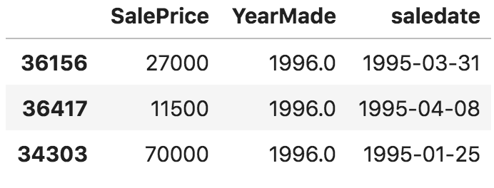
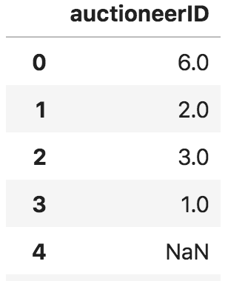
More clean up
Sold before manufactured? (ask stakeholders) Can adjust date or delete if there few enough of those records
Some columns are read in as numbers but are really categorical; e.g., bulldozer auctioneerID; we can set to strings (affects missing data handling):
?
df['auctioneerID’] = df['auctioneerID'].astype(str)
Don’t replace with median (to impute value)

Slide 12
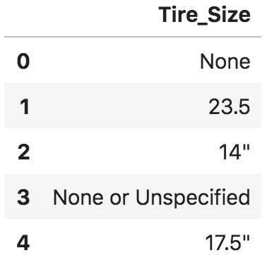
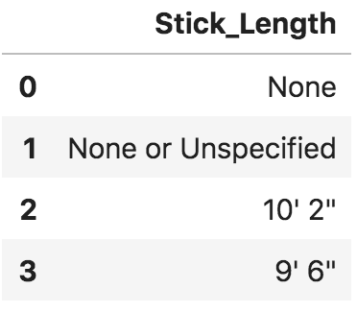
Normalization
Some columns are shown as strings but are numbers; e.g., bulldozer Tire_Size; delete double-quote and then convert column to numbers
Bulldozer Stick_length is more complicated but could still be normalized to inches rather than string
Bulldozer Enclosure has “EROPS w AC” and “EROPS AC”; normalize to one or other: df['Enclosure'].replace('EROPS w AC','EROPS AC')

Slide 13
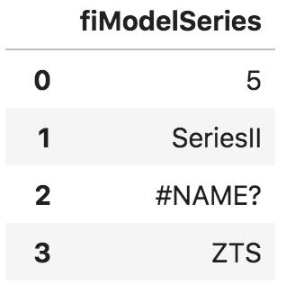
Find missing data indicators
Missing values are np.NaN after loading with pandas
BUT, some are physically-present numbers or strings that actually represent missing values:
Rent dataset: Some longitude/latitude values are 0 (off the west coast of Africa?)
Bulldozer dataset: strings like Tire_Size have “None or Unspecified”
Bulldozer fiModelSeries has “#Name?”
Replace those with NaN; for example:
df.loc[df['Tire_Size']=='None or Unspecified’,
'Tire_Size'] = np.nan

Slide 14
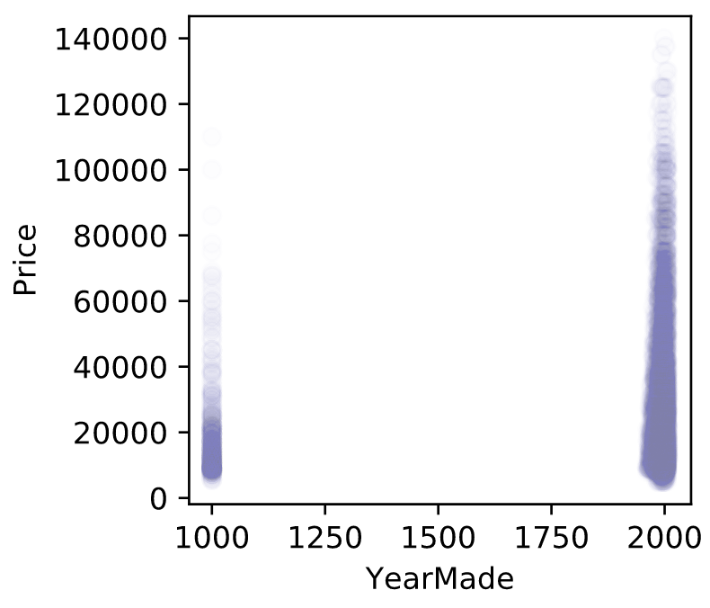
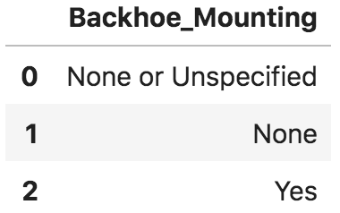
More missing data indicators
Something fishing with Bulldozer YearMade
YearMade=1000 must mean unknown (or don’t ask it’s age! haha)
Replace weird dates with NaN (missing):
Bulldozer Backhoe_Mounting should be boolean; normalize, convert to true/false, set type
df.loc[df.YearMade<1950, 'YearMade'] = np.nan

Slide 15
Encoding non-numeric variables

Slide 16
Encoding date variables
Date columns in datasets are often predictive of target variables
E.g., in bulldozer data set, the date of sale and the year of manufacture together are strongly predictive of the sale price
General procedure:
Shatter date columns into constituent components such as: year, month, day, day of week (1..7), day of year (1..365), and even things like “end of quarter” and “end of month”
After extracting the components, convert datetime64 column to integer with number of seconds since 1970 (unix time)
Can add business holidays, big snowstorm days, …
See https://mlbook.explained.ai/bulldozer-feateng.html

Slide 17
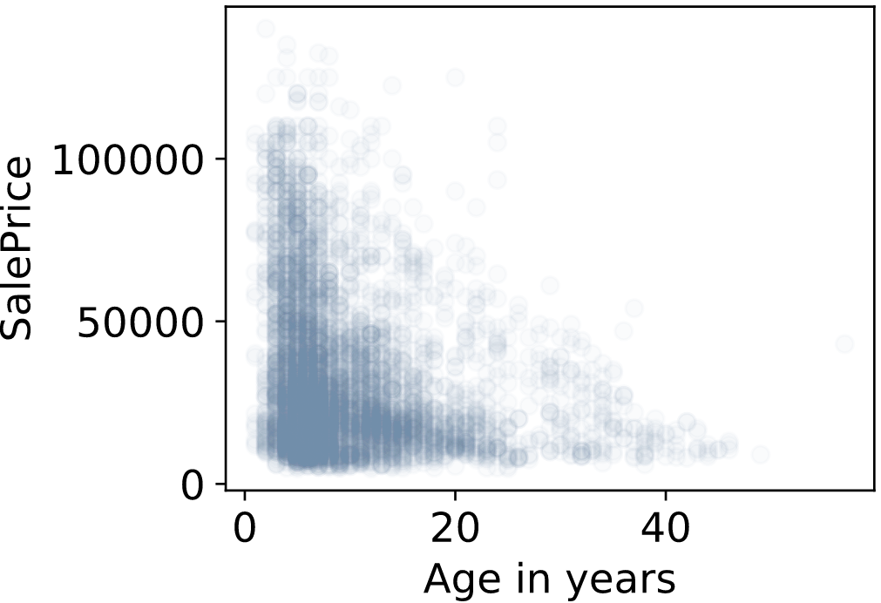
Date-related computations also useful
E.g., bulldozer should add age: Makes life easier on the RF model
Can try introducing variables like “days since event E” (e.g., “days since we had a big sale”) or other cumulative counts, averages, sums, etc…
df['age'] = df['saleyear'] - df['YearMade’]

Slide 18
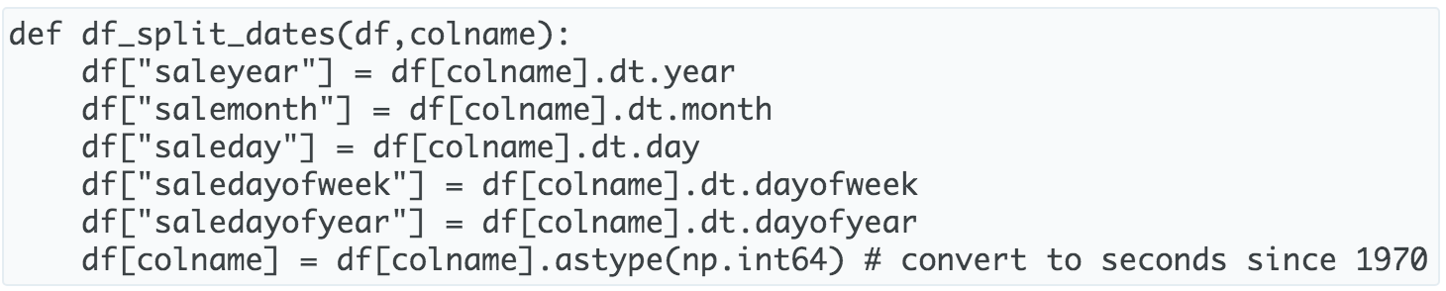
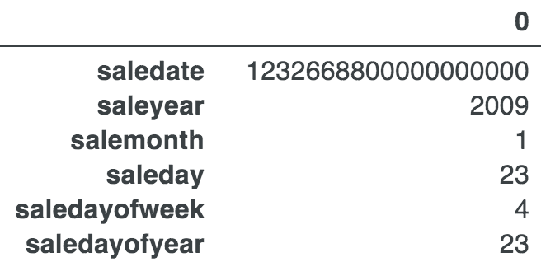
Sample date conversion code

Slide 19
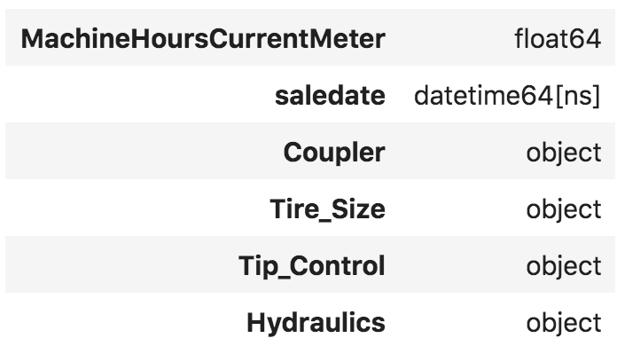
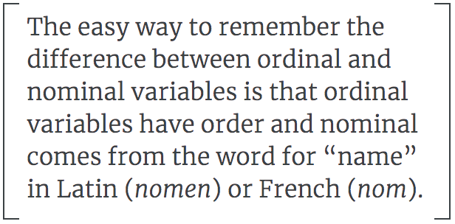
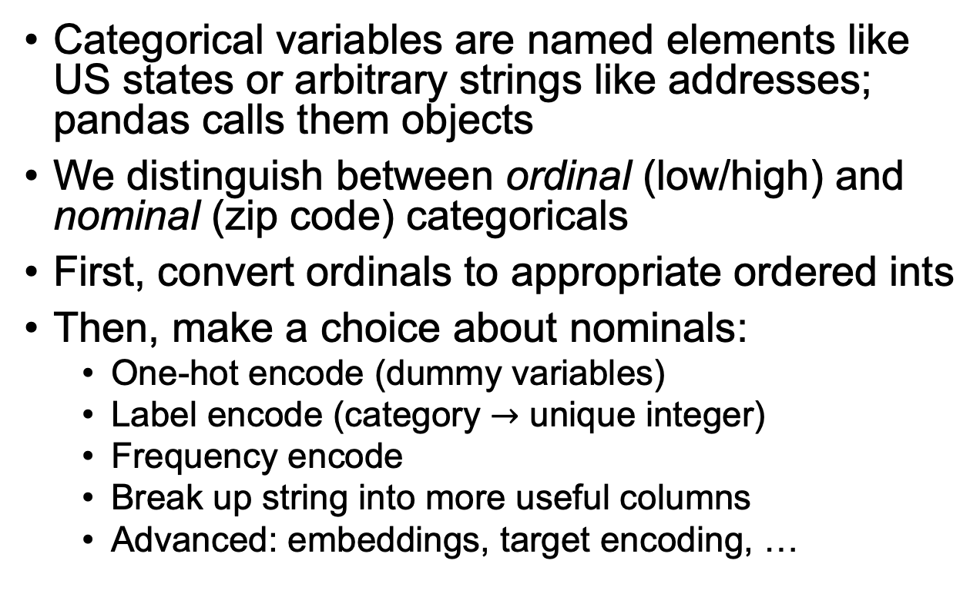
Encoding categorical vars
Categorical variables are named elements like US states or arbitrary strings like addresses; pandas calls them objects
We distinguish between ordinal (low/high) and nominal (zip code) categoricals
First, convert ordinals to appropriate ordered ints
Then, make a choice about nominals:
One-hot encode (dummy variables)
Label encode (category $→$ unique integer)
Frequency encode
Break up string into more useful columns
Advanced: embeddings, target encoding, …
See https://mlbook.explained.ai/catvars.html and https://mlbook.explained.ai/bulldozer-feateng.html

Slide 20
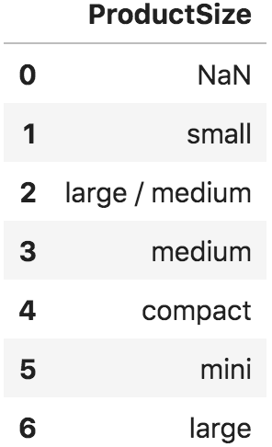
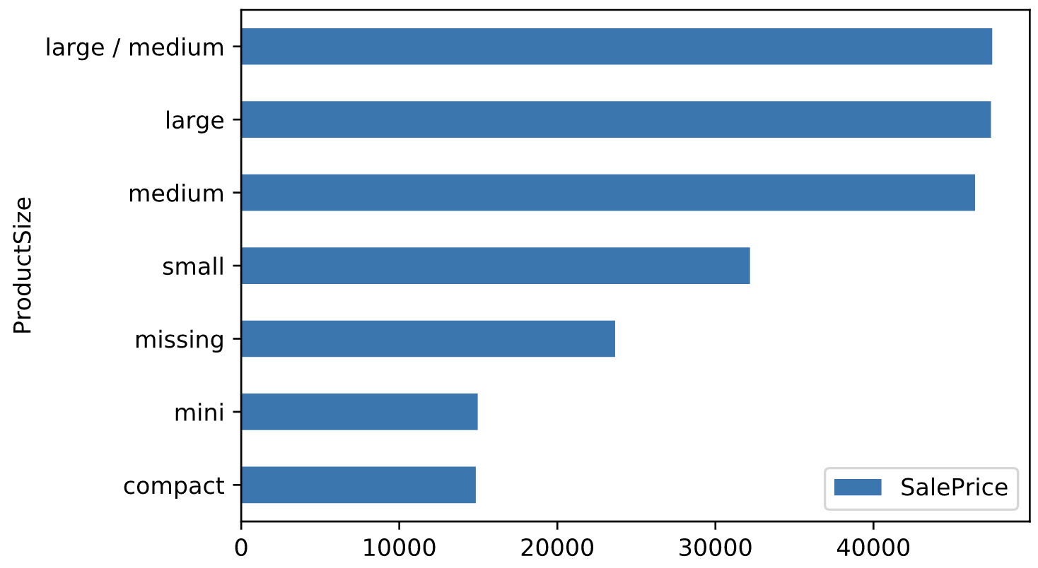
Start by converting ordinals
Bulldozer ProductSize categorical is ordinal not nominal so convert it to integers with appropriate order
Marginal plot makes it look very predictive
encoding
5
4
3
2
0
1
Articles on web say mini/compact are same
1

Slide 21
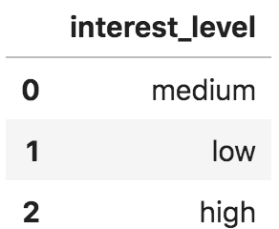
Ordinal encoding mechanics
Apply a dictionary, mapping name to ordered value
E.g., rent data set:
For RFs, only the order matters not the scale so {'low':10,'medium':20,'high':30} would also work
df['interest_level'] = \
df['interest_level'].map({'low':1,'medium':2,'high':3})

Slide 22
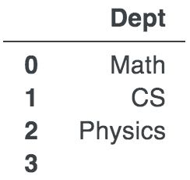
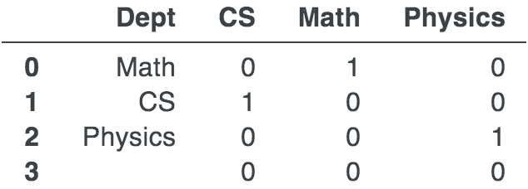
One-hot encoding (dummy variables)
Note: RFs don't require dummy variables but sometimes dummies are useful
Instead of a number, the “hot” position indicates the category
Notice how the missing value ends up with none hot (all 0s)
onehot = pd.get_dummies(df['Dept’])
df_encoded = pd.concat([df, onehot], axis=1)
del df_encoded[‘Dept’]
(Some people differentiate between one-hot and dummy vars.)

Slide 23
When to one-hot encode
Don’t one-hot encode when there are many cat levels otherwise you will end up with thousands of columns in your data set
That slows down training speed and usually doesn’t help (for RFs)
One-hot encoding is worth it for cat vars that are strongly predictive (if there are few levels)
E.g., “EROPS AC” gets, on average, twice the price of the other bulldozers meaning air-conditioning is important

Slide 24
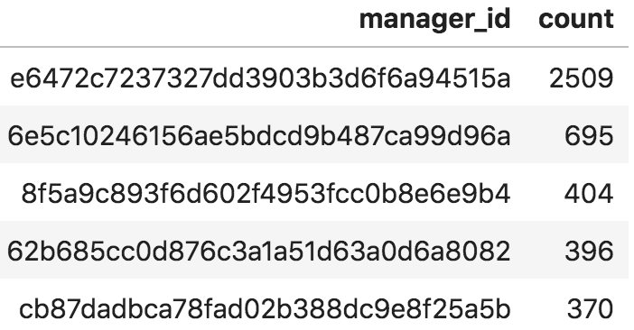
Frequency encoding
Sometimes we can extract some meaning from the nominals
Convert categories to the frequencies with which they appear in the training
E.g., rent data: might be predictive power in the number of apartments managed by a particular manager
managers_count = df['manager_id'].value_counts()
df['mgr_apt_count'] = df['manager_id'].map(managers_count)

Slide 25
Label encoding categoricals
If you can’t extract more useful information from a nominal variable, label encode it
There are more advanced techniques such as embeddings, target encoding but we’ll leave those to another class
Result: each category becomes a unique numeric value where missing becomes 0 and other categories are 1..n
We ignore the fact that the categories are not really ordered

Slide 26
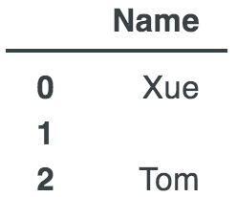
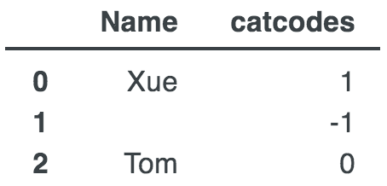
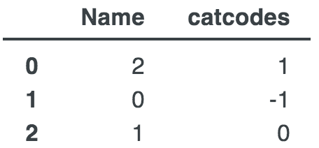
Label encoding mechanics
Convert string column to ordered categorical
Replace categories with cat code + 1
NaN gets cat code -1 so +1 means missing = 0
def df_string_to_cat(df):
for col in df.columns:
if is_string_dtype(df[col]):
df[col] = df[col].astype('category')
df[col] = df[col].cat.as_ordered()
def df_cat_to_catcode(df):
for col in df.columns:
if is_categorical_dtype(df[col]):
df[col] = df[col].cat.codes + 1

Slide 27
The unreasonable effectiveness of label encoding categorical variables
Why is it “legal” to convert all of those unordered (nominal) categorical variables to ordered integers?
RF models can still partition such converted categorical features in a way that is predictive
Might require more complex / bigger tree
Definitely not appropriate for models doing math on variables, such as linear models (which require one-hot encoding)
In practice, label encoding categorical variables is surprisingly effective
Some RF models do subset comparisons not int comparisons

Slide 28
Dealing with missing data

Slide 29
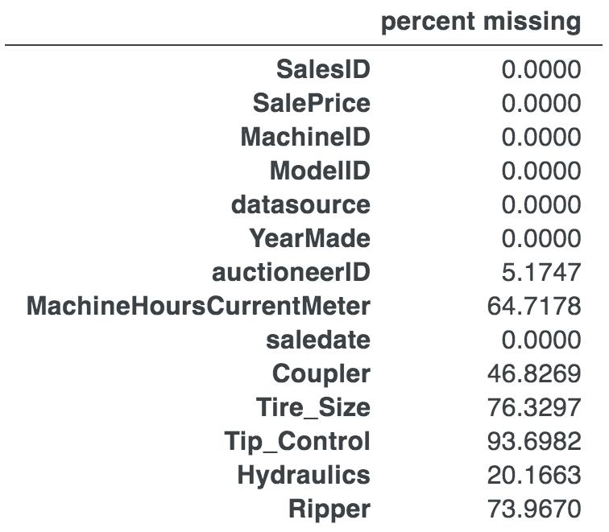
Real data sets are often full of holes
Here are some stats on Bulldozer data set

Slide 30
Missing categorical data
Missing categorical values are dealt with automatically because of the label-encoding process
We convert categories to unique integer values and missing values, np.nan, become category code 0 and all other categories are codes 1 and above
In other words, “missing” is just another category hardcoded to 0

Slide 31
Missing numeric data
Don’t delete columns/rows with missing values; destroys info!
Don’t just replace missing values; destroys fact they were missing
E.g., missing YearMade could mean “ancient”
E.g., missing Employer on loan app could mean ”unemployed” (or missing YearsOfEducation might mean ”no college degree”)
We still must fill in values in order to train a model, however, and we don’t want to skew the column distribution by replacing with 0 or 999999 or some other anomalous value

Slide 32
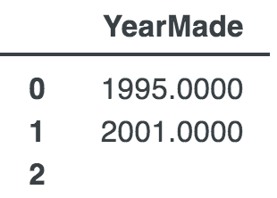
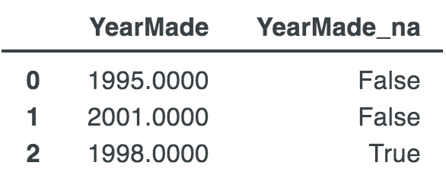
Imputing missing numeric values
Dealing with missing numeric values requires a new column and replacement of np.nans:
For column x, create a new boolean column x_na where x_na[i] is true if x[i] is missing.
Replace missing values in column x with the median of all x values in that column.
def fix_missing_num(df, colname):
df[colname+'_na'] = pd.isnull(df[colname])
df[colname].fillna(df[colname].median(), inplace=True)

Slide 33
Supporting academic work
See “On the consistency of supervised learning with missing values” https://hal.archives-ouvertes.fr/hal-02024202v2: “A striking result is that the widely-used method of imputing with the mean prior to learning is consistent when missing values are not informative.” “When missingness is related to the prediction target, imputation does not suffice and it is useful to add indicator variables of missing entries as features.”

Slide 34
Rectifying training and validation sets
Replacing missing values, encoding categorical variables, etc… introduces synchronization issues between training and validation/test sets
Key rules:
Transformations must be applied to features consistently across data subsets
Transformations of validation/test sets can only use data derived from training set
To follow those rules, we have to remember all transformations done to the training set for later application to the validation and test sets.
That means tracking the median of all numeric columns, all category-to-code mappings, frequency encodings, and one-hot’d categories
Special care is required to ensure that one-hot encoded variables use the same name and number of columns in the training and testing sets.
Beware: it's easy to screw up the synchronization!
For details, see https://mlbook.explained.ai/bulldozer-testing.html

