Slide 1
Basic feature engineering
Improving, synthesizing, and injecting new features
Terence Parr
MSDS program University of San Francisco

Slide 2
Overview
Huge topic and, after basic cleaning, this is where you’ll spend the most time
Good features are much more important than the model, assuming you pick good one like RF or gradient boosting
“At the end of the day, some machine learning projects succeed and some fail. What makes the difference? Easily the most important factor is the features used.” -- Pedro Domingos
From “a few useful things to Know about machine Learning”

Slide 3
Deriving numeric columns
Goal is to help model: either smaller trees or more accurate or both
Rent: Longer feature list, description, num photos could be predictive
Create interaction terms; ever have to wait for siblings to take a shower? Maybe there is some predictive power in the ratio of bedrooms to bathrooms; maybe beds+baths?
df["num_desc_words"] = df["description"].apply(lambda x: len(x.split()))
df["num_features"] = df["features"].apply(lambda x: len(x.split(",")))
df["num_photos"] = df["photos"].apply(lambda x: len(x.split(",")))
df["beds_to_baths"] = df["bedrooms"]/(df["bathrooms"]+1) # avoid div by 0

Slide 4
More numeric feature ideas
Loan or credit card application classifier example; count previous credit card attempts or average previous loan amount (or could derive boolean “has applied previously”)
For detecting ATM fraud, create column for average previous withdrawal amount; min or max withdrawal could be useful too
Rank encoding: convert raw numbers to their rank. It could be the order is more important than value, which could distract the model. It also squashes outliers

Slide 5
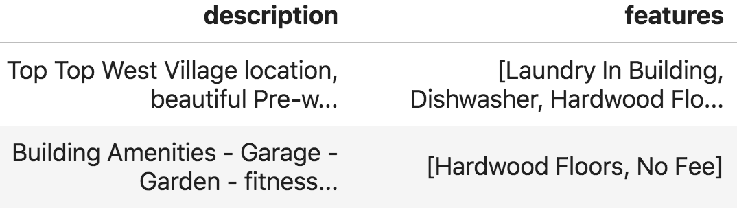
Synthesizing new vars from strings
Before label encoding, try to derive features from string features
E.g., Apt data: count words in description or number of features or derive column indicating apt has a doorman, garage, …

Slide 6
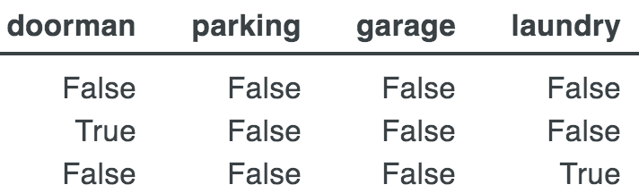
Simple string computations
Replace missing with blank
First normalize
Then, identify key words or subphrases
df['description'] = df['description'].fillna('')
df['description'] = df['description'].str.lower()
df['features'] = df['features'].fillna('')
df['features'] = df['features'].str.lower()
df[‘doorman’] = df['features'].str.contains(‘doorman’) …

Slide 7

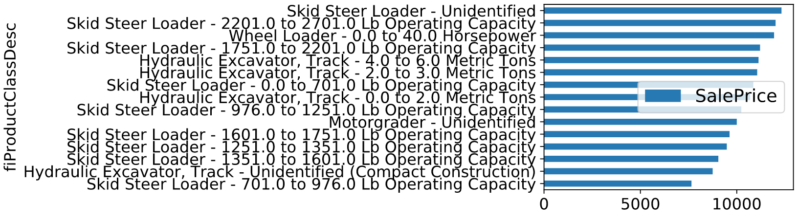
Splitting more complicated strings
Bulldozers with higher operating capacity get higher prices, according to marginal plot
Image credit: https://www.freepik.com/free-vector/tractor-excavator-bulldozer-set_1311014.htm

Slide 8
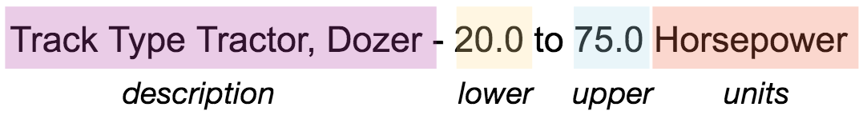

Splitting product class description string
We can make the information more explicit by splitting the description into four pieces (and put into 4 new columns):
Description is a categorical variable, chosen from a finite set of categories such as “Skip Steer Loader”
Lower and upper are numerical features
Units is a category, such as “Horsepower”

Slide 9
Mechanics for splitting strings
First split into description and spec on ‘-’ char
Then use regex to extract lower, upper, units
df_split = df_raw.fiProductClassDesc.str.split(' - ',expand=True)
df['fiProductClassDesc'] = df_split.values[:,0]
df['fiProductClassSpec'] = df_split[:,1] # temporary column
…
pattern = r'([0-9.\+]*)(?: to ([0-9.\+]*)|\+) ([a-zA-Z ]*)’
df_split = df['fiProductClassSpec'].str.extract(pattern, expand=True)
For details see https://mlbook.explained.ai/bulldozer-feateng.html

Slide 10
Injecting external data
Sometimes we can inject data from outside our provided data set to increase model performance
E.g., if sales for a store is 0, maybe that day was a national holiday or there was a hurricane; was there a pandemic?
E.g., GPS location is important for rent price, but maybe proximity to cool neighborhood is stronger / more precise?
E.g., home sales could be affected by many factors external to data set; what is the current consumer confidence index? How many IPOs recently in San Francisco? What is unemployment rate? Emigration rate for area?

Slide 11
Injecting external neighborhood info
Rent data set has longitude and latitude coordinates, but a more obvious price predictor would be a categorical variable identifying the neighborhood, though, a numeric feature might be more useful
Use proximity to desirable neighborhoods as a numeric feature (I love living within a few blocks of 50 different restaurants)
Forbes magazine has an article with neighborhood names; using a mapping website, we can estimate GPS for them
Compute so-called Manhattan distance (also called L1 distance) from each apartment to each neighborhood center

Slide 12
Injecting L1 proximity mechanics
Iterate over neighborhoods and use vector math to compute new column per neighborhood
BTW, dropping longitude and latitude and retraining a model shows a similar OOB score but shallower trees in my tests
hoods = {
"hells" : [40.7622, -73.9924],
"astoria" : [40.7796684, -73.9215888], … }
for hood,loc in hoods.items():
# compute L1 manhattan distance
df[hood] = np.abs(df.latitude - loc[0]) + \ np.abs(df.longitude - loc[1])

Slide 13
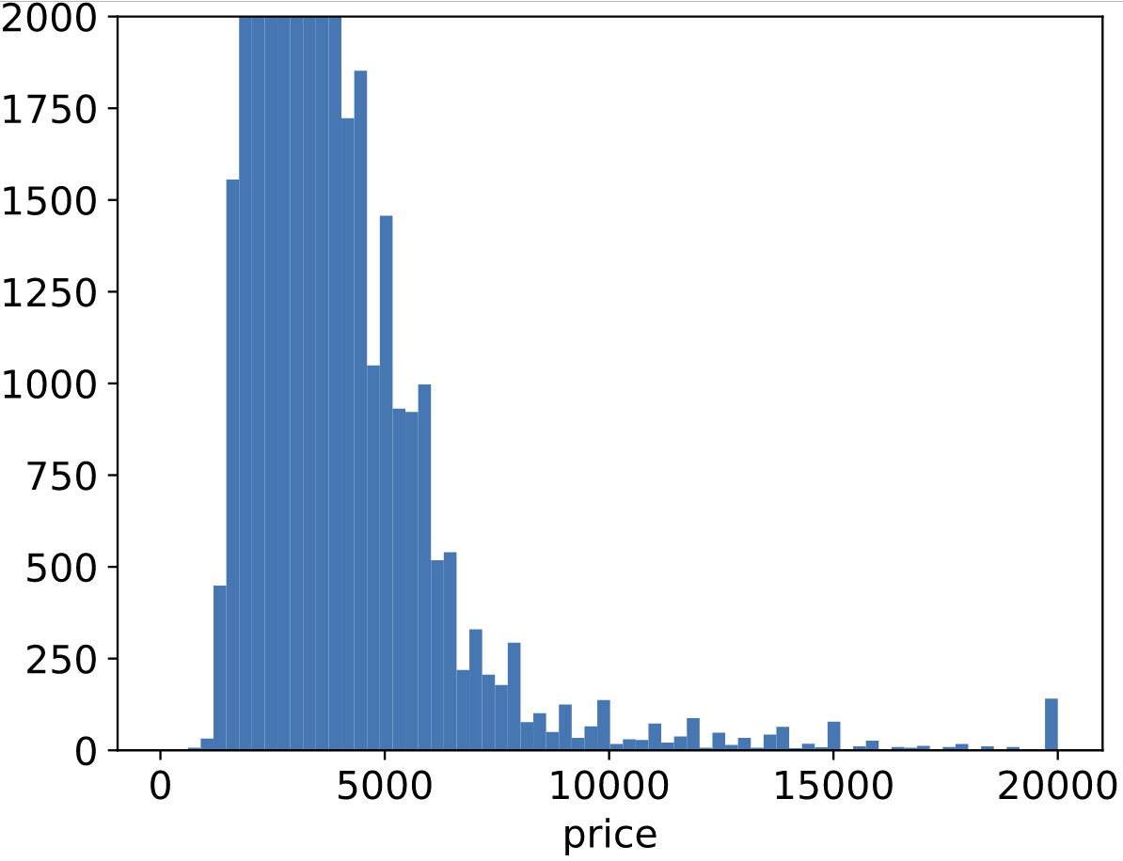
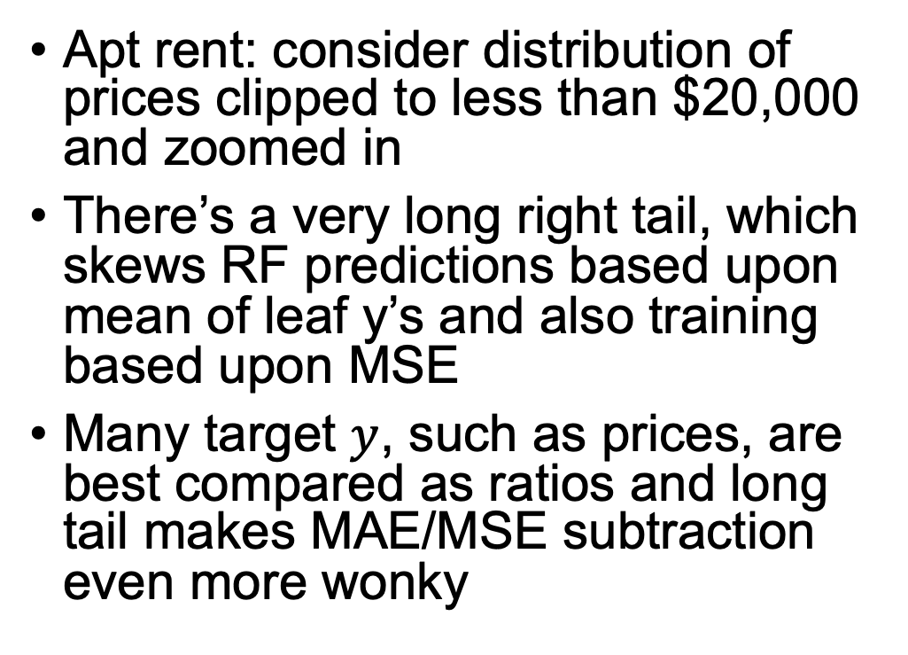
Log in, exp out for regression (Could be considered a part of data cleaning)
Apt rent: consider distribution of prices clipped to less than $20,000 and zoomed in
There’s a very long right tail, which skews RF predictions based upon mean of leaf y’s and also training based upon MSE
Many target $y$, such as prices, are best compared as ratios and long tail makes MAE/MSE subtraction even more wonky

Slide 14
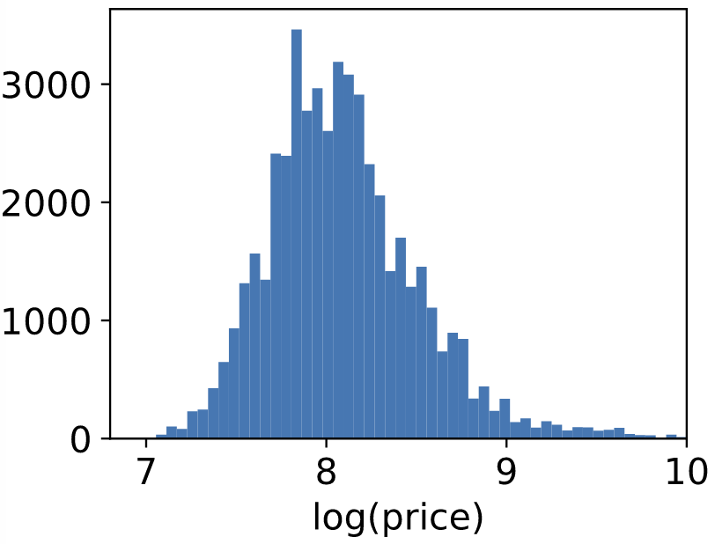
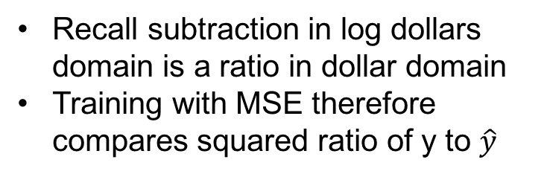
Transforming the target variable
Goal: a tighter, more uniform target space
Optimally, the distribution of prices would be a narrow “bell curve” distribution without tail
Even restricted to $1k..$10k it’s still skewed
BUT, check out what log does to distribution of ALL prices, not just < $20k! (shrinks large values a lot and smaller values a little)
Max price drops from millions to 10 without having to think or clip prices
RF on unclipped prices gets R^2~=0, but RF trained on log(unclipped price) gets R^2~=0.87
Recall subtraction in log dollars domain is a ratio in dollar domain
Training with MSE therefore compares squared ratio of y to $\hat{y}$

Slide 15
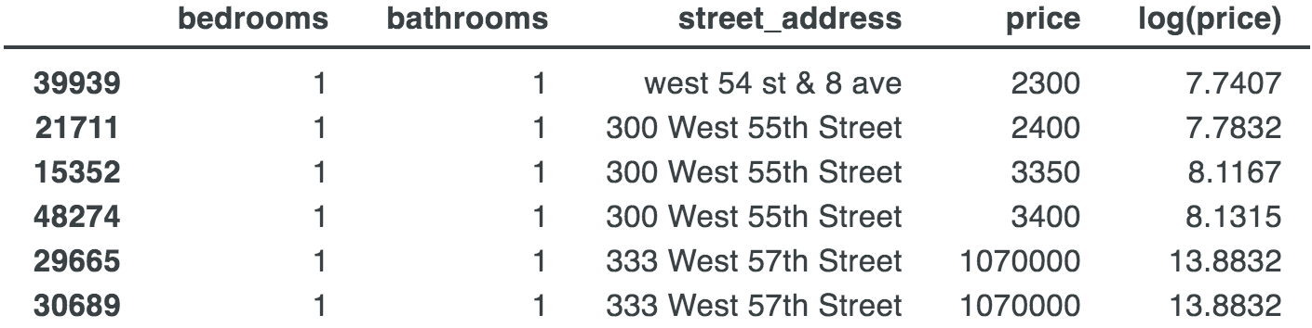
Effect on target space
y_pred_log = rf.predict(X_test)
y_pred = np.exp(y_pred_log)
Revisit small region of New York City with outliers
RF on raw prices predicts $358,575
RF on log(price) predicts 9.92 (in log $)
Transform predicted price back to $ space with exp => $20,395
Average in the log price space is less sensitive to outliers

Slide 16
Reminder: rectify training and test sets
Transformations must be applied to features consistently across data subsets (train, validation, test)
Transformations of validation/test sets can only use data derived from training set
To follow those rules, we have to remember all transformations done to the training set for later application to the validation and test sets.
That means tracking the median of all numeric columns, all category-to-code mappings, frequency encodings, and one-hot’d categories
Special care is required to ensure that one-hot encoded variables use the same name and number of columns in the training and testing sets.

Slide 17
Summary of techniques
Counting
Count number of photos or words in a description
for transaction-like data with multiple entries referring to same entity, count number of previous loan applications
Frequency encoding an option for nominals (replace ManagerID with # apts managed)
Interaction terms; price per square foot, bedrooms to bathrooms, …
Compute min,max,avg of key numerical columns (ATM withdrawal amounts)
Rank encoding; convert raw numbers to their rank
Extract important words from strings like "doorman” into Boolean columns
Extract numeric values from strings, such as “101 Howard”
Inject external data, such as holiday days or best neighborhoods in SF
Log transform the target for regressors

