Slide 1
RF out-of-bag samples
Validation sets for free!
Terence Parr
MSDS program University of San Francisco

Slide 2
RF's have built-in out-of-bag validation set
RFs have a major advantage over other models: OOB metrics
Each tree is trained on ~63% of data, leaving 37% OOB
The OOB record subsets available to each tree are different
It’s an excellent estimate of the validation error
Stick with OOB unless time-sensitive data or, if using sklearn, default score() is not suitable
Not having to process training and validation sets separately is a huge productivity win (assuming significant feature engineering)

Slide 3
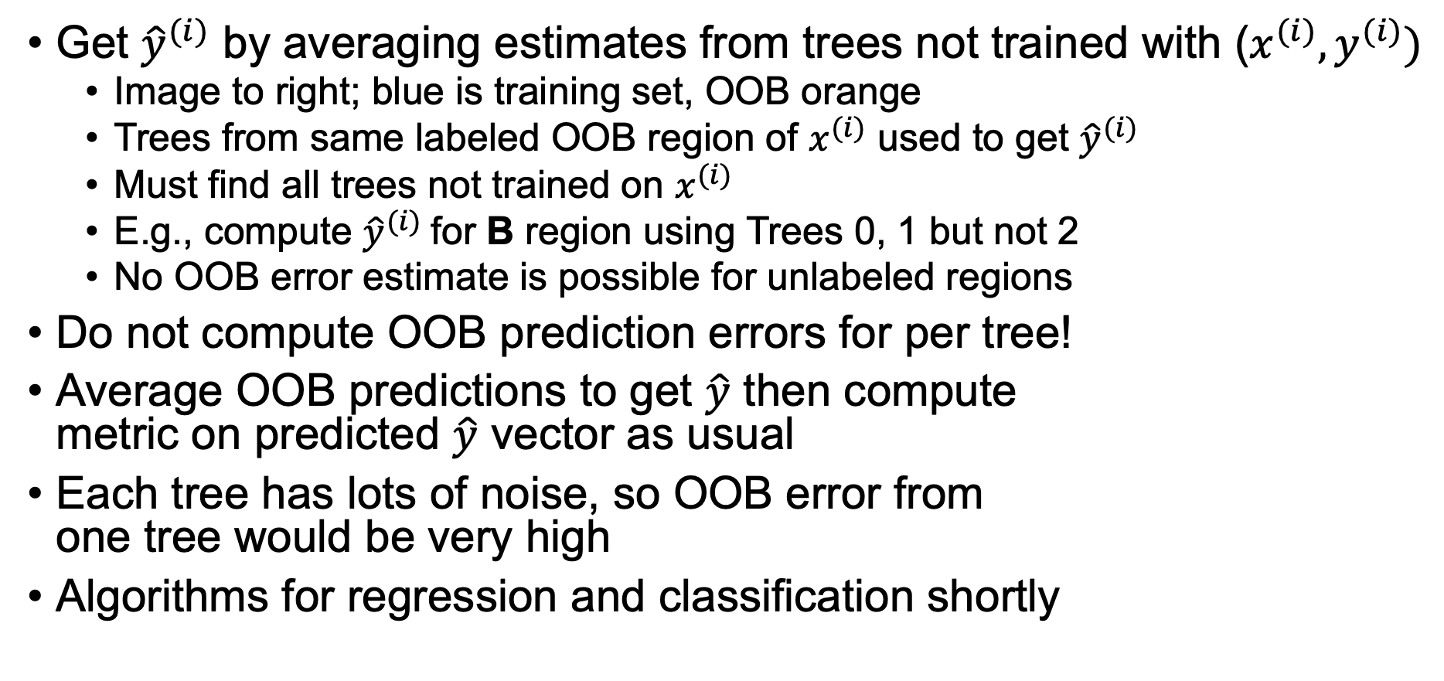
Computing OOB predictions
Get ${\hat{y}}^{(i)}$ by averaging estimates from trees not trained with ($x^{(i)},y^{(i)})$
Image to right; blue is training set, OOB orange
Trees from same labeled OOB region of $x^{(i)}$ used to get ${\hat{y}}^{(i)}$
Must find all trees not trained on $x^{(i)}$
E.g., compute ${\hat{y}}^{(i)}$for B region using Trees 0, 1 but not 2
No OOB error estimate is possible for unlabeled regions
Do not compute OOB prediction errors for per tree!
Average OOB predictions to get $\hat{y}$ then compute metric on predicted $\hat{y}$ vector as usual
Each tree has lots of noise, so OOB error from one tree would be very high
Algorithms for regression and classification shortly

Slide 4
OOB continued
OOB error might slightly overestimate test set error. Why?
OOB samples are not predicted with all trees in forest whereas test set uses whole forest, which presumably has lower noise/variation [1]
Some research suggests OOB overestimates error for binary classification https://journals.plos.org/plosone/article?id=10.1371/journal.pone.0201904
OOB metrics don’t affect training, just gives metric
OOB not to be used with time-sensitive data sets. Why not? Validation set for time-sensitive data can't be split randomly
[1] For n<<p case, see paper https://file.scirp.org/Html/9-1240025_8072.htm

Slide 5
When OOB error is lower than validation
Maybe the validation set is drawn from a different distribution than the training set or it's a time-sensitive data set (or we didn't extract the validation set properly)
Or, the model is overfit to the data in the training set, focusing on relationships that are not relevant to the test set
E.g., dropping SalesID transaction ID from training set improved our RF model as SalesID never seen in valid set but predictive in training set
(Sometimes the validation score is a bit better or worse than the OOB score, due to random fluctuations caused by the inherent randomness of RF construction)

Slide 6
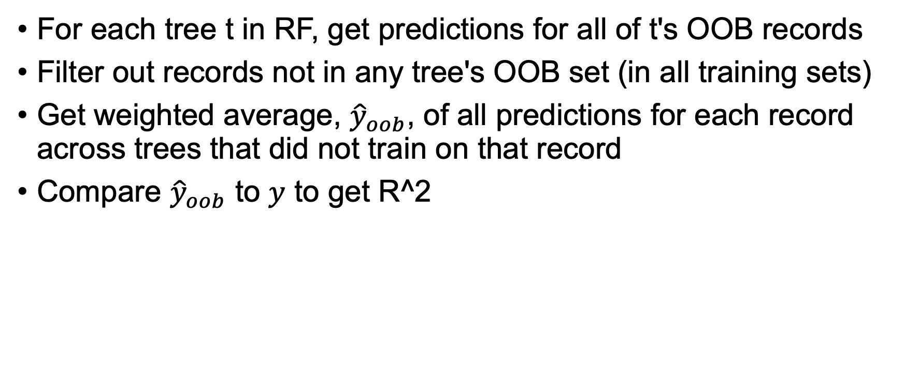
OOB regression scoring
For each tree t in RF, get predictions for all of t's OOB records
Filter out records not in any tree's OOB set (in all training sets)
Get weighted average, ${\hat{y}}_{oob}$, of all predictions for each record across trees that did not train on that record
Compare ${\hat{y}}_{oob}$ to $y$ to get R^2

Slide 7
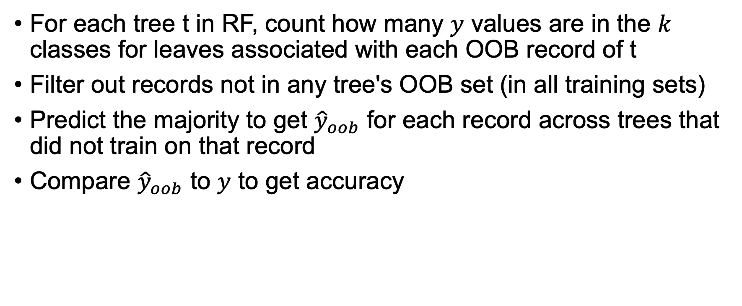
OOB classification scoring
For each tree t in RF, count how many $y$ values are in the $k$ classes for leaves associated with each OOB record of t
Filter out records not in any tree's OOB set (in all training sets)
Predict the majority to get ${\hat{y}}_{oob}$ for each record across trees that did not train on that record
Compare ${\hat{y}}_{oob}$ to $y$ to get accuracy

Slide 8
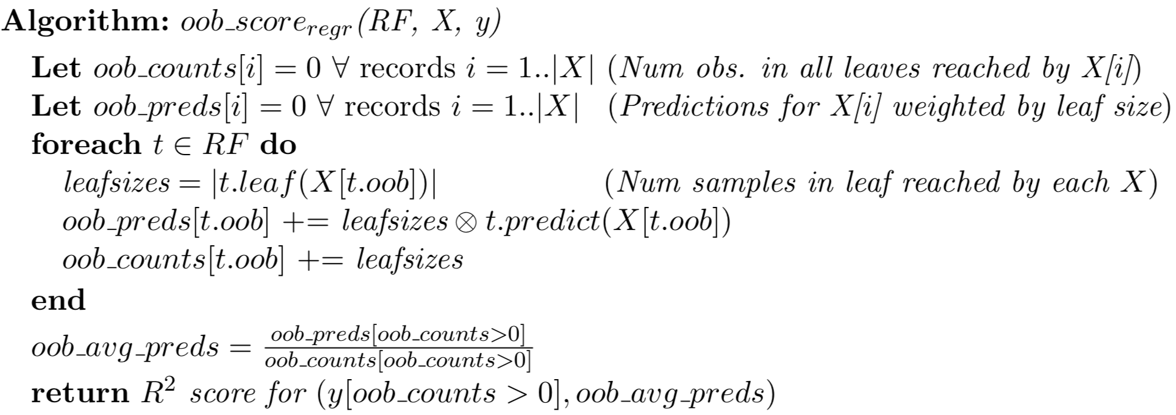
OOB regression scoring algorithm
Assumes each tree collects OOB sample indexes during fit()

Slide 9
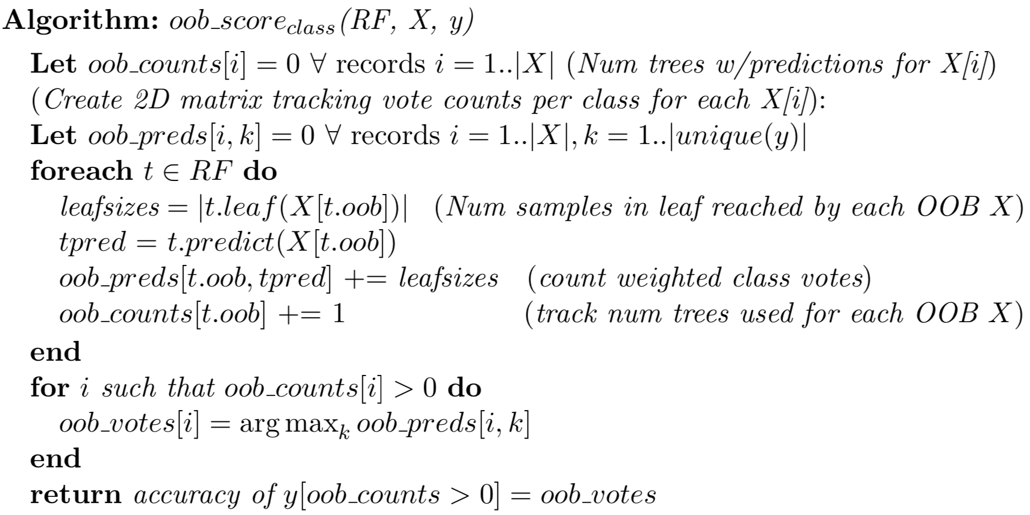
OOB classification scoring algorithm
Assumes each tree collects OOB sample indexes during fit()

