Slide 1
Training decision trees
Terence Parr
MSDS program University of San Francisco

Slide 2
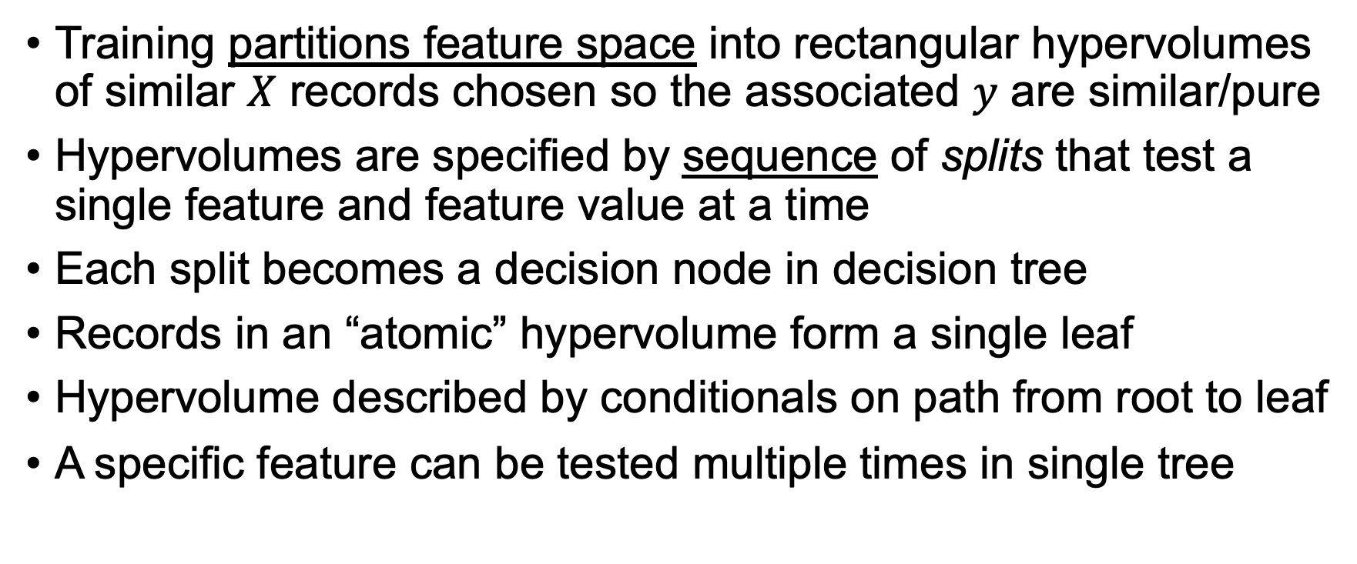
Training overview
Training partitions feature space into rectangular hypervolumes of similar $X$ records chosen so the associated $y$ are similar/pure
Hypervolumes are specified by sequence of splits that test a single feature and feature value at a time
Each split becomes a decision node in decision tree
Records in an “atomic” hypervolume form a single leaf
Hypervolume described by conditionals on path from root to leaf
A specific feature can be tested multiple times in single tree

Slide 3
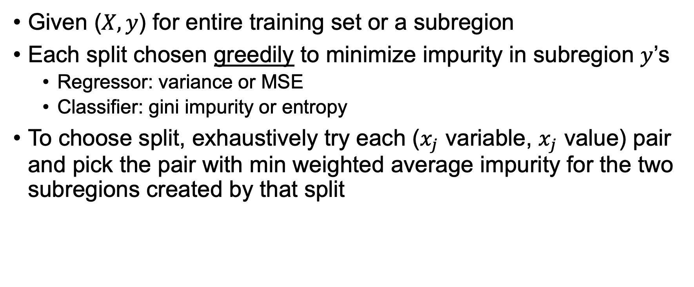
How to create a decision node
Given ($X,y$) for entire training set or a subregion
Each split chosen greedily to minimize impurity in subregion $y$’s
Regressor: variance or MSE
Classifier: gini impurity or entropy
To choose split, exhaustively try each ($x_{j}$ variable, $x_{j}$ value) pair and pick the pair with min weighted average impurity for the two subregions created by that split

Slide 4
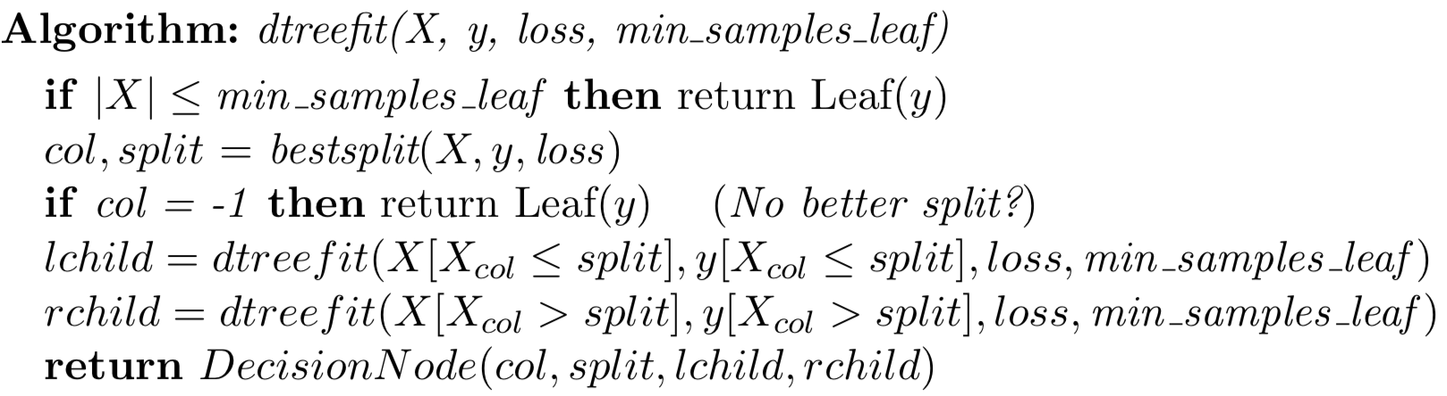
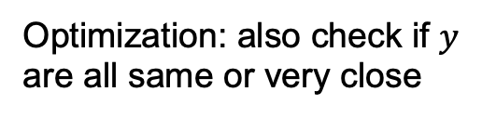
Fitting decision trees
subsets
MSE or gini function
Optimization: also check if $y$ are all same or very close
Overall fit: pass in full ($X$, $y$) to dtreefit() and get back the decision tree

Slide 5
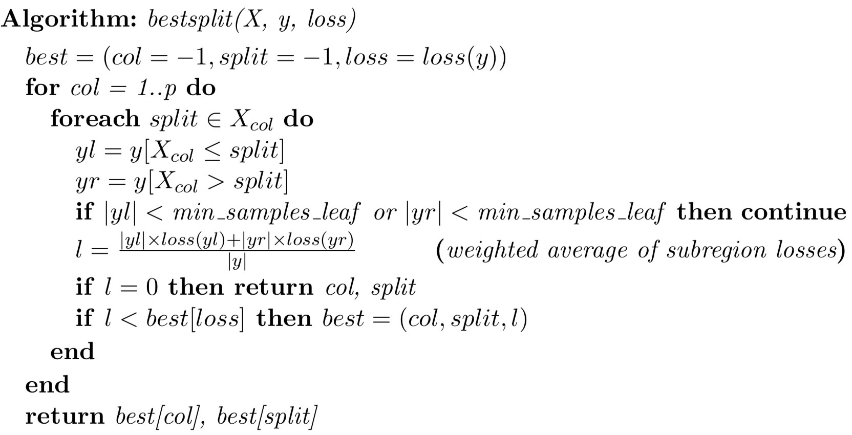
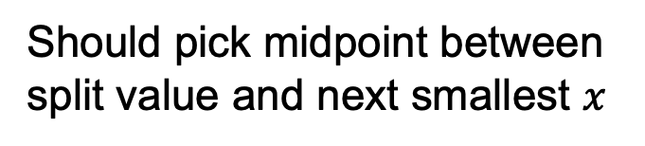
Best split var/value
Should pick midpoint between
split value and next smallest $x$

Slide 6
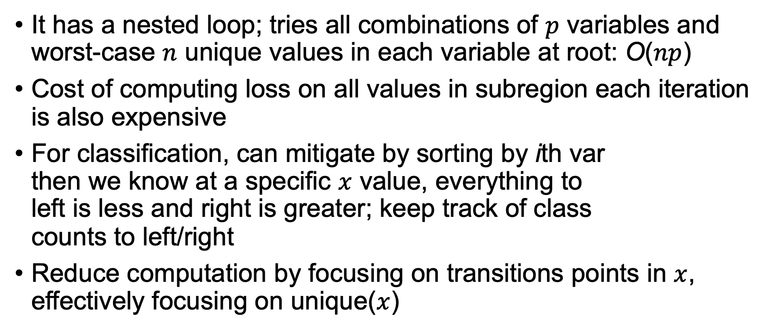
The usual bestsplit() is inefficient
It has a nested loop; tries all combinations of $p$ variables and worst-case $n$ unique values in each variable at root: O($np$)
Cost of computing loss on all values in subregion each iteration is also expensive
For classification, can mitigate by sorting by ith var then we know at a specific $x$ value, everything to left is less and right is greater; keep track of class counts to left/right
Reduce computation by focusing on transitions points in $x$, effectively focusing on unique($x$)

Slide 7
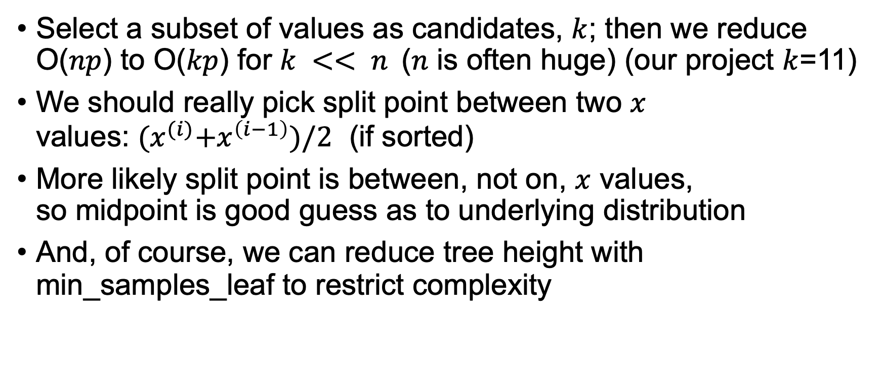
Improving generality and efficiency
Select a subset of values as candidates, $k$; then we reduce O($np$) to O($kp$) for $k << n$($n$ is often huge) (our project $k$=11)
We should really pick split point between two $x$ values: ${(x}^{(i)}+x^{\left(i−1\right)})/2$ (if sorted)
More likely split point is between, not on, $x$ values, so midpoint is good guess as to underlying distribution
And, of course, we can reduce tree height with min_samples_leaf to restrict complexity

Slide 8
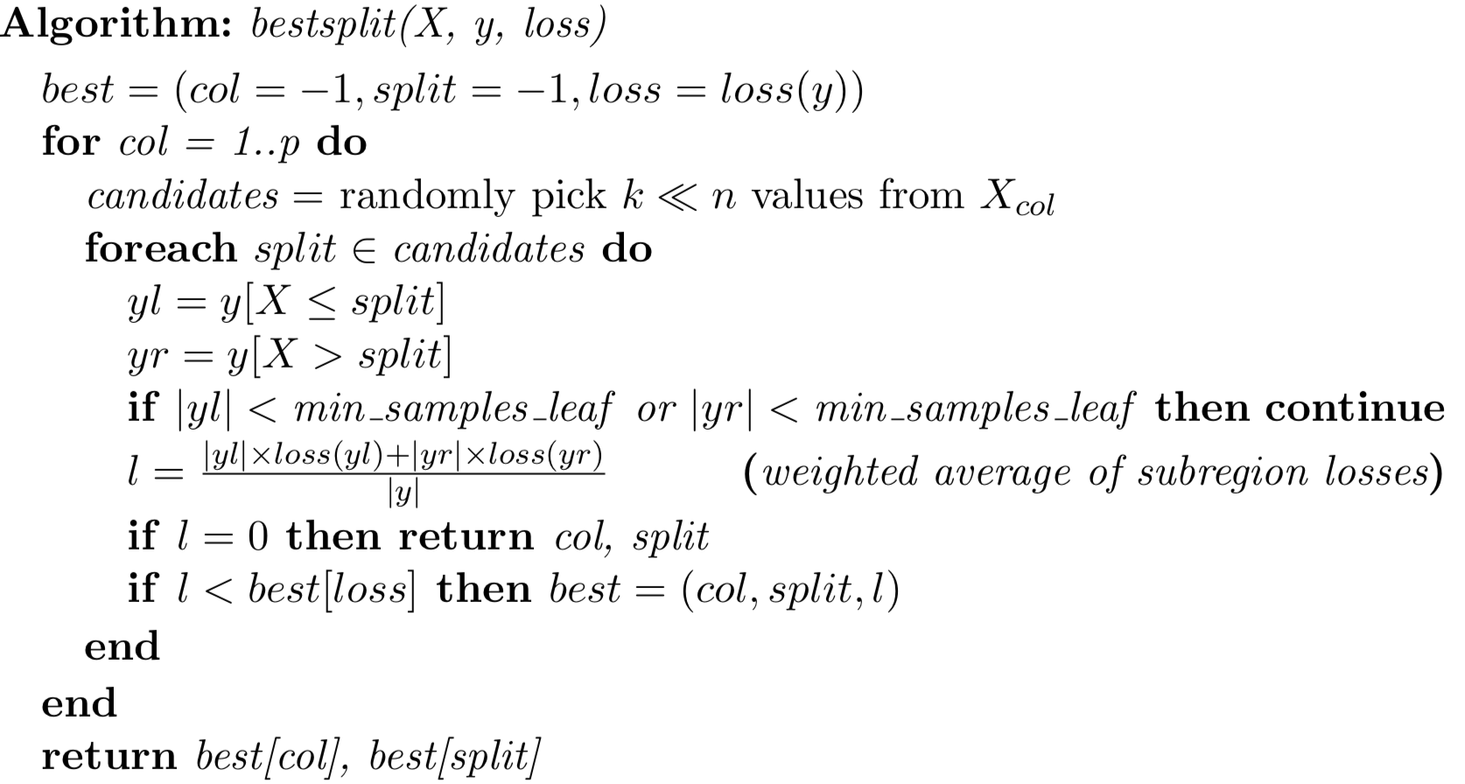
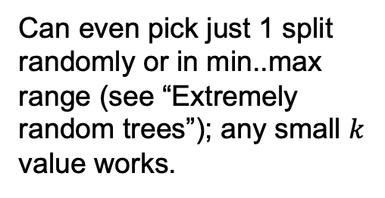
Decision tree prediction via x subset
Can even pick just 1 split randomly or in min..max range (see “Extremely random trees”); any small $k$ value works.

Slide 9
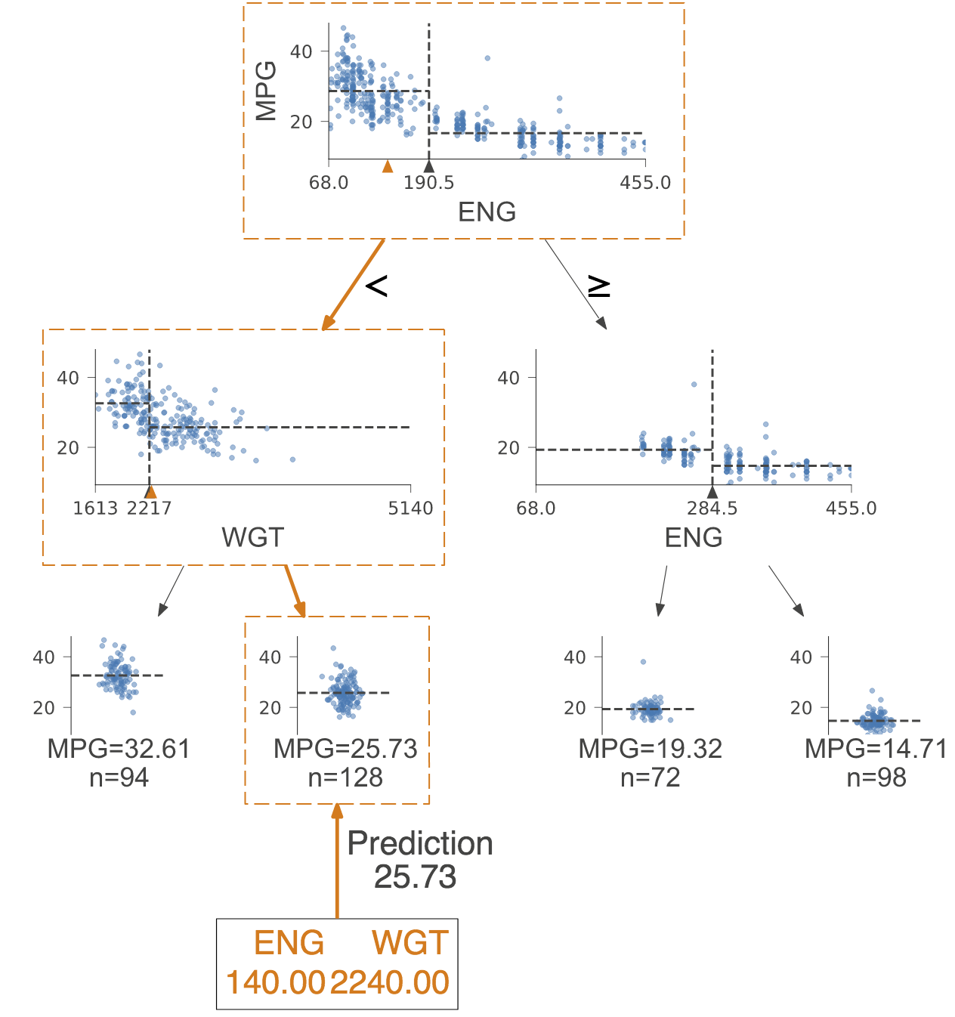
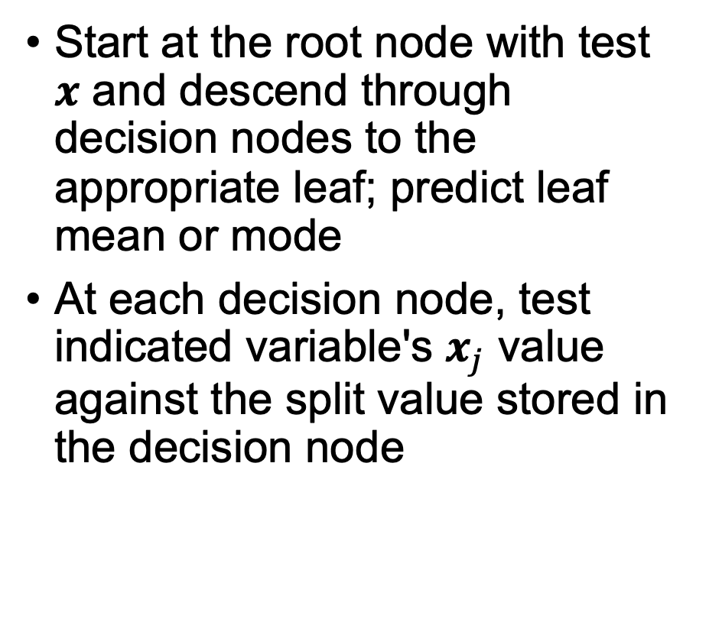

Prediction
Start at the root node with test $x$ and descend through decision nodes to the appropriate leaf; predict leaf mean or mode
At each decision node, test indicated variable's $x_{j}$ value against the split value stored in the decision node
$$x$$

Slide 10
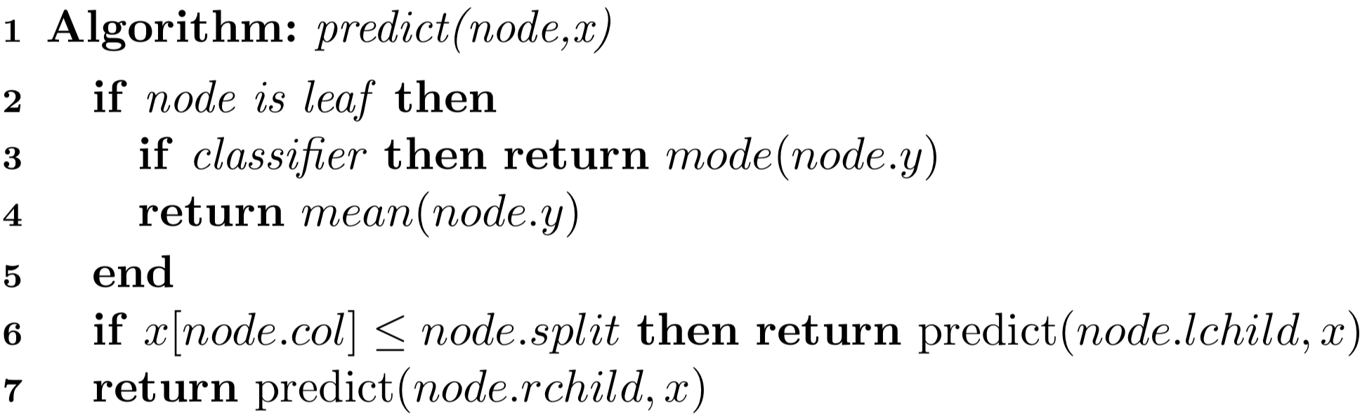

Prediction algorithm
$y$ for samples in leaf

