Slide 1
Model assessment
How good is my model and how do I properly test it?
Terence Parr
MSDS program University of San Francisco

Slide 2
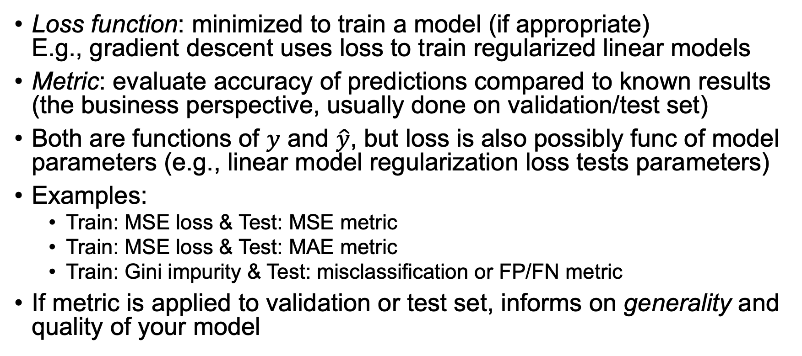
Terminology: Loss function vs metric
Loss function: minimized to train a model (if appropriate) E.g., gradient descent uses loss to train regularized linear models
Metric: evaluate accuracy of predictions compared to known results (the business perspective, usually done on validation/test set)
Both are functions of $y$ and $\hat{y}$, but loss is also possibly func of model parameters (e.g., linear model regularization loss tests parameters)
Examples:
Train: MSE loss & Test: MSE metric
Train: MSE loss & Test: MAE metric
Train: Gini impurity & Test: misclassification or FP/FN metric
If metric is applied to validation or test set, informs on generality and quality of your model
See also stackoverflow post by Christos Tsatsoulis: https://goo.gl/T5AmrT

Slide 3

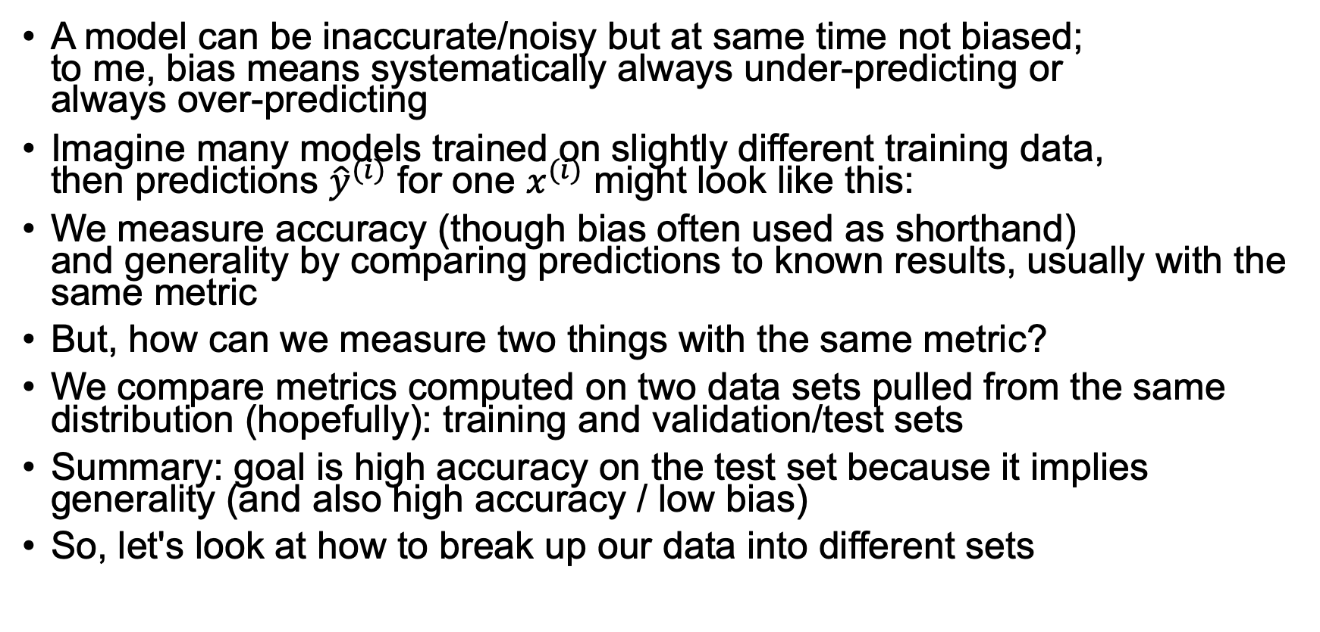
Accuracy, generality, & training-test sets
A model can be inaccurate/noisy but at same time not biased; to me, bias means systematically always under-predicting or always over-predicting
Imagine many models trained on slightly different training data, then predictions ${\hat{y}}^{(i)}$ for one $x^{(i)}$ might look like this:
We measure accuracy (though bias often used as shorthand) and generality by comparing predictions to known results, usually with the same metric
But, how can we measure two things with the same metric?
We compare metrics computed on two data sets pulled from the same distribution (hopefully): training and validation/test sets
Summary: goal is high accuracy on the test set because it implies generality (and also high accuracy / low bias)
So, let's look at how to break up our data into different sets
unbiased but high variance

Slide 4
Train, validate, test
This might be the most important slide of entire class!
We always need 3 data sets with known answers:
training (used to train model)
validation (as shorthand you’ll hear me / others call this test set)
testing (put in a vault and don’t peek!!)
Validation set: used to evaluate, tune models and features
Any changes you make to model tailor it to this specific validation set
Test set: used exactly once after you think you have best model
The only true measure of model’s generality, how it’ll perform in production
Never use test set to tune model
Production: recombine all sets back into a big training set again, retrain model but don’t change it according to test set metrics

Slide 5
How to extract validation, test sets
Extract random subsets; perhaps 70%/15%/15%; can shuffle then chop
Or, grab 15% test set (and hide it away) & use RF OOB or cross-fold on remainder for train/valid
For RF, we can start with out-of-bag score
Ensure validation set has same properties as test set (e.g., size, time, …):
if 10k samples in test, make 10k sample validation set
if test set is latest 2 months, validation must be latest 2 months of remaining data

Slide 6
Mechanics of splitting, testing validation set
Get X, y from dataframe, then use train_test_split() to split:
Train model with training data, test with other set:
X = df.drop('price', axis=1)
y = df['price']
X_train, X_test, y_train, y_test = \
train_test_split(X, y, 0.20)
rf = RandomForestRegressor()
rf.fit(X_train, y_train)
r2 = rf.score(X_test, y_test)
Or:
y_pred = rf.predict(X_test)
mae = mean_absolute_error(y_test, y_pred)

Slide 7
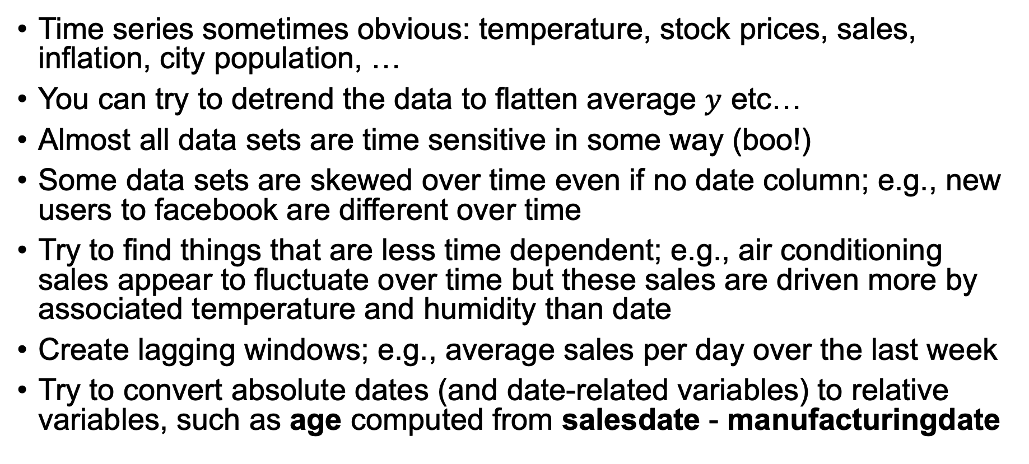
Key question: is your data time-sensitive?
Time series sometimes obvious: temperature, stock prices, sales, inflation, city population, …
You can try to detrend the data to flatten average $y$ etc…
Almost all data sets are time sensitive in some way (boo!)
Some data sets are skewed over time even if no date column; e.g., new users to facebook are different over time
Try to find things that are less time dependent; e.g., air conditioning sales appear to fluctuate over time but these sales are driven more by associated temperature and humidity than date
Create lagging windows; e.g., average sales per day over the last week
Try to convert absolute dates (and date-related variables) to relative variables, such as age computed from salesdate - manufacturingdate

Slide 8
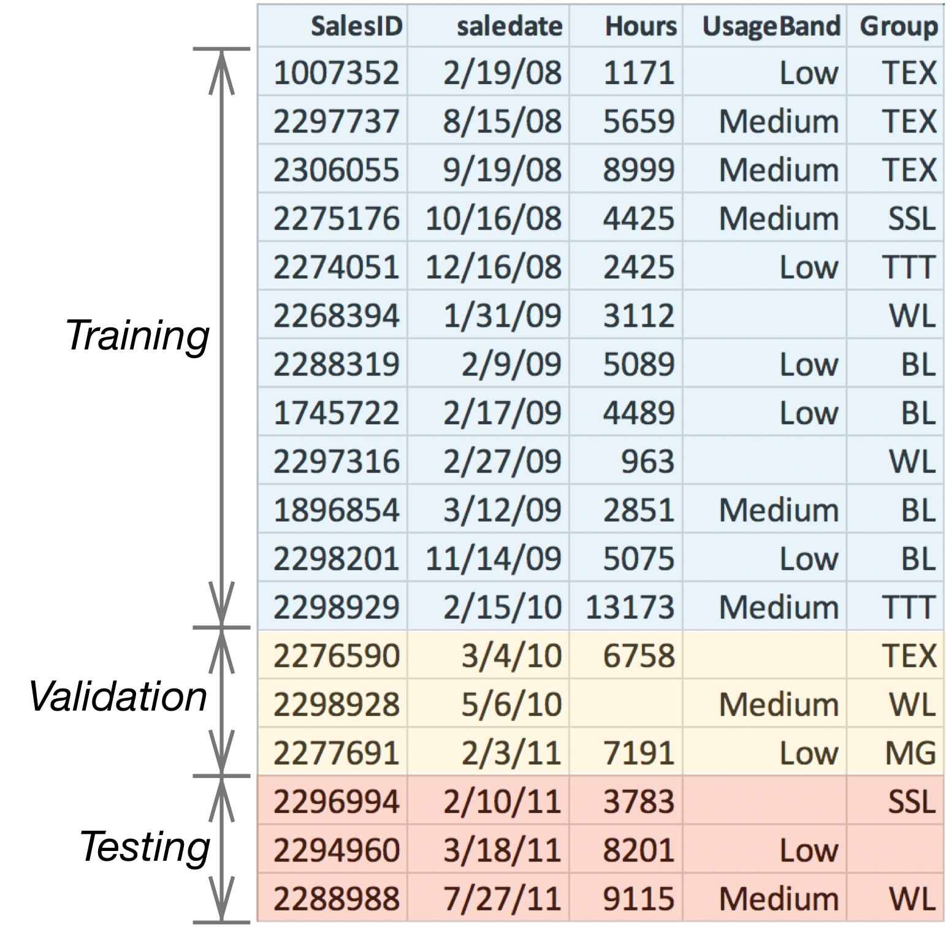
Splitting time-sensitive data sets
If your data set is time-sensitive, do not shuffle: sort by date then use newest rows as valid/test sets
This means OOB cannot be used for time-sensitive data sets as it randomly selects test records
df = df.sort_values('saledate')
n_train = len(df)-n_valid
df_train = df[:n_train]
df_valid = df[n_train:]

Slide 9
Testing strategies
Always split out test set
Validation cross-fold or leave-one-out
Or,

Slide 10
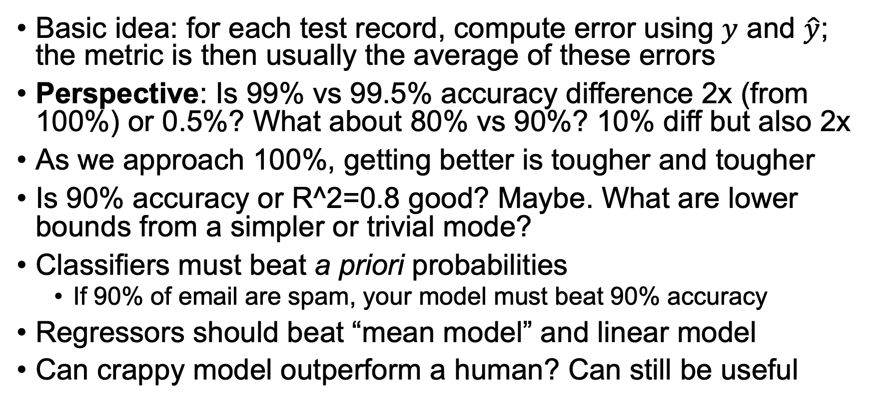
Metrics interpretation
Basic idea: for each test record, compute error using $y$ and $\hat{y}$; the metric is then usually the average of these errors
Perspective: Is 99% vs 99.5% accuracy difference 2x (from 100%) or 0.5%? What about 80% vs 90%? 10% diff but also 2x
As we approach 100%, getting better is tougher and tougher
Is 90% accuracy or R^2=0.8 good? Maybe. What are lower bounds from a simpler or trivial mode?
Classifiers must beat a priori probabilities
If 90% of email are spam, your model must beat 90% accuracy
Regressors should beat “mean model” and linear model
Can crappy model outperform a human? Can still be useful

Slide 11
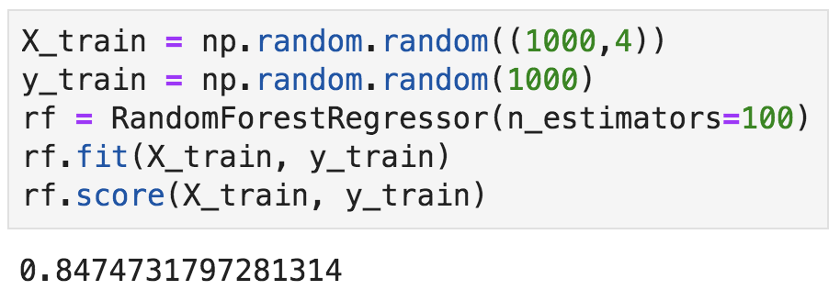
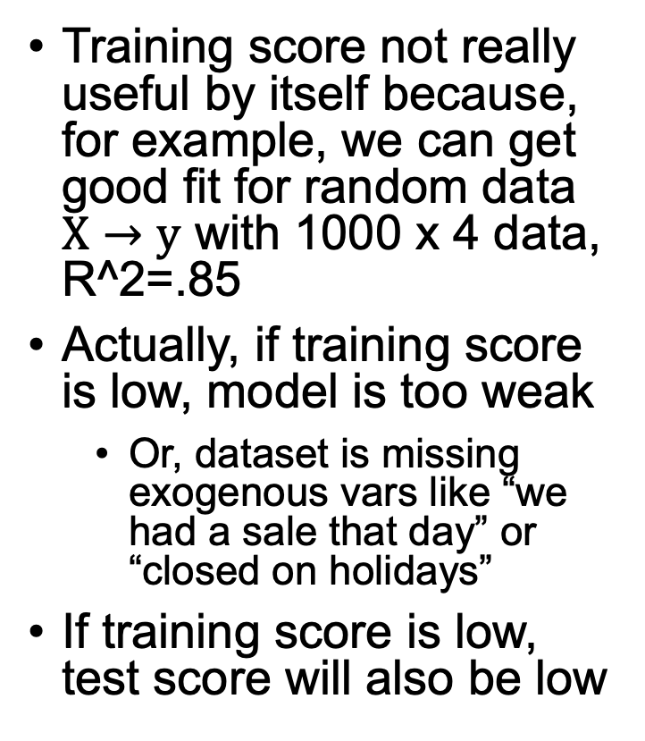
Training loss/metric isn't that useful
Training score not really useful by itself because, for example, we can get good fit for random data $X→y$ with 1000 x 4 data, R^2=.85
Actually, if training score is low, model is too weak
Or, dataset is missing exogenous vars like “we had a sale that day” or “closed on holidays”
If training score is low, test score will also be low
WOW!

Slide 12
What if training score is good but validation is very bad?
Overfit model?
Bad validation set? (didn’t extract random or time-sorted set or just given bad set?)
Time-sensitive data set diverging? (try detrending data)
Not properly applying feature transforms from training to validation set?
Bug?

Slide 13
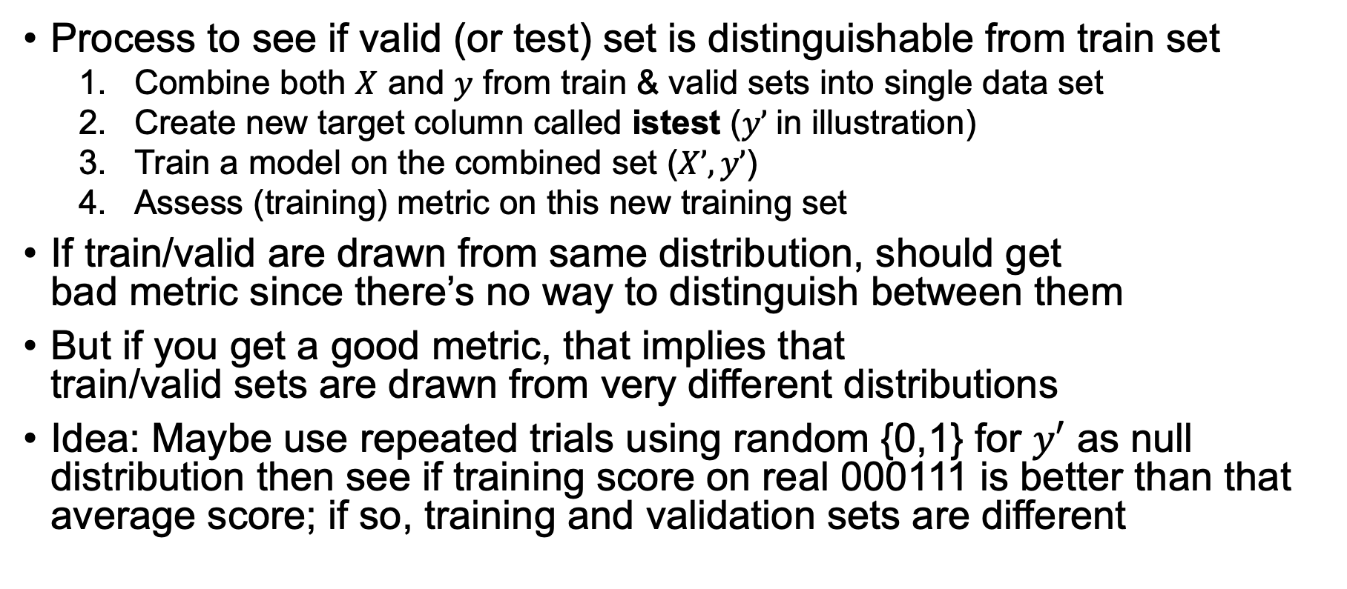
Comparing training / validation sets
Awesome but not
well-known trick
Process to see if valid (or test) set is distinguishable from train set
Combine both $X$ and $y$ from train & valid sets into single data set
Create new target column called istest ($y’$in illustration)
Train a model on the combined set ($X’, y’$)
Assess (training) metric on this new training set
If train/valid are drawn from same distribution, should get bad metric since there’s no way to distinguish between them
But if you get a good metric, that implies that train/valid sets are drawn from very different distributions
Idea: Maybe use repeated trials using random {0,1} for $y′$ as null distribution then see if training score on real 000111 is better than that average score; if so, training and validation sets are different

Slide 14
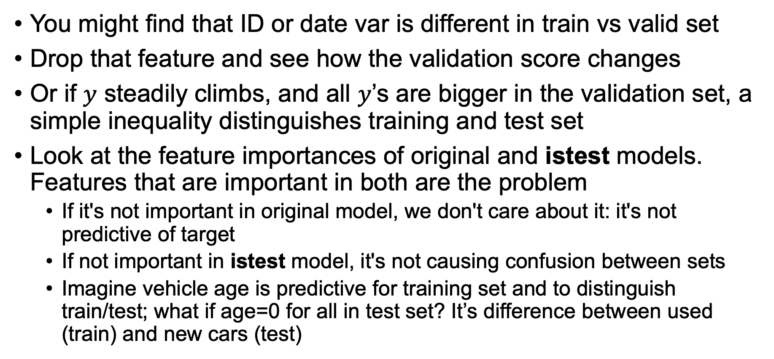
If train/test are easily distinguishable…
You might find that ID or date var is different in train vs valid set
Drop that feature and see how the validation score changes
Or if $y$ steadily climbs, and all $y$’s are bigger in the validation set, a simple inequality distinguishes training and test set
Look at the feature importances of original and istest models. Features that are important in both are the problem
If it's not important in original model, we don't care about it: it's not predictive of target
If not important in istest model, it's not causing confusion between sets
Imagine vehicle age is predictive for training set and to distinguish train/test; what if age=0 for all in test set? It’s difference between used (train) and new cars (test)

Slide 15
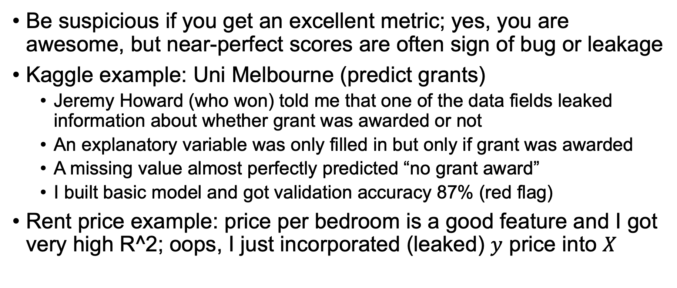
Leakage: What if your model is too good?
Be suspicious if you get an excellent metric; yes, you are awesome, but near-perfect scores are often sign of bug or leakage
Kaggle example: Uni Melbourne (predict grants)
Jeremy Howard (who won) told me that one of the data fields leaked information about whether grant was awarded or not
An explanatory variable was only filled in but only if grant was awarded
A missing value almost perfectly predicted “no grant award”
I built basic model and got validation accuracy 87% (red flag)
Rent price example: price per bedroom is a good feature and I got very high R^2; oops, I just incorporated (leaked) $y$ price into $X$
https://www.kaggle.com/c/unimelb

Slide 16
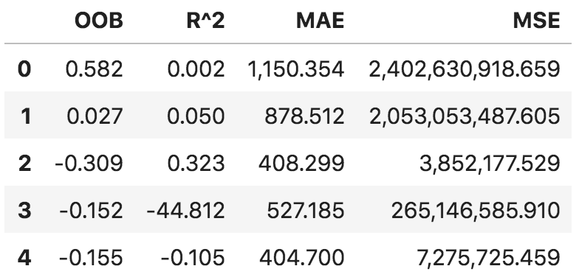
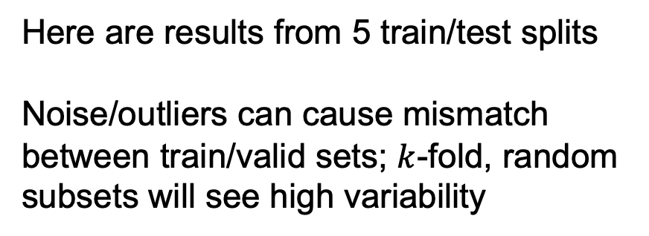
Stability of metric values
Getting a single validation metric is usually not enough because scores can vary from run to run because of outliers and anomalies (even with k-fold)
Also good to collect and compare a variety of metrics
Consider score fluctuations in NYC rent data (before cleaning)
Here are results from 5 train/test splits
Noise/outliers can cause mismatch between train/valid sets; $k$-fold, random subsets will see high variability
See https://github.com/parrt/msds621/blob/master/notebooks/assessment/metrics.ipynb

Slide 17
Summary
Start machine learning modeling by splitting data into training, validation, and test sets; lock away the test set as only true measure of generality tested after you have your final model
Good training metric is necessary but not sufficient; we want a good validation/test metric to show generality of model
Can use cross validation or just single split during development (OOB also with random forests)
Validation/test sets must have same distribution as training set
We use loss to train, metrics to validate/test
Next, we look at measuring regressor and classifier error

