Slide 1
SPoT: Better Frozen Model Adaptation through Soft Prompt Transfer
Yubo Zhang, NLC Group, MSRA
12 Aug 2022

Slide 2
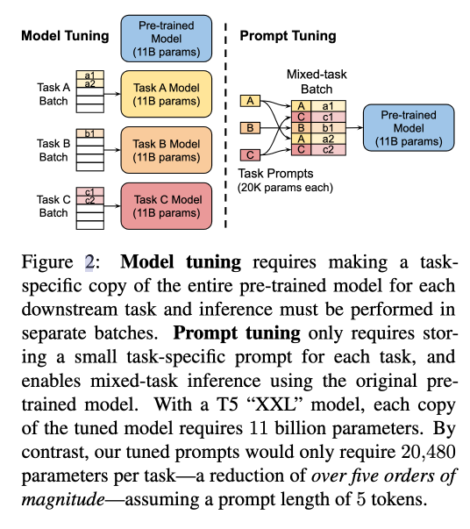
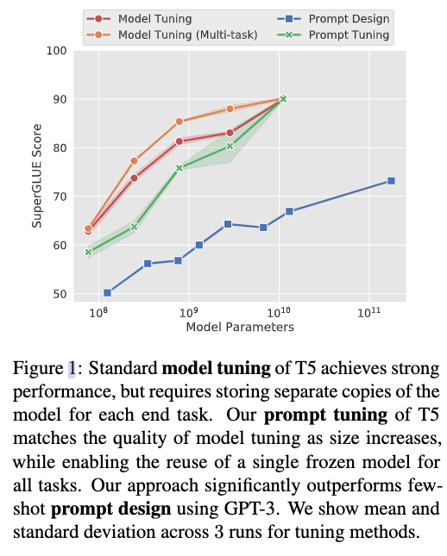
Background - soft prompt tuning
PromptTuning: The Power of Scale for Parameter-Efficient Prompt Tuning

Slide 3
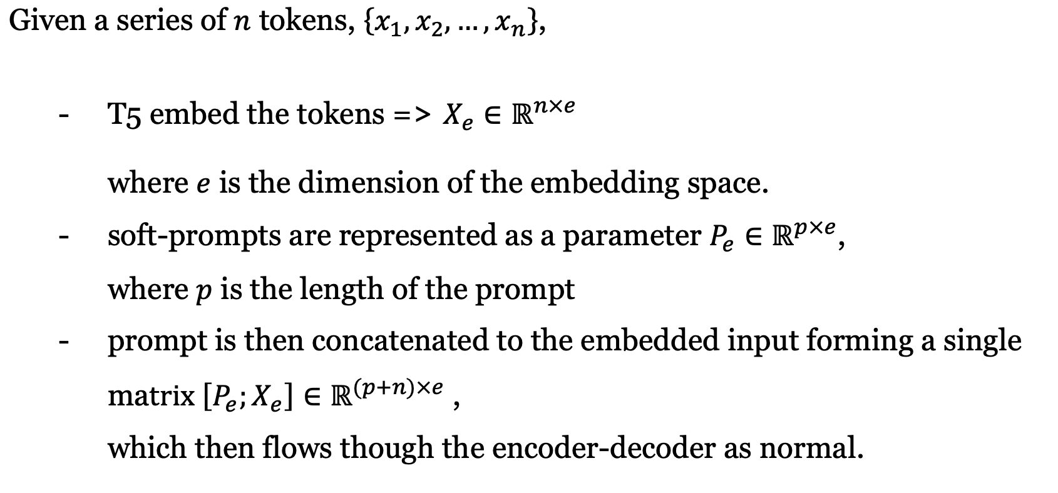
Background – PromptTuning

Slide 4
Compared PromptTuning with Prefix Tuning
Prefix-Tuning: Optimizing Continuous Prompts for Generation
A sequence of prefixes that are prepended at every transformer layer. Rely on a reparameterization of the prefix to stabilize learning, which adds a large number of parameters during training. PromptTuning:
a single prompt representation that is prepended to the embedded input.
does not require reparameterization => fewer parameters and allow the transformer to update the intermediate-layer task representations, as contextualized by an input example.
on GPT-2 or BART. PromptTuning: on T5; examines changes in performance and robustness to design choices as model size increases.
Includes prefixes on both the encoder and decoder network, when using BART. PromptTuning: only requires prompts on the encoder.

Slide 5
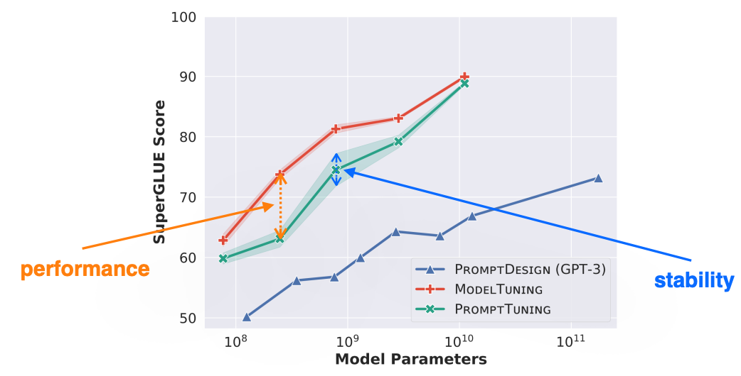
Room for improving PromptTuning
How to initialize the prompt representations?
Initialize each prompt token to an embedding drawn from the model‘s vocabulary.
To modulates the frozen network‘s behavior in the same way as text preceding the input.
Performance is not competitive with model tuning enough.
(will be improved in SPoT)

Slide 6
SPoT
A novel prompt-based transfer learning approach --- SPOT: Soft Prompt Transfer
1. first trains a prompt on one or more source tasks. (prompt pre-training)
2. then uses the resulting prompt to initialize the prompt for a target (downstream) task.
Two questions:
For a given target task, when does initializing the prompt from a source task boost performance?
Conduct a systematic study of the T5 model using 26 NLP tasks in 160 combinations of source and target tasks.
(b) Can we use task prompts to efficiently predict which source tasks will transfer well onto a novel target task?
Interpret the learned task prompts as task embeddings to construct a semantic space of tasks and formalize the similarity between tasks.

Slide 7
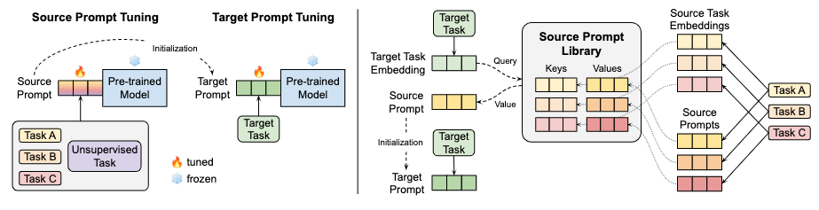
SPoT
An illustration of generic (left) and targeted (right) SPoT approaches.

Slide 8
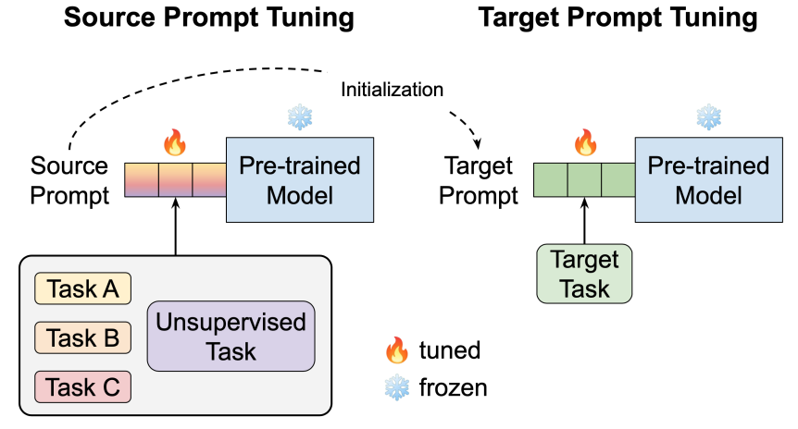
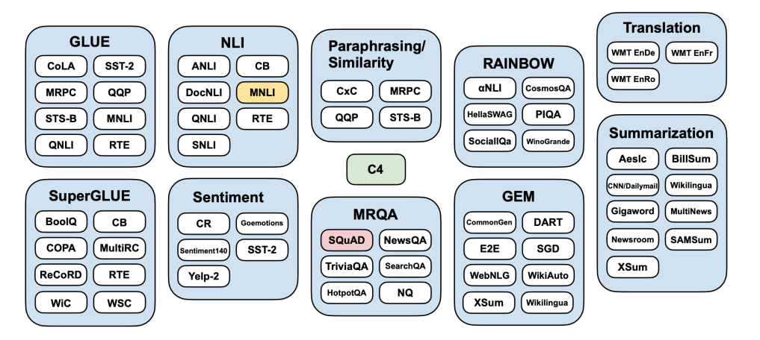
generic SPoT approach - Mixing datasets from different NLP benchmarks / task families
A single unsupervised learning task: C4
A single supervised learning task: MNLI, SQUAD
A multi-task mixture: GLUE, SUPERGLUE

Slide 9
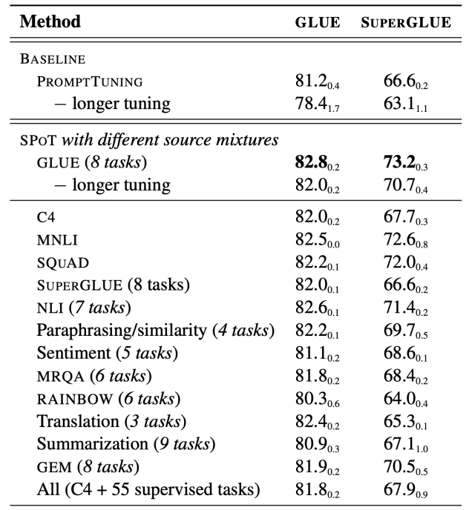
SPoT significantly improves performance and stability of Prompt Tuning
GLUE and SUPERGLUE results achieved by applying
T5 BASE with different prompt tuning approaches.
SPoT significantly improves the performance and stability of PromptTuning across the two benchmarks.

Slide 10
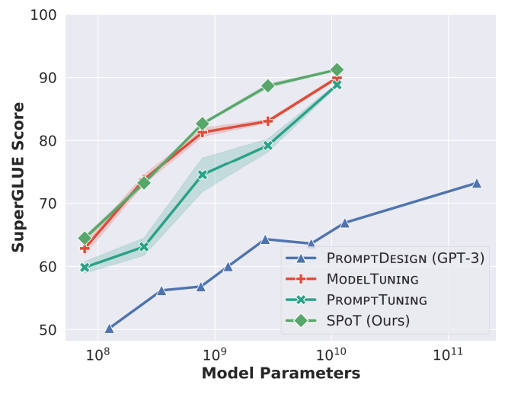
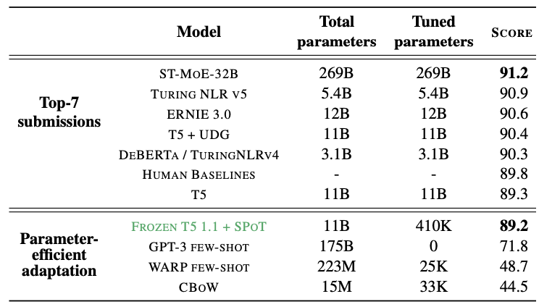
SPoT helps close the gap with Model Tuning across model sizes
SPoT is competitive with methods that tune billions of parameters
SPoT vanilla PromptTuning and GPT-3 on SuperGLUE by a large margin, matching or outperforming Model Tuning across all model sizes.

Slide 11
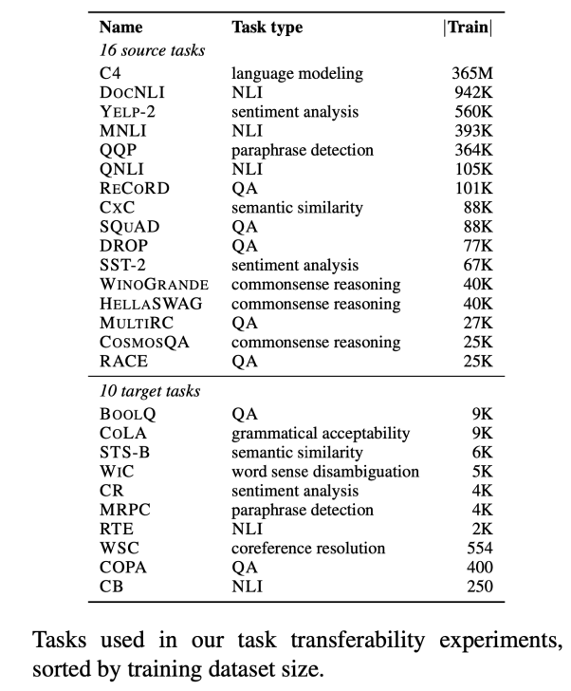
A large-scale study on task transferability in the context of prompt tuning
Recall Q1:
For a given target task, when does initializing the prompt from a source task boost performance?
26 NLP tasks
- 16 source tasks, 10 target tasks, 160 source-target combinations of tasks
- covering various task types

Slide 12
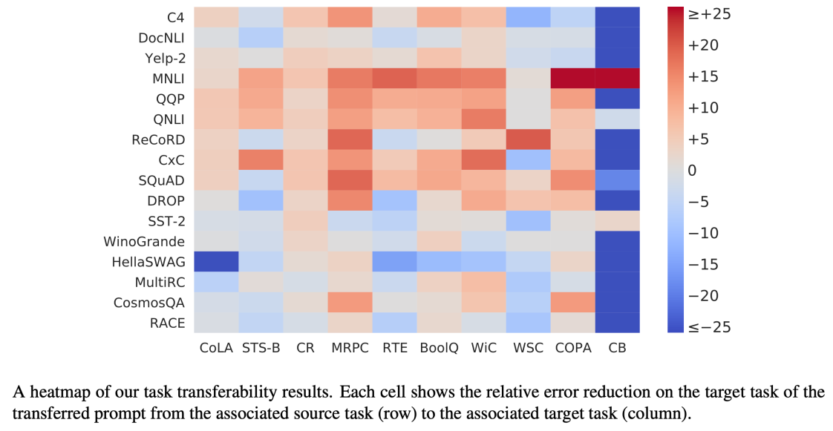
Many tasks can benefit each other via prompt transfer
Effective transfer from large source tasks that involve high-level reasoning about semantic relationships among sentences (e.g., MNLI), or when the source and target tasks are similar (e.g., CXC →STS-B).
Positive transfer can occur between relatively dissimilar tasks (e.g., RECORD→ WSC, SQUAD → MRPC, CXC → WIC).

Slide 13
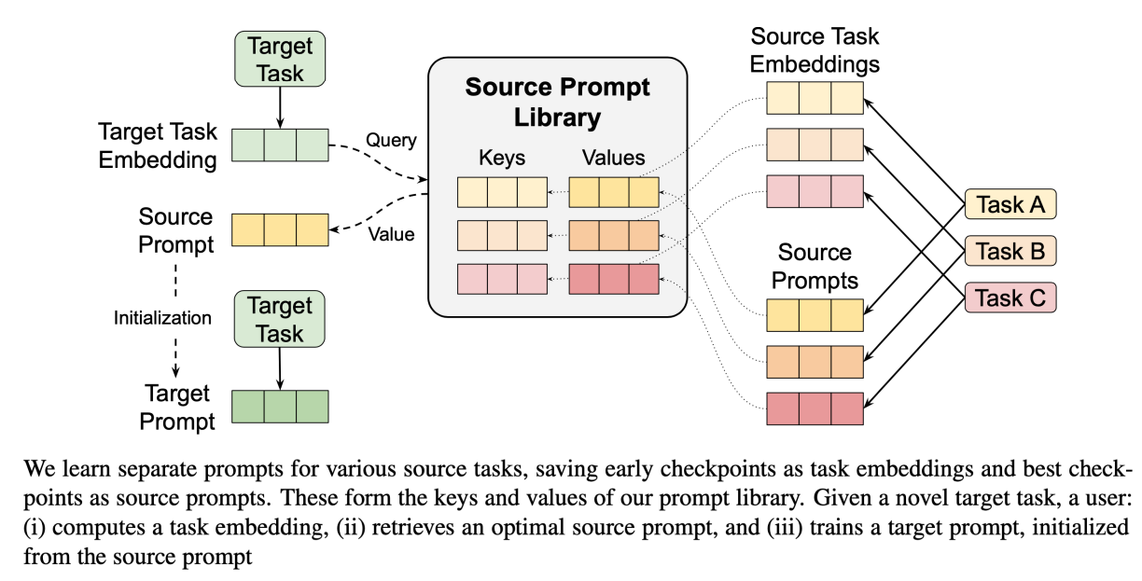
Recall targeted SPoT approach
Recall Q2: Can we use task prompts to efficiently predict which source tasks will transfer well onto a novel target task?

Slide 14
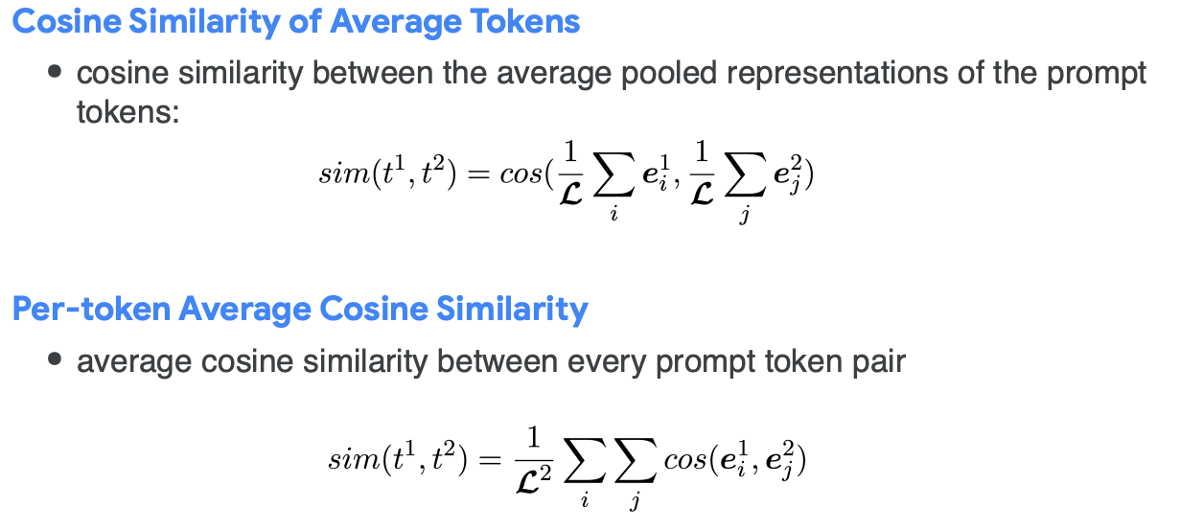
Measuring task similarity through prompts
Interpret task prompts as task embeddings and construct a semantic space of tasks:
define a task's embedding as the prompt checkpoint after training for 10K steps on that task.

Slide 15
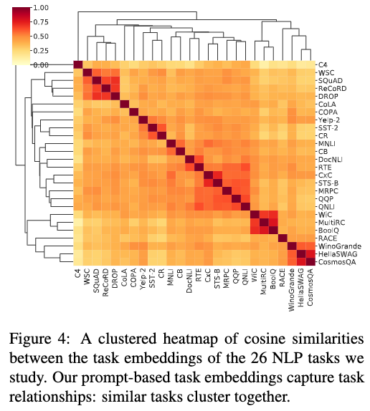
Task embeddings capture task relationships
Capture intuitive task relationships, e.g., QA (SQUAD, RECORD, and DROP; MULTIRC and BOOLQ) and unintuitive case of RECORD‘s high transferability to WSC.
NLI task built from the SQUAD dataset, is not closely linked to SQUAD => task embeddings are more sensitive to the type of task than domain similarity.
Task embeddings that are derived from different prompts of the same task have high similarity scores. (resulting task embeddings from all the three different prompt tuning runs on the task)

Slide 16
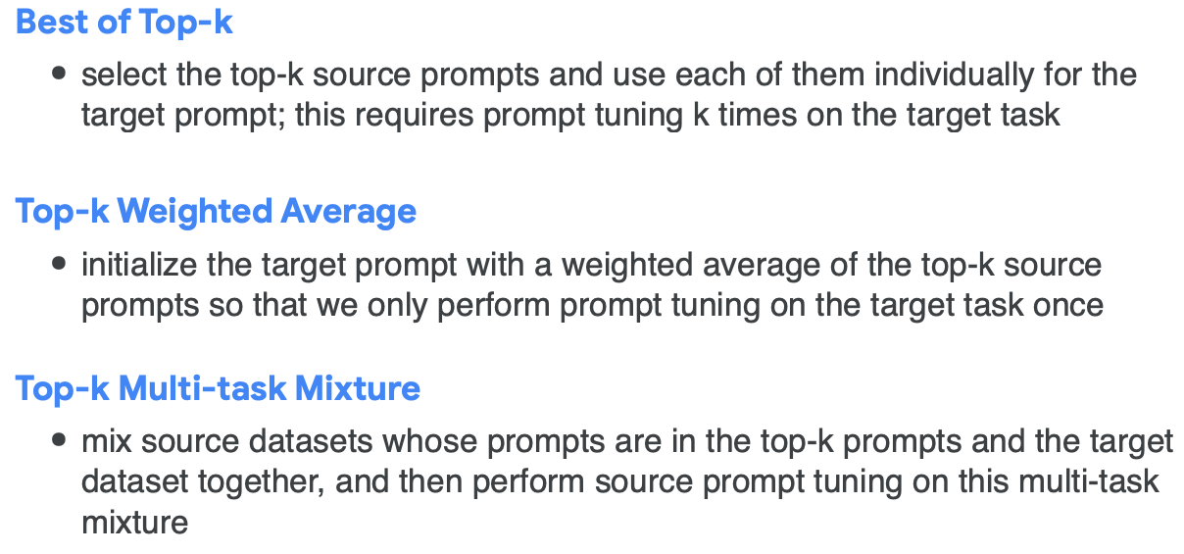
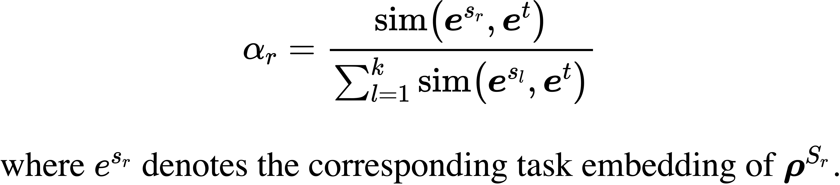
Predicting transferability via similarity
- Total 48 source prompts (16 source tasks*3 different prompt tuning runs on each). - Source prompts are ranked based on similarity between source prompt embedding and target task embedding.
- Three methods for using the ranked source prompts:

Slide 17
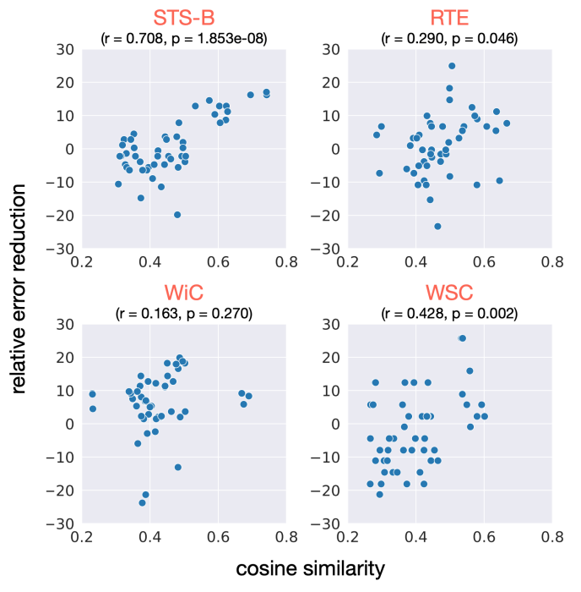
Correlation between task similarity & task transferability
Correlation between task similarity and task transferability.
Each point represents a source prompt.
The x-axis shows the cosine similarity between the associated source and target task embeddings, averaged over three runs for the target task (orange title).
The y-axis measures the relative error reduction on the target task achieved by each source prompt.
Include the Pearson correlation coefficient (r) and p-value.

Slide 18
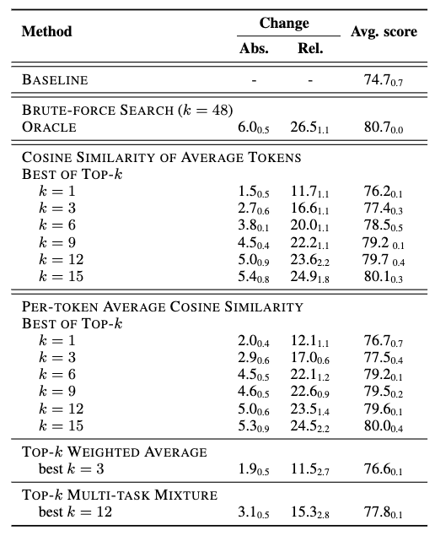
Retrieving targeted source tasks via task embeddings is helpful
BASELINE - prompt tuning on each target task from scratch
(i.e., without any prompt transfer)
ORACLE - the oracle results achieved by a brute-force search to identify the best possible out of 48 source prompts for each target task.
Task embeddings provide an effective means of predicting and exploiting task transferability, eliminating 69% of the source task search space while keeping 90% of the best-case quality gain obtained by oracle selection.

Slide 19
Limitations & Future work
Compared to PrompTuning:
PrompTuning is the most parameter efficient, requiring less than 0.01% task-specific parameters for most model sizes.
Simpler than other methods.
As model capacity increases, PromptTuning becomes more competitive with ModelTuning.
Could possibly be interpreted as natural language instructions.
Does not capture all of the factors that influence task transferability, we leave further exploration of other task embedding methods to future work.

Slide 20
Conclusion
Show that scale is not necessary for Prompt Tuning to match the performance of Model Tuning; our proposed SPOT approach matches or beats Model Tuning across all model sizes.
Conduct a large-scale and systematic study on task transferability in the context of prompt tuning.
Propose an efficient retrieval method that measures task embedding similarity to identify which tasks could benefit each other.

Slide 21
Thanks!

