Slide 1
CONFIT: Toward Faithful Dialogue Summarization with Linguistically-Informed Contrastive Fine-tuning
Xiangru Tang Arjun Nair Borui Wang Bingyao Wang Jai Desai Aaron Wade Haoran Li Asli Celikyilmaz Yashar Mehdad Dragomir Radev
Yale University , Meta AI

Slide 2
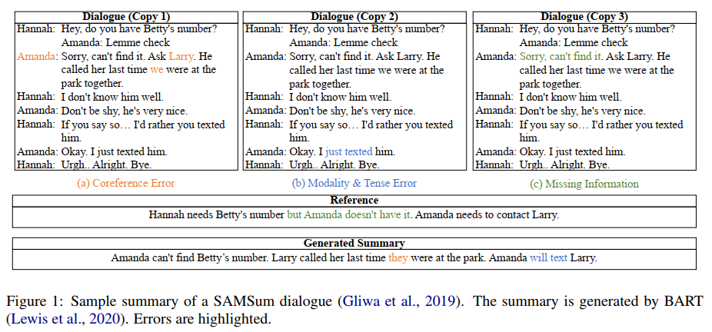
Dialogue Summarization

Slide 3
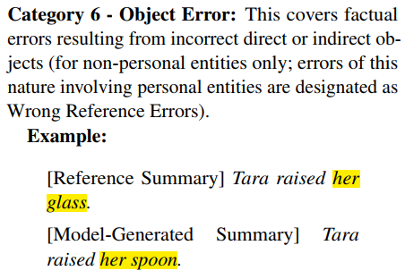
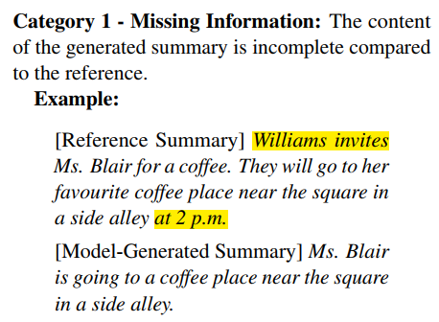
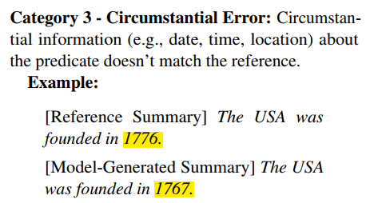
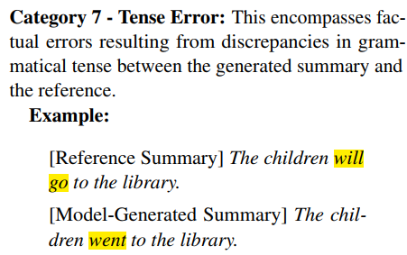
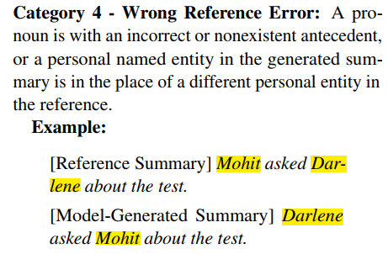
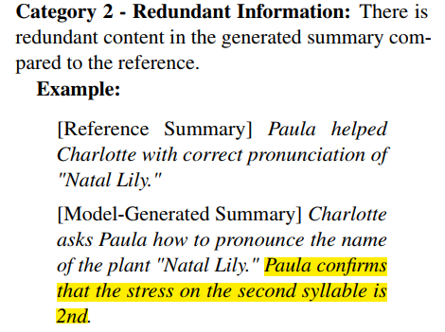
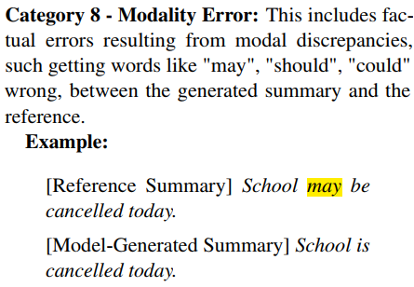
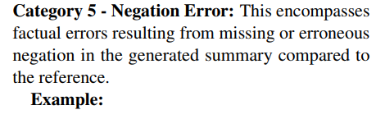
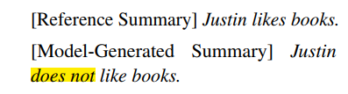
New Taxonomy of Factuality Errors

Slide 4
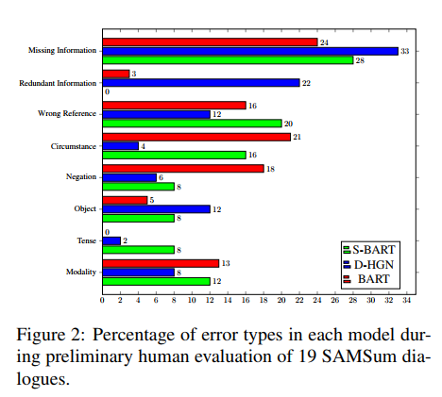
Distribution of factual errors
Approximately 45% of all errors fall into the categories of Missing Information and Wrong Reference.

Slide 5
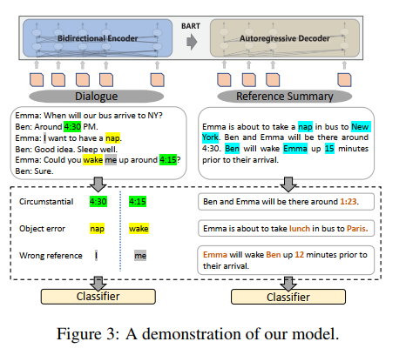


CONFIT Model
Standard cross-entropy loss:
Shortcomings:
Sub-optimal generalization
instability
Intuition: good generalization requires
Capturing the similarity in one class
Contrasting them in other classes
New training objective：

Slide 6

CONFIT Model
Contrastive Negative Samples：
Swap the nouns in the reference summary with each other randomly.
(wrong reference & object errors)
Swap the verbs in the reference summary with each other randomly.
(circumstance, tense and modality)
Mask numbers and years in the dialogue and then pass it into the model to generate a negative sample summary.
(circumstance)
4. Randomly delete 30% of the sentences in the dialogue and then pass it into the model to generate a negative sample summary.
(missing information)
5. Mask-and-fill coreferent entities with BART in the dialogue and then pass it into the model to generate a negative sample summary.
(wrong reference)
Contrastive Loss：

Slide 7

CONFIT Model
Challenge:
The model need to correctly identify the first-person pronouns (such as “I” or “we”) as being a reference to the speaker.
Method:
Randomly select k pairs of two tokens $t_{m}$ and $t_{n}$ from the dialogue, where $s_{m}$ and $s_{n}$ are their speakers.
C is the hidden vectors of the input dialogue.
Self-supervised Loss

Slide 8
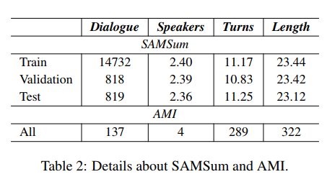
Experiments
Datasets
SAMSum: 75% are between two interlocutors and 25% are among three or more interlocutors.
AMI: 137 multiparty meeting transcripts.
Baselines: 1. BART 2.Pegasus 3.T5
Evaluation Metrics: 1.ROUGE 2.BARTScore 3.Human Evaluation (1-10 score)

Slide 9
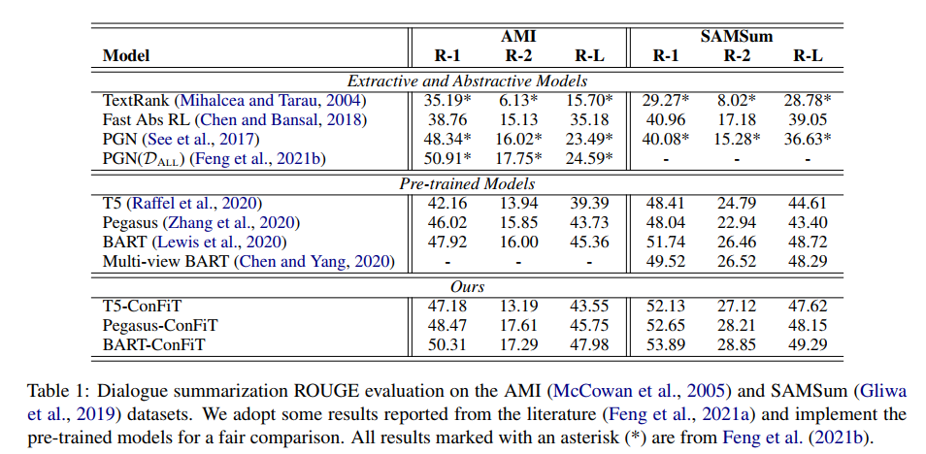
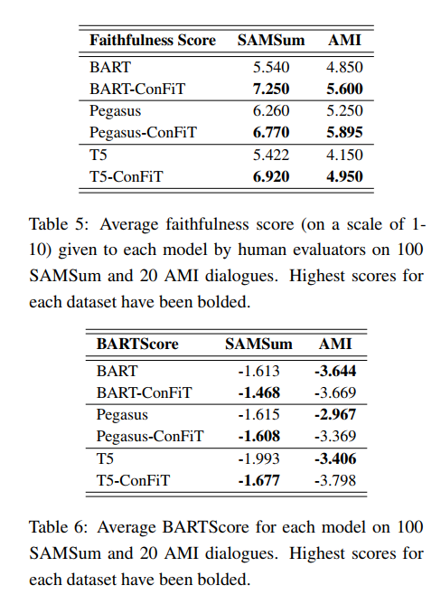
Results

Slide 10
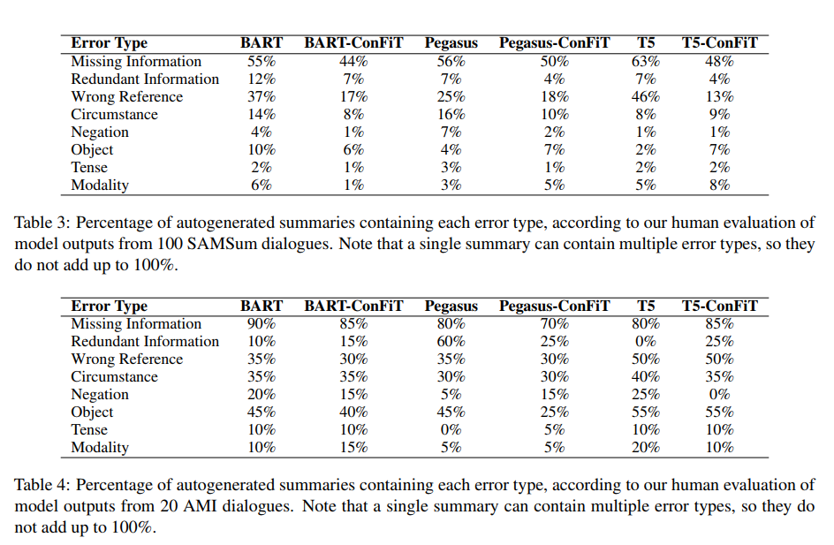
Error Analysis

Slide 11
Thanks!

