Slide 1
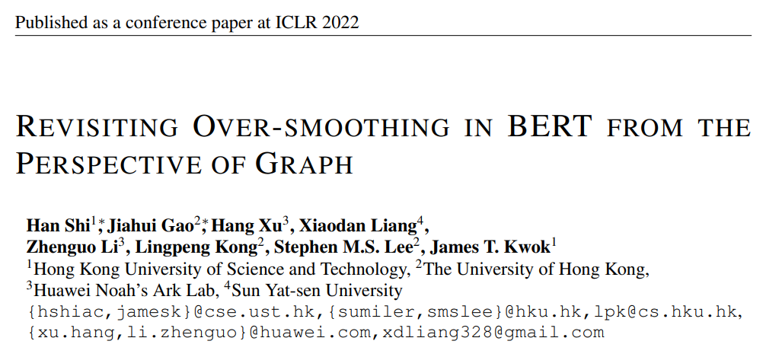
Pre: Haiteng zhao 2022 3 4

Slide 2
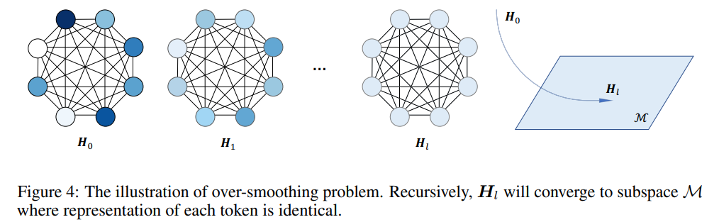
Oversmoothing in Graph Neural Network
Oversmoothing: the representation of all the nodes become nearly the same in graph neural network
The self-attention matrix can be seen as a normalized adjacent matrix of a corresponding graph.
Transformers may suffer from oversmoothing-problem, like graph neural networks.

Slide 3
Related Work
ResGCN (2019) adapts the residual connection and dilated convolution in the graph convolutional network (GCN), and successfully scales the GCN to 56 layers.
PairNorm (2020) propose a novel normalization layer, that prevents node embeddings from becoming too similar.
DropEdge (2020) randomly removes edges from the input graph at each training epoch, and reduces the effect of over-smoothing.
Dong et al. (2021) introduce the “token-uniformity” problem for self-attention, and show that skip connections and multi-layer perceptron can mitigate this problem.

Slide 4

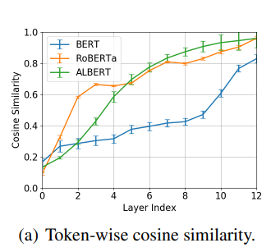
Oversmoothing in Transformer?
Transformer-based models fine-tuned on the SQuAD data set
CosSim values over all WikiBio data
Τhe original token representations are different from each other, while token similarities are high in the last layer.
The average token-wise cosine similarity of the last layer of ALBERT and RoBERTa are both larger than 90%.

Slide 5
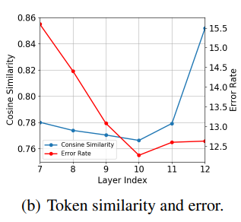
Oversmoothing and Accuracy
Ρepresentations from layer i as the final output and fine-tune the classifier.
fine-tuned on the MRPC data set
Layer 10 has the lowest cosine similarity and error rate.
At layers 11 and 12, the tokens have larger cosine similarities and performance drop.

Slide 6
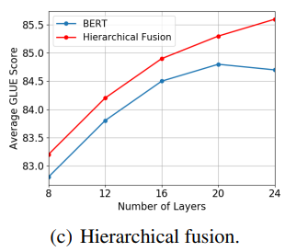
When the Model Gets Deeper
Hypothesis: The performance cannot be improved when the model gets deeper.
The performance of vanilla BERT cannot improve as the model gets deeper.
The proposed hierarchical fusion has better and better performance as the model gets deeper.

Slide 7


Self-attention VS ResGCN
Transformer:
Two layer normalization operations are performed after the self-attention layer and fully-connected layer, respectively.
GNN:

Slide 8
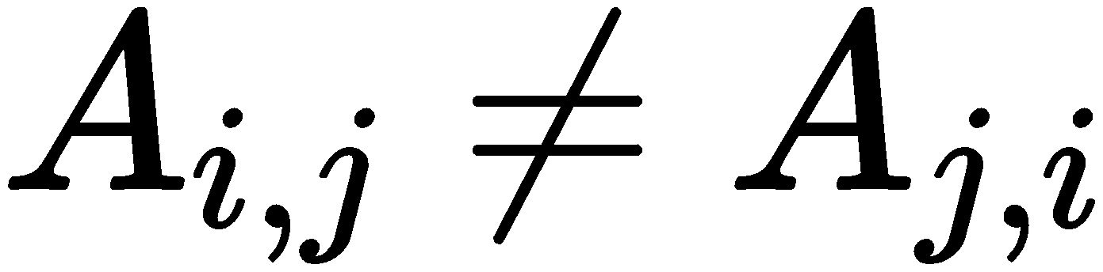


Self-attention VS ResGCN
Since in general, G in self-attention is a directed graph
in self-attention is the random walk normalization, while GCN usually uses the symmetric normalization version
The attention matrices constructed at different Transformer layers are different, while in typical graphs, the adjacency matrices are usually static.

Slide 9
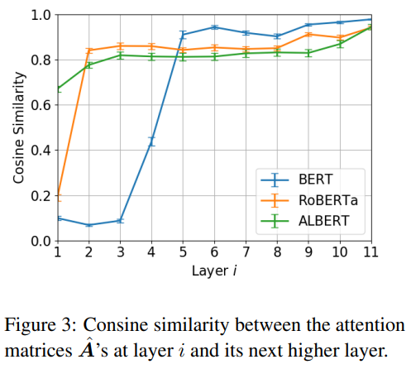
Compare the Self-Attention at Different Transformer Layers
Flatten the multi-head attention and measure the cosine similarity between Aˆ’s at successive layers.
On the WikiBio data set
The similarities at the last few layers are high
Those at the first few layers are different from each other.
The attention patterns at the first few layers are changing, and become stable at the upper layers.

Slide 10
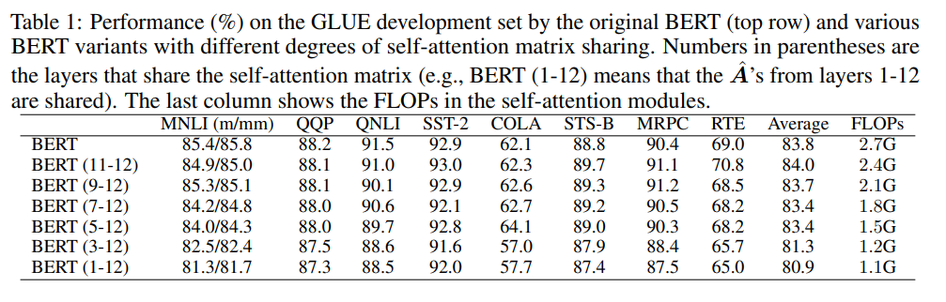
How Many Layers Can Share The Same Self-Attention Matrix?
Sharing attention matrices among the last 8 layers (i.e., layers 5- 12) does not harm model performance.
BERT (5-12) reduces 44.4% FLOPs compared with the vanilla BERT, while still achieving comparable average GLUE scores.

Slide 11

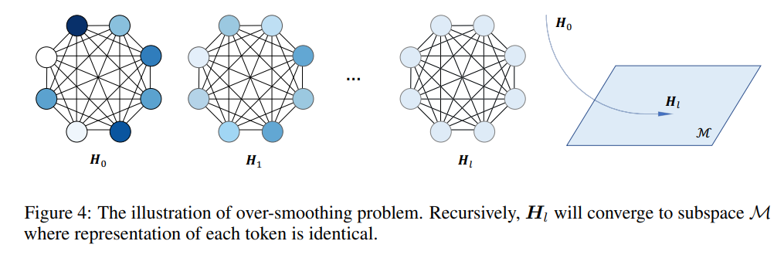
Over-Smoothing In Bert
Define the distance between matrix and M as

Slide 12
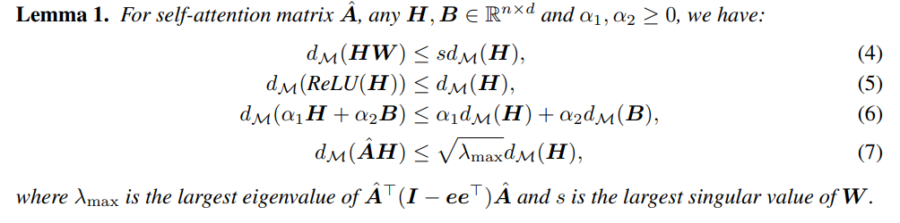
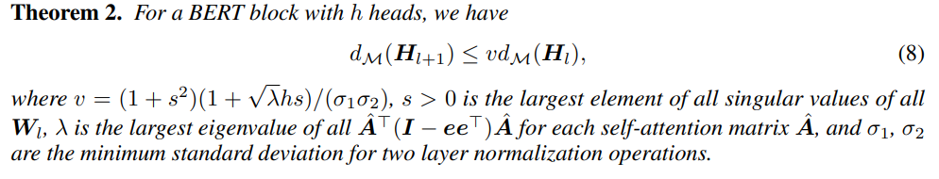

Slide 13
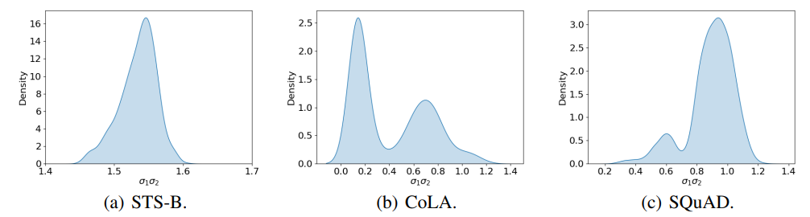
The Condition of Over Smoothing
The output of layer l + 1 will be closer to M than the output of layer l
STS-B (Cer et al., 2017), CoLA (Warstadt et al., 2019), SQuAD (Rajpurkar et al., 2016) as input to the fine-tuned models and visualize the distribution of σ1σ2 at the last layer

Slide 14



Improve the Model
Since only deep layers suffer from the over-smoothing issue, we allow the model select representations from both shallow layers and deep layers as final output.
Concat Fusion:
Max Fusion: taking the maximum value across all layers for each dimension
Gate Fusion: The final representation for token t
Note: all of these fusions have been investigated in the graph field

Slide 15
Experiment
Pre-training: vanilla masked language modeling (MLM) and next sentence prediction (NSP)
English BooksCorpus and Wikipedia(16G in total).
Fine-tuning: downstream experiments on the GLUE, SWAG and SQuAD benchmarks.

Slide 16
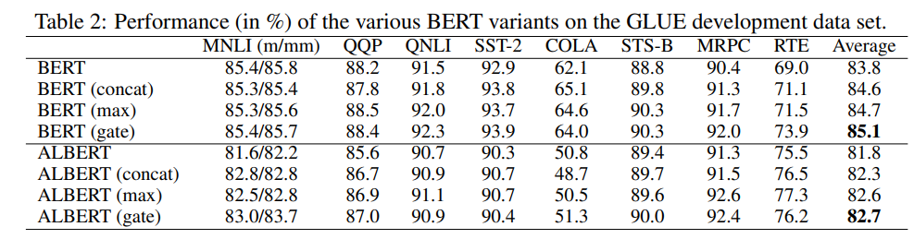
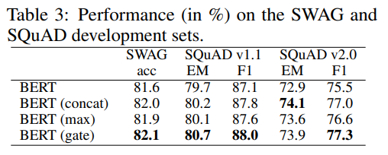
Experiment

Slide 17
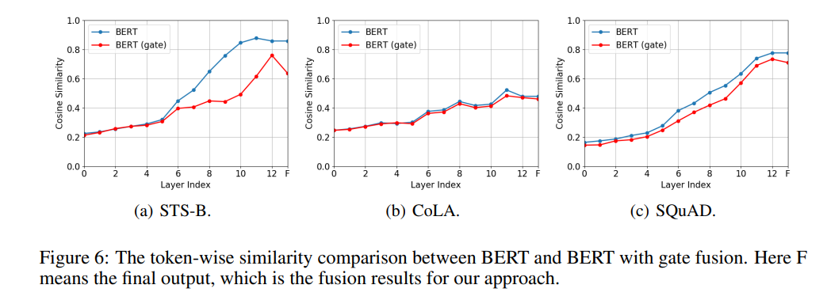
Experiment
For all three data sets, the cosine similarity has a drop in the last layer compared with baseline.
Similarity drop is the most obvious in STS-B, which is consistent with empirical verification that STS-B’s σ1σ2 is the largest.

Slide 18
Discussion
Dose over-smoothing really exist?
Similarity over 0.9 is still enough for neural network to distinguish
Theoretical result is not specific to attention
Does token wise over-smoothing really harm the performance?
Different input may be still distinguishable
Fusion mechanism cannot be fully explained in terms of over smoothing

