Slide 1
Sparse MoEs meet Efficient Ensembles
https://arxiv.org/pdf/2110.03360.pdf
Notes:
更像是ft moe的trick

Slide 2
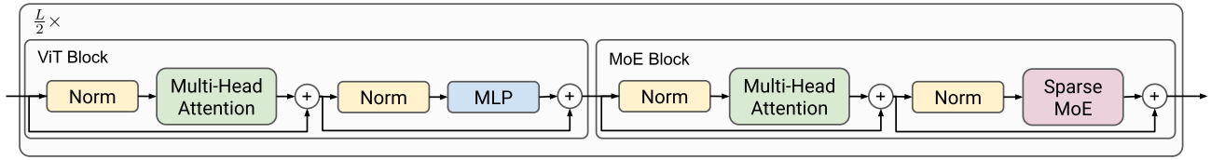


Background – ViT and Sparse MoEs
ViT -> V-MoE
MoE layers are placed in the MLP layers of the Transformer
routing weights combine the outputs of the different experts , sets all but largest weights to zero
V-MoEs in this paper are under “last-n” setting, which retains most of the performance gains while greatly reducing the training cost
Notes:
通过routing，选中k个experts

Slide 3



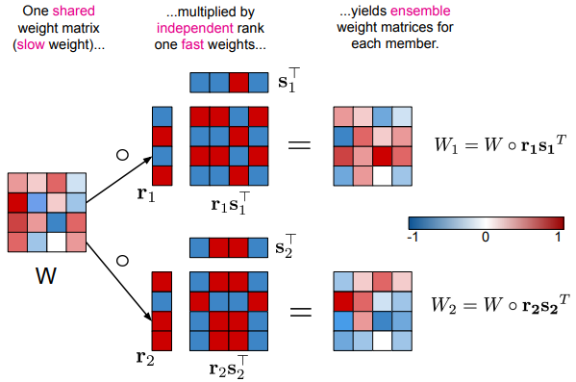
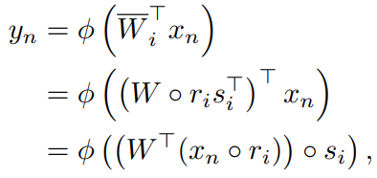

Background – Ensembles
Ensembles
Given a set of model parameters ,prediction proceeds by computing , i.e., the average probability vector.
Batch ensembles
For a dense layer, each ensemble member has weight matrix
Mini-batch version
Repeats the input mini-batch M times during testing
Notes:
BE在inference的时候只需要一次forward，普通的ensemble需要M次

Slide 4
Contributions
Complementarity of MoEs and ensembles
Ensembles of MoEs provide the best predictive performance.
Partitioned batch ensembles (pBE)
pBE matches the performance of deep ensembles for 30%-43% fewer FLOPs.
Standard sparse-MoE checkpoints can be used directly to initialize pBEs for fine-tuning.

Slide 5
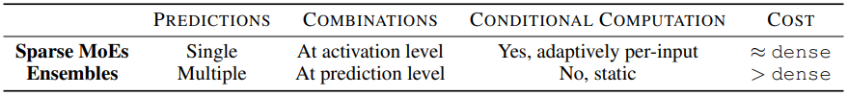
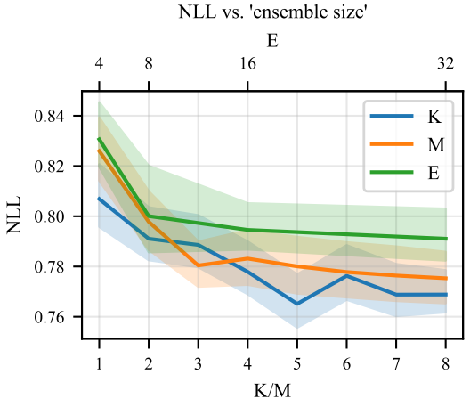
Sparse MoEs meets Ensembles
Sparse MoEs vs. Ensembles
Setting: downstream deep ensembles
all ensemble members having the same upstream checkpoint.
formed by M independent V-MoEs with E experts per MoE layer and a sparsity level K.

Slide 6
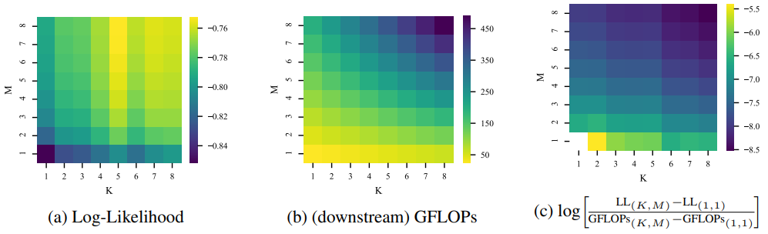
Sparse MoEs meets Ensembles
The static combination of ensembles is beneficial when applied to sparse MoEs.
The number of FLOPs grows more quickly along the M axis than along the K axis.
It appears more advantageous to first grow K before growing M.
Notes:
MoE不能完全取代ensemble的作用

Slide 7
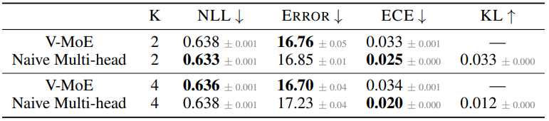
Feature-level vs. Prediction-level Ensembling
Replace last MoE layer of form (1) with (2) to generate K predictions.
Observations
The multi-head variant is unable to provide diverse predictions.
two VMoEs with K = 1 provides a much higher diversity of 0.073
Prediction level ensembling can be beneficial for uncertainty calibration of MoEs.
Notes:
Expected calibration error
Two V-MoEs with K=1 provides a much higher diversity of 0.073

Slide 8




Partitioned Batch Ensembles (pBE)
Disjoint subsets of experts as ensemble members
The set of E experts is partitioned into M sets of E/M experts: , for example and for E=6 and M=2.
The M sets of experts plays the role of M ensemble members.
The routing function is also partitioned into M groups

Slide 9


Partitioned Batch Ensembles (pBE)
Tiled representation
Given tiled inputs , is the representation of the i-th input for the m-th member, the routing logic in pBE is:
pBE brings together the static and adaptive combination of ensembles and sparse MoEs.
pBE has an effect only from the first MoE layer onwards (“last-n“ setting)
For L/16 and K=M=2, pBE saves 47% of the FLOPS.

Slide 10
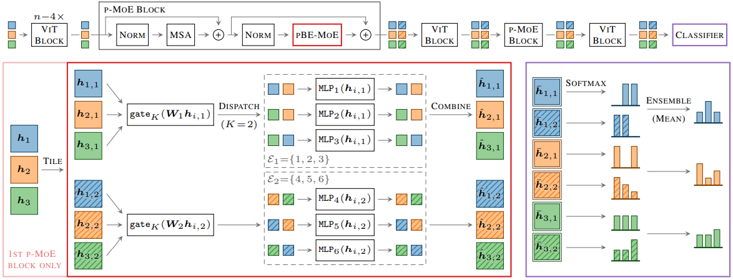
Partitioned Batch Ensembles (pBE)
End-to-end overview of pBE with E = 6 experts, M = 2 partitions, sparsity of K = 2, and a “last-2” configuration.

Slide 11
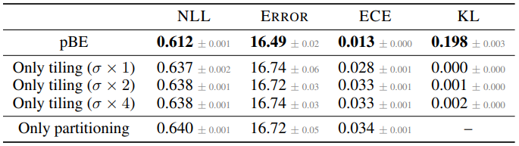
Partitioned Batch Ensembles (pBE)
Partitioning w/o tiling
K x M selected experts per input:
Tiling w/o partitioning
To discourage select identical sets of experts

Slide 12
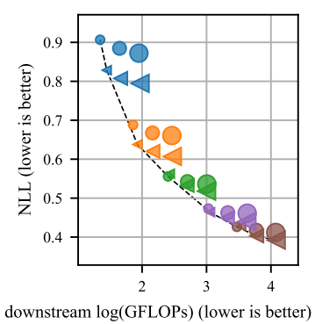
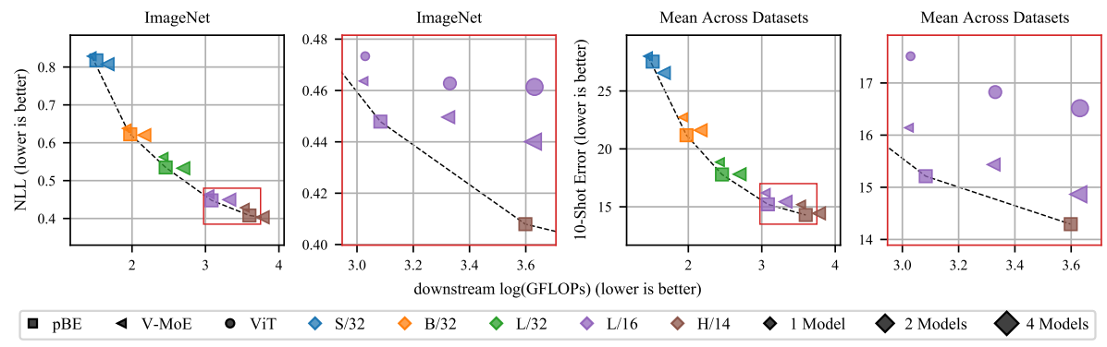
Evaluation – V-MoE vs. ViT
Ensembles help V-MoE just as much as ViT.

Slide 13
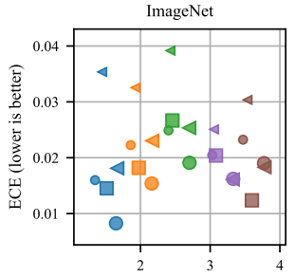
Evaluation – V-MoE vs. ViT
ViT consistently provides better ECE than V-MoE.
Even with better NLL
ECE is not consistent for different ViT/V-MoE families.
Increasing model size does not improve calibration, while ensembling does.
Notes:
参数量大->overfitting->less diversity

Slide 14
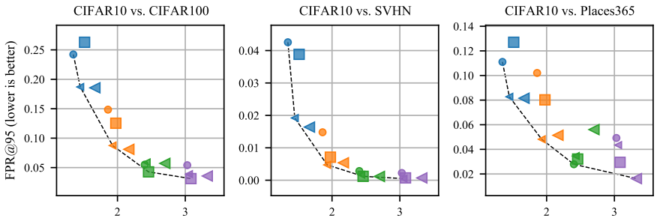
Evaluation – V-MoE vs. ViT
V-MoE outperforms ViT in OOD detection.

Slide 15
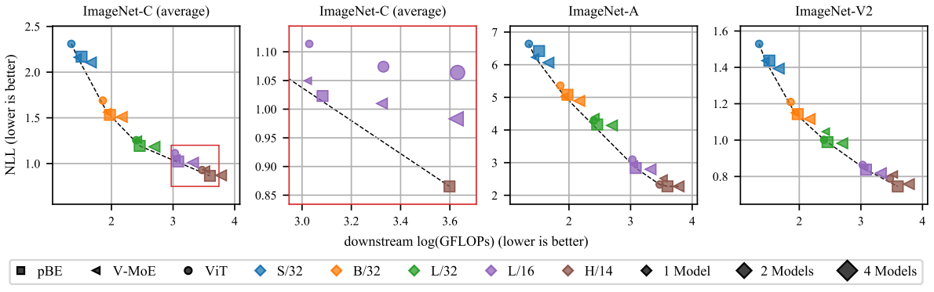
Evaluation – V-MoE vs. ViT
For smaller ViT families, V-MoE outperforms ViT in the presence of distribution shift.
as the ViT family becomes larger (H/14), this trend reverses
Notes:
V-MoE transfer的更好

Slide 16
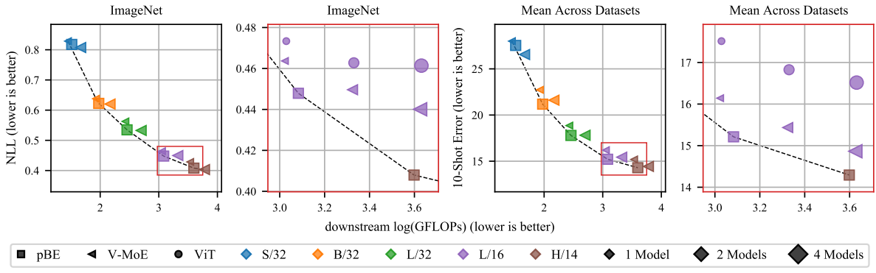
Evaluation – pBE
pBE improves classification performance.

Slide 17
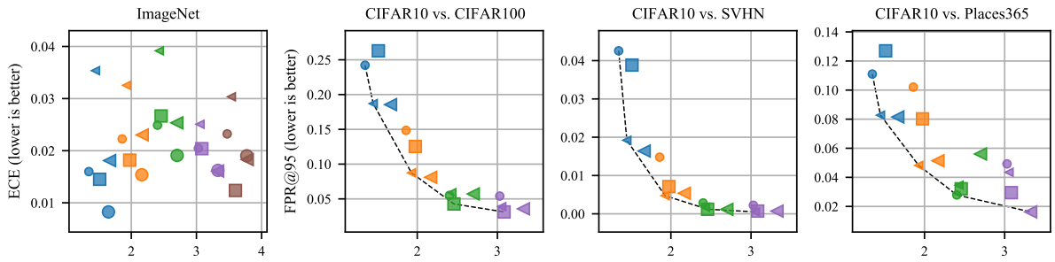
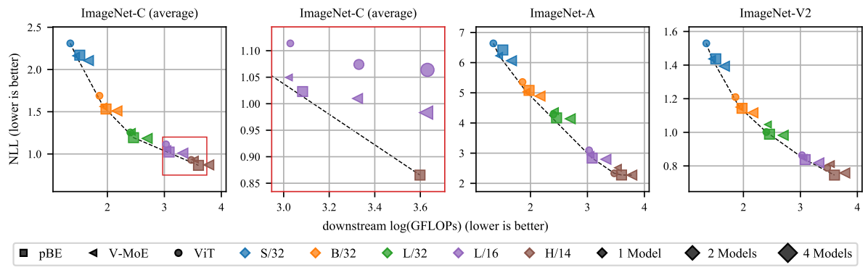
Evaluation – pBE
Different in predictive performance between pBE and V-MoE increases as the ViT family becomes larger.

Slide 18
Evaluation – pBE
pBE tends to be Pareto efficient in the presence of distribution shift.
Despite for H/14, V-MoE is worse than ViT.

Slide 19
Evaluation – pBE
pBE improves ECE over ViT and V-MoE.
Despite V-MoE providing poor ECE, pBE does not suffer from this limitation.

Slide 20
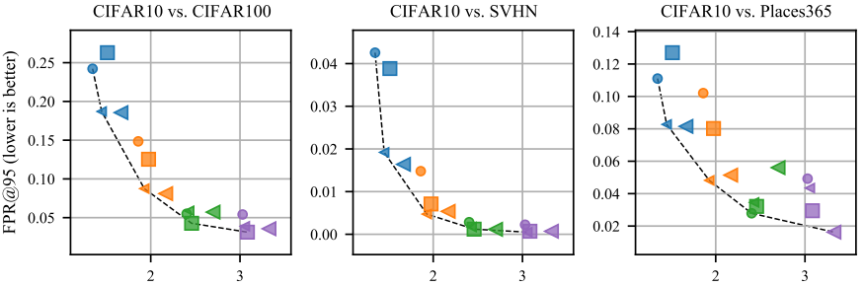
Evaluation – pBE
pBE does not provide consistent OOD detection performance.
V-MoE performs better for small ViT families.

Slide 21
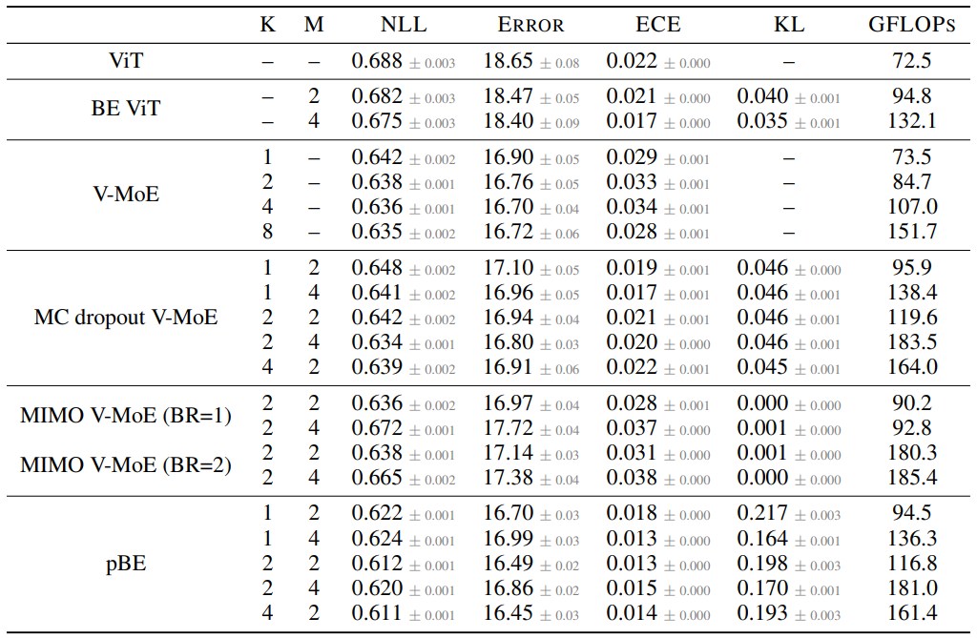
Efficient Ensemble Comparisons

Slide 22
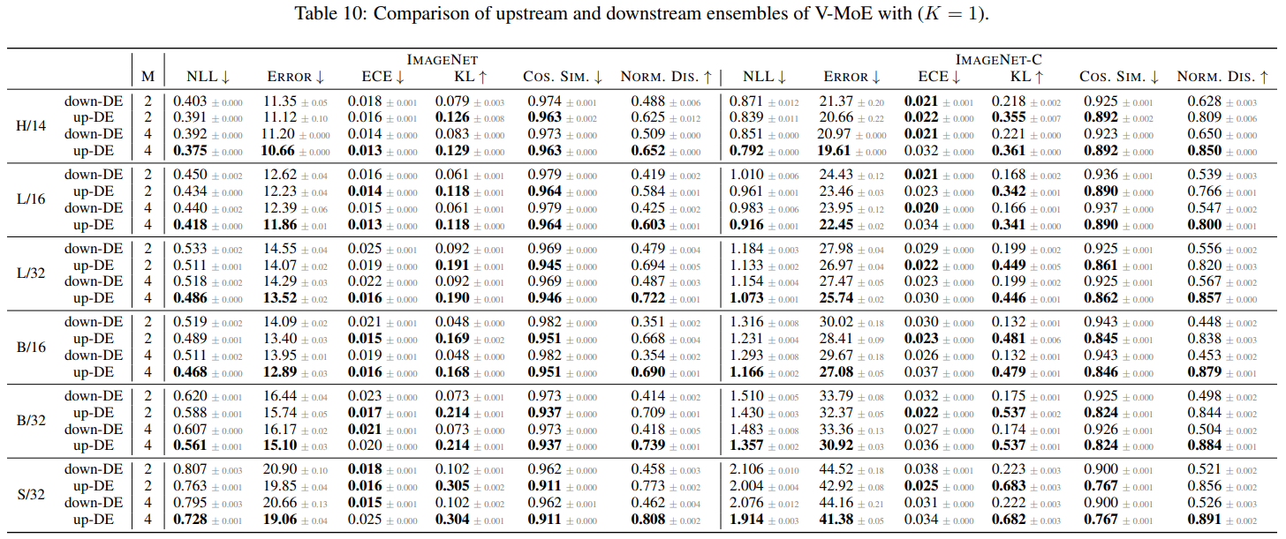
Upstream & Downstream vs. downstream-only Ensembles

Slide 23
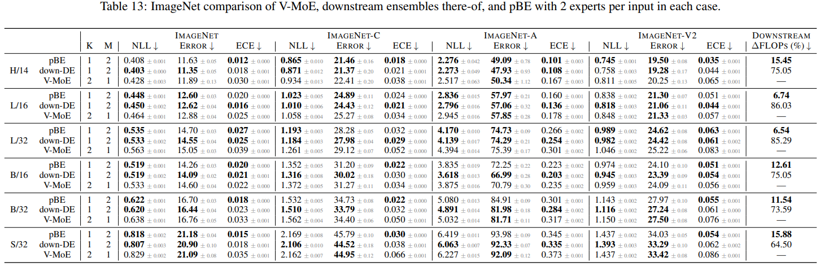
Comparison on ImageNet

Slide 24
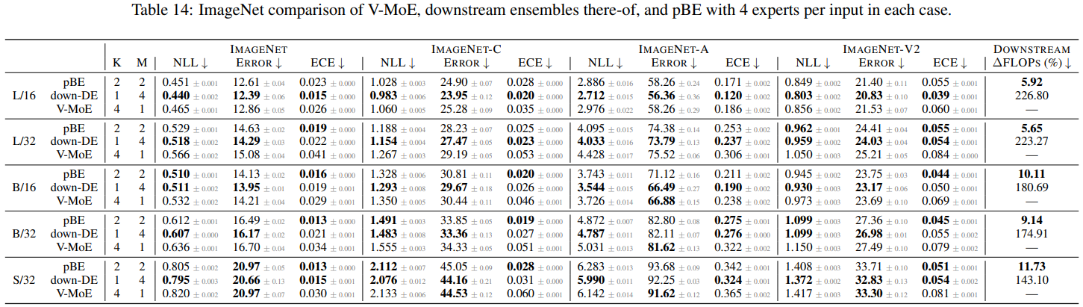
Comparison on ImageNet

Slide 25
Conclusion & discussion
pBE exemplifies mutual benefits between sparse MoEs and ensembles.
pBE can be readily applicable to the modeling of text, where sparse MoEs have been shown to be remarkably effective.
pBE in this paper focused on downstream fine-tuned models, what about pre-training?
Diversity of different sets of experts in pre-trained sparse MoEs

Slide 26
Thank you

