Slide 1
When Attention Meets Fast Recurrence: Training Language Models with Reduced Compute
Chengyi Wang
11/2/2021

Slide 2
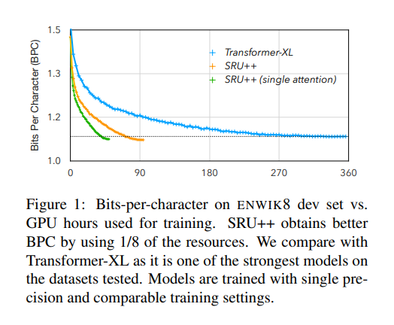
Is attention all we need for modeling?
The advantage of attention mechanism can be complemented with other computation designed for computation modeling.

Slide 3
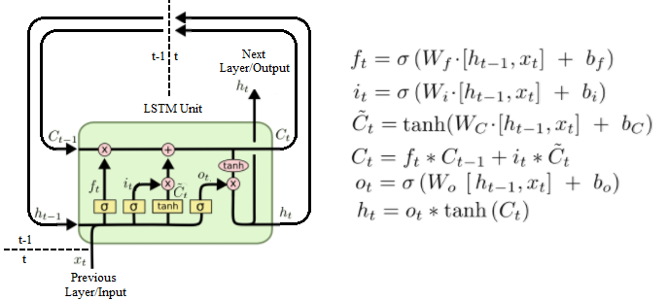
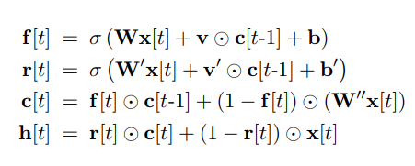
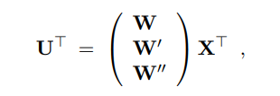
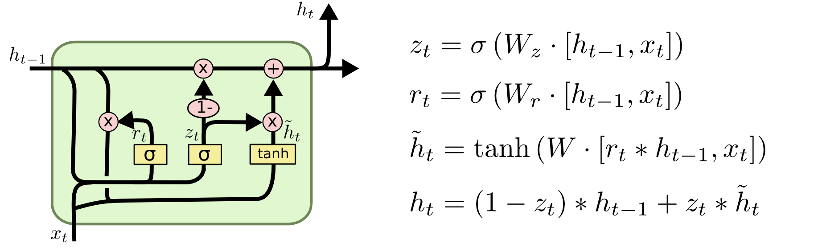
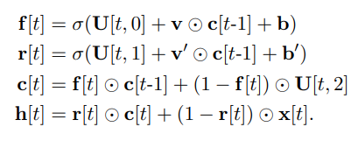
Background: SRU

Slide 4
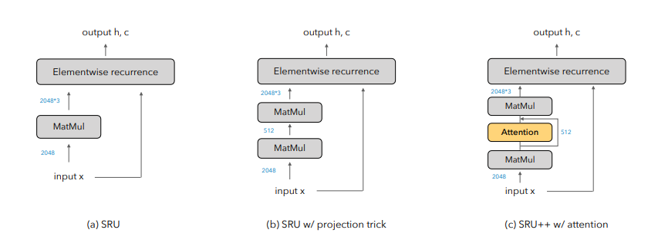
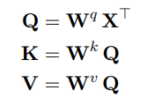




SRU++

Slide 5
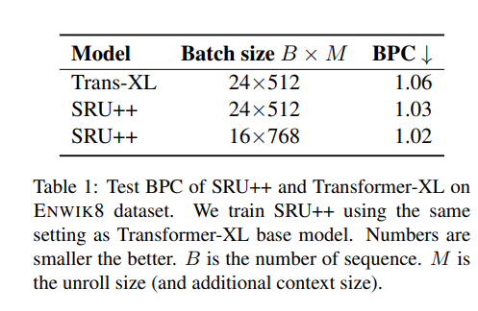
Experiments: Does recurrence improve upon attention-only model?
Dataset : ENWIK8 train: 90M tokens, dev: 5M tokens, test 5M tokens
Metric: BPC
Baseline: 12 layer Transformer-XL
Model: 10 layer SRU++ d:d’ = 4:1

Slide 6
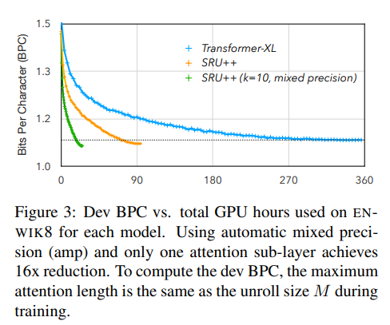
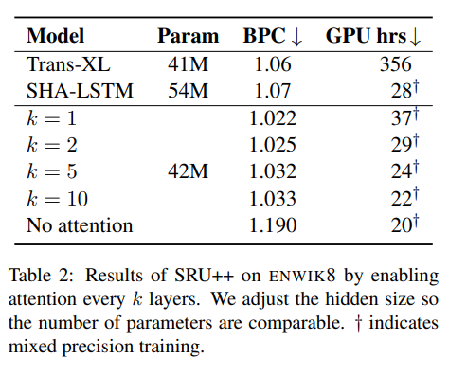
Experiments: How much attention is needed?

Slide 7
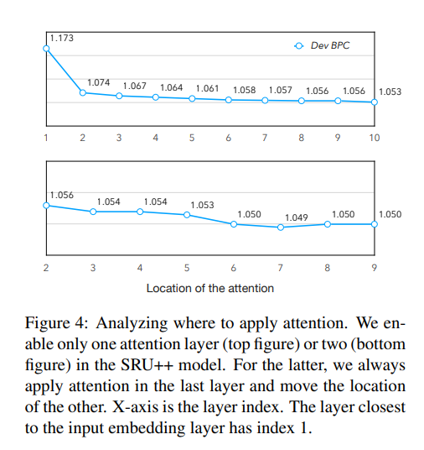
Experiments: Where to use attention?

Slide 8
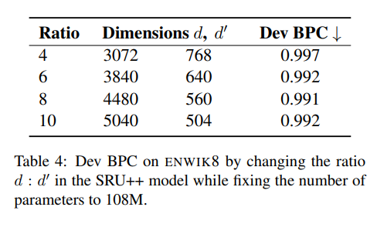
Experiments: Does the ratio d:d’ matter?

Slide 9
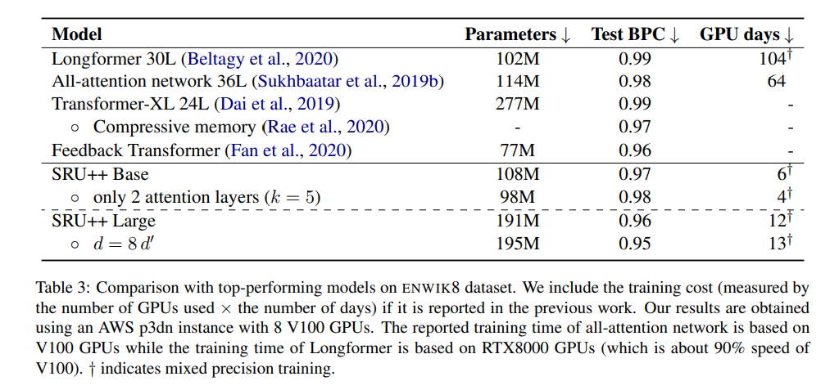
Experiments: ENWIK8

Slide 10
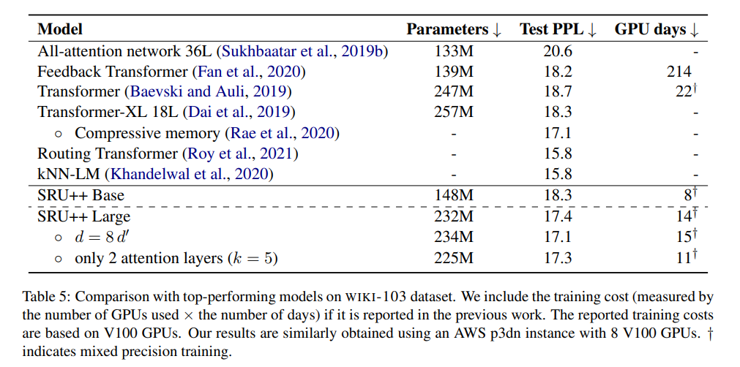
Experiments: WIKI-103
Dataset :WIKI-103 100M tokens
Model: Base d=3072 Large d=4096

Slide 11
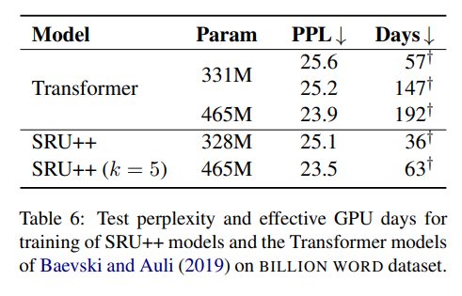
Experiments: Billion Word
Dataset :WIKI-103 100M tokens
Model: Base d=4096 Large d=7616

Slide 12
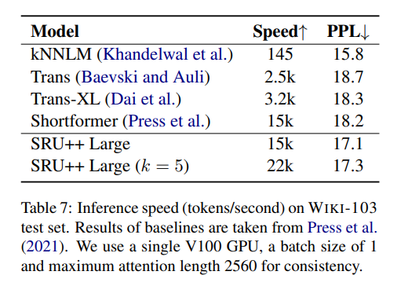
Experiments: Inference Speed

Slide 13
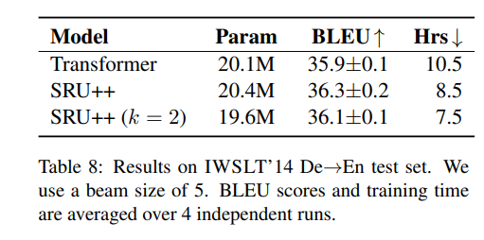
Experiments: IWSLT
Dataset : IWSLT DE-EN 170k pairs
Model: 6-layer SRU++ d= 1024
8-layer Transformer

Slide 14
Why does SRU++ reduce training cost?
Stronger modeling capacity: fewer model layers
fewer training steps & smaller training batch
model implementation

Slide 15
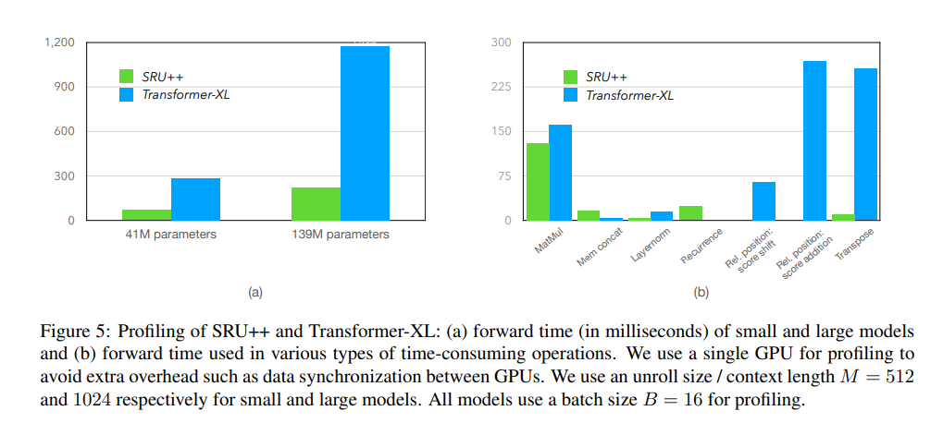
Why does SRU++ reduce training cost?

Slide 16
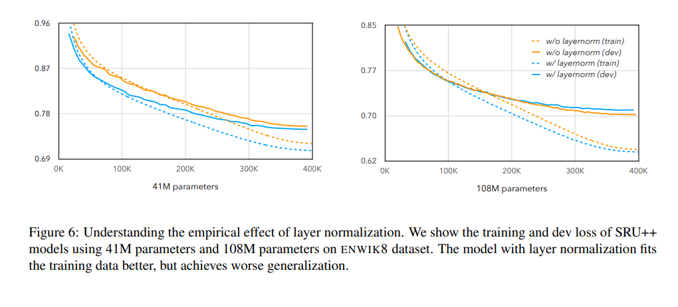
The effectiveness of layer normalization

