Slide 1
Data Distributional Properties Drive Emergent In-Context Learning in Transformers
Yutao Sun
v-yutaosun@microsoft.com
2022.8.4

Slide 2
Introduction
What is in-context learning?

Slide 3
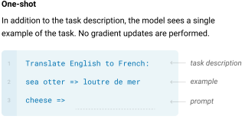
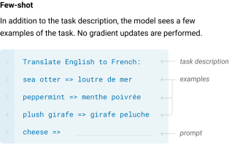
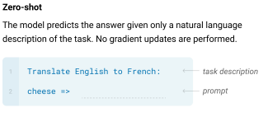

Slide 4
Data
How to design the experiment?

Slide 5
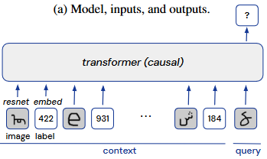
Training Data
Omniglot dataset (Lake et al., 2019, MIT License), a standard image-label dataset for few-shot learning
Consists of 1623 different character classes from various international alphabets

Slide 6


In-Context & In-Weights Learning
In-Context
A random ordering of 2 different image classes with 4 examples each
The labels were randomly re-assigned for each sequence
In-Weights
Evaluation sequences consisted of image classes that were selected uniformly without replacement
The same labels that were used in training

Slide 7
Experiment
What kinds of training data promote in-context learning?

Slide 8
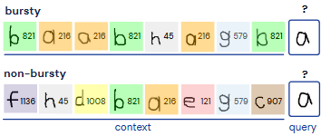
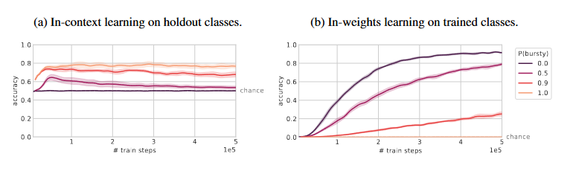
Burstiness
A given entity (word, person, object, etc) may have a distribution that is not uniform across time, instead tending to appear in clusters

Slide 9
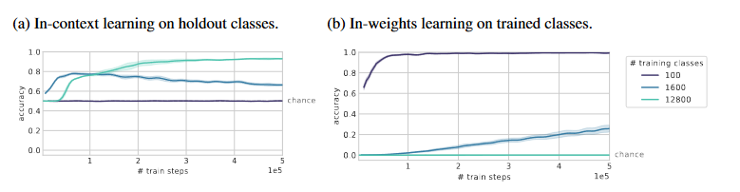
Number of rarely occurring classes
Increase the number of classes from 100 to 1600
In order to further increase the number of classes beyond the 1623 available in the original Omniglot dataset, we rotated (0◦, 90◦, 180◦, 270◦) and flipped (left-right) the images, obtaining 8× more image classes

Slide 10
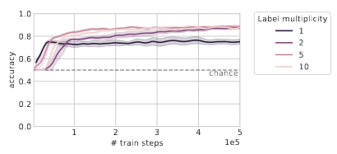
Multiplicity of labels
A single entity can have multiple possible interpretations (polysemy and homonymy, in language)
Each image class was assigned to multiple possible labels and, in the data sequences, the label shown after each image was randomly selected among the possible labels

Slide 11
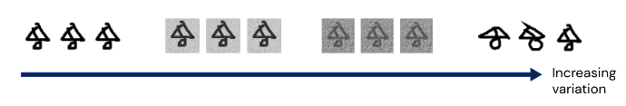
Within-class variation
Multiple entities can map to the same interpretation (synonymy, in language), usually in a context-dependent way
Make a variation:
In the lowest-variation condition, each image class consists of only a single image;
In the medium-variation conditions, we added Gaussian pixel noise to the images;
In the high-varation condition, we used the full Omniglot classes (each class consists of 20 different images drawn by 20 different people);

Slide 12
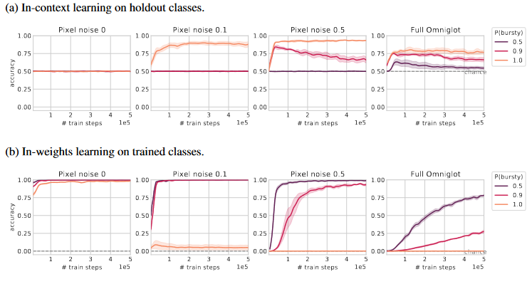
Within-class variation

Slide 13
Experiment
What kinds of training data enable in-context learning and in-weights learning to co-exist in the same model?

Slide 14

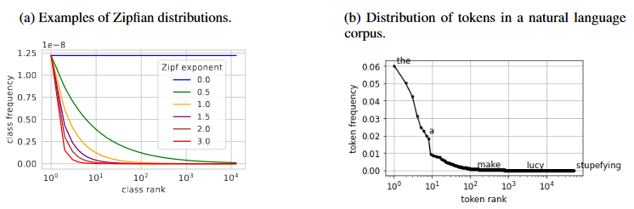
Zipfian Distribution
Many natural phenomena such as word distributions take this form, and are classically described as a Zipfian (power law) distribution:

Slide 15
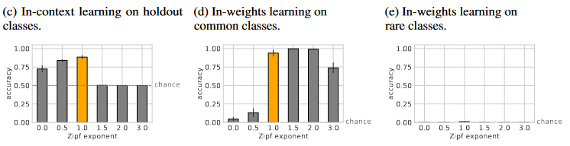
Zipfian Distribution
In between the two extremes, we observe a sweet spot at Zipf exponent = 1, where the model maintains high levels of both in-context learning and in-weights learning of common classes
Intriguingly, natural languages are best described by a Zipfian distribution with an exponent of approximately 1

Slide 16
Experiment
But architecture does matter too!

Slide 17
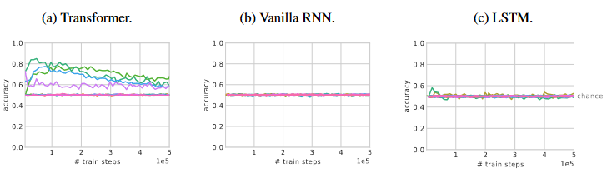
RNN & LSTM & Transformers
The recurrent models were matched to the transformer for depth, number of parameters, and hidden layer size

Slide 18
Discussion
More about general in-context learning…

Slide 19
Implications
For language models:
pointing to specific distributional properties of training data that both exist in language and also promote in-context learning
These results are counter to an emerging narrative that large language models may not actually be performing genuine in-context learning, and simply draw on examples seen in training
Design and collect datasets to achieve in-context learning in domains outside of language:
Reinforcement learning environments are generally designed to be uniformly distributed
supervised datasets are frequently rebalanced to have more uniform distributions
Thanks for discussion!

