Slide 1
Decision Transformer
Weizhi Wang

Slide 2
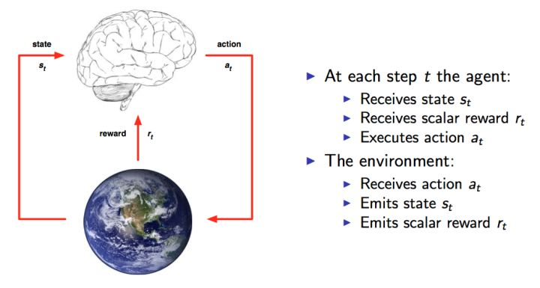
Question
If generative trajectory modeling – i.e. modeling the joint distribution of the sequence of states, actions, and rewards – can serve as a replacement for conventional RL algorithms.

Slide 3
Motivation: RL Methods Scale Poorly
Some Hypothesis:
Limited by small-scale, single-task nature of training
Poor modeling of large distributions
Non-stationarity caused by learning of both actor & critic networks
Often complex solutions (that don’t scale) are used to fix instabilities
Goal: model RL in same framework that has scaled language successfully

Slide 4
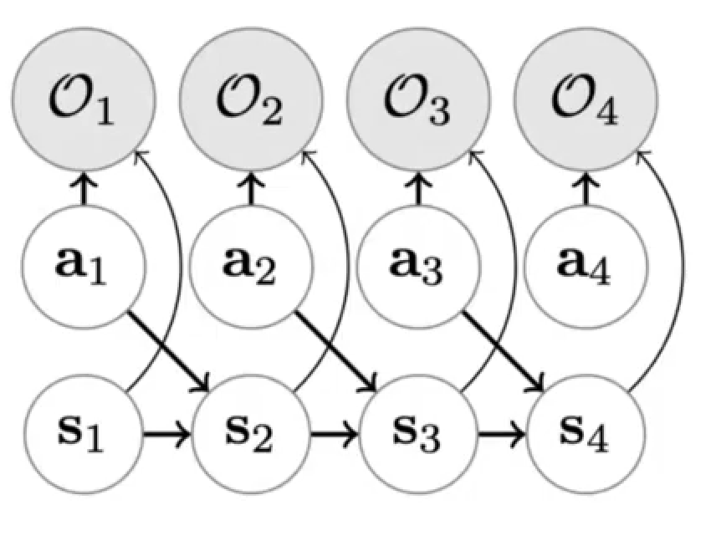
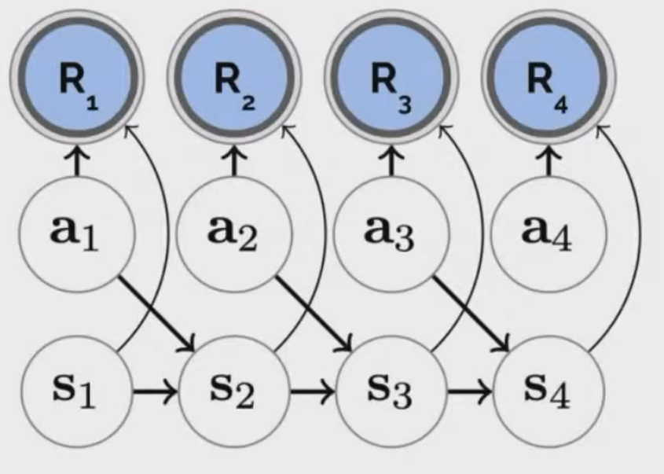
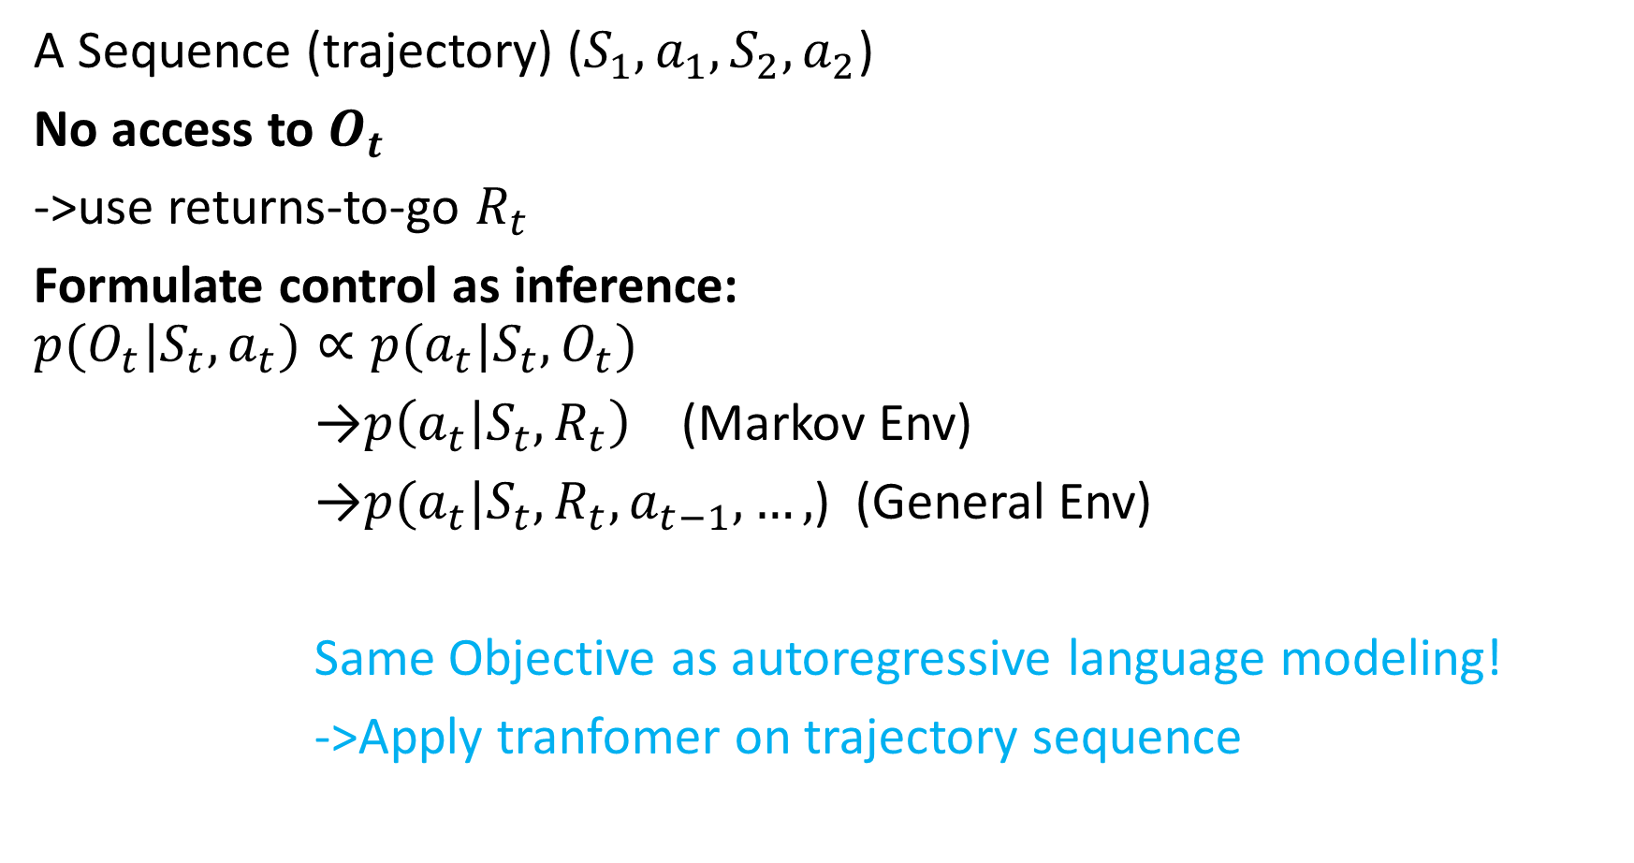
Reinforcement Learning as probabilistic inference
A Sequence (trajectory) ($S_{1},a_{1},S_{2},a_{2}$)
No access to $O_{t}$
->use returns-to-go $R_{t}$
Formulate control as inference:
$$p(O_{t}|S_{t},a_{t})∝p(a_{t}|{S_{t},O}_{t})$$
→$p\left(a_{t} | S_{t},R_{t}\right)$ (Markov Env)
→$p(a_{t}|S_{t},R_{t},a_{t−1},…,$) (General Env)
Same Objective as autoregressive language modeling!
->Apply tranfomer on trajectory sequence

Slide 5
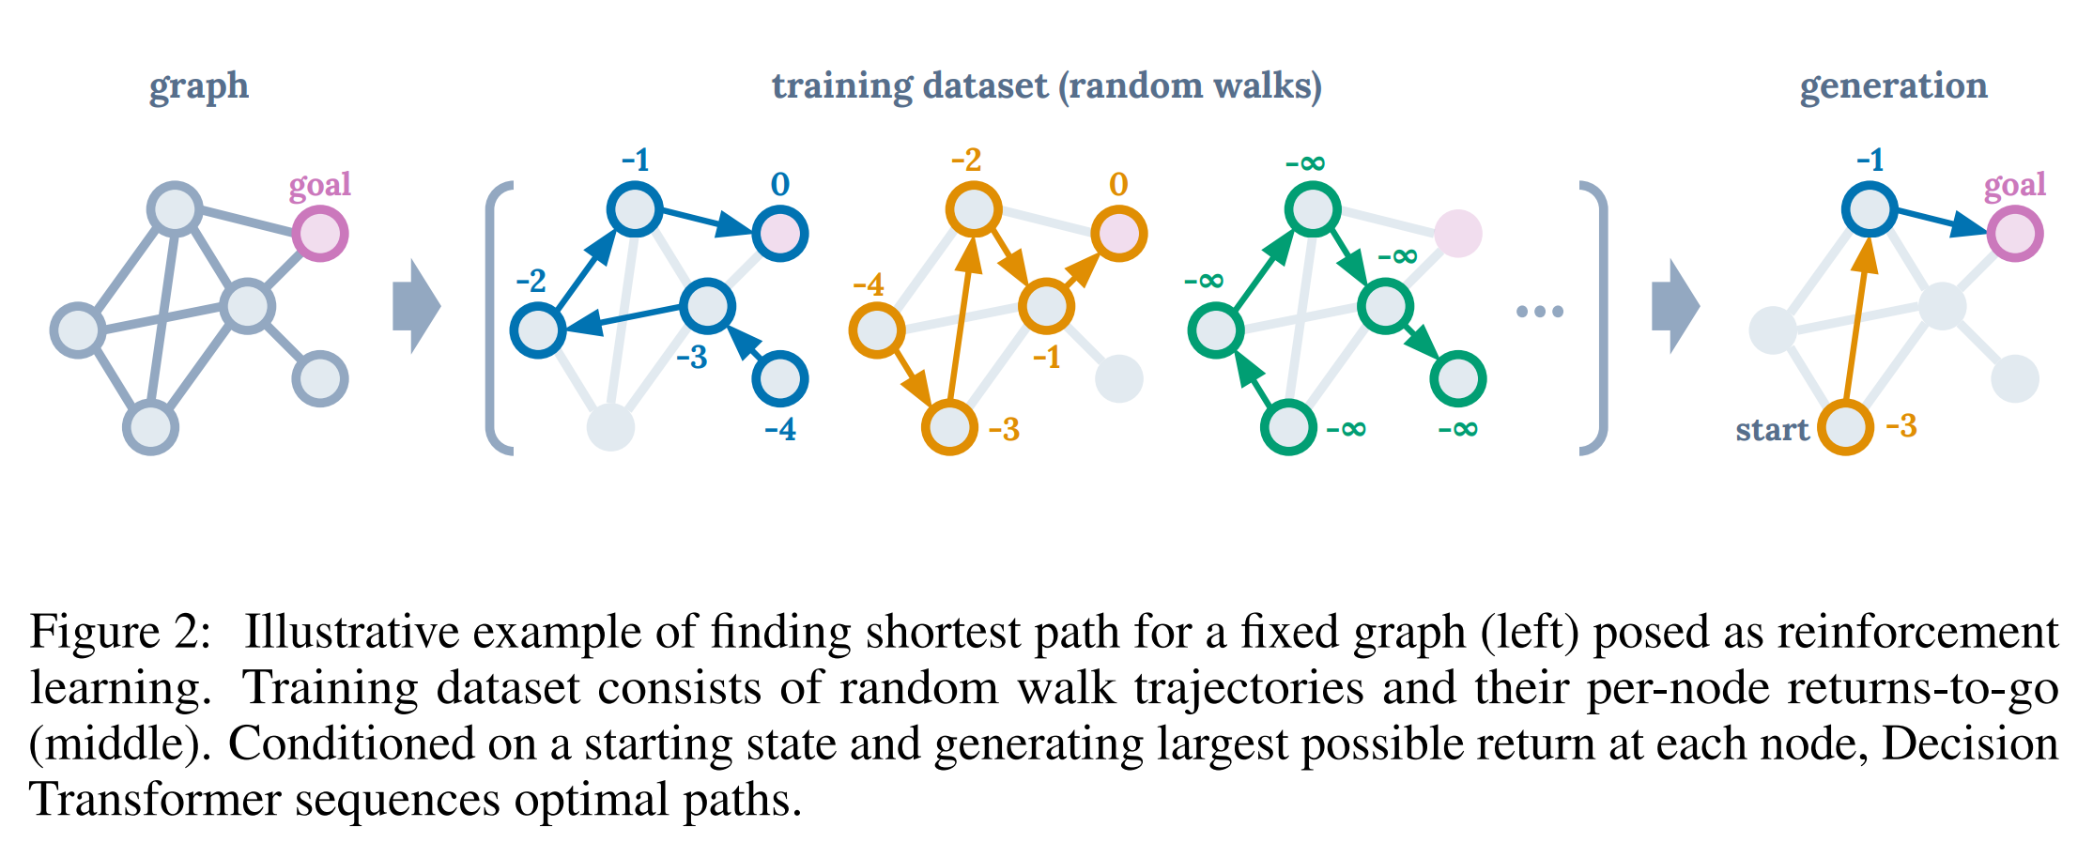
Illustrative Example: Finding the Shortest in DG
The reward is 0 when the agent is at the goal node and −1 otherwise

Slide 6
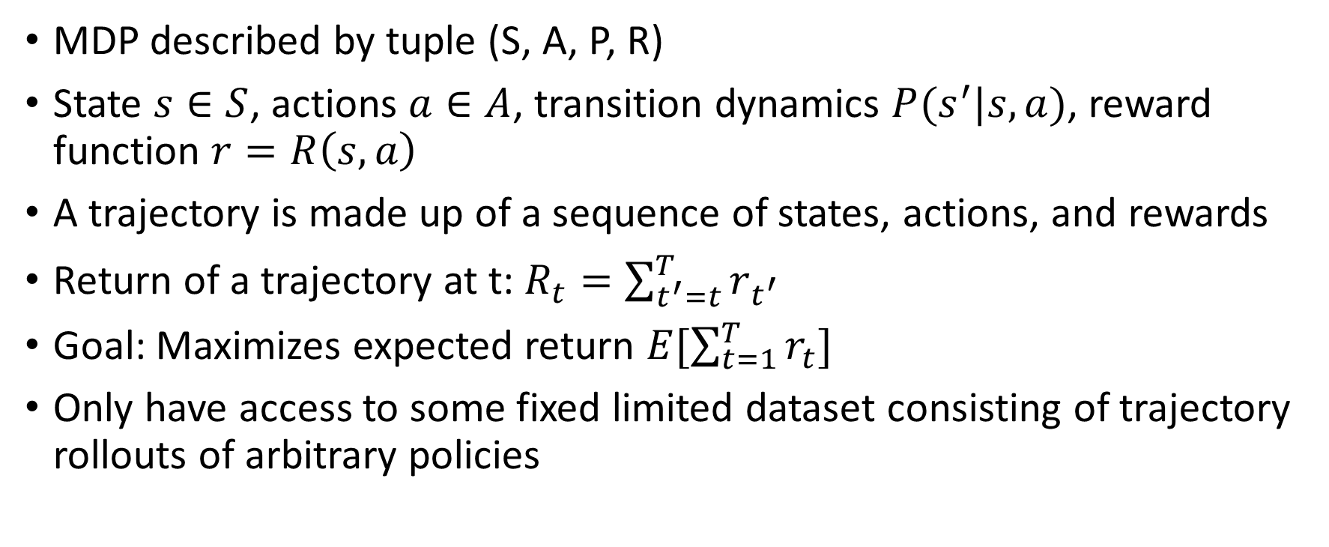
Offline Reinforcement Learning
MDP described by tuple (S, A, P, R)
State $s∈S$, actions $a∈A$, transition dynamics $P(s^{′}|s,a)$, reward function $r=R\left(s,a\right)$
A trajectory is made up of a sequence of states, actions, and rewards
Return of a trajectory at t: $R_{t}=\sum_{t^{′}=t}^{T}{r_{t^{′}}}$
Goal: Maximizes expected return $E[\sum_{t=1}^{T}{r_{t}}]$
Only have access to some fixed limited dataset consisting of trajectory rollouts of arbitrary policies

Slide 7
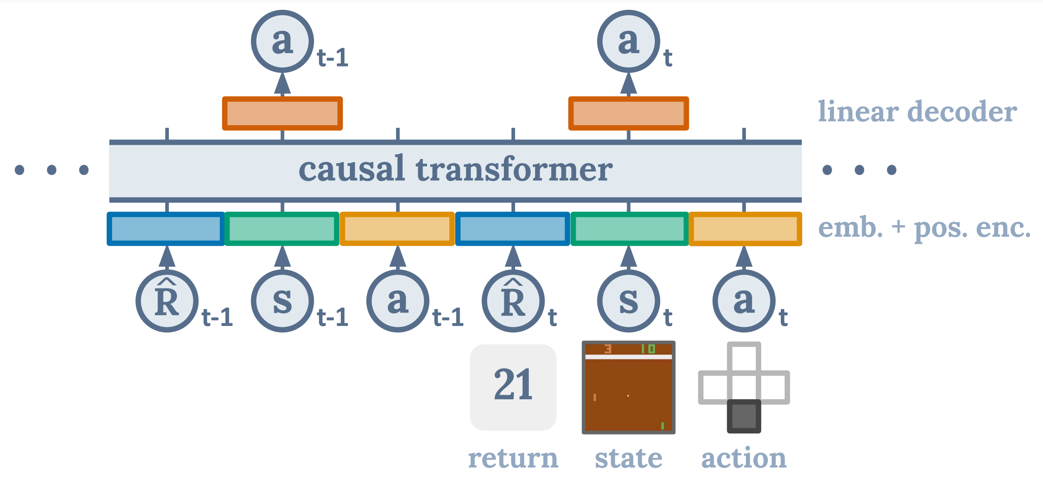
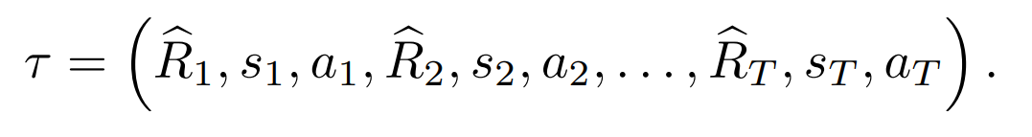
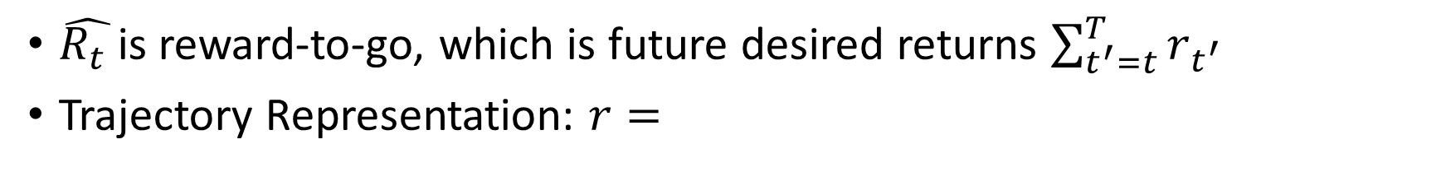
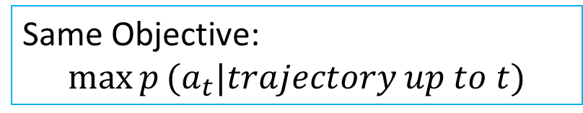
Architecture
Same Objective:
$$\max{p}(a_{t}|trajectory up to t)$$
$\hat{R_{t} }$is reward-to-go, which is future desired returns $\sum_{t^{′}=t}^{T}{r_{t^{′}}}$
Trajectory Representation: $r=$

Slide 8
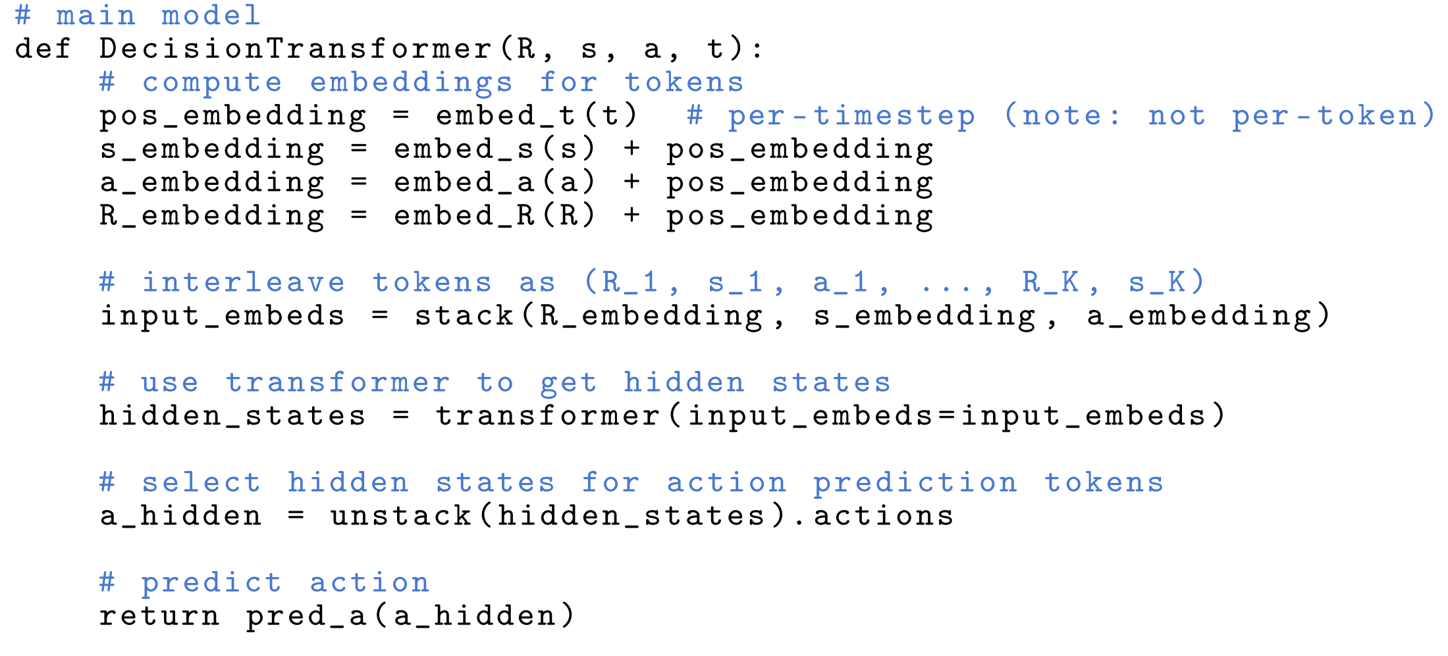
Architecture
K timesteps->3K tokens for R, S, A
Separate Embedding Layer for R, S, A

Slide 9
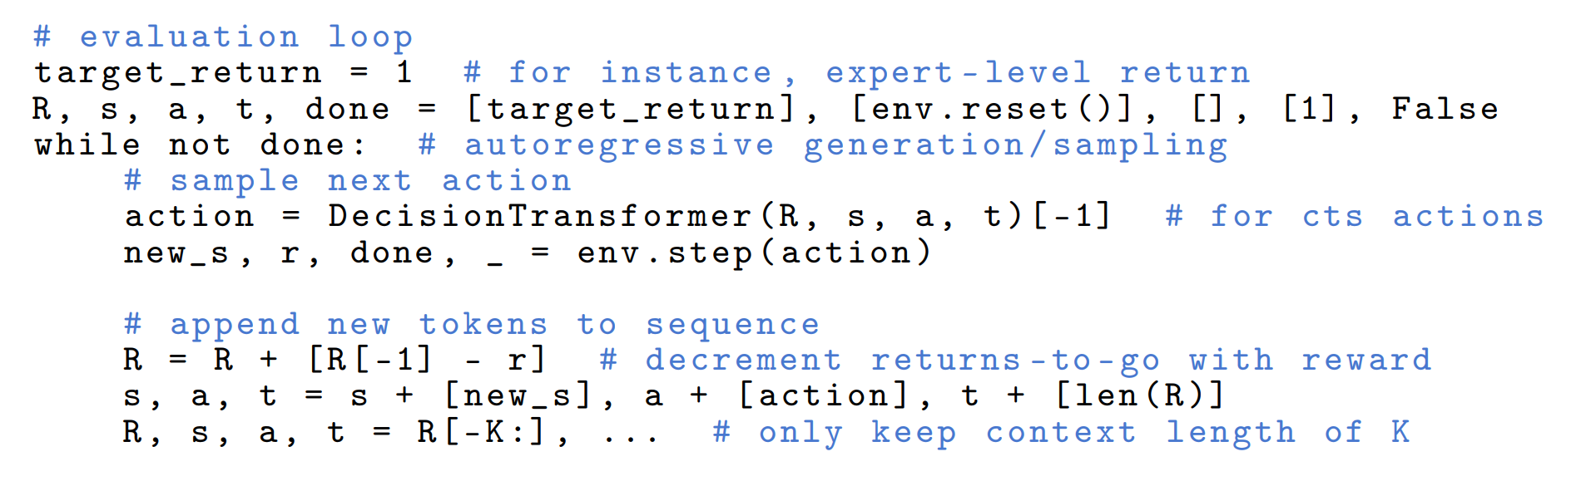

Inference
Set up R_0 (Expert-level performance or 1.5x SOTA Method Performance)
Environment would return r for timestep t, but the $R_{t}=R_{t−1}−r$ because $R_{0}=\sum_{t^{′}=0}^{T}{r_{t^{′}}}$

Slide 10
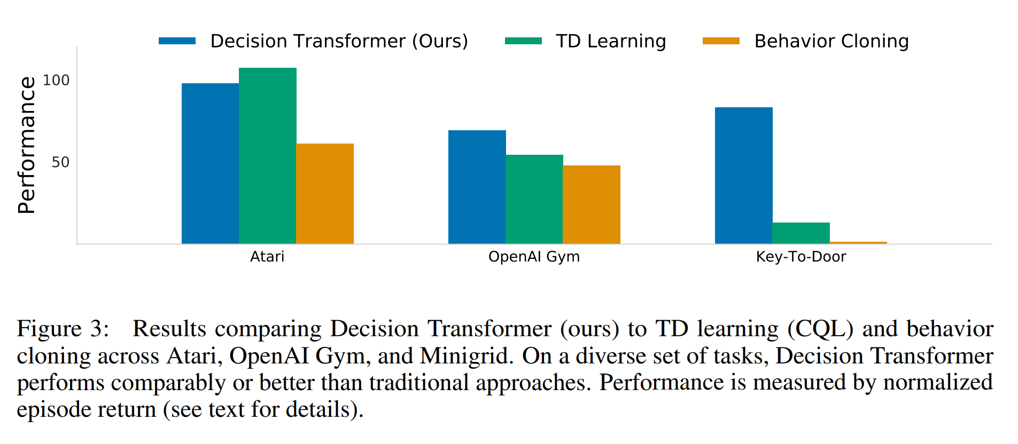
Performance
TD Learning: best model-free TD learning method
Behavior Cloning: predict action given states (without returns-to-go)

Slide 11
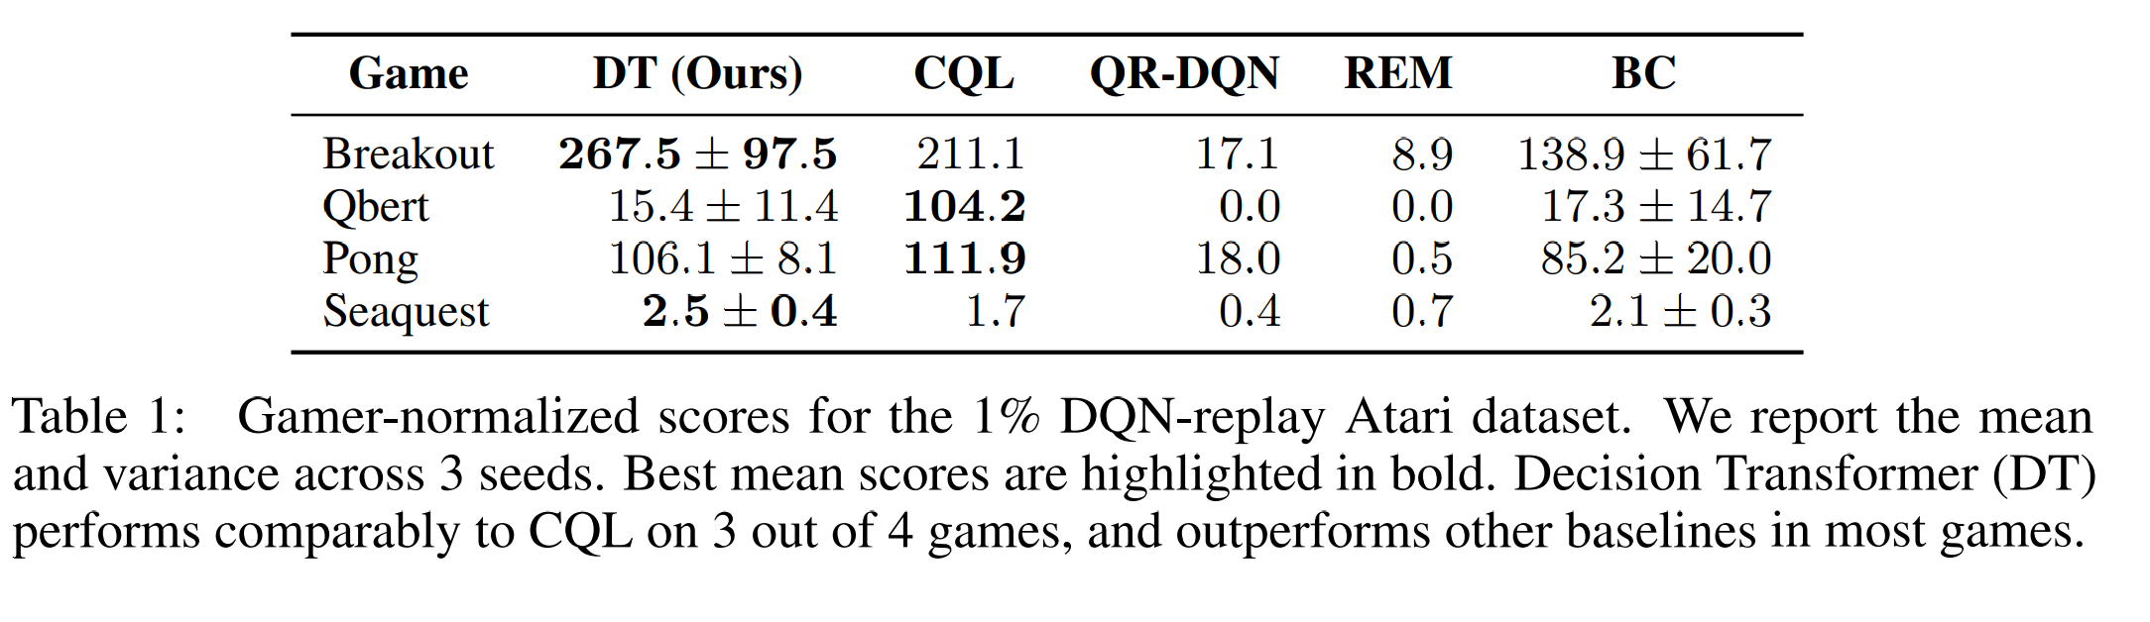
Atari

Slide 12
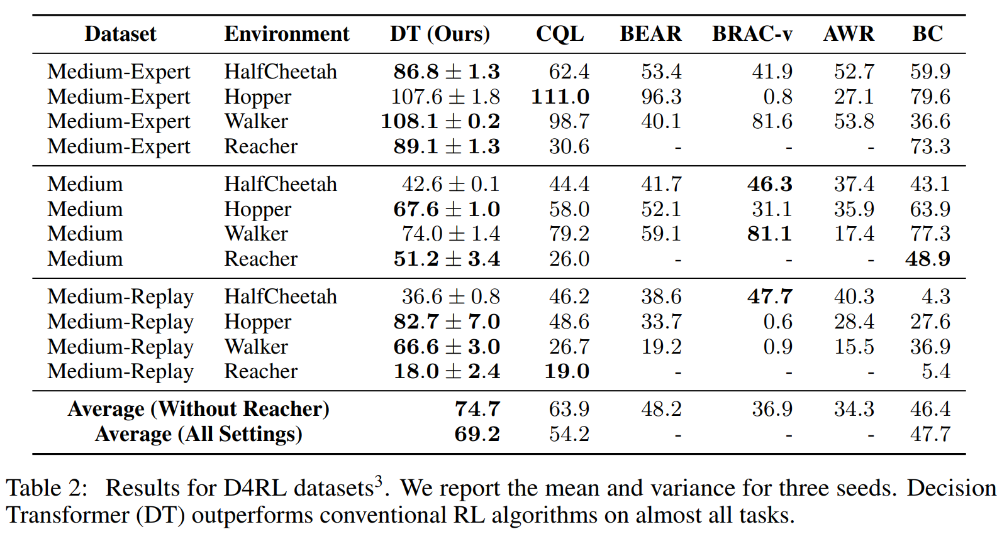
D4RL

Slide 13
Does Decision Transformer perform behavior cloning on a subset of the data?
Comparison with %BC (behavior cloning)
The percentile X% interpolates between standard BC (X = 100%) that trains on the entire dataset and only cloning the best observed trajectory (X → 0%).
Trade-off between better generalization and a specialized model on a desirable subset of data.
Decision Transformer either outperforms or is competitive to %BC, without the confound of having to select the optimal subset.

Slide 14
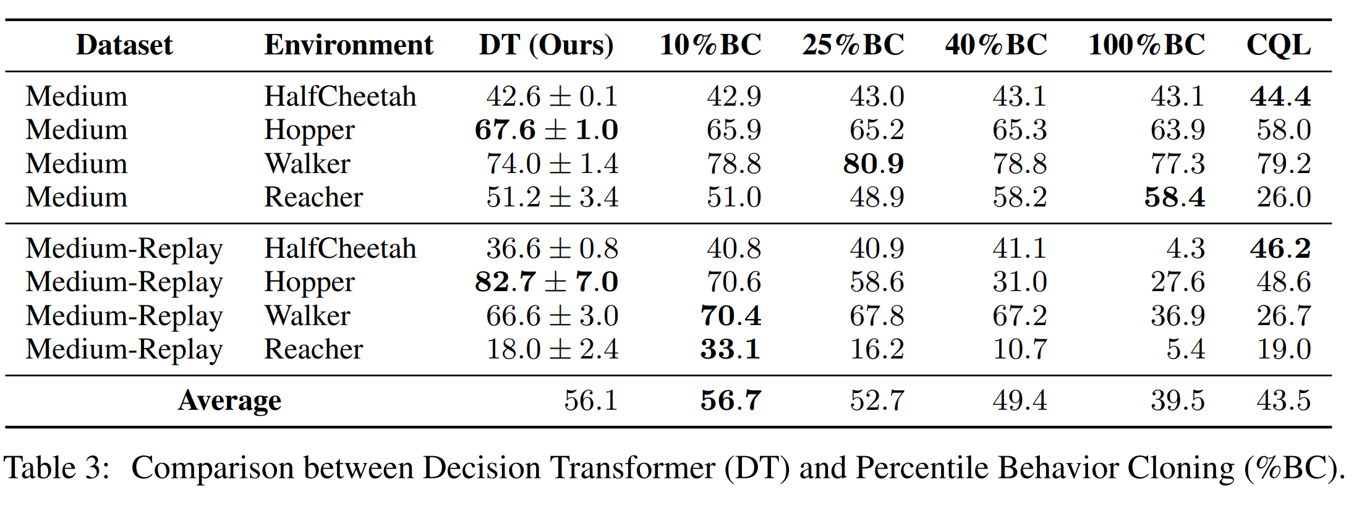
Does Decision Transformer perform behavior cloning on a subset of the data?
Data Sufficient Setting (D4RL)

Slide 15
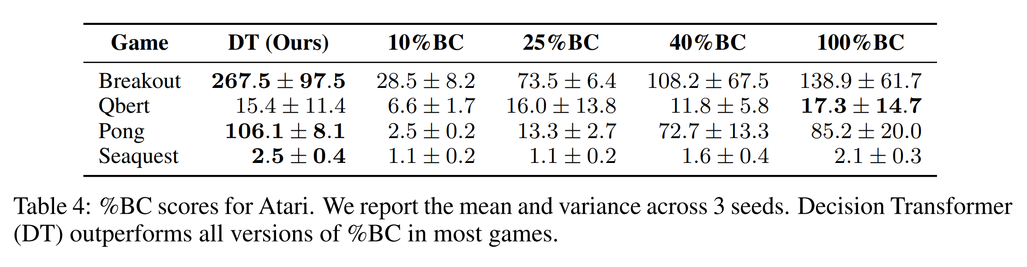
Does Decision Transformer perform behavior cloning on a subset of the data?
Data Limited Setting (Atari)
Decision Transformer can outperform %BC by using all trajectories in the dataset to improve generalization.

Slide 16
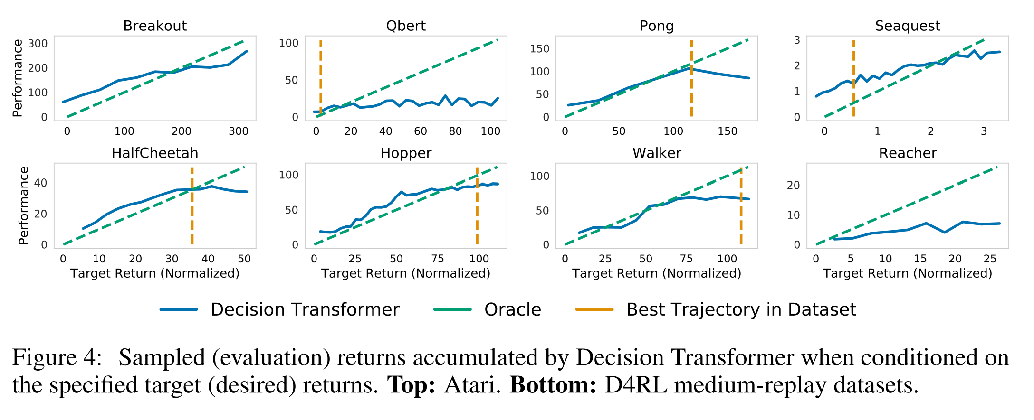
How well does Decision Transformer model the distribution of returns?
The decoding process would return a trajectory determined by the target return we set.
On every task, the desired target returns and the true observed returns are highly correlated.
Decision Transformer generates trajectories that almost perfectly match the desired returns.

Slide 17
How well does Decision Transformer model the distribution of returns?
Decision Transformer generates trajectories that almost perfectly match the desired returns.

Slide 18
How well does Decision Transformer model the distribution of returns?
We can prompt the Decision Transformer with higher returns than the maximum episode return available in the dataset, demonstrating that Decision Transformer is sometimes capable of extrapolation

