Slide 1
HuBERT
Presented by Junyi Ao
Nov 19, 2021

Slide 2
Speech Pre-Train
Use large amount of speech data and self-supervised learning to get a high-fidelity speech representations
Two types of information: Spoken content VS non-lexical information
Spoken content: lexical information
Non-lexical information
Speaker identity, emotion, hesitation and interruptions
Structured Noise, like laughter, coughing …

Slide 3
Speech Pre-Train
Compared to CV and NLP, self-supervised learning for speech signal has some challenges
Unlike CV, there are multiple sounds in each utterance
Unlike NLP, there is no discrete sound units since speech signal sequence is continuous
The boundaries between sound units are not known

Slide 4
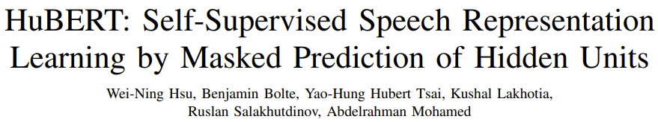
Hubert
Audio format:
Raw Waveform: 16000 sampling point per second, 16000 * 1
MFCC: 100 frames per second, 100 * 39, generated from raw waveform
Motivation: use some clustering algorithms like k-means to get the pseudo label of speech signal

Slide 5
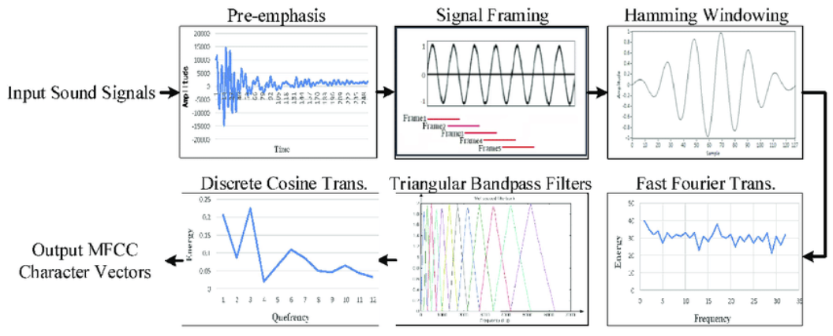
MFCC: Mel-Frequency Cepstral Coefficients
MFCC is usually used as the input of some speech tasks
It is produced by some complicated algorithms
The simplest speech representations
640 times shorter than the speech signal

Slide 6
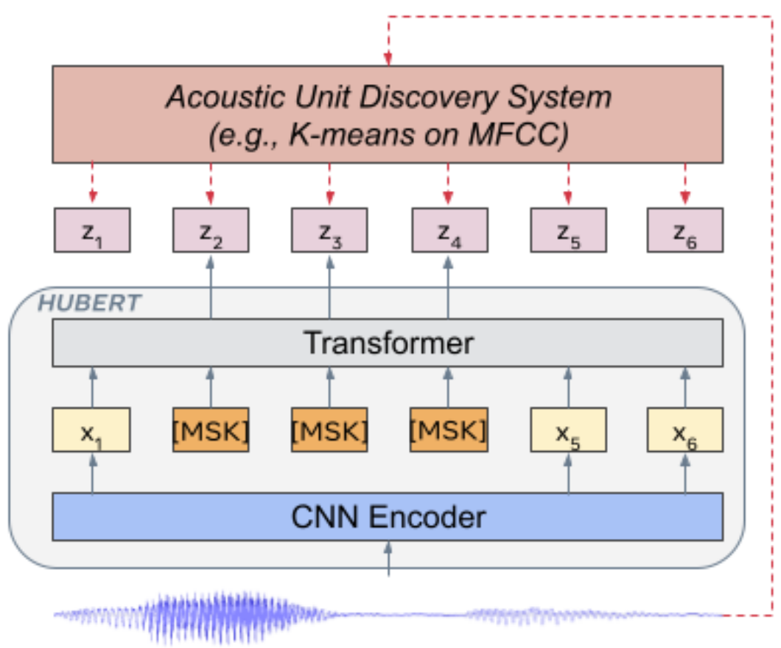
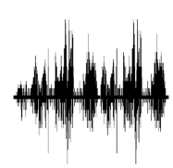
Hubert Model Structure
CNN Encoder: down-sample the input speech signal, so that the output length is 320 times shorter than the length of raw waveform
Assume 1s waveform, then
Raw waveform with the length of 16000 as the input,
Label from k-means on MFCC, with the length of 100 as the output
Raw Waveform: 16000

Slide 7
Hubert Model Structure
CNN Encoder: down-sample the input speech signal, so that the output length is 320 times shorter than the length of raw waveform
Assume 1s waveform, then
Raw waveform with the length of 16000 as the input,
Label from k-means on MFCC, with the length of 100 as the output
HuBERT
50x768
Raw Waveform: 16000
Sequence Length
Model Dimension

Slide 8

Hubert Model Structure
CNN Encoder: down-sample the input speech signal, so that the output length is 320 times shorter than the length of raw waveform
Assume 1s waveform, then
Raw waveform with the length of 16000 as the input,
Label from k-means on MFCC, with the length of 100 as the output
1 1 3 5 5 9 6 3 4
1 1 3 5 5 9 6 3 4
HuBERT
50x768
Raw Waveform: 16000
Sequence Length
Model Dimension

Slide 9
Hubert Model Structure
Two stages for training
First iteration: K-means is used to generate a pseudo label for each MFCC frame
Second iteration: K-means is applied on the 6-th layer transformer layer of the first iteration
Third iteration (large model): K-means on the 9-th transformer layer of the second iteration

Slide 10
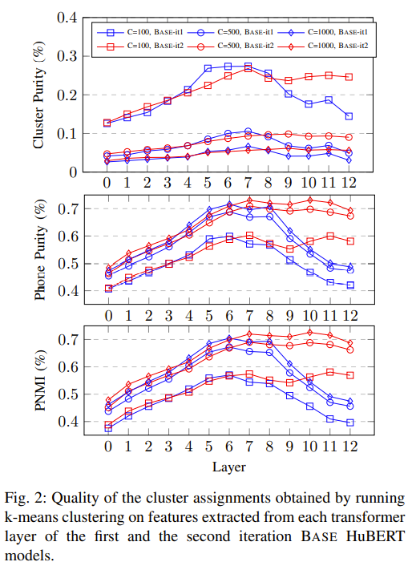
Why 6-th layer of Iteration 1 and 9-th layer of iteration 2?
Phone Purity
Conditional Probability of phone given a k-means label
Cluster Purity
Conditional Probability of a k-means label given phone label
Phone-normalized Mutual Information (PNMI)
the percentage of uncertainty about the phone label eliminated after observing the k-means label

Slide 11
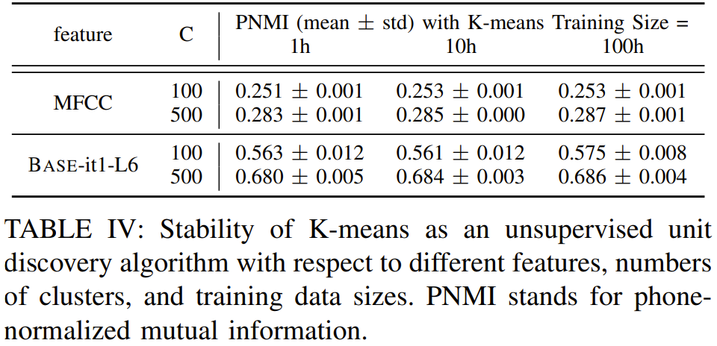
Ablation study: K-Means Stability
PNMI: phone-normalized mutual information
Labels of first iteration and second iteration for 100 and 500 clusters (C)
Increasing the amount of data, the gain is small
Much higher PNMI when clustering on HuBERT features

Slide 12
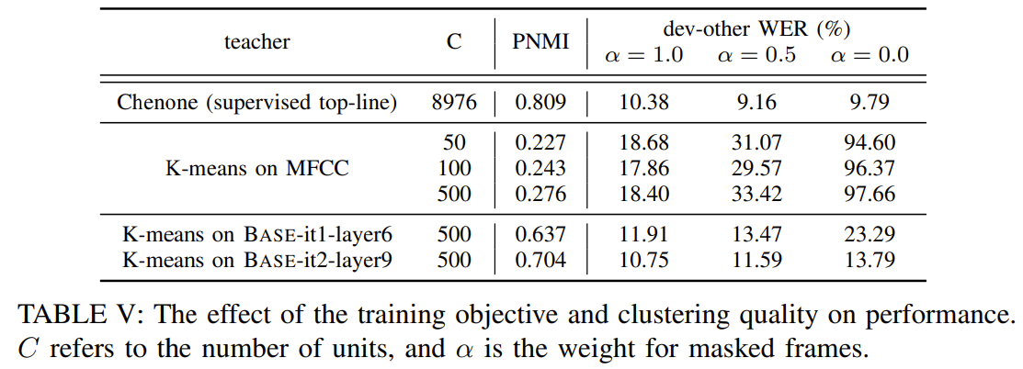
Ablation study: The Importance of Predicting Masked Frames

Slide 13
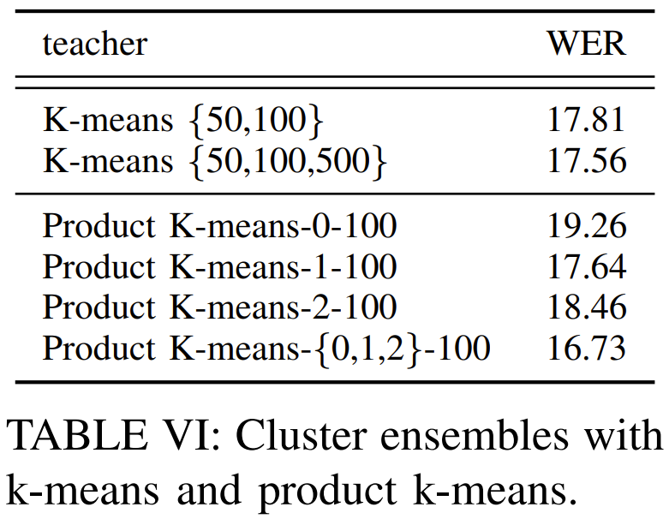
Ablation study: The Effect of Cluster Ensembles

Slide 14
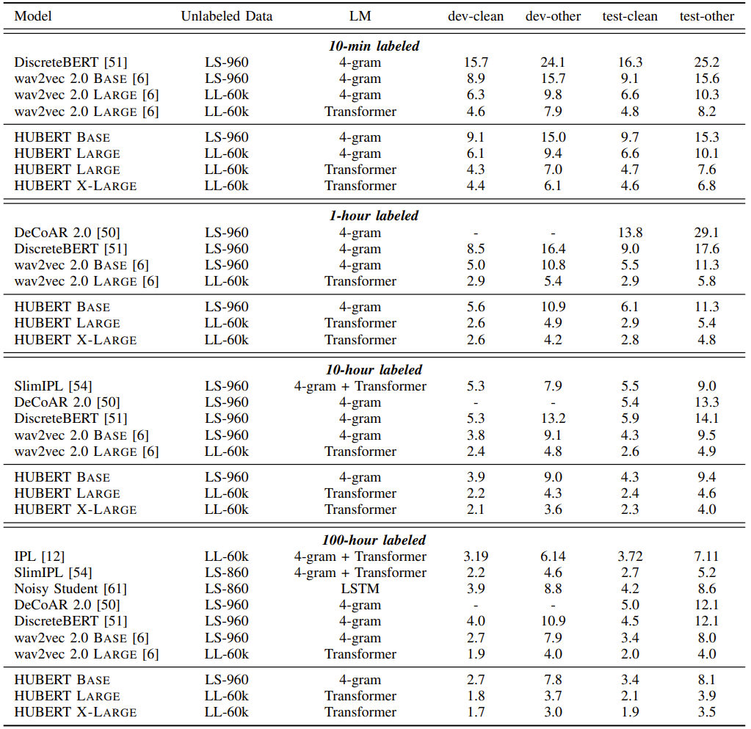
Hubert Results on Low Resource Setups

Slide 15
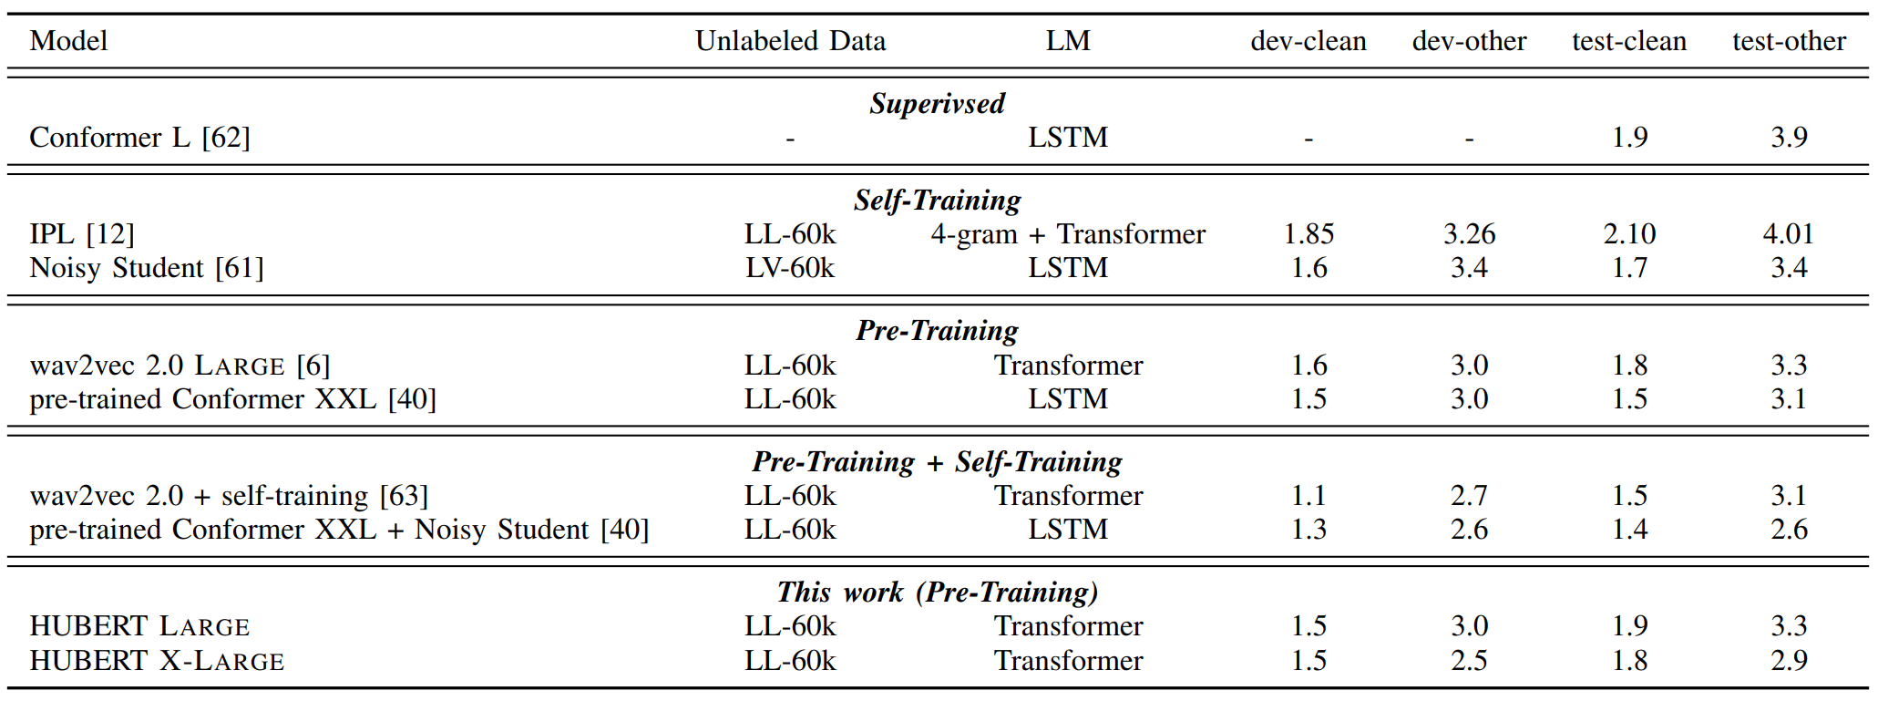
Hubert Results on High Resource Setups

Slide 16
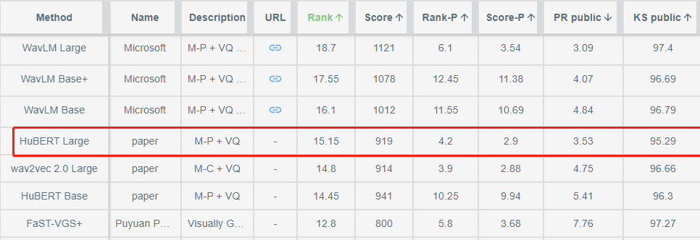
Superb Benchmark
Leaderboard to benchmark the performance of speech pretrain models
Hubert achieves the best performance on almost all the tasks before WavLM
https://superbbenchmark.org/leaderboard

