Slide 1
TRAIN SHORT, TEST LONG: ATTENTION WITH LINEAR BIASES ENABLES INPUT LENGTH EXTRAPOLATION
2021.09.24
https://github.com/ofirpress/attention_with_linear_biases

Slide 2
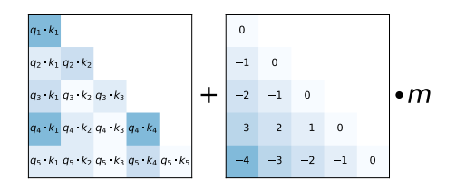
Abstract
This paper introduces an efficient method, Attention with Linear Biases (ALiBi) to achieve extrapolation at inference time to longer sequences than seen during training.
They provide the analysis of ALiBi to understand why it leads to better performance.

Slide 3
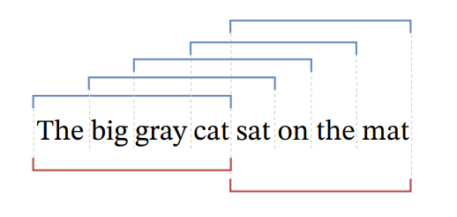
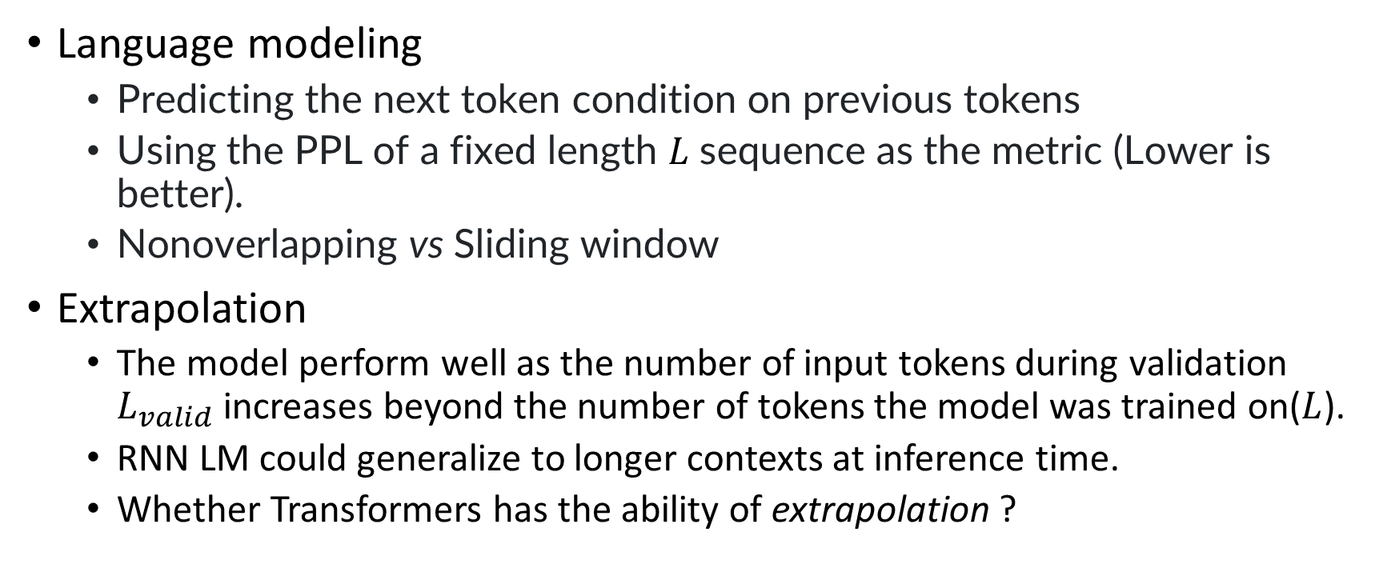
Background
Language modeling
Predicting the next token condition on previous tokens
Using the PPL of a fixed length $L$sequence as the metric (Lower is better).
Nonoverlapping vs Sliding window
Extrapolation
The model perform well as the number of input tokens during validation $L_{valid}$ increases beyond the number of tokens the model was trained on($L$).
RNN LM could generalize to longer contexts at inference time.
Whether Transformers has the ability of extrapolation ?

Slide 4

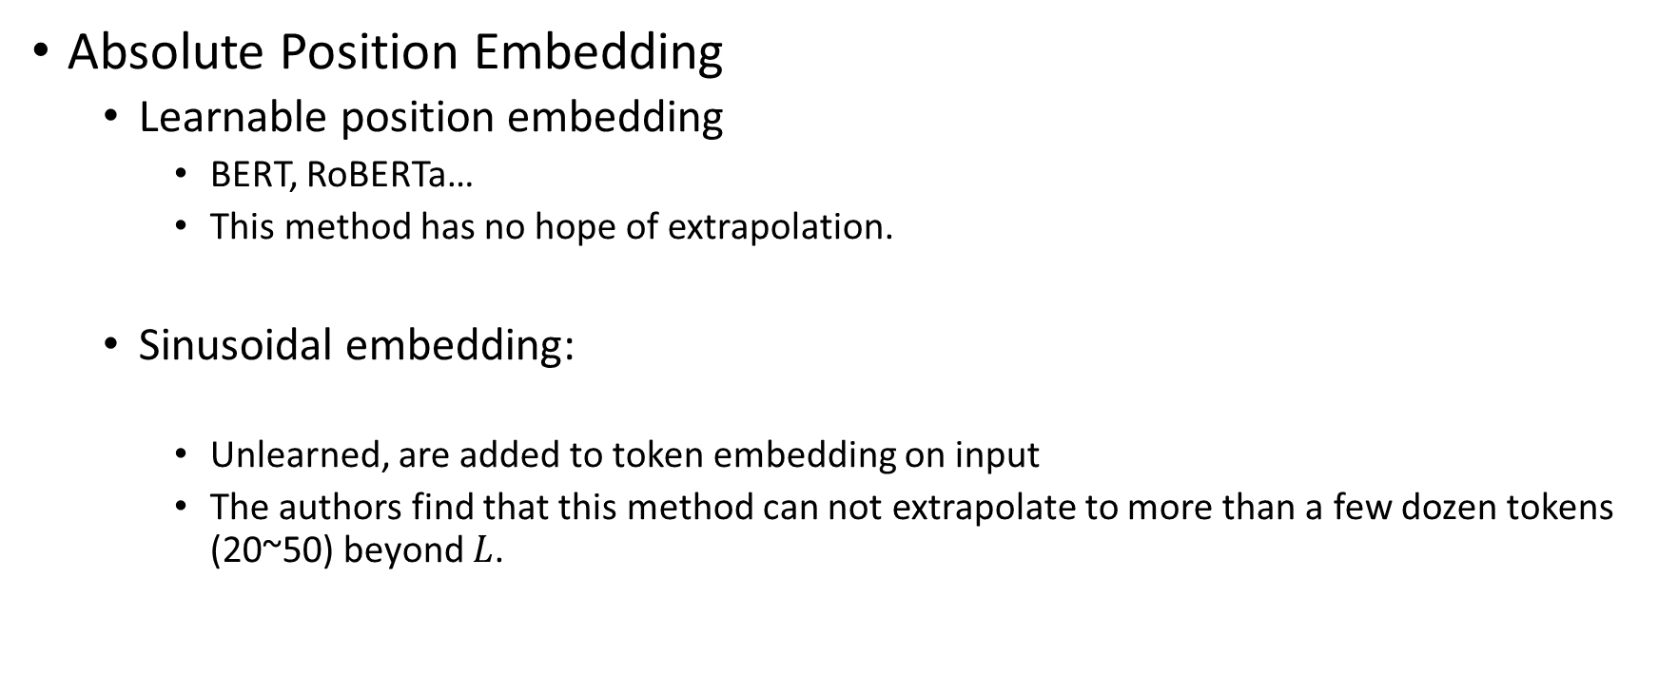
Background
Absolute Position Embedding
Learnable position embedding
BERT, RoBERTa…
This method has no hope of extrapolation.
Sinusoidal embedding:
Unlearned, are added to token embedding on input
The authors find that this method can not extrapolate to more than a few dozen tokens (20~50) beyond $L$.

Slide 5
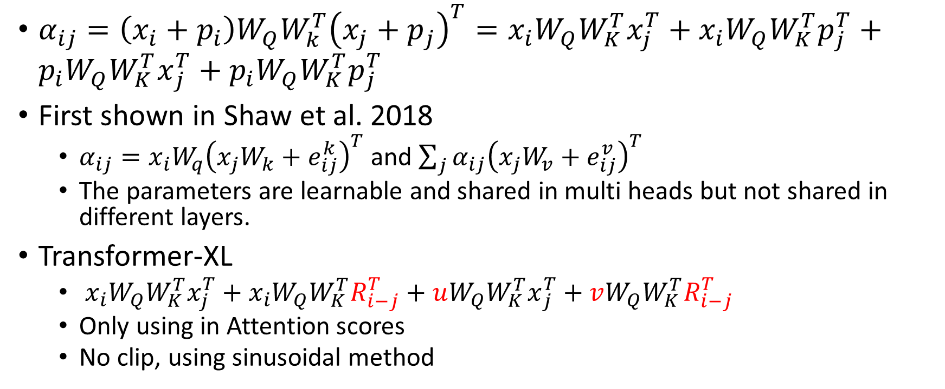
Relative Position Embedding
$α_{ij}=\left(x_{i}+p_{i}\right)W_{Q}W_{k}^{T}{\left(x_{j}+p_{j}\right)}^{T}=x_{i}W_{Q}W_{K}^{T}x_{j}^{T}+x_{i}W_{Q}W_{K}^{T}p_{j}^{T}+p_{i}W_{Q}{W_{K}^{T}x}_{j}^{T}+p_{i}W_{Q}W_{K}^{T}p_{j}^{T}$
First shown in Shaw et al. 2018
$α_{ij}=x_{i}W_{q}{\left(x_{j}W_{k}+e_{ij}^{k}\right)}^{T}$ and $\sum_{j}{α_{ij}{\left(x_{j}W_{v}+e_{ij}^{v}\right)}^{T}}$
The parameters are learnable and shared in multi heads but not shared in different layers.
Transformer-XL
$x_{i}W_{Q}W_{K}^{T}x_{j}^{T}+x_{i}W_{Q}W_{K}^{T}R_{i−j}^{T}+uW_{Q}{W_{K}^{T}x}_{j}^{T}+vW_{Q}W_{K}^{T}R_{i−j}^{T}$
Only using in Attention scores
No clip, using sinusoidal method

Slide 6
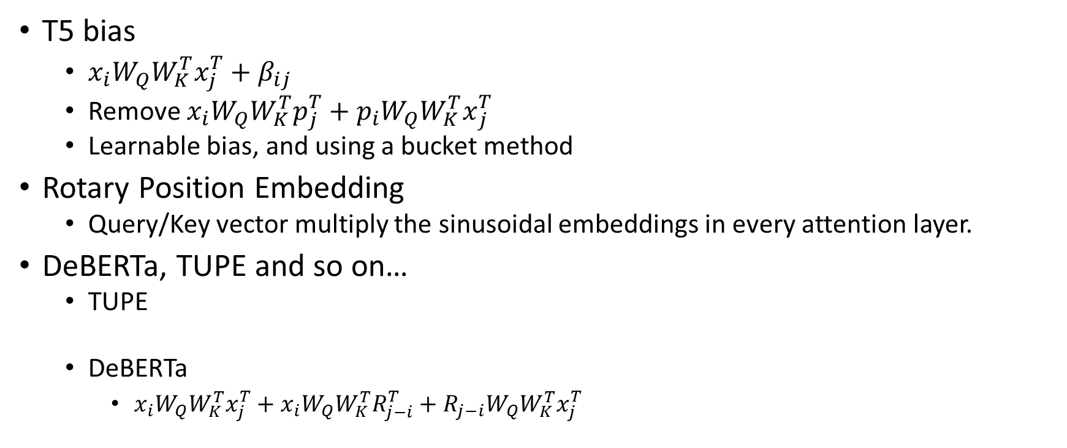
Relative Position Embedding
T5 bias
$x_{i}W_{Q}W_{K}^{T}x_{j}^{T}+β_{ij}$
Remove $x_{i}W_{Q}W_{K}^{T}p_{j}^{T}+p_{i}W_{Q}{W_{K}^{T}x}_{j}^{T}$
Learnable bias, and using a bucket method
Rotary Position Embedding
Query/Key vector multiply the sinusoidal embeddings in every attention layer.
DeBERTa, TUPE and so on…
TUPE
DeBERTa
$x_{i}W_{Q}W_{K}^{T}x_{j}^{T}+x_{i}W_{Q}W_{K}^{T}R_{j−i}^{T}+R_{j−i}W_{Q}W_{K}^{T}x_{j}^{T}$

Slide 7
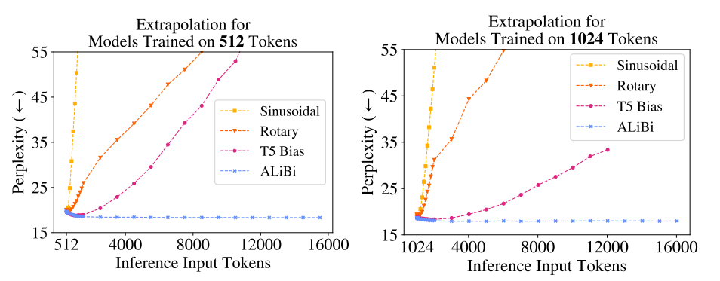
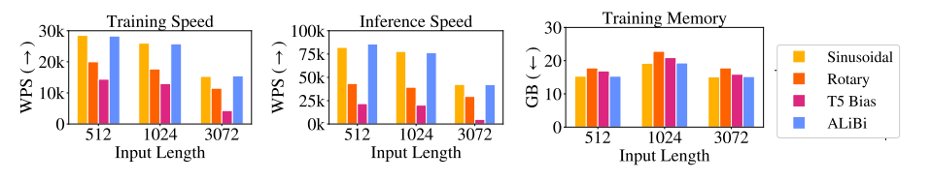
Limitation

Slide 8

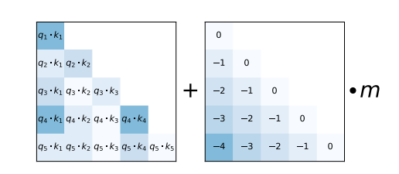
ALiBi
Compared to a sinusoidal model trained on the same input length, ALiBi does not require additional runtime or parameters and incurs only a negligible (0–0.7%) memory increase.
ALiBi allows for training on much smaller sequences while still achieving (and sometimes surpassing) results obtained using sinusoidal embeddings on longer sequences.

Slide 9
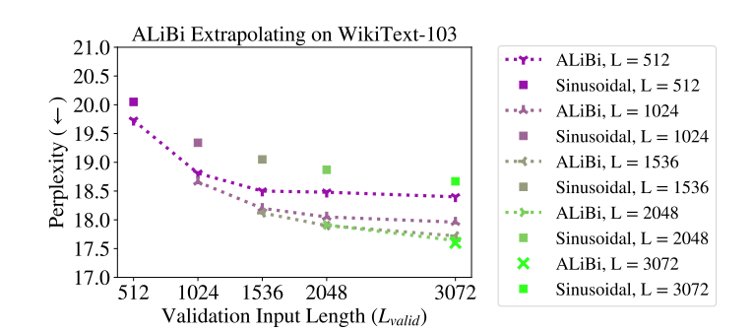
PPL Results

Slide 10
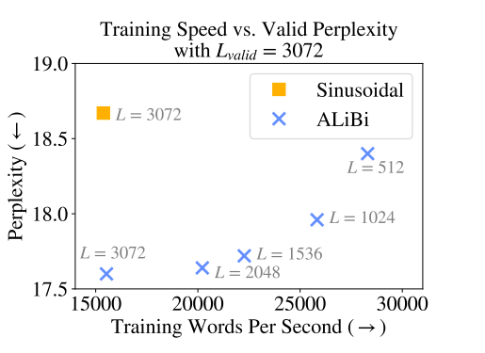
Training Speed

Slide 11
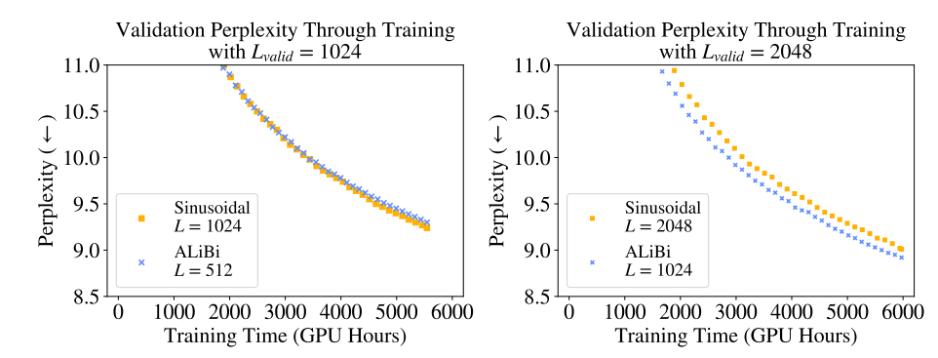
Training Time

Slide 12
Analysis
The results show that the ALiBi method (or T5 bias) allow language models to extrapolate during inference.
Why
The models use longer contexts to make more accurate predictions.
Longer input sequences mean the early token curse is reduced.
Use sliding window evaluation with a stride of 1

Slide 13
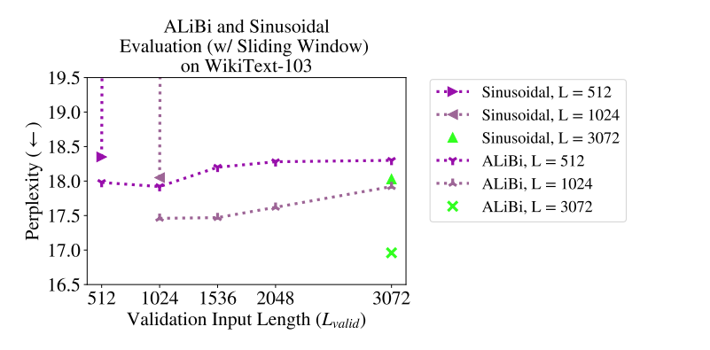
Analysis

Slide 14
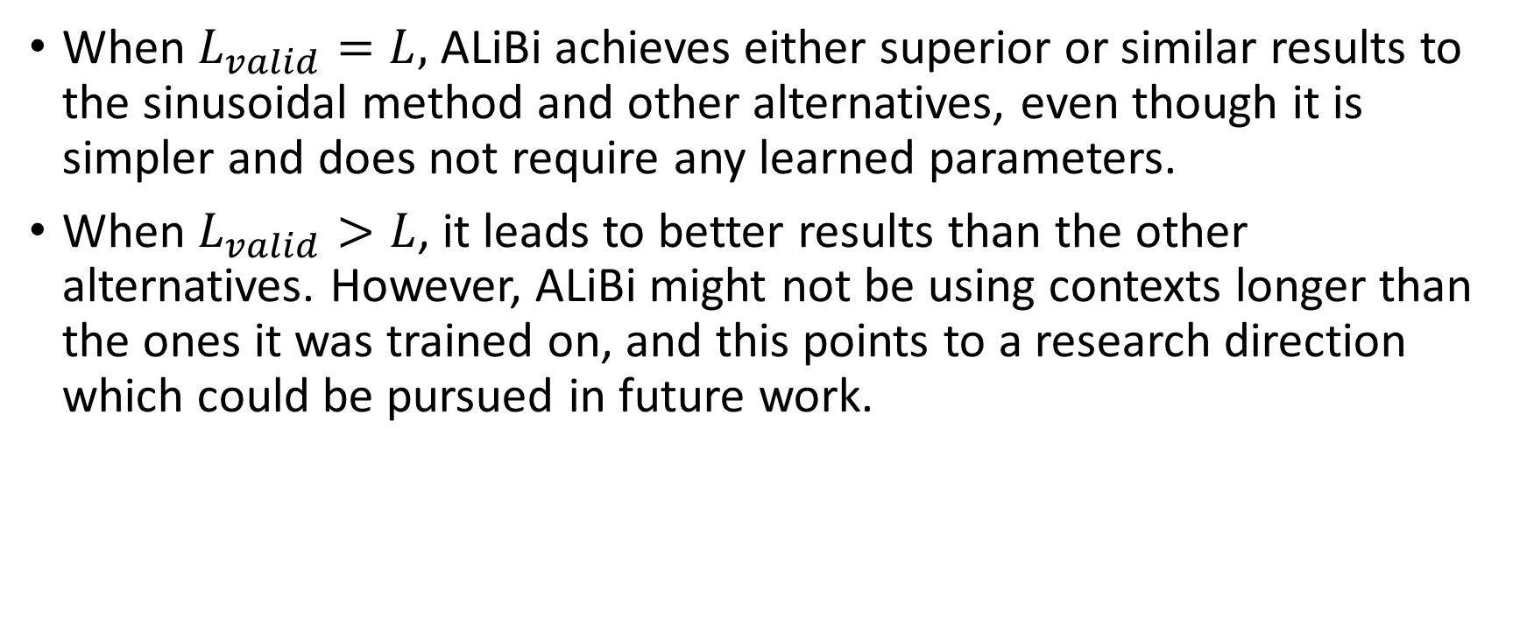
Overall
When $L_{valid}=L,$ ALiBi achieves either superior or similar results to the sinusoidal method and other alternatives, even though it is simpler and does not require any learned parameters.
When $L_{valid}>L$, it leads to better results than the other alternatives. However, ALiBi might not be using contexts longer than the ones it was trained on, and this points to a research direction which could be pursued in future work.

Slide 15
Resource
https://github.com/ofirpress/attention_with_linear_biases
https://github.com/huggingface/transformers/blob/master/src/transformers/models/t5/modeling_t5.py/
https://github.com/ZhuiyiTechnology/roformer

