Slide 1
Data2vec: A General Framework for Self-supervised Learning in Speech, Vision and Language
Presented by Ziqiang Zhang
Apr 22, 2022

Slide 2
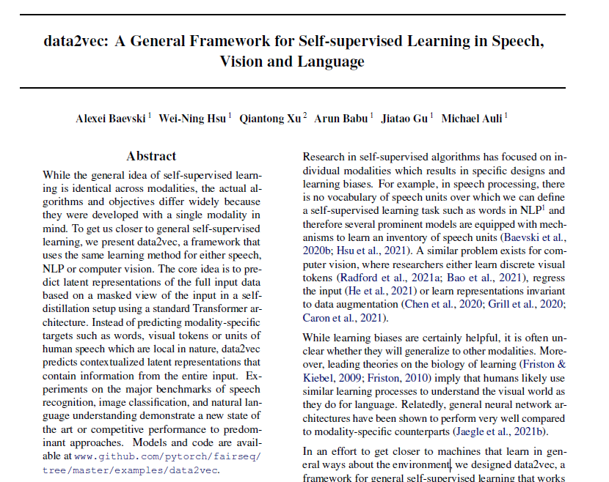
Outline
Background
SSL for language
SSL for vision
SSL for speech
Introduction of data2vec
Method
Experiments
Discussions

Slide 3
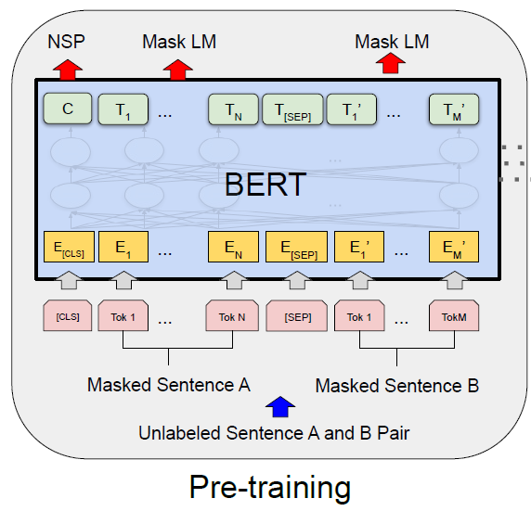
Background: SSL for language
Learn a language model from unlabeled text, boosting downstream NLP tasks
A very popular framework: BERT [1]
Predicting masked tokens from their context
Key components:
Input: Sequential tokens with masking
Target: Masked tokens
Model: Transformer
Tokens are pre-defined! e.g. word, sub-word, …
Image source: [1] https://arxiv.org/abs/1810.04805

Slide 4
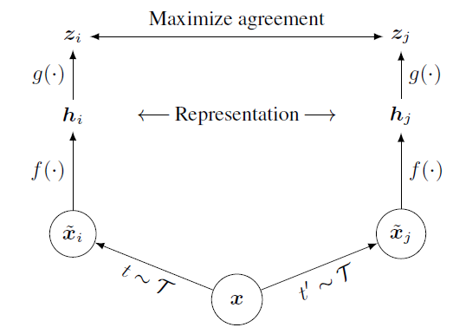
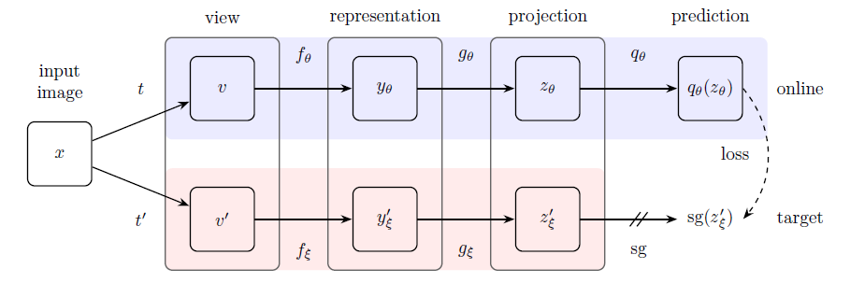
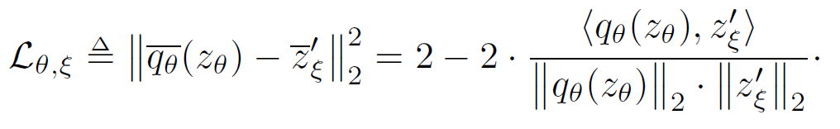
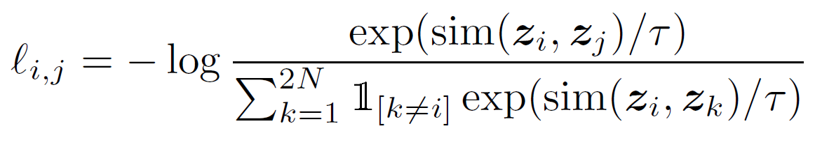

Background: SSL for Vision
Consistency based
Agreement between different augmentations of the same image
Key components:
Input: Two streams of a same image
Target: Representations from another stream
Model: ResNet
BYOL [3] (similarity)
SimCLR [2] (contrastive)
[2] Chen, Ting, et al. A simple framework for contrastive learning of visual representations.
[3] Grill, Jean-Bastien, et al. Bootstrap your own latent-a new approach to self-supervised learning.

Slide 5
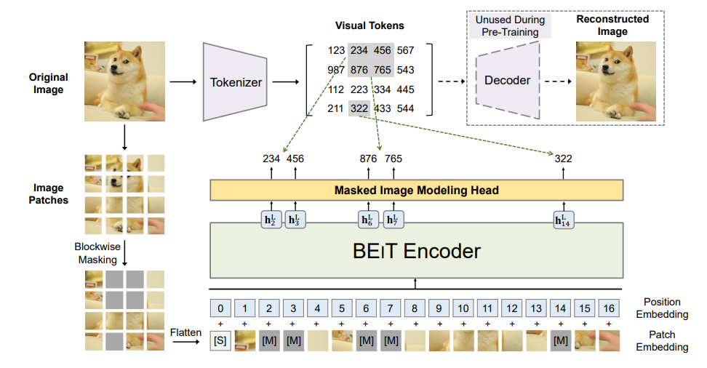
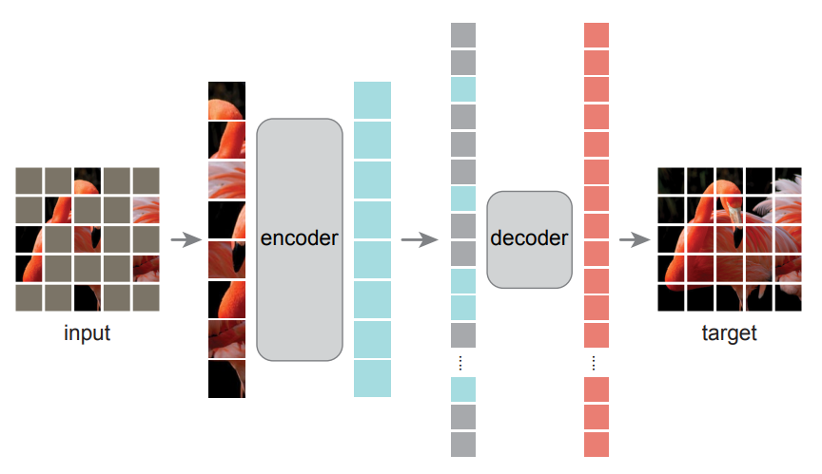
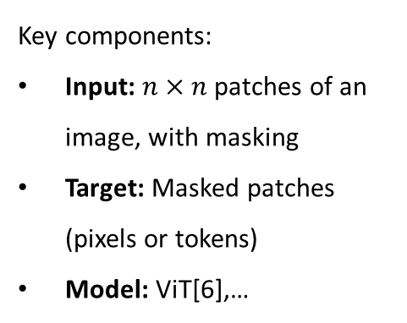
Background: SSL for Vision
BERT based
Modeling a series of patches (of an image) and their dependency
Key components:
Input: $n×n$ patches of an image, with masking
Target: Masked patches (pixels or tokens)
Model: ViT[6],…
A pre-learned image tokenizer
VAE [5]
Reconstruct masked patches by a decoder
BEiT [4]
Every patch corresponds to a discrete token
[4] Bao, Hangbo, et. al. "Beit: Bert pre-training of image transformers.”
[5] He, Kaiming, et al. "Masked autoencoders are scalable vision learners.”
[6] Dosovitskiy, Alexey, et al. "An image is worth 16x16 words: Transformers for image recognition at scale."

Slide 6
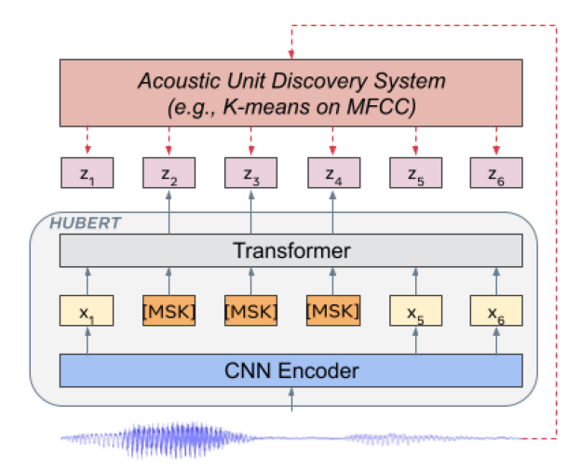
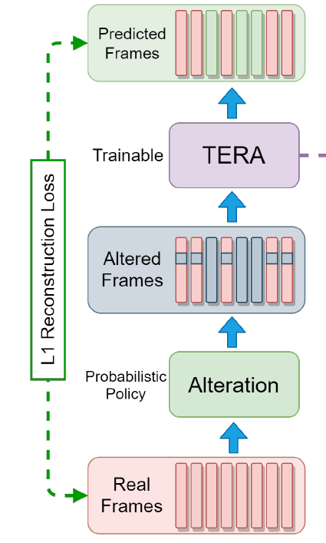
Background: SSL for Speech (sequential)
BERT based
Predict masked speech frames
Key components:
Input: Down-sampled speech frames (MFCC or CNN), with masking
Target: Masked frames (MFCC or discrete tokens)
Model: CNN-Transformer
Hubert [7]
Predicts tokens of the masked frames
TERA [8]
Reconstruct masked(altered) frames
[7] Hsu, Wei-Ning, et al. "Hubert: Self-supervised speech representation learning by masked prediction of hidden units." IEEE/ACM Transactions on Audio, Speech, and Language Processing 29 (2021): 3451-3460.
[8] Liu, Andy T., Shang-Wen Li, and Hung-yi Lee. "Tera: Self-supervised learning of transformer encoder representation for speech." IEEE/ACM Transactions on Audio, Speech, and Language Processing 29 (2021): 2351-2366.

Slide 7
Background: Sumamry of SSL for different modalities
Task (shared): Predicting the corrupted region of input
Discrete tokens
Target: various definations
Continuous signal
Reprent. of (other) model
Predictor
Decoder / Classifier,…
Model: partially modality-agnostic
Backbone
Transformer / ResNet,…
Corruption
Masking / Data augmentation,…
Input: modality specific
Feature Net
Embedding / Linear / CNN,…
Words
(Sub)Image
Speech features

Slide 8
Data2vec: Overview
Motivation:
A general framework for self-supervised learning that works for images, speech and text
The learning objective is identical in each modality: predicting contextualized latent representations
Free of modality-specific targets (pre-defined subwords, offline visual tokens, speech units,…)
Still, use modality specific feature net, and uniform transformer backbone
Still, use masked prediction as pre-training task
Work individually for each modality

Slide 9
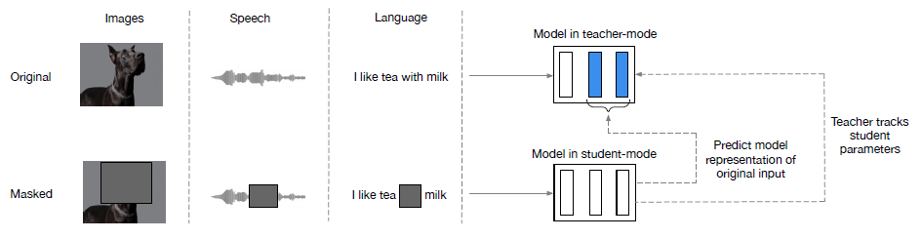
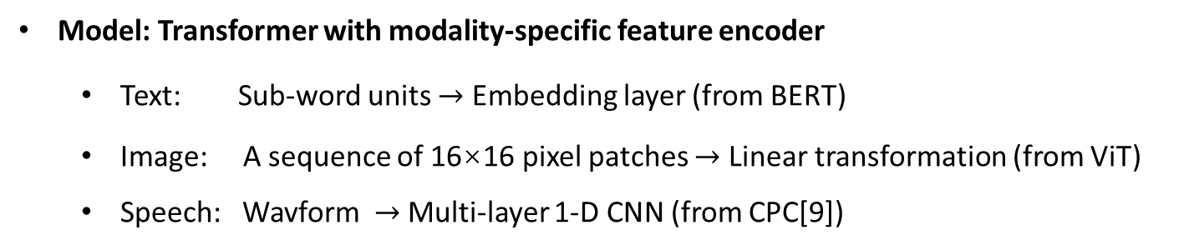
Data2vec: Method
Model: Transformer with modality-specific feature encoder
Text: Sub-word units $→$ Embedding layer (from BERT)
Image: A sequence of 16×16 pixel patches $→$ Linear transformation (from ViT)
Speech: Wavform $→$ Multi-layer 1-D CNN (from CPC[9])
[9] Oord, Aaron van den, Yazhe Li, and Oriol Vinyals. "Representation learning with contrastive predictive coding." arXiv preprint arXiv:1807.03748 (2018).

Slide 10
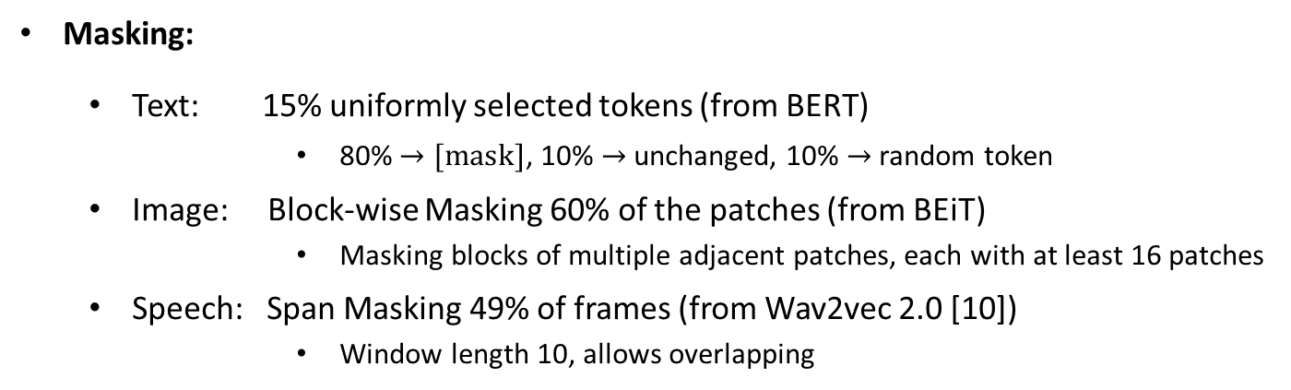
Data2vec: Method
Masking:
Text: 15% uniformly selected tokens (from BERT)
80% $→[mask]$, 10% $→$ unchanged, 10% $→$ random token
Image: Block-wise Masking 60% of the patches (from BEiT)
Masking blocks of multiple adjacent patches, each with at least 16 patches
Speech: Span Masking 49% of frames (from Wav2vec 2.0 [10])
Window length 10, allows overlapping
[10] Baevski, Alexei, et al. "wav2vec 2.0: A framework for self-supervised learning of speech representations." Advances in Neural Information Processing Systems 33 (2020): 12449-12460.

Slide 11
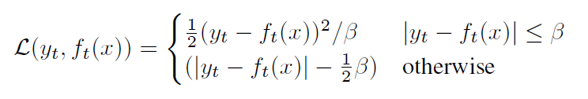
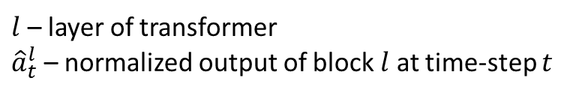
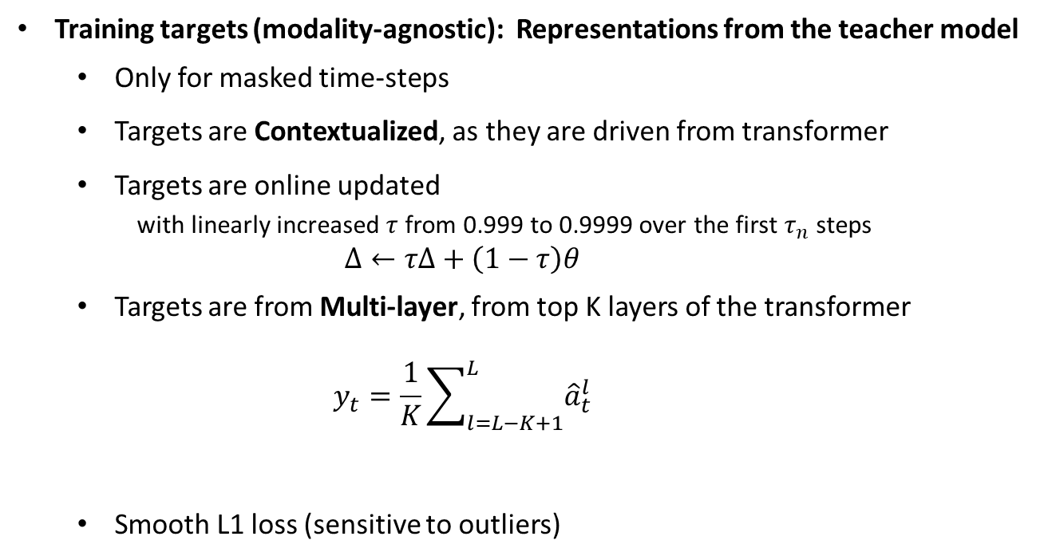
Data2vec: Method
Training targets (modality-agnostic): Representations from the teacher model
Only for masked time-steps
Targets are Contextualized, as they are driven from transformer
Targets are online updated
with linearly increased $τ$ from 0.999 to 0.9999 over the first $τ_{n}$ steps
$$Δ←τΔ+\left(1−τ\right)θ$$
Targets are from Multi-layer, from top K layers of the transformer
$$y_{t}=\frac{1}{K}\sum_{l=L−K+1}^{L}{{\hat{a}}_{t}^{l}}$$
Smooth L1 loss (sensitive to outliers)
$l$ – layer of transformer
${\hat{a}}_{t}^{l}$ – normalized output of block $l$ at time-step $t$

Slide 12
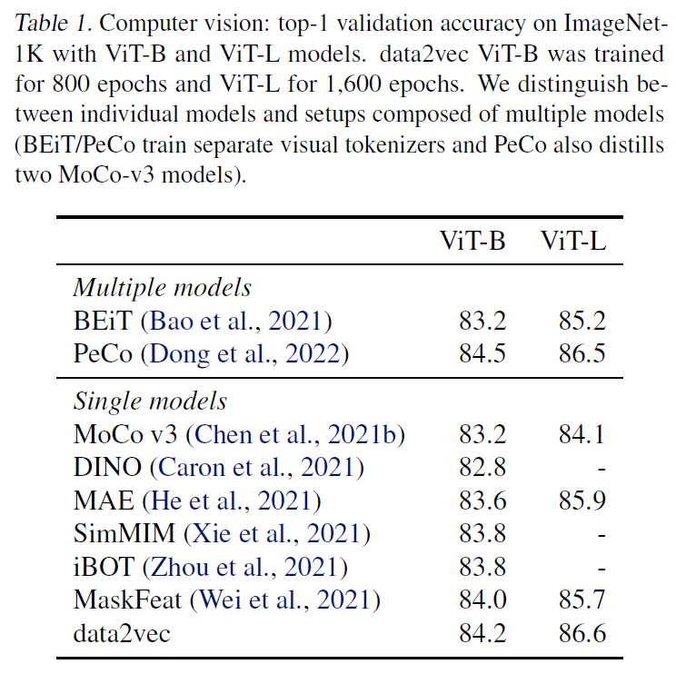
Data2vec: Experiments – Vision
Predicting contextualized latent representations in a masked prediction setup can perform very well
Also outperform prior self-distillation methods (only regressed the final layer, DINO)

Slide 13
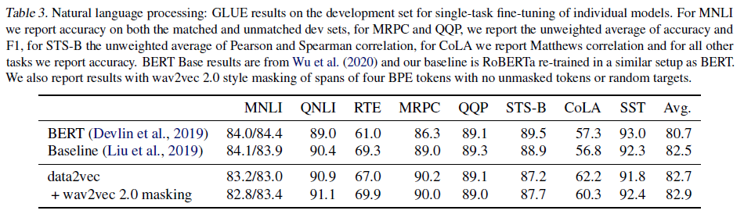
Data2vec: Experiments – Language
Outperform the RoBERTa baseline
Enable the model to predict targets with specific properties of the current sequence, rather than generic representations
Wav2vec 2.0 masking even performs better
4 bpe tokens, 0.35%
Natural language inference: NMLI, QNLI, RTE
Sentence similarity: MRPC, QQP, STS-B
Grammaticality: CoLA
Sentiment analysis: SST

Slide 14
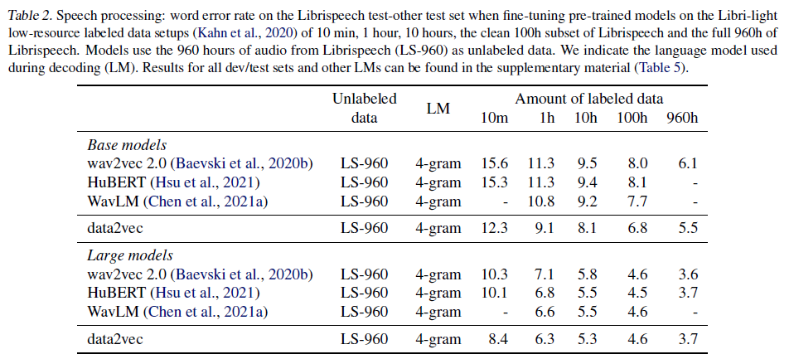
Data2vec: Experiments – Speech
Improvements for most setups, especially for low-resource setup (10m)
Learning discrete units is not required when rich contextualized targets are used

Slide 15
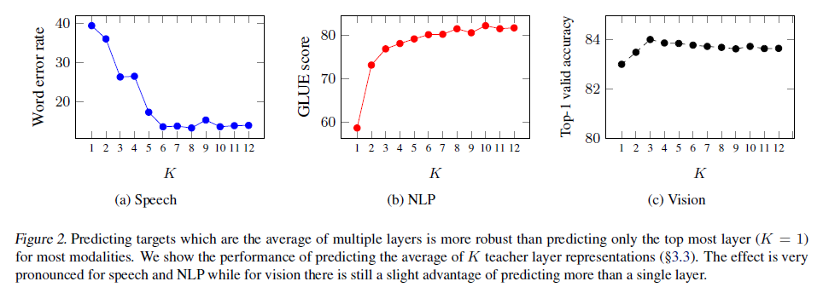
Data2vec: Experiments – Multi-layer targets
Averaging multi-layer representations is surprising effective !
Results in figure are obtained in reduced experimental setting (shorter pre-training)
Different types of features are extracted at different layers

Slide 16
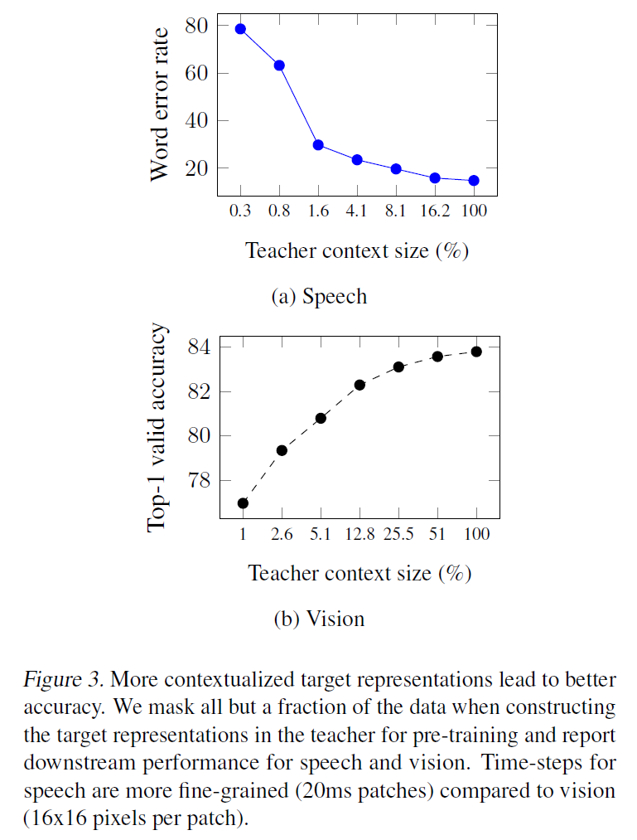
Data2vec: Experiments – Contextualized targets
Obtain local targets by restricting the self-attention mechansim of the teacher to only be able to access a portion of the input surrounding the current time-step
Local targets perform badly, contextualized targets are required for data2vec

Slide 17
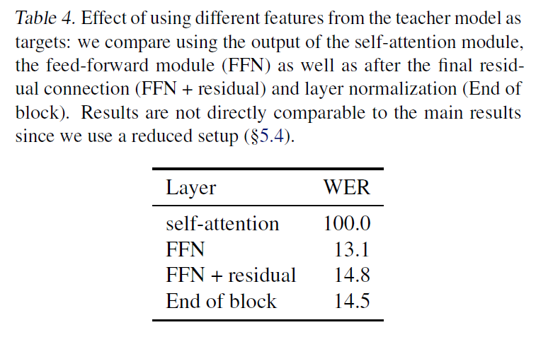
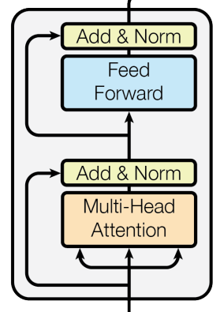
Data2vec: Experiments – Target feature type
Output of self-attention layer doesn’t work
Self-attention output is before the residual connection and features are heavily biased towards other time-steps
Output of FFN layer performs better

Slide 18
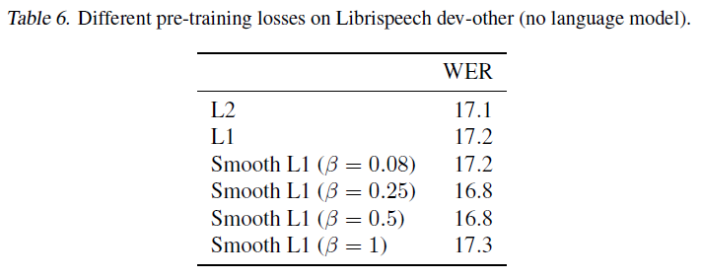
Data2vec: Experiments – Loss functions
loss function have a relatively small effect on final performance

Slide 19
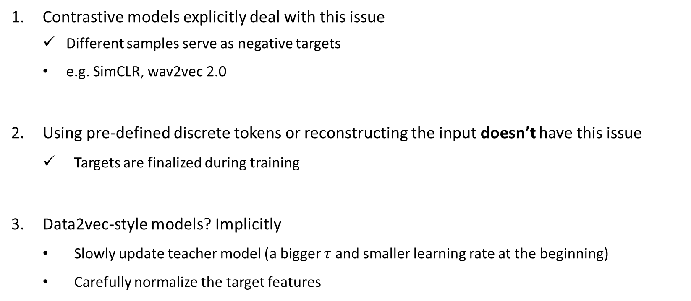
Data2vec: Discussion – Representation collapse in SSL
Model produces very similar representations and is indenpent of the inputs
Contrastive models explicitly deal with this issue
Different samples serve as negative targets
e.g. SimCLR, wav2vec 2.0
Using pre-defined discrete tokens or reconstructing the input doesn’t have this issue
Targets are finalized during training
Data2vec-style models? Implicitly
Slowly update teacher model (a bigger $τ$ and smaller learning rate at the beginning)
Carefully normalize the target features

Slide 20
Data2vec: Discussion – Future work
Data2vec makes it easier to learn across modalities
Cross-modal retrieval
Audio-visual speech recognition

Slide 21
Thanks!

