Slide 1
VQ-VAE: Origin, Development & Application

Slide 2
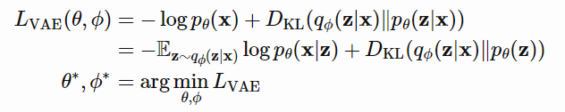
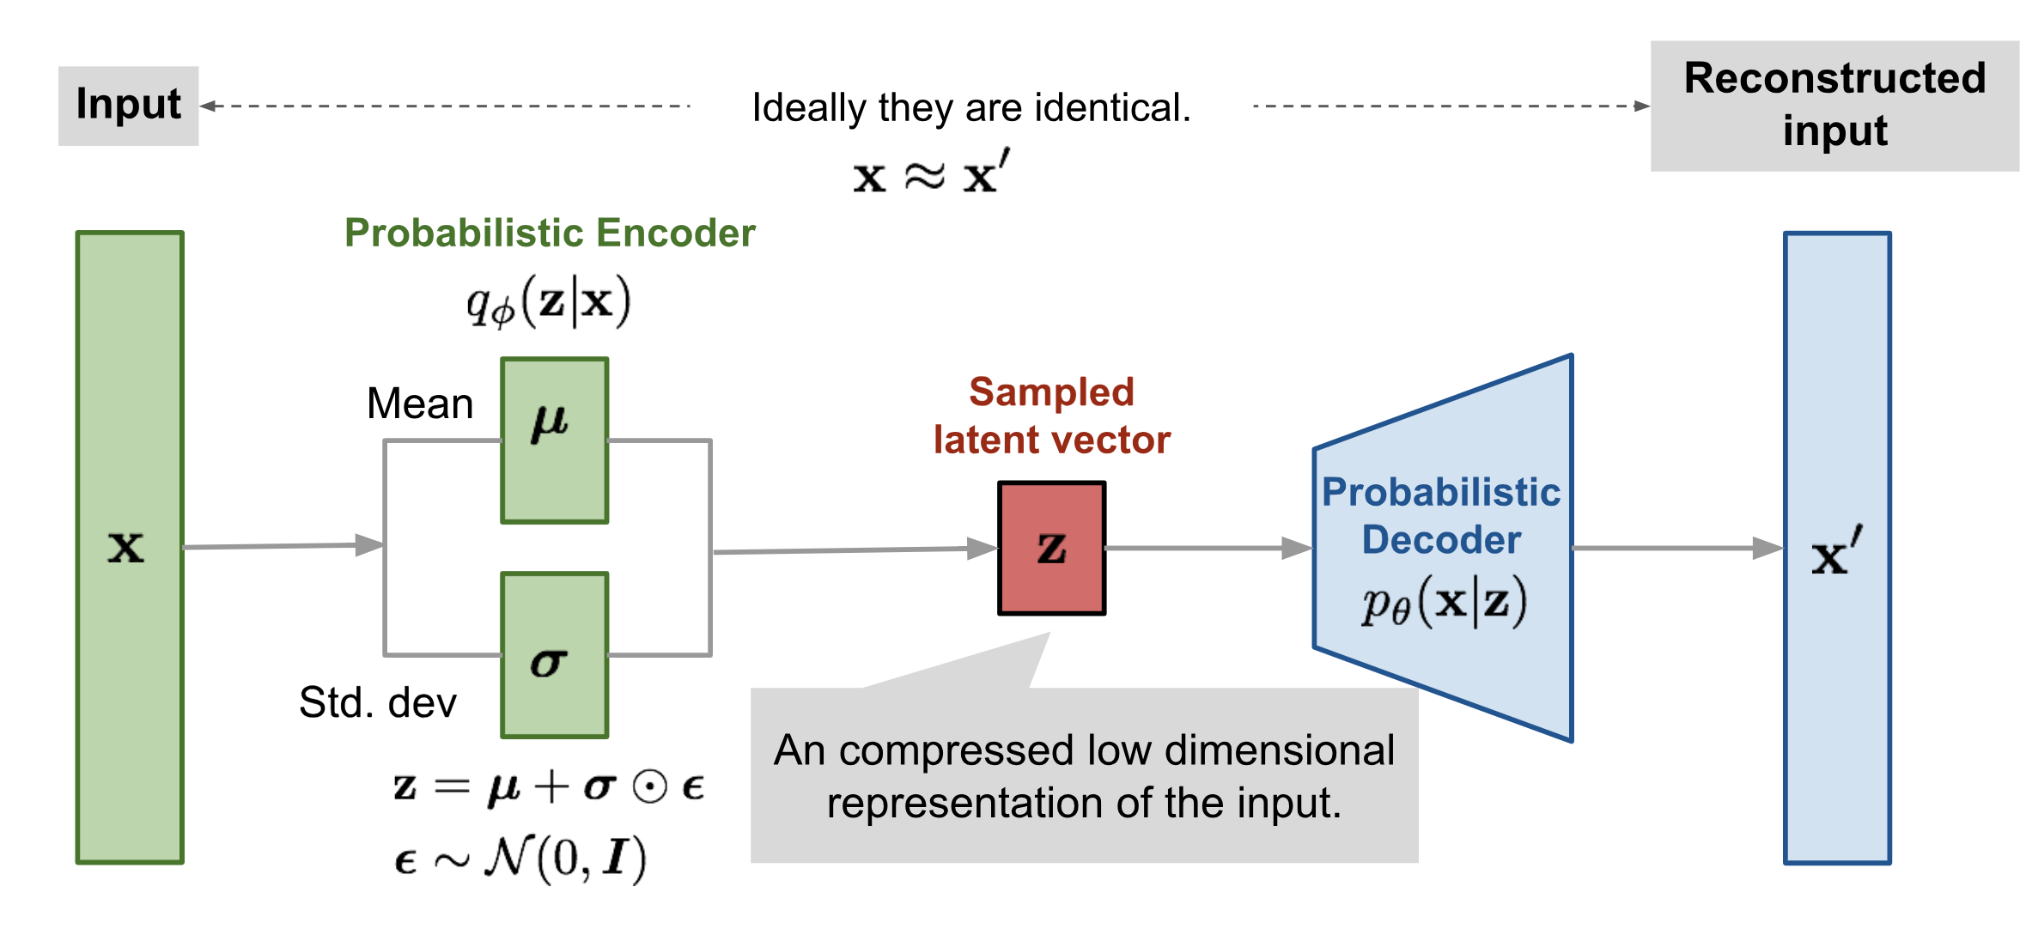
Recall: VAE

Slide 3
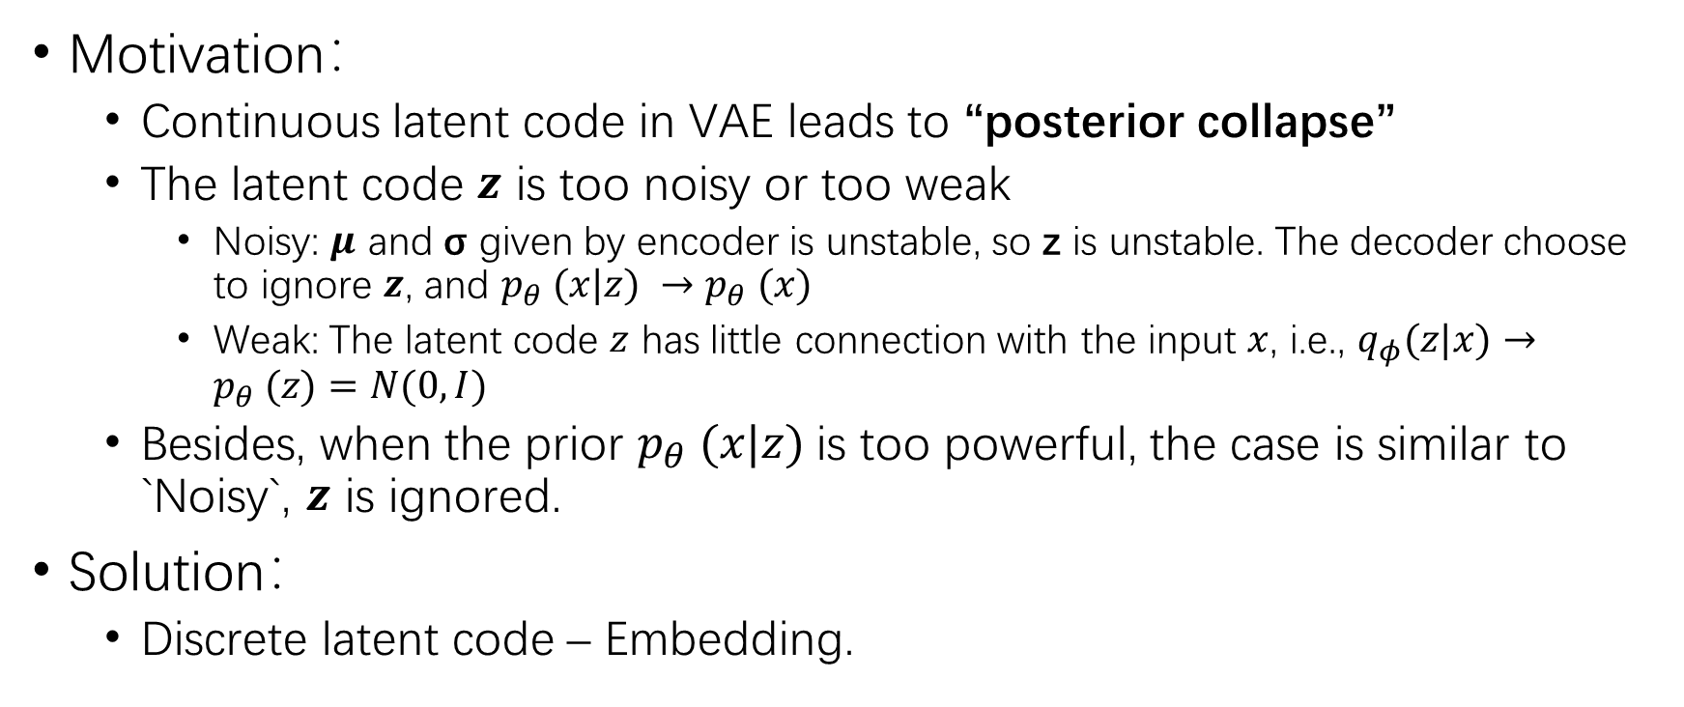
VQ-VAE
Motivation：
Continuous latent code in VAE leads to “posterior collapse”
The latent code $z$ is too noisy or too weak
Noisy: $μ$ and σ given by encoder is unstable, so z is unstable. The decoder choose to ignore $z$, and $p_{θ} (x|z) →p_{θ} (x)$
Weak: The latent code $z$ has little connection with the input $x$, i.e., $q_{φ}(z|x)→p_{θ} (z)=N(0,I)$
Besides, when the prior $p_{θ} (x|z)$is too powerful, the case is similar to `Noisy`, $z$ is ignored.
Solution：
Discrete latent code – Embedding.

Slide 4
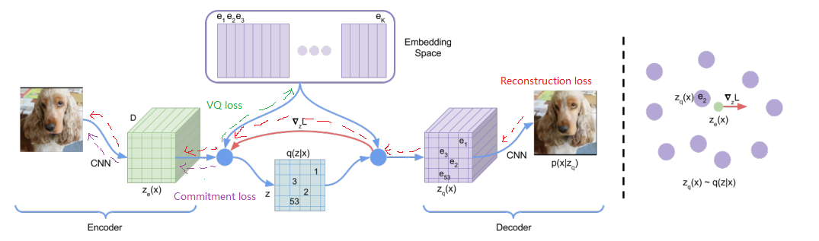

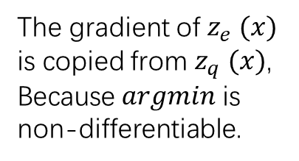
VQ-VAE: Stage 1
The gradient of $z_{e} (x)$
is copied from $z_{q} (x)$,
Because $argmin$ is
non-differentiable.
Vector quantization:
Reconstruction loss VQ loss Commitment loss

Slide 5
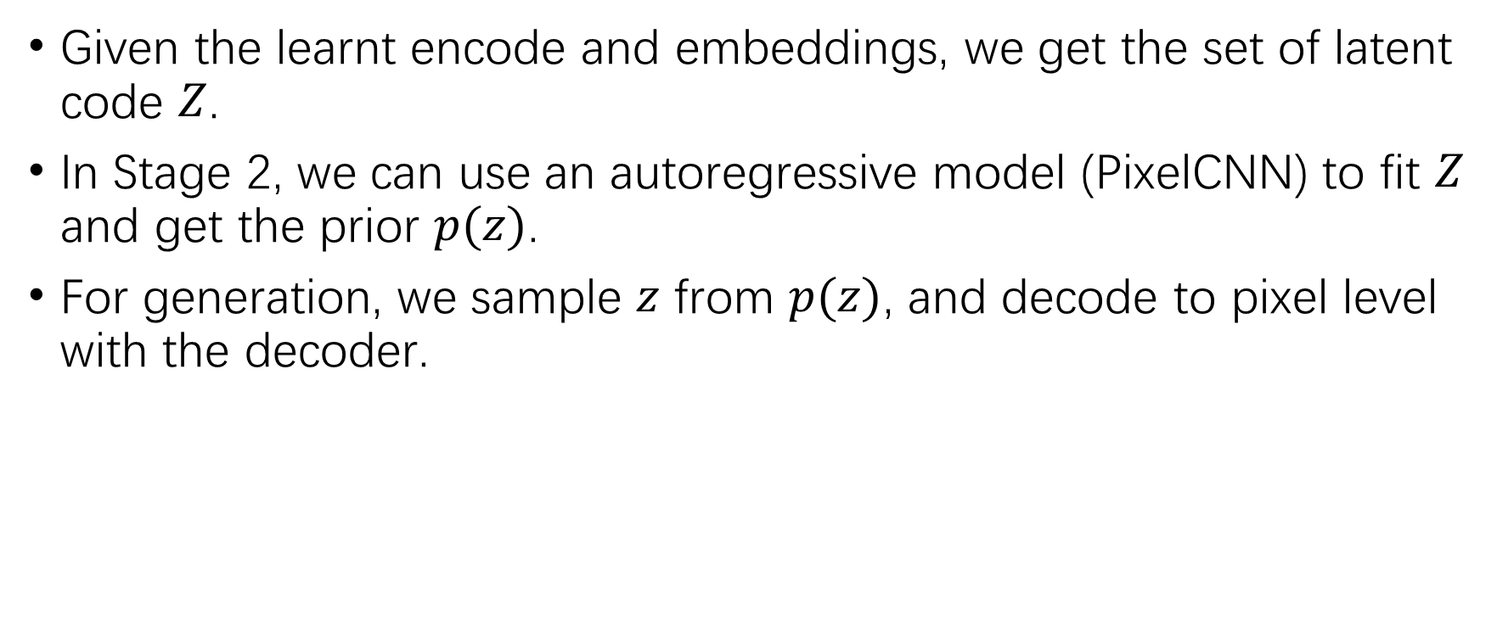
VQ-VAE: Stage 2
Given the learnt encode and embeddings, we get the set of latent code $Z$.
In Stage 2, we can use an autoregressive model (PixelCNN) to fit $Z$ and get the prior $p(z)$.
For generation, we sample $z$ from $p(z)$, and decode to pixel level with the decoder.

Slide 6
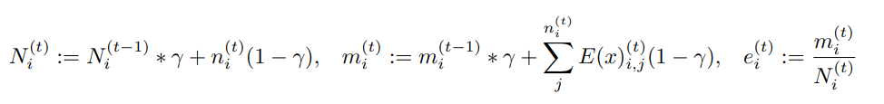
VQ-VAE2
Modification:
The discrete latent codes, or embeddings, are updated via EMA (exponential moving average).
Use a more powerful autoregressive model for prior: PixelSnail (PixelCNN with self-attention)

Slide 7
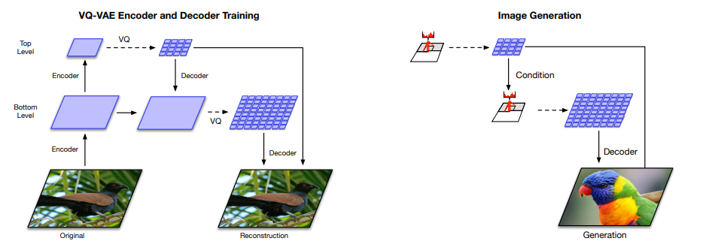
VQ-VAE2
Modification:
Hierarchical organization – separate local patterns (i.e., texture) from global information (i.e., object shapes).

Slide 8
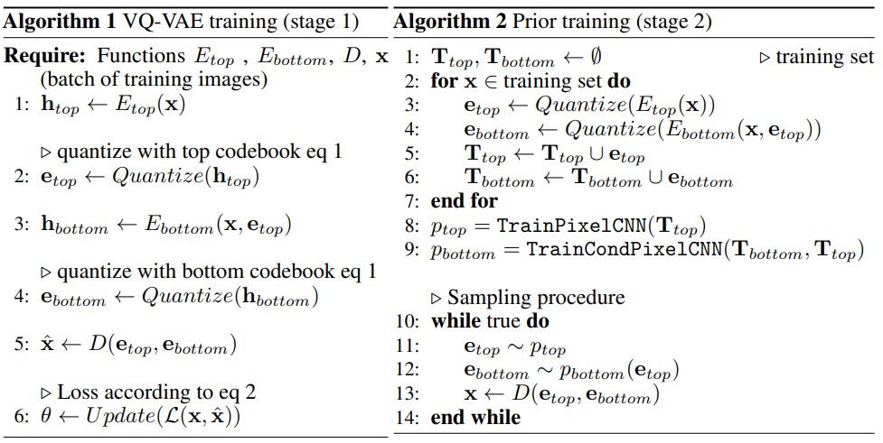
VQ-VAE2
Modification:
Hierarchical organization

Slide 9
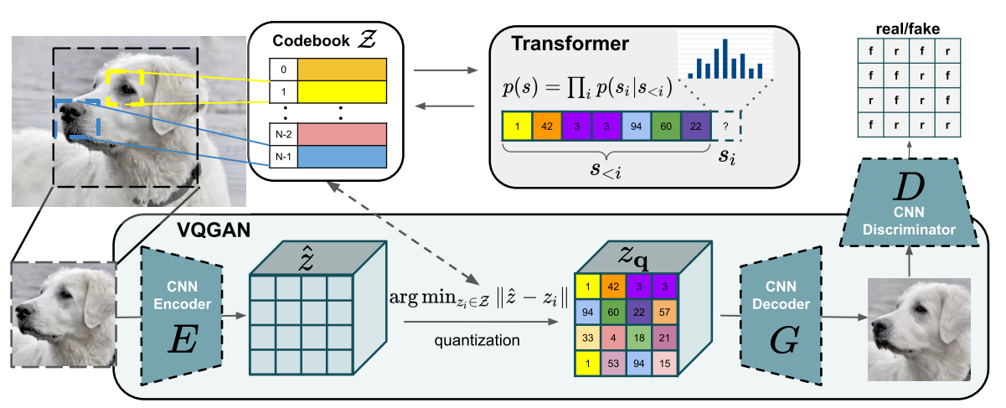
VQ-GAN
Modification:
Add a patch-level GAN loss to the original VQ-VAE loss to learn a learn a perceptually rich codebook.
Use the powerful transformers as the autoregressive prior model to model long-range interactions,.

Slide 10
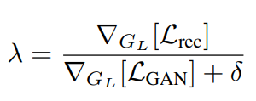
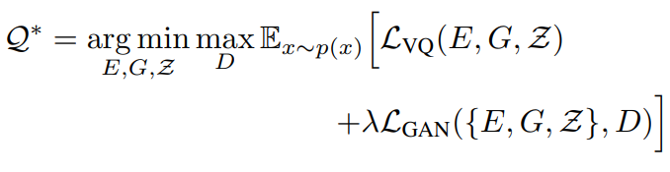

VQ-GAN
Modification:
The loss in training the codebook changes:
where

Slide 11



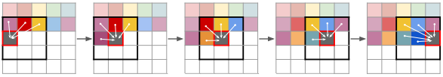
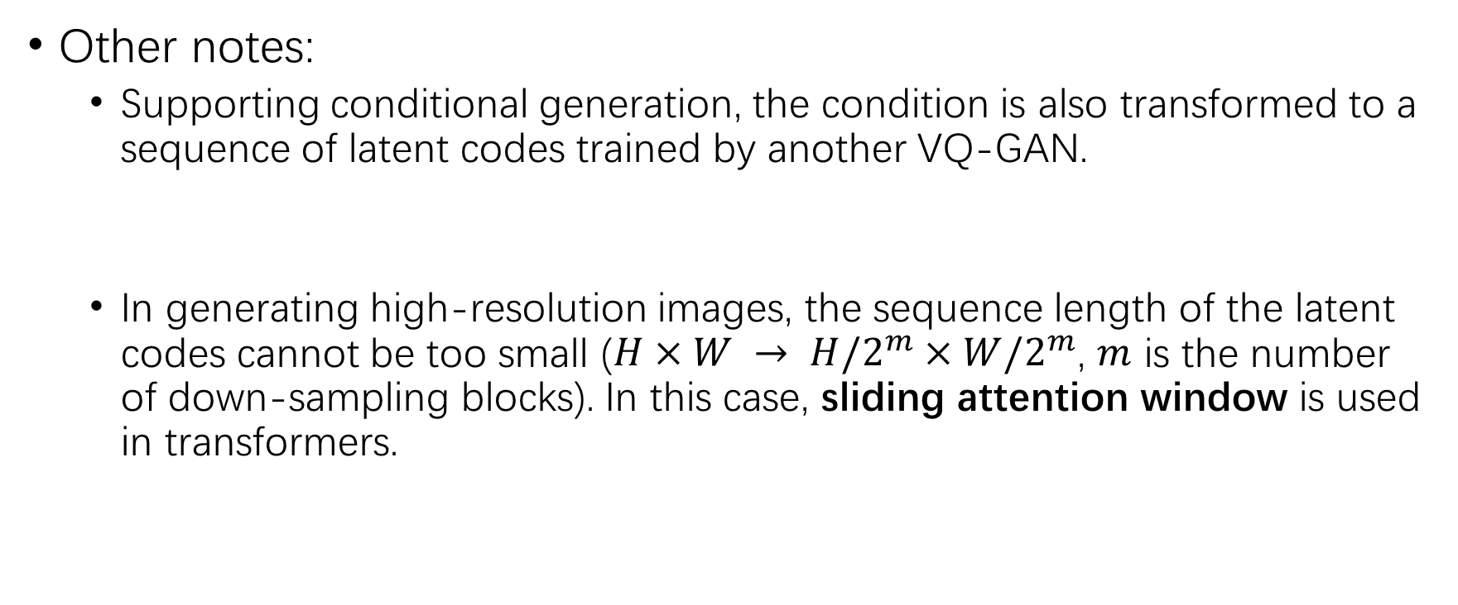
VQ-GAN
Other notes:
Supporting conditional generation, the condition is also transformed to a sequence of latent codes trained by another VQ-GAN.
In generating high-resolution images, the sequence length of the latent codes cannot be too small ($H×W → H/2^{m}×W/2^{m}$, $m$ is the number of down-sampling blocks). In this case, sliding attention window is used in transformers.

Slide 12
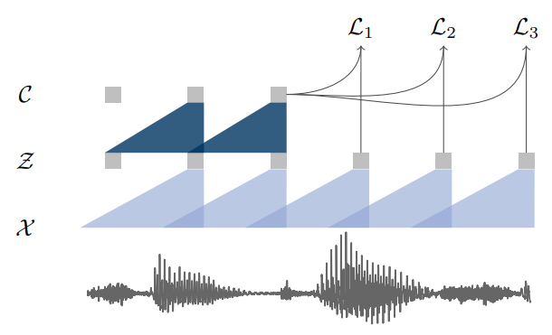
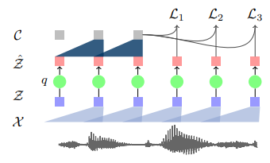

VQ wav2vec
Motivation:
Quantize the dense representation of speech in wav2vec.
Pretrain BERT on the discretized speech data by masked span prediction.

Slide 13
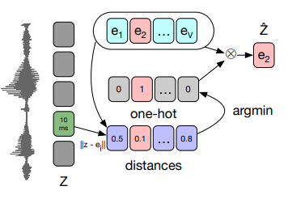


VQ wav2vec
Two ways of quantization:
K-means clustering, like previous mentioned VQ-VAE
Directly use the result of encoder $z$ to get the latent code by L2 norm.
The gradient is copied from $\hat{z}$to $z$.

Slide 14
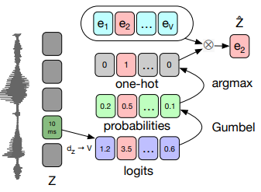



VQ wav2vec
Two ways of quantization: (Gumbel better than K-means)
First map the encoder result $z$ to V-logits (V is the size of latent code.)
Then softmax to get probability distribution, do sampling and one-hot.
The sampling is equivalent to Gumbel Max.
Gumbel softmax is differentiable approximation of one-hot(Gumbel Max).
Gumbel Max:
Gumbel Softmax:

Slide 15
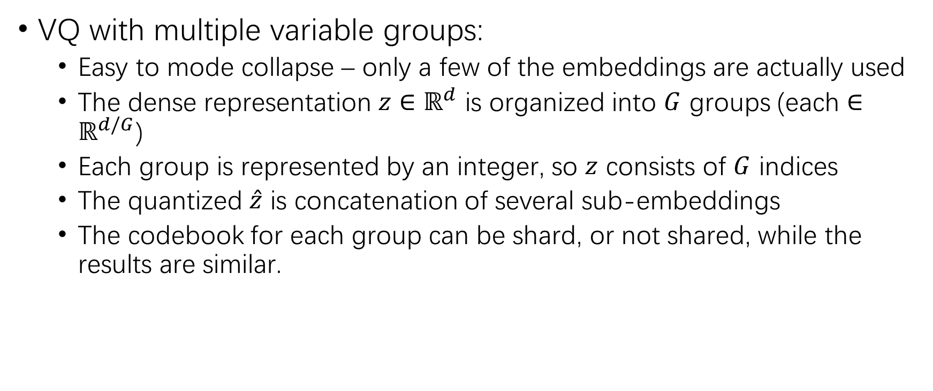
VQ wav2vec
VQ with multiple variable groups:
Easy to mode collapse – only a few of the embeddings are actually used
The dense representation $z∈ℝ^{d}$ is organized into $G$ groups (each $∈ℝ^{d/G}$)
Each group is represented by an integer, so $z$ consists of $G$ indices
The quantized $\hat{z}$ is concatenation of several sub-embeddings
The codebook for each group can be shard, or not shared, while the results are similar.

Slide 16

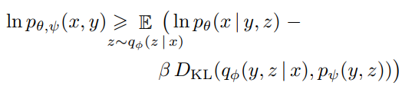
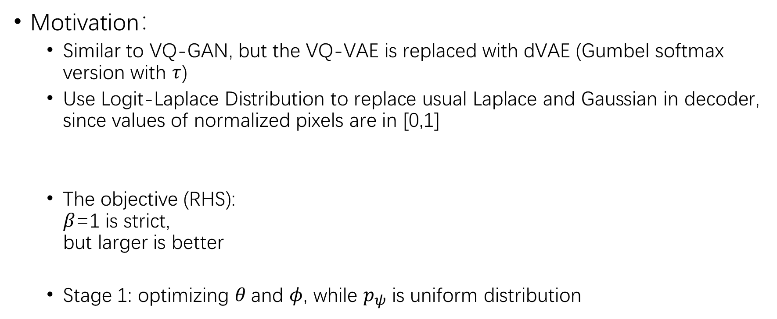
DALL·E
Motivation：
Similar to VQ-GAN, but the VQ-VAE is replaced with dVAE (Gumbel softmax version with $τ$)
Use Logit-Laplace Distribution to replace usual Laplace and Gaussian in decoder, since values of normalized pixels are in [0,1]
The objective (RHS): $β$=1 is strict, but larger is better
Stage 1: optimizing $θ$and $φ$, while $p_{ψ}$ is uniform distribution

Slide 17
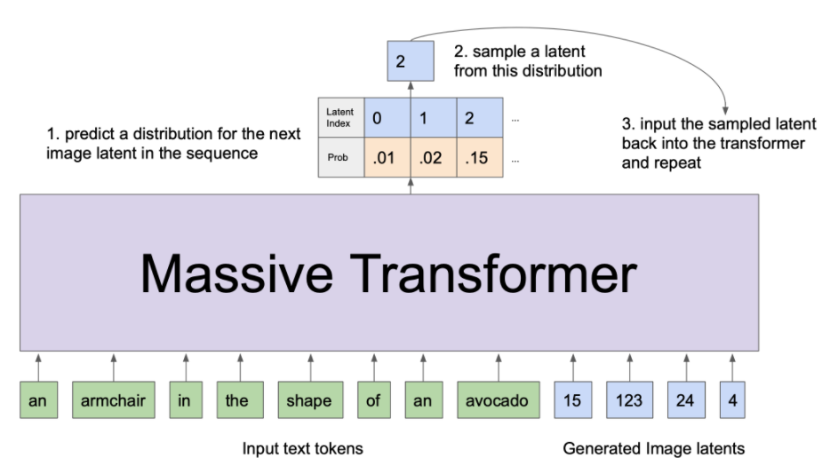

DALL·E
Motivation(con’t):
Stage 2: fix$θ$and $φ$, and optimize over $ψ$, text is tokenized by BPE – transformer part, autoregressively

Slide 18
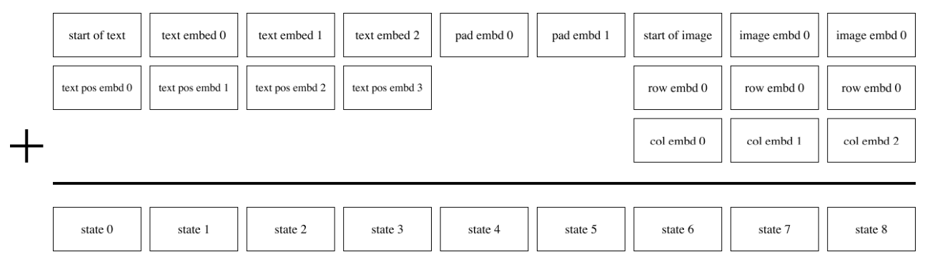
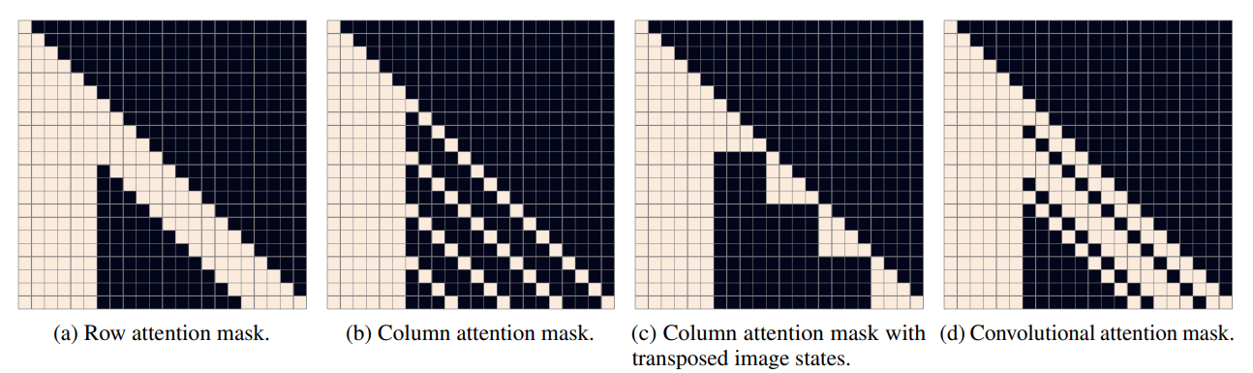
DALL·E
Transformer architecture:
Input end:
Self attention: 64layers r, c, r, r,…,conv

Slide 19
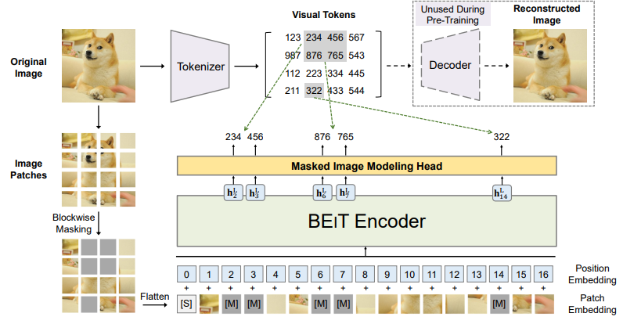
BEIT
Motivation:
A step towards BERT moment in CV
Visual tokens are generated by dVAE, and then MIM (like MLM)

Slide 20

PECO
Motivation:
Follow BEIT, while aims to learning a Perceptual Codebook for transformers
Vanilla VQ-VAE loss:
One observation, MSE term in vanilla VQ-VAE loss (corresponding to Gaussian distribution) is pixel level
Pixel level loss is too sensitive, do not capture perceptual difference
“A small shift and rotation operation on the original image may not cause perceptual change but induce a large MSE change”
Add a perceptual term to learn high-level semantic meanings

Slide 21

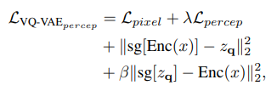
PECO
Implementation:
Use a feature extraction model to measure difference between feature maps (ViT, ResNet, VGG..)
Append the term to get a new VQ-VAE loss
MIM pre-training keeps the same

Slide 22
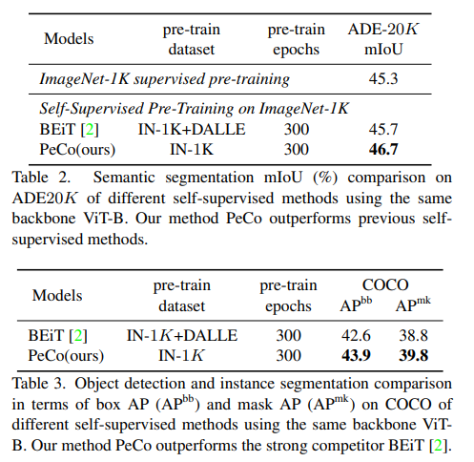
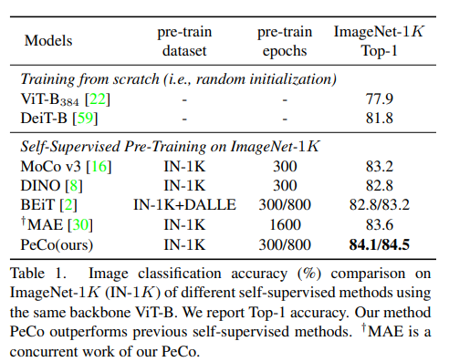
PECO
Results:

Slide 23
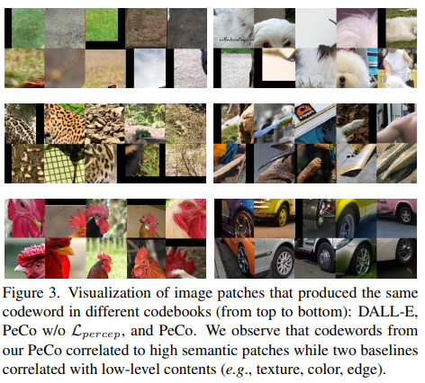
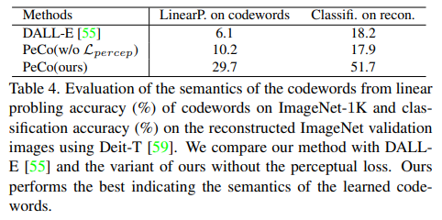
PECO
Analysis:
Codewords with more semantic meaning

Slide 24
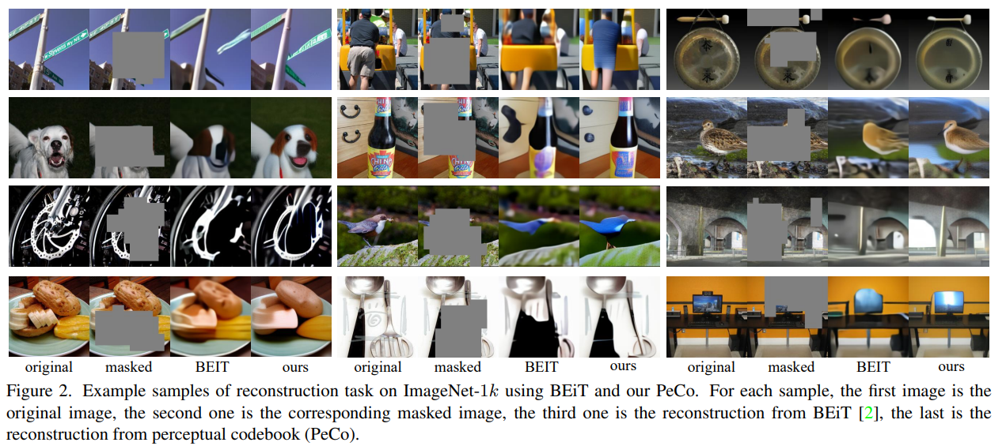
PECO
Analysis:
Codewords with more semantic meaning

Slide 25
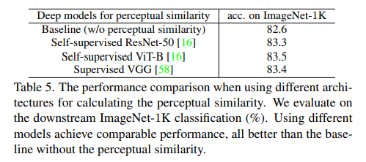
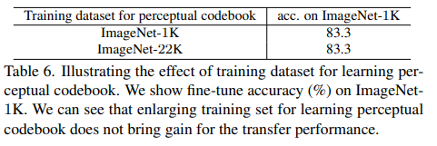
PECO
Analysis:
Different architecture for perceptual loss show little difference
Small data is enough for training the codebook

Slide 26
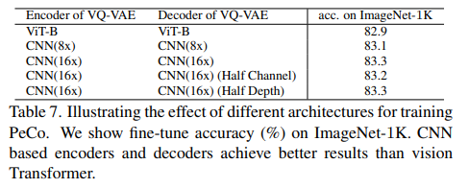
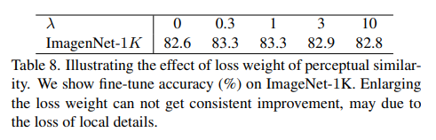

PECO
Analysis:
CNN-based VQ-VAE is better than transformer-based
Effects of $λ$ for perceptual loss

Slide 27
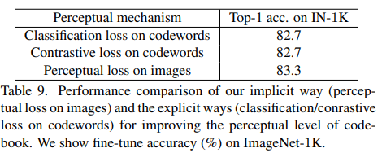
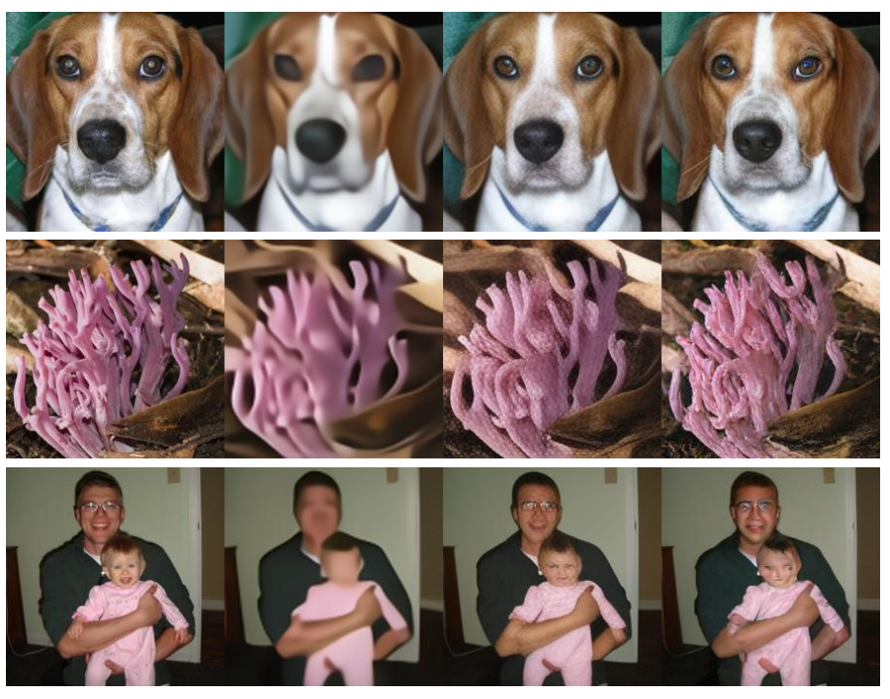

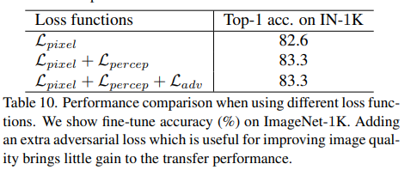
PECO
Analysis:
Explicitly learning the perceptual code book or not
Adding GAN loss like VQ-GAN
input pix pix+per pix+per+adv

Slide 28
Thanks!

