Slide 1
Unsupervised Corpus Aware Language Model Pre-training for Dense Passage Retrieval
Luyu Gao and Jamie Callan
Language Technologies Institute
Carnegie Mellon University

Slide 2
Introduction
Retrieval Task
Given a query, find the most relevant documents from a large corpus (~8M in MS MARCO)
BM25 suffer from vocabulary mismatch problem
BERT-based cross-encoder is not efficient enough for first-stage retrieval

Slide 3
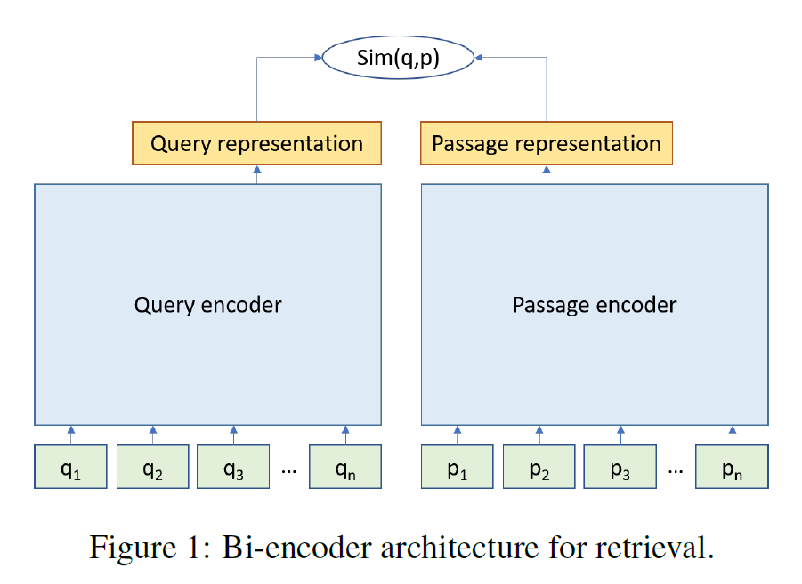
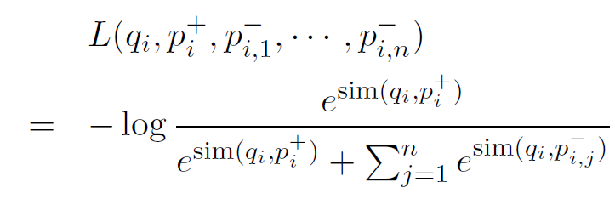
Dense Retrieval

Slide 4
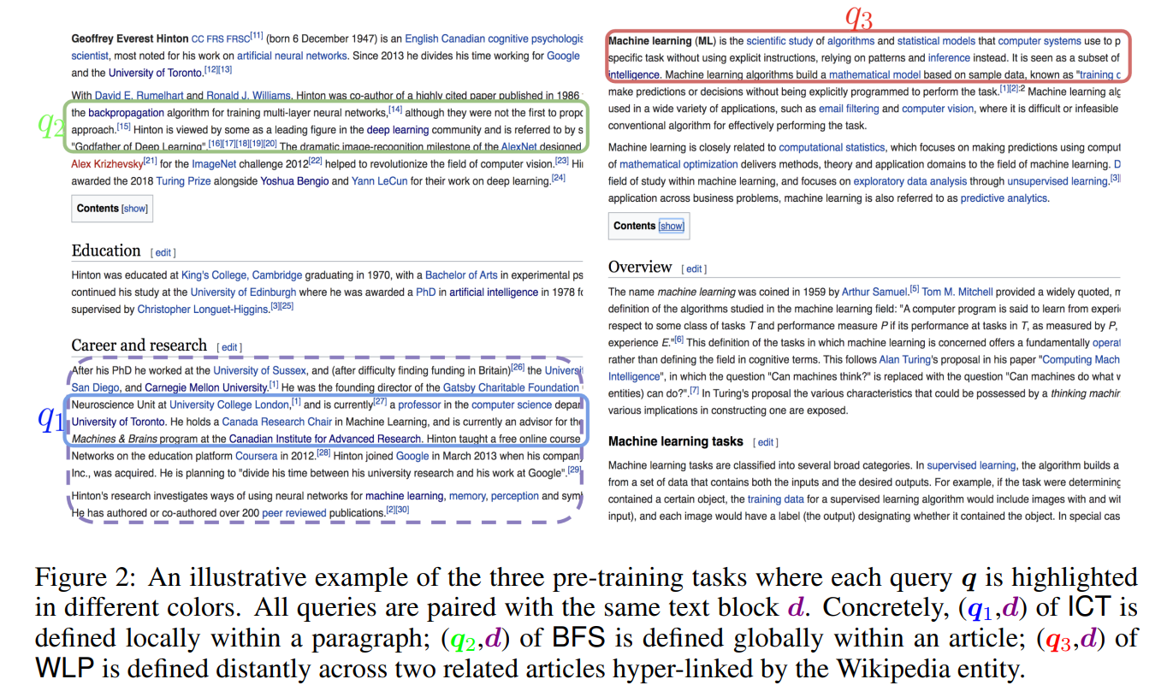

Pretraining for Dense Retrieval
Unsupervised construction of $\left(q, d_{+}\right)$ pairs
Inverse Cloze Task (ICT)
Body First Selection (BFS)
Wiki Link Prediction (WLP)

Slide 5
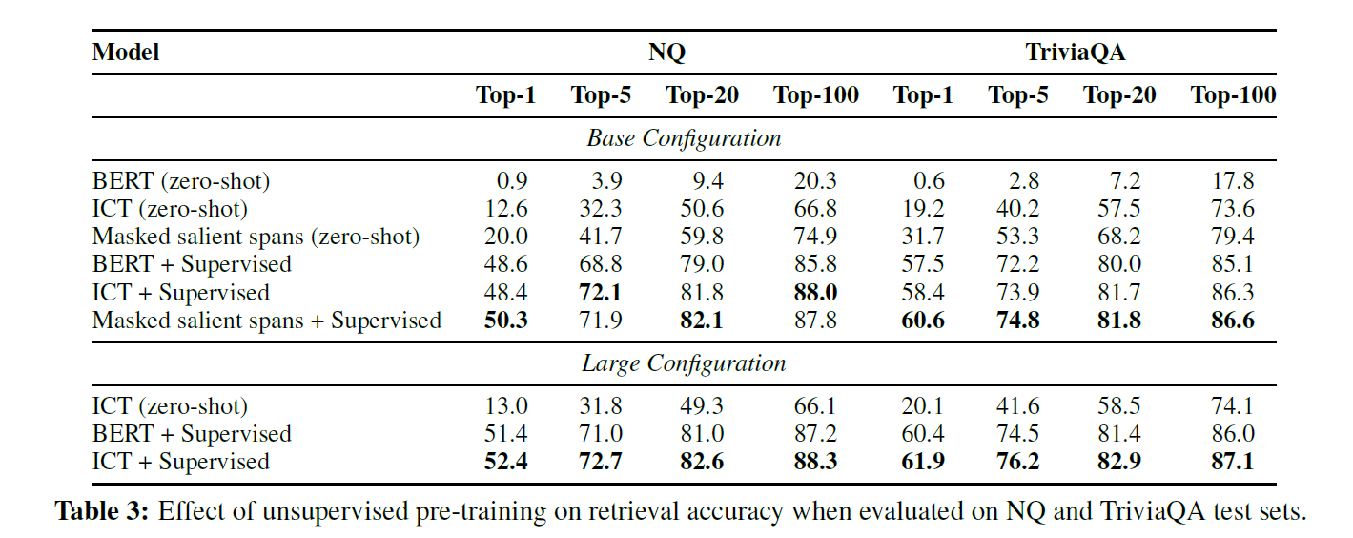
Does Unsupervised Pretraining help Supervised Finetuning?

Slide 6
Problems with BERT
[CLS] token pretrained with MLM and NSP has a large gap with downstream dense retrieval task
MLM task doesn’t emphasize [CLS] token for sentence-level global semantic aggregation
NSP task uses [CLS] for cross-encoder classification rather than dual-encoder retrieval

Slide 7
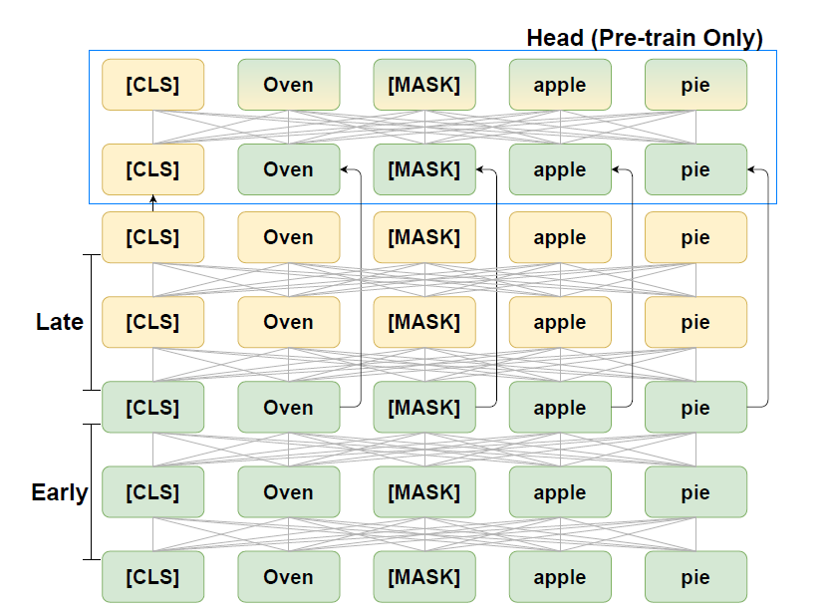
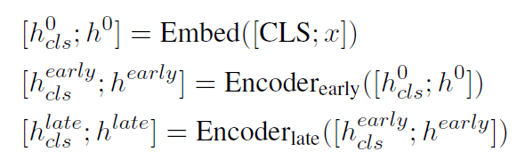


Condenser
Motivation: Refine [CLS] representation via MLM pretraining with bottleneck

Slide 8
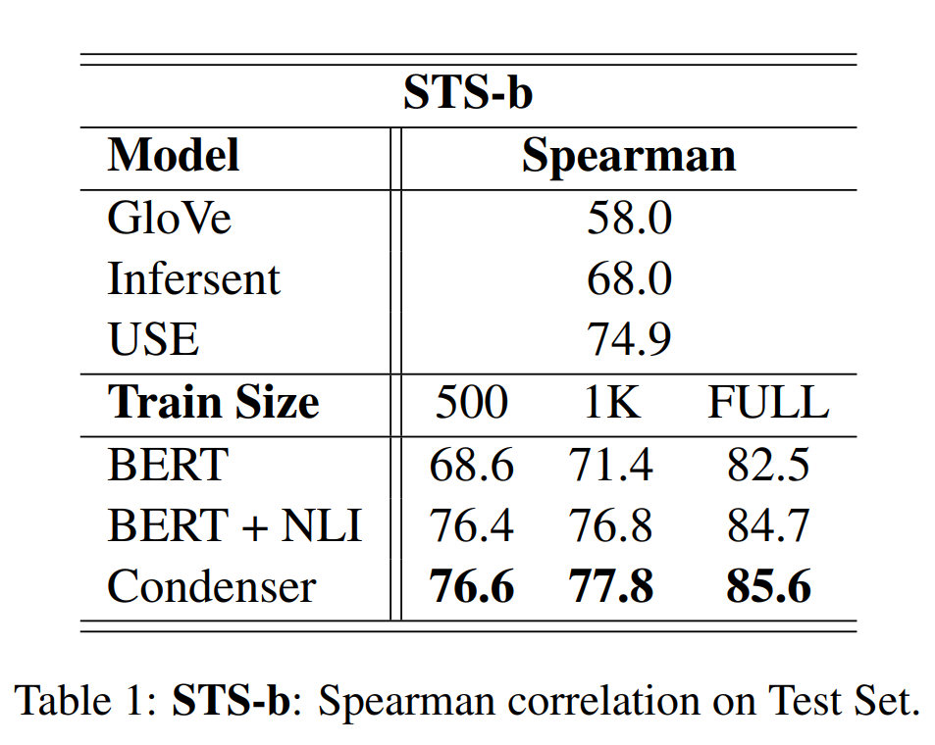
Results - Condenser
Sentence Similarity

Slide 9
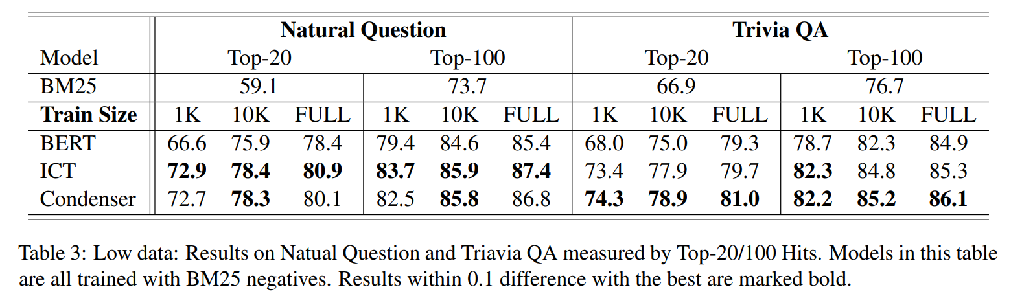
Results - Condenser
Retrieval for Open QA

Slide 10
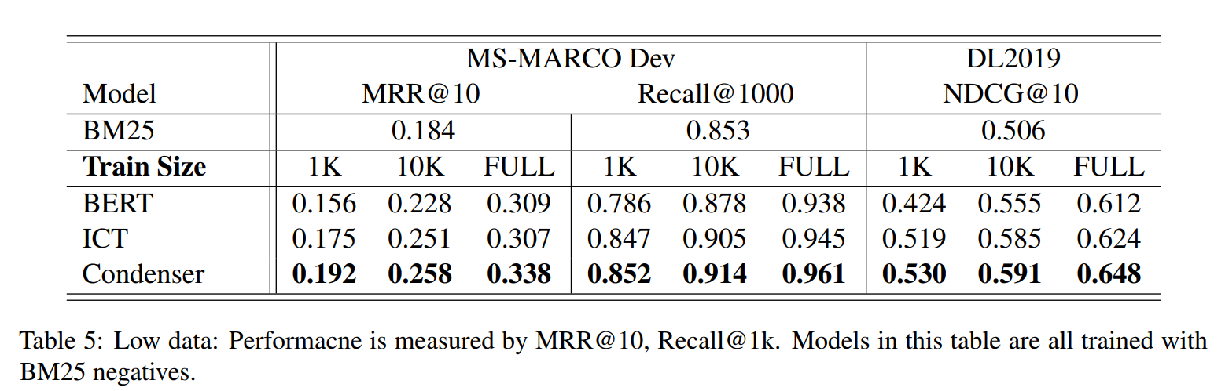
Results - Condenser
Retrieval for Web Search

Slide 11
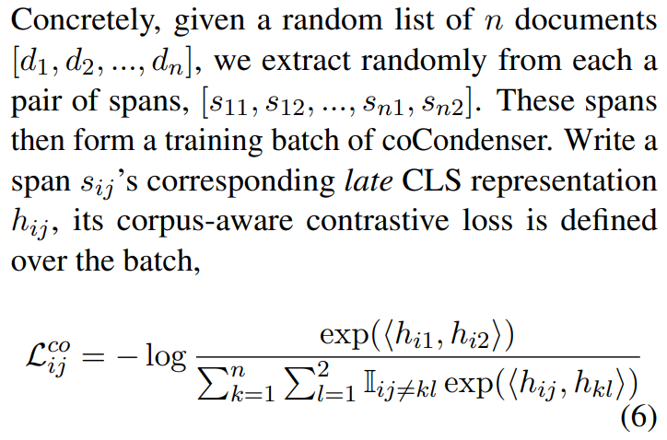
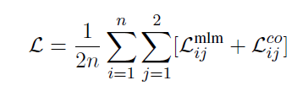
coCondenser
Motivation: Warm up the [CLS] representation space for dense retrieval
Approach: span-level contrastive learning (akin to SimCLR)

Slide 12
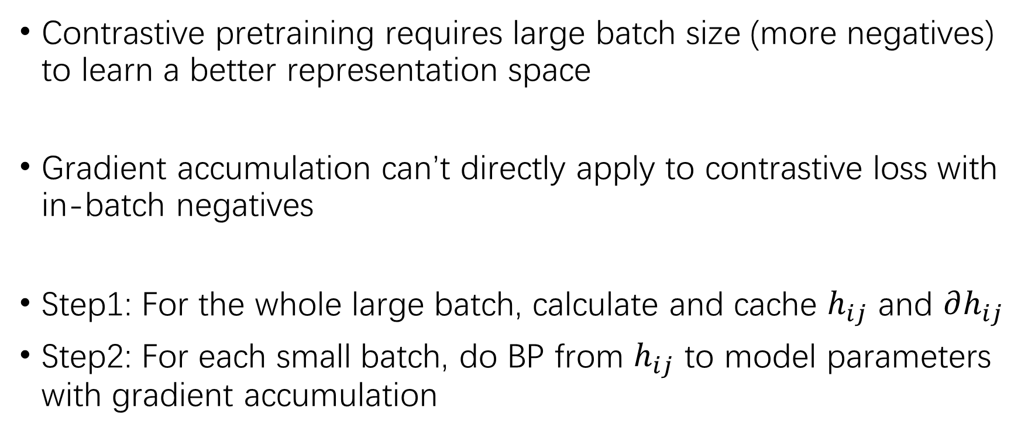
Gradient Cache
Contrastive pretraining requires large batch size (more negatives) to learn a better representation space
Gradient accumulation can’t directly apply to contrastive loss with in-batch negatives
Step1: For the whole large batch, calculate and cache $h_{ij}$ and $∂h_{ij}$
Step2: For each small batch, do BP from $h_{ij}$ to model parameters with gradient accumulation

Slide 13
Unsupervised Pretraining
Two-stage pretraining
First stage
Condenser pretraining (MLM)
Data: English Wikipedia and the BookCorpus (same as BERT)
Second stage
coCondenser pretraining (MLM + SimCLR)
Data: downstream retrieval corpus (Wikipedia for QA, Web Collections for MS MARCO)

Slide 14
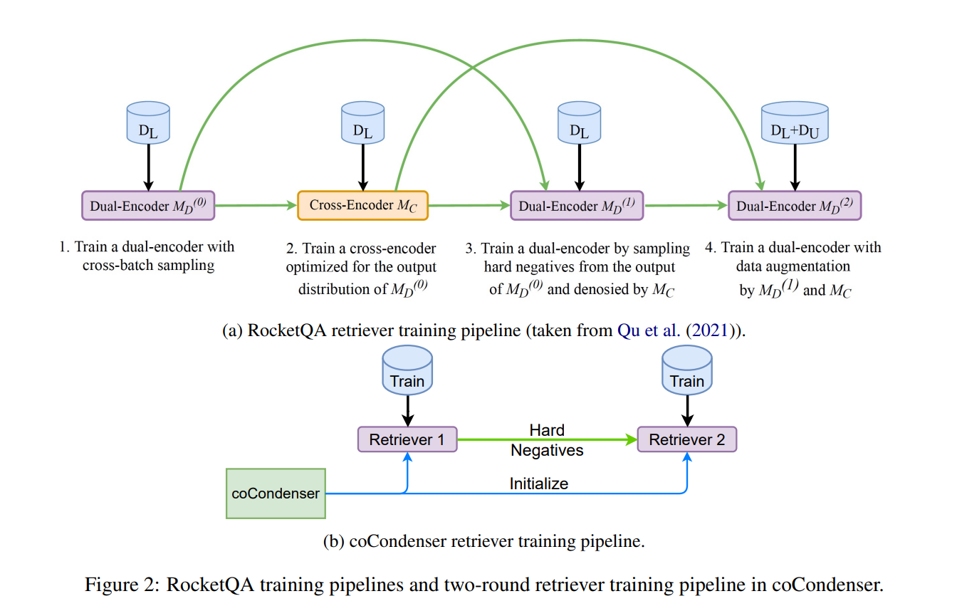
Supervised Finetuning

Slide 15
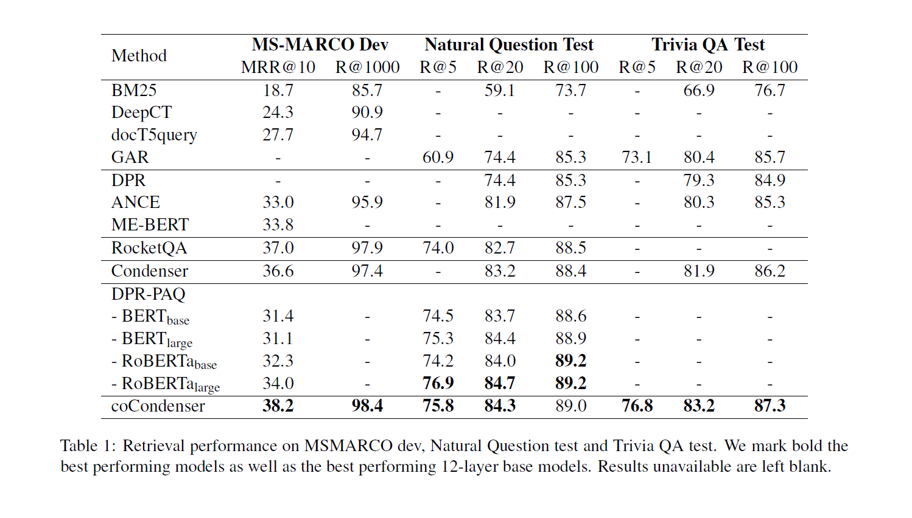
Results - coCondenser

Slide 16
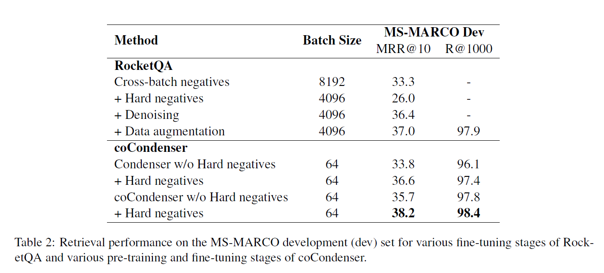
Training Stage Analysis

Slide 17
Conclusion
A general pretrained model for dense retrieval
Masked Language Modeling + Span-level Contrastive Learning
Orthogonal to other complex training strategies
Distillation, data augmentation, negative sampling, false negatives denoising

Slide 18
Discussion
Is Condenser the optimal pretraining architecture for retrieval?
How does Span-level Contrastive Learning compare to ICT?

Slide 19
Thanks

