Slide 1
Wav2Seq: Pre-training Speech-to-Text
Encoder-Decoder Models Using Pseudo Languages
Presented by Zhuoyuan Yao
May 13, 2022

Slide 2
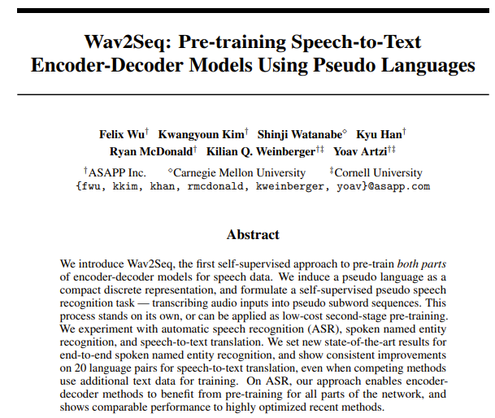
Outline
Background
Speech-to-Text Models
Speech SSL
Introduction of wav2seq
Method
Experiments
Discussions

Slide 3
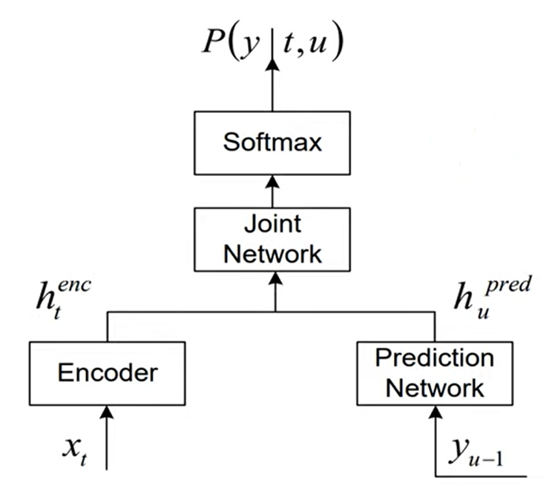
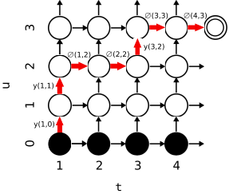
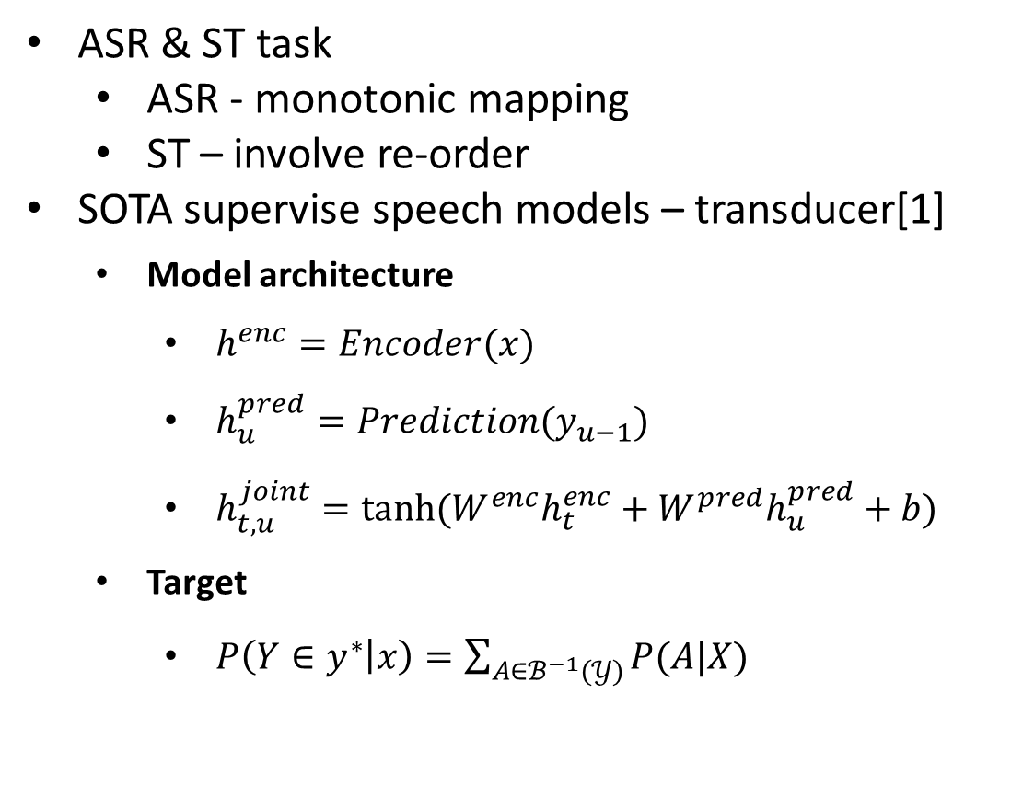
Background: Speech-to-Text Model
ASR & ST task
ASR - monotonic mapping
ST – involve re-order
SOTA supervise speech models – transducer[1]
Model architecture
$h^{enc}=Encoder(x)$
$h_{u}^{pred}=Prediction(y_{u−1})$
$h_{t,u}^{joint}=tanh⁡(W^{enc}h_{t}^{enc}+W^{pred}h_{u}^{pred}+b)$
Target
$P\left(Y∈y^{∗} | x\right)=\sum_{A∈ℬ^{−1}(𝒴)}{P(A|X)}$
[1] A. Graves, “Sequence Transduction with Recurrent Neural Networks,” CoRR, vol. abs/1211.3711, 2012.
Notes:
简单说一下
Monotonic mapping 主要有两种方法，CTC 和Transducer
Involve re-order 主要方法是Encoder-Decoder Attention

Slide 4
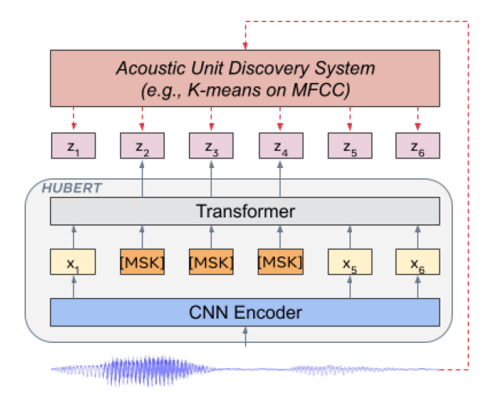
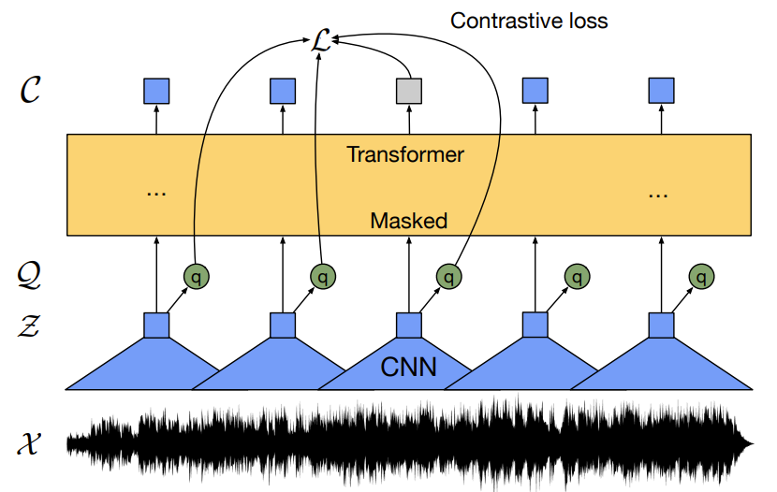
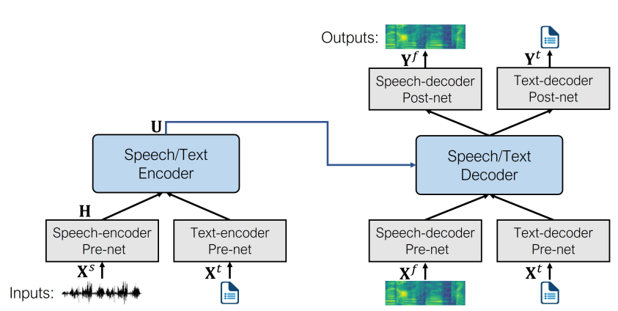
Background: SSL for Speech
Wav2vec2.0 [2]
Contrastive
Hubert [3]
Masked language modeling
Speech T5 [4]
Reconstruct the feature
[2] Alexei Baevski, Henry Zhou, Abdelrahman Mohamed, and Michael Auli. wav2vec 2.0: A framework for self-supervised learning of speech representations. arXiv preprint arXiv:2006.11477, 2020.
[3] Hsu, Wei-Ning, et al. "Hubert: Self-supervised speech representation learning by masked prediction of hidden units." IEEE/ACM Transactions on Audio, Speech, and Language Processing 29 (2021): 3451-3460.
[4] Junyi Ao, Rui Wang, Long Zhou, Shujie Liu, Shuo Ren, Yu Wu, Tom Ko, Qing Li, Yu Zhang, Zhihua Wei, et al. Speecht5: Unified-modal encoder-decoder pre-training for spoken language processing. arXiv preprint arXiv:2110.07205, 2021.
Notes:
语音的预训练从训练方式上看主要有下面三方面，一是使用Contrastive Loss，二是使用MLM，三是重构音频特征
和Speech T5 类似，本文也选择encoder decoder 结构，并且不同于上述三种 loss 使用最大化后验概率来进行训练

Slide 5
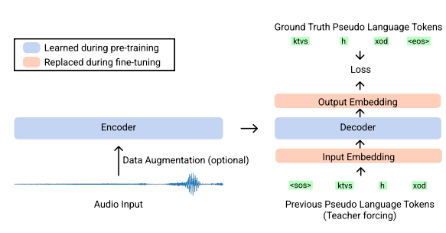

Wav2seq: Method
Model: Encoder-Decoder
Pseudo ASR
Minimizing the negative log likelihood
Notes:
这里 log-likelihood loss不是必须的，可以换成其他loss

Slide 6
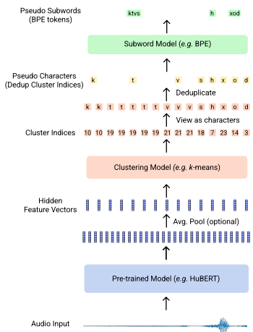
Wav2seq: Method
Inducing Pseudo Languages:
Motivation
Reduce the computation
Remain the quality
Pseudo subword generation
Extract hidden feature from a Hubert model
Average polling
K-means
Deduplicate
BPE
[10] Baevski, Alexei, et al. "wav2vec 2.0: A framework for self-supervised learning of speech representations." Advances in Neural Information Processing Systems 33 (2020): 12449-12460.

Slide 7
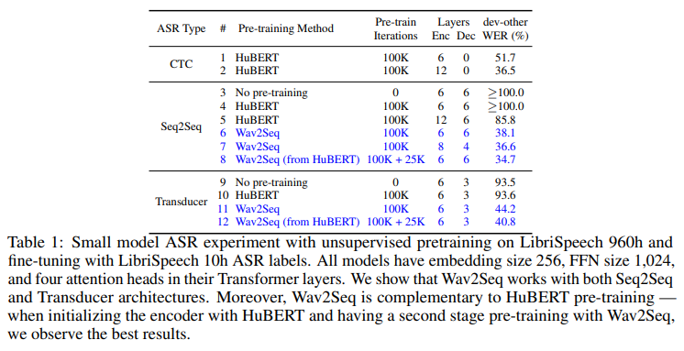
Wav2seq: Experiments – ASR
Wav2Seq can close the gap between CTC fine-tuning and Seq2Seq models
deeper encoder and shallower decoder get better performance
Using Hubert initialize can outperform the Hubert CTC finetune with only small amount of pretraining cost
Transducer require large space complexity, so the cluster’s K number and the BPE vocabulary size is limited

Slide 8
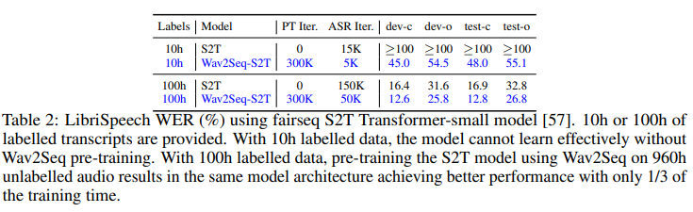
Wav2seq: Experiments – ASR-S2T
S2T Transformer model is an opensource Seq2Seq ASR model takes Fbank as input
Wav2Seq improve the WER of model while requireless fine-tuning time

Slide 9
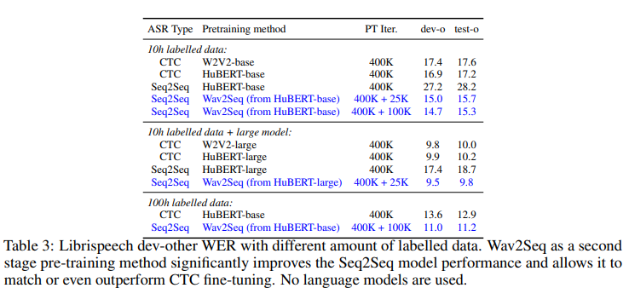
Wav2seq: Experiments – ASR-high resource
Pretrain on LibriSpeech and LibriLight
Using Wav2Seq outperform the CTC counterparts
Pretrain longer is not helpful

Slide 10
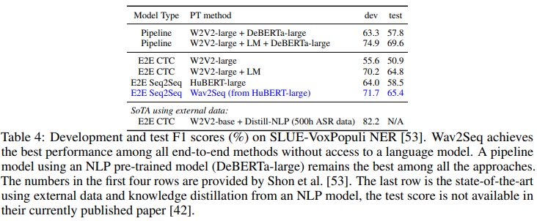
Wav2seq: Experiments – SNER
Spoken named entity recognition
Using SLUE-VoxPopuli dev and test set
Outperform the CTC baseline with and without LM

Slide 11
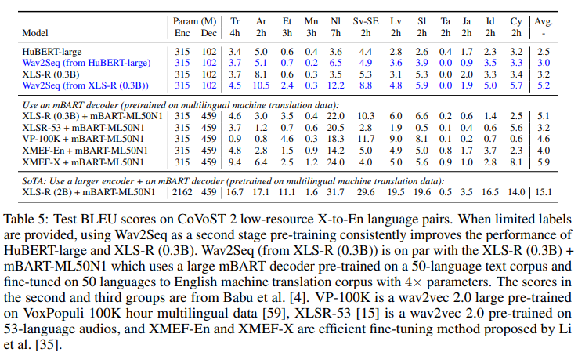
Wav2seq: Experiments – ST-low resource
Hubert
First stage: English
Second stage: English
XLS-R
First stage: 128 languages
Second stage: English
Spoken named entity recognition
Wav2Seq improve Hubert and XLS-R model
Wav2Seq XLS-R can match XLS-R with mBART-ML50N1

Slide 12
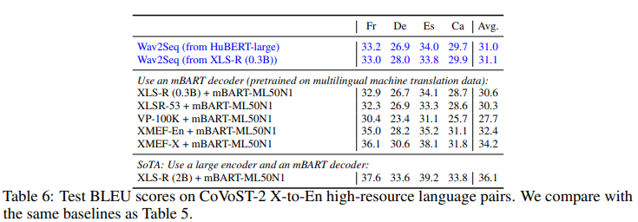
Wav2seq: Experiments – ST-high resource
Outperform the XLS-R + mBART-ML50N1

Slide 13
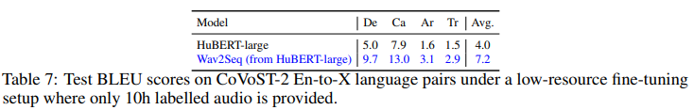
Wav2seq: Experiments – ST-low resource
English-to-X
Every Paired language has 10h subset
Outperform the Hubert Large model

Slide 14
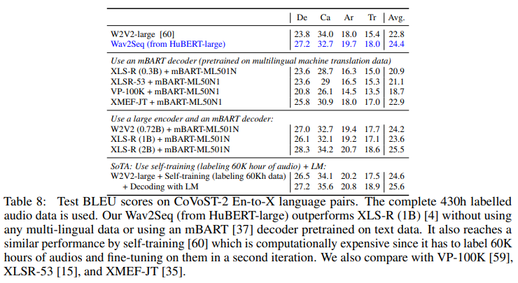
Wav2seq: Experiments – ST-high resource
English-to-X
Every Paired language has 430h labeled data
Match the performance of w2v2 using 60k hours of audio pretrain

Slide 15
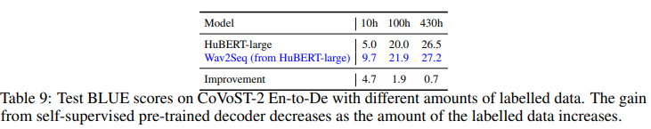
Wav2seq: Experiments – ST
This experiment shows the performance gain of Wav2seq with different amount of labelled data
The gain diminishes with more supervision

Slide 16
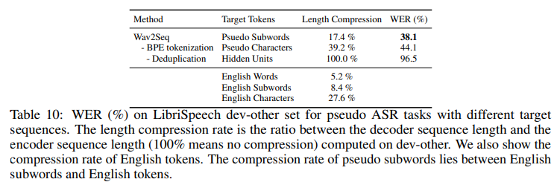
Wav2seq: Experiments – Ablation study
Deduplication plays a vital role
BPE tokenization can further reduce WER

Slide 17
Wav2seq: Discussion – Representation collapse in SSL
Pretrain both encoder-decoder architectures without aligned text data
ASR: Close the performance gap between enc-dec models and CTC models
NER: achieves the best performance
ST: improve the performance of Hubert and XLS-R, match mBART decoder initialization
Limitation
Study ASR model without language models
CTC decoding is more faster than AR model
Do not fusion the text information to induce the label

Slide 18
Thanks!

