Slide 1
Chain of Thought Prompting Elicits Reasoning in Large Language Models
Presented by Zonglin Yang
July 29th

Slide 2
Background
Scaling up the size of language models has been shown to confer a range of efficiency. However, scaling up model size along has not proved sufficient for achieving high performance on challenging tasks such as arithmetic, commonsense, and symbolic reasoning.
Question: How to improve the reasoning ability of (large) language models?

Slide 3
Motivation
In neuro-symbolic computing it has been recognized that generating intermediate results significantly improves accuracy when a desired input-output mapping involves multiple computational steps.
Large language models offer the exciting prospect of in-context few-shot learning via prompting.

Slide 4
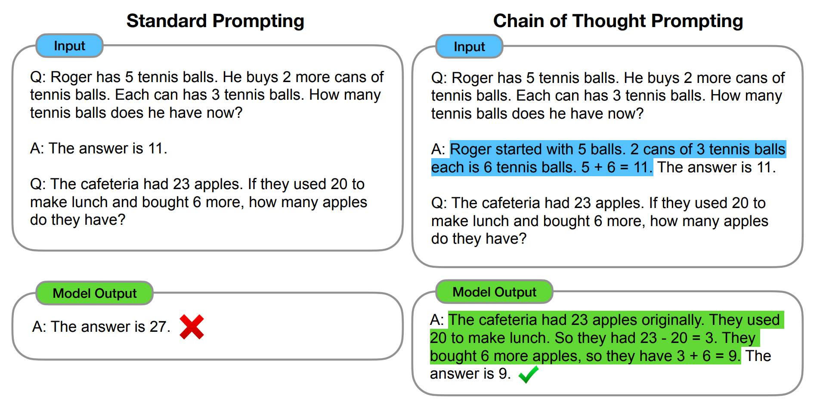
Method
Combine the two motivations and explore the ability of large language models to perform few-shot prompting for reasoning tasks, given a prompt that consists of triples: <input, chain of thoughts, output>

Slide 5
Experiments
Evaluate chain of thought prompting for 3 classes of reasoning tasks, including arithmetic reasoning, commonsense reasoning, and symbolic reasoning.

Slide 6
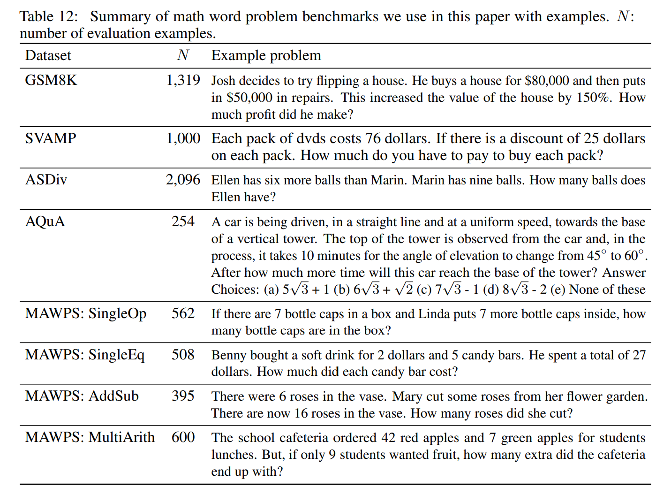
Arithmetic Reasoning
Benchmarks

Slide 7
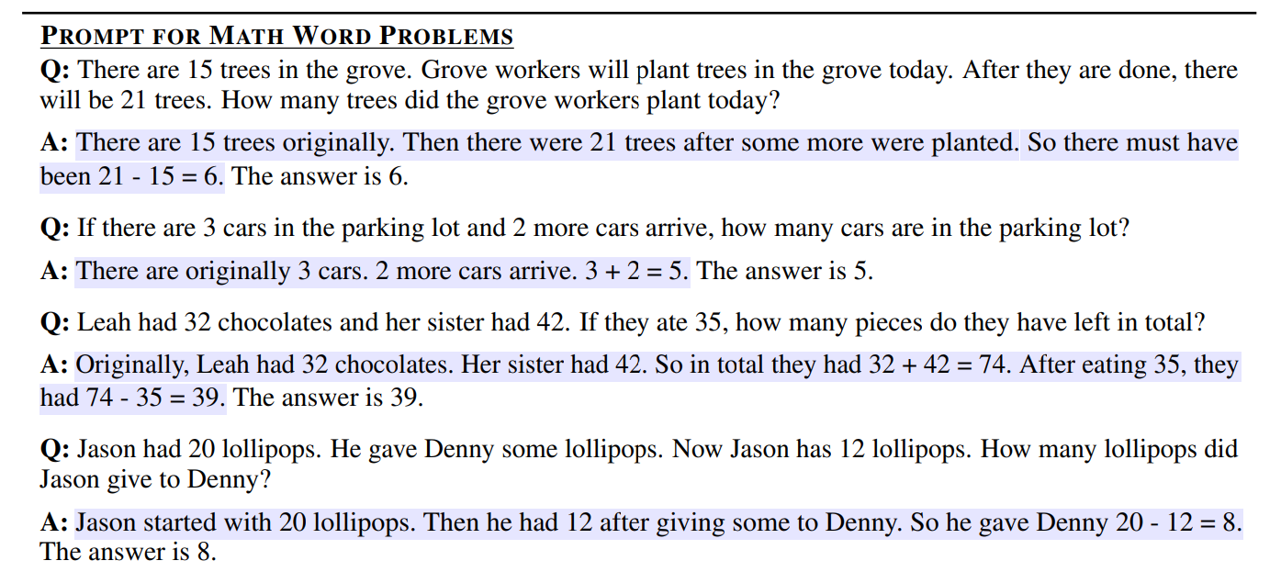
Arithmetic Reasoning
Chain of thought prompt used

Slide 8
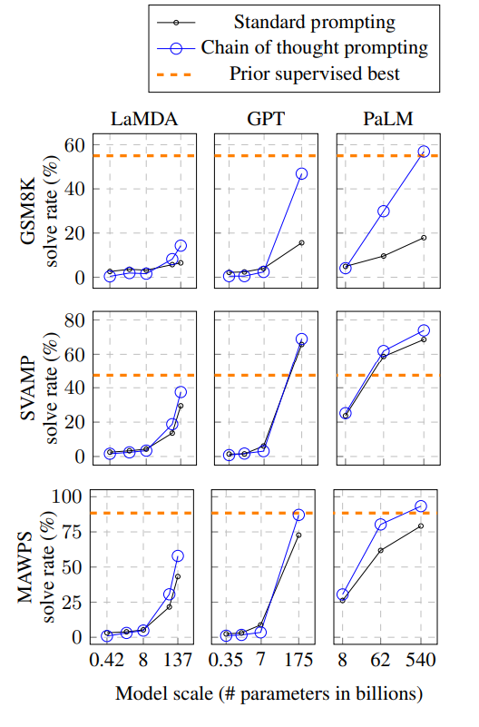
Arithmetic Reasoning
Results

Slide 9
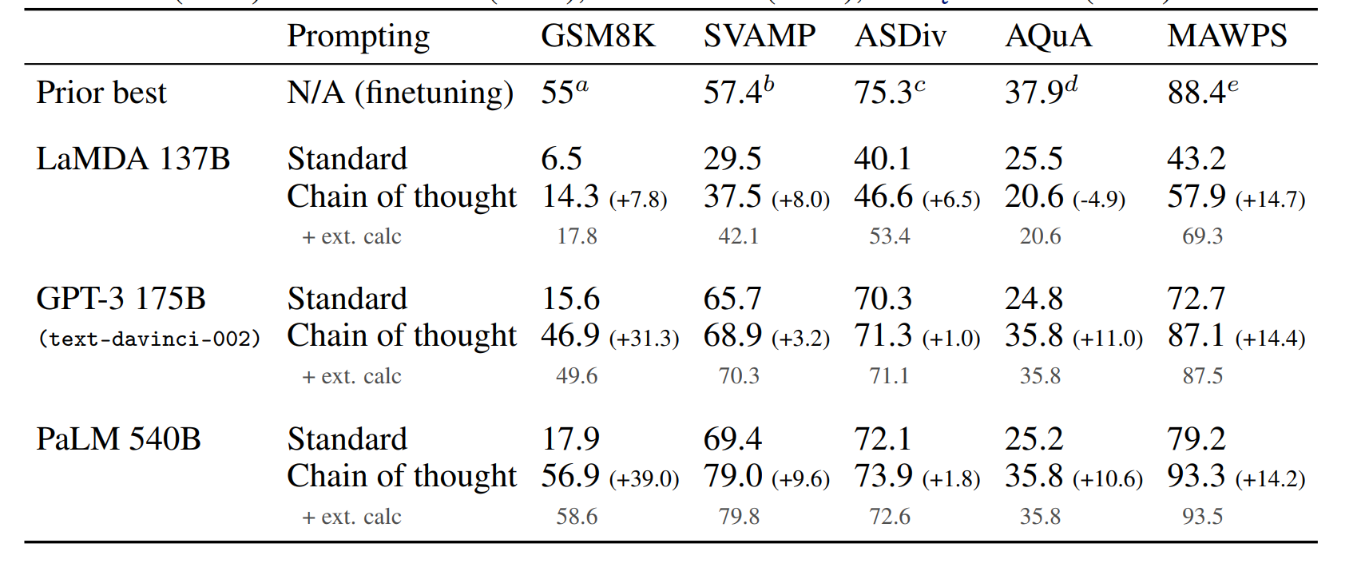
External Calculator

Slide 10
Arithmetic Reasoning (findings)
Sufficient large scale of language models is required for large performance gains
Smaller scale produces fluent but illogical chains of thought
Chain of thought prompting has larger performance gains for more-complicated problems (such as GSM8k)
Very large language models such as GPT-3 175B and PaLM 540B compares favorably to prior state-of-the-art, which typically finetunes a task-specific model on a labeled training dataset.

Slide 11
Arithmetic Reasoning (quantitative analysis)
Of 50 random examples where the model returned the correct final answer, all of the generated chains of thought were also logically and mathematically correct except two that coincidentally arrived at the correct answer.
Of 50 random examples where the model returned the wrong final answer, 46% of the chains of thought were almost correct, barring minor mistakes (calculate error, symbolic mapping error, or one reasoning steps missing); the other 54% had major errors in semantic understanding or coherence.

Slide 12
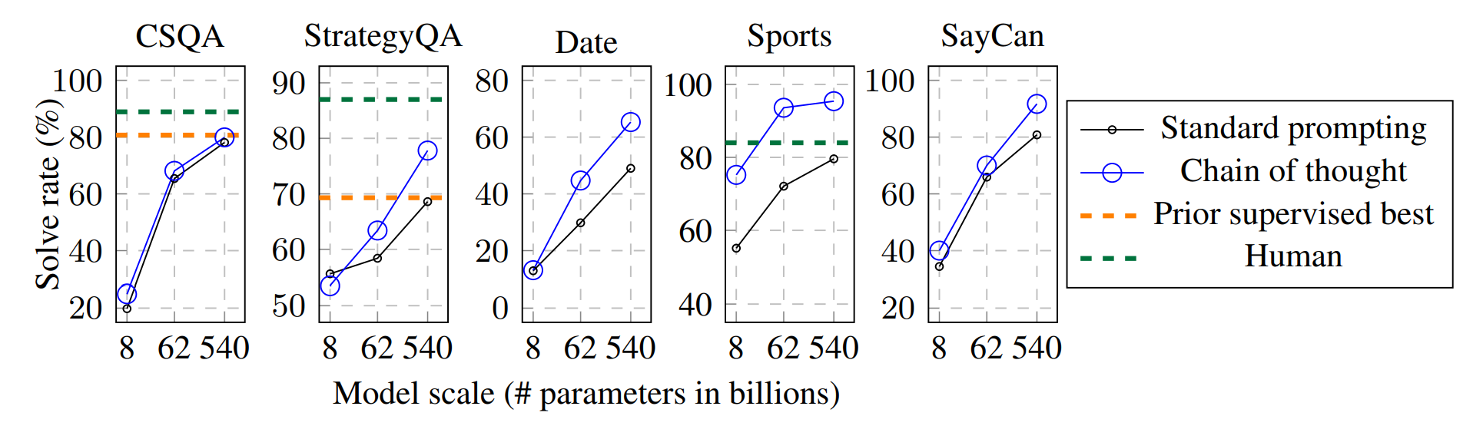
Commonsense Reasoning (results)

Slide 13
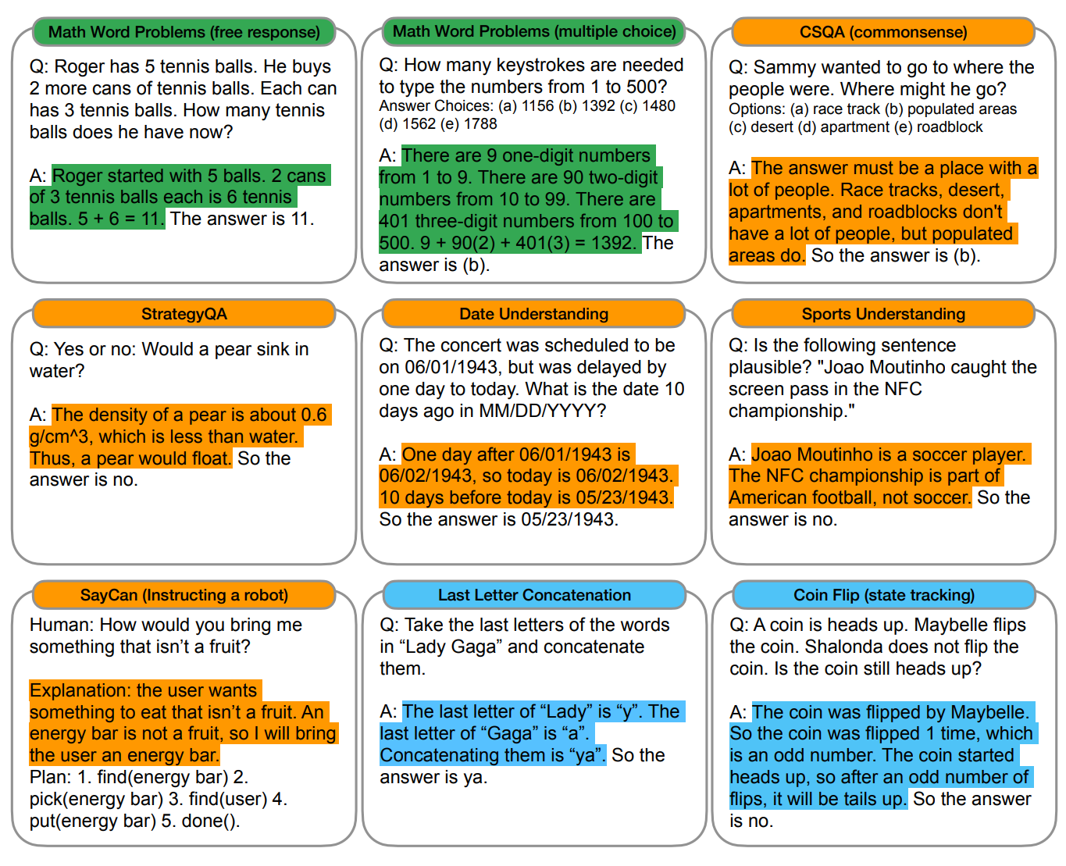
Commonsense Reasoning

Slide 14
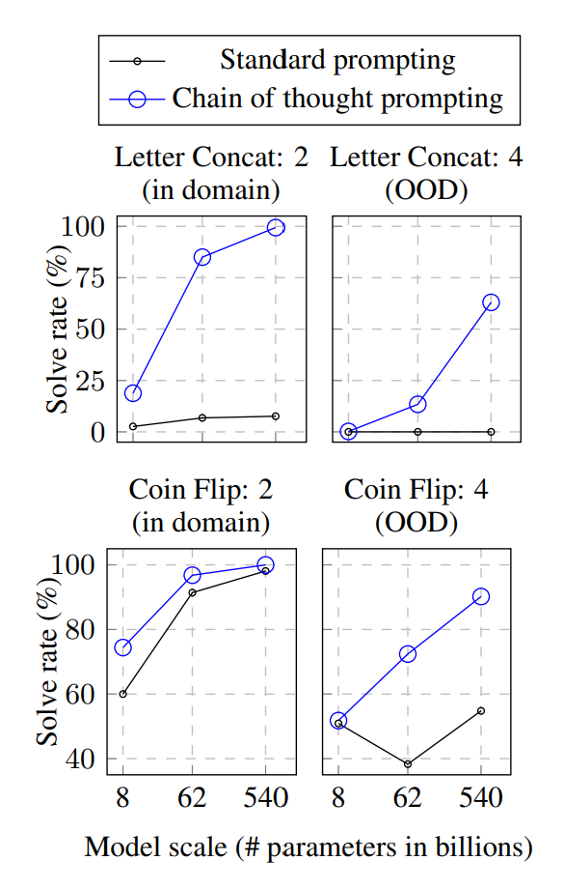
Symbolic Reasoning (results)

Slide 15
Limitations
It does not answer whether the neural network is actually “reasoning”.
Dependence on chain of thought prompting and sufficiently large language models.

