Slide 1
Wav2vec-U 2.0：Towards End-to-end
Unsupervised Speech Recognition
Ziyang Ma 2022.7.22
Liu, A. H., Hsu, W. N., Auli, M., & Baevski, A. (2022). Towards End-to-end Unsupervised Speech Recognition. arXiv preprint arXiv:2204.02492.

Slide 2
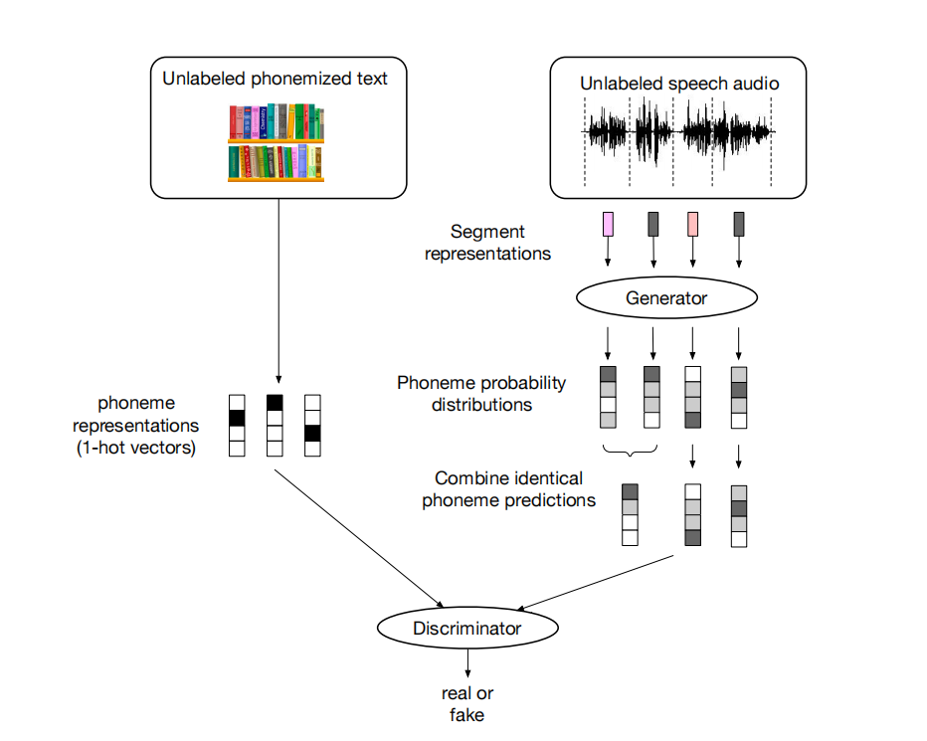
Background: Unsupervised Speech Recognition
Baevski et al., 2021. Unsupervised speech recognition. In Proc. NIPS
Notes:
Unsupervised model architecture

Slide 3
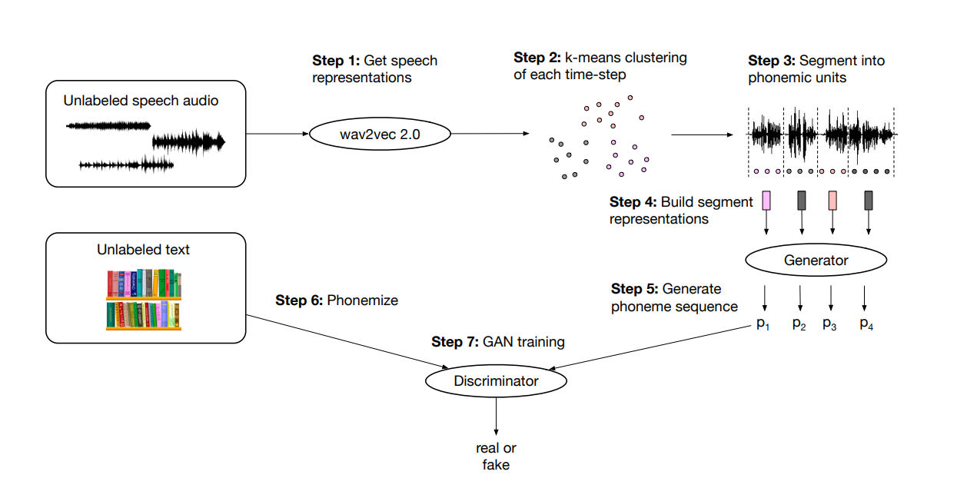
Background: Wav2vec-U 1.0
Baevski et al., 2021. Unsupervised speech recognition. In Proc. NIPS
Notes:
Unsupervised model architecture

Slide 4
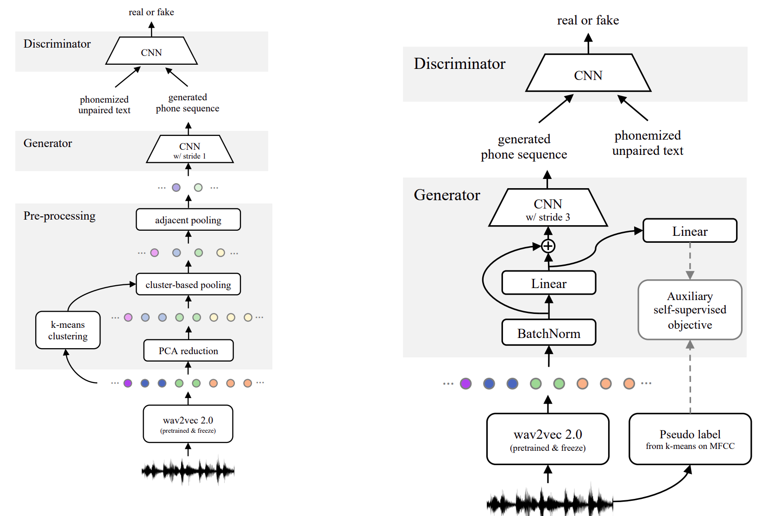
Differences of Model Architecture
1.0
2.0

Slide 5
1 Speech and Text Representations
speech audio
phn, char, word
good
representations

Slide 6
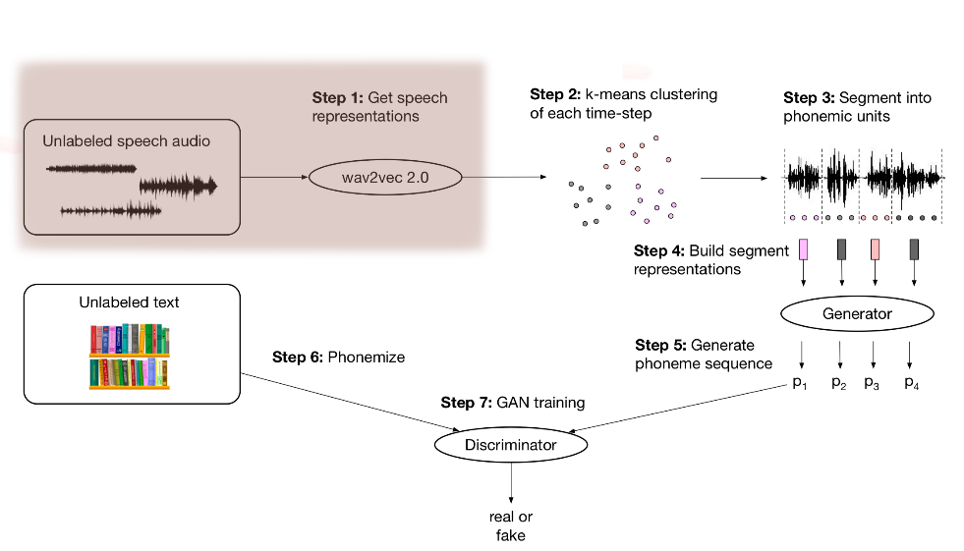
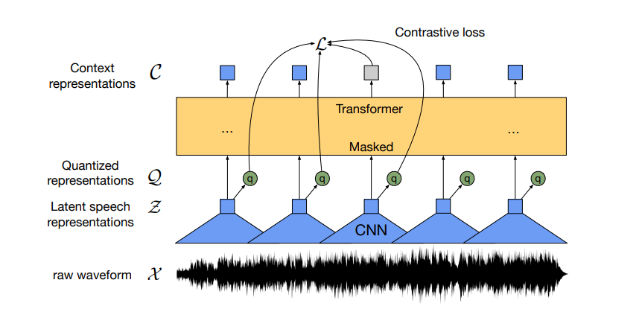
1.1 Speech Representation
Baevski, A., Zhou, Y., Mohamed, A., & Auli, M. (2020). wav2vec 2.0: A framework for self-supervised learning of speech representations. In Proc. NIPS

Slide 7
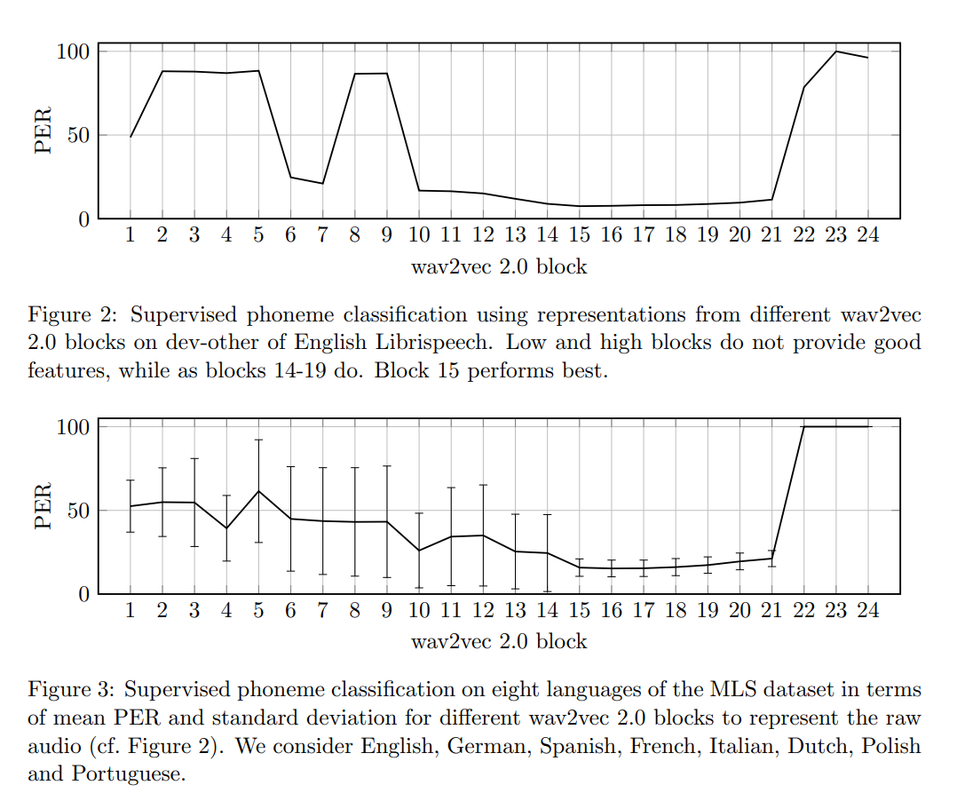
1.1 Speech Representation
English wav2vec 2.0 LARGE model pre-trained on Libri-Light
top of the each of the 24 blocks
Notes:
这里为什么用有监督的模型来评价？

Slide 8
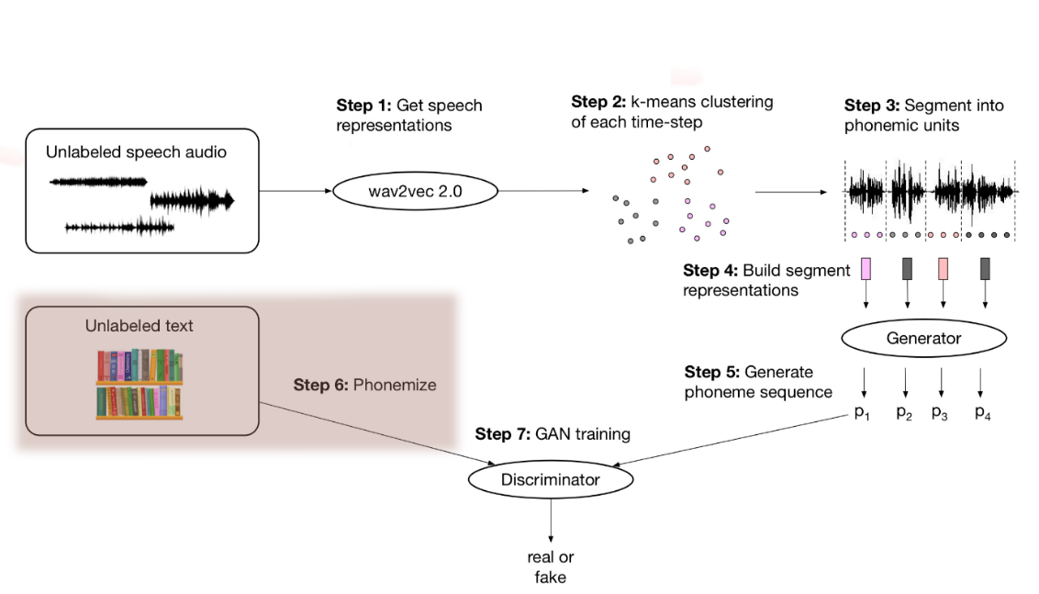
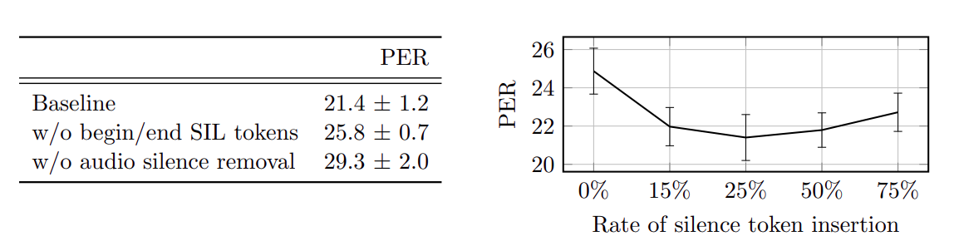
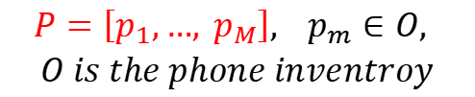

1.2 Text Representation
Phonemization
Lexicon or G2P
$$P=\left[p_{1},…, p_{M}\right], { p}_{m}∈O,$$
$O is the phone inventroy$
Word Sequence $Y$
Silence token insertion
Notes:
声学模型
Librispeech dev-other 右图结果
Librispeech -- > G2P phonemizer; timit 自带
随机插入

Slide 9
Model Architecture
Two layer CNN
Two layer CNN
1.0
2.0

Slide 10

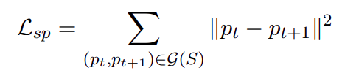

2.1 Objective
Gradient penalty
Segment smoothness penalty
Phoneme diversity loss

Slide 11

2.2 Objective
wav2vec-U 1.0
wav2vec-U 2.0
Auxiliary Self-supervised Objective

Slide 12
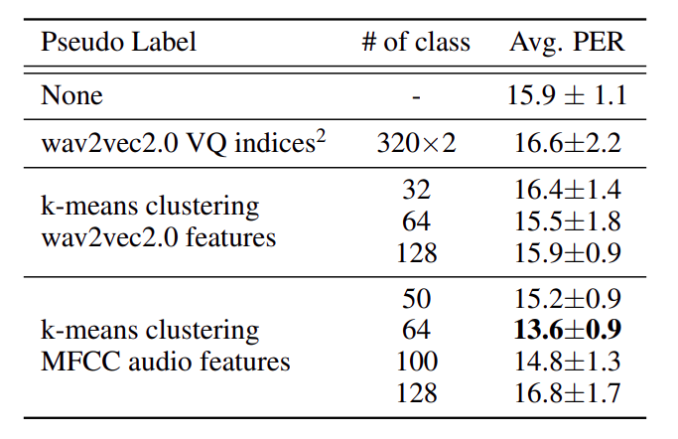
2.2 Objective
Auxiliary Self-supervised Objective

Slide 13
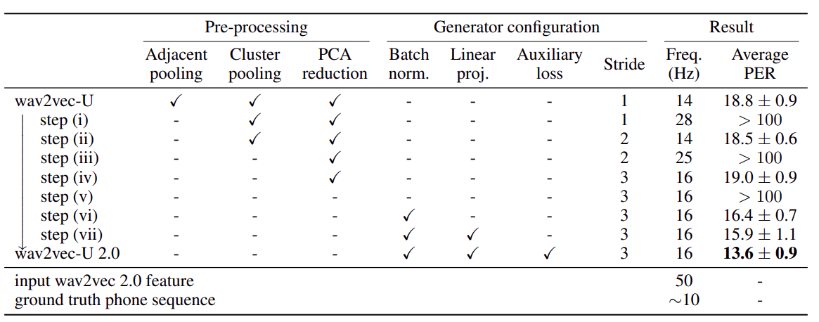
3.1 Interpolation from 1.0 to 2.0
Table: Interpolation from wav2vec-U (Fig. 1) to wav2vec-U 2.0 (Fig. 2). Phone Error Rate (PER) computed with greedy decoding on LibriSpeech dev-other set averaged over 8 runs. Freq. refers to the frequency of sequence, i.e. number of tokens per second.

Slide 14


3.2 Self-Training
(all training data)
Wav2vec-U
+ WFST
pseudo labels
(Word)
$$Y$$
$$X$$
HMM
fine-tune
wav2vec 2.0
CTC

Slide 15
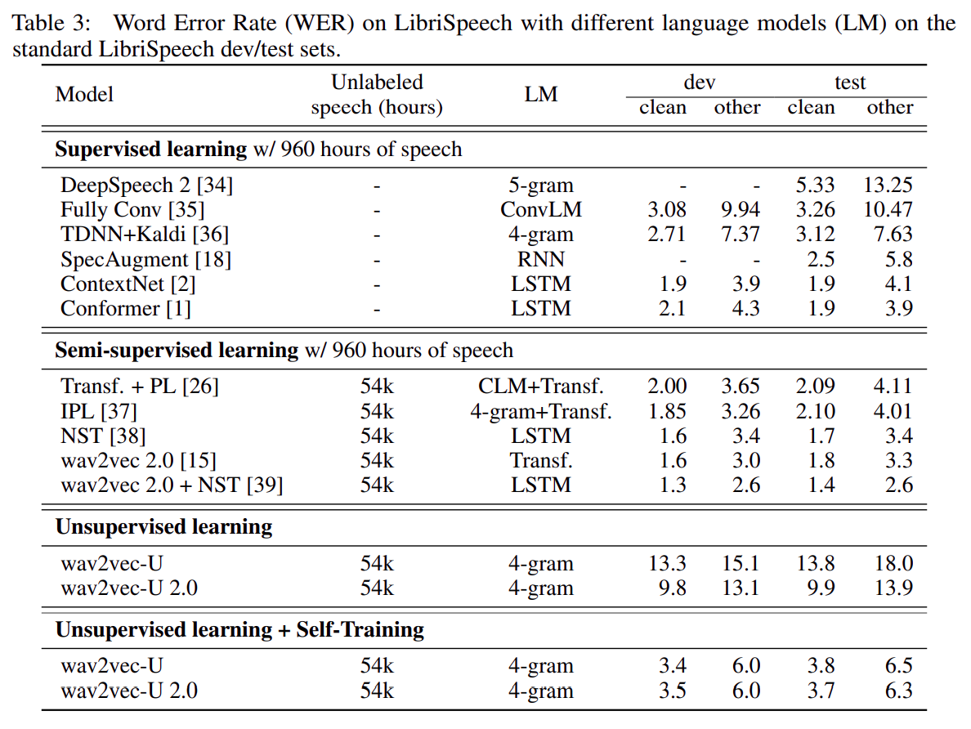
3.2 Results on LibriSpeech

Slide 16
Thanks for listening!
Ziyang Ma 2022.7.22

