Slide 1
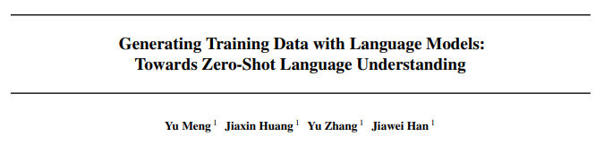
Paper Reading:
Generating Training Data with Language Models:
Toward Zero-shot Language Understanding
Presenter: Jian Yang
Date: Mar 18, 2022

Slide 2
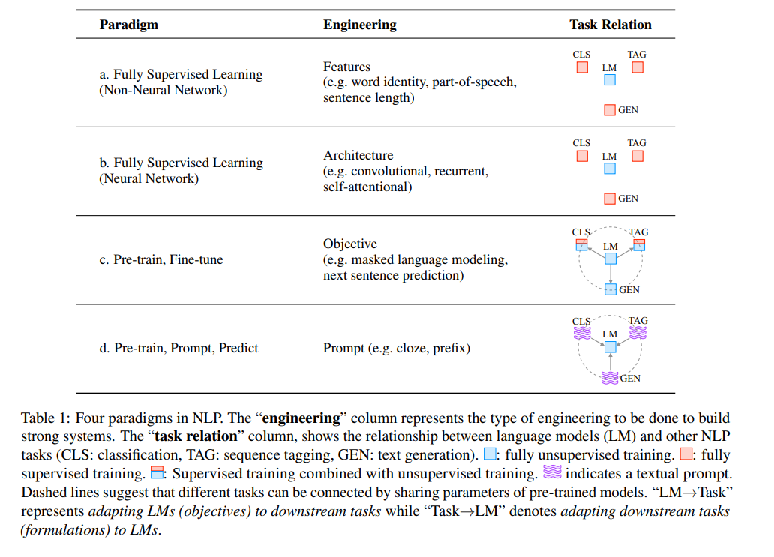
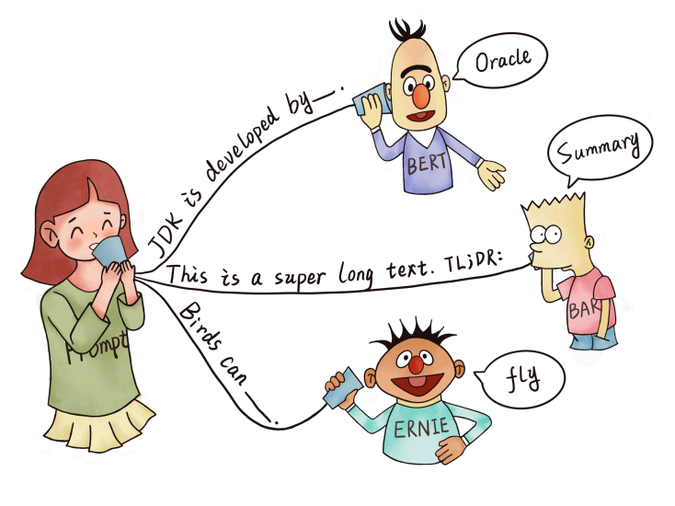
Background: Prompt
[1] Pre-train, Prompt, and Predict: A Systematic Survey of Prompting Methods in Natural Language Processing

Slide 3
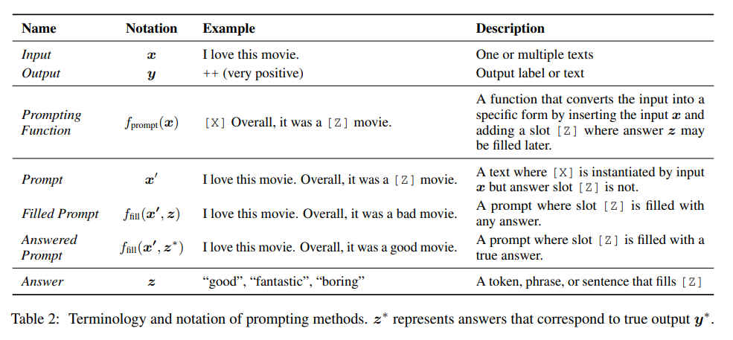
Background: Prompt
[1] Pre-train, Prompt, and Predict: A Systematic Survey of Prompting Methods in Natural Language Processing

Slide 4
Background: Prompt
Prompt Addition
Apply a template: Apply a template, which is a textual string that has two slots: an input slot [X] for input x and an answer slot [Z] for an intermediate generated answer text z that will later be mapped into y.
Fill slot [X] with the input text x.
Example
In the case of sentiment analysis where x =“I love this movie.”, the template may take a form such as “[X] Overall, it was a [Z] movie.”. Then, x 0 would become “I love this movie. Overall it was a [Z] movie.” given the previous example. In the case of machine translation, the template may take a form such as “Finnish: [X] English: [Z]”, where the text of the input and answer are connected together with headers indicating the language
[1] Pre-train, Prompt, and Predict: A Systematic Survey of Prompting Methods in Natural Language Processing

Slide 5

Background: Prompt
Answer Search
Next, we search for the highest-scoring text z that maximizes the score of the LM. We first define Z as a set of permissible values for z. Z could range from the entirety of the language in the case of generative tasks, or could be a small subset of the words in the language in the case of classification
This search function could be an argmax search that searches for the highest-scoring output, or sampling that randomly generates outputs following the probability distribution of the LM.
[1] Pre-train, Prompt, and Predict: A Systematic Survey of Prompting Methods in Natural Language Processing

Slide 6
Background: Prompt
Answer Mapping
This is trivial in some cases
Finally, we would like to go from the highest-scoring answer z to the highest-scoring output y. This is trivial in some cases, where the answer itself is the output (as in language generation tasks such as translation), but there are also other cases where multiple answers could result in the same output.
Example
one may use multiple different sentiment-bearing words (e.g. “excellent”, “fabulous”, “wonderful”) to represent a single class (e.g. “++”), in which case it is necessary to have a mapping between the searched answer and the output value.
[1] Pre-train, Prompt, and Predict: A Systematic Survey of Prompting Methods in Natural Language Processing

Slide 7
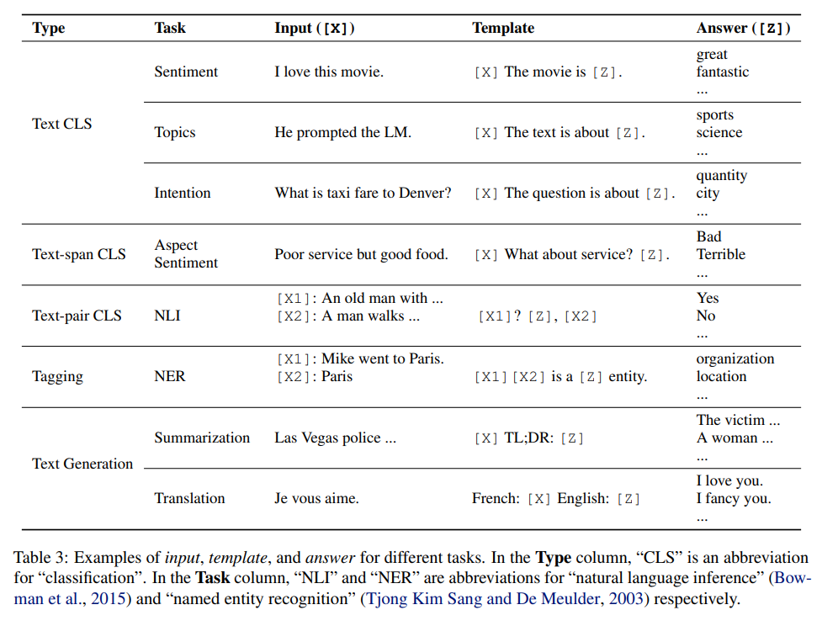
Background: Prompt
[1] Pre-train, Prompt, and Predict: A Systematic Survey of Prompting Methods in Natural Language Processing

Slide 8
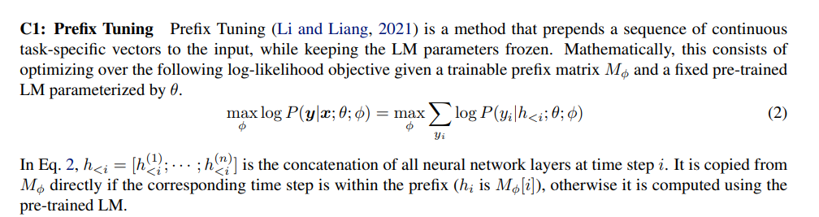
Background: Prompt
Prefix Tuning
[1] Pre-train, Prompt, and Predict: A Systematic Survey of Prompting Methods in Natural Language Processing

Slide 9
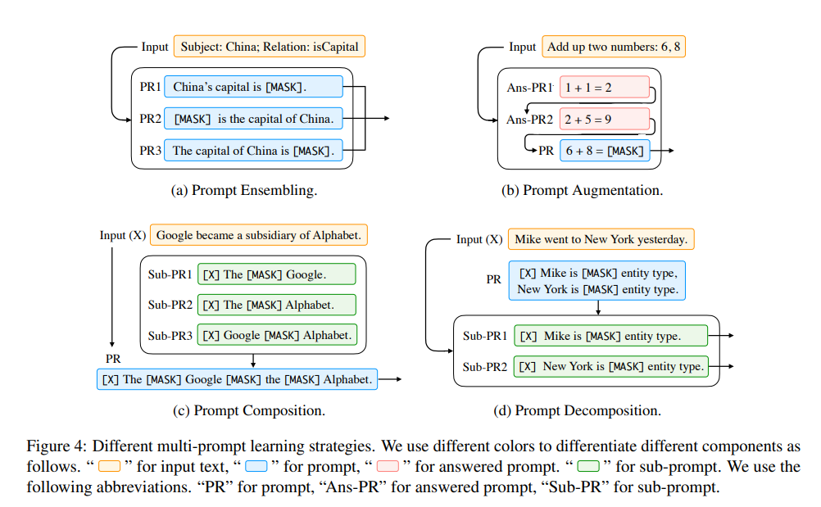
Background: Prompt
Multi-Prompt Learning
Mix Prompt: Simply Concatenate all possible results
[1] Pre-train, Prompt, and Predict: A Systematic Survey of Prompting Methods in Natural Language Processing

Slide 10
SuperGen
Unidirectional PLMs (e.g., GPT, CTRL)
Superior text generation capabilities
Bidirectional PLMs (e.g., BERT, COCO-LM)
Prominent choice for natural language understanding (NLU) tasks
Background
While both types of models have achieved promising few-shot learning performance, their potential for zero-shot learning has been underexplored
SuperGen
A Supervision Generation approach, wherein training data are created via a unidirectional PLM (i.e., the generator) which generates class-conditioned texts guided by label-descriptive prompts. A bidirectional PLM (i.e., the classifier) is then fine-tuned on the generated texts to perform the corresponding task
[1] Generating Training Data with Language Models: Towards Zero-Shot Language Understanding

Slide 11
SuperGen
Motivation
Prompt-based methods are applied to the zero-shot setting, however, the PLMs’ predictions are much less accurate.
GPT-3’s zero-shot performance is much degraded relative to its few-shot performance (Brown et al., 2020), especially on challenging tasks like natural language inference (NLI). Without any task-specific samples, it is indeed challenging for PLMs to effectively interpret the prompts that come in different formats and are unseen in the pretraining data.
To familiarize PLMs with various prompts for zero-shot generalization to unseen tasks
Previous work (Wei et al., 2022) finetunes PLMs on a large collection of different tasks described by instructions. Despite its strong performance, its success is grounded in the large number of cross-task annotated datasets (e.g., train on many non-NLI tasks and transfer to NLI tasks), posing great challenges for training and using such models in most real-world applications.
[1] Generating Training Data with Language Models: Towards Zero-Shot Language Understanding

Slide 12
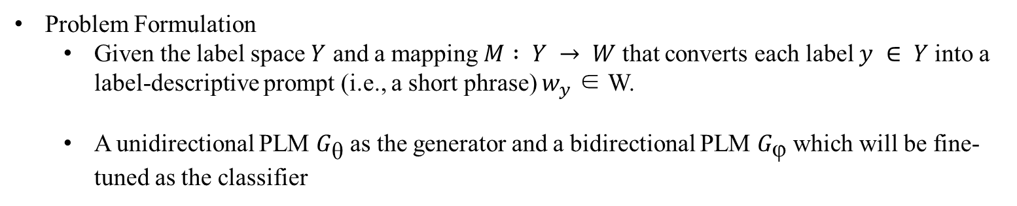
SuperGen
Problem Formulation
Given the label space $Y$ and a mapping $M : Y → W$that converts each label $y ∈ Y$into a label-descriptive prompt (i.e., a short phrase) $w_{y}$ ∈ W.
A unidirectional PLM $G_{\text{θ}}$ as the generator and a bidirectional PLM $G_{\text{φ}}$ which will be fine-tuned as the classifier
[1] Generating Training Data with Language Models: Towards Zero-Shot Language Understanding

Slide 13
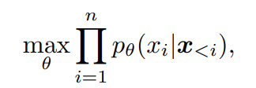
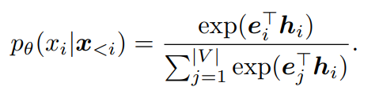
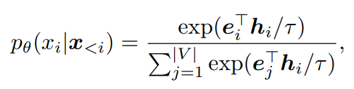
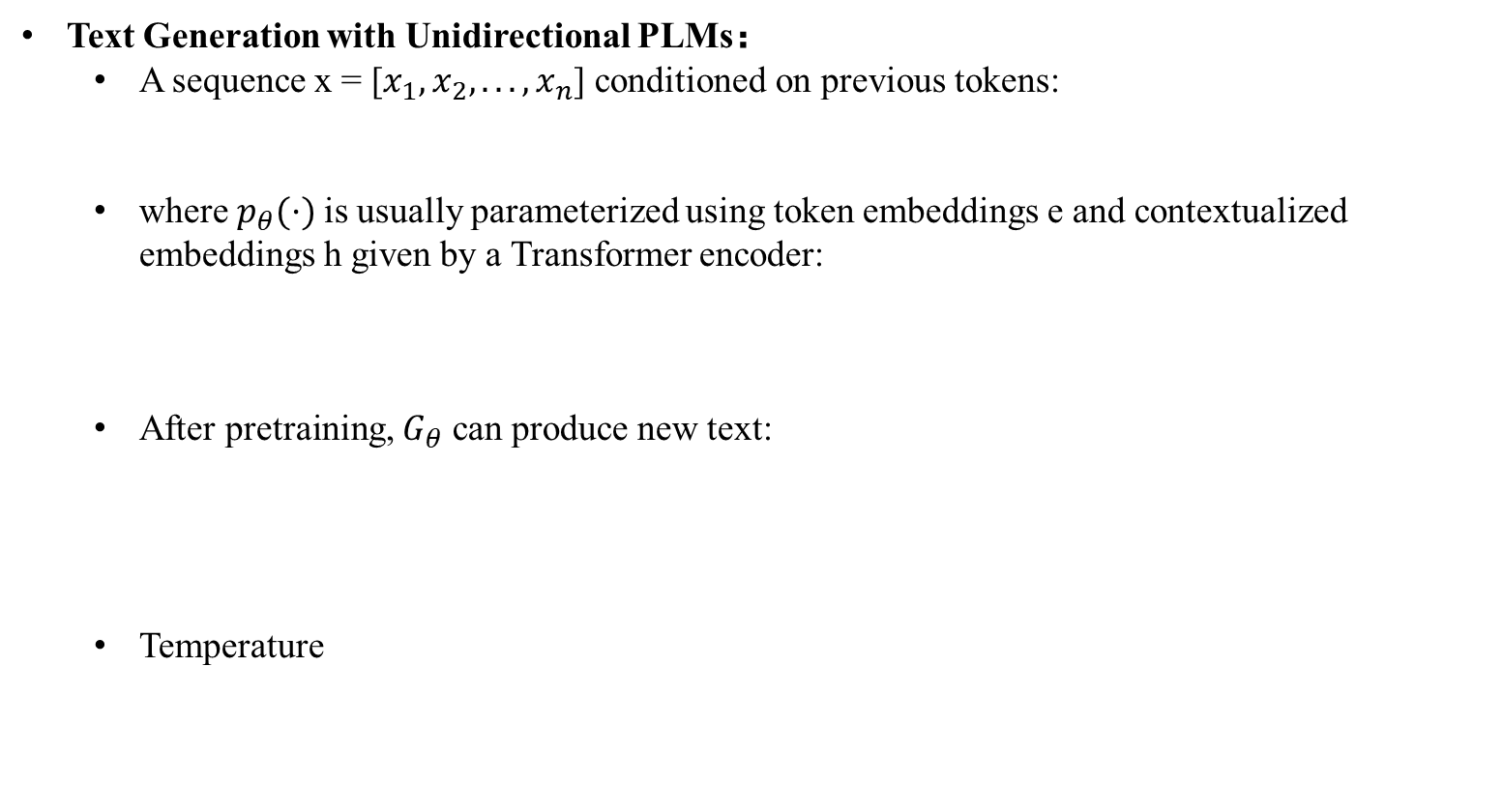
SuperGen
Text Generation with Unidirectional PLMs：
A sequence x = [$x_{1},x_{2}, . . . ,x_{n}$] conditioned on previous tokens:
where $p_{θ}(·)$is usually parameterized using token embeddings e and contextualized embeddings h given by a Transformer encoder:
After pretraining, $G_{θ}$ can produce new text:
Temperature
[1] Generating Training Data with Language Models: Towards Zero-Shot Language Understanding

Slide 14
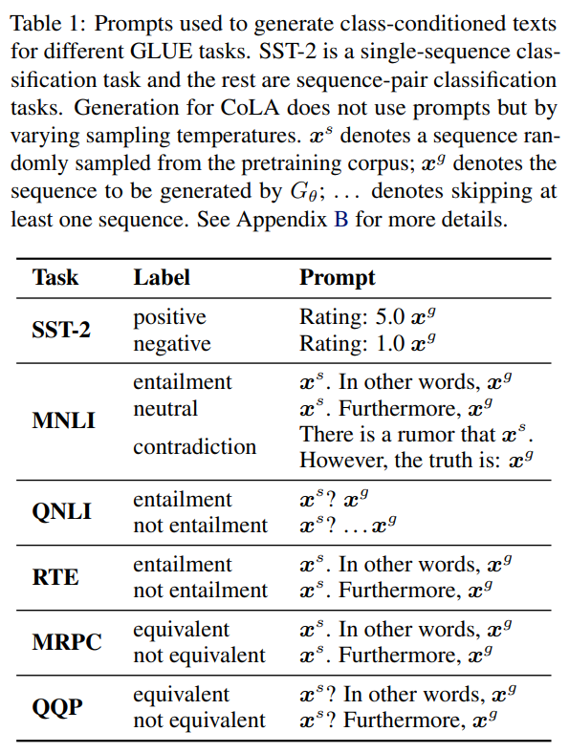
SuperGen
[1] Generating Training Data with Language Models: Towards Zero-Shot Language Understanding

Slide 15

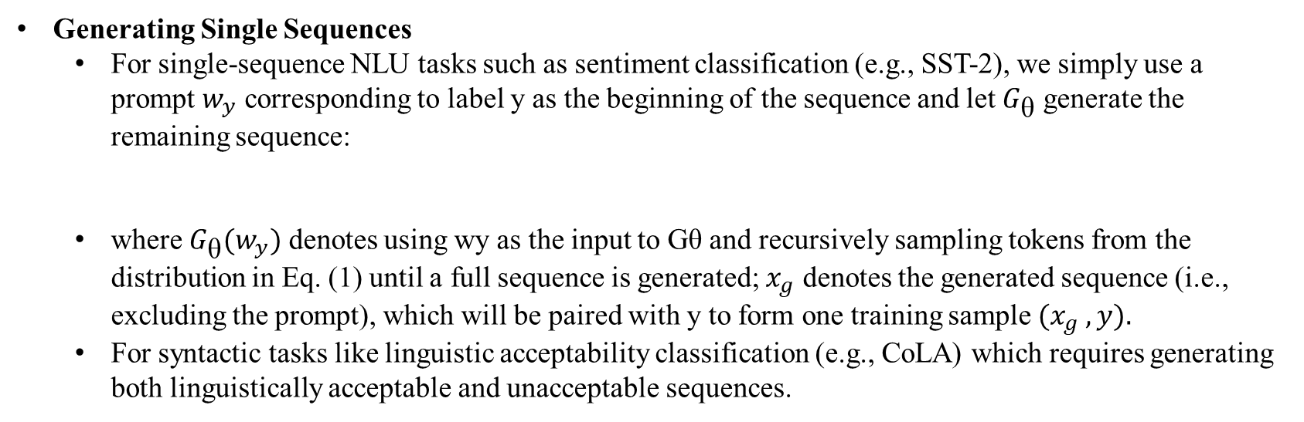
SuperGen
Generating Single Sequences
For single-sequence NLU tasks such as sentiment classification (e.g., SST-2), we simply use a prompt $w_{y}$ corresponding to label y as the beginning of the sequence and let $G_{\text{θ}}$ generate the remaining sequence:
where $G_{\text{θ}}(w_{y})$ denotes using wy as the input to Gθ and recursively sampling tokens from the distribution in Eq. (1) until a full sequence is generated; $x_{g}$ denotes the generated sequence (i.e., excluding the prompt), which will be paired with y to form one training sample $(x_{g} , y).$
For syntactic tasks like linguistic acceptability classification (e.g., CoLA) which requires generating both linguistically acceptable and unacceptable sequences.
[1] Generating Training Data with Language Models: Towards Zero-Shot Language Understanding

Slide 16
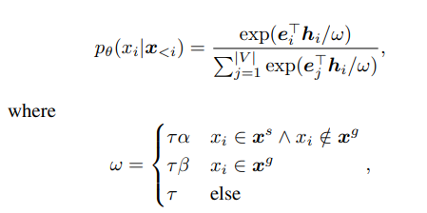
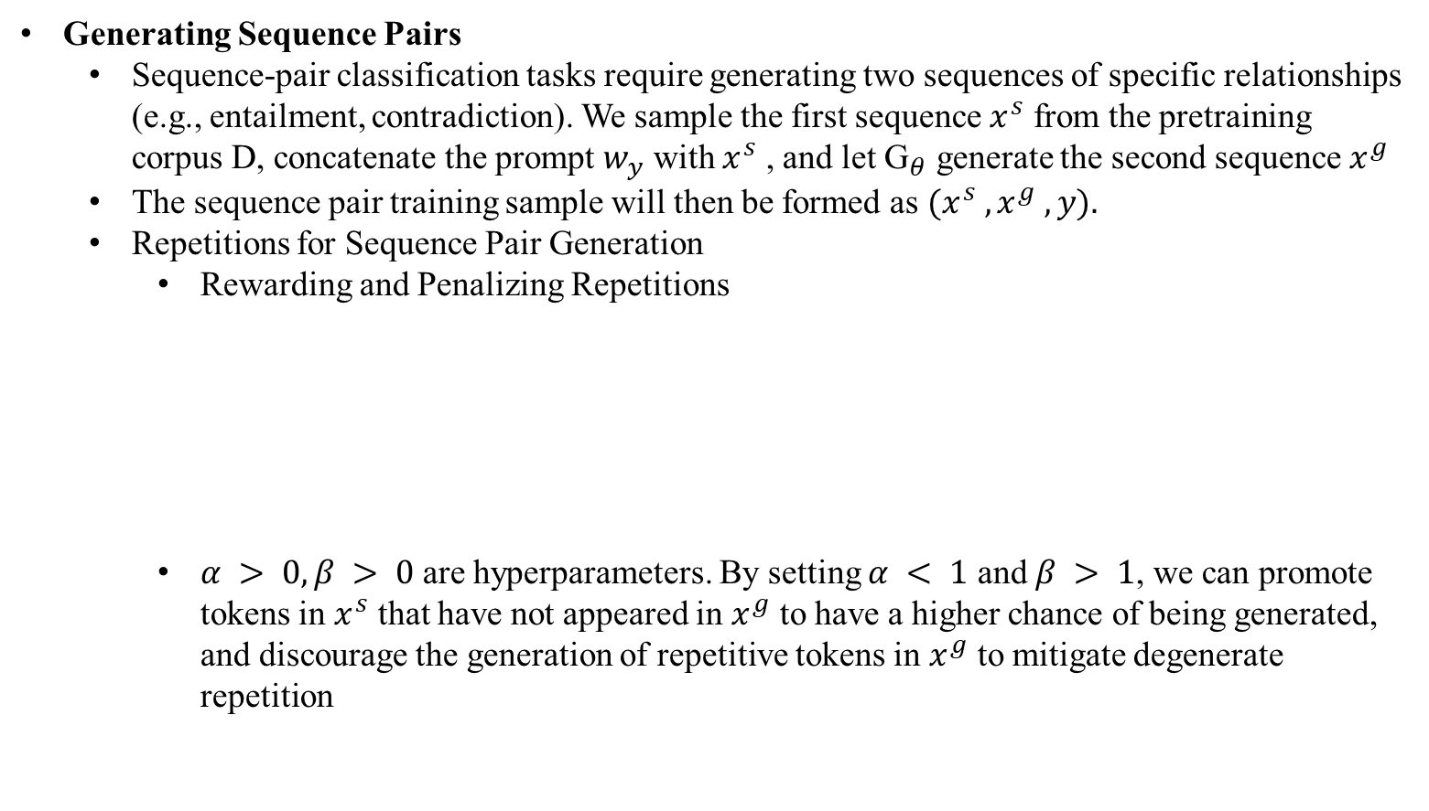
SuperGen
Generating Sequence Pairs
Sequence-pair classification tasks require generating two sequences of specific relationships (e.g., entailment, contradiction). We sample the first sequence $x^{s}$ from the pretraining corpus D, concatenate the prompt $w_{y}$ with $x^{s}$ , and let ${\text{G}}_{θ}$ generate the second sequence $x^{g}$
The sequence pair training sample will then be formed as $(x^{s} , x^{g} , y).$
Repetitions for Sequence Pair Generation
Rewarding and Penalizing Repetitions
$α > 0, β > 0$are hyperparameters. By setting $α < 1$ and $β > 1$, we can promote tokens in $x^{s}$ that have not appeared in $x^{g}$ to have a higher chance of being generated, and discourage the generation of repetitive tokens in $x^{g}$ to mitigate degenerate repetition
[1] Generating Training Data with Language Models: Towards Zero-Shot Language Understanding

Slide 17


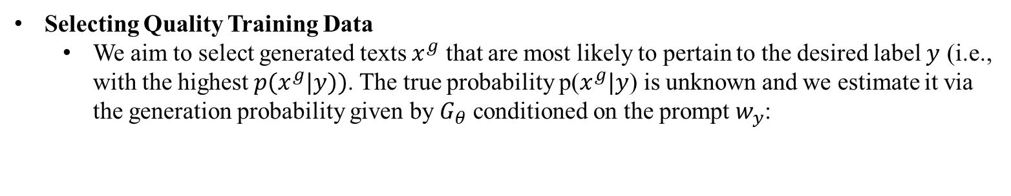
SuperGen
Selecting Quality Training Data
We aim to select generated texts $x^{g}$ that are most likely to pertain to the desired label $y$ (i.e., with the highest $p(x^{g}|y))$. The true probability p($x^{g}|y$) is unknown and we estimate it via the generation probability given by $G_{θ}$ conditioned on the prompt $w_{y}$:
[1] Generating Training Data with Language Models: Towards Zero-Shot Language Understanding

Slide 18

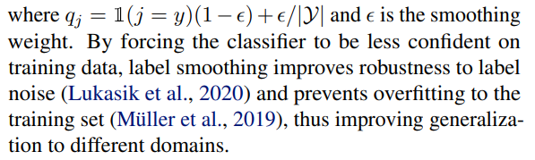
SuperGen
Label Smoothing
+1~2 Improvement for results
[1] Generating Training Data with Language Models: Towards Zero-Shot Language Understanding

Slide 19

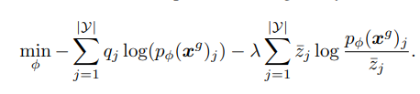
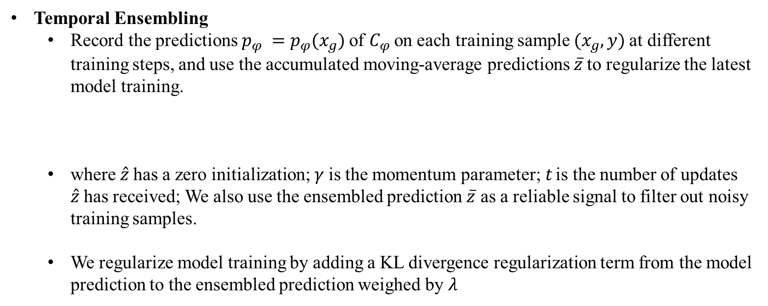
SuperGen
Temporal Ensembling
Record the predictions $p_{φ} =p_{φ}(x_{g})$of $C_{φ}$on each training sample $(x_{g},y)$at different training steps, and use the accumulated moving-average predictions $\overline{z}$to regularize the latest model training.
where $\hat{z}$has a zero initialization; $γ$is the momentum parameter;$t$ is the number of updates $\hat{z}$has received; We also use the ensembled prediction $\overline{z}$ as a reliable signal to filter out noisy training samples.
We regularize model training by adding a KL divergence regularization term from the model prediction to the ensembled prediction weighed by $λ$
[1] Generating Training Data with Language Models: Towards Zero-Shot Language Understanding

Slide 20
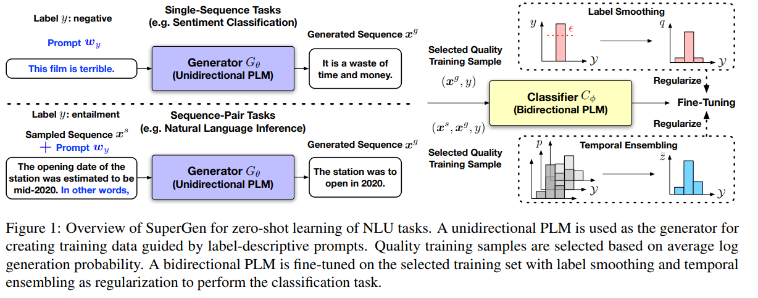
SuperGen
[1] Generating Training Data with Language Models: Towards Zero-Shot Language Understanding

Slide 21
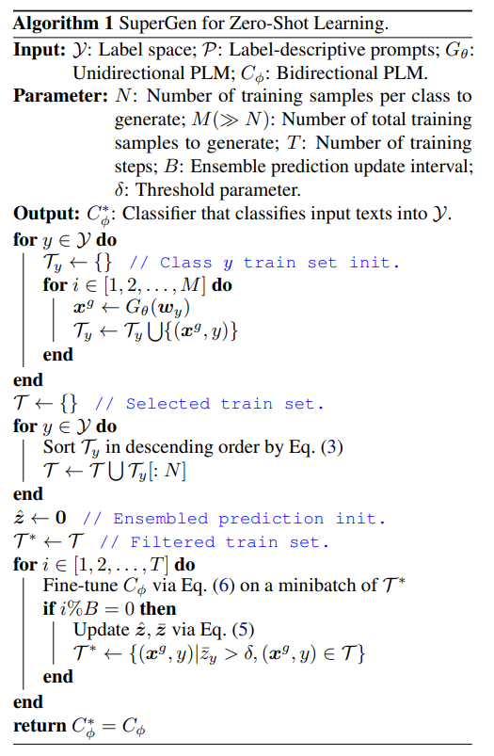
SuperGen
[1] Generating Training Data with Language Models: Towards Zero-Shot Language Understanding

Slide 22
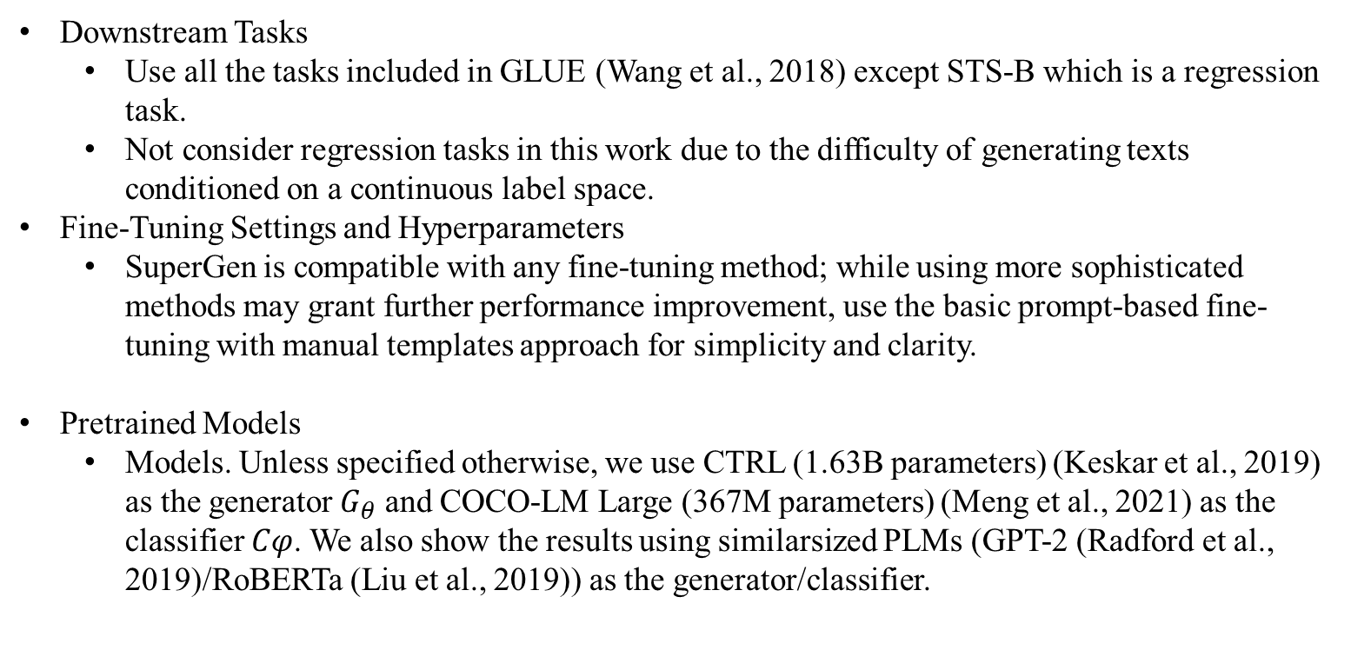
SuperGen
Downstream Tasks
Use all the tasks included in GLUE (Wang et al., 2018) except STS-B which is a regression task.
Not consider regression tasks in this work due to the difficulty of generating texts conditioned on a continuous label space.
Fine-Tuning Settings and Hyperparameters
SuperGen is compatible with any fine-tuning method; while using more sophisticated methods may grant further performance improvement, use the basic prompt-based fine-tuning with manual templates approach for simplicity and clarity.
Pretrained Models
Models. Unless specified otherwise, we use CTRL (1.63B parameters) (Keskar et al., 2019) as the generator $G_{θ}$ and COCO-LM Large (367M parameters) (Meng et al., 2021) as the classifier $Cφ$. We also show the results using similarsized PLMs (GPT-2 (Radford et al., 2019)/RoBERTa (Liu et al., 2019)) as the generator/classifier.
[1] Generating Training Data with Language Models: Towards Zero-Shot Language Understanding

Slide 23
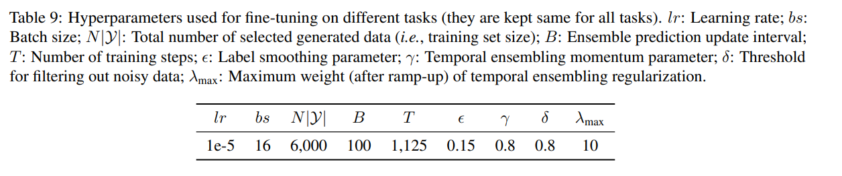
SuperGen
Hyperparameter
[1] Generating Training Data with Language Models: Towards Zero-Shot Language Understanding

Slide 24
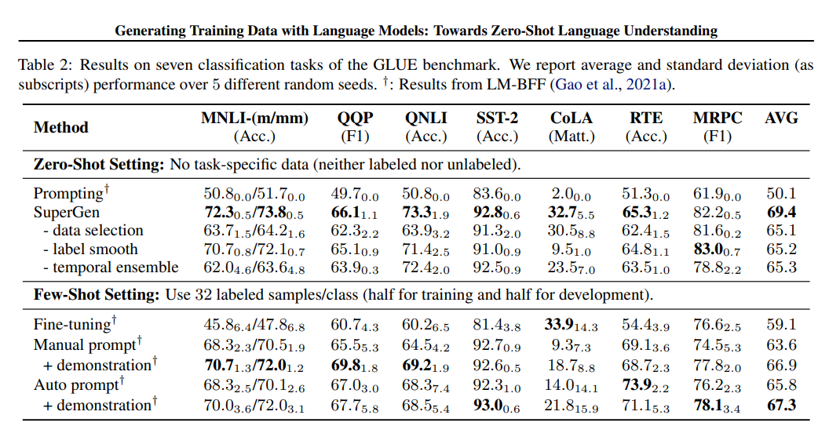
SuperGen: Results
demonstrates strong performance across seven classification tasks of the GLUE benchmark (e.g., 72.3/73.8 on MNLI-m/mm and 92.8 on SST-2), significantly outperforming zero-shot prompting methods and achieving even comparable results to strong few-shot approaches using 32 training samples per class
[1] Generating Training Data with Language Models: Towards Zero-Shot Language Understanding

Slide 25
SuperGen: Results
SuperGen can improve few-shot learning methods: Few-shot samples can be either used in the training data generation stage of SuperGen as demonstrations for steering the generator PLM towards producing texts closer to the task distribution.
(In-domain Data Generation)
[1] Generating Training Data with Language Models: Towards Zero-Shot Language Understanding

Slide 26
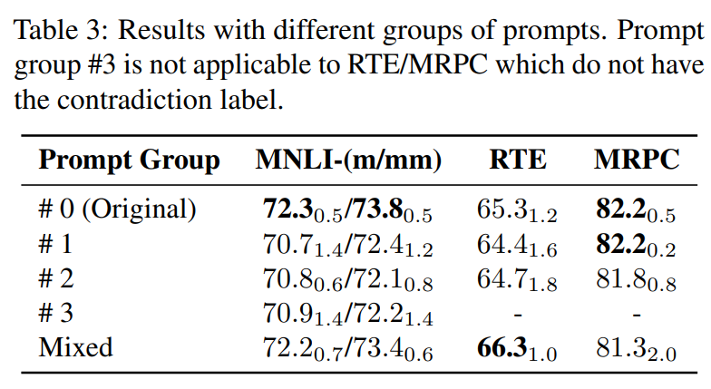
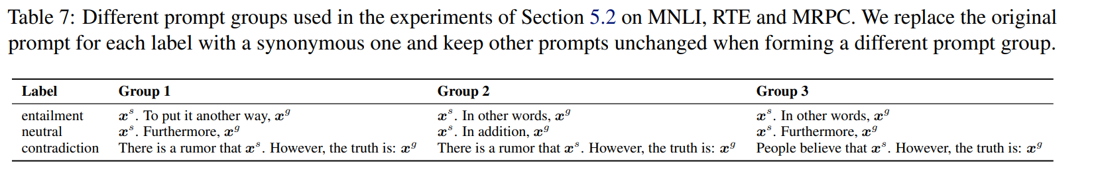
SuperGen: Analysis
Mixed: experiment with mixing the generated data by different prompt groups.
[1] Generating Training Data with Language Models: Towards Zero-Shot Language Understanding

Slide 27
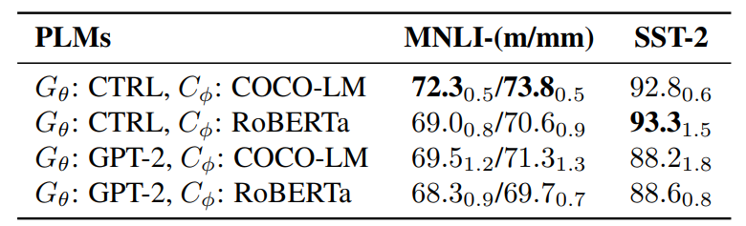
SuperGen: Analysis
Different Pretrained Models
[1] Generating Training Data with Language Models: Towards Zero-Shot Language Understanding

Slide 28
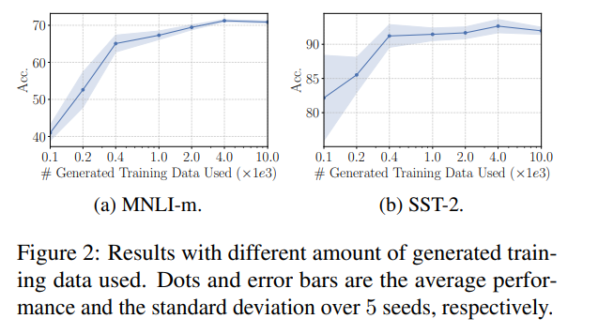
SuperGen: Analysis
An important future direction is to develop better data selection strategies for large-scale generated training sets of high-quality at low cost.
[1] Generating Training Data with Language Models: Towards Zero-Shot Language Understanding

Slide 29
SuperGen: Conclusion
(1) SuperGen differs from previous transfer-learning-based zero-shot methods in that SuperGen does not rely on cross-task annotations and eliminates the task difference in training and inference.
(2) Several strategies are important for effective and stable fine-tuning on generated data, including quality training data selection, label smoothing and temporal ensembling.
(3) SuperGen achieves strong performance on seven classification tasks of the GLUE benchmark, even yielding comparable or better results than sophisticated fewshot learning methods and offering better stability.
[1] Generating Training Data with Language Models: Towards Zero-Shot Language Understanding

Slide 30
Thank You for Your Listening !
Any Questions ?

Slide 31
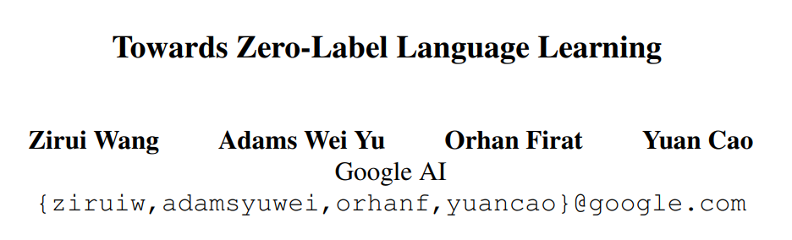
Related Work

Slide 32
Zero-label Language Learning
Task Definition
No human-annotated data is used anywhere during training and models are trained purely on synthetic data
This Work
Present a training data creation procedure named Unsupervised Data Generation (UDG), which leverages few-shot prompts to synthesize high-quality training data without real human annotations

Slide 33
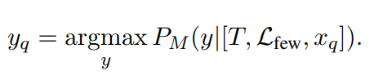
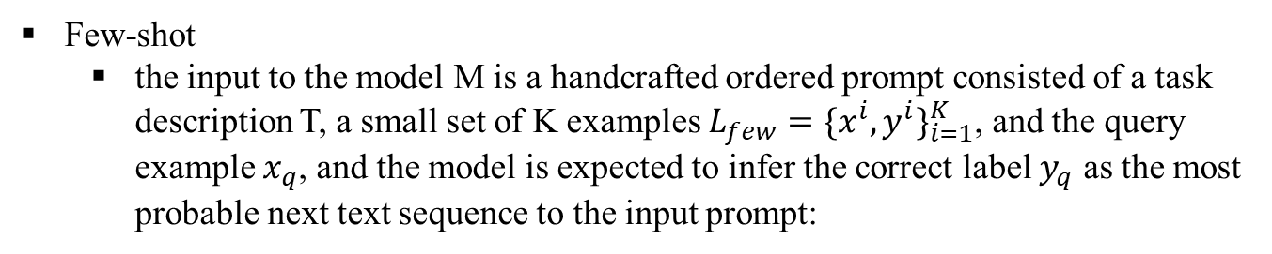
Zero-label Language Learning
Few-shot
the input to the model M is a handcrafted ordered prompt consisted of a task description T, a small set of K examples $L_{few}{=\{x^{i},y^{i}\}}_{i=1}^{K}$, and the query example $x_{q}$, and the model is expected to infer the correct label $y_{q}$ as the most probable next text sequence to the input prompt:

Slide 34
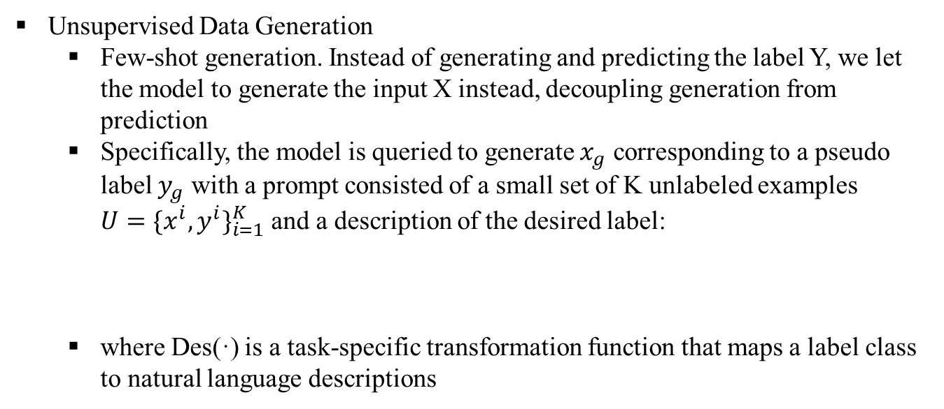
Zero-label Language Learning
Unsupervised Data Generation
Few-shot generation. Instead of generating and predicting the label Y, we let the model to generate the input X instead, decoupling generation from prediction
Specifically, the model is queried to generate $x_{g}$ corresponding to a pseudo label $y_{g}$ with a prompt consisted of a small set of K unlabeled examples $U{=\{x^{i},y^{i}\}}_{i=1}^{K}$and a description of the desired label:
where Des(·) is a task-specific transformation function that maps a label class to natural language descriptions

Slide 35
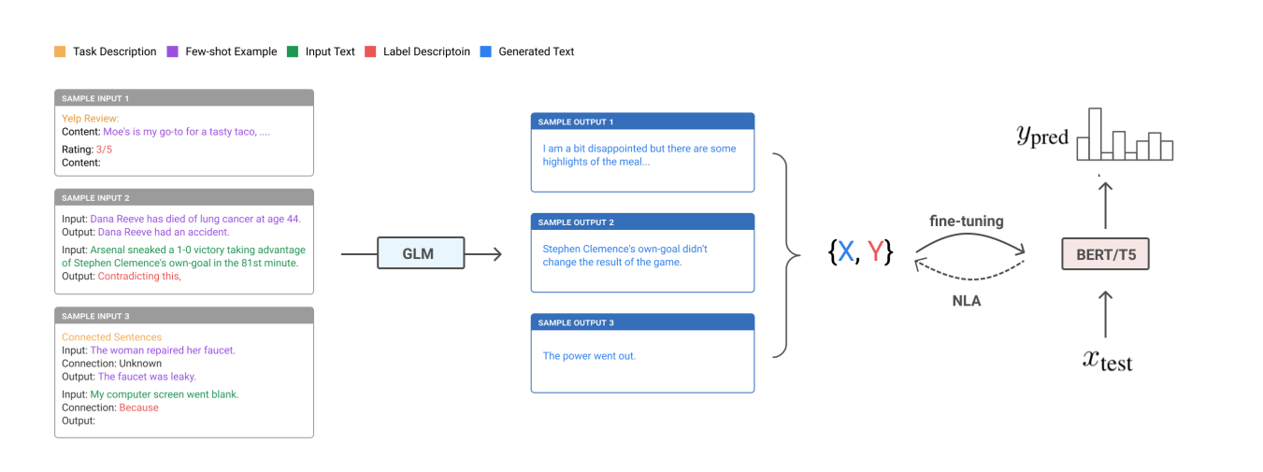
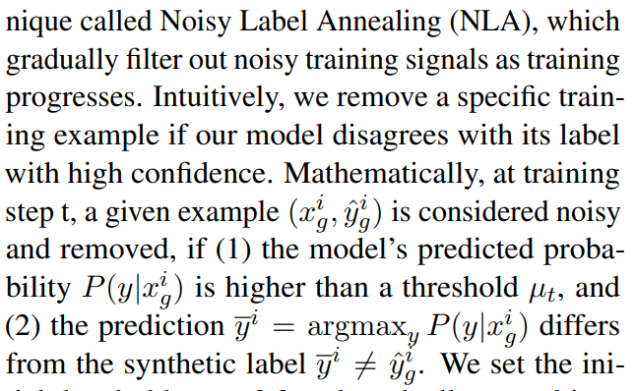
Zero-label Language Learning

Slide 36
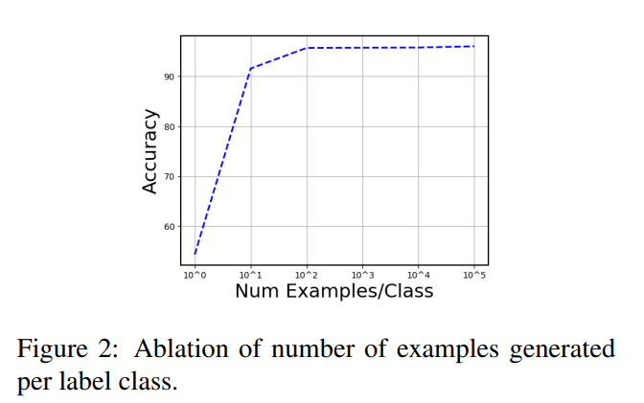
Zero-label Language Learning
We find the final performance to continuously improve with more generated data, showing that the language model can generate diverse examples.
One key benefit of our method is that we can sample as much data as needed with no additional cost or supervision. This is particularly useful for tasks from low-resource domains with limited unsupervised data available.

Slide 37
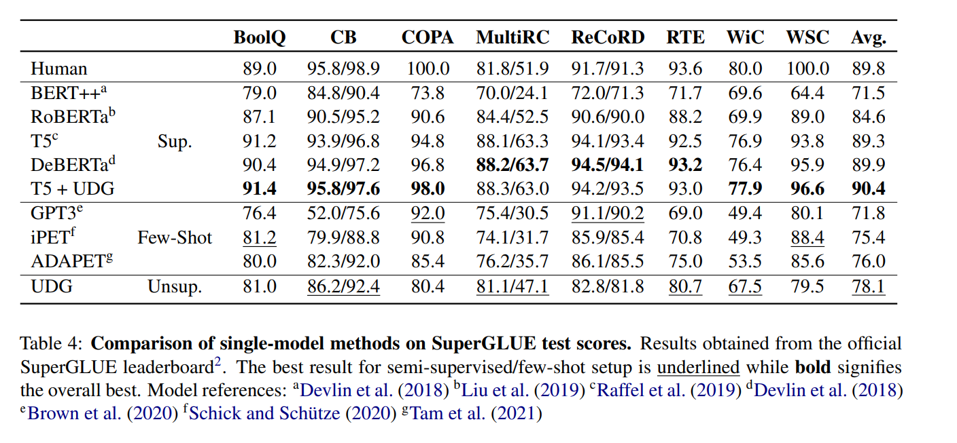
Zero-label Language Learning
Unsupervised Data Generation
Data Augmentation

Slide 38
Thank You for Your Listening !

