Slide 1
Graphing Quadratic Inequalities

Slide 2
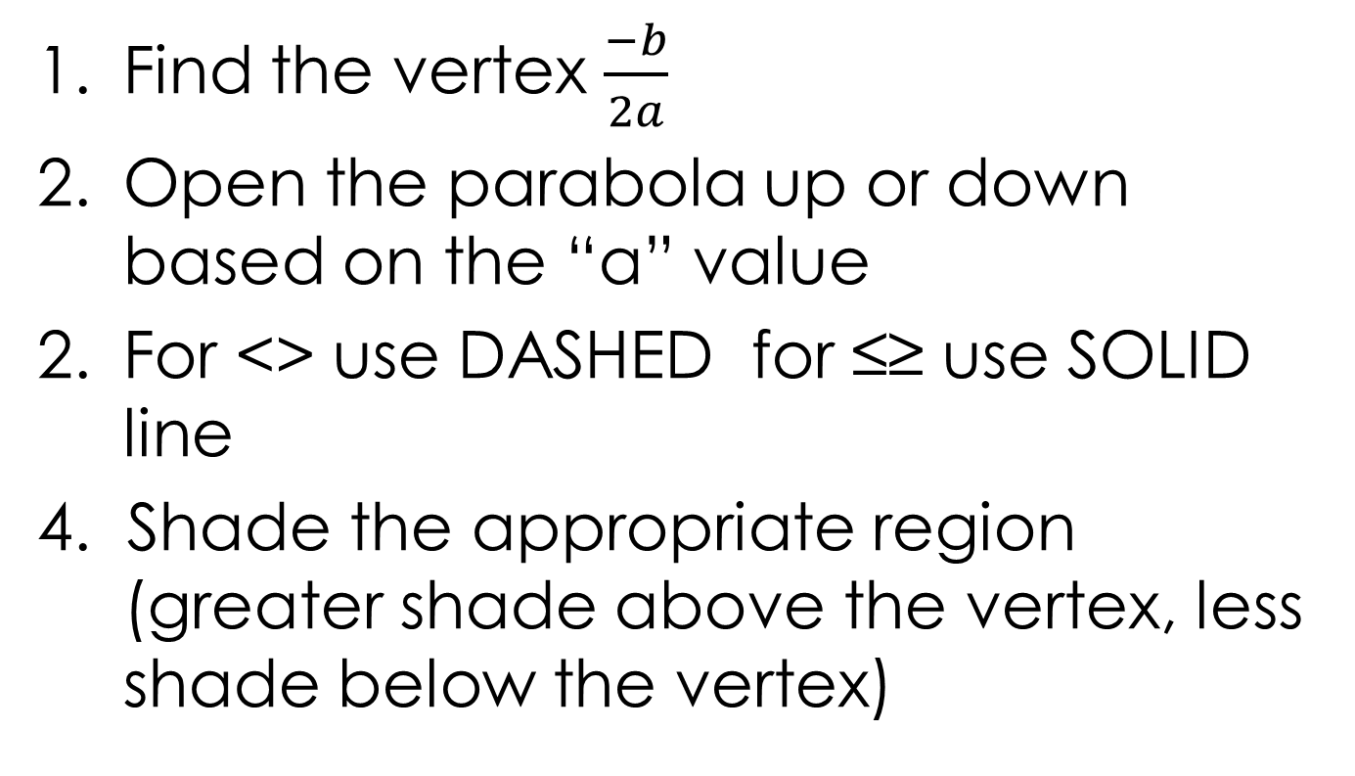
Steps for Graphing (quickly)

Slide 3
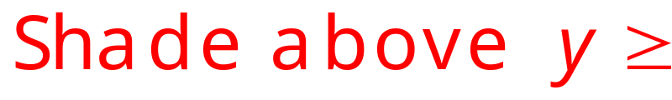

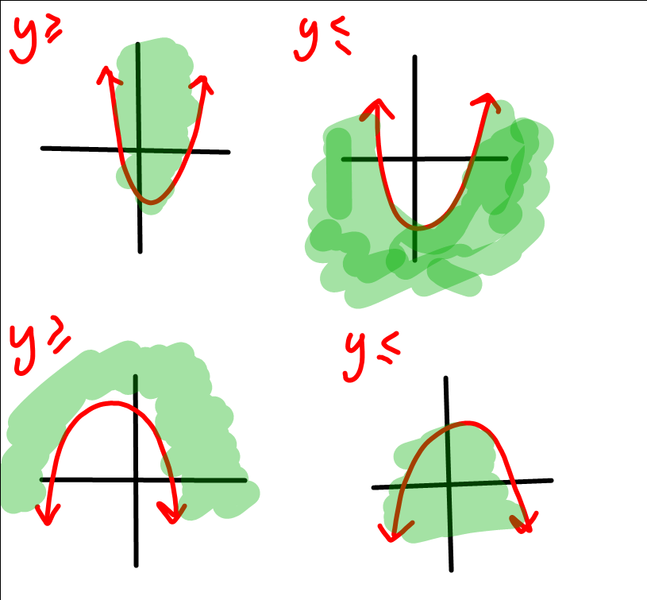
Shading

Slide 4
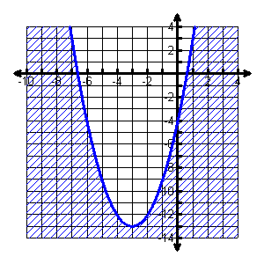
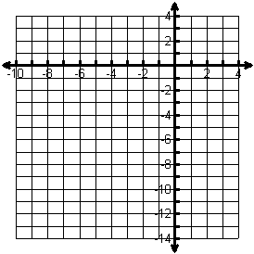
Graph: y ≤ x² + 6x – 4
* Vertex: (-3,-13)
Slope 1, 3, 5
* Solid Line
* Less than means shade BELOW

Slide 5
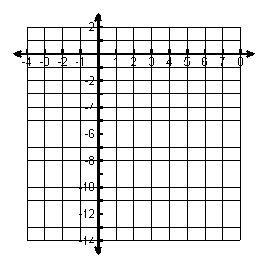
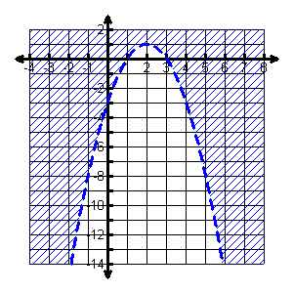
Graph: y > -x² + 4x – 3
* Vertex: (2, 1)
Slope -1, -3, -5
* Dashed Line
* Greater than means shade ABOVE

Slide 6
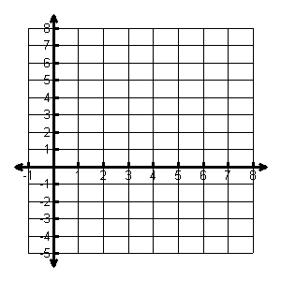
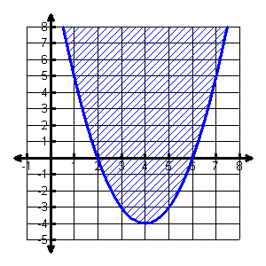
Graph: y ≥ x² – 8x + 12
* Vertex: (4, -4)
Slope 1, 3, 5
* Solid Line
* Greater than means shade ABOVE

Slide 7
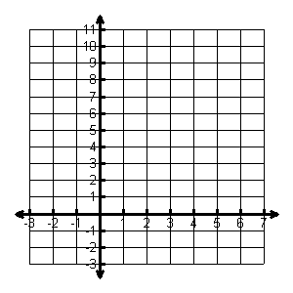
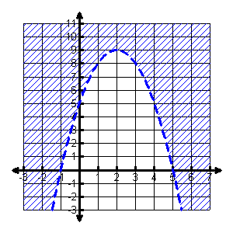
Graph: y > -x² + 4x + 5
* Vertex: (2, 9)
Slope -1, -3, -5
* Dashed Line
* Greater than means shade ABOVE

Slide 8
Solving a Quadratic Inequality

Slide 9
Steps for solving
Write the original inequality as an equation
Set equal to 0, factor, and solve.
> ≥ → GREAT OR – or must be in the answer
Write the answer

Slide 10
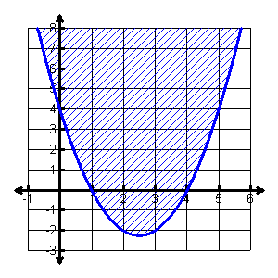
Solve: x² – 5x ≤ – 4
x² – 5x = -4
x² – 5x + 4 = 0
(x – 4) (x – 1) = 0
x = 1, 4
Answer: 1 ≤ x ≤ 4

Slide 11
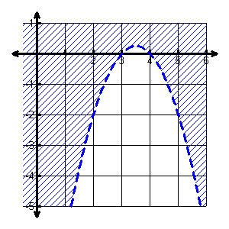
Solve: -x² + 7x < 12
-x² + 7x = 12
-x² + 7x – 12 = 0
x² – 7x + 12 = 0
(x – 4) (x – 3) = 0
x = 3, 4
Answer: x < 3 or x > 4

Slide 12
What if it can’t factor?
Graph it!

Slide 13
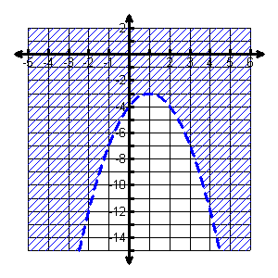
Solve: -(x – 1)² – 3 < 0
-(x – 1)² – 3 < y
y > -(x – 1)² – 3
Answer: all real numbers

Slide 14
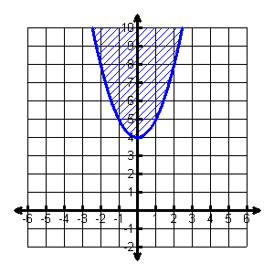
Solve: x² + 4 ≤ 0
x² + 4 ≤ y
y ≥ x² + 4
Answer: no solution

