Slide 1
Modes of Vibration & Hooke’s Law
Honey Dumralia
10007

Slide 2
Modes of Vibration
In order for a vibrational mode in a sample to be "IR active", it must be associated with changes in the dipole moment. A permanent dipole is not necessary, as the rule requires only a change in dipole moment. A molecule can vibrate in many ways, and each way is called a vibrational mode. Simple diatomic molecules have only one bond, which may stretch. More complex molecules have more than one bonds and different types of vibrations may occur. Vibrations fall into the two main categories of stretching and bending.
Vibrations can be subdivided into two classes, depending on whether the bond length or angle is changing:
Stretching (symmetric and asymmetric)
Bending (scissoring, rocking, wagging and twisting)

Slide 3
STRETCHING VIBRATION:
They involve movement of atom within the same bond axis such that the bond length changes in without any changes without any change in bond angle in regular interval.
Types of Stretching vibration:
SYMMETRICAL STRETCHING: The atoms of a molecule either move away or towards the central atom, but in the same direction. In this type of stretching, bond length increase or decrease symmetrically
ASYMMETRICAL STRETCHING: One atom approach towards the central atom while other departs from it. In this type of stretching, length of one bond increases and the other one decreases.
BENDING VIBRATION:
They involve movement of atoms which are attached to a common central atom, such that there is change in bond axis and bond angle of each individual atom without change in their bond lengths. Bending vibration generally requires less energy and occur at longer wavelength than stretching vibrations, The bending vibrations are also called as deformation vibrations.

Slide 4
Types of bending ions:
IN-PLANE VIBRATIONS: In these types of vibrations, there is a change in bond angle. This type of bending takes place within the same plane, In plane bending are of two types.
Scissoring: In-plane bending of atoms occur wherein they move back and forth in, the approach to each other
Rocking: In-plane bending of atoms occur wherein they swing back and forth with respect to the central atom.
OUT PLANE VIBRATIONS: This type of bending takes plane outside of the plan of molecule.
Wagging: Two atoms oscillate up and below the plane with respect to the central atom.
Twisting : One of atom moved up the plane while other down the plane with respect to central atom

Slide 5
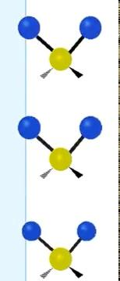

Symmetrical Vibration
Asymmetrical Vibration
Wagging
Twisting
Scissoring
Rocking

Slide 6
Calculate Number of Vibrational Modes
Degree of freedom is the number of variables required to describe the motion of a particle completely.
The degrees of vibrational modes for linear molecules can be calculated using the formula: 3N−5
The degrees of freedom for nonlinear molecules can be calculated using the formula: 3N−6
n is equal to the number of atoms within the molecule of interest.

Slide 7
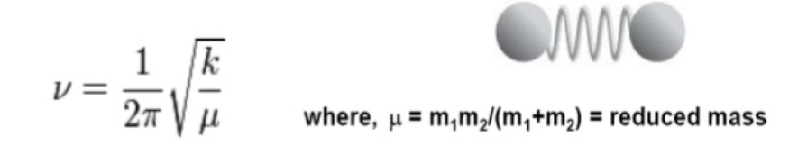
Hooke’s Law
The Hooke’s Law is a mathematical formula that relates the vibrational frequency of a spring connected to two spheres to the stiffness of the spring and to the masses of the spheres.
Vibrations of a covalent bond is thought to be similar to those of the above system. Thus, the Hooke’s Law can be applied to the vibrations of a covalent bond. Given below is the Hooke’s Law as it applies to a covalent bond.
According to the Hooke’s Law,
All else being equal, the stronger the bond, the faster the bonds vibrates.
All else being equal, the lighter the atoms linked by the bond, the faster the bond vibrates.

Slide 8
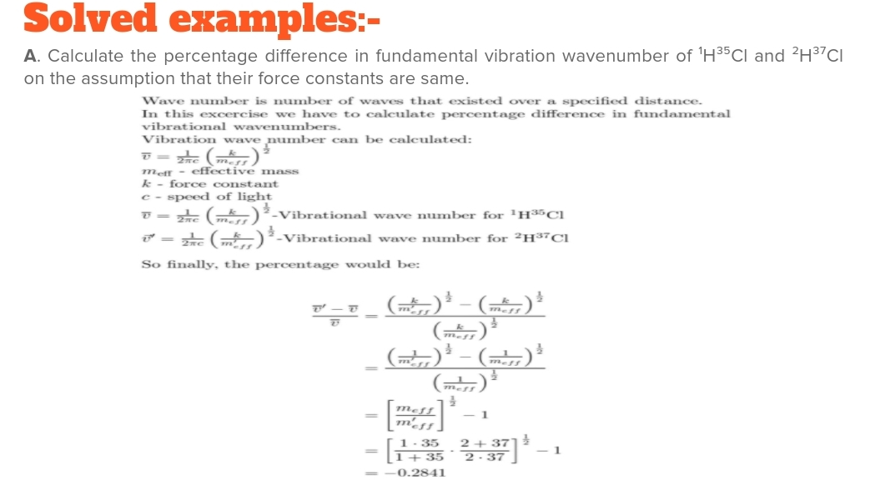

Slide 9
