Slide 1
2021 FBLA Coding and Programming Presentation
By: Abhinav Chavali

Slide 2
The Product
The end product is a fully-featured quiz app. It includes many different kinds of question types, grades, and generates a report. All questions are stored persistently in PostgreSQL relational database
It was built with the user in mind, and thus has a clean and elegant user display. It allows the user to easily create quizzes through a file or manually
Quizzes are graded automatically after each submission, and an elegant report is generated, along with a printable PDF document. Average scores can be viewed through a profile tab
The main demonstration will be of a 50 question FBLA quiz.

Slide 3
The Technologies
Python==3.8 was the main programming language of choice, used in order to code logic and represent the database tables
Django==3.1 was the web framework of choice. I used it to allow the HTML components of my website to connect with my database
I used the PostgreSQL database in order to hold all data, including questions, quizzes, and user instances. SQL Dumps are created to backup the PostgreSQL database to a file periodically
HTML, CSS, Javascript, and Bootstrap==4 were used in order to style the site and build it appropriately
I used the Docker==3 containerization engine to virtualize my code and make it easily replicable

Slide 4
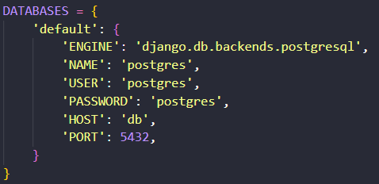
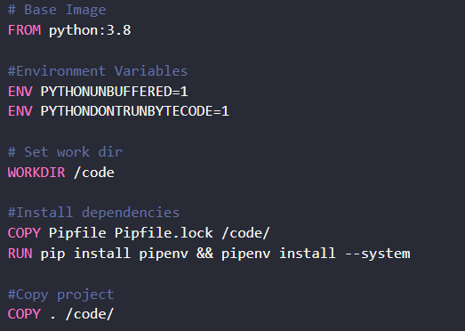
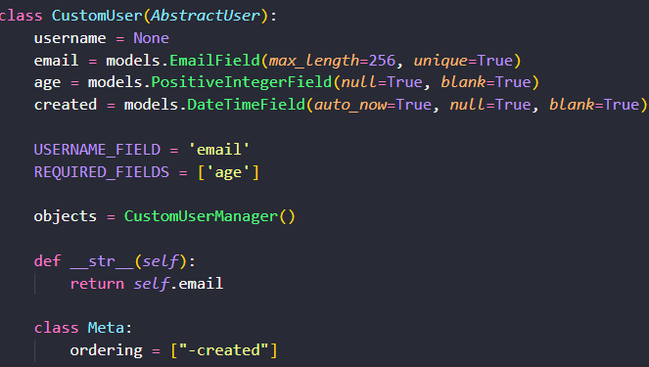
The Technologies (Part 2)
PostgreSQL Database through Docker
Dockerfile
Django Web Framework Database Table Creation

Slide 5
Program Structure and Content (Part 1)
The program is structured logically, and uses appropriate identifiers for variables, constants, arrays, and more
A single consistent naming format is used: Uppercase for constants and Snake Casing for variable names, functions, and classes (Pep 8)
CSS classes use hyphenated lowercases
Appropriate Error Handling

Slide 6
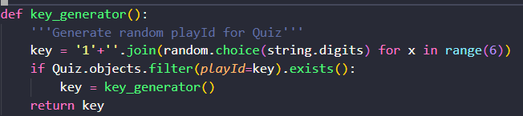
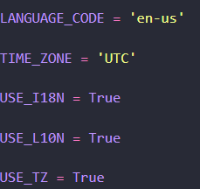
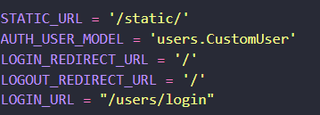
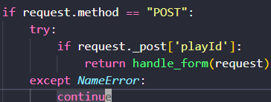
Program structure and Content (Part 1 continued)
Function naming syntax for custom key generator
Constant Variable naming for locale setup
Constant Variable naming for URL’s
Error Handling

Slide 7
Program Structure and Content (Part 2)
Efficient use of many data structures and algorithms with an intent to make as few database queries as possible. Preserves querysets and uses asynchronous queries
Efficient use of Python statements to make few requests and keep the program quick
Use of tools like Docker to containerize program and avoid runtime errors
Use of Git version controller and Github to track versions and serve as documentation for users

Slide 8
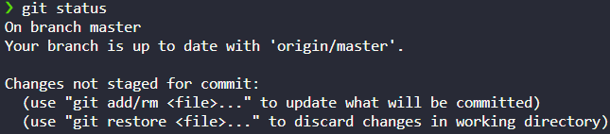
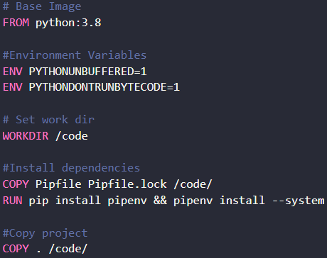
Program Structure and Content (Part 2 continued)
Preloading entire querysets
Use of Git version control system (git status)
Use of Docker containerization technology

Slide 9
Program Structure and Content (Part 3)
Appropriate use of comments. Each block of code set to do a specific task is commented appropriately
All functions and classes are documented with docstrings
Main documentation is a README.md file, filled with advanced configuration options and running the server locally. Detailed instructions for every part of the code, including screenshots are written
Extensive, Exhaustive tests have been written for almost every feature of the program. A program without tests is a broken program by design

Slide 10
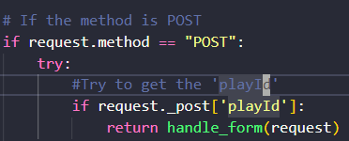

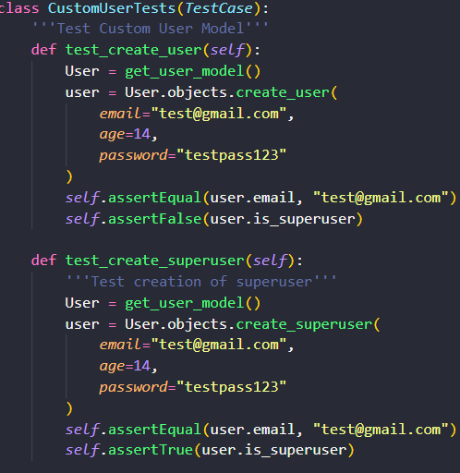

Program Structure and Content (Part 3 continued)
Comments
Docstrings
Test Example

Slide 11
Walkthrough
Now, I will demonstrate a live walkthrough of the app
It will be following the thorough documentation on github
Visit here: https://github.com/dumrich/QuizApp

