Slide 1

Sumcheck Protocol
FPGA Accelerator
Hardware-Accelerated Zero-Knowledge Proof Prover on Kria KV260
ECE-9413 | NYU Tandon | Spring 2026
Abdulhaseeb Khan & Sahil Dunani

Slide 2



The Sumcheck Protocol
A fundamental building block in zero-knowledge proof systems. The prover convinces a verifier about a sum over a multilinear polynomial without the verifier evaluating it directly.
Round Structure
MLE Folding
Base Expressions
For n variables, the protocol runs n rounds. Each round, the prover evaluates the polynomial at degree+1 points and sends evaluations to the verifier.
After each round, the verifier sends a random challenge r. The prover folds all tables via multilinear extension update, halving the table size each round.
a (degree 1)
a*b (degree 2)
a*b + c (degree 2)
a*b*c (degree 3)
Each requires degree+1 evaluation points per round.

Slide 3
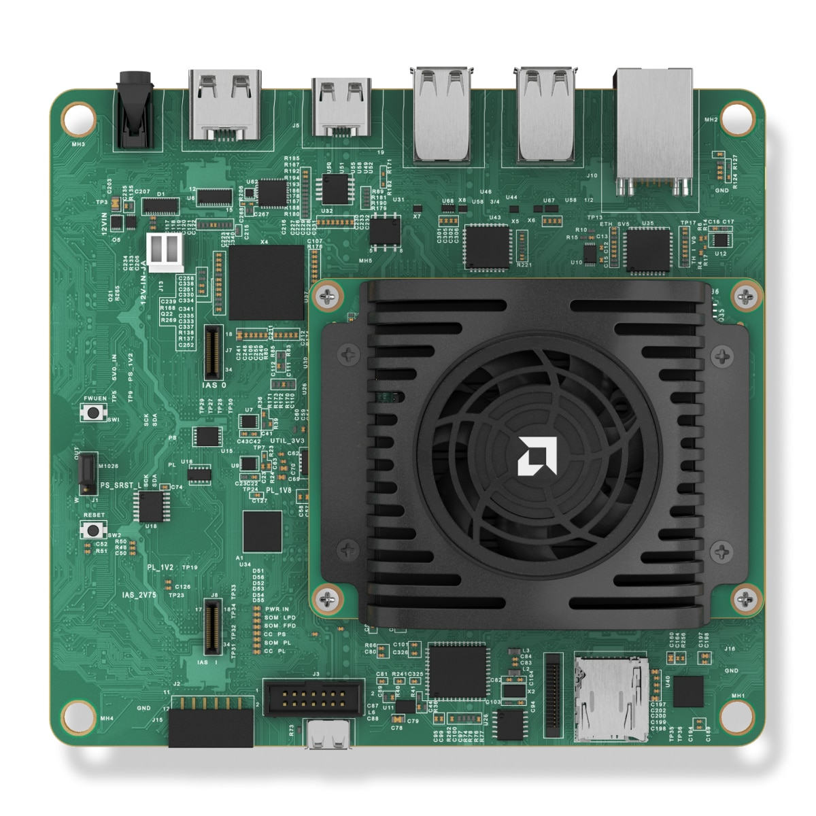
Target Platform: Kria KV260
FPGA Fabric
Zynq UltraScale+ ZU5EV (xck26)
LUTs
117,120 available
DSP Slices
1,248 × DSP48E2
Block RAM
~5 MB (144 × 36 Kb)
DDR4
4 GB, 64-bit @ 2400 MT/s
ARM Cores
4× Cortex-A53 @ 1.3 GHz
PL Clock
200 MHz (5 ns period)
OS / Runtime
Ubuntu 22.04 + PYNQ 3.0
AMD Kria KV260 Vision AI Starter Kit
PL fabric power draw: ~5 W — 70× less than an RTX 6000 Pro GPU (350 W)

Slide 4

Design & Build Flow
1
2
3
4
HLS C++
RTL IP
Block Design
PYNQ Deploy
Vitis HLS 2023.2
Barrett reduction
BRAM prefetch
csim → csynth → cosim
Export to
Vivado IP Catalog
(.zip package)
Vivado 2023.2
Zynq PS + kernel IP
3× AXI HP 128-bit ports
Bitstream generation
Ubuntu 22.04 on KV260
Overlay .bit + .hwh
Register MMIO writes
Python test driver

Slide 5
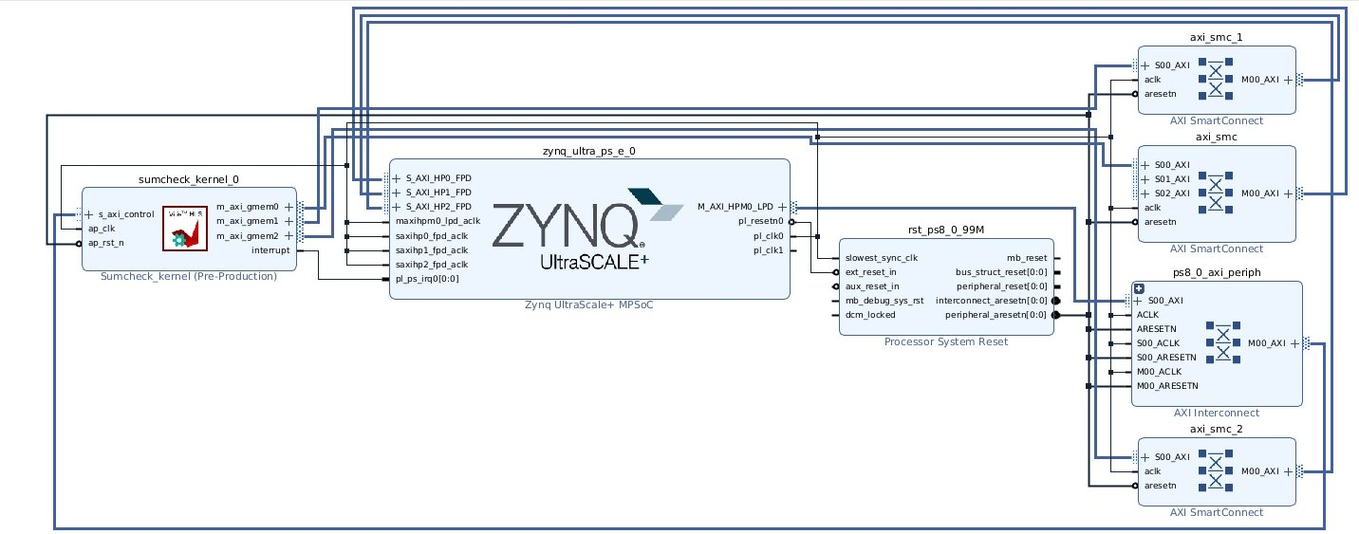
Vivado Block Design
Single unified sumcheck_kernel IP connected to Zynq UltraScale+ PS via 3 AXI HP ports (128-bit each) and 1 AXI-Lite control port. Mode register selects prove (mode=0) or fold (mode=1) at runtime.

Slide 6
IP Interface Definition
AXI Interfaces
s_axilite Register Map
m_axi gmem0 (128-bit) → S_AXI_HP0_FPD — tables a, b
0x00 CTRL — ap_start / ap_done / ap_idle
m_axi gmem1 (128-bit) → S_AXI_HP1_FPD — tables c, d
0x10 tables_01 — DDR pointer (64-bit)
0x34 q — 32-bit field prime modulus
m_axi gmem2 (128-bit) → S_AXI_HP2_FPD — tables e, g
0x50 barrett_m — floor(2⁶³ / q)
s_axilite (32-bit) → M_AXI_HPM0_LPD — control registers
0x58 num_pairs — pairs this round
interrupt → pl_ps_irq0 — completion signal
0x60 table_stride — fixed DDR stride
0x80 expr_terms — expression encoding
0x90 challenge — verifier's random r
0x98 mode — 0 = prove, 1 = fold
0x40 round_evals — output (read after prove)

Slide 7
Key Optimizations
Barrett Reduction
3× DDR Ports
BRAM Chunk Prefetch
Replaced 64-bit hardware divider (% q) with multiply-based Barrett reduction using ap_uint types. Maps to DSP48E2 slices instead of LUT-based divider.
Split 6 MLE tables across 3 independent AXI HP ports (128-bit each, 2 tables per port). Enables parallel DDR reads at ~19 GB/s aggregate bandwidth.
Burst-read 256-pair chunks from DDR into on-chip BRAM (6 × 2 KB buffers). Process from BRAM at 1-cycle latency vs ~100 ns DDR latency.
19× prove speedup
3× memory bandwidth
7× prove speedup
Unified Kernel
Stride Addressing
FPGA Fold
Single IP with mode register for prove/fold. Hardware resources shared since they never run simultaneously. Full 117K LUT budget for prove pipeline.
Fixed table_stride parameter eliminates ARM buffer reallocation and memcpy between rounds. Zero PS software overhead per round.
Table folding moved from ARM Python (~5 s) to FPGA with chunked burst reads/writes and parallel 3-port processing. Non-inlined Barrett for timing closure.
Fits on KV260
53 ms eliminated
755× fold speedup

Slide 8
Performance Results
Optimized from 5,630 ms → 12.2 ms on vars16 (461× speedup across 9 design iterations)
vars4
vars16
vars20
16 entries | 4 rounds
65,536 entries | 16 rounds
1,048,576 entries | 20 rounds
0.10 ms
12.2 ms
192.4 ms
total
total
total
Prove: 0.06 ms
Prove: 5.7 ms
Prove: 90.7 ms
Fold: 0.04 ms
Fold: 6.5 ms
Fold: 101.8 ms
Baseline (v3, vars16): 5,630 ms → Final (v9): 12.2 ms = 461× speedup

Slide 9

Resource Utilization & Verification
Resource | Used | Available | Utilization
LUT | 39,560 | 117,120 | 34%
Flip-Flops | 24,703 | 234,240 | 11%
DSP48E2 | 372 | 1,248 | 30%
Block RAM (36 Kb) | 26 | 144 | 18%
URAM | 0 | 64 | 0%
Timing
Target: 5.00 ns (200 MHz)
Estimated: 3.65 ns
Slack: +1.35 ns
Vivado WNS: +4.47 ns
All timing constraints met ✓
Verification & Testing
HLS C Simulation (csim): Bit-exact match against golden test vectors for all 4 base expressions
RTL Co-simulation (cosim): Generated Verilog verified against C reference
On-board FPGA execution: vars4 (16 entries), vars16 (65K entries), vars20 (1M entries) — all rounds pass
All 4 expressions verified: a, a*b, a*b + c, a*b*c across all test sizes

Slide 10

Summary
1
Built a fully functional sumcheck protocol prover accelerator on the Kria KV260 FPGA (xck26, 200 MHz)
2
461× end-to-end speedup through 9 iterative design versions — from 5,630 ms to 12.2 ms on vars16 (65K entries)
3
Key techniques: Barrett reduction, 3-port DDR parallelism, BRAM burst prefetch, unified prove/fold kernel, stride-based zero-copy addressing
4
Bit-exact correctness verified across vars4 (16 entries, 4 rounds), vars16 (65K entries, 16 rounds), and vars20 (1M entries, 20 rounds)
5
Complete end-to-end flow: Vitis HLS C++ → Vivado block design → PYNQ Python deployment on real hardware
Abdulhaseeb Khan & Sahil Dunani

