Slide 1

THIRD MEETING: ADVENTURE AWAITS!
10/14/2024

Slide 2
WHAT IS ADVENTURE ANIME?
Adventure anime typically center around exploring the world the author created. Pretty self explanatory!
Examples:
Hunter x Hunter
Sword Art Online
One Piece, Naruto, Dragon Ball
Seven Deadly Sins
Jojo’s Bizarre Adventure

Slide 3

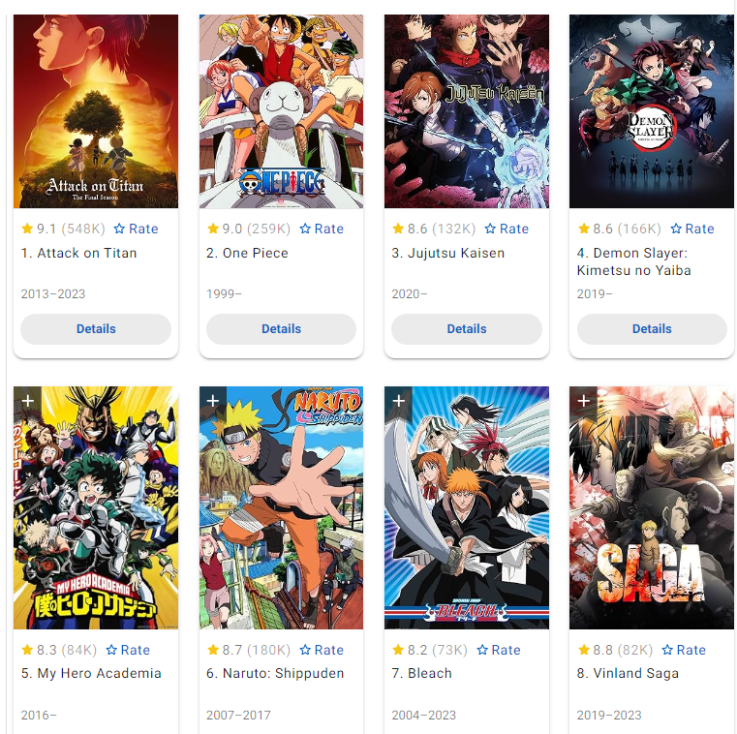
BREAD AND BUTTER
Adventure anime are commonly also action shows. This is probably partially because going on an adventure allows the cast to meet interesting and strong fighters.
Typical Overlaps:
Action, literally everything else
There are more adventure anime than any other genre!

Slide 4
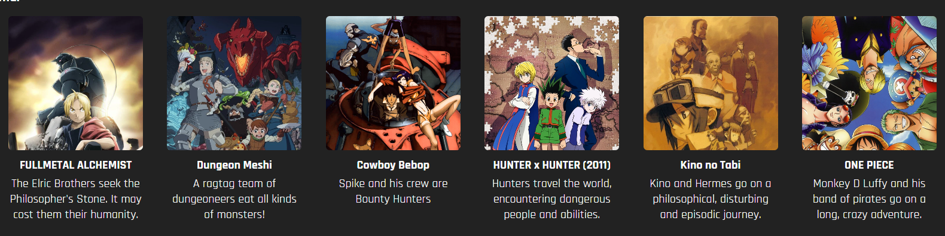
Examples:

Slide 5





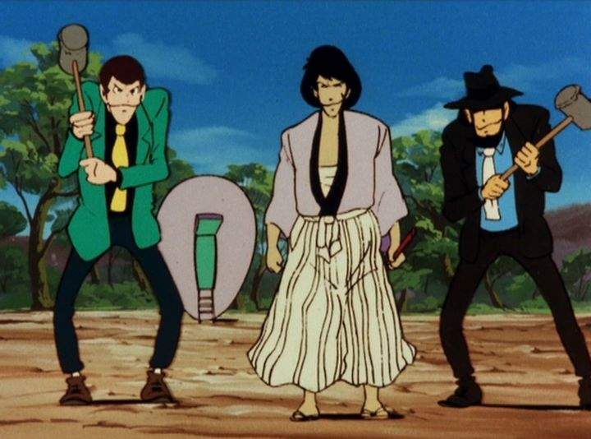




ADVENTURE OVER TIME (A LONG TIME)
Son Goku (1926)
Corporal Norakuro (1934)
The Bear Dodger (1948)
Mogura No Adventure (1958)
Shounen Ninja (1965)
Lupin III (1971)
Nausicaa of the valley of wind (1984)
Magic Knight Rayearth (1995)
Naruto (2003)
Made in Abyss (2017)

Slide 6
REMEMBER THE RULES
We are going to watch one episode of multiple shows this week
If there’s one we really enjoy, we will watch it during every meeting until it’s done.
I sent out an email to everyone asking for suggestions.
We are not watching more than 1 episode if there are people in the club who have already seen the show!

Slide 7
BONUS: MOVIE NIGHT
We are going to try to run a movie night this week. Dates TBA but will be announced via email. Invites are open! (Tickets might cost money? Fundraising)

