Slide 1
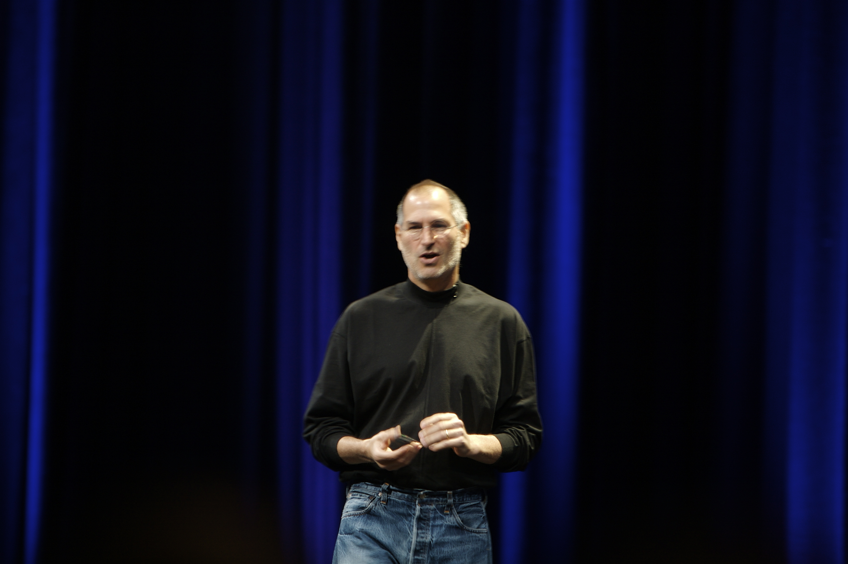
“... a computer is … the equivalent of a bicycle for our minds ...”
Steve Jobs quoted on http://en.wikiquote.org/wiki/Steve_Jobs.
Photo courtesy http://www.flickr.com/photos/acaben/.

Slide 2
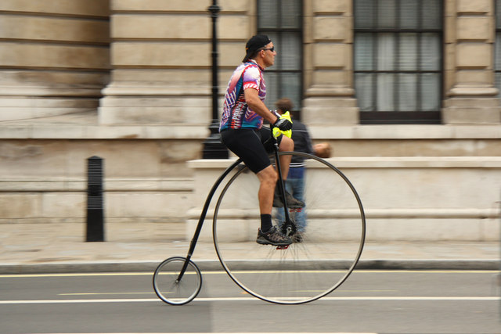
bicycles go where you want them to
Penny Farthing photo courtesy Richard Croft.

Slide 3
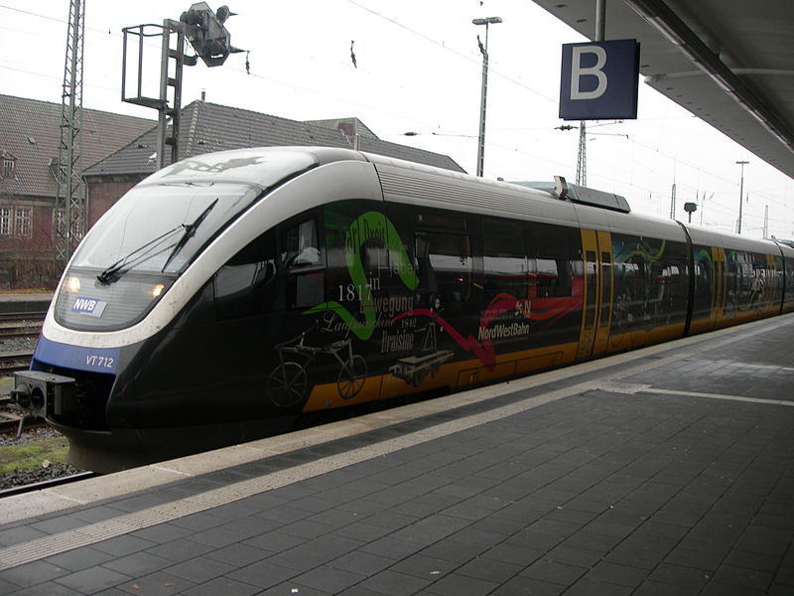
GUIs go where they are designed to go
Train photo courtesy Wikimedia Commons.
Train metaphor courtesy LoperOS.

Slide 4

… if you're lucky ...
Unreliable train courtesy the Victorian Government.

Slide 5
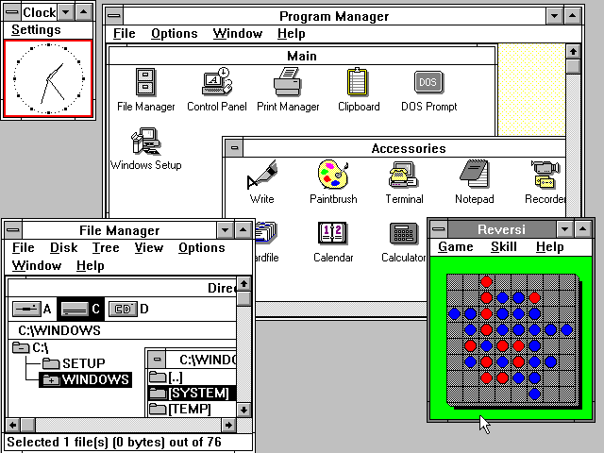
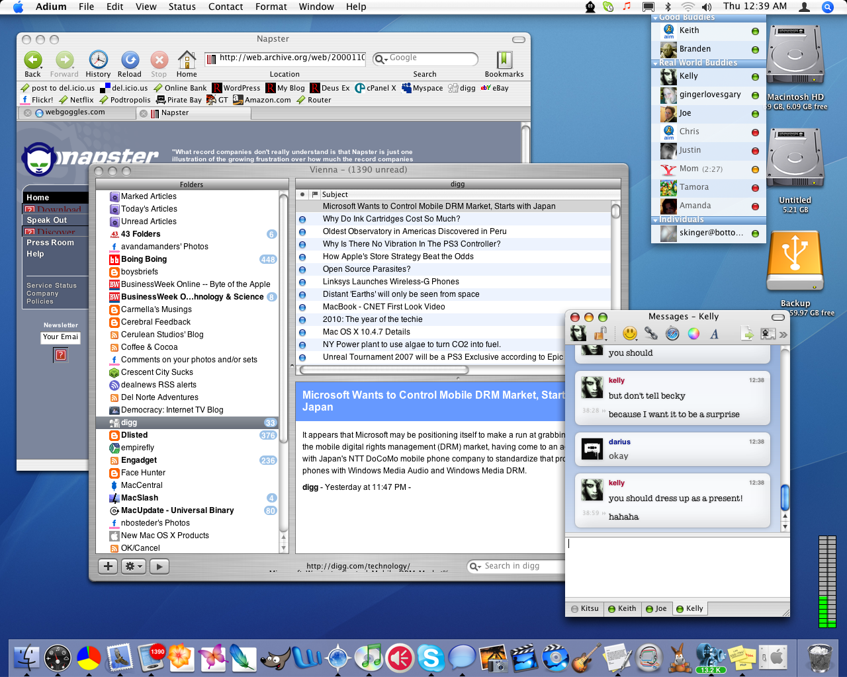
paradigms haven't changed much
( … and touch GUIs are no more flexible)
1990
2012
Windows 3.0 screenshot courtesy Microsoft and Wikipedia.
OSX screenshot courtesy http://www.flickr.com/photos/dariusofthedark.

Slide 6
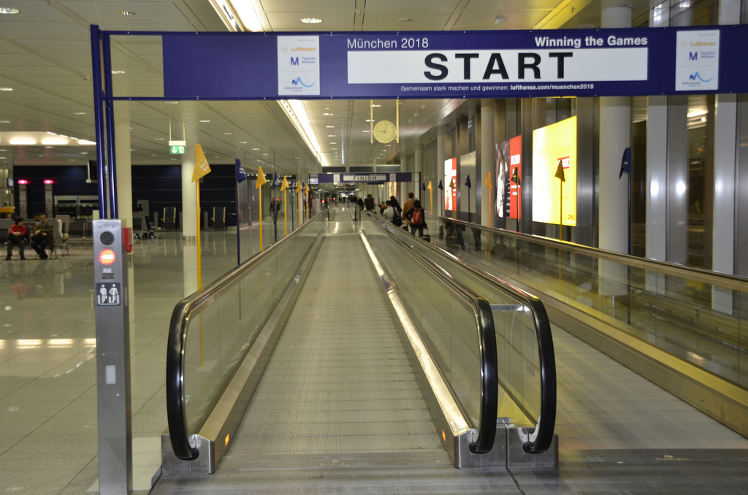

discoverability is different ...
… to usability
Cessna 195 photo courtesy http://www.flickr.com/photos/obriendigital.
Moving walkway photo courtesy http://www.flickr.com/photos/spirosk.

Slide 7
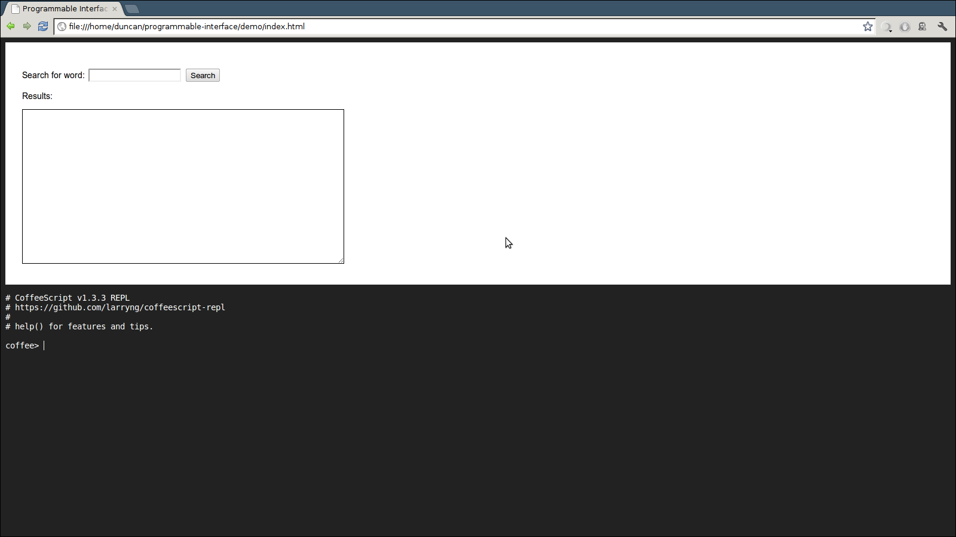
how might it look?
CoffeeScript REPL courtesy http://github.com/larryng/coffeescript-repl.
Demo code available at http://github.com/duncan-bayne/programmable-interface/.

Slide 8
advantages
as discoverable as a traditional GUI
easily extensible by advanced users
makes your app a platform for new uses
much easier to test

Slide 9
this has succeeded before...
Microsoft Office
AutoCAD
Emacs
LibreOffice

Slide 10
questions?
dhgbayne@gmail.com
http://duncan-bayne.github.com/

