Slide 1



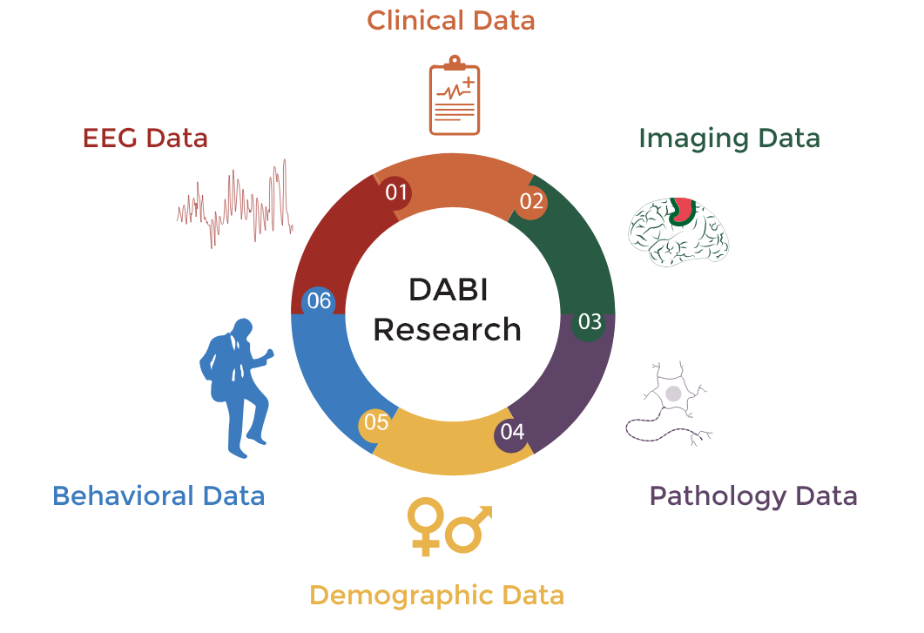
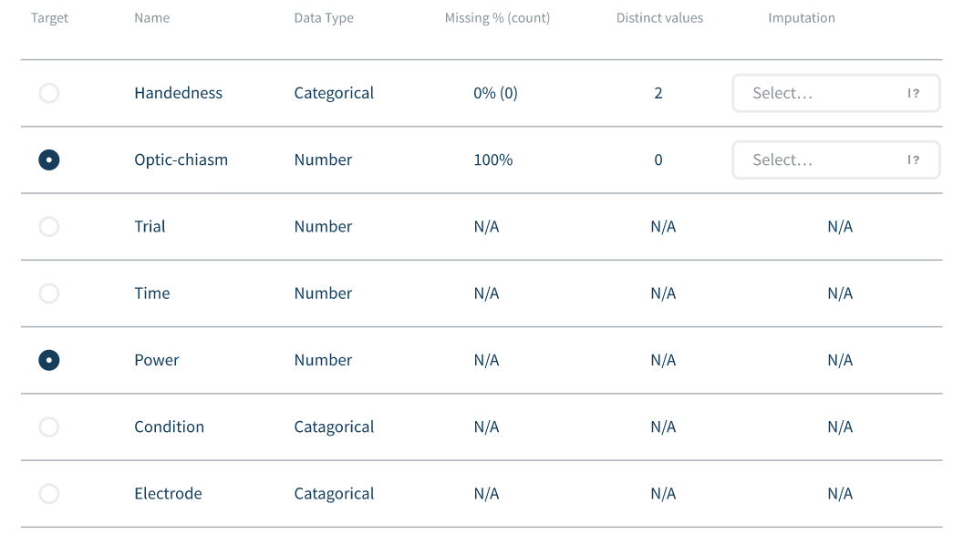
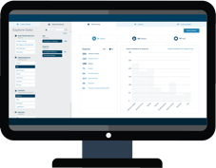
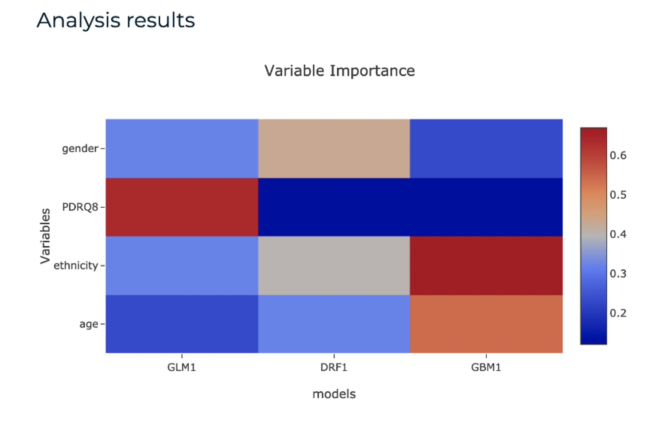
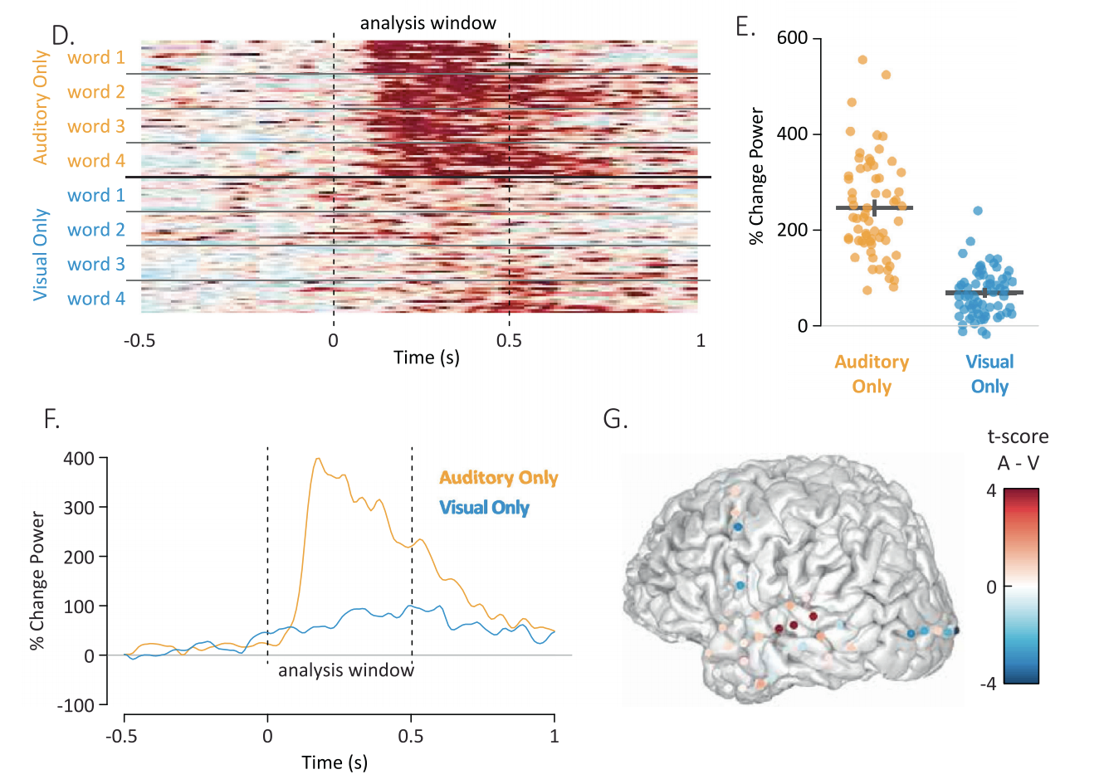
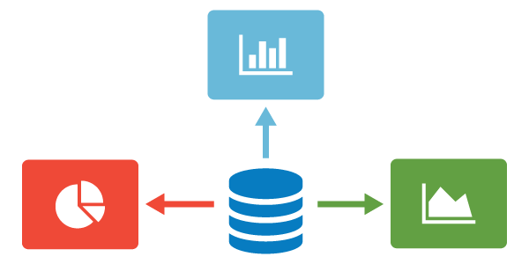
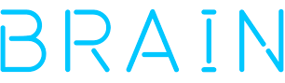


Statistical and Machine Learning Framework to Facilitate Analysis in the
Data Archive for the BRAIN Initiative (DABI)
Rachael Garner¹, Faraz Rabbani¹, Samuel Hobel¹, Tom Picton¹, Nader Pouratian², Arthur Toga¹, Dominique Duncan¹
https://dabi.loni.usc.edu
1 Laboratory of Neuro Imaging, USC Stevens Neuroimaging and Informatics Institute, Keck School of Medicine of USC, University of Southern California, 2025 Zonal Avenue, Los Angeles CA 90033
2 Department of Neurological Surgery, University of Texas Southwestern Medical Center, 5323 Harry Hines Boulevard, Dallas TX 75390
Project Aims
Statistical and Machine Learning Framework
Optimizing analysis for large-scale, longitudinal intracranial recordings
DABI’s statistical and machine learning (ML) ecosystem eases identification of correlations between multiple variables (nominal and/or numeric) and a target parameter via batch processing. For statistics, after users select the target parameter, appropriate statistical tests are automatically applied. The ML framework includes supervised learning to perform classification and regression with standard algorithms in the H2O library.³
The Data Archive for the BRAIN Initiative (DABI)¹ stores intracranial neurophysiology data for more than 500 human subjects recruited from 24 NIH BRAIN awards. Therefore, DABI is poised to build analytic tools optimized for large-scale neurophysiology data and is working towards a comprehensive, multimodal analysis platform that approaches analytics from a big-data perspective to support leveraging these large datasets.
Figure 2: Sample of data preparation for machine learning. Models can be built within minutes without programming or machine learning expertise. The interface guides users to select a cohort, the target variable, and minimal parameters, such as maximum run-time and number of folds for k-fold cross-validation.
Progress: Advances in intracranial neurophysiology acquisition and stimulation have broadened capabilities for naturalistic, longitudinal recording
Challenge: Chronic recordings yield challenges for effective analysis due to the burdens of managing and processing continuous, large-scale data
Supported statistical tests and ML models
Statistical tests: Theil’s U Test, One-Way ANOVA, Welch T-test, Correlation Ratio Test, Person Test, Spearman Test
ML Models: General Linear Model, Random Forest, XGBOOST, Gradient Boosting Machine, Deep Learning, and Stacked Ensemble
Evaluation Metrics: Logloss, Area Under the ROC Curve (AUC), AUC Precision Recall, Mean Per Class Error, Mean Squared Error (MSE), Root MSE
Feature Generation & Data Integration
Nominal Variables:
Figure 3: Analysis results of machine learning include model explainability measures such as variable importance across all models tested.
Categorical variables include harmonized metadata (see Poster #4083 for details)
Patient demographics (age, sex, handedness)
Clinical variables (diagnoses, symptoms)
Benefit to Investigators
Numeric Variables:
Machine learning ecosystem supports supervised data exploration
Continuous variables include task data and analysis
Task-based behavioral results (reaction times)
Survey & questionnaire responses
Spectral and conditional analysis (Fig.1)
Identify complex & multivariate relationships in big datasets that are unidentifiable from other analytic techniques
End-to-end analysis (raw volumes can be passed as features, without preprocessing for volumetrics, etc.)
Agnostic to variable type or significance (the model identifies what the features are/what is important)
Figure 1: Sample analyses conducted in R Analysis and Visualization of iEEG (RAVE).² RAVE outputs can be integrated as features for machine learning.
References
[1] Data Archive for the BRAIN Initiative (DABI): https://dabi.loni.usc.edu
[2] Magnotti JF, Wang Z, Beauchamp MS. RAVE: Comprehensive open-source software for reproducible analysis and visualization of intracranial EEG data. Neuroimage. 2020;223.
[3] H2O Library: https://github.com/h2oai/h2o-3
This work was supported by the National Institutes of Health under Award Number R24MH114796.

