Slide 1

Programming Project 1
Oct 12, 2020
Group 7
Learning Analytics Visualization

Slide 2




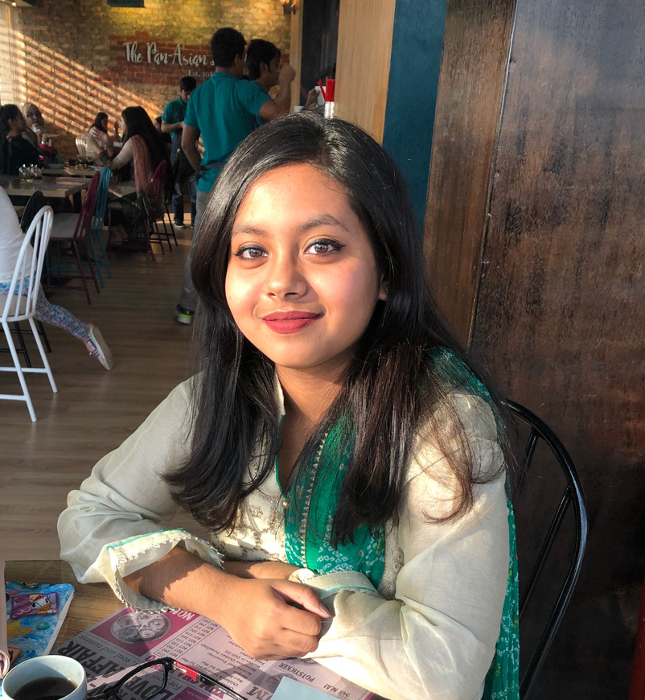
Programming Project 1
Group 7
Introduction
Duncan - Product Owner
Labiba- Scrum Master
Joel - Development Team
Fahim - Development Team
Duncan Do
Fahim Tahmeed
Our goal was to conduct an investigation on a publicly available dataset of parking events in Melbourne and write a report on our findings.
Joel Jacob
Labiba Islam

Slide 3


Programming Project 1
Group 7
1
Team Retro
Today's
Agenda
Technical Architecture and Stack
2
3
Quick Demo

Slide 4









Team Retro
1
2
3
4
What went well
What could have gone better
What surprised us
Lessons learnt
  Should have been more proactive when tackling the issue of large dataset
  Should have planned timeline better
  Dataset takes too long to run
  AWS Sagemaker fail
  Fahim's Logistic Regression model for the third predictive analysis question
  Be more proactive on issues with future consequences
  Put more foresight into planning to avoid time management issues
  Communication
  Organisation
  Troubleshooting
Sprint 1
Sprint 7
Predictive Analysis
yes!
this is great
Prescriptuve analysis
Time management
Sprint 8

Slide 5

Final Thoughts
New Classification Models
Project Management
Feature Selection
Let's end on a positive note. What good the project did to us?
Got a deeper knowledge of the entire data science process
Understand predictive models better
Learnt more about strategies to optimise results (Hill Climbing and Parameter Tuning)
Project Management
Working in a scrum team
Learnt useful skills for the field/workplace regardless of the project

Slide 6
Programming Project 1
Group 7
1
Python pandas library
Technical Architecture & Stack
2
Jupyter Notebook
3
Matplotlib
4
Seaborn
5
Numpy
6
Scikit-learn
7
Classification models
8
GridSearch

Slide 7


Programming Project 1
Group 7
Are you ready?
QUICK DEMO!

Slide 8
Programming Project 1
Group 7
Thank you!
Any
questions?

