Slide 1
ISYS1087 ASSIGNMENT 4
<< Ivan’s Angels >>
Task 4 Group 17
Duncan Do, Tam Doan, Jeffrey Lee, Justin Mackenzie, Caleb McCash, Anh Vu

Slide 2
TEST APPROACH
1

Slide 3
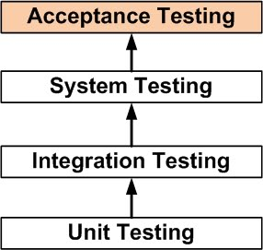
Levels / phases
Unit testing
System/Integration testing
Acceptance testing

Slide 4
Unit Testing
Proof of unit testing
Test case lists
Sample outputs
Data printouts
Defect information

Slide 5
System/Integration Testing
In charge: Test Manager & Dev leader
Test:
System components interaction.
System’s compliance with specifications.
Limited to 2 major defects:
Time constraints

Slide 6
User Acceptance Testing
In charge: End users
Supported by test manager and dev leader
Test:
User Acceptance Criteria.
Open critical and major defects:
MUST be corrected and verified by the Customer test representative.

Slide 7
Measures and Metrics
Defect record:
Severity
Origin
Investigation time
Number of times ‘ready-to-test’ is submitted.
Defects could’ve been caught earlier.

Slide 8
Configuration Management/Change Control
Two parallel environments:
Development
Staging
Tested and Verified on Dev → pilot testing on Prod

Slide 9
TEST REQUIREMENTS
2

Slide 10
Test Requirements Overview
Development environment requirements
Staging environment requirements
Testers requirements
Training requirements

Slide 11
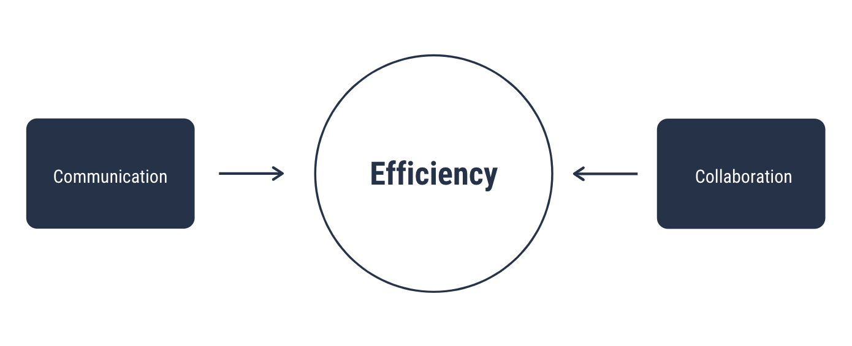
Test Requirements Goals

Slide 12
Development Environment Requirements
Legacy Data configuration
Test Data configuration
Test Framework and Tools

Slide 13
Staging Environment Requirements
Functional test framework setup
Hardware and software specific to the spectrum of the end user

Slide 14
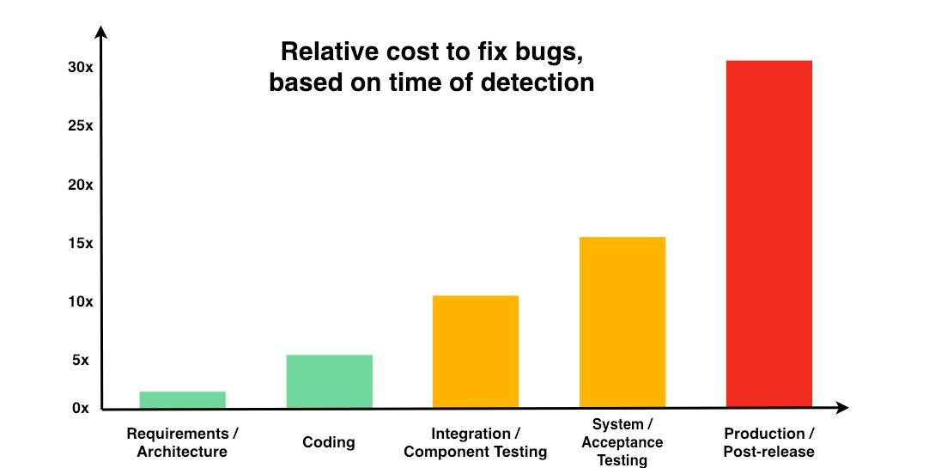
Efficient Environment Setup

Slide 15
Tester’s Requirements
Aware of the legislation in regards to healthcare system records.
Adept in understanding user requirements, functional and non-functional system requirements.

Slide 16
Training Requirements
Staff to be trained in the new system, with basic cloud application training.
Appropriate members of the testing team to be trained in the legacy system.

Slide 17
SCOPE
3

Slide 18
The Scope
Analyse requirements
Analyse Project Brief (Background and Problem Setting)
Determine extent features and system capabilities need to stretch to meet them
Nothing more to reduce cost in terms of finance/effort/time
...

Slide 19
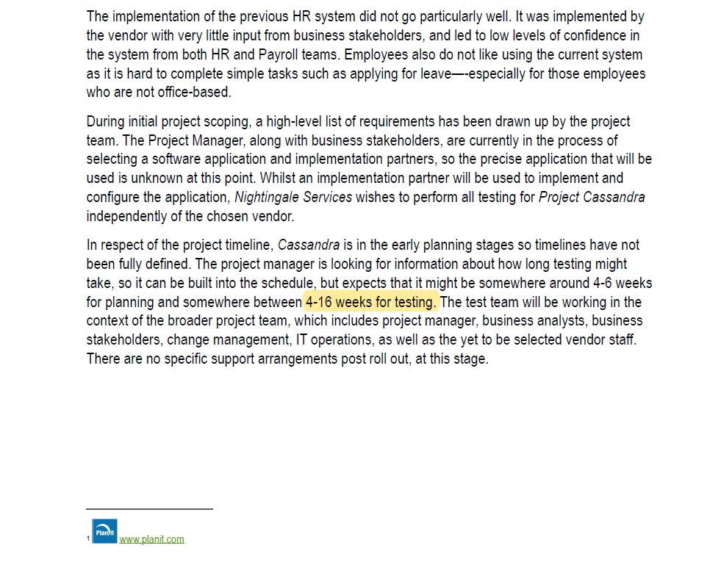
The Scope
1. Test what is possible in the time frame

Slide 20
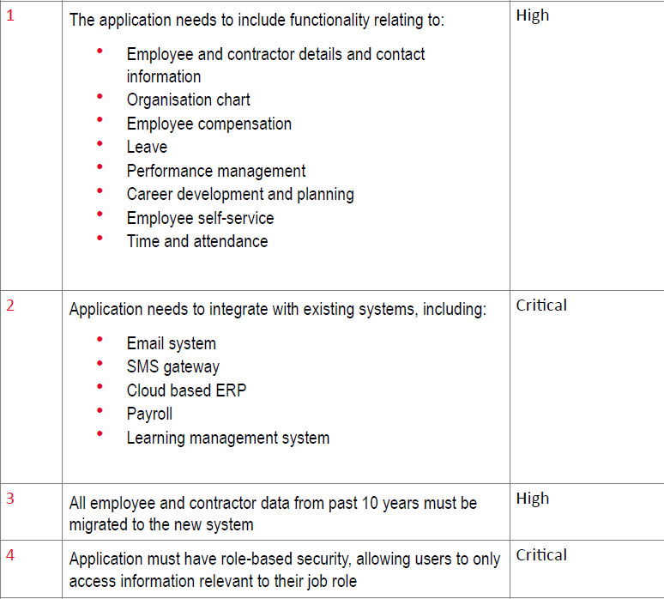
The Scope
1. Develop these functionality only
2. Integrate only the following systems
3. Only account for employee and contractor data from the past 10 years
4. Security and permission levels defined by job role

Slide 21
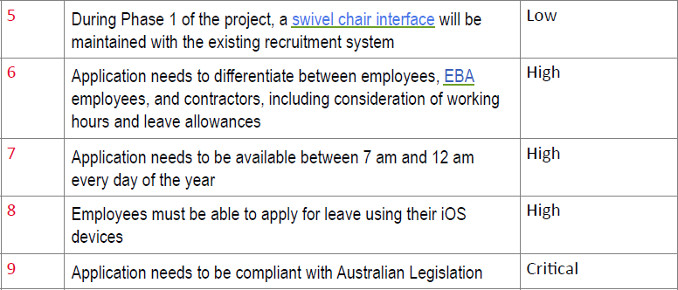
The Scope
5. Use manual key entering data in phase 1
6. Application behaviour must differ for each employee type
7. Only have servers active 17 hours of the day
8. Develop mobile version of software for apple users
9. Analyse and develop the system based on the Australian legislative laws

Slide 22
HIGH LEVEL TEST SCHEDULE
4

Slide 23

The Schedule

Slide 24
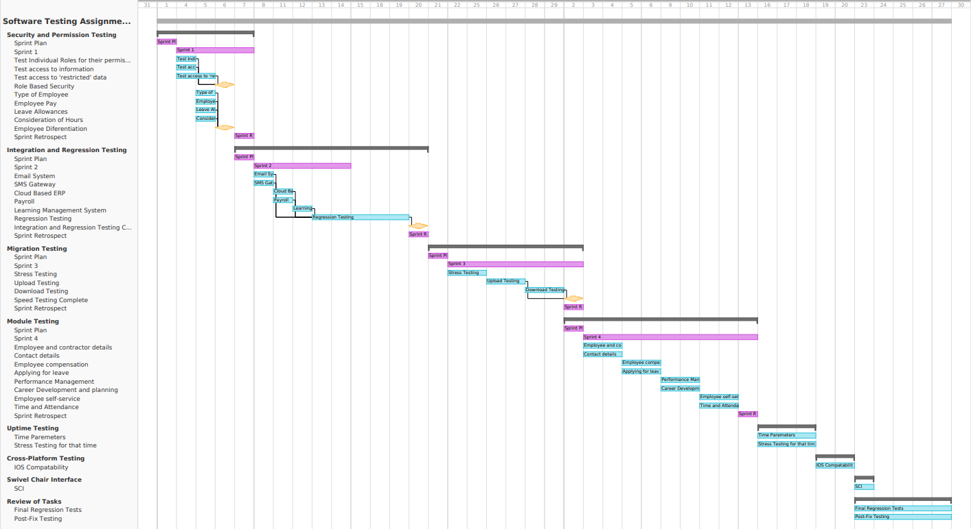
The Schedule

Slide 25
Our Reasoning
Agile. Why Sprints were better for us.
Order of Operations
Time critical prioritisation

Slide 26
RISKS IDENTIFIED & PLANNED MITIGATION
5

Slide 27

Risks
Schedule risk
Budget risk
Operational Risk
Technical risks
https://www.joetheitguy.com/wp-content/uploads/2018/11/Risk.png

Slide 28
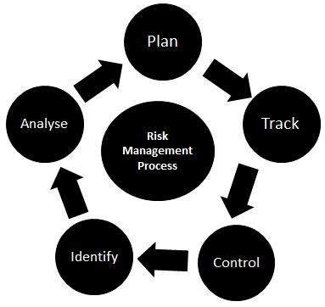
Planned mitigation
Mitigate risk before test execution
Utilize test management tools
Planning
https://www.tutorialspoint.com/software_testing_dictionary/images/risk_management.jpg

Slide 29
ASSUMPTIONS OR DEPENDENCIES
6

Slide 30
ASSUMPTIONS | DEPENDENCIES
Test Approach
General
Scope
Test Schedule
Risks

Slide 31
Test Approach
Budget and time constraints
Unrealistic to employ independent test person
Test allocated to test manager and development team

Slide 32
General
Management is using a SCRUM based methodology

Slide 33
Scope
Requirement 5
Swivel chair interface is used exclusively for phase 1 of project

Slide 34
Test Schedule
Assumed start date (beginning of the month)
Broad assumption on time taken for each task
Assumed legal aspects are not involved in software testing

Slide 35
Risks
Previous failure in HR system due to lack of communication and confidence
Possible chance of recurrence if there is improper training or communication

Slide 36
THANK YOU!
Any questions?

