Slide 1
Automation: How it affects the Australian Job Industry
Duncan Do (s3718718)
Susanna Huang (s3609812)
Kurt Invernon (s3663139)
Solomon Claringbull (s3663489)

Slide 2
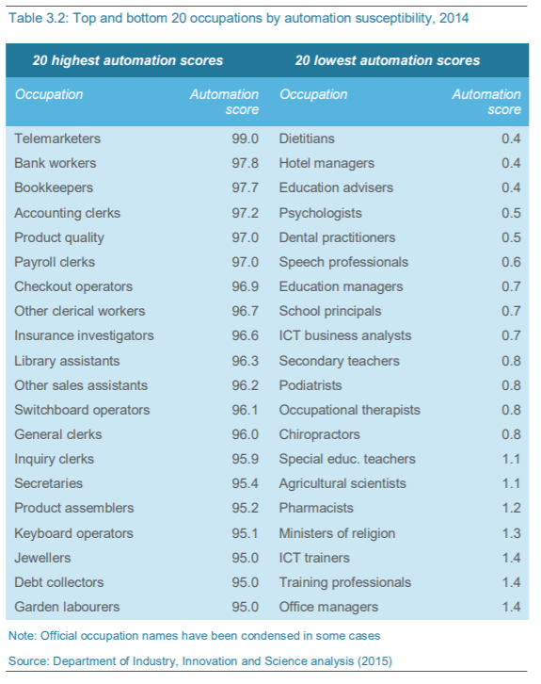
What ethical dilemmas can
automation cause?
Employees are increasingly made redundant by automation.
Many are being displaced.
However, automation promotes industry growth
and competition.

Slide 3

Who are the stakeholders affected?
Automation typically affects:
People in clerical work
People working in mines
Factory/assembly line workers
These are routine based positions, which:
are simple to code
Therefore, highly susceptibility to automation
Persons from low-socio economics background often hold these positions
Automation may leave these persons unable to provide for themselves and their
families.

Slide 4
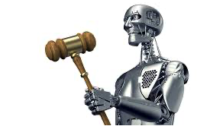
Are you protected?
No laws designed to protect employees from automation.
The Fair Work Act 2009 states that in the case of redundancy:
The employer must consult with employees prior to their position being made redundant.
The employer must offer the employee another position within the company if available and reasonable.
These laws still do not properly protect employees against automation.
Law firms have proposed new laws around automation, however, they all come with negative side effects restricting industry growth.

Slide 5

Impacts
Social
Pushes people to upskill
Eliminates sources of income
Negates education of certain fields
Environmental
Facilities to produce automation
Requires landscape areas
Produces pollution
Automation machinery runs on:
Electricity
Or fuel
Both are typically created from fossil fuels

Slide 6

Suggested Solutions
Create new job opportunities through aggressive investment (The Solution)
Alternative occupations
Jobs fit for people rather than machines
Requires judgment calls
Requires empathy
Address increased rate of change with more nimble education systems (The Solution)
Refactor education infrastructure
Adapt to rapid technological evolution
Enhance social safety nets to smooth automation impacts (The Solution)
Safety net for those transitioning
Large government investment

Slide 7

Suggested Solutions Cont.
Create new job opportunities through aggressive investment (Is it sustainable?)
Forgets those in lower socio-economic classes
Address increased rate of change with more nimble education systems (Is it sustainable?)
Automation pro: pushes people to upskill
Downside: upskilling takes time
Enhance social safety nets to smooth automation impacts (Is it sustainable?)
How much to invest in safety nets?
Differs for each person
Too little and too much have severe consequences

Slide 8

Conclusion

