Slide 1
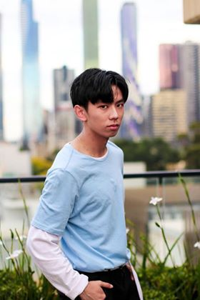

Digital Marketing Instructional Video
Duncan Do
s3718718

Slide 2
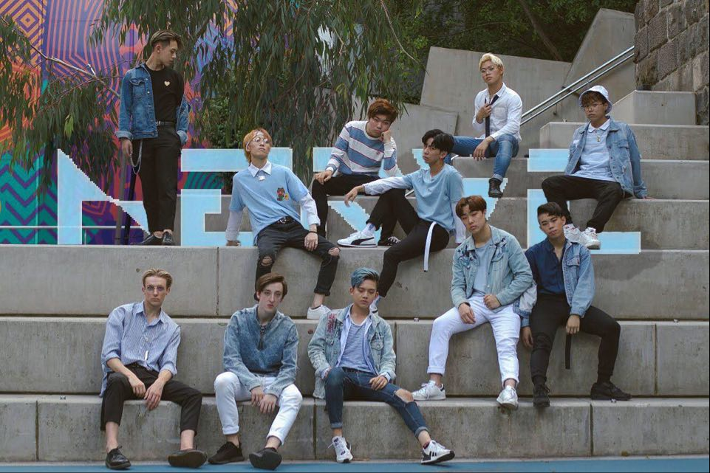


The Client
Melbourne-based all male Kpop Dance Crew
Uploads Kpop dance covers to YouTube
Promotes content on Instagram
Attends and performs at dance events and competitions
@nerve.dancecrew
“Nerve Dance Crew”

Slide 3

Social Media Strategy
Focus on Instagram
Build stronger “content creator”-”audience” relationship
Maintain content consistency

Slide 4
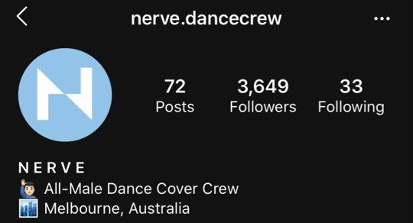
Why Instagram?
Highly accessible
Device shift to smart phones
Nerve’s Instagram has the highest interaction
YouTube is for content
Facebook audience is small

Slide 5
The right platform
Advice for companies using social media by Kaplan & Haenlein (2010)
Choose carefully
Access to all

Slide 6
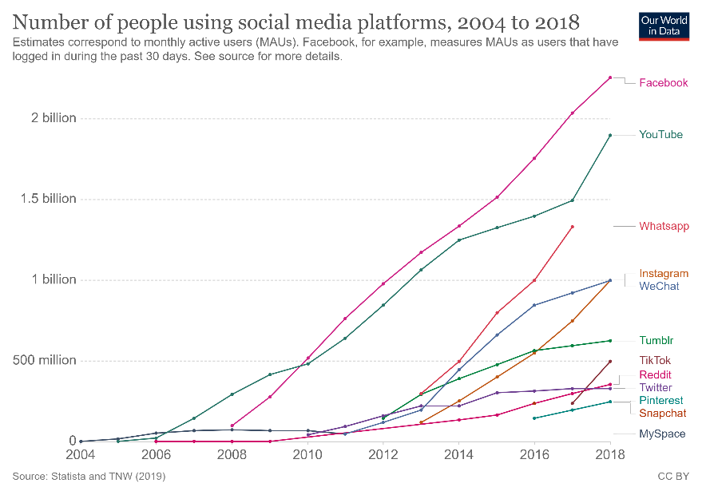
Instagram is popular
Facebook is the most used
Source: Our Word in Data: https://ourworldindata.org/rise-of-social-media#:~:text=With%202.3%20billion%20users%2C%20Facebook,media%20platforms%2C%20year%20by%20year.

Slide 7
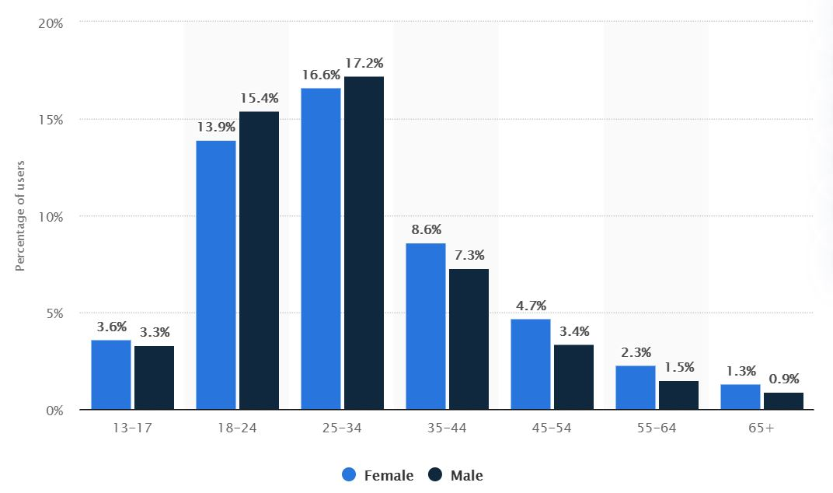
Analytics of Instagram’s users categorised by age
Statista - https://www.statista.com/statistics/248769/age-distribution-of-worldwide-instagram-users/

Slide 8
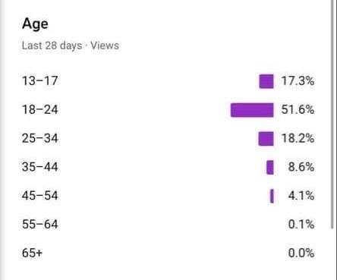
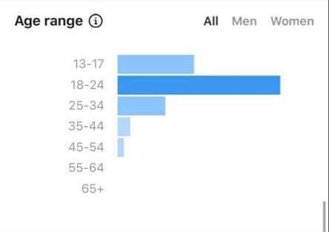
Nerve Dance Crew’s YouTube analytics of the age of their audience
Nerve Dance Crew’s Instagram analytics of the age of their audience

Slide 9
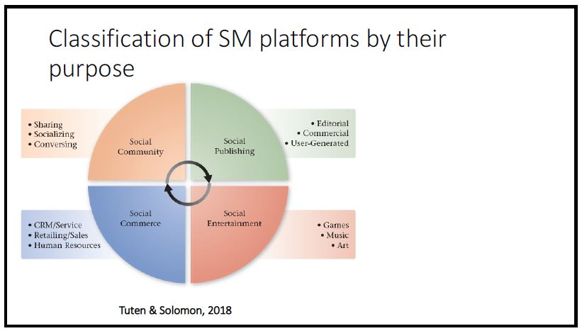

Slide 10
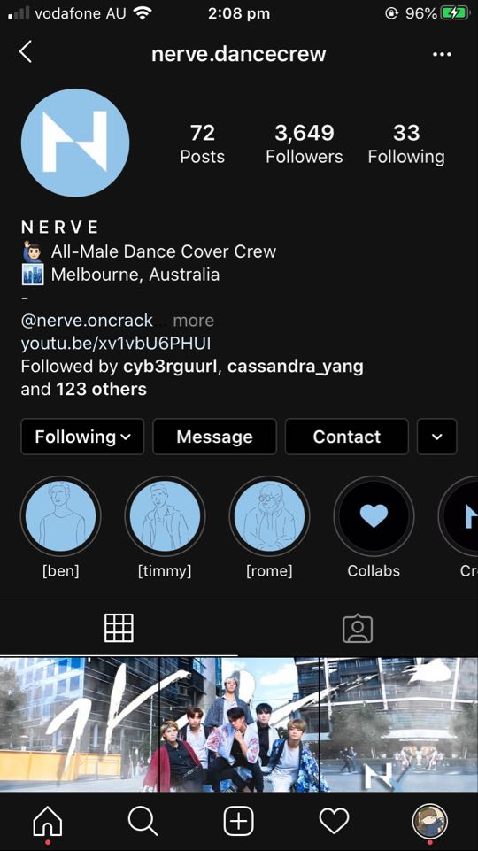
(updated) Member Profiles
Personalised profiles of ALL members, new or old
Provide mini-bio
Showcase of each member’s work
For content creator-audience relationship

Slide 11


Slide 12
Why do this?
Help the audience get to know the dancers
More personal/emotional attachment to the content creators
Facilitates the “niche” of Kpop Dance Crews
Emulate real Kpop groups

Slide 13
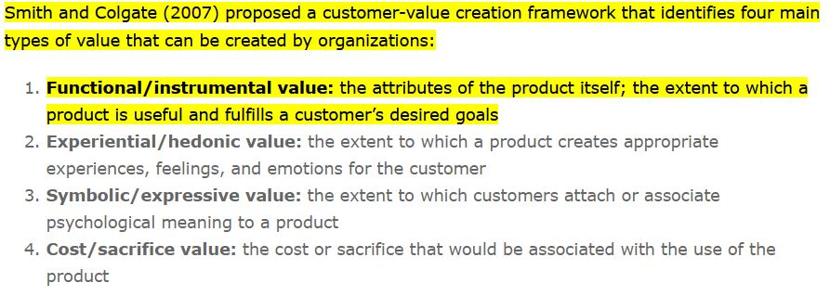
Customer value
Smith and Colgate’s categorisation of customer value
THIS IMPLEMENTATION:
Hedonic Value
Invokes feelings of closeness and familiarity
Instrumental Value
Helps fulfil the desire to of an entity that emulates real Kpop
groups

Slide 14
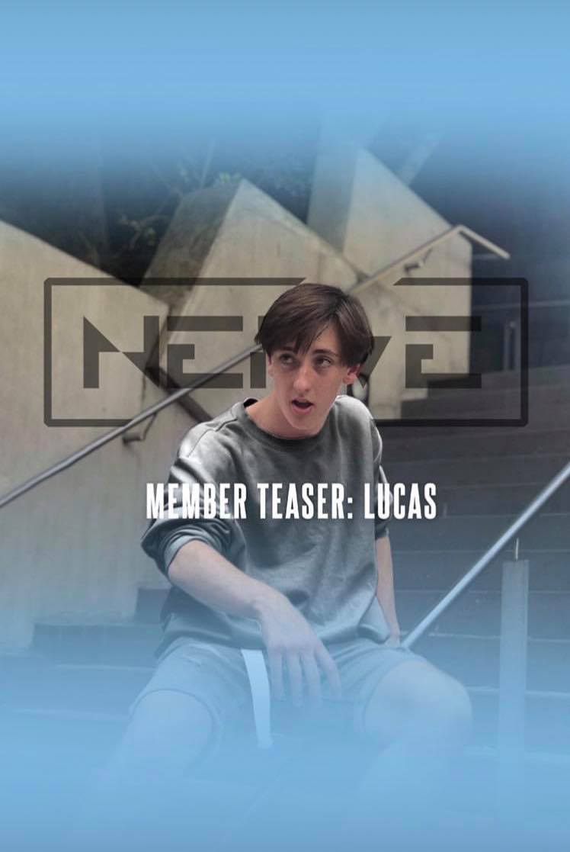
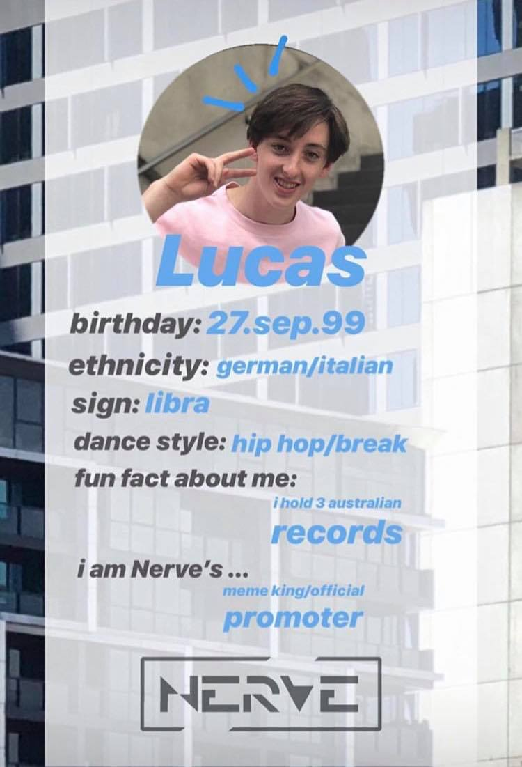
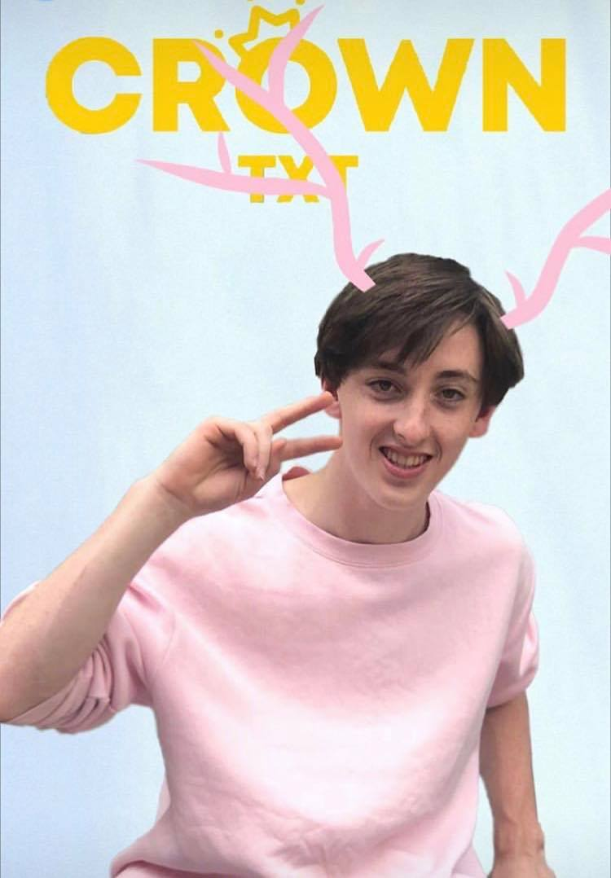

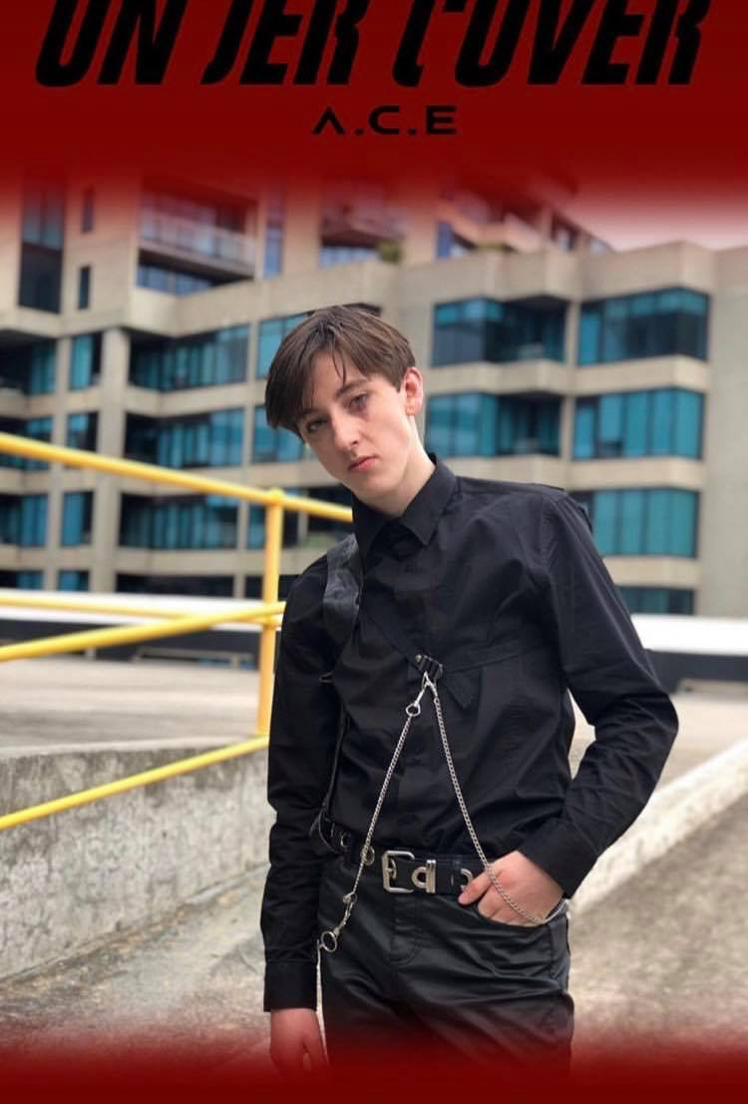
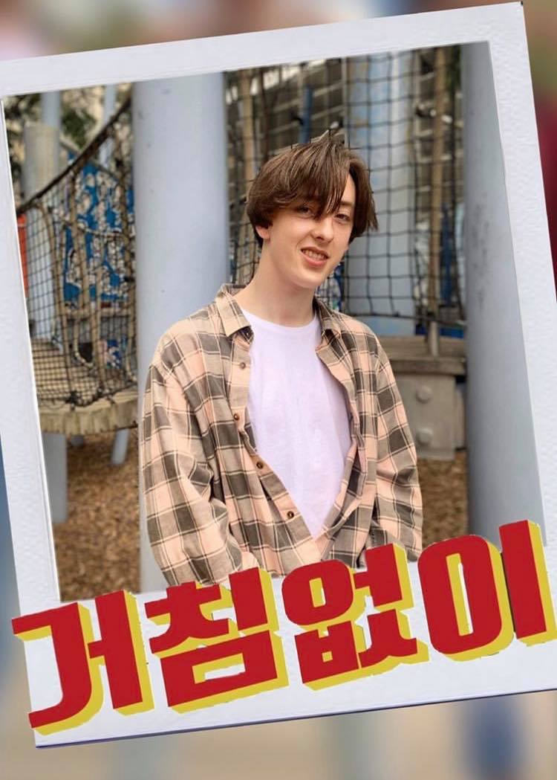
Mock Implementation

Slide 15
Instagram dance cover posts
Facilitates continuous engagement
Advice for companies using social media by Kaplan & Haenlein (2010)
Be active
Alternative route of content creation due to COVID-19
restrictions

Slide 16
Why do this?
Current use of Nerve’s Instagram account…

Slide 17
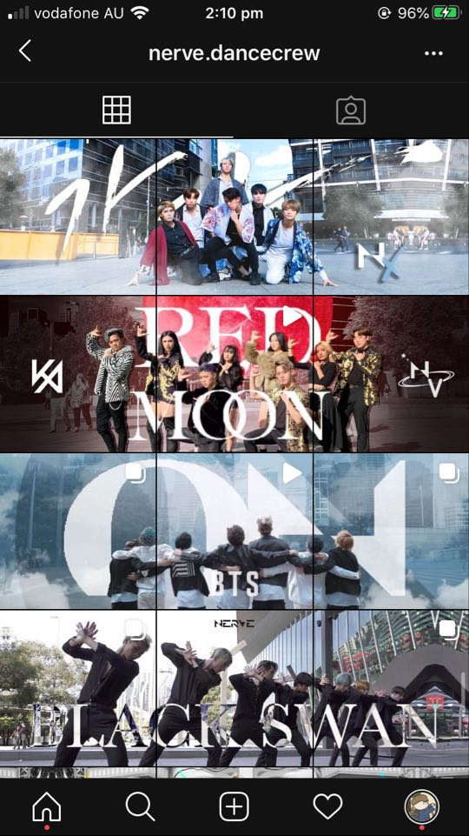
Each row of posts is promotional material for a corresponding YouTube video

Slide 18
Why do this?
Current use of Nerve’s Instagram account…
Can be used as a content platform itself!

Slide 19
Customer value
Smith and Colgate’s categorisation of customer value
THIS IMPLEMENTATION:
Hedonic Value
Helps build the dancer identity of each member for the audience
Instrumental Value
Fulfils the expected content from a Dance Crew
(While primary method, YouTube videos filmed in public,
is not available)

Slide 20
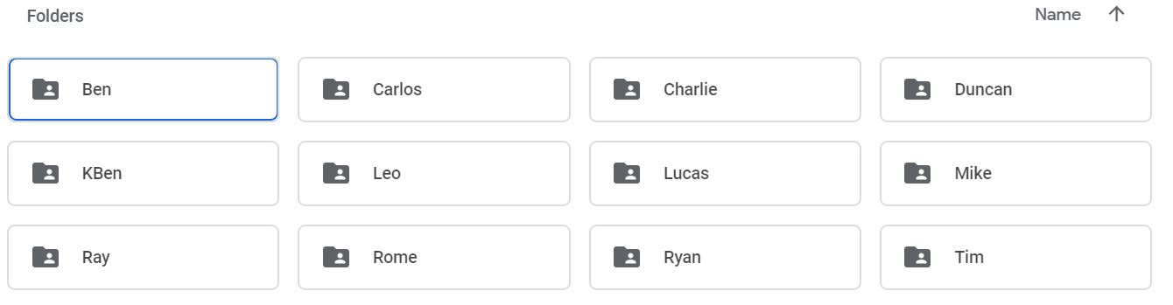
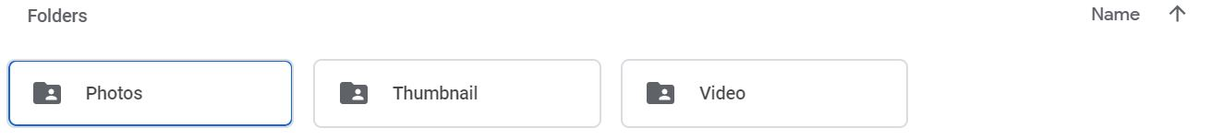
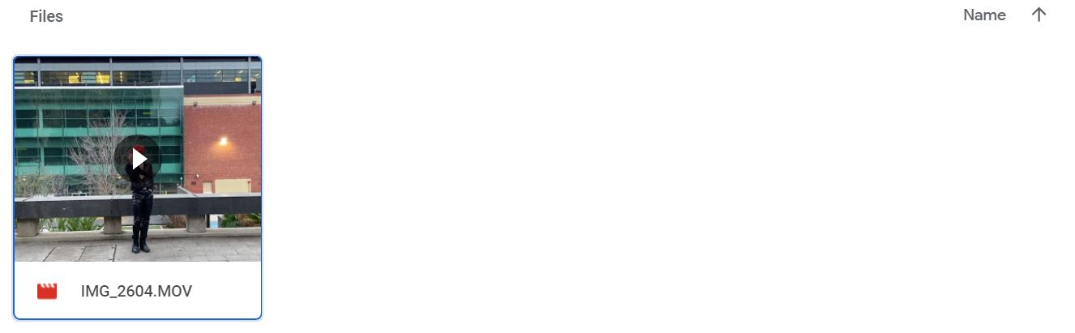

Slide 21
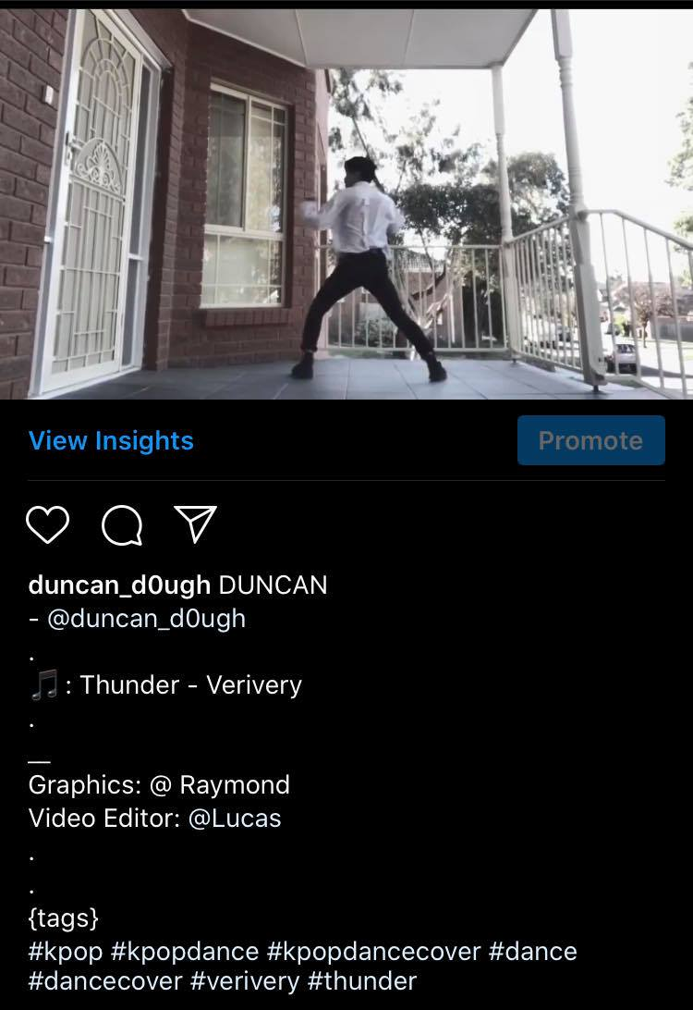

Slide 22
