Slide 1

Early Detection of Erlang Communication Errors
WIP
mailboxer
Duncan Paul Attard • Simon Fowler • Simon Gay • Danielle Marshall • Phil Trinder
CodeBEAM Europe • 2024
Notes:
In this session, I am talking about our work to bring mailbox types to Erlang.

Slide 2
BEAM languages are concurrent
Computation
Coordination
Manipulates data
Focus on algorithms & data structs
Spawn and kill processes
Communication: ! receive
Data type errors
Communication errors
Notes:
When we develop message-driven concurrent systems, we specify two aspects:
Sequential computation that manipulates data locally
Process communication that decomposes computation tasks and how processes coordinate
In both cases, errors are bound to arise:
Data type errors occur during computation
Protocol errors occur when process interact or cooperate with one another
In Erlang, such errors are typically reported when the program executes. What are common communication errors that arise?

Slide 3
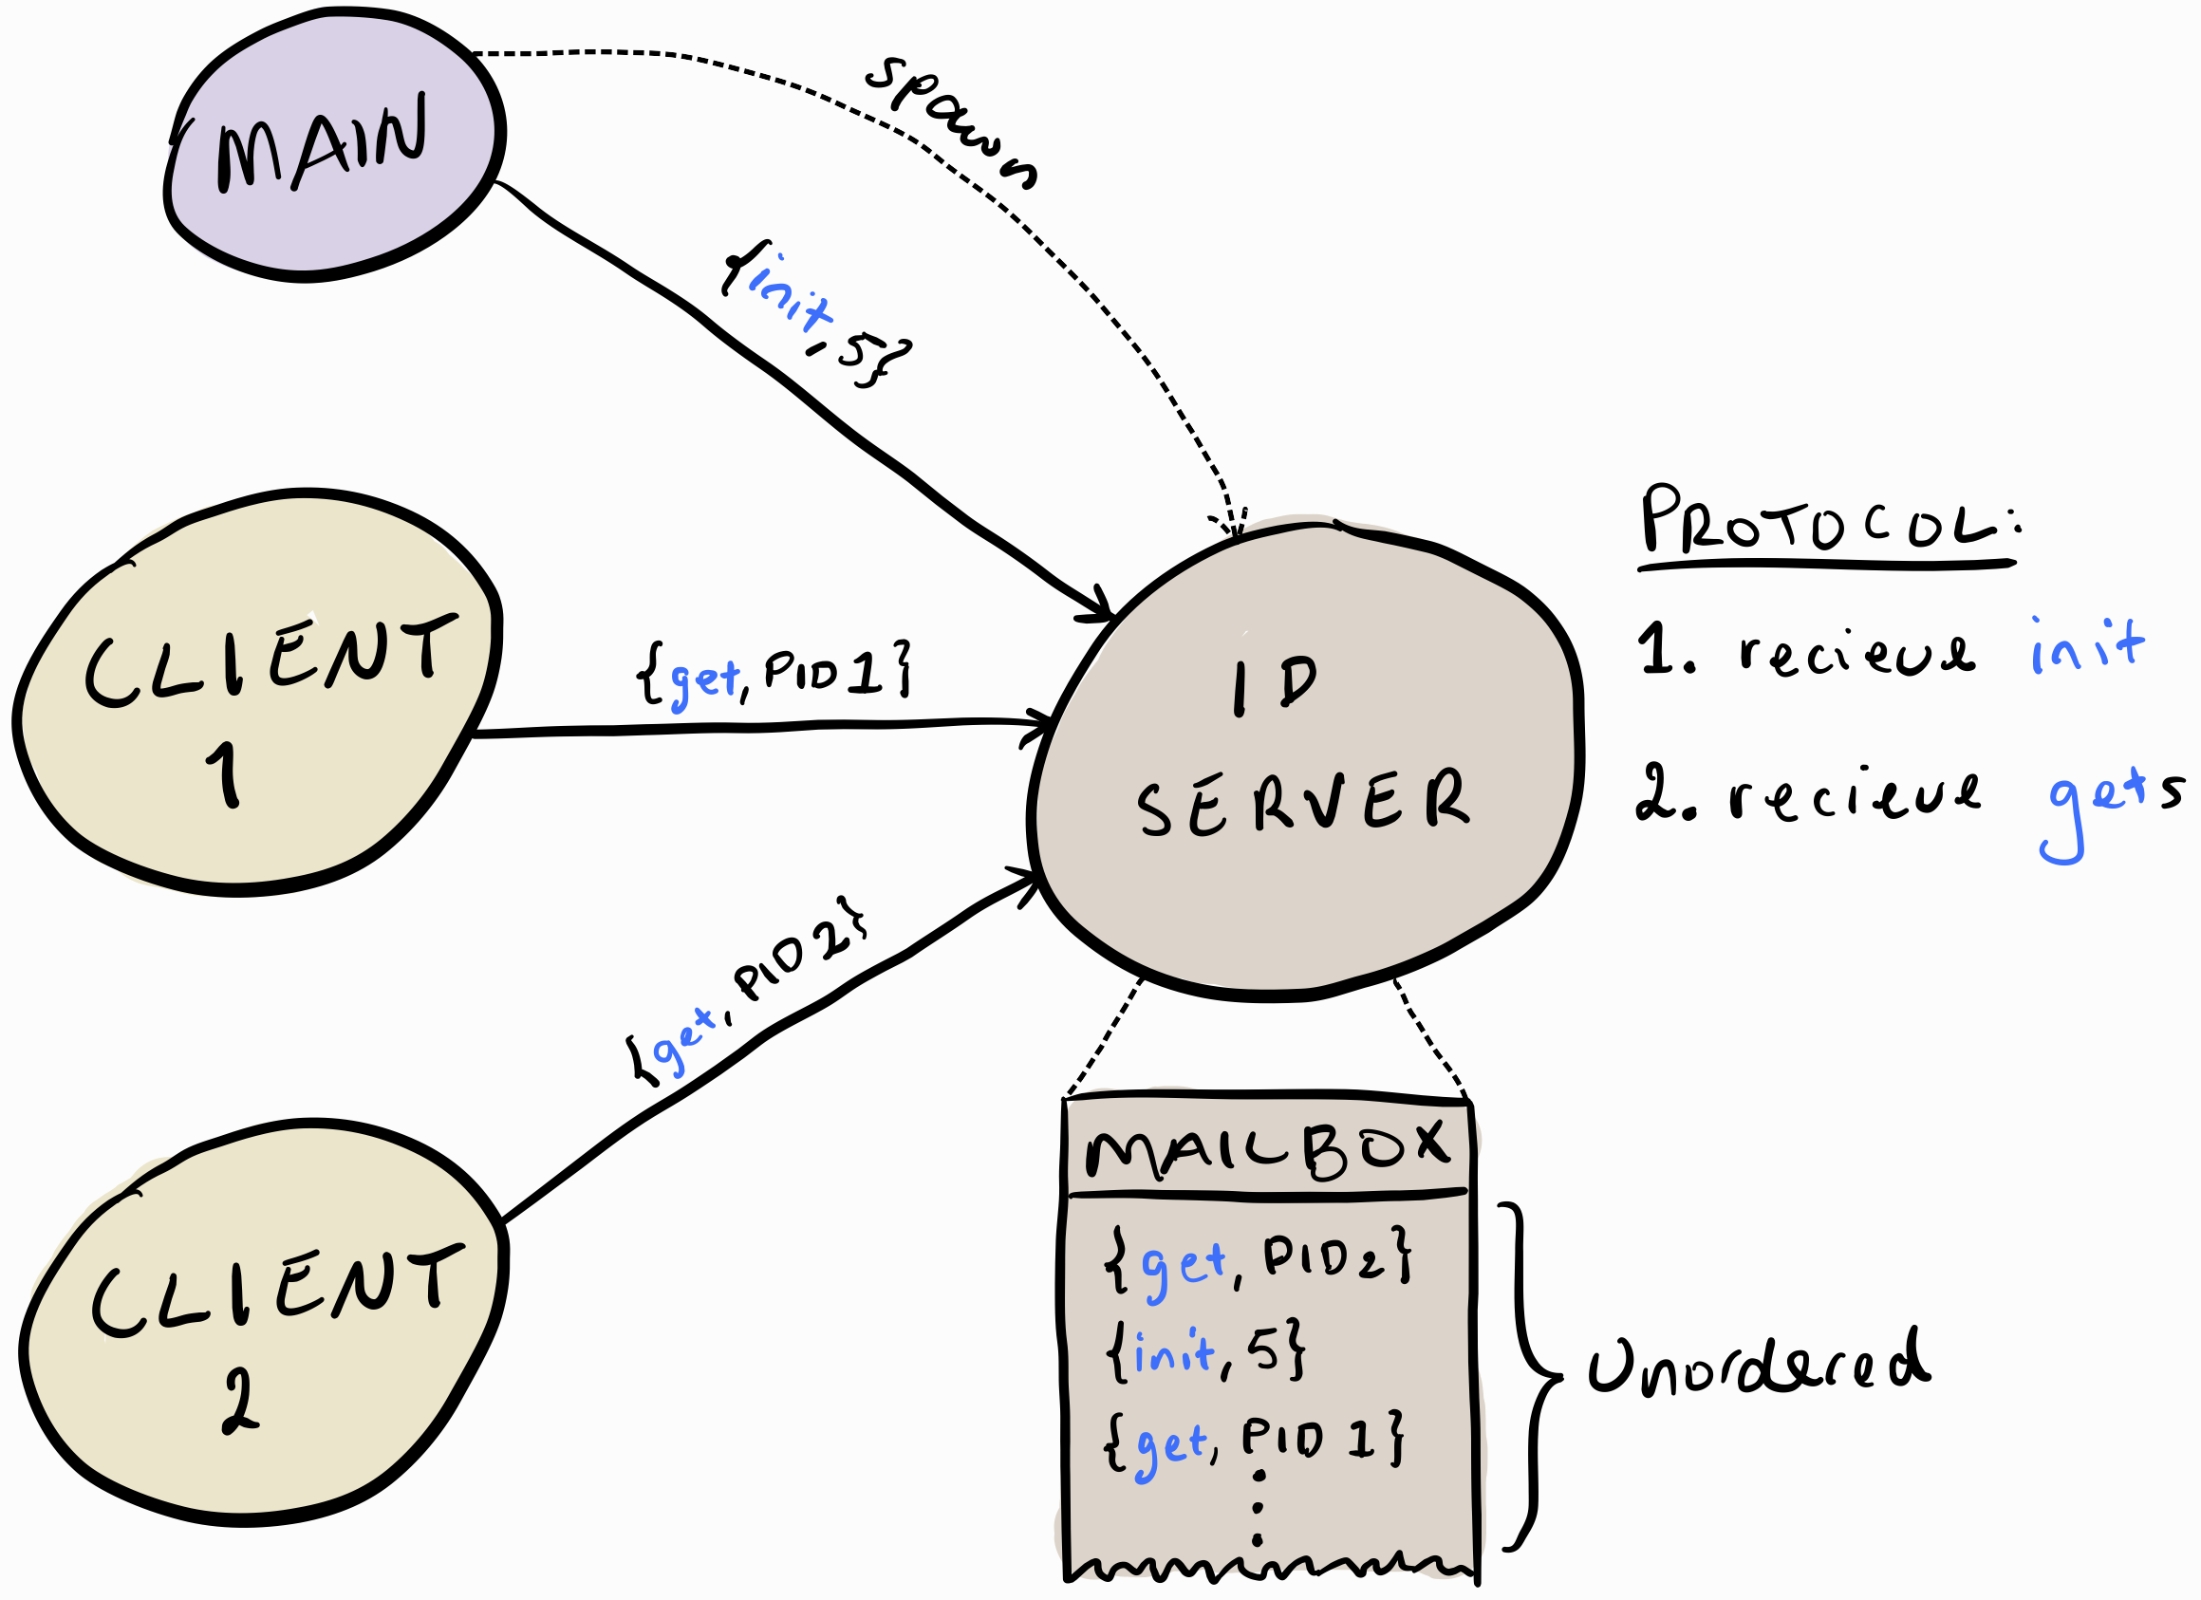
BEAM language communication
Many processes can send
Messages are stored in a mailbox
Selective receive:
receive
{init, N} ⟶ ...

Slide 4
Communication errors
Erlang communication example
id_server() ⟶
receive
{init, N} ⟶ id_server_loop(N)
end.
id_server_loop(N) ⟶
receive
{get, Client} ⟶
Client ! {id, N},
id_server_loop(N + 1);
{init, _} ⟶ error
end.
client() ⟶
% Create server.
Server = spawn {id_server, []},
% Initialize server.
Server ! {init, 5},
Server ! {get, self},
receive
{id, Id} ⟶ print Id
end.
Selective message receive
Server ! {get, self},
Server ! {init, 5},
Notes:
Explain the ID server and client. The server is bootstrapped via an init message.
Remark that it is given in pseudo-Erlang.
Payload mismatch: the types in the message payload do not match, leading to a server crash.

Slide 5
Communication errors (payload mismatch)
Communication errors
id_server() ⟶
receive
{init, N} ⟶ id_server_loop(N)
end.
id_server_loop(N) ⟶
receive
{get, Client} ⟶
Client ! {id, N},
id_server_loop(N + 1);
{init, _} ⟶ error
end.
client() ⟶
% Create server.
Server = spawn {id_server, []},
% Initialize server.
Server ! {init, 5},
Server ! {get, self},
receive
{id, Id} ⟶ print Id
end.
Wrong type
Server ! {init, “5”},
Crash
Notes:
Explain the ID server and client. The server is bootstrapped via an init message.
Remark that it is given in pseudo-Erlang.
Payload mismatch: the types in the message payload do not match, leading to a server crash.

Slide 6
Communication errors (unsupported request)
Communication errors
id_server() ⟶
receive
{init, N} ⟶ id_server_loop(N)
end.
id_server_loop(N) ⟶
receive
{get, Client} ⟶
Client ! {id, N},
id_server_loop(N + 1);
{init, _} ⟶ error
end.
client() ⟶
% Create server.
Server = spawn {id_server, []},
% Initialize server.
Server ! {init, 5},
Server ! {get, self},
receive
{id, Id} ⟶ print Id
end.
Mailbox junk
Wrong tag
Server ! {gte, self},
Notes:
Unsupported request: the client (or any other process) sends messages the server logic or protocol does not handle, leading to mailbox junk.

Slide 7
Communication errors (unexpected request)
Communication errors
id_server() ⟶
receive
{init, N} ⟶ id_server_loop(N)
end.
id_server_loop(N) ⟶
receive
{get, Client} ⟶
Client ! {id, N},
id_server_loop(N + 1);
{init, _} ⟶ error
end.
client() ⟶
% Create server.
Server = spawn {id_server, []},
% Initialize server.
Server ! {init, 5},
Server ! {init, 5},
Server ! {get, self},
receive
{id, Id} ⟶ print Id
end.
Extra init
Crash
Notes:
Unexpected request: the client sends a message that violates the protocol, e.g., here we initialise the server twice, which leads to the crash in the defensive expression being triggered.

Slide 8
Communication errors (omitted reply)
Communication errors
id_server() ⟶
receive
{init, N} ⟶ id_server_loop(N)
end.
id_server_loop(N) ⟶
receive
{get, Client} ⟶
Client ! {id, N},
id_server_loop(N + 1);
{init, _} ⟶ error
end.
client() ⟶
% Create server.
Server = spawn {id_server, []},
% Initialize server.
Server ! {init, 5},
Server ! {get, self},
receive
{id, Id} ⟶ print Id
end.
Omitted id
Blocked
Notes:
Omitted reply: the server erroneously omits sending a reply in response to a request issued by the client, causing the client to block.

Slide 9
Issues with communication errors
Defensive code
Bloated codebase
Extra maintenance
Late error detection
Process crashes
Blocked processes
Mailbox junk
Notes:
Interpret slide in own words.

Slide 10
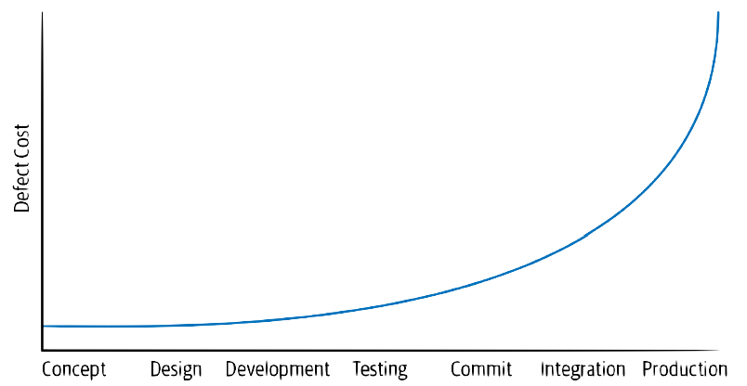
Fail fast, cheaply
Less debugging effort
Avoid production failures
Reduce overall cost
Safeguard reputation
Notes:
I’m showing a typical cycle in the development process.
Lesson: fail fast, fail cheap and fail early.
If you do get something wrong, get it wrong when the cost of fixing the problem is still low.
Moral: catch errors as early as possible!

Slide 11
Fail fast, cheaply
Less debugging effort
Avoid production failures
Reduce overall cost
Safeguard reputation
Sprint 1
Sprint 2
Sprint 3
Sprint 4
Notes:
Agile development follows the same approach in an iterative fashion, which still benefits from catching errors early.
But how do we catch errors early in practice?

Slide 12
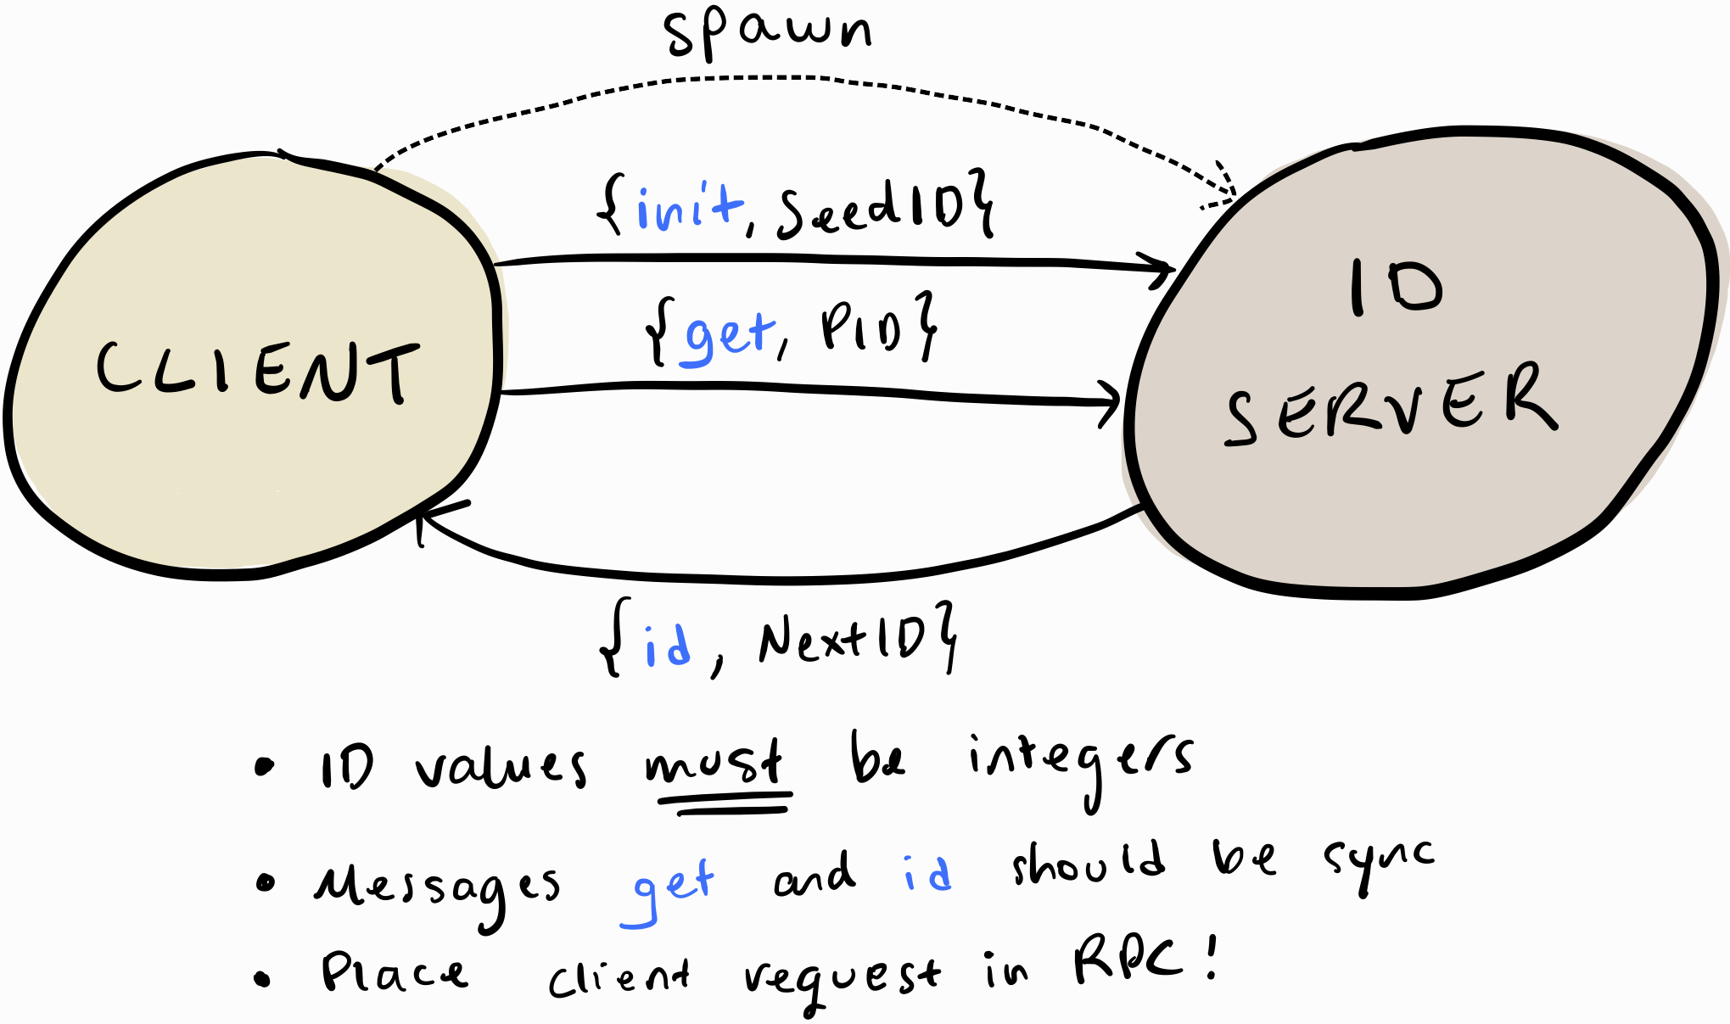
Documenting the developer’s intention
Model-code disconnect
Model-code becomes out-of-sync
Intended communication is
not apparent in the code
not available to tools
Notes:
Interpret slide in own words.

Slide 13
Type checking
: detect errors early
Notes:
One tried and tested approach we all use is type-checking.

Slide 14
Type checking
Data typing
detects computation errors
Behavioural typing
detects communication errors
Types describe functions/APIs and data structures
Data values match expected types
-spec id_server() ⟶ any().
Types describe protocol interaction
Interactions match expected protocols
dialyzer: success typing
etylizer: set-theoretic typing
mailboxer: mailbox typing
Notes:
We are all familiar with data typing: it detects computation errors.
Types describe the structure of data, e.g., an integer, a string, or a function type.
Data types focus on what the program is in terms of data and their relationships.
In Erlang, we specify the type of data with type definitions and function specs.
Some examples:
Dialyzer: uses success typing to report errors only in cases where it can prove that our code or specs are incorrect (errors can still slip through).
Etylizer: uses set-theoretic typing to report cases where it cannot prove that our code is correct (may rule out valid programs).
Same goes for eqWAlizer.
Behavioural typing: it detects communication errors.
Types describe the protocol interaction, e.g. send one message, receive another message.
Behavioural types focus on that the program does in terms of the process communication protocol.
One example is mailbox typing, which is the focus of this presentation. What are the advantages of mailbox typing?
Detailed notes in case people ask:
eqWAlizer: gradual typing, local typing and inference (function by function) -> errors are localised and easy to interpret, developed in Scala, covers most of the syntax except for contrived cases.
etylizer: set-theoretic typing, type checking done per module -> errors are localised and easy to interpret, developed in Erlang, does not cover the full Erlang syntax.
dialyzer: global type checking and inference (goes over module boundaries) -> errors can be a bit difficult to interpret, developed in Erlang, covers the full Erlang syntax.

Slide 15
Mailbox typing to catch protocol errors
Compile time
Early error detection
Eliminate some defensive code
Lightweight
Fast execution
Usable during development
Annotated code
Use Erlang type annotations
In-code documentation
Compatible with existing tools
Available to new tools
Scalable
Applicable to large code bases
Notes:
Interpret slide in own words.

Slide 16
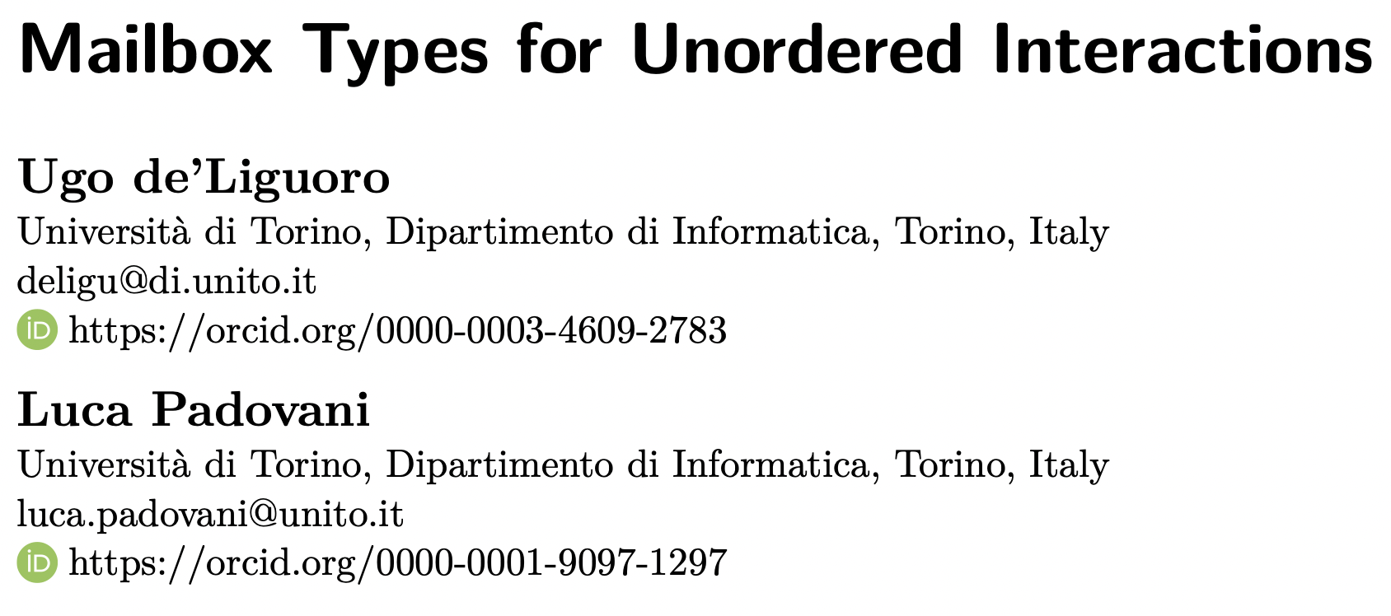
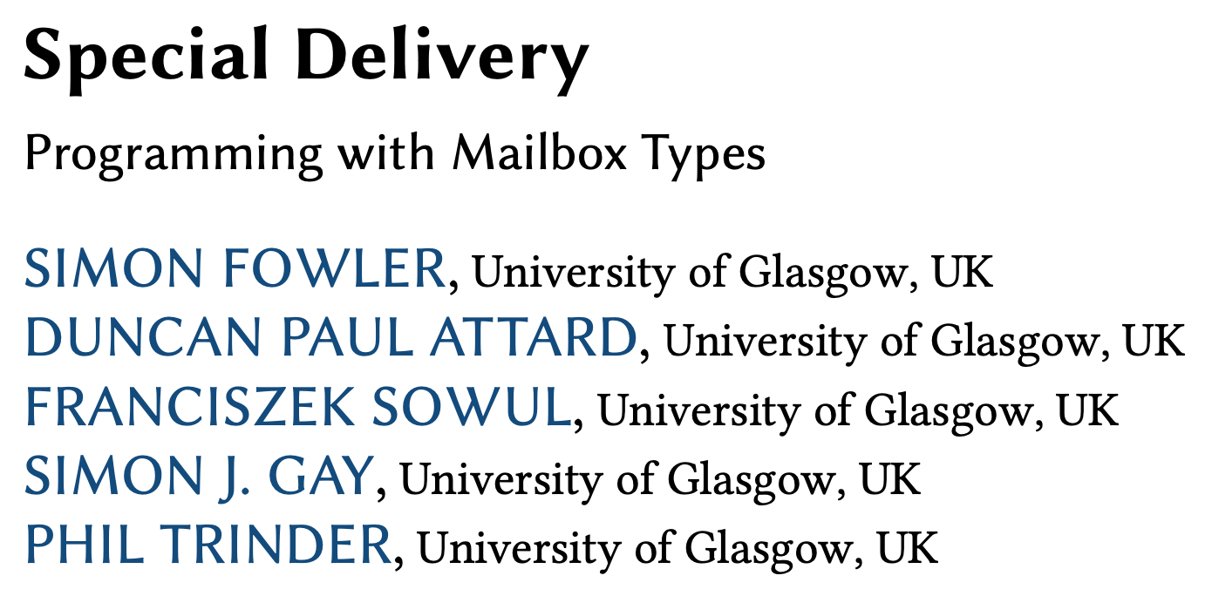
mailboxer
Mailbox types describe process interaction
Mailboxes are first-class entities with a type
Reasoning on the mailbox contents
ECOOP’18
ICFP’23
Pattern
Type = Capability + Pattern
!P Messages that must be sent
?P Messages that a mailbox can contain
Notes:
Send capability: obligation to send messages with pattern P
Receive capability: mailbox contains messages with pattern P
Many writer, one reader: sending simply adds a message to the mailbox, but it is the consumption of the message that determines the behaviour of the process.

Slide 17
A pattern describes the mailbox contents
It's a commutative regular expression:
Captures out-of-order message deposits
Captures selective message reception
Receive one init and many get messages ⇒ ?"init.get*"
Send one id message ⇒ !"id"
Receive many get and one init message ⇒ "init.get*"
⇒ ?"init.get*"
Notes:
Interpret slide in own words.

Slide 18
Aim: sends and receives must balance out

Slide 19
Interface: isolates mailbox type + state
A set of messages that a mailbox can receive
Annotate process functions: -new or -use
ID client interface:
id messages
-spec id :: {id, int}.
-spec id_client :: id.
-spec init :: {init, int}.
-spec get :: {get, id_client}.
-spec id_server :: init | get.
ID server interface:
init and get messages
Notes:
Concept of an interface: a set of messages that a mailbox can receive.
We then associate interfaces with Erlang functions using function specs.
How do we implement it in Erlang? Using type definitions as shown.

Slide 20
Logical id_server mailbox
-new id_server.
-spec id_server() ⟶ unit.
id_server() ⟶
assert(“init.get*”),
receive
{init, N} ⟶ id_server_loop(N)
end.
-use id_server.
-spec id_server_loop(int) ⟶ unit.
id_server_loop(N) ⟶
assert(“get*”),
receive
{get, Client} ⟶
Client ! {id, N},
id_server_loop(N + 1)
end.
Logical id_client mailbox
-new id_client.
-spec client() ⟶ unit.
client() ⟶
Server = spawn {id_server, []},
Server ! {init, 5},
Server ! {get, self},
assert(“id”),
receive
{id, Id} ⟶ print Id
end.
Continue using id_server mailbox
Remove defensive error-handling code {init, _} ⟶ error
Notes:
-new and –use are tied with the function scope. Once the function decorated with new goes out of scope, so does the associated mailbox.
Remark: in practice, Erlang does not yet support custom function attributes, which is why we codify the association between interfaces and Erlang functions using module-level attributes.

Slide 21
mailboxer demo

Slide 22
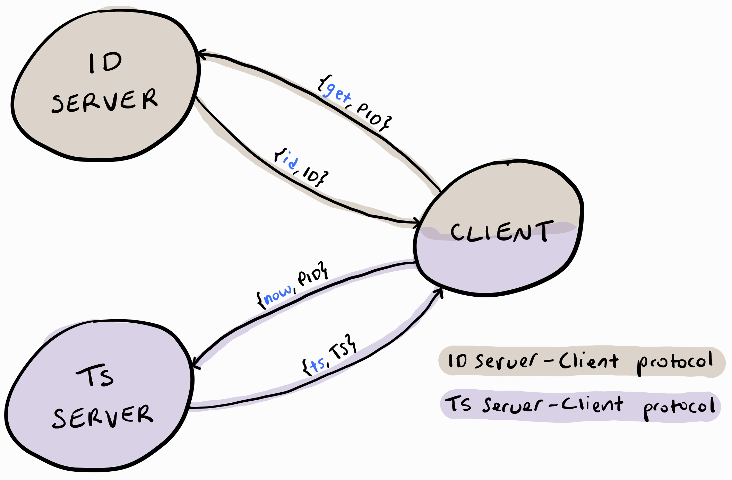
mailboxer scales to
multiple protocols
Project monolithic mailbox
⇓
Multiple logical mailboxes
!

Slide 23
Logical id_client mailbox
-new id_client.
-spec id_rpc(id_server) ⟶ int.
id_rpc(To) ⟶
To ! {get, self},
assert(“id”),
receive
{id, Id} ⟶ Id
end.
-spec id_server :: init | get.
-spec ts_server :: now.
-spec id_client :: id.
-spec ts_client :: ts.
Two interfaces
Local reasoning
Logical ts_client mailbox
-spec ts_asy(ts_server) ⟶ unit.
ts_asy(To) ⟶ To ! {now, self}.
-spec ts_get() ⟶ int.
ts_get() ⟶
assert(“ts”),
receive
{ts, Ts} ⟶ Ts
end.
-new ts_client.
-spec client() ⟶ unit.
client() ⟶
IdServer = spawn {id_server, …
TsServer = spawn {ts_server, …
ts_asy(TsServer), % Async.
print id_rpc(IdServer), % Sync.
print ts_get().
Isolated mailboxes
Local reasoning
Notes:
Describe how it is done.

Slide 24
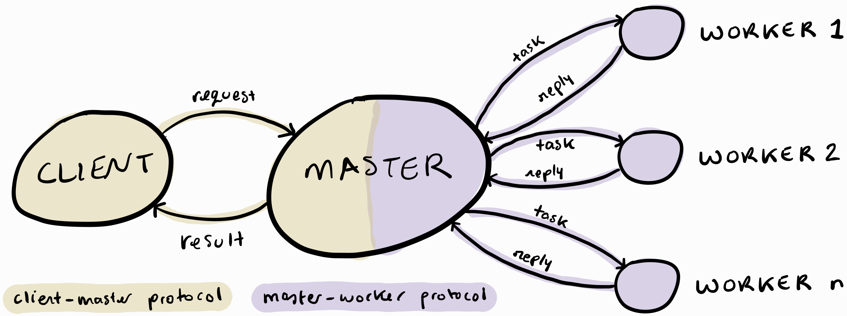
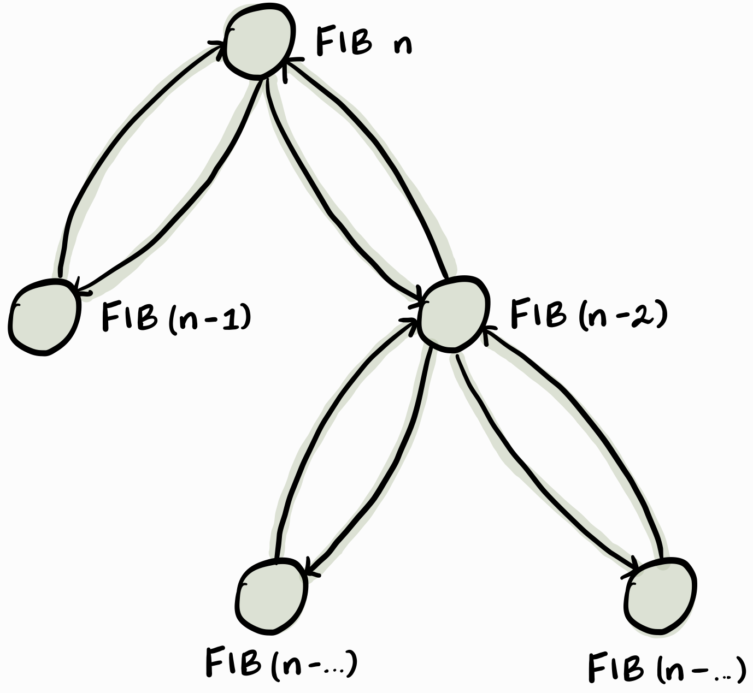
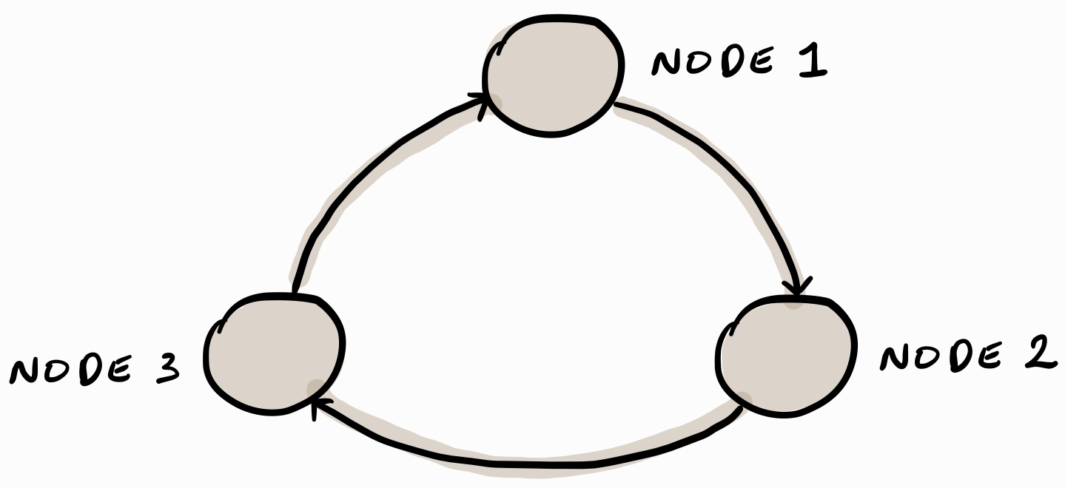
mailboxer captures common paradigms
Expresses 11/17 examples from ICFP’23
Notes:
Our current implementation captures these common communication paradigms.
11/17 expressiveness examples from ICFP’23.

Slide 25
mailboxer prototype development
Ongoing effort
Support more Erlang syntax | ⟶ e.g., n-ary tuples, lists, etc.
Longer term plan
Make mailbox types less verbose | ⟶ Type/pattern inference
Use on partially-annotated code bases | ⟶ Gradual typing
Provide mailbox types for OTP ⇒ use on existing codebases
Notes:
We start with a syntactical subset of the full Erlang syntax (do not use the word “core” since this can be misunderstood as Core Erlang).
In the longer term we want to:
- Allow Mailboxer to function with code that can be annotated gradually to lower the its adoption barrier
- Apply Mailboxer on existing code bases or not burdening the developer with having to specify obvious types or communication patterns.

Slide 26

mailboxer: catch communication errors early!
WIP
Mailbox types
Embed communication model in code
Document intended communication between processes
Available to tools and developers
mailboxer
Scales to specify multiple protocols
Expresses common communication paradigms
Notes:
Main message: Mailboxer is the first tool of its kind to bring mailbox types to Erlang and focusses on catching communication errors.
It can be used in tandem with other tools, such as Dialyzer and the other static approaches mentioned earlier.
It shows promise in that it can scale to describe different protocols by partitioning the mailbox logically.
It can express common communication paradigms.

Slide 27
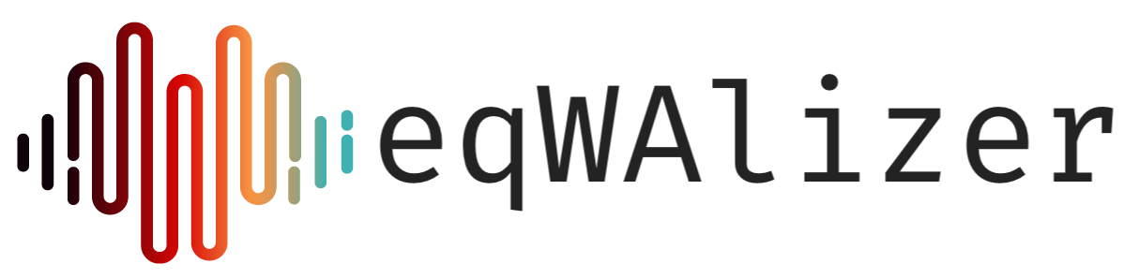
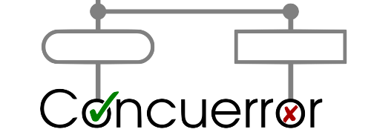
Erlang error-detection tool landscape
Lightweight
Full-blown
eqWAlizer
(data typing)
Code annotations
Scalable
Not for concurrency
Detects errors early
Less precise
Concuerror
(systematic testing)
Relies on test suites
Less scalable
Targets concurrency
Detects errors later
More precise
Notes:
eqWAlizer: a static typing approach.
Concuerror: a dynamic analysis approach that performs systematic testing to uncover concurrency errors, e.g., deadlocks and errors due to race conditions.

Slide 28
Erlang error-detection tool landscape
Lightweight
Full-blown
eqWAlizer
(data typing)
Code annotations
Scalable
Not for concurrency
Detects errors early
Less precise
MailboxEr
(mailbox typing)
Code annotations
Scalable
Targets concurrency
Detects errors early
Less precise
mailboxer
Concuerror
(systematic testing)
Relies on test suites
Less scalable
Targets concurrency
Detects errors later
More precise
Notes:
Mailboxer: a compromise between lightweight and full-blown analysis that still detects communication-centric errors that can be performed efficiently as the code is being developed.
The three approaches complement each other. Type checking does not catch all errors, which is why testing and dynamic model checking tools such as concuerror combined give us more assurances about our code.

