Slide 1
SBOM & Vulnerability Management
Automating Software Composition Analysis with Dependency-Track
Know every component. Manage every vulnerability.
Automated SBOM Generation
Continuous Monitoring
Vulnerability Reporting
Maven Plugin Integration
SBOM & Vulnerability Management · Dependency-Track

Slide 2
What is an SBOM?
Software Bill of Materials
CycloneDX Format
An SBOM is a formal, machine-readable inventory of every open-source and third-party component included in an application — along with their versions, licences, and supply-chain relationships. It is the foundation for understanding what your software is made of and identifying where security risks exist.
CycloneDX is an OWASP standard for SBOMs. It is natively supported by Dependency-Track, cdxgen, and the CycloneDX Maven / Gradle plugins.
Why do SBOMs matter?
An SBOM records:
▸ Component name & version
▸ Package supplier / origin
▸ Dependency relationships
▸ Licence identifiers (SPDX)
▸ Known vulnerability references (CVEs)
✓ Visibility into ALL transitive dependencies
✓ Rapid impact assessment when a new CVE drops
✓ Licence compliance & open-source governance
✓ Supply-chain security & audit trail
SBOM & Vulnerability Management · Dependency-Track

Slide 3
How SBOMs Are Generated
Two complementary approaches — both feed directly into Dependency-Track
cdxgen — Any Language / Repository
CycloneDX Maven Plugin — In-House Java Code
▸ Polyglot support: Java, Node.js, Python, .NET, Go, Ruby …
▸ Scans the source tree and lock files automatically
▸ Runs as a Jenkins pipeline step via the cdxgenRepo() shared library call
▸ Produces a CycloneDX JSON SBOM in one command
▸ No changes needed to the target repository
▸ Supports pinned versions for reproducible builds
▸ Added directly to pom.xml — no extra tooling required
▸ Runs during the standard Maven build lifecycle
▸ Generates a precise SBOM reflecting the exact resolved dependency tree
▸ Uploads the SBOM to Dependency-Track automatically at build time
▸ Keeps vulnerability data current with every CI build
▸ Developers get instant feedback on new vulnerabilities introduced
Both routes → uploadSBOM() → Dependency-Track
SBOM & Vulnerability Management · Dependency-Track

Slide 4
Maven Plugin — In-House Code Integration
Add the CycloneDX Maven plugin to your pom.xml and your SBOM is generated and published to Dependency-Track on every build.
pom.xml
What this gives you
<plugin> <groupId>org.cyclonedx</groupId> <artifactId> cyclonedx-maven-plugin </artifactId> <version>2.9.1</version> <executions> <execution> <phase>package</phase> <goals> <goal>makeAggregateBom</goal> </goals> </execution> </executions> <configuration> <outputFormat>json</outputFormat> <outputName>sbom</outputName> </configuration> </plugin>
✓ Zero manual steps — SBOM published on every mvn package
✓ Vulnerability status visible in DT the moment the build lands
✓ Policy violations surface in the CI pipeline, not weeks later
✓ Full transitive dependency tree — nothing hidden
Pipeline flow
1. Developer pushes code
2. Jenkins triggers Maven build
3. cyclonedx-maven-plugin generates sbom.json
4. uploadSBOM() posts SBOM to Dependency-Track
5. DT enriches with NVD / OSV / GitHub Advisory data
6. Vulnerabilities visible immediately in DT dashboard
SBOM & Vulnerability Management · Dependency-Track

Slide 5
Dependency-Track — Overview
Dependency-Track is an OWASP flagship platform that ingests SBOMs and continuously monitors every component for new vulnerabilities.
Continuous Monitoring
Policy Engine
Portfolio View
REST API & Integrations
Checks every component against NVD, OSV, GitHub Advisory, and Sonatype OSS Index automatically — no manual CVE searches.
Define licence policies, severity thresholds, and component allow/block lists. Violations are surfaced instantly.
Group projects into collections. See aggregate risk across an entire product portfolio at a glance.
Fully headless via REST API. Integrates with Jenkins, GitHub Actions, Slack notifications, and JIRA ticketing.
Dependency-Track — Project Portfolio Dashboard
Project
Version
Critical
High
Medium
Low
Risk Score
Last BOM
my-billing-service
2.4.1
0
3
7
12
4.2
Today
customer-api
1.8.0
1
5
9
4
7.8
Today
reporting-engine
3.1.2
0
1
3
8
2.1
Yesterday
auth-service
1.2.0
2
8
11
6
9.1
Today
SBOM & Vulnerability Management · Dependency-Track

Slide 6
Detection Tools & Vulnerability Intelligence Sources
The pipeline combines best-in-class SBOM generators with Dependency-Track's multi-source vulnerability intelligence to achieve comprehensive coverage.
SBOM Generation Tools
Vulnerability Intelligence Sources
cdxgen
Dependency-Track queries these feeds automatically — no manual CVE searching:
Polyglot — Java, Node.js, Python, Go, .NET, Ruby & more. Runs as a Docker container; no host install required.
NVD — National Vulnerability Database
NIST canonical CVE registry with CVSS v2/v3/v4 scores. The primary authoritative source for all CVEs.
CycloneDX Maven Plugin
Embedded in pom.xml; runs at mvn package phase. Generates a precise resolved-dependency-tree SBOM.
OSV — Open Source Vulnerabilities
Google's open database covering PyPI, npm, Maven, Go, Ruby gems, Cargo, and more.
Syft (Anchore)
Scans Docker image layers to produce a container SBOM. Used via the syftImage() Jenkins shared-library step.
GitHub Advisory Database
Curated advisories tied directly to GitHub-hosted packages. Highly accurate package-URL matching.
Grype (Anchore)
Vulnerability scanner that consumes a Syft/cdxgen SBOM. Used via the grypeScan() step for pre-upload triage.
Sonatype OSS Index
Component intelligence focused on Maven Central and npm. Includes licence and ecosystem data.
CycloneDX Gradle / Node / .NET
Ecosystem-specific plugins that mirror the Maven plugin's approach for Gradle, npm, and .NET SDK projects.
VulnDB (optional commercial)
Broader coverage than NVD with earlier disclosure. Configurable as an additional feed in DT settings.
SBOM & Vulnerability Management · Dependency-Track

Slide 7
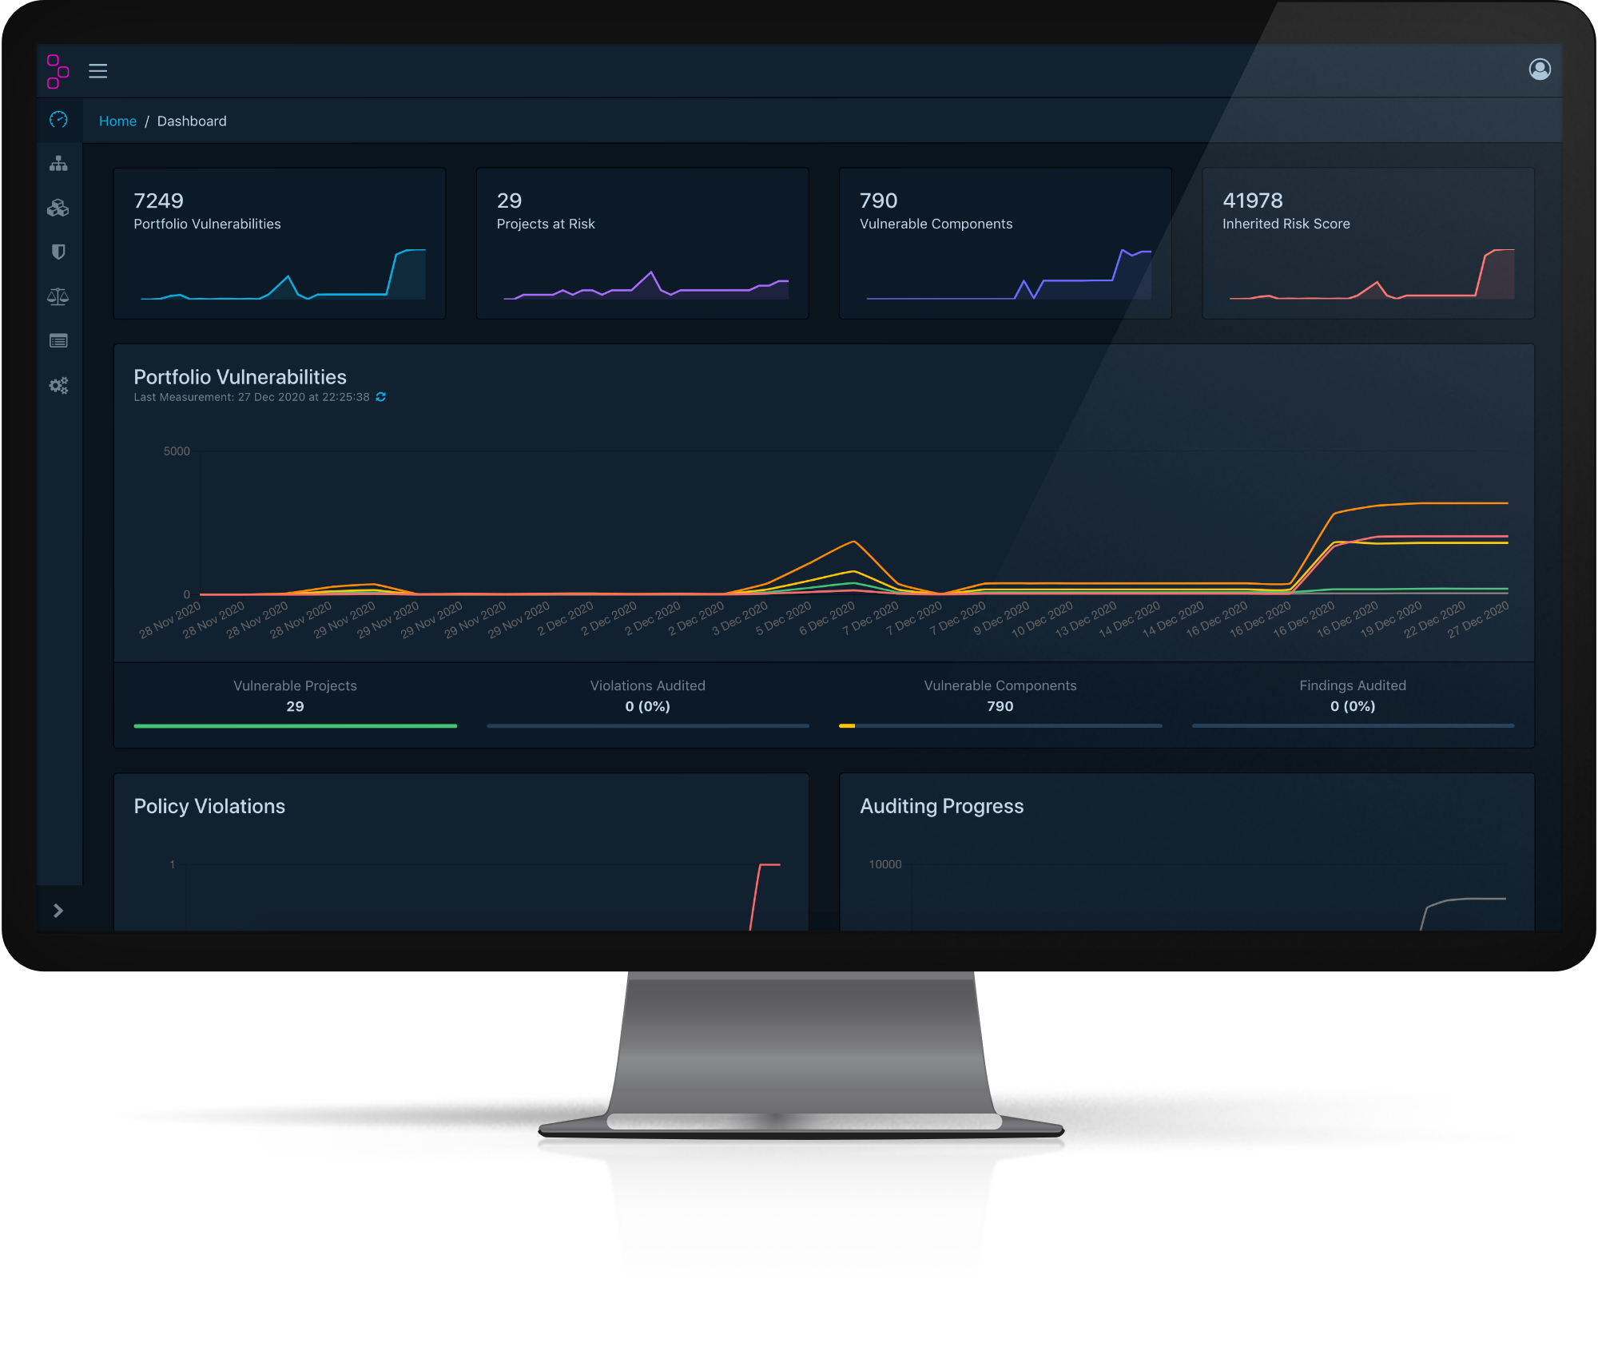
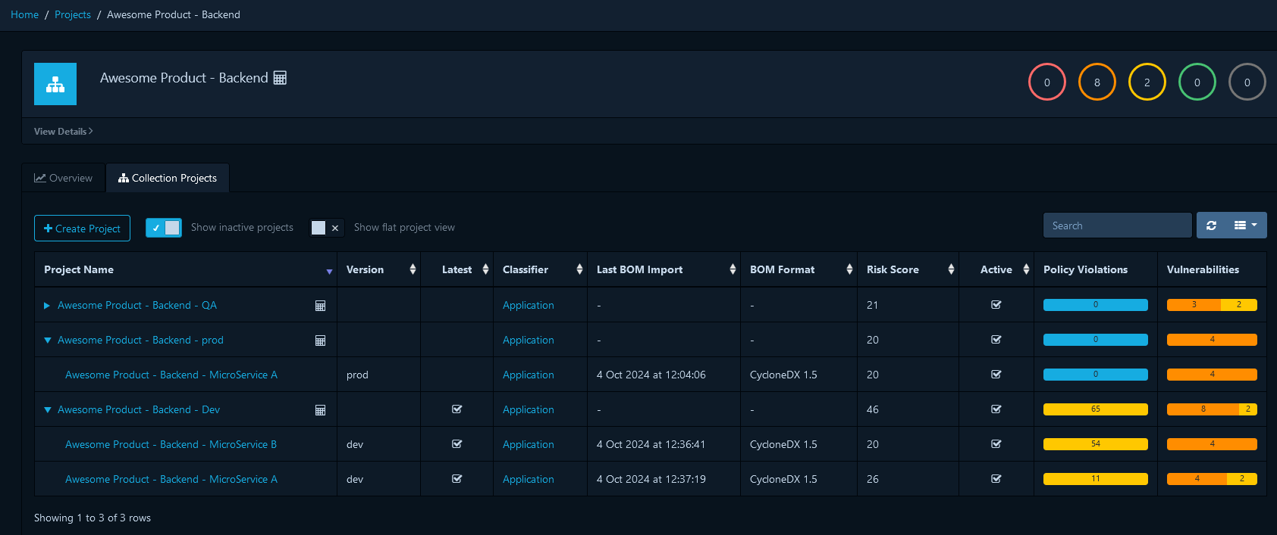
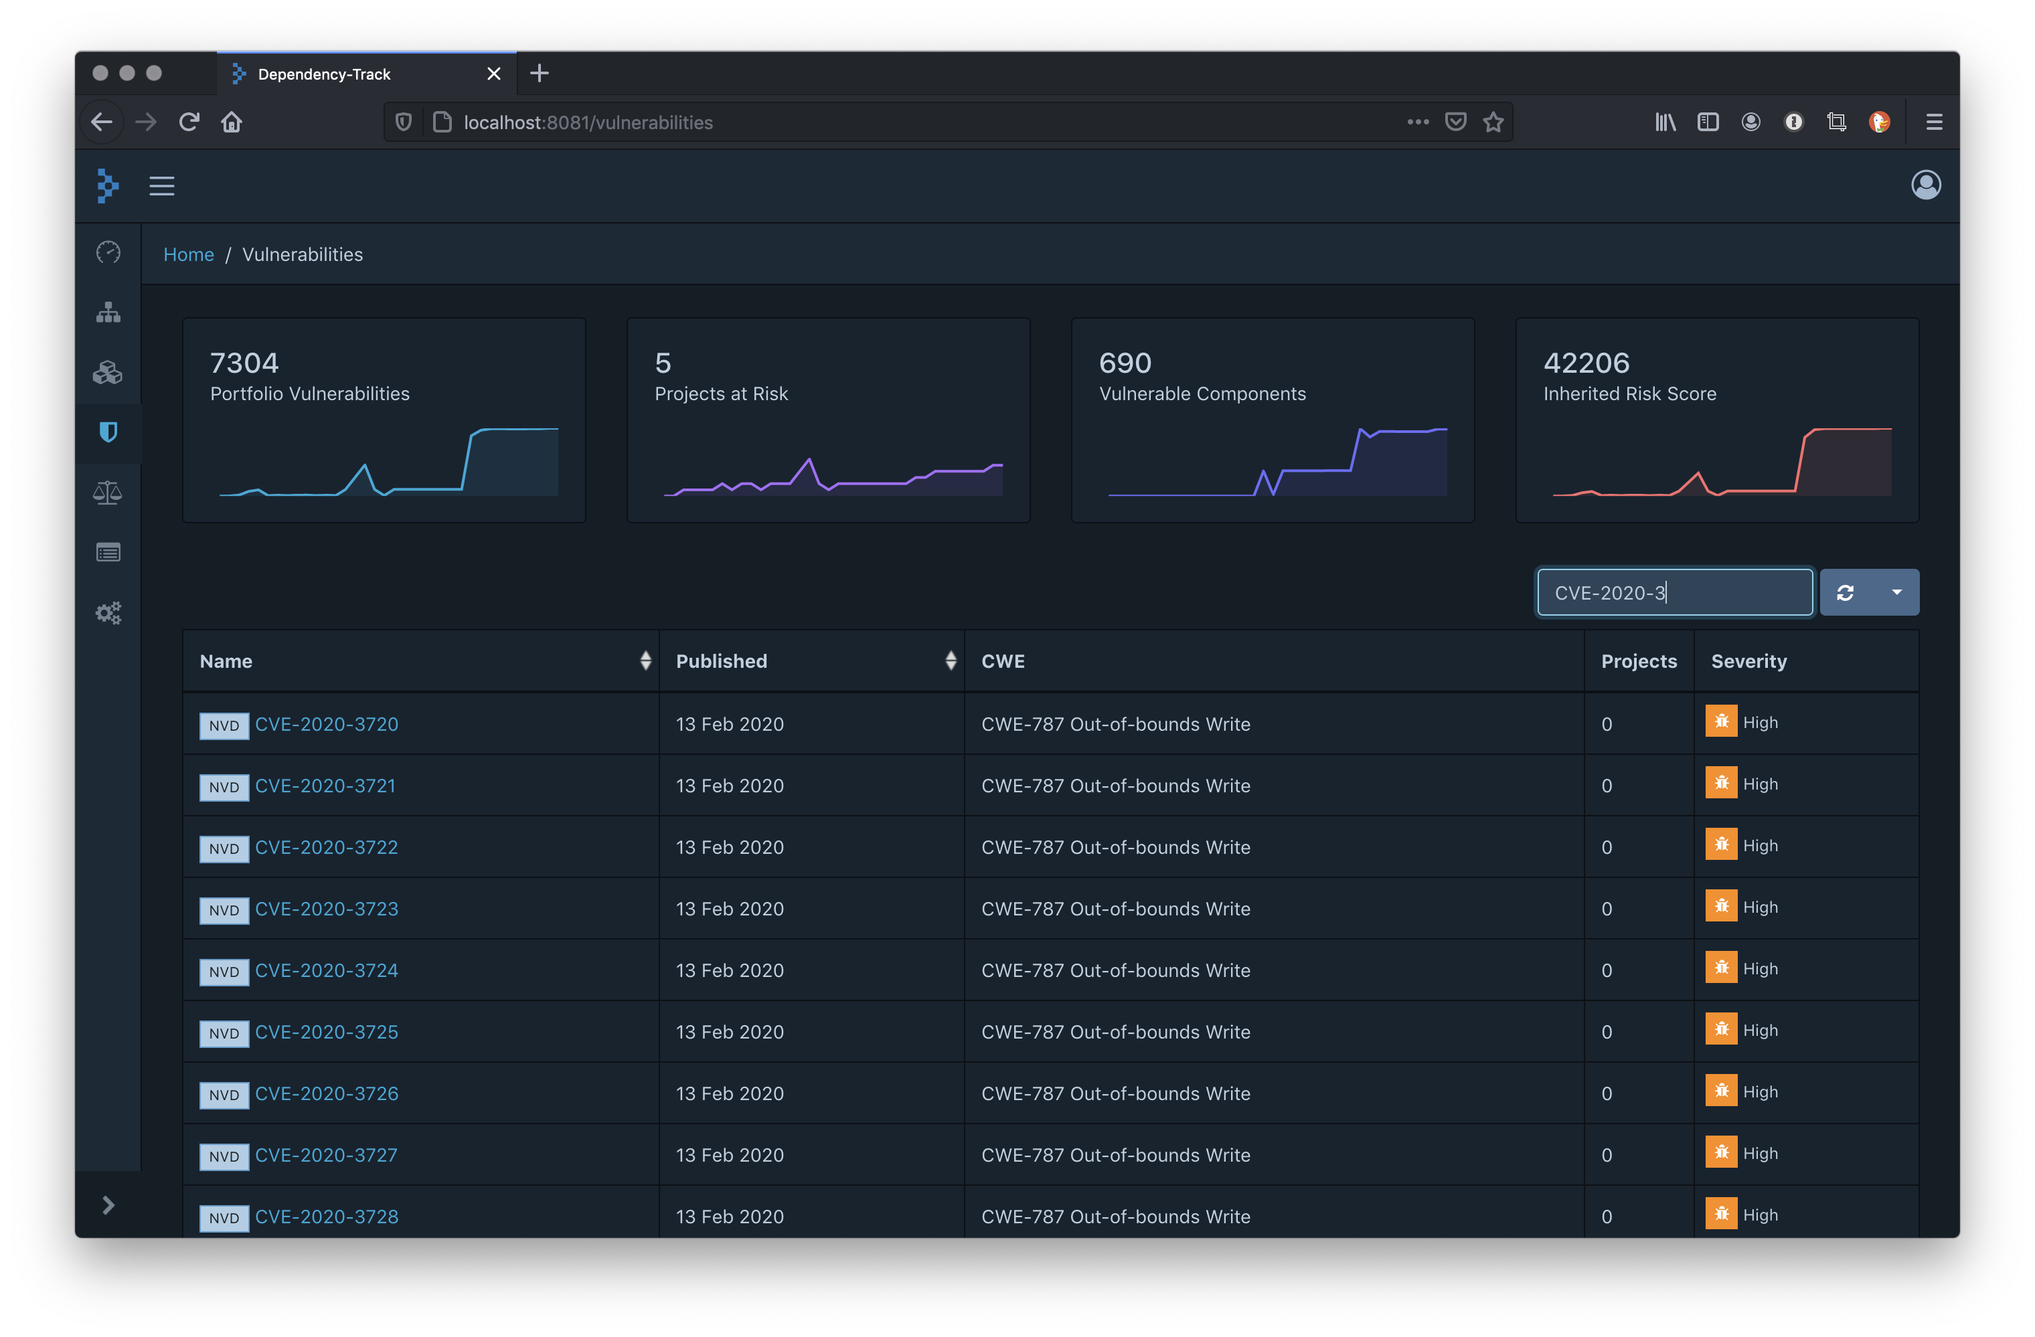
Dependency-Track — User Interface
Real Dependency-Track UI — portfolio dashboard, project collection view, and vulnerability findings list
Portfolio Dashboard
Collection Project
Vulnerability Findings
SBOM & Vulnerability Management · Dependency-Track

Slide 8
Managing Vulnerabilities — The Workflow
Dependency-Track surfaces every finding. Your team then triages, analyses, and resolves each one — all recorded within the platform.
1. Ingest SBOM
2. Review Findings
3. Triage
4. Record Analysis
5. Remediate & Re-scan
SBOM uploaded via Jenkins pipeline. DT resolves all components and enriches with CVE data from multiple advisories databases.
Open the project in DT. Findings are listed by severity — Critical, High, Medium, Low — with CVE details and CVSS scores.
Decide the appropriate action for each finding: Escalate to the engineering team, suppress, or mark as not affected.
Document your analysis inside DT: add comments, set the analysis state, and optionally suppress the finding.
Engineering upgrades the dependency. The next pipeline run re-uploads the SBOM and the finding disappears automatically.
Dependency-Track — Findings tab for a project (screenshot)
CVE-2021-44228
log4j-core
2.14.1
CRITICAL
10.0
Remote Code Execution via JNDI lookup
CVE-2022-42003
jackson-databind
2.13.0
HIGH
7.5
Uncontrolled resource consumption
CVE-2023-20863
spring-expression
5.3.25
MEDIUM
5.9
Regular expression denial of service
SBOM & Vulnerability Management · Dependency-Track

Slide 9
Vulnerability Analysis — Comments, Suppression & State
Every finding in Dependency-Track can be analysed, commented on, and formally recorded — creating an audit trail of your security decisions.
Analysis Panel — CVE-2021-44228 / log4j-core 2.14.1
Available Analysis States
Analysis State
NOT_AFFECTED
The component is present but the vulnerability does not apply to this deployment context.
▼ NOT_AFFECTED
Justification
IN_TRIAGE
The finding is being actively investigated. Interim state until a final decision is made.
▼ PROTECTED_BY_MITIGATING_CONTROL
Suppressed
ON
EXPLOITABLE
Confirmed — the vulnerability is present and exploitable. Immediate remediation required.
Analyst Comment
Reviewed 2025-01-15 by J. Smith. Our deployment uses the JNDI lookup feature is disabled via log4j2.formatMsgNoLookups=true JVM flag set at container startup. Confirmed with DevOps — the attack vector is mitigated. Tracking upgrade to log4j 2.17.1 in Q1 sprint board (JIRA-4821).
RESOLVED
The dependency has been upgraded and the vulnerability is no longer present in the component inventory.
FALSE_POSITIVE
The vulnerability does not apply — typically because the affected code path is never invoked.
SBOM & Vulnerability Management · Dependency-Track

Slide 10
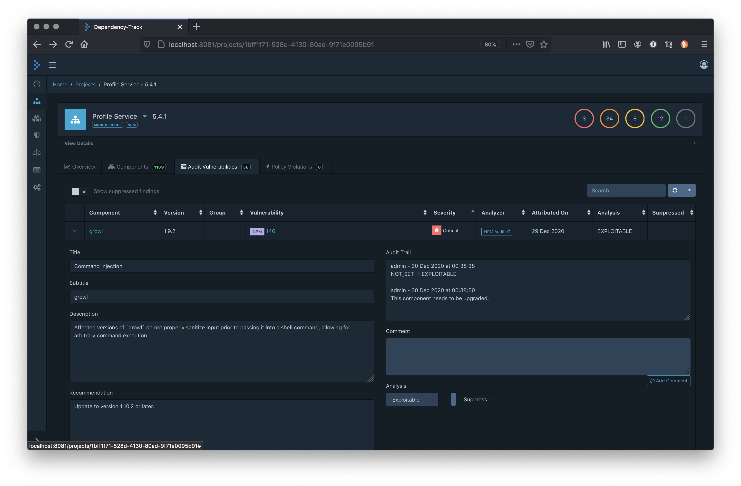
Dependency-Track — Auditing a Finding
The audit panel lets analysts set the analysis state, record a justification, add comments, and suppress the finding — all with a full audit trail.
Audit Finding — Analysis Panel
SBOM & Vulnerability Management · Dependency-Track

Slide 11
Suppression — Hiding Accepted Risk
When a finding is accepted or not applicable, it can be suppressed so it no longer inflates your vulnerability counts — but it is never deleted.
How suppression works
▸ Suppressed findings are hidden from the default dashboard view
▸ They remain fully searchable and visible with the 'Show suppressed' filter
▸ The original CVE details, CVSS score, and analyst notes are preserved
▸ Suppression can be revoked at any time — full reversibility
▸ Suppressed findings are still exported in the vulnerability PDF report
▸ Audit trail records who suppressed a finding and when
When should you suppress?
✓ The vulnerability is in a library path that is never executed
✓ A mitigating control is already in place (WAF rule, JVM flag, etc.)
✓ You have accepted the risk and documented why
✓ The finding is a confirmed false positive
✓ A fix is not yet available and the risk is formally accepted
⚠ Suppression is not remediation — always pair suppression with a documented justification and a remediation timeline where applicable.
SBOM & Vulnerability Management · Dependency-Track

Slide 12
Automated Reporting
Jenkins pipelines generate shareable PDF reports from live Dependency-Track data — no manual export steps required.
Security Analysis (Vulnerability) Report
SBOM Component Report
▸ One report per project or across all projects
▸ Executive summary: Critical / High / Medium / Low counts
▸ Overall risk level: CRITICAL / HIGH / MODERATE / LOW
▸ Per-vulnerability detail: CVE ID, component, version, CVSS score
▸ Analyst comments and suppression status included
▸ Landscape A4 PDF — ready to share with management or auditors
▸ Auto-archived as a Jenkins build artefact
▸ Full component inventory: name, version, supplier, licence
▸ Supports single project or all active projects
▸ Collection projects produce merged reports across all children
▸ Useful for licence compliance audits
▸ Identifies components with missing or restrictive licences
▸ Landscape A4 PDF — consistent, branded format
▸ Auto-archived as a Jenkins build artefact
SBOM & Vulnerability Management · Dependency-Track

Slide 13
Example — Security Analysis Report
Security Analysis Report
customer-api v1.8.0
1
5
9
4
RISK: HIGH
CRITICAL
HIGH
MEDIUM
LOW
CVE ID
Component
Version
Severity
CVSS
Analysis State
Description
CVE-2021-44228
log4j-core
2.14.1
CRITICAL
10.0
NOT_AFFECTED
JNDI disabled via JVM flag — mitigated
CVE-2022-42003
jackson-databind
2.13.0
HIGH
7.5
IN_TRIAGE
Resource consumption — under review
CVE-2023-20863
spring-expression
5.3.25
HIGH
6.5
IN_TRIAGE
ReDoS — investigating impact
CVE-2022-45868
h2database
2.1.210
HIGH
7.8
EXPLOITABLE
Upgrade to 2.2.x scheduled sprint 14
CVE-2023-34042
spring-security-web
5.7.5
MEDIUM
5.3
FALSE_POSITIVE
Unused endpoint — confirmed FP
CVE-2023-20861
spring-expression
5.3.25
MEDIUM
5.9
RESOLVED
Upgraded to 6.0.8 in PR #441
SBOM & Vulnerability Management · Dependency-Track

Slide 14
Example — SBOM Component Report
SBOM Component Report
my-billing-service v2.4.1 | Generated 2025-04-22
187
43
144
12
3
Total Components
Direct Dependencies
Transitive
Unique Licences
Missing Licence
Component
Version
Supplier
Type
Licence
Scope
spring-boot-starter-web
3.2.1
Pivotal / VMware
Library
Apache-2.0
Required
jackson-databind
2.16.1
FasterXML
Library
Apache-2.0
Required
log4j-api
2.22.1
Apache
Library
Apache-2.0
Required
hibernate-core
6.4.2
Red Hat
Library
LGPL-2.1
Required
commons-lang3
3.14.0
Apache
Library
Apache-2.0
Required
bouncy-castle-provider
1.78
Legion of the BC
Library
MIT
Optional
netty-handler
4.1.107
Netty Project
Library
Apache-2.0
Required
unknown-lib
0.9.1
(unknown)
Library
UNKNOWN
Required
SBOM & Vulnerability Management · Dependency-Track

Slide 15
End-to-End Pipeline Overview
From source code commit to vulnerability insight — fully automated
Source Code
SBOM Generation
Upload to DT
Enrichment
Findings
Analysis & Report
Developer pushes to Git Jenkins pipeline triggered
→
cdxgen or cyclonedx-maven-plugin creates sbom.json
→
uploadSBOM() posts BOM to Dependency-Track via REST API
→
DT resolves components against NVD, OSV, GitHub Advisories
→
Vulnerabilities listed by severity with CVSS scores
→
Team triages findings PDF report generated and archived
Jenkins Shared Library — Key Pipeline Steps
cdxgenRepo()
uploadSBOM()
createDTCollectionProject()
exportDTReport()
exportAllDTReports()
exportSBOMReport()
Generate SBOM for any language repo using cdxgen
Upload SBOM and create/ update DT project
Group child projects into an aggregate collection
Generate vulnerability PDF for one project
Generate PDF for every active DT project
Generate component PDF for one project
SBOM & Vulnerability Management · Dependency-Track

Slide 16
API Explorer & Integration Ecosystem
Everything visible in the Dependency-Track UI is automatable via its REST API — enabling deep integration with your existing toolchain.
Swagger UI Explorer
Integration Ecosystem
Dependency-Track ships a built-in interactive OpenAPI / Swagger explorer. Authenticate with your API key and execute every endpoint live:
Full visibility from developer laptop to boardroom:
Jira / Ticketing
http://<dt-host>/api/swagger-ui/
Auto-create issues from Critical findings; sync analysis state back via webhook
• Try any endpoint interactively before writing code
Splunk / Elasticsearch
• POST a BOM and inspect the raw API response
Stream vulnerability events into your SIEM for correlation and compliance alerting
• Bulk-set analysis states via PUT /api/v1/analysis
Grafana Dashboards
Pull live risk scores from /metrics/portfolio for real-time executive panels
• Pull live portfolio risk scores for Grafana feeds
MS Teams / Slack
• Impact analysis — find every project using a component
Webhook notifications on new Critical or High severity findings
• Import dependencytrack-openapi.yaml into Postman
PagerDuty / OpsGenie
Trigger on-call alerts when newly introduced Critical vulnerabilities are detected
Executive Reporting
Scheduled metrics export — from developer laptop to boardroom in one pipeline
SBOM & Vulnerability Management · Dependency-Track

Slide 17
Benefits Summary
Complete Visibility
Continuous Monitoring
Structured Triage
Every dependency — direct and transitive — is known and tracked. No blind spots in your software supply chain.
New CVEs are automatically matched against your component inventory. You are notified without running a scan.
Analysis states, analyst comments, and suppression provide a governed workflow so decisions are documented and auditable.
Automated Reporting
Shift-Left Security
Policy Enforcement
Shareable PDF reports generated on demand or on a schedule — no manual work needed to produce management-ready output.
In-house Maven builds upload SBOMs at build time, surfacing vulnerabilities before code reaches production.
Define rules for severity thresholds and licence types. Violations break the build before deployment.
SBOM & Vulnerability Management · Dependency-Track

