Slide 2


Slide 3
Motivation
March 2017

Slide 4
Questions
How is the human mind motivated?

Slide 5
Types of Motivation
POSITIVE
NEGATIVE
The subject is motivated to achieve a goal that is desirable
The subject is motivated to avoid a circumstance that would be disadvantageous or harmful.

Slide 6
Motivational Theories

Slide 7
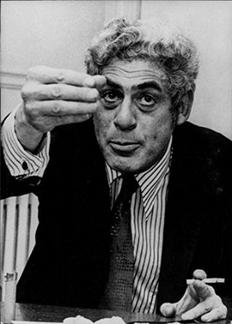
Two-Factor Theory

Slide 8
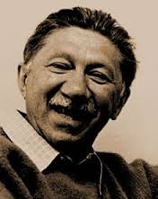
Maslow’s Hierarchy of Needs Theory

Slide 9
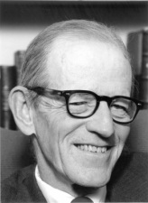
Hawthorne Effect

Slide 10
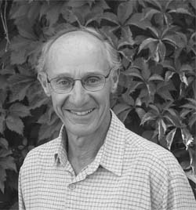
Three-Dimensional Human Motivation Theory of Attribution

Slide 11
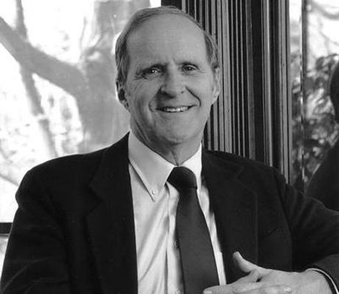
Vroom’s Theory of Expectancy

Slide 12



Victor H. Vroom
Vroom studied at McGill University and the University of Michigan
Holds the position of Chairman of Administrative Sciences at the University of Yale

Slide 13
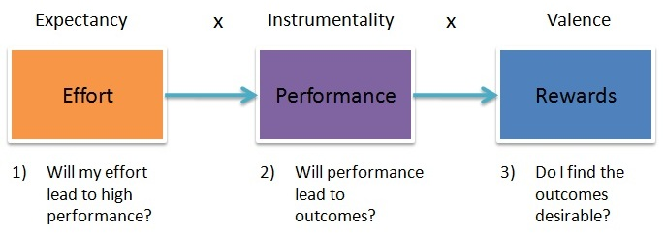

Slide 14

Effort

Slide 15

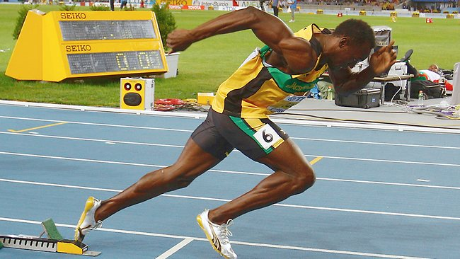
Performance

Slide 16

Rewards

Slide 17
Vroom’s Formula Overview

Slide 18


Positive and Negative Motivations Analysed by Vroom’s Theory of Expectancy
POSITIVE
NEGATIVE

Slide 19
Review of Questions
How is the human mind motivated?

Slide 20
Questions?
Thank You

