Slide 1
Chapter Goals
Discuss the CIA triad
Types of authentication credentials
Create secure passwords and assess the security level of others
Define categories of malware
List the types of security attacks

Slide 2
Information Security
Information security
The techniques and policies used to ensure proper access to data
Confidentiality
Ensuring that data is protected from unauthorized access

Slide 3
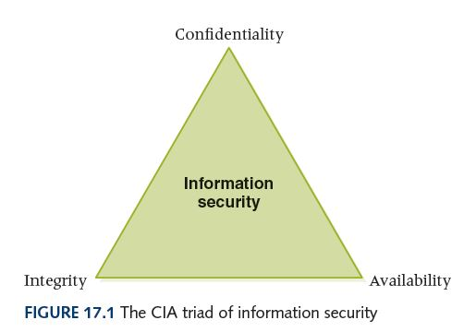
CIA Triad of Information Security
Ensuring
that data
can be
modified
only by
appropriate
mechanisms
Ensuring that data is
protected from
unauthorized access
The degree to which authorized
users can access information for
legitimate purposes

Slide 4
Preventing Unauthorized Access
Authentication credentials
Information users provide to identify themselves for computer access
  User knowledge Name, password, PIN
  Smart card/Token A card or hardware token with an embedded memory chip used for identification (Can also be an app on your smartphone now)
  Biometrics Human characteristics such as fingerprints, retina or voice patterns

Slide 5
Preventing Unauthorized Access
Guidelines for passwords
Easy to remember, hard to guess
Don’t use family or pet names
Don’t make it accessible
Use combination uppercase/lowercase letters, digits and special characters
Don’t leave computer when logged in
Don’t ever tell anyone
Don’t include in an email
Don’t use the same password in lots of places

Slide 6
Preventing Unauthorized Access
Typical Password Criteria
Contain six or more characters
Contain at least one uppercase and one lowercase letter
Contain at least one digit
Contain at least one special character

Slide 7
Good or Bad?
nelldale
JohnLewis
GingerCat
Longhorns
aatnv.AATNV
One2Three
7December1939
red&whIte%blUe7
g&OoD#3PaSs
Worst? Acceptable? Marginable? Good?

Slide 8
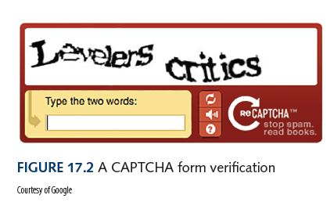
Preventing Unauthorized Access
CAPTCHA
Software that verifies that the user is not another computer
You have to look at a weird set of characters and key them back in.
Why does this work?

Slide 9
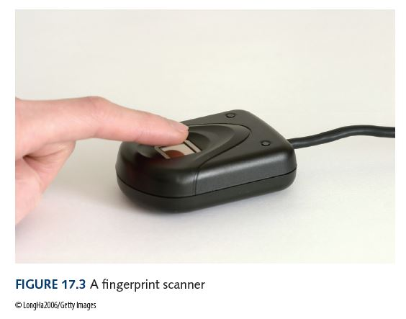
Preventing Unauthorized Access
Fingerprint analysis – a stronger level of verification than username and password
iPhone Touch ID
What if somebody steals your digitized fingerprint?

Slide 10
2 Factor Authentication
Two Factor Authentication, also known as 2FA, two step verification or TFA (as an acronym), is an extra layer of security that is known as "multi factor authentication" that requires not only a password and username but also something that only, and only, that user has on them, i.e. a piece of information only they should know or have immediately to hand - such as a physical token.
Using a username and password together with a piece of information that only the user knows makes it harder for potential intruders to gain access and steal that person's personal data or identity.

Slide 11
Computer Security
Malicious Code
A computer program that attempts to bypass appropriate authorization and/or perform unauthorized functions
  Worm stands alone, targets network resources
  Trojan horse disguised as benevolent resource
  Virus self-replicating
  Logic bomb set up to execute at system event

Slide 12
Antivirus Software
Software installed to detect and remove malicious code
Signature detection recognizes known malware and removes
Heuristics are strategies used to identify general patterns

Slide 13
Computer Security
Security Attacks
An attack on the computer system itself
  Password guessing Obvious
  Phishing Trick users into revealing security information
  Spoofing Malicious user masquerades as authorized user
  Back door Unauthorized access to anyone who knows it exists

Slide 14
Computer Security
  Buffer overflow Defect that could cause a system to crash and leave the user with heightened privileges
  Denial-of-service Attacks that prevent authorized user from accessing the system
  Man-in-the-middle Network communication is intercepted in an attempt to obtain key data
  Have you ever experienced one of these?

