Slide 1
AUSTIN CRIME ANALYSIS
Dundar Karabay
Rahul Mirpuri
Arhum Khan

Slide 2
A Broad Analysis of Crime in Austin
How does the time of day, month, household income, poverty rate, and education affect crime rates in Austin?
How has the surge in population affected the crime rate in Austin?
What can our results suggest about the best places to live in Austin?

Slide 3
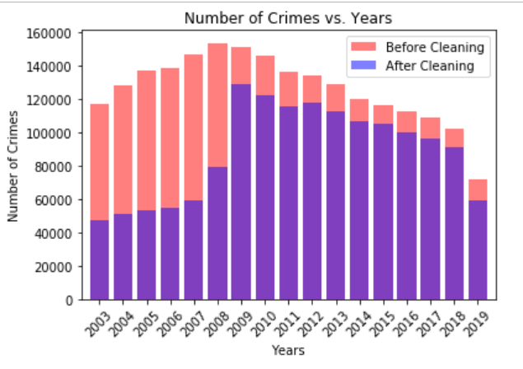
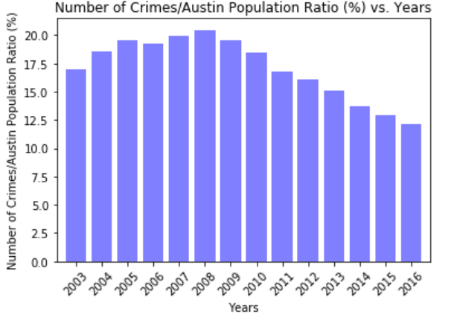
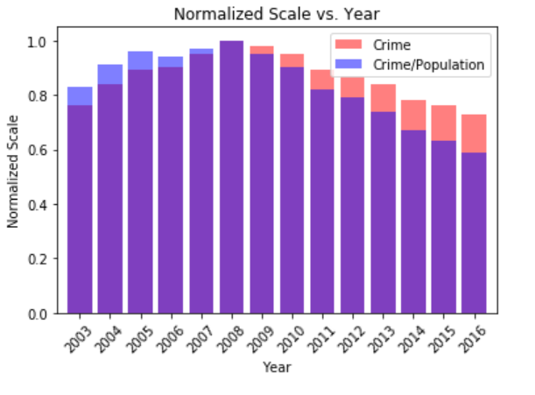
Number of crimes between 2013-2019

Slide 4
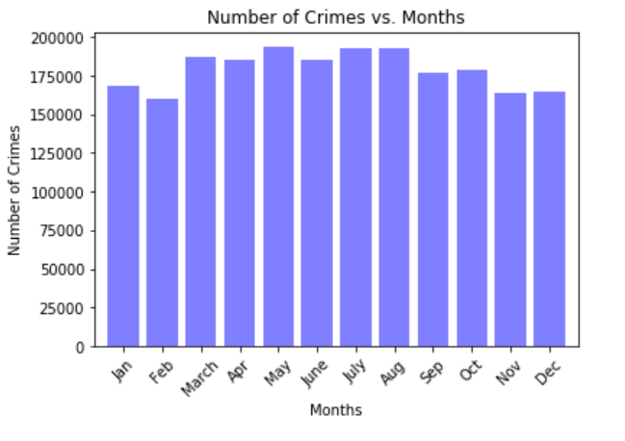
Number of Crimes distribution over months between 2013-2019

Slide 5
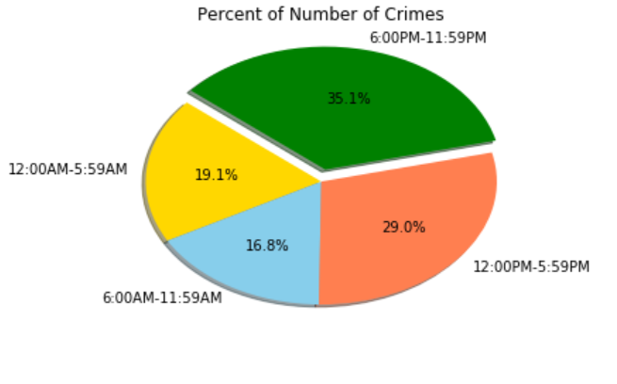
Number of crimes distribution over different quarters of day

Slide 6
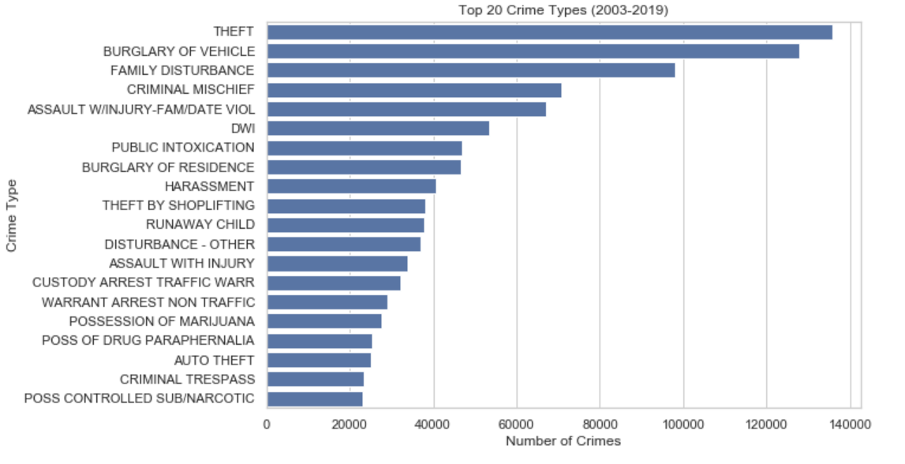
Top 20 crime types between 2013-2019

Slide 7
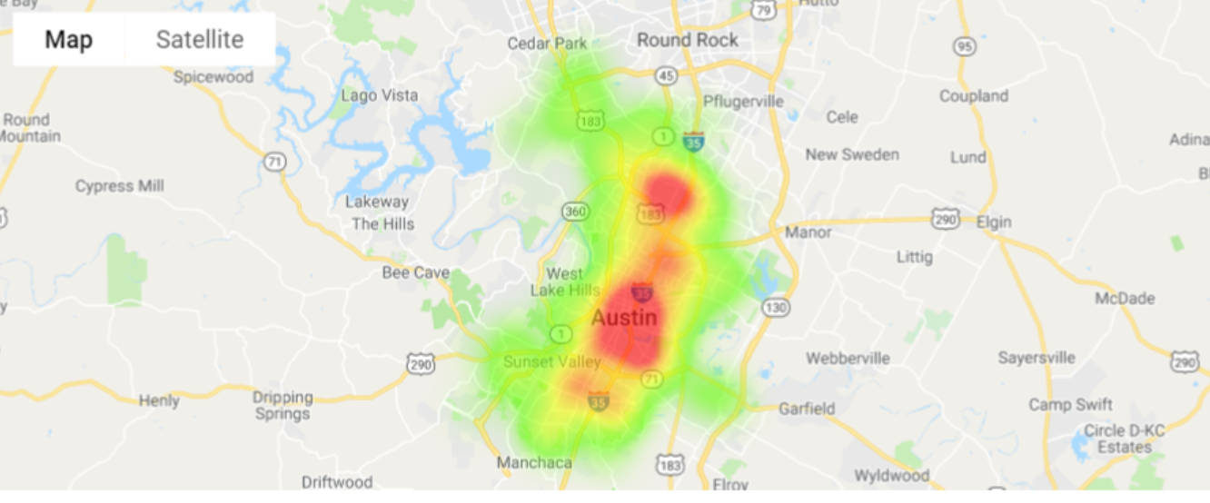
Heat Map based on crime rates in each Austin zipcode

Slide 8
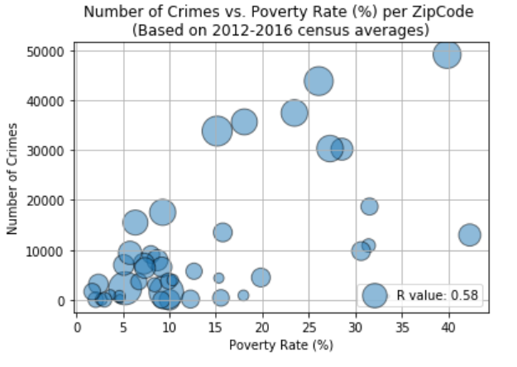
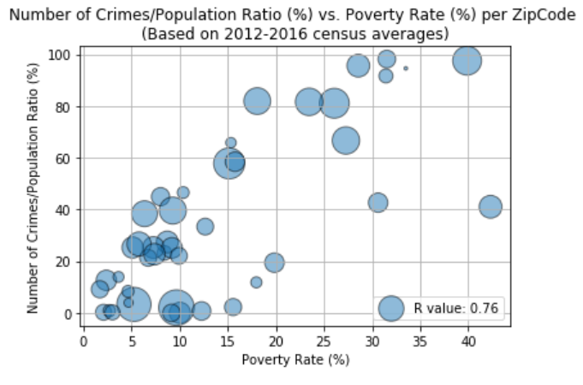
Number of Crimes vs. Poverty Rate

Slide 9
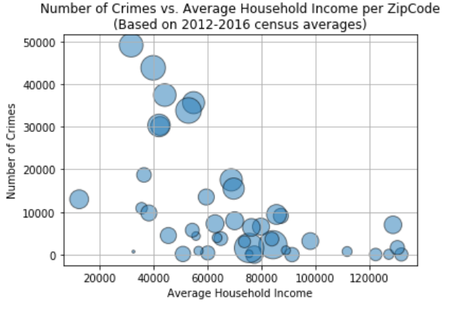
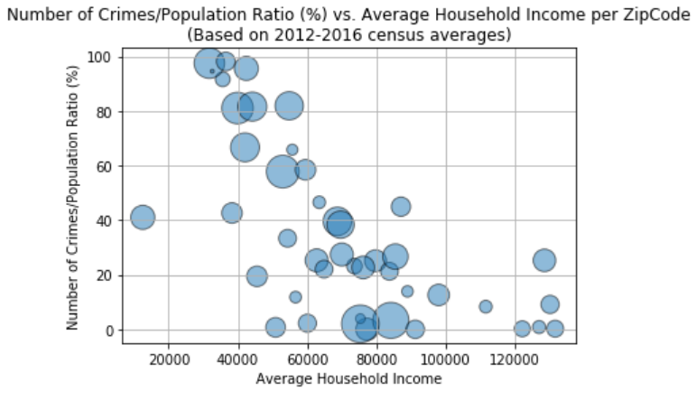
Number of Crimes vs. Annual Household Income

Slide 10
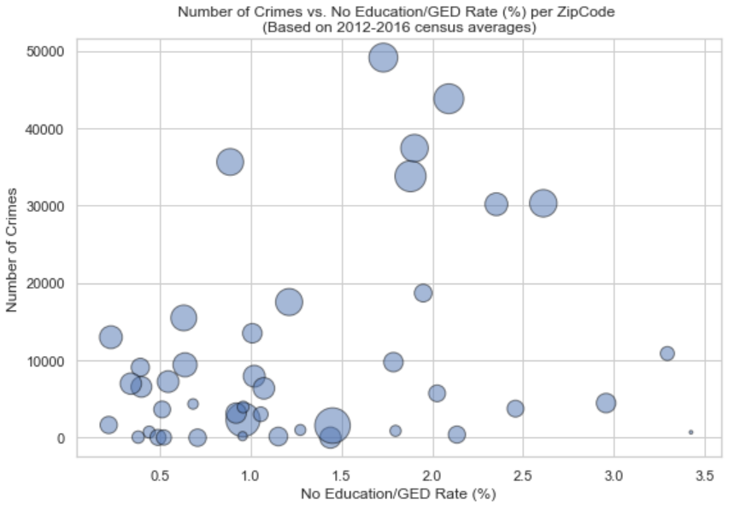
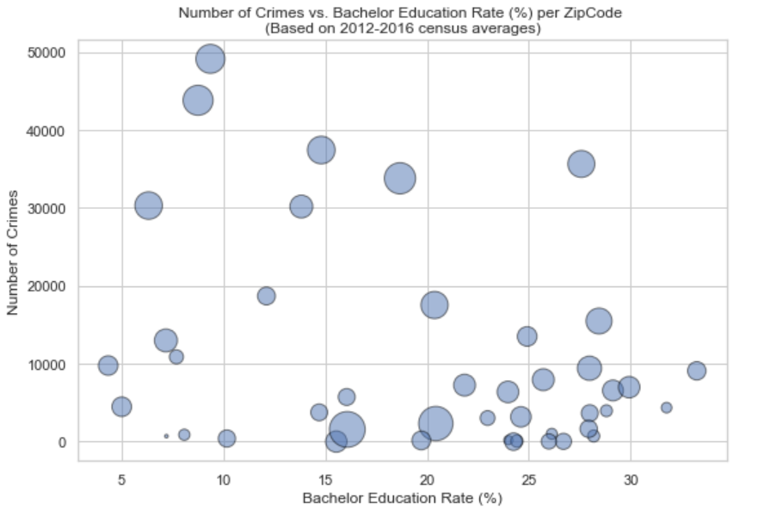
Number of Crimes vs. Education Level

