Slide 1
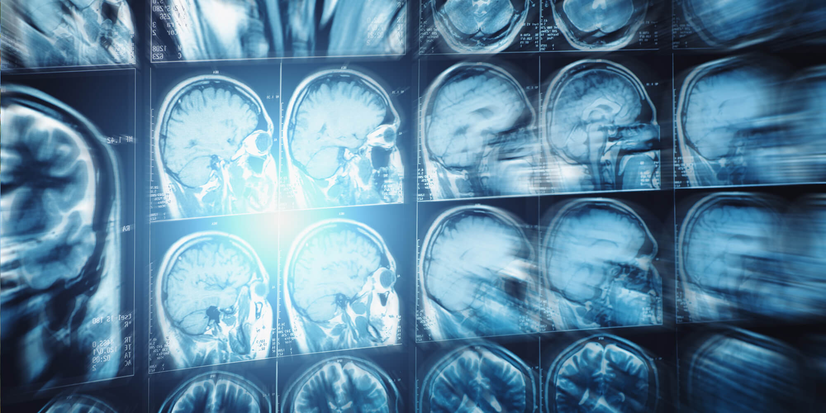
Multi-Level Image Segmentation via Particle Swarm Optimization
Presented by Metehan Dündar
Notes:
"Hello everyone. I'm Metehan Dündar, and today I want to share a project I've been working on. Think of it like teaching a computer to be really good at a special kind of 'coloring by numbers' for medical scans, like MRIs.»
"Essentially, I'm using a smart digital search team to help us to find important details hidden in these scans. I'm excited to show you how it works and what I found!"

Slide 2
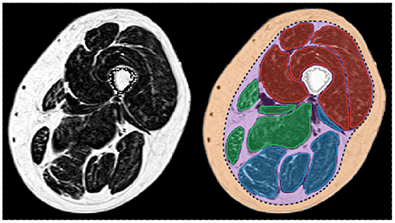
What's the Big Picture? Helping Doctors See Better
The Challenge: Seeing Inside with Medical Scans (like MRIs)
Scans show doctors what's happening inside the body.
But sometimes, important details can be hard to spot.
Our Goal: "Coloring" the Scan to Highlight Different Parts
This is called Image Segmentation.
It's like drawing outlines around different tissues or areas.
How? Brightness "Cut-off Points" (Multi-Level Thresholding)
We tell the computer: "Everything darker than X is one color, between X and Y is another color, and brighter than Y is a third color."
Finding the best X, Y, Z... cut-off points is tricky!
Notes:
"So, we all know medical scans like MRIs are amazing tools for doctors. They let us see inside the human body without any surgery. But if you look at a raw scan (like the one on the right), it can sometimes be a bit like a complicated grayscale photograph – lots of shades, and it can be tough to pick out specific areas clearly.»
"Our big goal is to help make these scans easier to understand. We do this by 'coloring' the scan to highlight different parts – in technical terms, this is called 'image segmentation.' Think of it as giving the computer a set of crayons and asking it to color all the similar parts the same color, making it easier to see distinct regions, for example like different types of brain tissue.»
"How do we tell the computer what 'similar parts' are? One common way is by looking at brightness. We can set 'cut-off points' based on how bright or dark a pixel is. For example, we might say 'all very dark pixels are blue, medium-dark pixels are green, and brighter pixels are red.' This method of using several cut-off points is called 'multi-level thresholding.’»
"Now, the really big question is: what are the best cut-off points to use for any given image? If we pick bad ones, our coloring won't be helpful. If we pick good ones, it could reveal important details. Finding these best points is the main challenge we're tackling."

Slide 3
My Project: A Smart Search Team for the Best "Cut-off Points"
My Project's Aim:
Teach a computer to automatically find the very best brightness cut-off points for any MRI scan.
My Tool: A Digital Search Team called "Particle Swarm Optimization" (PSO)
Imagine tiny digital "explorers" (particles).
Each explorer suggests a different set of cut-off points.
They work together as a team (a swarm) to find the best possible set.
Notes:
"So, the main goal of my project was to build a system where the computer can figure out these best brightness cut-off points all by itself, without a human having to guess.»
"To do this, I used a clever technique called Particle Swarm Optimization. You can think of PSO like having a team of tiny, digital explorers. We send this whole team – or 'swarm' – into the 'world' of all possible cut-off points.»
"Each little explorer in the team has its own idea of what the best cut-off points might be. They start by guessing, and then they look around. As a team, they communicate and learn from each other to gradually zero in on the very best set of cut-off points for that specific image."

Slide 4
How the "Search Team" Works & Decides What's "Best"
The "Explorers" (Particles):
Each suggests a set of cut-off points (e.g., "cut at brightness 50, 120, 180").
Learning & Improving:
Each explorer remembers its own best suggestion so far.
The whole team knows the overall best suggestion found by anyone in the team.
They use this to make better suggestions in the next round.
The "Goodness Score" (Fitness Function): How we tell if cut-offs are good.
We need a way to score how good each explorer's suggested cut-off points are.
Score #1: Kapur's Entropy – Aims for "interesting" and "well-separated" colored regions. (High score = good)
Score #2: Otsu's Variance – Aims for colored regions that are very "different" from each other. (High score = good)
Input Image: We used a special black-and-white version (L* channel) focusing only on brightness.
Notes:
"Let's look at a bit closer how this PSO search team operates. As I said, each 'explorer' – or particle – proposes a set of brightness cut-off points. For example, one explorer might suggest cutting the brightness scale at levels 50, 120, and 180.”
But, "Now, how do they get smarter? Well, each explorer keeps track of the best set of cut-off points it has personally found so far. And, importantly, there's a team leader, or a shared bulletin board, that shows the absolute best set of cut-off points found by anyone in the entire team up to that point. In each round of searching, the explorers look at their own best find and the team's best find, and use that information to make a more educated guess for their next suggestion."
"But how do they know if a set of cut-off points is 'good' or 'bad'? Well, we need a way to give them a score. This score is called a 'fitness function.' For this project, we used two main scoring methods:”
"Our primary one was Kapur's Entropy. This is a bit technical, but imagine it as a score that's higher if the resulting-colored regions are very 'interesting' on their own and very 'well-separated' from the other regions. A high Kapur's score is what we want.”
"We also used another well-known scoring method called Otsu's Variance. This score is higher if the different colored regions are as 'different' from each other in brightness as possible. Again, a high score is good.”
"And just a reminder, for these scores to work best, we fed the PSO a special black-and-white version of the MRI that purely represents brightness levels – this is called the L-star channel."

Slide 5
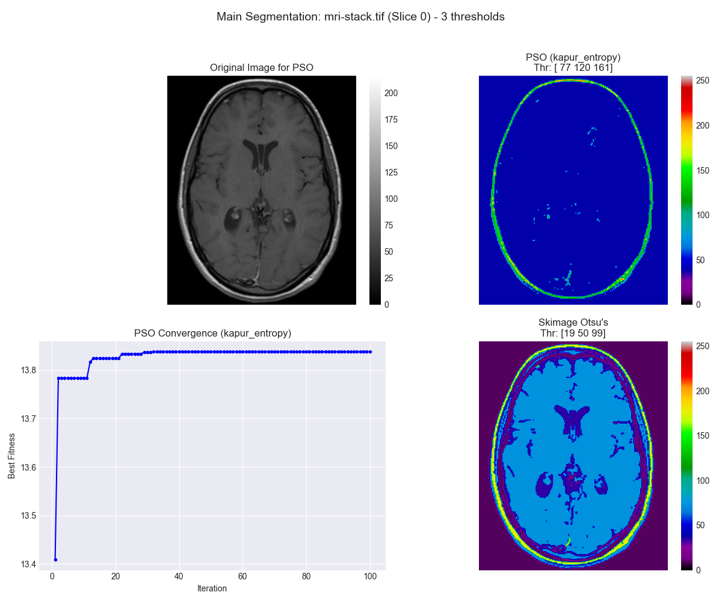
Results - Part 1: Using the "Interesting & Separated" Score (Kapur's)
Goal: Make colored regions "interesting & well-separated" (Kapur's Score)
Our PSO Team's Best Cut-offs: [77, 120, 161] -> Kapur Score: 13.84
A Standard Method (Skimage Otsu): Cut-offs [19, 50, 99] -> Kapur Score: 11.68
Finding: Our PSO team got a better "interesting & separated" score!
Notes:
"Okay, so let's see what happened when we asked our PSO search team to use that first 'goodness score' which is Kapur's Entropy, the one that likes 'interesting and well-separated' regions. Take a look at Figure please.”
"On the top left is the brightness version of the MRI scan we started with. The plot on the bottom left shows how our PSO team's score improved over time – you can see it gets much better quickly and then settles on a high score. This means the explorers agreed they found a great spot!”
"Our PSO team decided that the best cut-off points for this score were [77, 120, 161]. This gave a Kapur's 'interestingness' score of 13.84.”
"Now, to see how good that is, we compared it to a common, standard computer method called 'Skimage Otsu'. That method suggested different cut-off points: [19, 50, 99]. When we calculated the Kapur's 'interestingness' score for these cut-off points, it was only 11.68.”
"So, this is a great result! Our PSO search team actually found cut-off points that were 'more interesting and well-separated' – according to Kapur's rules – than the standard method. The top-right image shows the coloring from our PSO, and the bottom-right shows the coloring from the standard Otsu method. They look different, and as I mentioned, the one that gets the highest mathematical score might not always be the one that looks best for every single purpose to the human eye, but our PSO definitely succeeded at its mathematical goal here."

Slide 6
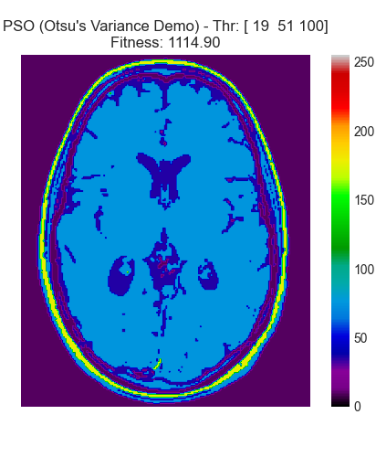
Results - Part 2: Using the "Very Different Regions" Score (Otsu's) - A Sanity Check!
Goal: Make colored regions "very different" from each other (Otsu's Score)
Our PSO Team's Best Cut-offs: [19, 51, 100] -> Otsu Score: 1114.90
Standard Otsu Method's Cut-offs: [19, 50, 99] (This method is designed to be optimal for this score!)
Finding: Our PSO team found almost the exact same cut-off points as the standard method! This means our team is working correctly!
Notes:
"Next, we did a really important check. We changed the 'goodness score' for our PSO team. This time, we told them to use Otsu's Variance – the score that wants the colored regions to be as 'different' from each other as possible.”
"Why is this important? Well, the standard 'Skimage Otsu' method we compared against earlier is specifically designed to be the best at this particular score. So, if our PSO team is working correctly, when we ask it to achieve the same goal, it should come up with a very similar answer.”
"And guess what? It did! Our PSO team found cut-off points [19, 51, 100], which gave a very high Otsu 'difference' score of over 1000. The standard Skimage Otsu method's cut-off points were [19, 50, 99]. They are incredibly close actually!”
"If you look at Figure on the right, which shows the coloring from our PSO using this 'very different' score, it looks almost identical to the coloring we got from the standard Skimage Otsu method in the previous slide. This is fantastic news because it tells us our PSO search team is built correctly and is a reliable tool. When it's given a clear target, it can find it effectively."

Slide 7
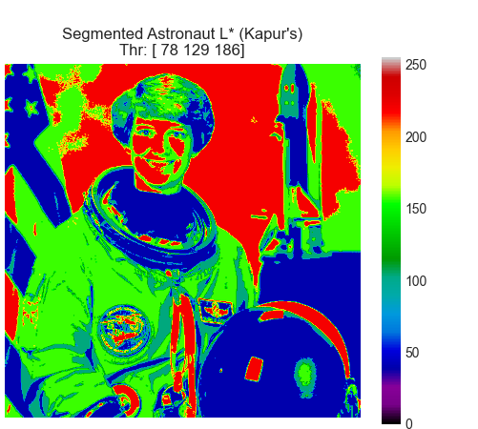
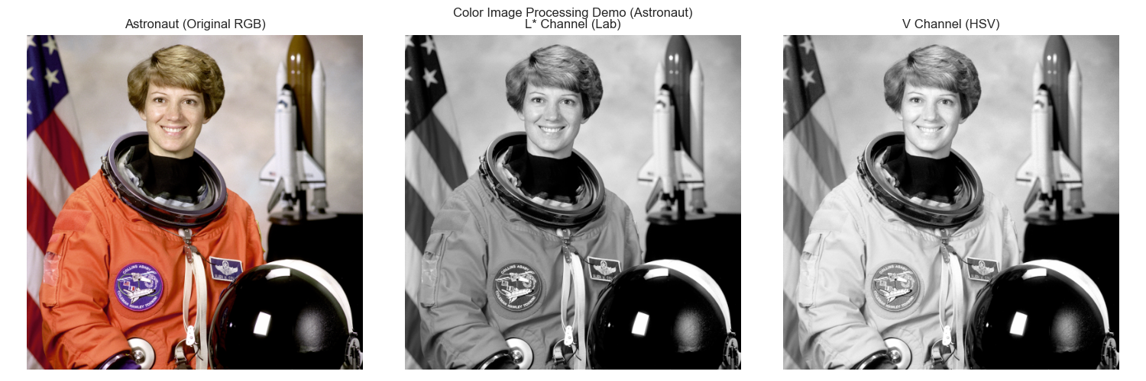
Other Cool Things We Tried
1. Working with Color:
We showed we can take a color image and pick out its ”lightness" and "brightness" information.
This means the same PSO team could work on different kinds of images.
Notes:
"We also explored a couple of other neat ideas. First, we showed that even if we started with a full-color image, our method can intelligently extract the lightness and brightness information. These channels help isolate intensity-based features, which are useful for segmentation. We then apply PSO using Kapur’s entropy as the fitness function again to segment the L* channel. The final image shows the segmented result using the best thresholds: [78, 129, 186] with a fitness score of 15.23, effectively separating key visual regions."

Slide 8
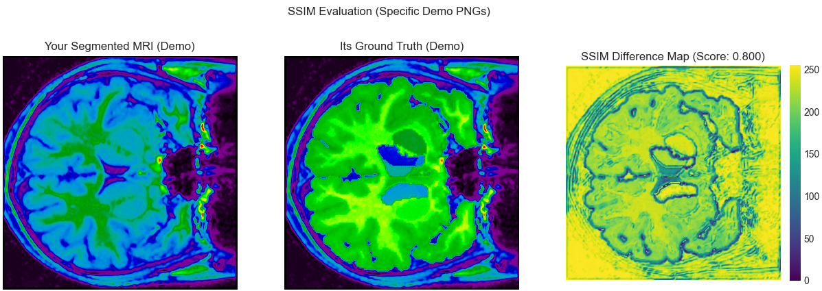
Other Cool Things We Tried
2. Checking Against a "Perfect Example" (SSIM Score):
We had a "perfectly colored" example image (called a Ground Truth).
We compared our PSO's coloring to it and got a similarity score (SSIM) of 0.800 (out of 1).
The "Difference Map" (Figure 4) shows where our coloring matched well and where it was different.
Notes:
"Second, we did a test where we had access to what we might call a 'perfectly colored' version of the MRI, created by an expert perhaps – this is called a 'ground truth.' We then compared the coloring done by our PSO team (using the Kapur's 'interesting' score) to this perfect example. This is shown in Figure.»
"We used a special similarity score called SSIM, which goes from 0 (completely different) to 1 (identical). Our PSO's coloring got a score of about 0.8, so very similar. The third picture, the 'Difference Map,' is really useful because the yellow and bright green areas show where our PSO's coloring was most similar to the perfect example, and the darker areas show where it was not a good match. This helps us understand exactly how well our segmentation matches a gold standard."

Slide 9
So, What Did We Learn? (Conclusion)
Our "Digital Search Team" (PSO) is a good detective for finding hidden details!
Key Discoveries:
When we asked it to make regions "interesting & well-separated" (Kapur's), it did even better than a standard method (Score 13.84 vs 11.68).
When we asked it to make regions "very different" (Otsu's), it found almost the exact same best solution as the standard method designed for that task! (This means our team works right!)
The "goodness score" we choose really changes what the final "colored" picture looks like.
Plus: We showed it can handle different image types (like brightness from color) and we can check its work against a "perfect example" (SSIM score 0.8).
Notes:
"So, after all these experiments, what's the main takeaway? Well, it turns out our 'digital search team,' the PSO, is actually a pretty good detective when it comes to finding these brightness cut-off points and highlighting details in medical scans!»
"Here are the main things we learned: First, when we gave it the goal of making regions 'interesting and well-separated' using Kapur's score, our PSO team found cut-off points that achieved an even higher score than a commonly used standard method. That's a win for our approach!»
"Second, and very importantly, when we gave our PSO team a different goal – making regions 'very different' using Otsu's score – it found cut-off points that were almost identical to the standard Otsu method, which is designed to be perfect for that specific goal. This tells us that our PSO search team is built correctly and is reliable.»
"A really crucial point is that the 'goodness score' we choose to guide the PSO makes a big difference in what the final segmented, or 'colored,' picture looks like. Different scores lead to different ways of highlighting details.»
"And as bonus findings, we showed our method is flexible enough to pull brightness and lightness information from color images if needed, and we can also objectively measure how similar its results are to a 'perfect example' using scores like SSIM, where we got about 0.8 out of 1."

Slide 10
What's Next? Making the Search Team Even Better!
Smarter Explorers: Use even more advanced PSO techniques (like the "CIWP-PSO" ideas).
Look at Shapes Too: Teach the team to consider shapes and textures, not just brightness.
Try New "Goodness Scores": Explore other ways to define what a "good" coloring is.
More Pictures, More Tests: Try it on many different scans to see how well it works everywhere.
Let the Team Decide: Could the PSO team learn to pick the right number of cut-off points by itself?
Notes:
"This project has been a great learning experience, and there are many exciting ways we could make this 'digital search team' even better in the future.»
"For example, there are more advanced versions of PSO – one is called CIWP-PSO from the paper that inspired this project that have extra tricks to help the explorers search more efficiently or avoid getting stuck. We could try implementing some of those.»
"Right now, our team only looks at brightness. It would be a big step forward to teach them to also consider shapes, sizes, and textures in the image when deciding on the cut-off points. This could lead to much more human-like segmentations.»
"We could also experiment with completely new 'goodness scores' that might be better suited for specific medical tasks. And, of course, testing the system on a much larger and more varied collection of MRI scans would be essential to really understand its strengths and weaknesses.»
"A really challenging but potentially very rewarding idea would be to see if we can make the PSO team smart enough to decide for itself how many cut-off points are actually needed for any given image, instead of us telling it beforehand."

Slide 11
Thank You & Questions
Thank You
Any Questions?
Notes:
"That concludes my overview of the project. I hope I've been able to give you a clear idea of what we set out to do, how our 'digital search team' works, and some of the interesting results we found in using it to analyze medical images.»
"Thank you all very much for your time and for listening. I'd be delighted to try and answer any questions you might have now."

