Slide 1
How to Laser
Computer Setup
Material Selection
Running the Laser

Slide 2
Computer Setup

Slide 3
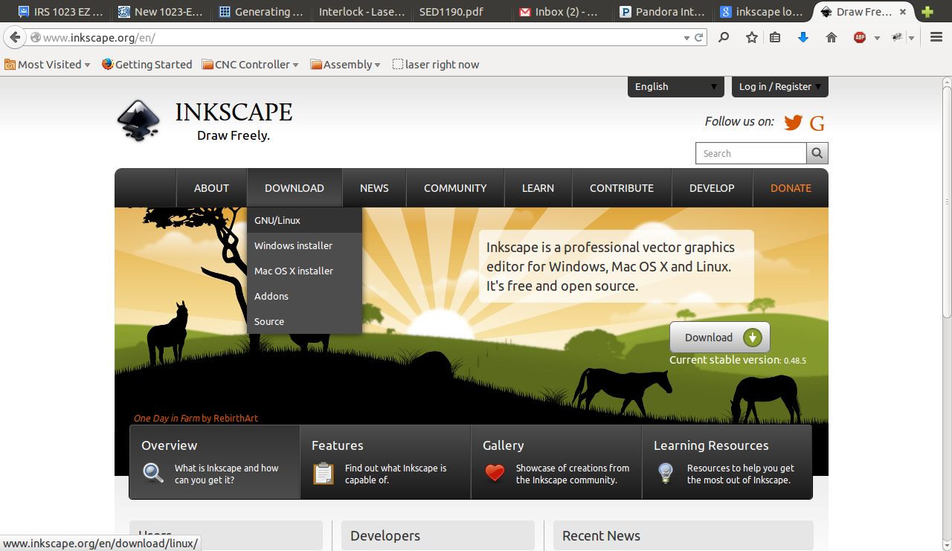
Inkscape Install
Download and install Inkscape
Go to www.inkscape.com and follow the install instructions

Slide 4
Download gcodetools
Gcodetools is an extention for Inkscape.
It converts your vector drawing to a machine readable language called g-code
search for “gcodetools inkscape” and if you got to a russian forum, you're in the right place
or click here for the link to the file

Slide 5
Install gcodetools
Toss the extracted gcodetools files into either:
  Program Files\Inkscape\share\extensions\
    or
  /usr/share/inkscape/extensions/
Depending on what operating system you're on
**Don't put the files in a sub-directory. Just put all of the files directly in 'extentions'

Slide 6
Material Selection
Do's:
Acrylic, Wood, Paper, Polystyrene
Dont's:
PVC(REALLY DON'T), Shiny things, Polycarbonate, ABS, Pizza
If you aren't sure, just use some of the scraps hanging around the laser.

Slide 7
Laser Operation

Slide 8
Turning on the Laser
1. Turn on the power strip under the table
2. Flip the green switch to the “ON” position
3. Close the door
4. Turn the black nob to 7 o'clock

Slide 9
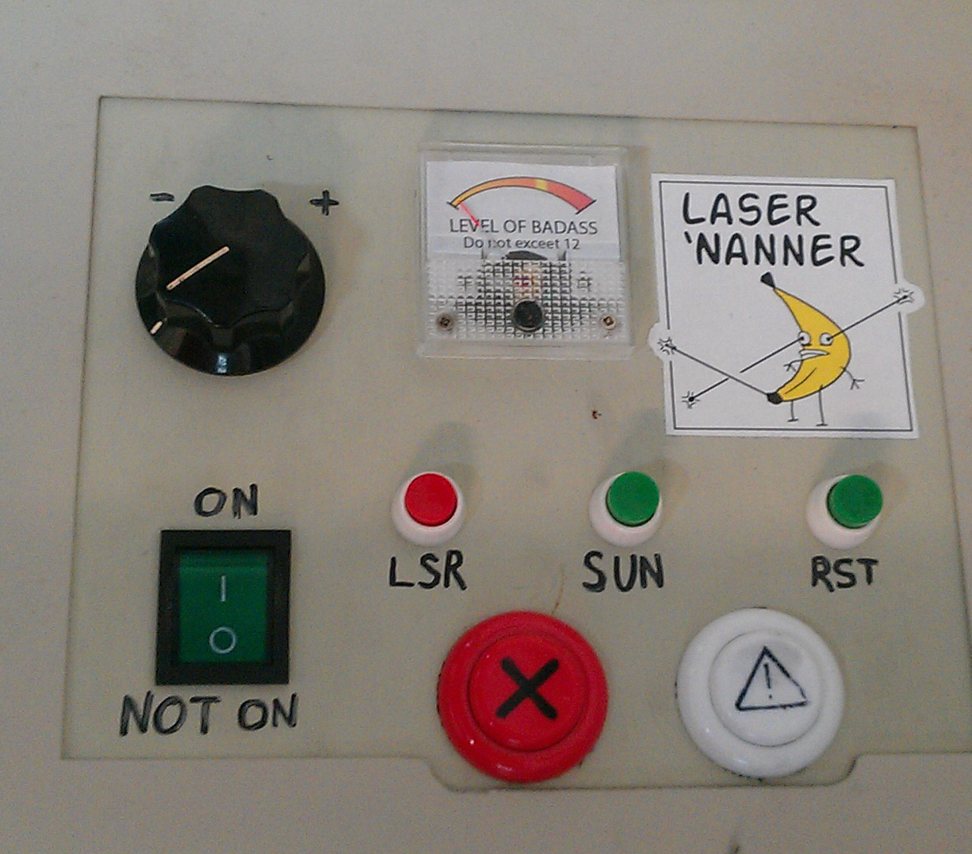
Controls
Work Light
On/Off
Badass Level
Adjuster
Laser
Enable/Disable
Big Green
Power Switch
Doesn't work
Test
Fire
Doesn't work

Slide 10
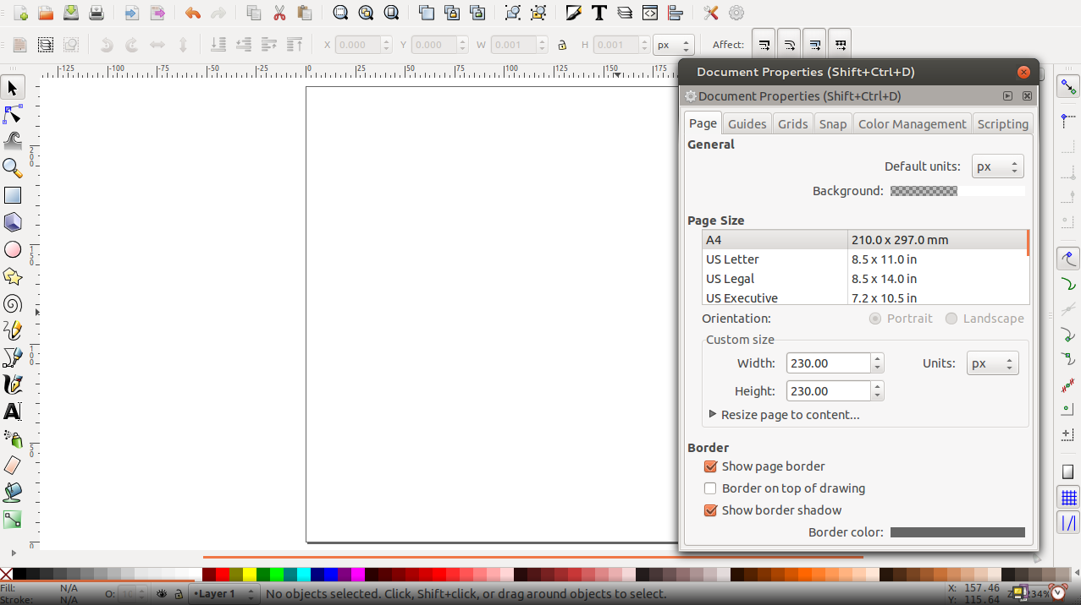
Lets cut a part: Rectangle
1. Open up Inkscape
2. Set the page size to 230 by 230 pixels
(note that 1 pixel will represent 1 mm)

Slide 11
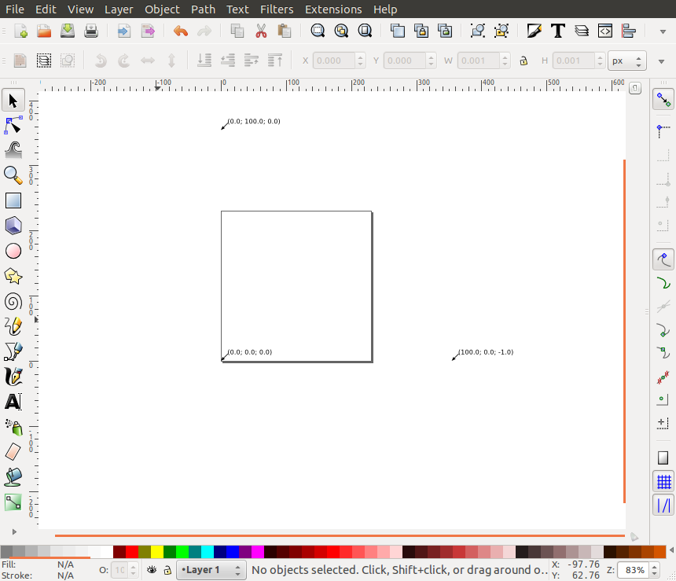
Lets cut a part: Rectangle
3. Go Extentions>Gcodetools>Orientation Points...
4. Select “3-Point Mode” and press apply
Your canvas should now look like this:

Slide 12
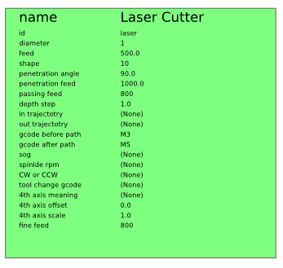
Lets cut a part: Rectangle
5. Go Extentions>Gcodetools>Tools Library
6. Select “Default Tool” and press “apply”
It should appear somewhere above the canvas
7. Fill it out like this:

Slide 13
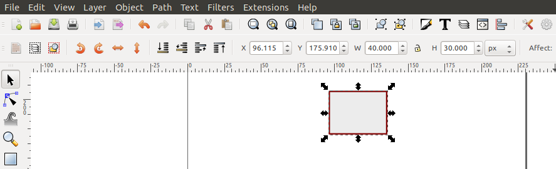
Lets cut a part: Rectangle
8. Select the rectangle tool and draw a rectangle
9. Change the dimensions of the rectangle to 30mm to 40mm
10. You need to turn things that arent “paths” into “paths” by going Path>Object to Path

Slide 14
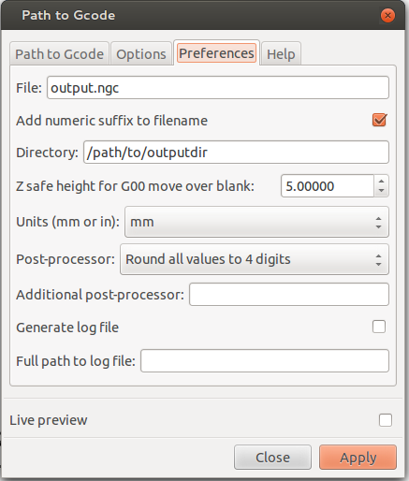
Lets cut a part: Rectangle
11. Put the rectangle in the bottom corner where the orientation arrow is.
12. Go Extentions>Gcodetools>Path to Gcode
13. Set the Preferences:
14. Click on Path to Gcode
tab and click “apply”

Slide 15
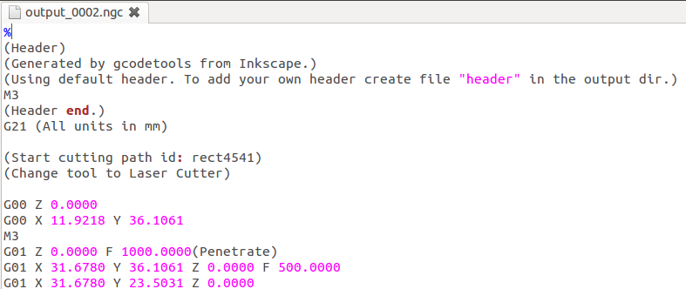
Lets cut a part: Rectangle
15. You just created a text file called output-something.ngc. Get rid of the first M3.

Slide 16
Lets cut a part: Rectangle
16. Turn laser on by turning on the power strip followed by the green laser power switch.
17. Nav to laser.interlockroc.net in your web browser
18. Copy and paste your G-Code into the text box.
19. Select “mm” for the units

Slide 17
Lets cut a part: Rectangle
20. Adjust the laser head to the bottom left corner of your material.
21. Close Lid
22. Adjust power knob to 12 o'clock position
(or wherever you want)
23. Press “Send G-Code”
Hey, be safe. You could shoot your eye out with this thing.

