Slide 1

Revisiting Large-Kernel CNN Design via Structural Re-Parameterization for Sensor-Based Human Activity Recognition
IEEE SENSORS JOURNAL, VOL. 24, NO. 8, 15 APRIL 2024

Slide 2
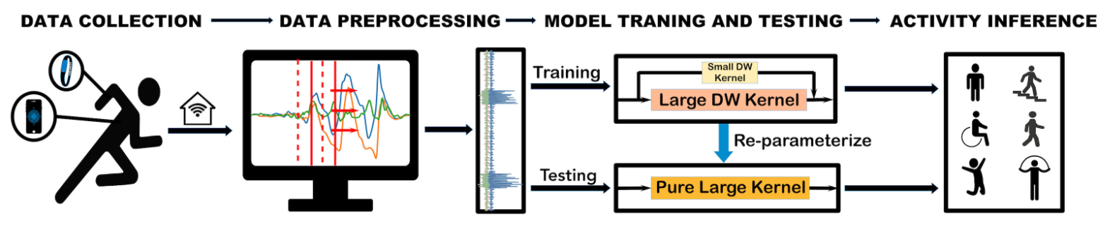
01
02
03
深度卷积
卷积层-归一层融合
卷积核重参数融合
研究内容
Notes:
5c58fb83-5d9f-454d-bd56-a1031a856887.source.3.zh-Hans

Slide 3
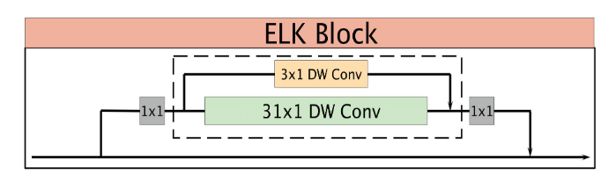
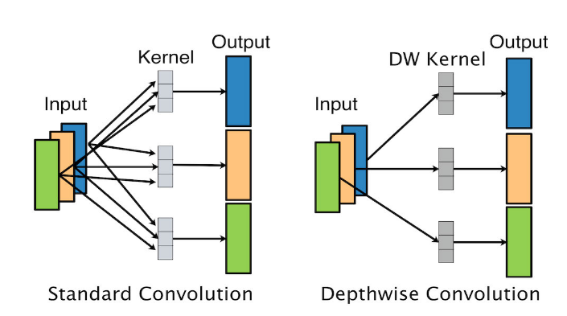
深度卷积

Slide 4
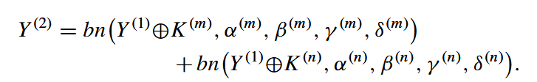

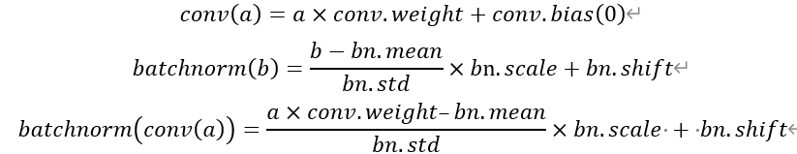
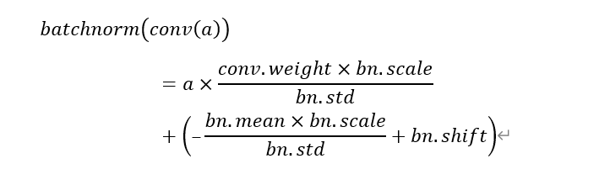
卷积层-归一层融合

Slide 5
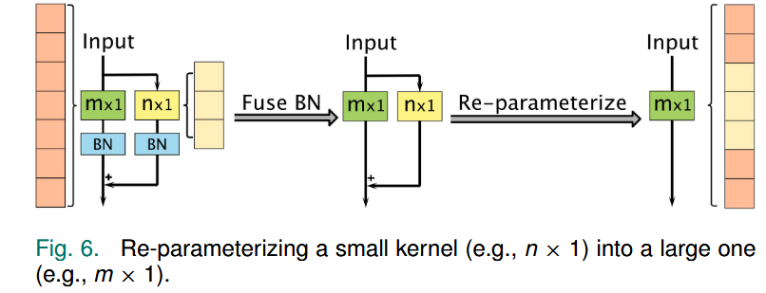
卷积核重参数融合
卷积核接受野[batch_size, 1, 3, 1] -> [batch_size, 1, 31, 1]
通过维度扩充，将第3维填充至31维

Slide 6
谢谢

